Slide 1
Status of Dark Photon/Higgs Search Upgrade
Kun Liu and Ming Liu
Los Alamos
With Grass, Dave C., Xinkun et. al.

Slide 2
Outline
Physics
Detector upgrade
  Displaced dimuon trigger
  DAQ
New development
  EMCal from PHENIX
  Early implementation of electron and charged pion capability
Possible schedules and tasks
  E906 extended to summer 2017
  DAQ, Trigger
  Electron/hadron trigger
  ADC/TDC?

Slide 3

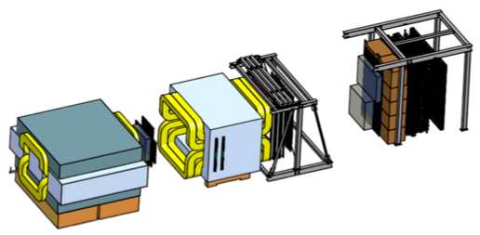
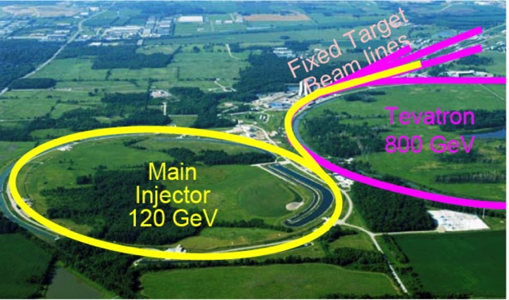
Intensity Frontier at Fermilab: 120 GeV Beam
World’s highest intensity high energy proton beam:
“beam dump mode” @E-1067
35,000 fb⁻¹ NN (in 2 years of parasitic runs)
LHC-II: 300 fb⁻¹ (~2025), achieved 25fb⁻¹ in Run-I
B-factory@KEK: 50,000 fb⁻¹ (~2023)
Absorber wall and proportional
tube based Muon ID
Spectrometer magnet
Δpt = 0.4 GeV
Focusing magnet
and solid iron dump
Δpt = 2.9 GeV
Beam
120 GeV proton from Main Injector
19ns RF, 4s spill, 0.5×10¹³ protons per spill
25 m
Target system
Liquid H and D
Solid C, Fe, W
- Capture most beam in beam dump mode: p+Fe collisions!
- Parasitic run mode possible with other experiments, E906/E1039

Slide 4
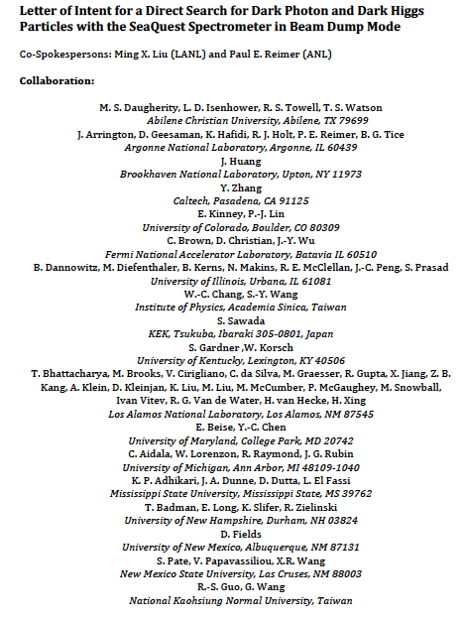
LOI submitted to Fermilab PAC
on May 20, 2015
A joint experimental and theoretical collaboration
(most E906/E1039 + new members, ~60)
---------------------------------------
Phase-I: (parasitic runs)
Addition of a new displaced dimuon trigger to tag long-lived downstream decayed dark photons (dark Higgs).
Parasitic data taking with E1039 in 2017-2019;
  A short dedicated run (up to ~1 month) if needed.
POT 1.44x10¹⁸
Phase-II: (upgrade)
Dedicated runs later with EMCal/HCal upgrades, e^{+/-} and h^{+/-} capabilities.
Cover the full parameter phase space allowed by beam energy and luminosity
POT: >> 1.4x10¹⁸
Phase-II request will be presented to PAC at a later time.
Notes:
Responding to P5 reprot, we submitted LOI last month .. And the membership is growing …

Slide 5
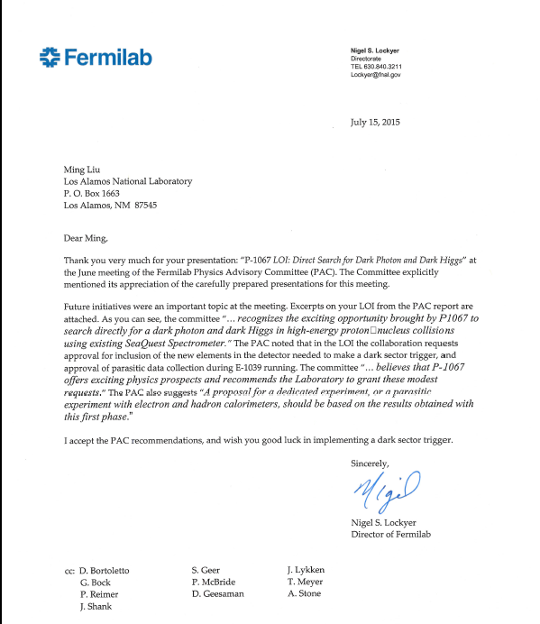
A heart-full endorsement
from Fermilab Director and PAC
July 15, 2015!
New experiment! E-1067

Slide 6
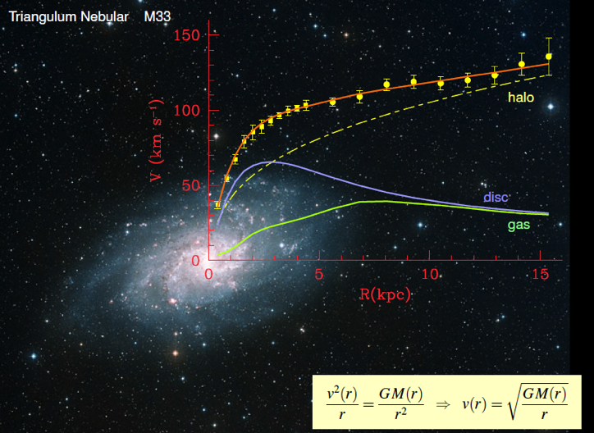
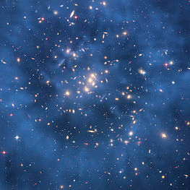
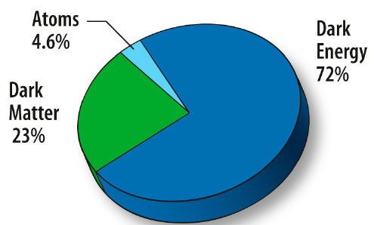
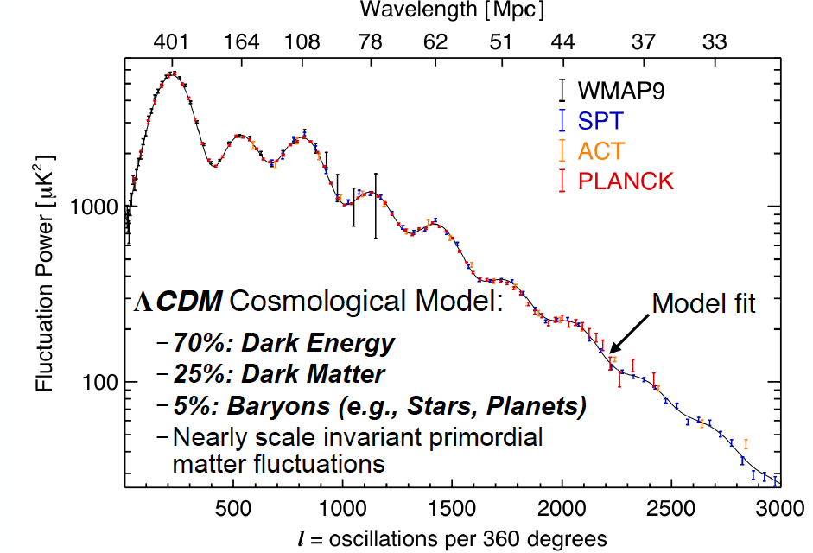
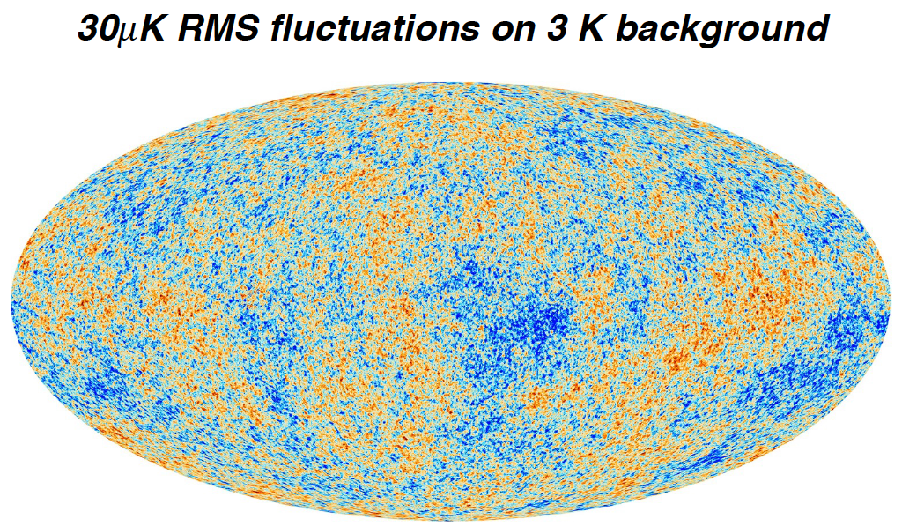
Dark Matter?
Galaxies’ rotation curve
Gravitational lensing (Hubble 2007)
F. Zwicky, ApJ 86 (1937) 217, V. Rubin et al, ApJ 238 (1980) 471
Planck: 2013
Benson’s talk @CIPANP 2015
Notes:
It is widely accepted today that visible matter only account for 5% of matter and energy, with 25% dark matter .. With many compelling experimental obseravtions , how ever the nature of dark matter and dark energy remtain as the biggest scientific challenges for hunam being … sa they only interactio with SM particels very weakly .. Only shown in gravitaiton sectors ..

Slide 7
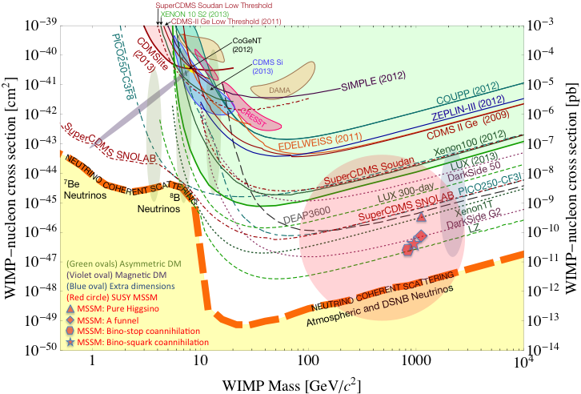
Direct Search for WIMP
Montgomery’s talk at CIPANP2015
“a vision of nuclear and particle physics”
WIMP being excluded?
Recent anomalies observed by satellite and terrestrial experiments have motivated dark matter models introducing a new “dark sector”
There are “portals” between the dark sector and the SM.
  “vector portal”: dark photon
  “scalar portal”: dark Higgs
  …
“Sub-GeV” low mass weakly-interacting dark particles become very interesting!
Mass: O(MeV ~ GeV)
In particular, high-intensity colliders (B-factories) and fixed target experiments (Fermilab, JLab, LHC etc.) offer an ideal environment to probe these new ideas.
- Imaginable space for these experiments is rapidly disappearing
- the “natural” theory space is also disappearing.
- I like to think that Dark Matter is on solid ground, maybe not!!!
Notes:
What are the DM? WIMP is considered one of the primary candidates of DM …

Slide 8
What is Dark Matter?
WIMP
…
Axion &
ALPs
Superheavy
DM
Dark Matter
Sterile neutrino
Extra dimension
Dark sector
Recent results from the LHC and direct detection experiments “challenge” the traditional WIMP paradigm and motivate the exploration of new ideas.

Slide 9
Portals to a Dark Sectors?
SM symmetries limit the allowed couplings
  scalar, vector, tensor interactions etc.
SM
g, W±,Z⁰,γ, H
Dark Sector
particles &
interactions
E-1067/SeaQuest: Dark photon (vector) and Dark Higgs (saclar) Portals

Slide 10
Dark Photons and Dark Higgs Productions in p+Fe Collisions at Fermilab
Photon portal: “vector”
Higgs portal: “scalar”
θ = μ v/m_{h}²

Slide 11
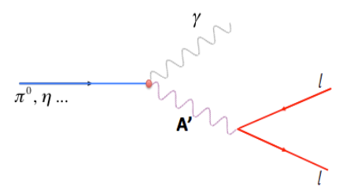
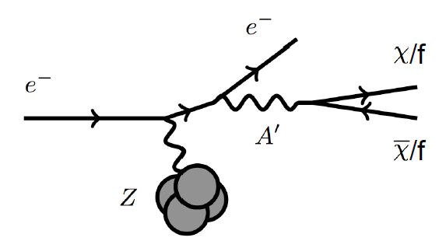
Dark Photon Detection in Dimuon Decay Channel
Drell-Yan like
π⁰, η, … decay
Bremsstrahlung
(DM)
MiniBooNE
Beam-dump
(DM)
p
l⁺
p
l⁻
Also see: S. Gori, S. Gardner and K Liu’s talks

Slide 12
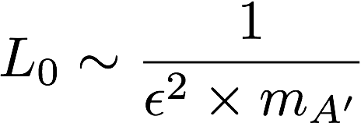
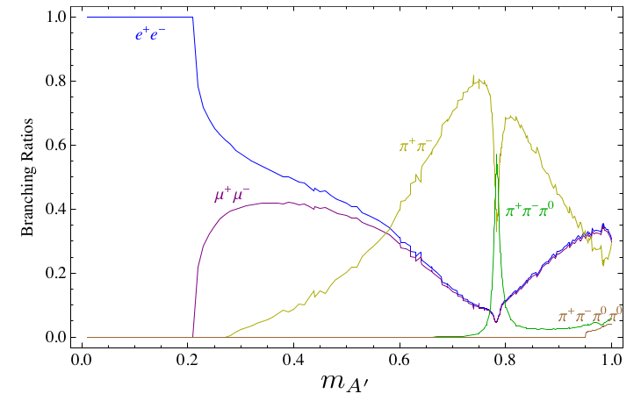
Dark Photon Decay Modes
“Minimal” Decay:
Dark photon is the lightest in the dark sector;
  SM final state particles only
Long proper decay length: L₀ ~ O(1m)
D. Curtin, et al, arXiv: 1312.4992
“General” Decay:
Decay into other dark particles,
dominant channel if allowed
  Dark -> Dark
  Dark -> SM particles
(GeV)

Slide 13
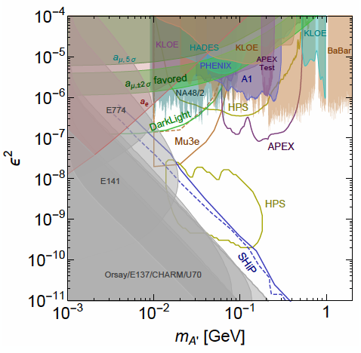
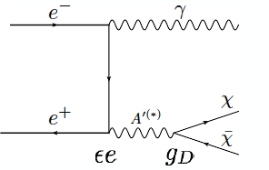

Dark Photon Current and Future Limits
Several new results in recent years
and more to come
Muon (g-2) region disfavored
- for A’ directly decay into SM;
- but allowed with some “invisible modes”
New experimental proposals
Fermilab E-1067 beam dump,
SHiP at CERN

Slide 14
Detector Upgrades and Expected Signals
Dark photon trigger upgrade
  Add a fine-granularity scintillating strip based trigger/tracking to tag dimuons from the same decay Z-vertex
  A new trigger for events with displaced down-stream dimuons
Unique signals
  Displaced dimuon decay vertex for long-lived particles
  Invariant mass peak in dimuon mass spectrum
  Mostly from beam dump (target ~10% λ_{I}.)
Beam time
  Run parasitically with E906/E1039 (2017-2019)
  Possible dedicated runs later with upgraded (e^{+/-}, h^{+/-})
-- 2.5%
-- 6.0%
Dimuon mass resolution
Z (meter)

Slide 15
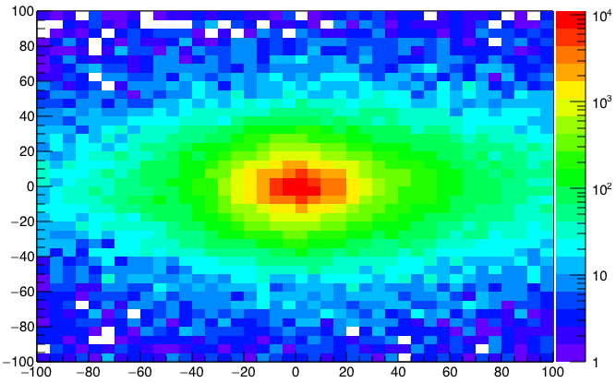
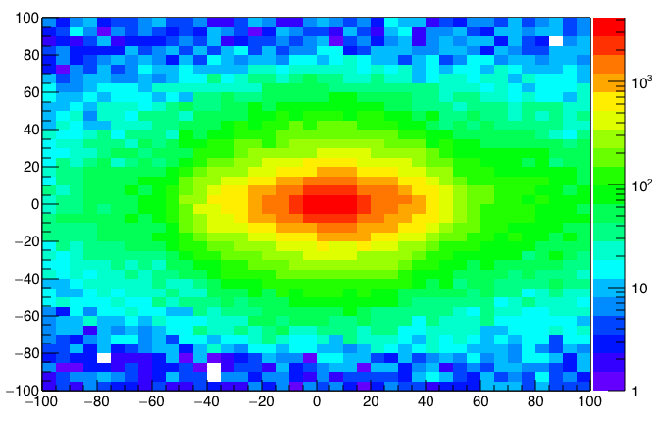
A New High-Granularity Displayed Dimuon Vertex Trigger
High rejection power, very low rate, << 1 kHz(current E906 DAQ limit)
Y-Plane (non-bending) Trigger:
A quadrant panel: 80cm x 72cm (100cmx72cm @ST-2)
  ST1: 1cm x 1cm x 80 cm scintillating strips, SiPM readout
  ST2: 2cm x 2 cm x 100 cm strips
- Straight line projection, 30cm Z-vertex resolution
Displaced z-vertex, mostly low mass < 3GeV
Y-channels per quadrant:
1x V1495
72(St1) + 72(St2) + 8x2 (St4-Y1,2) = 116
96+64 = 160 inputs possible
  (2NIM=RFCLK+ComSTOP)
72x4x2 =576 SiPMs needed (600)
Y
Dimuon Z-vertex (cm)
ST1
X
St1
St2
Z
Coincident Z-vtx
window matched@L2
ST2

Slide 16
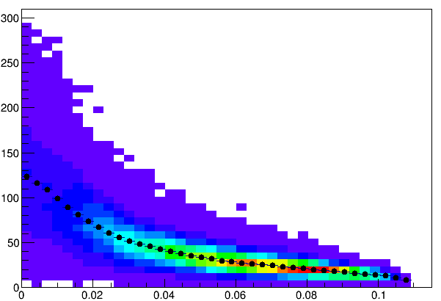
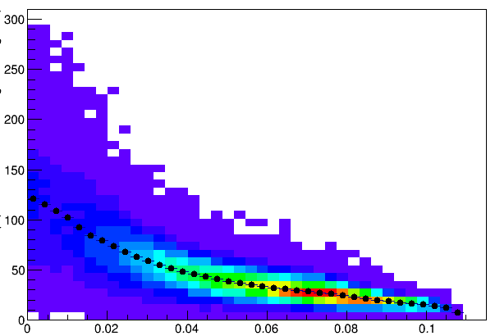
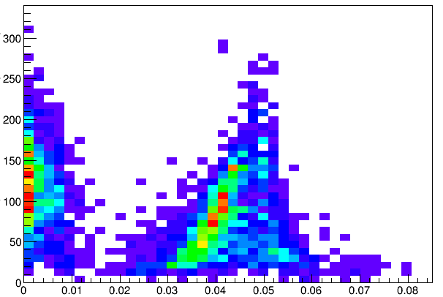
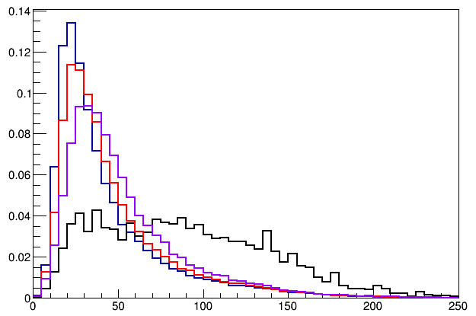
Single Muon Z-Vertex Resolutions
Forward: 1cm
Backward: 1cm
Forward: 1cm
Backward: 2cm
Forward: 1cm
Backward: 1cm
Forward: 1cm
Backward: 2cm
Forward: 2cm
Backward: 2cm
E906
Current
E906

Slide 17
Displaced Dark Photon Trigger
DAQ/Data stream
LVDS cable 2x16ch bundle available
Q1 (LVL1)
DAQ Trigger
LVL2
(vtxZ matching)
Q2 (LVL1)
TS
(12 inputs total)
(1-free bit available)
Q3 (LVL1)
DP Trigger
1-bit
Q4 (LVL1)
4 x 16-bit from 4 Q1-4/V1495
(2 x 32LVDS cables)
Q1: 72(ST1’) + 72 (ST2’) + 2x8(ST4-Y1/2) = 160, FANOUT ST4 Hodo (or EMCal Cluster)

Slide 18
Low Mass Prompt Dimuon Trigger Rate Study in 2015
Current E906 setup
Proposed 2-layer trigger upgrade (10x improvement)
Additional Y-trigger after ST-3 absorber, and also using existing E906 X-Plane trigger
(additional ~2x improvement)
Current E906 DAQ 1kHz, can be improved to ~10kHz with small cost
100+kHz possible in the future (reprograming trigger firmware etc.)
Parasitic mode: use up to ~10% DAQ bandwidth
Expected (Prompt) Low mass dimuon trigger performance

Slide 19
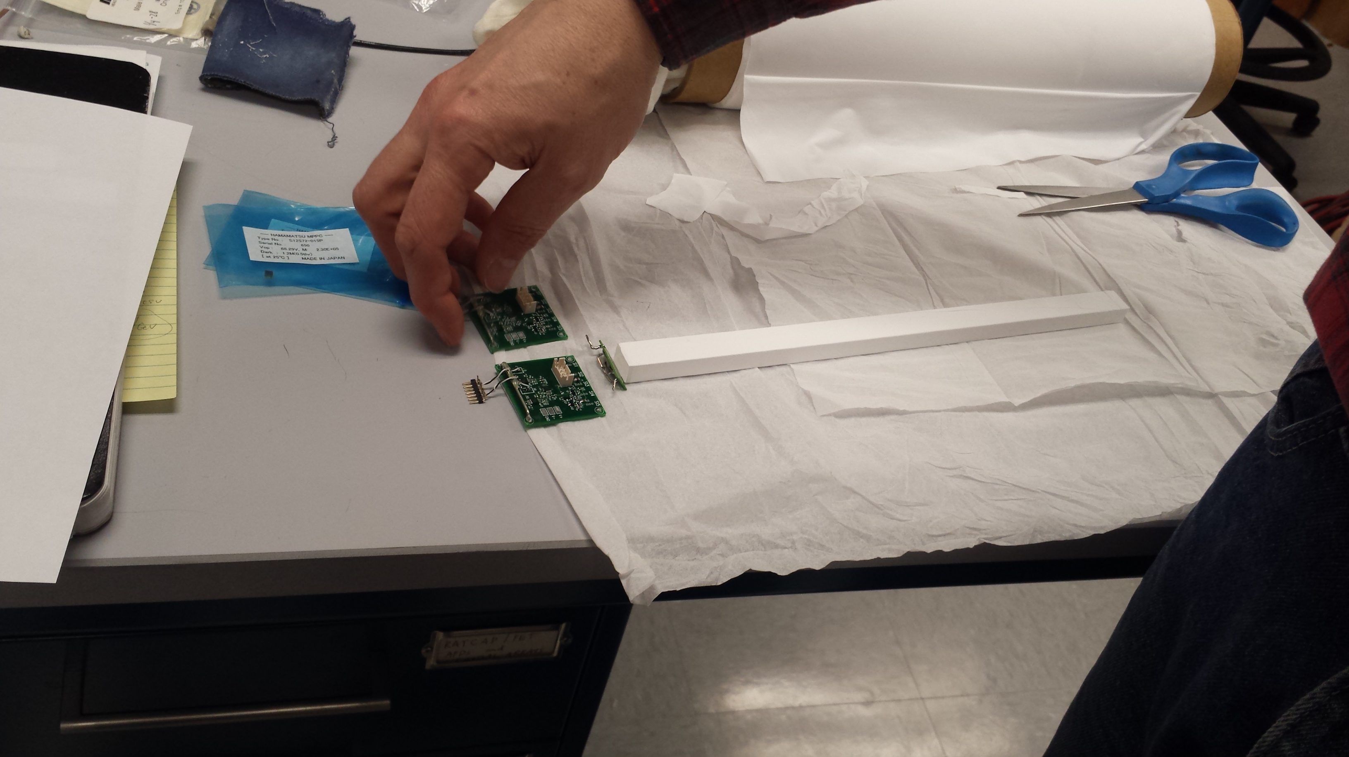
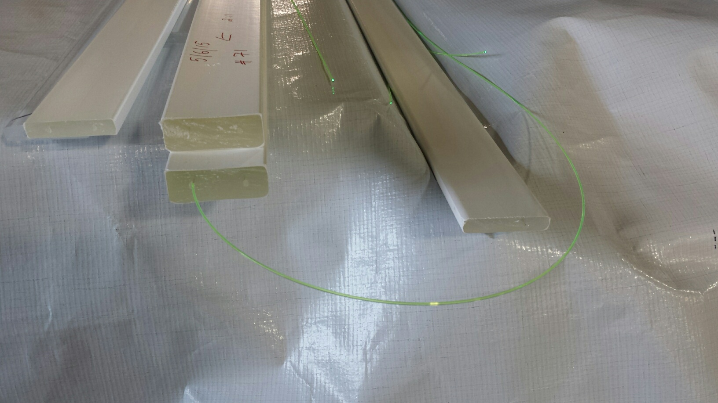
Trigger Scintillator Options
High quality Scintillator bars
  1x1x50cm
  sPHENIX EMCal SiPM readout
  Expensive, $100/per ch.
Fermilab extruded scintillators + WLSF
  1x1cm
  2x2cm
  SiPM readout

Slide 20
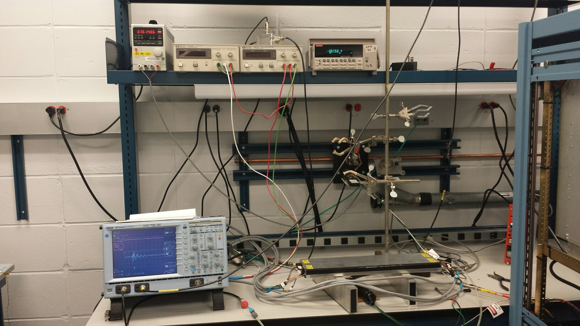
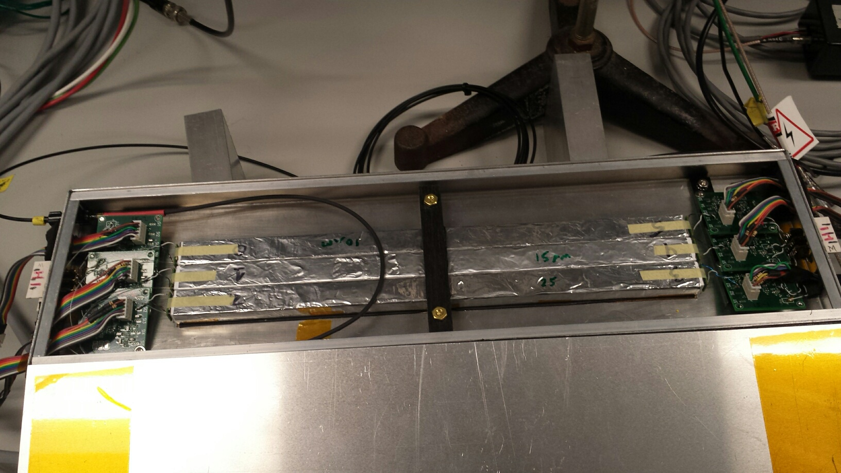
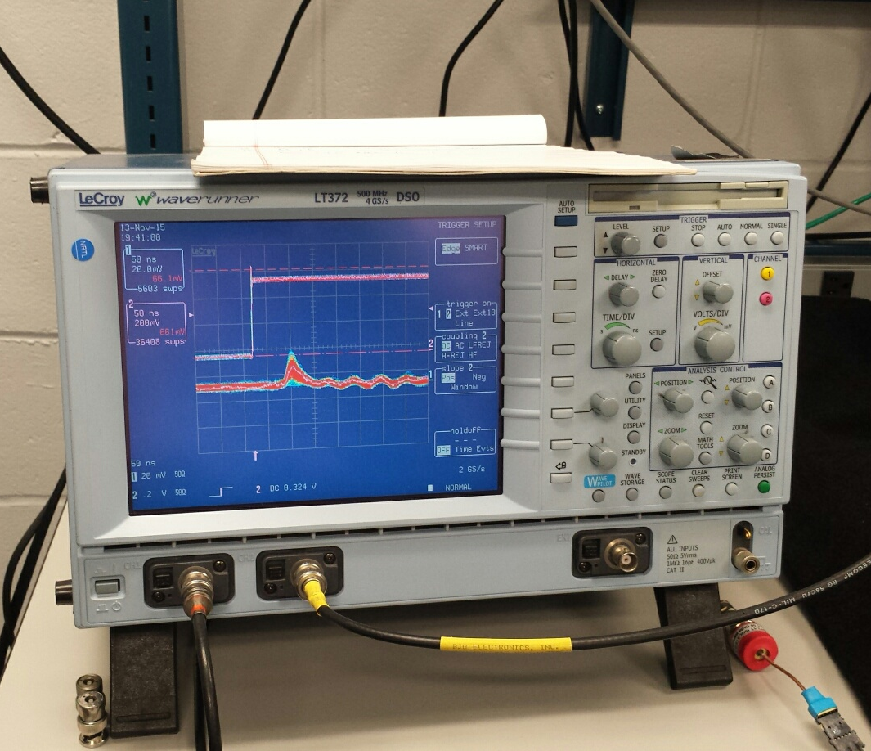
Trigger Prototype R&D (I)
- 10mm x 10mm x 500 mm
- Scintillators + SiPM readout
- Cosmic rays
- Fast <~ 10nS rising time

Slide 21
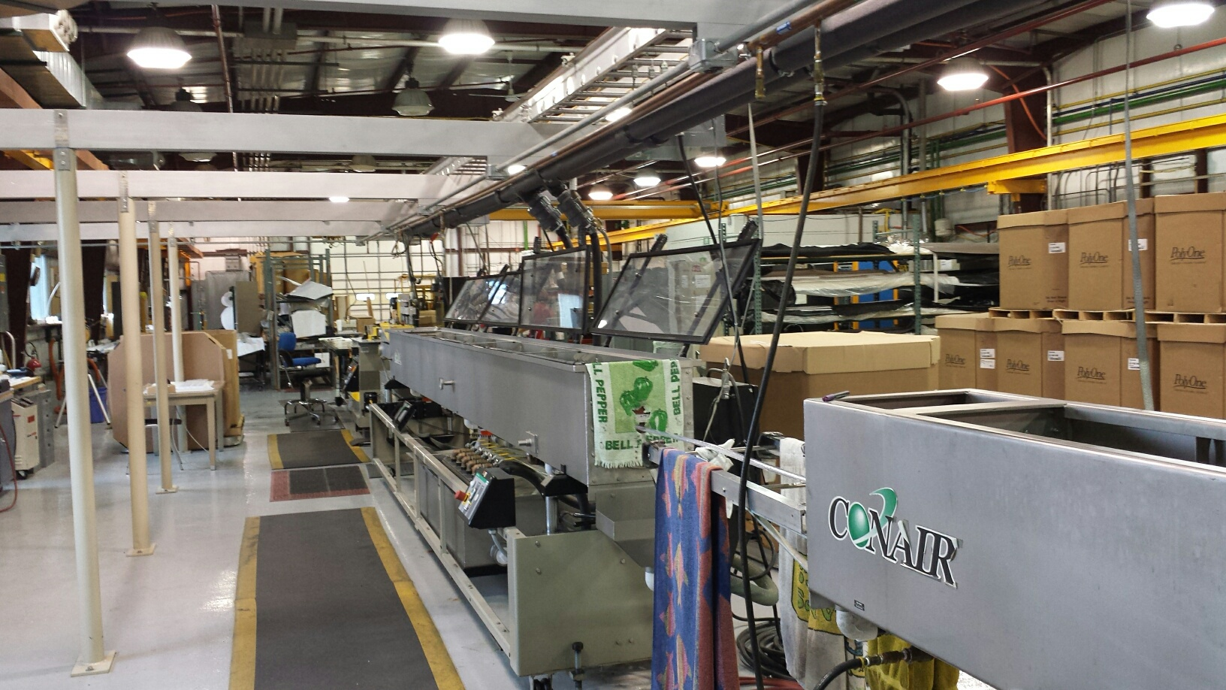
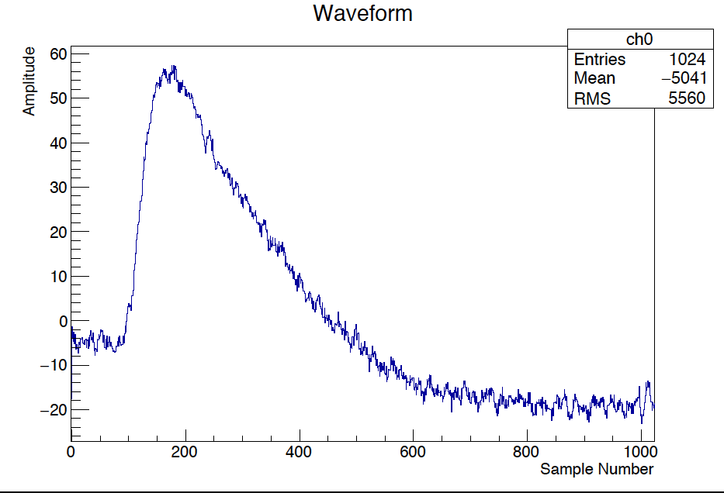
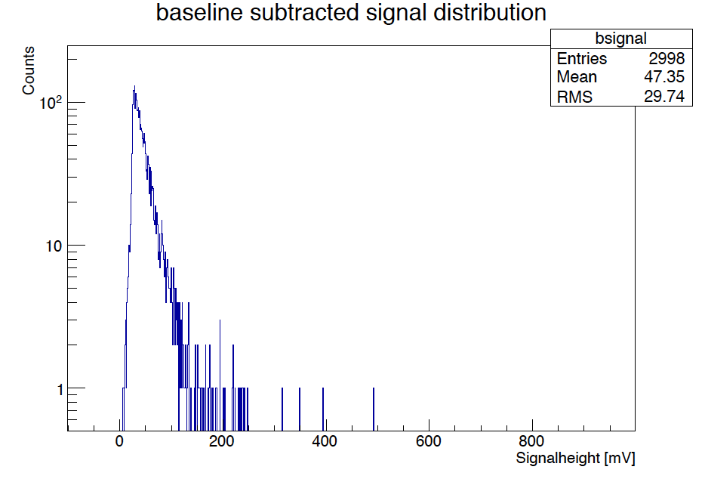
Trigger Prototype R&D (II)
- Fermilab extruded scintillators + WLSF
SiPM readout
Low cost (~$10/per ch. ?)
2 x 2 x 50 cm + 1mmD WLSF
+ SiPM readout

Slide 22
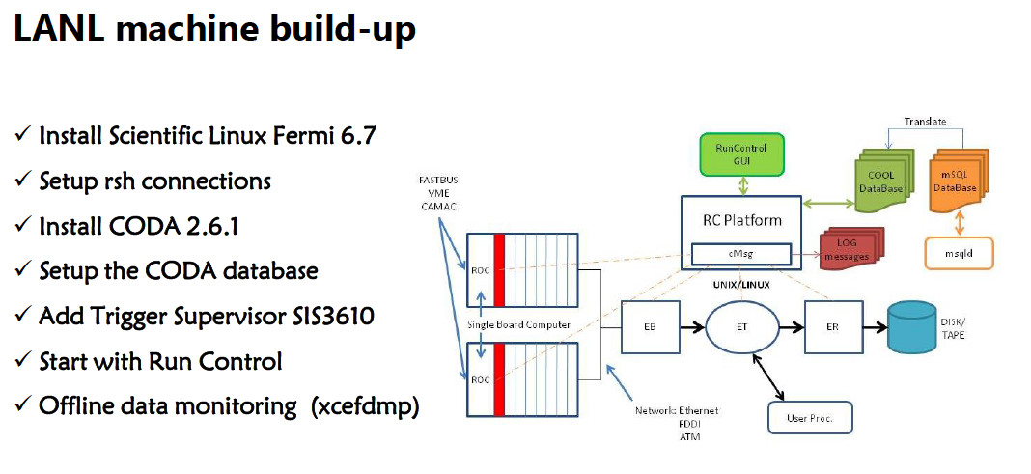
DAQ and Trigger Upgrade R&D
Improve the DAQ bandwidth
  Xinkun, Kun, Grass, Dave C. et al
Trigger upgrade
  Build scintillator based displaced dimuon trigger detectors
    Mechanical assembly and support structure
    Readout
  Develop trigger firmware for displaced vertex
    V1495
  Grass, Kun, Hubert, Ming et al
  Can use more help
Standalone DAQ
  DAQ improvement
  Trigger algorithm development (Byron Roe, Daniel Morton, Kun et al)
  Trigger firmware and DAQ integration (?, LANL?)
  Can use more help

Slide 23
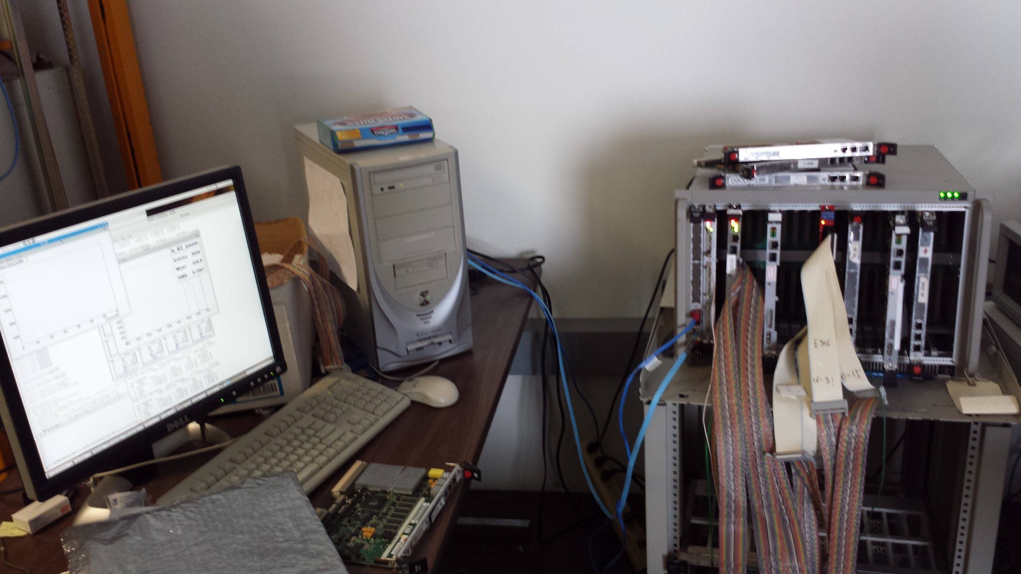
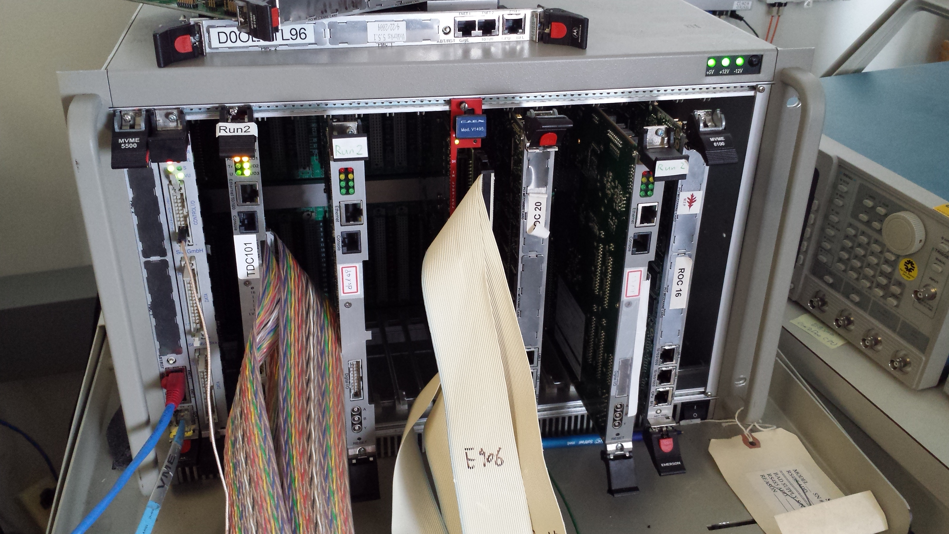
DAQ/Trigger R&D
PC/Linux: Jlab CODA, Ethernet Readout
CPU MVME5500: old VxWork (Jlab)
“TS” SIS3200
TDC-II
V1495 pulse generator
V1495 L1 Trigger “development brd”
Windows PC: Altara FPGA programing
-CNTRL
-SIS3200, as TS
-TDC-II (x)
-TDC-II (x)
-V1495, trigger inputs
at least 4
-V1495 as trigger
pattern emulator

Slide 24
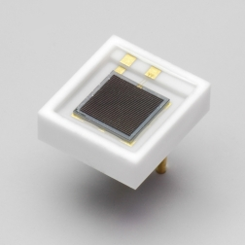
Hardware in hand/Ordered
WLSF: Y-11 (200)
  1 mm D, 1,000m
  1.5 mm D, 1,000m
Extruded scintillators
  Quote:work in progress
SiPMs
  3x3mm, 600 ordered
  S13360-3050CS
  Gain ~ 1.7 x 10^6
VMEs
  1 VME crates
  1 new Linux CPU
  2 old MW5500
  1 Linux computer
V1495 boards
  2 V1495
  6 daughter cards
  Splitting Y-cables (12)
E906 spares
  V1495, 4(LVL-0)+2
  Daughter cards, #?
One standalone DAQ
  Full CODA

Slide 25
Progress in Theory and Simulations
Active theoretical collaboration
    LANL (Kang, Vitev, Cirigliano, Gupta, Graesser et al)
    SLAC (Toro, Schuster, Gori et al)
    Caltech(Zhang, An et al)
    SBU (Zhong, Essig)
  cross check dark photon and dark Higgs signals
    Long-lived decays
    Bump search from “prompt” productions
    SM backgrounds
Physics and Detector simulations
  New root-based GEANT package (Kun, DavidK)
  New trigger optimization (LANL, U. Michigan)
  Parasitic runs with E906/E1039
    Detector and trigger optimization
    Help polarized DY signals
    Single muons from target/dump

Slide 26
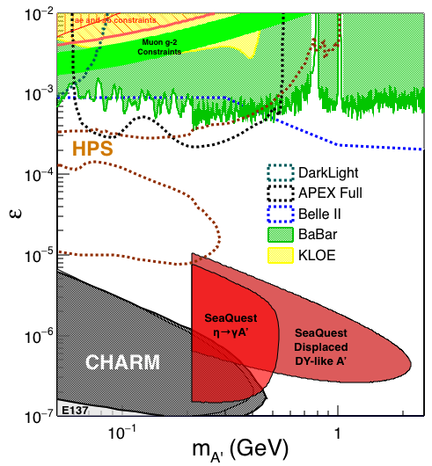
Search Mode (1): Long-lived Dark Photons
Reconstructed dimuons with downstream Z-vertex:
3m < Z-vertex < 6m
Very low trigger rate, << 1kHz
Almost SM background free
Dimuon mass peak
- 5x10¹² ppp ( current E906)
200 days
1.4 x 10¹⁸ POT (recorded)
4 events contours (2-sigma)
2-sigma (95%) exclusion plots
Excellent coverage of uncharted region!

Slide 27


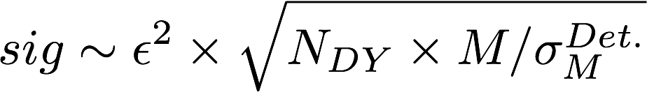
Search Mode (2): “Prompt” Dark Photons vs Drell-Yan
Z-vertx < 3m
Expected Drell-Yan like signal and backgrounds:
Excluded phi
resonance region
Dark photon
signal
Drell-Yan Background
Work in progress …

Slide 28
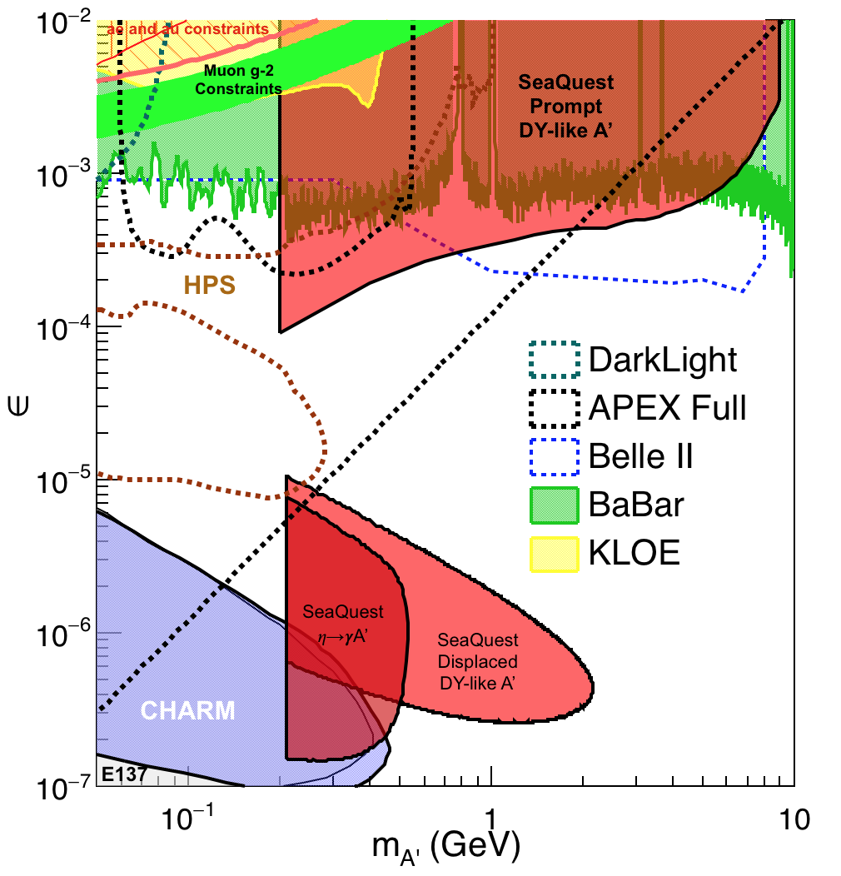
Summary: Dark Photon Sensitivity
(parasitic run w/ E906/1039)
Signals considered:
Drell-Yan like
Eta decays
Bremsstralung
Covers a wide range of unexplored parameter phase space
Displaced dimuons
- Minimal SM background
Prompt dimuons
- Excellent coverage over BELLE-II
projection
- Possible dedicated runs later to fully
restore mass < 3GeV (Phase-II)
Phase-II with upgrades
Access below 200MeV with di-electrons
( add EMCal)
Work in progress!

Slide 29
Dark Higgs Search at E-1067
Y. Zhang et al, arXiv:1502.06983
θ = μ v/m_{h}²
arXiv:1312.4992
e⁺e⁻
Phase-I:
High-mass: μ⁺μ⁻ and hadrons
Advantage of using hadron beams
with muon probes over electrons
Phase-II:
Low-mass: e⁺e⁻, <200MeV possible
High-mass: hadrons, (5x)
μ⁺μ⁻

Slide 30
E-1067 Dark Higgs Sensitivity
POT:1.4x10¹⁸ (Phase-I)
Y. Zhang (2015)
Dimuons with downstream displaced decay vertices
Limited sensitivity to “prompt” large mixing case due to small cross-section
Dark Higgs or dark photons?
  Dimuon kinematic and angular distributions
Phase-II
  Dedicated high luminosity runs optimized for low mass acceptance, mass<3GeV
1x
5x
25x

Slide 31
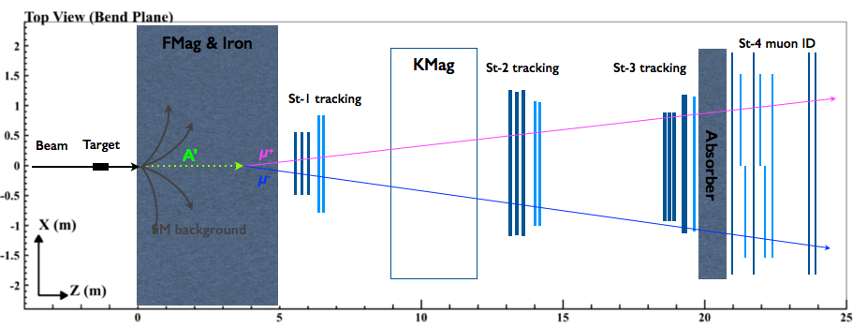
E1067/SeaQuest Upgrade Plan(2020+)
Fine-pitched vertex trigger
Efficiently trigger on the dilepton pairs generated from downstream while suppressing the background rate
Significantly enlarge the fiducial region from ~2m to ~6m
Supported by LANL LDRD
EMCal/HCal
Add e^{+/-} and 𝜋^{+/-} capabilities to SeaQuest spectrometer
Extend the physics reach to A’ from 𝜋⁰ decay, dark 𝝆, and hadronic decay mode for heavier A’
Re-commission the existing detectors (EMCal from PHENIX being considered)
Modest upgrades with significantly increased physics reach.
Data taking expected to start in summer 2017!

Slide 32
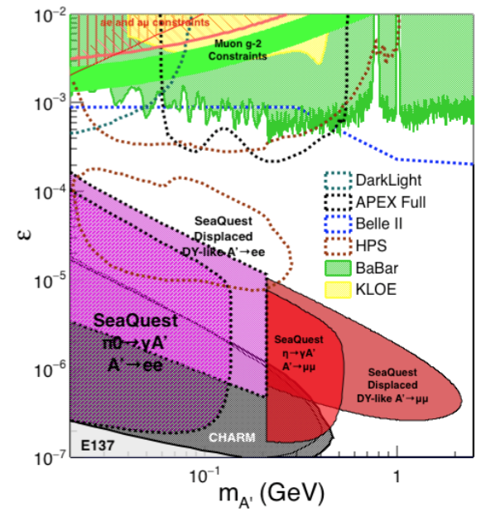
Phase-II: Displaced Dark Photons with future detector “EMCal/HCal” upgrades
Projection: POT 1.4 x 10¹⁸
Detector upgrades
  EMCal: e^{+/-}
  HCal: π^{+/-}
  Recycle from other experiments, PHENIX/RHIC etc.
DAQ upgrade
  100+ kHz
Timeline of dedicated runs
  2020+
Detector configuration
  Access low mass region with optimized Fmag settting

Slide 33
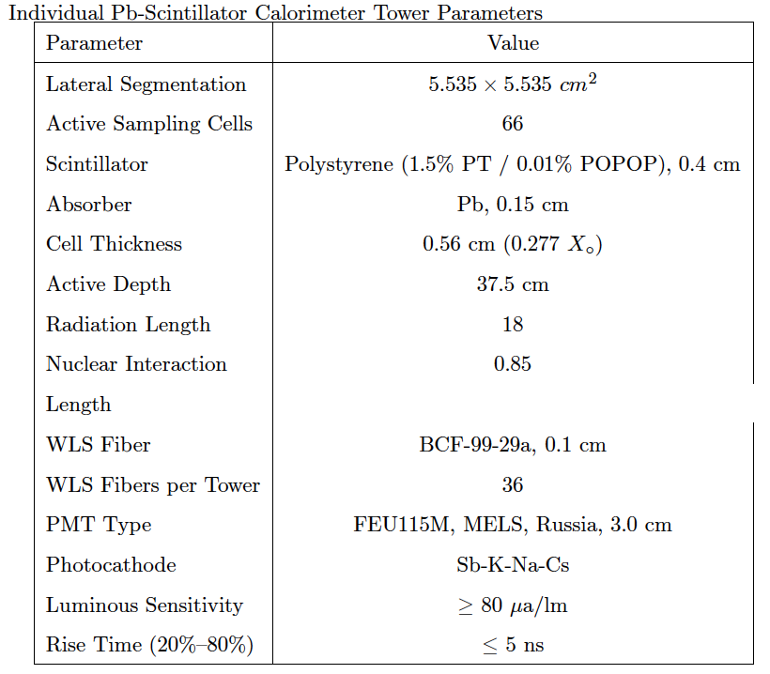
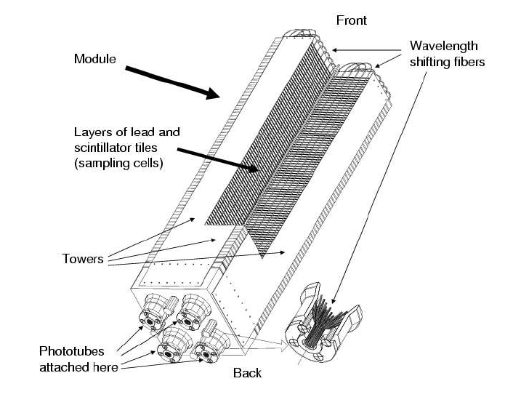
EMCal from PHENIX/RHIC in this Year!
2 EMCal sectors are available from PHENIX experiment at RHIC, ~Sept/Oct 2016
  A sector:
    2m x 4m, 18 (3x6)super modules
    Super module = 36 modules
    Module = 4 towers
    36 x 4 x 18 = 2592 channels
    Could gang 2x2 (or 3x3) into one ADC/TDC readout
dE/E = 8.1%/sqrt(E) + 2.1%
dT < 200 ps

Slide 34
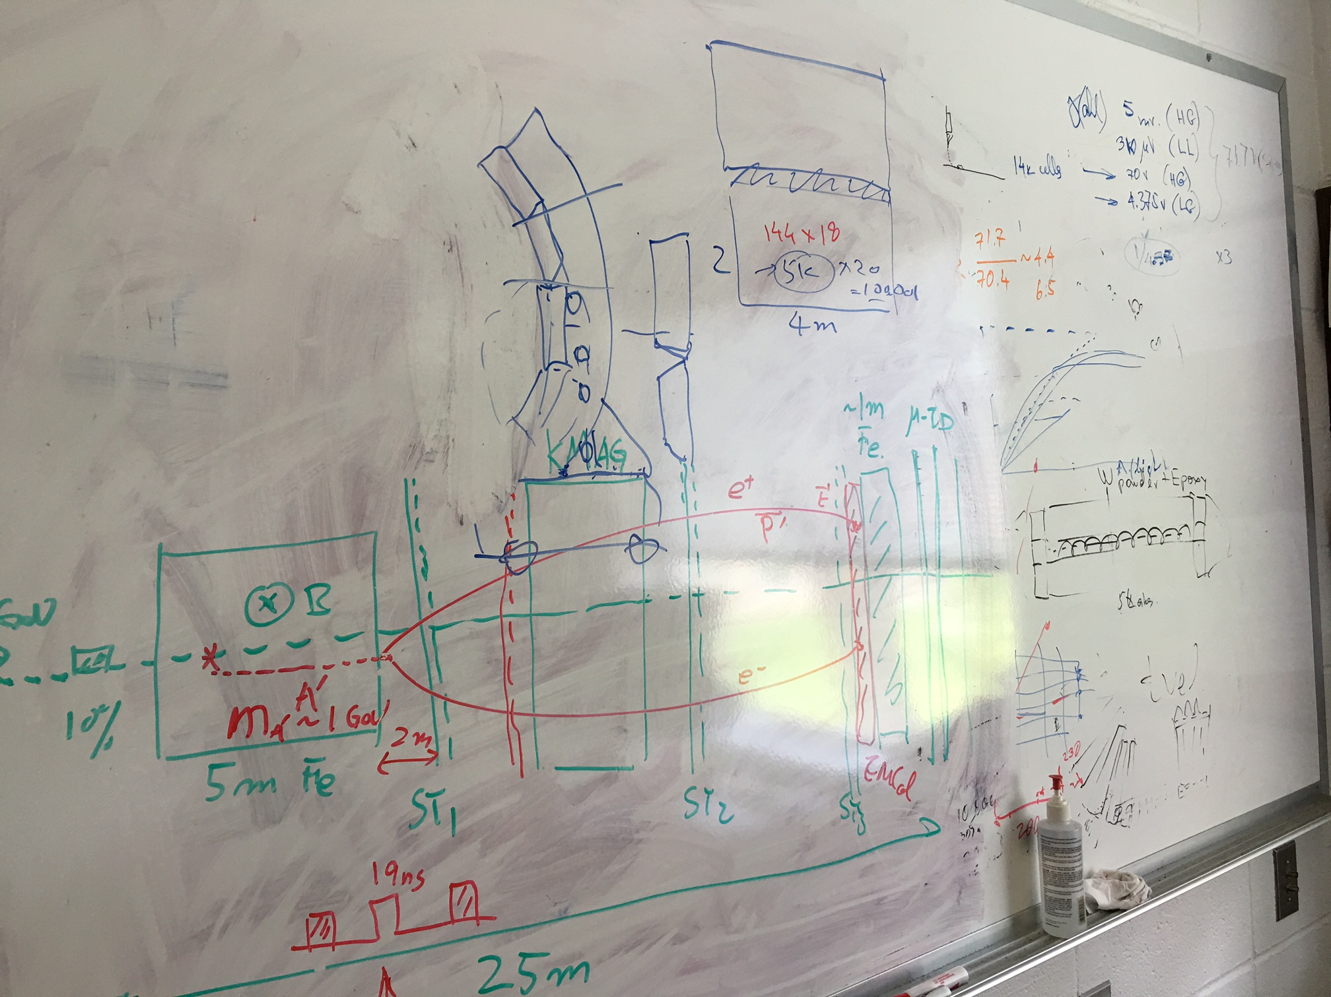
We can just ship the whole PHENIX EMCal
detectors to Fermilab this summer
and install them at SeaQuest

Slide 35
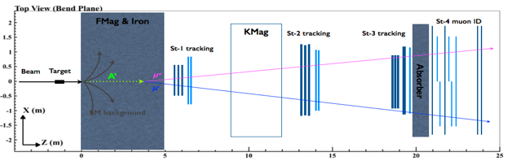
Two incorporation scenarios and potential impacts
Incorporation options:
Option 1: use EMCal to
replace the absorber
Option II: insert EMCal between H3 and absorber (will need to slightly adjust station-3 position)
Potential impacts on our primary physics goal:
How does the EMCal affect our muon identification power?
How does the EMCal change our acceptance? (MC shows no impact)
How does the EMCal (particularly if absorber is removed) change the occupancy in station-4 and thus our raw trigger rate?
How does the additional detector changes our data volume and DAQ deadtime?
Test MC samples (for each scenario):
500k single 𝛑/μ/e tracks with 5 GeV < P < 115 GeV
1M high mass (M > 4 GeV) target DY pairs
2E10 inclusive pp collisions (refer to MC simulation talk by David K.)

Slide 36
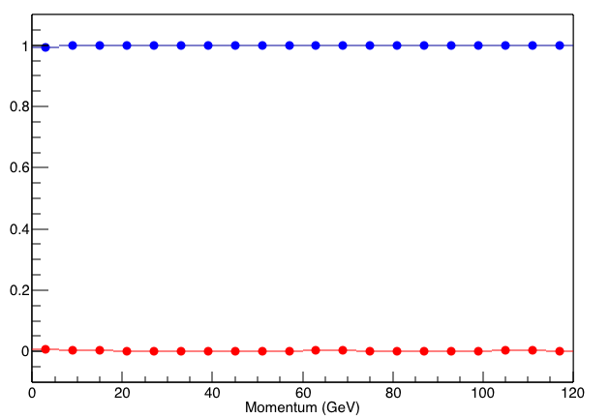
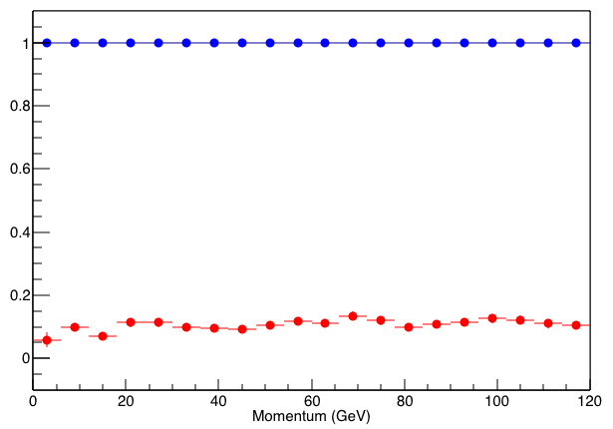
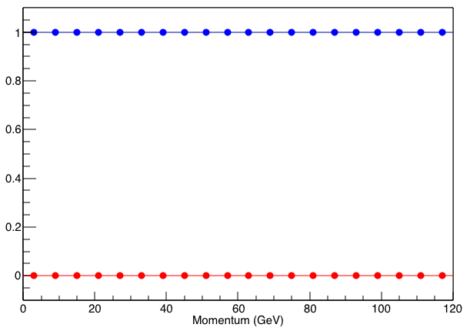
μ/𝛑 separation: case 1 vs. case 2 vs. original
Orignal
Case 1
Case 2
μ survival chance
𝛑 survival chance
For μ survival chance (or μ-ID efficiency), all 3 cases are very close to 100%
For 𝛑 survival change (or 𝛑 contamination):
  original design is around 0.5%
  case 1 is around 10%
  case 2 is around 0.1%
μ identification favors case 2

Slide 37
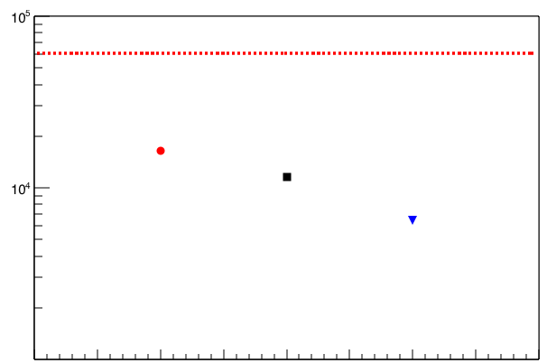
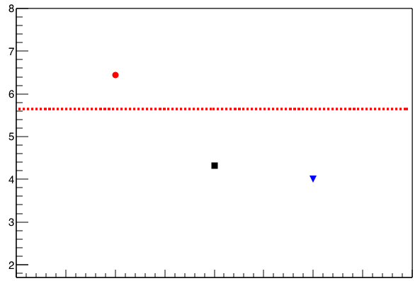
Station-4 occupancy: case 1 vs. case 2 vs. original
Avg. RawMATRIX1 per spill
Avg. H4T occupancy per MATRIX1 event
Run 12525
Case 1
Run 12525
Case 1
Original
Case 2
Original
Case 2
In terms of both raw trigger rate and station-4 occupancy, case 2 works much better than case 1
By adding EMCal between station-3 and absorber (case 2), we could also slightly improve w.r.t our current design
Station-4 occupancy and raw trigger rate favors case 2

Slide 38
Extra DAQ requirements: case 1/2 vs. original
If fully instrumented, 2 sectors of EMCal add 5184 channels to our DAQ:
5184/64 = 81 new TDCs
81/7 = 12 new VME crates (includes 12 new ROCs and trigger interface cards)
data volume per event will be increased by ~5% (based on simulation)
If 4 towers are ganged together, total number of channels reduced by a factor of 4:
1296/64 = 21 new TDCs
21/7 = 3 new VME crates (includes 3 new ROCs and trigger interface cards)
data volume per event will be increased by ~3%
Adding EMCal requires significant amount of extra electronics, but adds very little deadtime

Slide 39
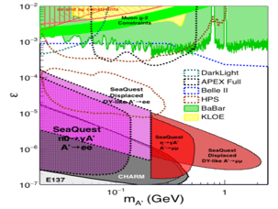
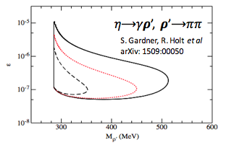
Summary: EMCal Upgrade
2 sectors (4×4 m² coverage) PHENIX EMCal will be available this summer almost for free (not including shipping and instrumentation)
With EMCal installed, we will be able to access:
  dark photon from 𝛑⁰ decay
  dark 𝝆 decays to 𝛑𝛑
  enhanced dark higgs sensitivity
Two different scenarios of including EMCal have been studied via MC, and it poses little impact to our primary physics goal
Potential bonus of better background rejection on trigger level (studies underway).

Slide 40

Schedules of SeaQuest Experiments
E-906 complete data taking in summer 2017
  E906 targets are located ~1.3m upstream of the beam-dump, ~10% λ_{I}.
E-1039 will replace current E906 targets with a polarized NH₃ target.
  No change to E906 spectrometer setup
  New target located about 3.5m upstream of the beam-dump, ~6% λ_{I}.
  Target/trigger installation: 2016 - 2017
  Data taking: 2017 – 2019
E-1067 Timeline – Dark photon/Higgs Search!
  Phase-I (Parasitic run) with E906/E1039: 2017-2019
  (Phase-II: detector upgrades and dedicated runs)
E-1027 polarized Main Injector (future)
A lot of upgrade tasks can be
done this summer !
E-1067
Dark photon(Higgs)
Search: 2017-2019
parasitic run, E906/E1039
E906 started
E-1039 starts

Slide 41
backup

Slide 42


2014 US P-5 Report
Great Opportunities at the Fermilab Intensity Frontier!!!
Notes:
P5 reprot highted the 5 sciecne driver …
We respond to the call of P5 report and identified a new opportunity to explore key physics at Femirlab intensity frontier

Slide 43
A New High-Granularity Displayed Dimuon Vertex Trigger
High rejection power, very low rate, << 1 kHz(E906 DAQ limit)
Y-Plane Trigger:
A quadrant panel: 50cm x 50cm, 1cm thick
  1cm x 1cm x 50 cm scintillating strips, SiPM readout
- Straight line projection, 30cm Z-vertex resolution
- Displaced z-vertex, mostly low mass < 3GeV
Coincident with St-4 Hodos(muons), or EMCal(e^{+/-})
Y-channels per quadrant:
1x V1495
50(St1) + 50(St2) + 8x2 (St4-Y1,2) = 116
96+64 = 160 inputs possible
  72+72+16 = 160 (possible)
  (2NIM=RFCLK+ComSTOP )
Bigger one?!, 72 channel per Q/station
  576 SiPMs needed (600)
Y
X
St1
St2
Z
Coincident Z-vtx
window matched@L2
Dimuon Z-vertex (cm)

Slide 44

V1495 Board
2 Altara FPGA Chips: Cyclone-V
Trigger lookup table

Slide 45

E-1067 Future Upgrade: Phase-II
2020 ~ 2025+ ?
Add tracking close to “target” to improve mass resolution
Add EMCal + Hcal, PID?
e^{+/-}, h^{+/-} , π^{+/-}

Slide 46

Phase-II: Access Low Mass Region with e⁺e⁻ with future detector upgrades
S. Gardner, R. Holt et al
p
l⁺
p
l⁻

Slide 47

Phase-II: Full Coverage with future detector “EMCal/HCal” upgrades
Projection: POT 1.4 x 10¹⁸
Detector upgrades
  EMCal: e^{+/-}
  HCal: π^{+/-}
  Recycle from other experiments, RHIC/JLab etc.
DAQ upgrade
  100 kHz
Timeline of dedicated runs
  2019+
Detector configuration
  Access low mass region with optimized Fmag settting

Slide 48
Phase-II: Probe Non Abelian Dark Sector with future detector “HCal” upgrades
non-Abelian dark sector process
S. Gardner and R. Holt
[Note: Batell, Pospelov, and Ritz, PRD 80 (2009) 095024 for a review re fixed target expts.]
Here we consider a non-Abelian (gluon) portal
[Baumgart et al., JHEP 0904, 014 (2009); Gardner and He, PRD 87 (2013) 116012]
The “shining through walls” design – unique to Seaquest – makes this possible ,
to yield, e.g., via a “minimal” decay….

Slide 49

E-1067: A New Program to Probe Dark Sector in Beam Dump Mode
E906/E1039: Targets ~10% λ_{I}

Slide 50

Summary and Outlook
Phase-I
  Great discovery potential!
  Add a new displayed vertex trigger
  Early parasitic data taking 2017-2019+
    A short dedicated run up to ~1 month if needed
  POT 1.4 x10¹⁸
Phase-II
  Possible detector upgrade later, add electrons and hadrons
  A new dedicated dark matter program at Intensity Frontier!
Dark Higgs
search
Preparation Phase-I (parasitic runs)
Phase-II
2015
2016
2017
2018
2019
2020+

Slide 51


Vector Portal and Dark Photon
A simplest model of dark sector
An extra U(1)_{X}, kinetic mixing
Not suppressed by mass scale
Holdom
Galison, Manohar
SU(3)_{C} x SU(2)_{L} x U(1)_{Y} x U(1)_{X}

Slide 52


Expectations from GUT
After EWSB, there is a coupling ε between the dark photon and the photon (also the Z, less important at low energies).
Theoretical prejudice for a mass scale
m_{A}’ ~ √ε m_{EW} ~ (MeV – GeV)
e.g. Arkani-Hamed & Weiner;
Cheung, Ruderman, Wang, Yavin;
Morrissey, Poland, Zurek;
Essig, Schuster, Toro;

Slide 53

Current Limits on Dark Photon Search
Slide credit: Bertrand Echenard
BaBar (2014)

Slide 54
Current E906 Trigger & DAQ System
Pulse Gen.
V1495 @TB
DAQ
VME/CPU
Ethernet
Hodos
Hits/
Start
TDC (xx)
Threshold Discriminator
……
L1-Trigger
V1495 (4)
(96)
L0 Trigger: not “actively” used
- 4 V1495 boards available
L1 Trigger: in operation
- 4 V1495 boards
(2) for Y-plane, not used
(2) for X-Plane, in use
- 700nS latency
L2 Trigger: pass through
1 V1495
Could do simple look-up
TS: Trigger Supervisor
L2-Trigger
V1495 (1)
L2: limited I/O
1(O), 5(I), 32x
only 2 (I) used
Trigger Supervisor
Comm.
Stop/Trigger

Slide 55



PHENIX EMCal
2 sectors available in this summer!
Key specs:
Tower size: 5.525 × 5.535 cm²
Number of towers per sector: 72 × 36
Active sampling cells: 66
  Scintillator: Polystyrene, 0.4 cm
  Absorber: Pb, 0.15 cm
Active depth: 37.5 cm
Radiation Length: 18
Nuclear Int. Length: 0.85
Energy resolution
𝛑/e separation

