Slide 1
Drell-Yan Asymmetry (II) 05/27/2015
Use beam-dump events as reference, R(phi)
Use target events as signal, S(phi)
Asymmetry(phi) = S(phi)/Ref(Phi)
This is a follow up of previous discussions about DY spin asymmetry measurements
https://p25ext.lanl.gov/elog/Drell-Yan/29
https://www.phenix.bnl.gov/WWW/publish/mxliu/E906/LDRD-Pol-DY-Work-2015-Ming.pdf (pptx)

Slide 2
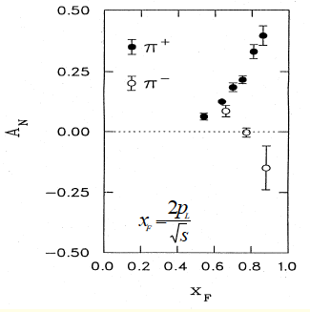
Confirm positive signals from charged hadrons h+/-
Targer @ Z= -350cm
Decay muons from charged pi+/- and K+/-
Confirm positive signal from mu+ and mu-
Asy (phi) = S(phi)/Ref(phi)
Need to rum full MC to simulate
Single mu+/- from pi/K decays
Kinematics and single muon trigger optimization
Improve DAQ from 1kHz -> 10(100)kHz

Slide 3
Experimental Layout for Single Muon Positive Signals
Polarized
target
ST-1
ST-2
ST-3
ST-4
ç
ç
ç
ç
Z=-350cm
Z=0
Tag: single muons from pi/K decays
- from target and beam dump
2. Trigger: single muons
- high statistic single muon to provide positive AN signals
For mu+ and mu-

Slide 4
Summer work
Install telescopes
Check rates
Coverage of x2
DAQ upgrade?
1kHz -> 10kHz (100kHz?)
Single muon triggers
Large x₂, or low momentum muons, pZ
New trigger map
New MC framework – root based analysis
Single muon MC to optimize AN(Mu+) and AN(mu-)
Trigger optimization

