Slide 1
New Physics Topics with E1039
Gluons Sivers functions in “valence region”
Xg = 0.1~0.3
Gluon Sivers functinos can be best determined in E1039
Large AN observed from valance quark in this x-range, it would be very interesting to explore the gluon sector in this kinematic region.
Open charm and anti-Charm A_{N}
Single muon A_{N} for mu+ and mu- from charm decay
Reveals the underlying physics of color interaction
J/Psi and Psi’
If Gluon’s Sivers functions are non-zero, one could study the J/Psi production mechanisms with A_{N}.
Early theoretical work shows J/Psi A_{N} is sensitive to production processes (Feng Yuan et al)
Ligh hadrom AN using decay muons
This is the one we plan to use to calibrate the Drell-Yan A_{N} measurements

Slide 2
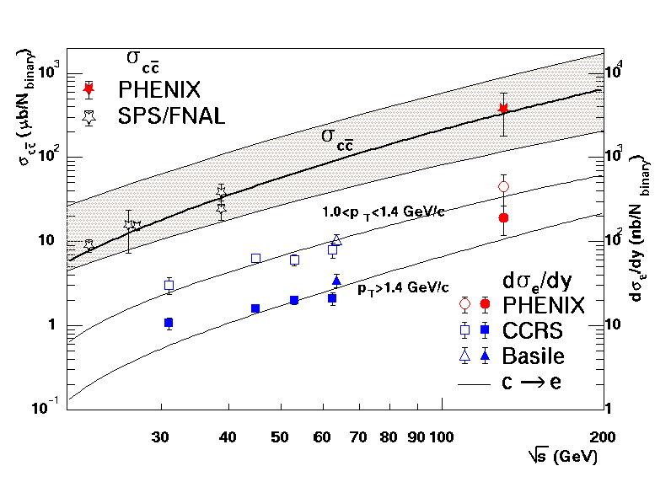
New Idea: High Luminosity Polarized Fixed Target p+p?
Drell-Yan
Open charm@ low √s
J/Psi

Slide 3
TSSA in Heavy Quark Production in p+p
Kang, Qiu, Vogelsang, Yuan, PRD 2008

Slide 4
Open Charm TSSA in Twist-3 Approach
Qiu, 2010

Slide 5
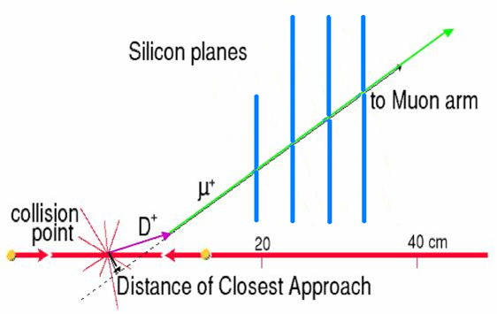
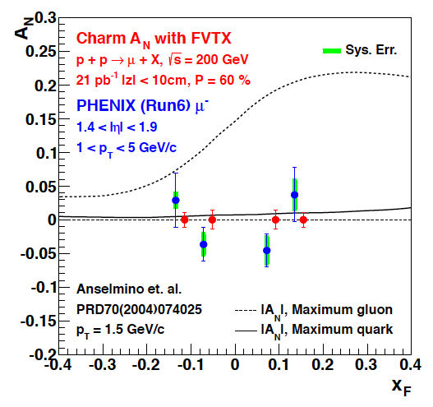
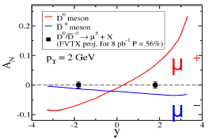
Expectation from Run 2015 p+p & p+A with F/VTX
Drell-Yan
prompt
π→μ
Expect much improved results from Run 15
110 pb⁻¹, Pol = 57% (Run15)
10x FOM(Run12)
GTMD model
Twist-3 Approach

Slide 6
TSSA in Charm Production at Low Energy (I)
F. Yuan and J. Zhou PLB 668 (2008) 216-220
Low energy
Initial state interactions
Final state interactions

Slide 7
Heavy Quark TSSA at Low Energy (cont.) Twist-3 quark-gluon correlation fun.
Different color factors for charm and anti-charm
F. Yuan and J. Zhou PLB 668 (2008) 216-220
Initial state
Charm
anti-Charm

Slide 8
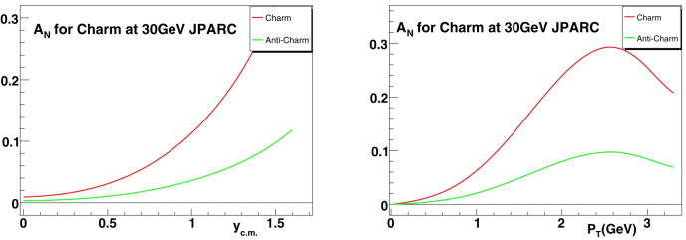
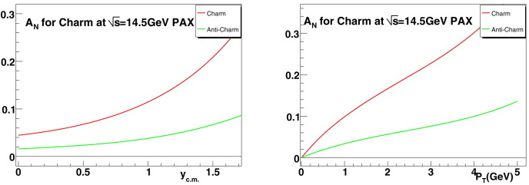
JPARC p+p
GSI: p+pbar

Slide 9
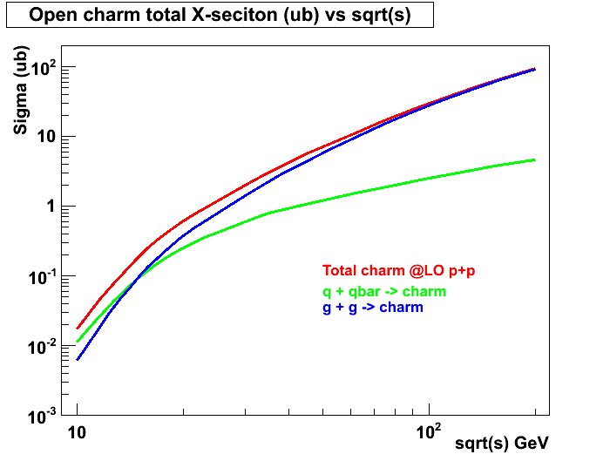
Open Charm Production in p+p with PYTHIA (LO)
RHIC 200 GeV
RHIC 62GeV
E906
JAPRC

Slide 10
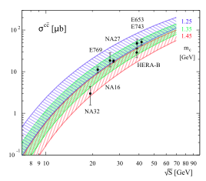
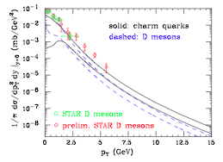
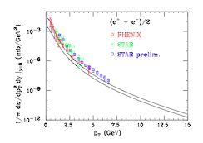
More on Open Charm Production
Fixed targets vs NLO
Collider mode @RHIC
EPJ C 52, 987 (2007) J. Riedl, A. Schafer, M. Stratmann
PRL 95, 122001 (2005) M. Cacciari, P. Nason, R. Vogt

Slide 11
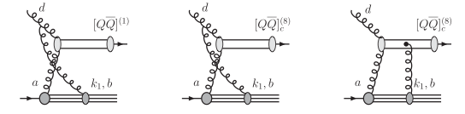
J/ψ A_{N}
J/ψ A_{N} is sensitive to the production mechanisms
Assuming a non-zero gluon Sivers function, in pp scattering, J/ψ A_{N} vanishes if the pair are produced in a color-octet model but survives in the color-singlet model
Feng Yuan, Phys. Rev D78, 014024(2008)
One color-singlet diagram
— no cancellation, asymmetry generated by the initial state interaction, A_{N}≠0
Two color-octet diagrams
— cancellation between initial and final state interactions, no asymmetry A_{N}=0

Slide 12
NRQCD and J/ψ Polarization
NRQCD failed on J/ψ polarization.
J/ψ production mechanism is still an open question.
Very active field of theoretical study…

Slide 13
To Do List
MC samples of MB, J/Psi and Open charm
Open charm measurements with single muons
High pT single muons?
Decay light hadrons?
Move the polarized target to different locations?
Add an intermidiate C-target at different locations to determine the light hadron contribution?

