Slide 1
Direct Search for Dark Photon and Dark Higgs at Fermilab
Weakly interacting dark photon(Higgs)
Photon Portal:
Higgs Portal:

Slide 2
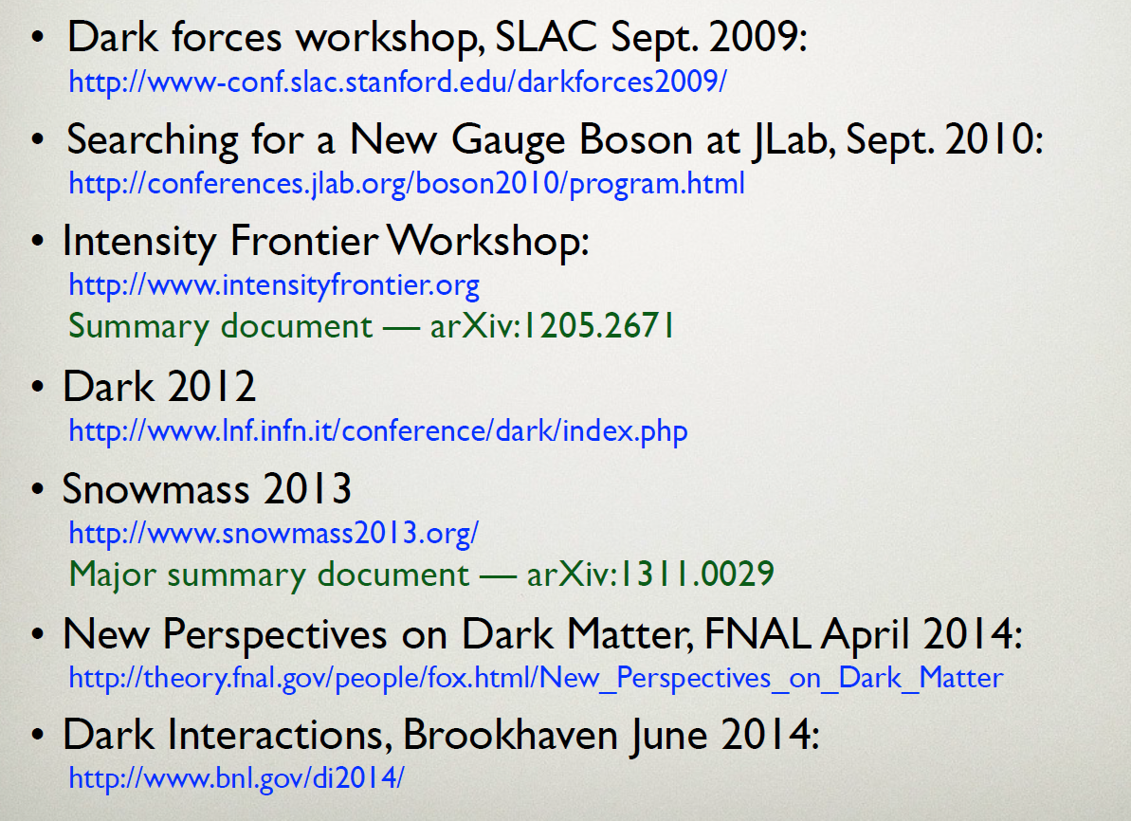
Very active field with many new results
Roy Holt,
LANL Seminar

Slide 3
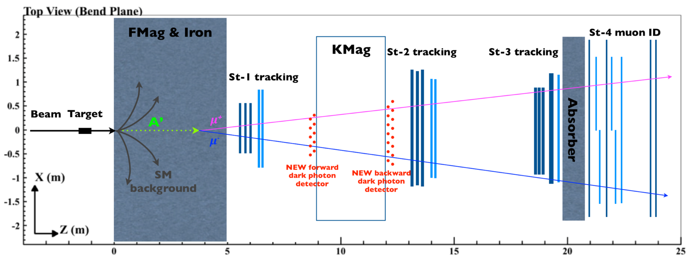
Dark Photon(Higgs) Search @SeaQuest
Beam Dump Mode
Displaced Dimuon Vertex Trigger Upgrade
  Requires dimuon Zvtx > 200 cm, “SM background free”
(meter)

Slide 4
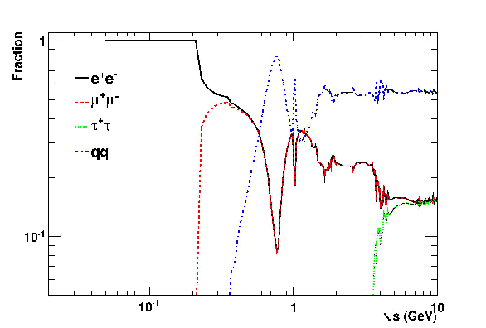
Dark Photon -> DiMuon
A’ BF
Future upgrades:
- Electrons (EMCal)
- Charged pions (HCal)

Slide 5
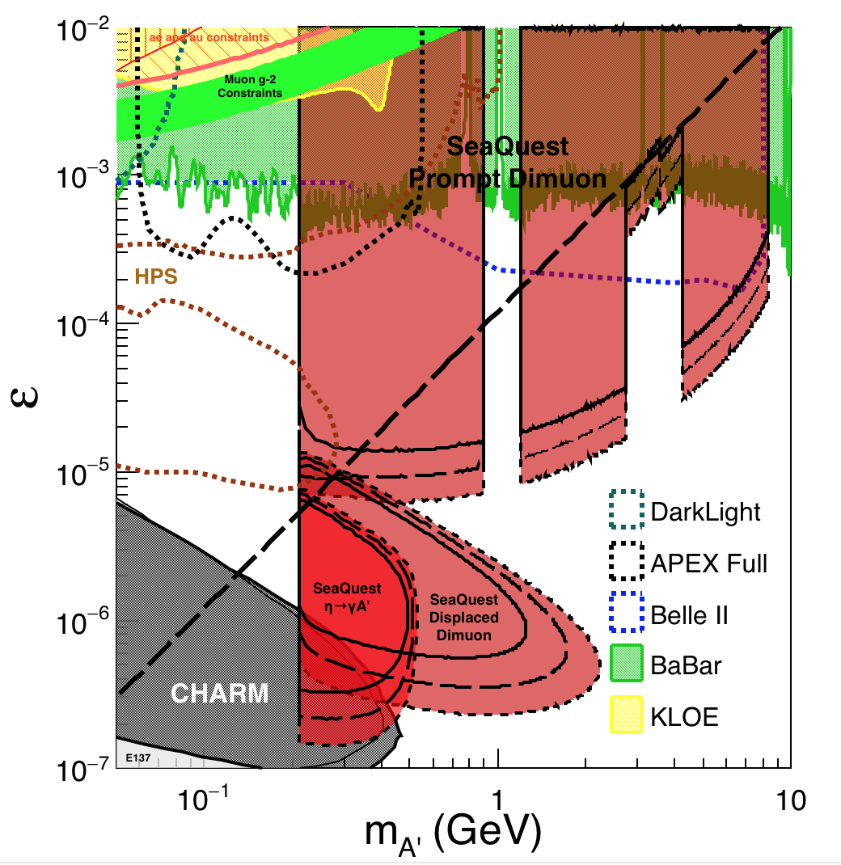
SeaQuest Dark Photon Sensitivity
POT:1.4x10¹⁸ (parasitic w/ E1039), 5x, 25x

Slide 6
Dark Higgs -> Dimuon
Future upgrades:
- Charged pions (HCal)
Note: diMuon yields >> di-electrons

Slide 7
SeaQuest Dark Higgs Sensitivity
POT:1.4x10¹⁸, 5x, 25x

Slide 8
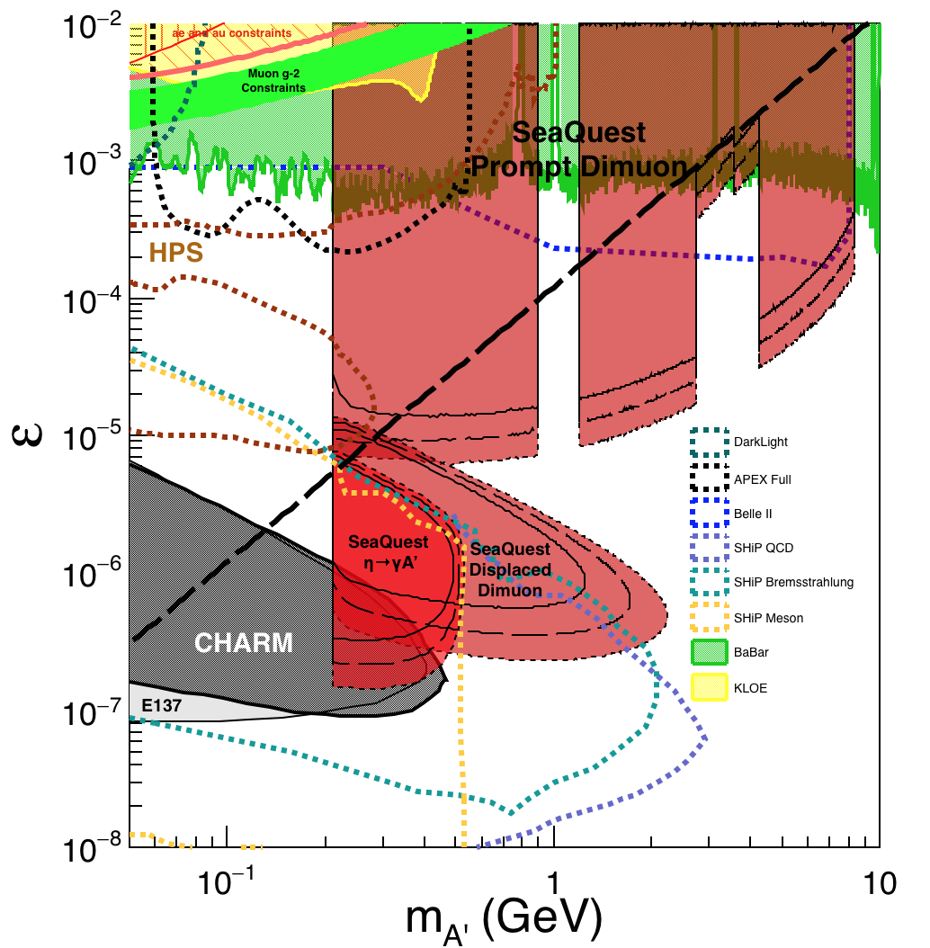
SeaQuest@FNAL vs SHiP@CERN
120 GeV@FNAL: 2016 – 2018 - 2025? 400GeV@SPS: ~2025 or sooner? POT: 1.4x 10¹⁸, 5x, 25x(0.35 x10²⁰) POT: 4x10²⁰ over 5 years
Dark photon
Dark Higgs

Slide 9
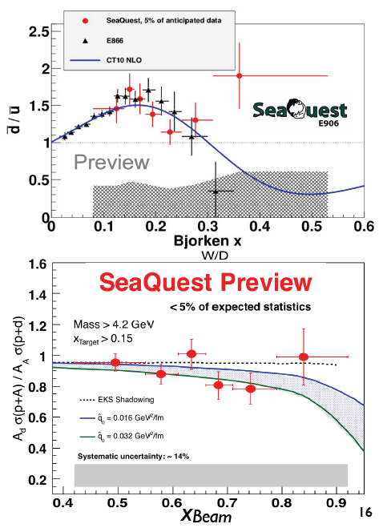
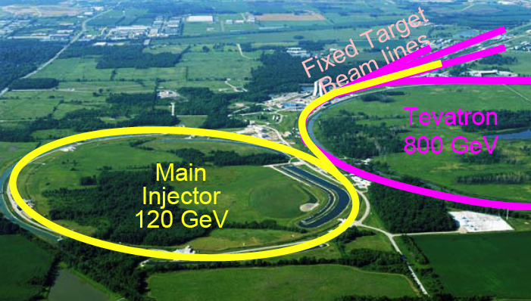
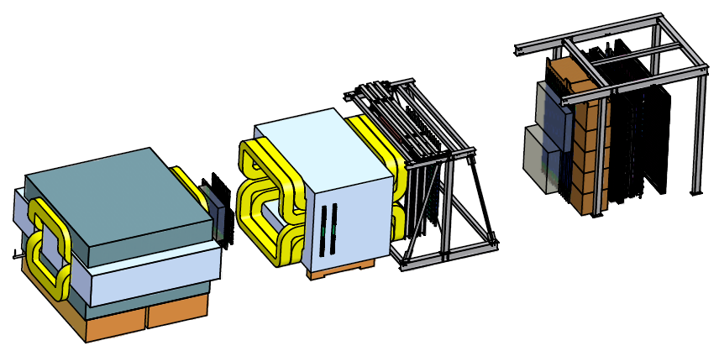
LANL Efforts at Fermilab: E906 (dE/dx)->E1039(Pol Drell-Yan)->E????(Dark Photon/Higgs)
LANL built Stat-4 muon ID commissioned & operated in the first engineering run 2012
  LANL/LDRD $1M contribution in hardware
Developed offline tracking
  First J/Psi reported, Jan. 2013
  First results from Run-2, 2015
LANL-Led Physics @E906
  Quark energy loss in p+A, dE/dx (2013-16+)
A new follow-up program with polarized targets @E1039
  LANL T/P LDRD (FY13-16)
  E1039 pol. Drell-Yan
Dark photon/Higgs search – new development
First Physics
@DIS 2015
LANL LDRD investments: >$6.5M in E906/Fermilab
E906
p+A collisions
E906 Experiment @Fermilab
Notes:
LANL has been carrying out a very active study of dE/dx using E906 spextrometer …
We hav eprovide St-4 MuID and St-1 DC…

Slide 10
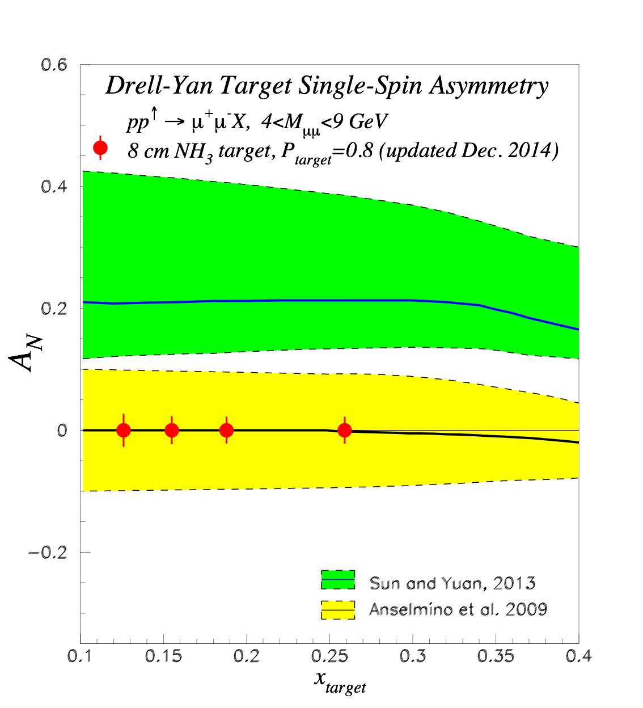
LANL’s Long Term Program @Fermilab
E906: 2010 – 2016+
  Parton dE/dX
  dbar/ubar
E1039: 2016 – 2018+?( – 2020+?)
  Polarized fixed target NH₃
    2017-2018
  Polarized fixed target ND₃(?)
    2019 – 2020+?
    Parasitic Dark Photon Search
Dark Photon/Dark Higgs Search: 2016 ~ 2021+
  2016 – 2018, parasitic run with E1039
    1.4 x10¹⁸ POT
  2019 – 2021+, dedicated search
    1x 10²⁰ POT
    Detector upgrades: electron and charged pions
    DAQ upgrade: 100 kHz
  LANL LDRD proposal submitted
  Fermilab LOI planned for this summer
E1027: 202x?
  Polarized beam in the Main Injector
New ideas?

Slide 11
LANL LDRD submitted: FY16-FY18
Direct Search for Low Mass Dark Photon Production in p+A Collisions at Fermilab
High Intensity Frontier – Main Injector
E906 Dimuon Spectrometer
New dedicated dark photon triggers
A dark photon of mass m_{A’} is produced via kinetic mixing with a virtual photon produced through quark and antiquark annihilation in a high-energy proton-nucleus collision with a coupling constant ε.

Slide 12
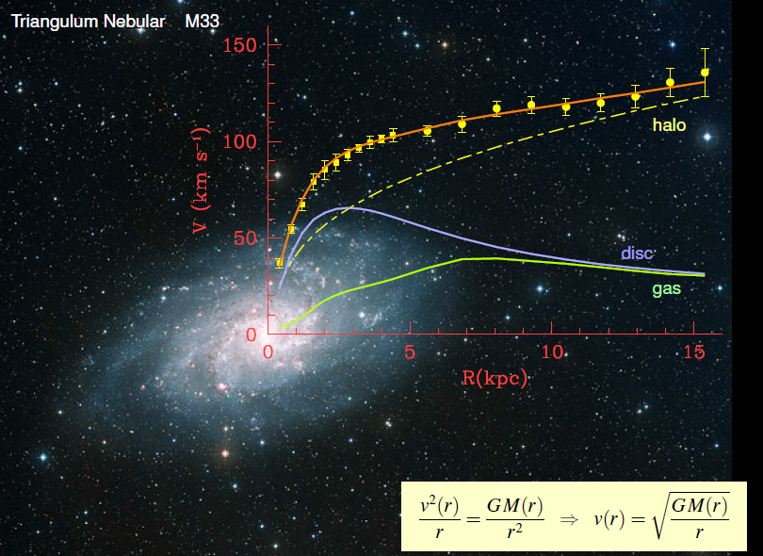
Rotation curves of galaxies
Roy Holt,
LANL Seminar
Figure credit: H. Merkel
F. Zwicky, ApJ 86 (1937) 217, V. Rubin et al, ApJ 238 (1980) 471

