Slide 1
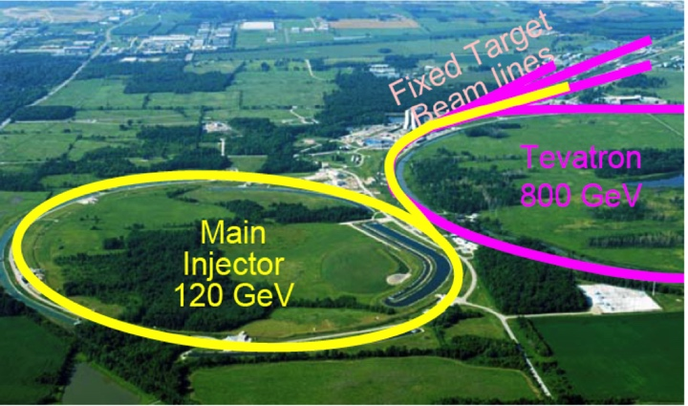
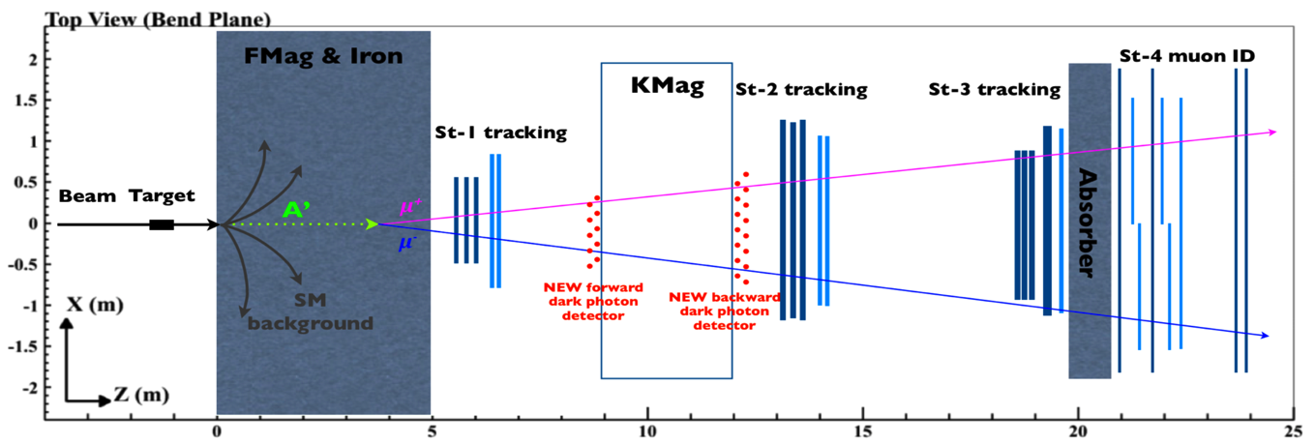
Prospects of direct search for dark photons and dark Higgs in p+A collisions at Fermilab E-1067/SeaQuest Experiment
Ming Liu
Los Alamos National Laboratory

Slide 2
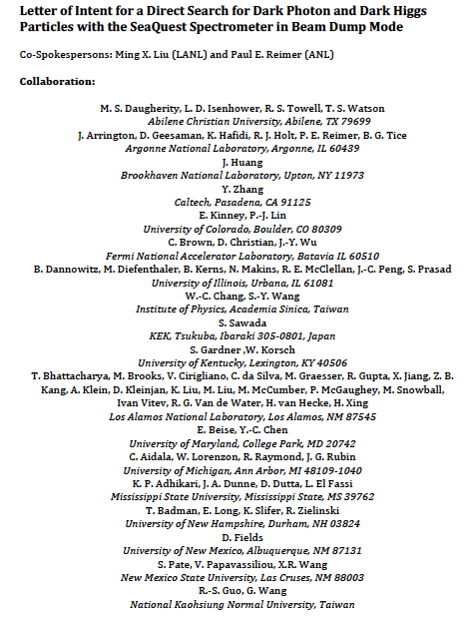
LOI submitted to Fermilab PAC
on May 20, 2015
A joint experimental and theoretical collaboration
(most E906/E1039 + new members)
---------------------------------------
Phase-I: (parasitic runs)
Addition of a new displaced dimuon trigger to tag long-lived downstream decayed dark photons (dark Higgs).
Parasitic data taking with E1039 in 2017-2019;
  A short dedicated run (up to ~1 month) if needed.
POT 1.44x10¹⁸
Phase-II: (upgrade)
Dedicated runs later with EMCal/HCal upgrades, e^{+/-} and h^{+/-} capabilities.
Cover the full parameter phase space allowed by beam energy and luminosity
POT: >> 1.4x10¹⁸
Phase-II request will be presented to PAC at a later time.
Notes:
Responding to P5 reprot, we submitted LOI last month .. And the membership is growing …

Slide 3
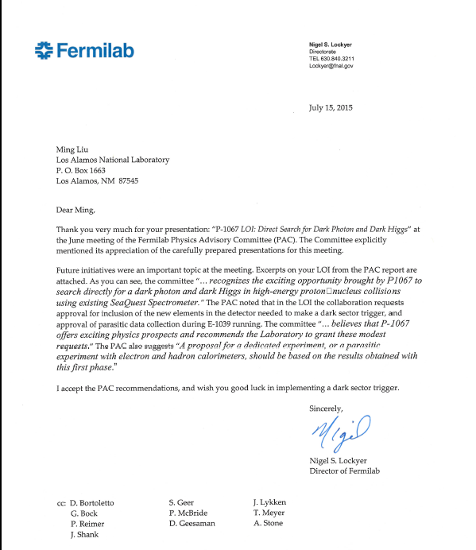
A heart-full endorsement
from Fermilab Director and PAC
July 15, 2015!
New experiment! E-1067

Slide 4
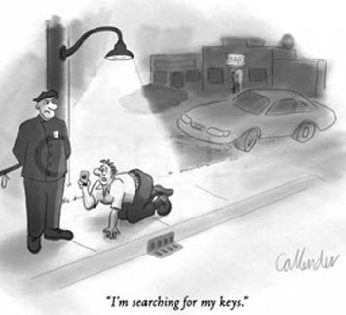
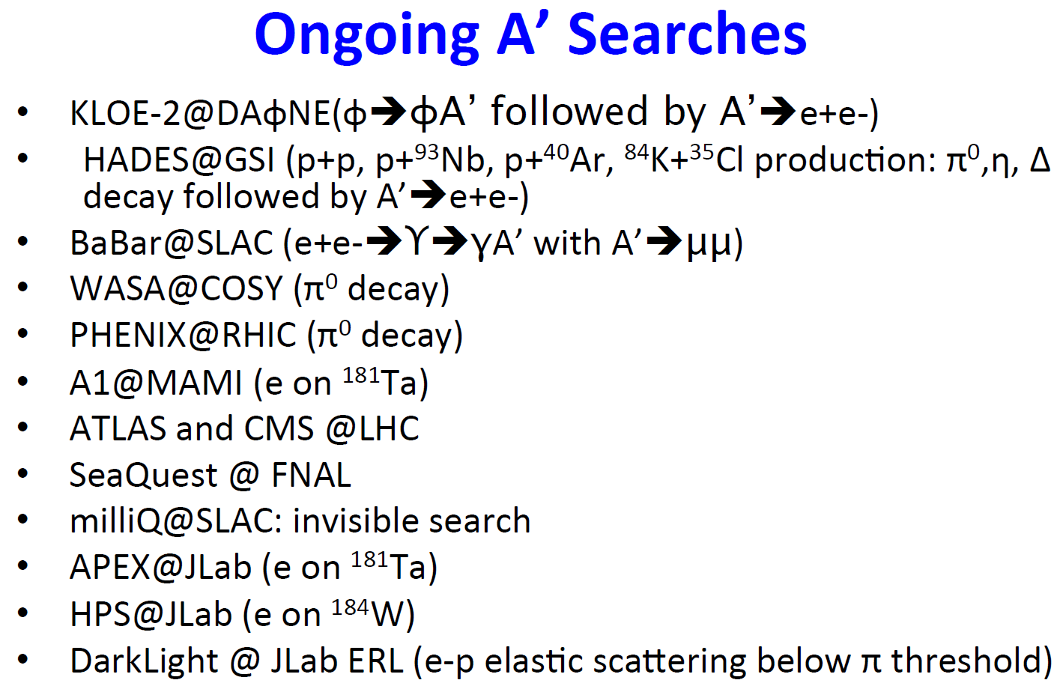
Very Active Field
Courtesy: R. Milner at the Fundamental Interactions Town Meeting, Chicago, Sept. 28-29, 2014

Slide 5
Outline
Motivation
  Dark Matter, dark photons and dark Higgs
Current E-906/SeaQuest at Fermilab
  Nucleon/Nuclear structures physic with Drell-Yan
E-1067: a new search of dark photons/Higgs
  Phase-I 2017-2019
  Phase-II with upgrade 2020+

Slide 6
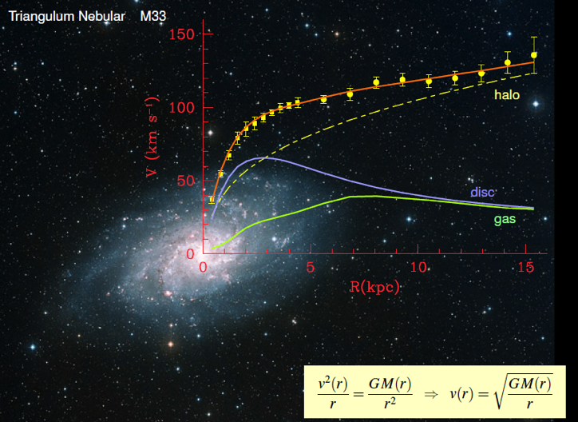
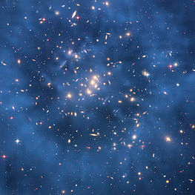
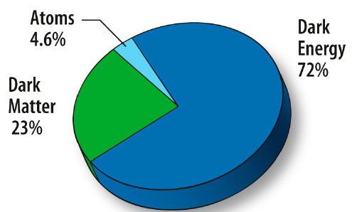
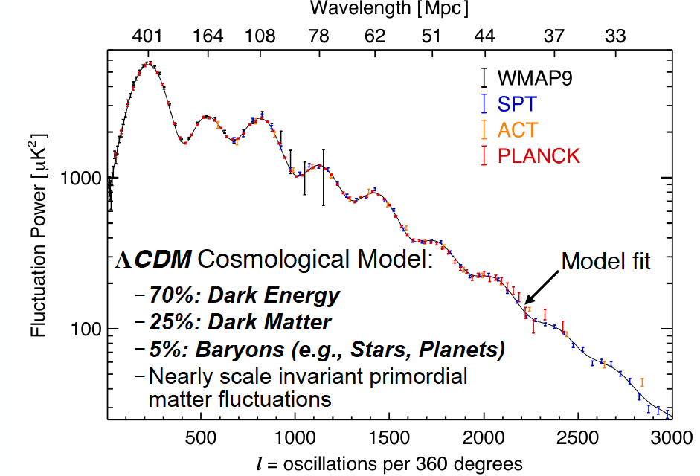
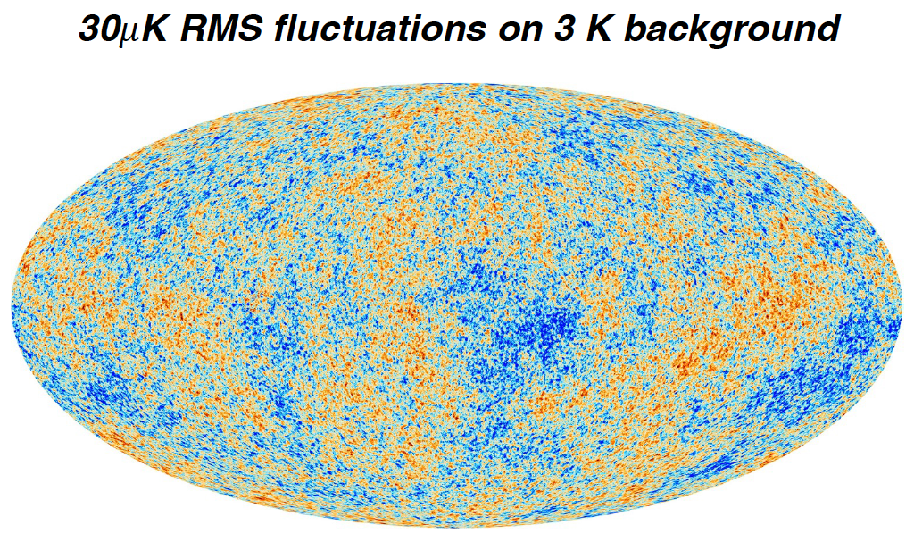
Dark Matter?
Galaxies’ rotation curve
Gravitational lensing (Hubble 2007)
F. Zwicky, ApJ 86 (1937) 217, V. Rubin et al, ApJ 238 (1980) 471
Planck: 2013
Benson’s talk @CIPANP 2015
Notes:
It is widely accepted today that visible matter only account for 5% of matter and energy, with 25% dark matter .. With many compelling experimental obseravtions , how ever the nature of dark matter and dark energy remtain as the biggest scientific challenges for hunam being … sa they only interactio with SM particels very weakly .. Only shown in gravitaiton sectors ..

Slide 7
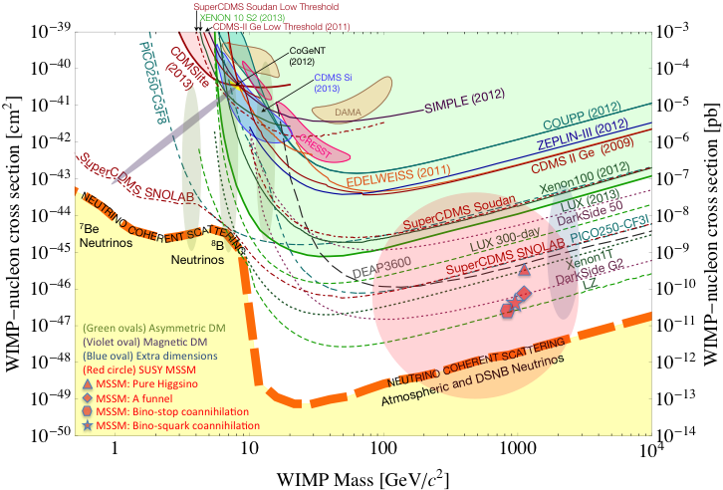
Direct Search for Dark Particles
WIMP being excluded?
Recent anomalies observed by satellite and terrestrial experiments have motivated dark matter models introducing a new dark sector
“Sub-GeV” low mass weakly-interacting dark particles become very interesting!
Mass: O(MeV ~ GeV)
In particular, high-intensity colliders (B-factories) and fixed target experiments (Fermilab, JLab, LHC) offer an ideal environment to probe these new ideas.
Montgomery’s talk at CIPANP2015
“a vision of nuclear and particle physics”
- Imaginable space for these experiments is rapidly disappearing
- the “natural” theory space is also disappearing.
- I like to think that Dark Matter is on solid ground, maybe not!!!
Notes:
What are the DM? WIMP is considered one of the primary candidates of DM …

Slide 8
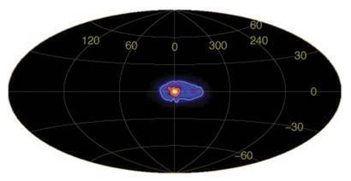
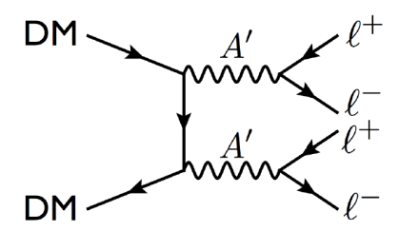
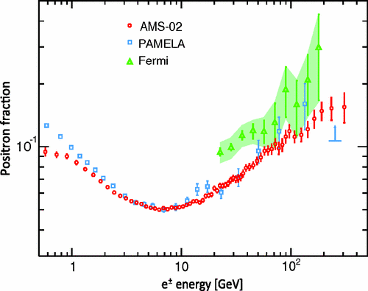
A Dark Sector?
511 keV gamma ray excess
from galactic center(INTEGRAL)
Recent anomalies observed by satellite and terrestrial experiments have motivated dark matter models introducing a new sector with a ‘dark’ force.
Low mass weak-interacting “dark particles”
There are “portals” between the dark sector and the SM.
  “vector coupling”: dark photon
  “scalar coupling”: dark Higgs
  …
  could be within experimental reach
In particular, low-energy and high-intensity colliders (B-factories) and fixed target experiments (Jlab, Fermilab) offer an ideal environment to probe these new ideas.
Phys. Rev. Lett. 110, 141102 (2013)

Slide 9

A New Possibility – a Dark Sector?
Recent anomalies observed by satellite and terrestrial experiments have motivated dark matter models introducing a new sector with a ‘dark’ force.
Dark sector = new particles that do not couple directly to the SM content, but…
There are “portals” between the dark sector and the SM.
Implications for astrophysics, cosmology and particle physics.
In particular, low-energy colliders and fixed target experiments offer an ideal environment to probe these new ideas.
  Theoretically motivated: string theory and many BSM scenarios include dark sectors with extra U(1).
  Holdom’s question (‘86) : are there additional U(1)? (PLB 166 (1986) 196)
  Dark photons (A’) are the corresponding U(1) gauge bosons,
  mediating this dark force.
SU(3)_{C} x SU(2)_{L} x U(1)_{Y}
U(1)_{X} x ???
U(1)_{Y} x ???
???

Slide 10
Portals to a Dark Sectors?
SM symmetry limits the allowed couplings
  scaler, vector, tensor interactions
Dark sector
particles &
interactions
g, W±,Z⁰,γ, H
E-1067/SeaQuest: Dark photon (vector) and Dark Higgs (sacler) Portals

Slide 11
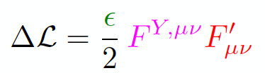
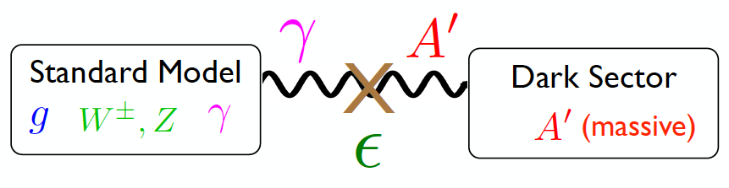
Dark Photon
A simplest model of dark sector
Kinetic mixing, an extra U(1)_{X}
Not suppressed by mass scale
Holdom
Galison, Manohar
SU(3)_{C} x SU(2)_{L} x U(1)_{Y} x U(1)_{X}

Slide 12
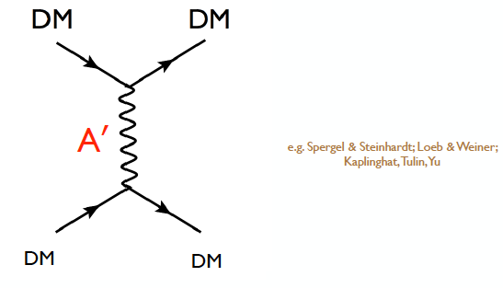
Dark Matter Interactions?
Could solve some of the “small-scale” problems

Slide 13
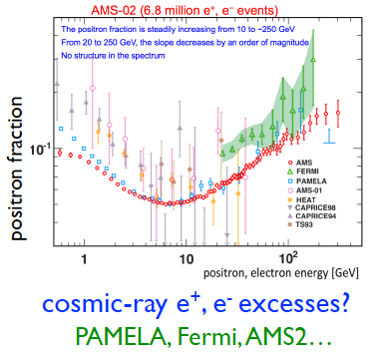
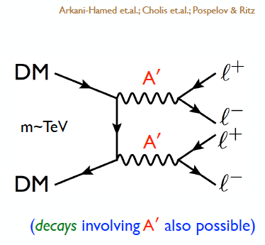
Recent Observations

Slide 14
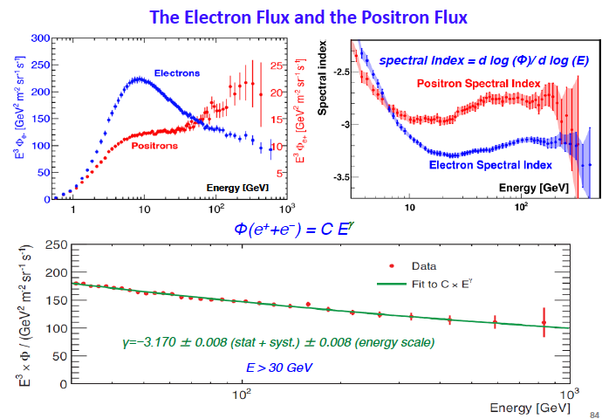
New Results from AMS-2
Slides from S.Ting 4/15/2015

Slide 15
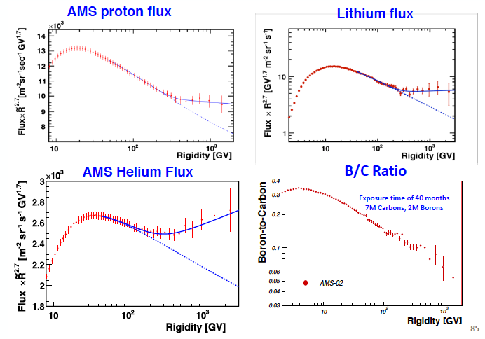
More New Results from AMS-02
Hints of Dark Matter?
Slides from S.Ting 4/15/2015

Slide 16
A dizzying list of candidates…
WIMP
…
Axion &
ALPs
Superheavy
DM
Dark Matter
Sterile neutrino
Extra dimension
Dark sector
Recent results from the LHC and direct detection experiments “challenge” the traditional WIMP paradigm and motivate the exploration of new ideas.

Slide 17
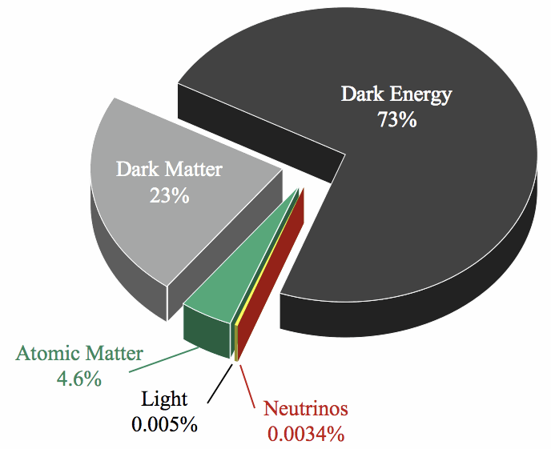
New Physics: Dark Matter?
Strong hints from astrophysical observations
  Rotation curve
  Gravitational lensing effects
  Dark sector?

Slide 18
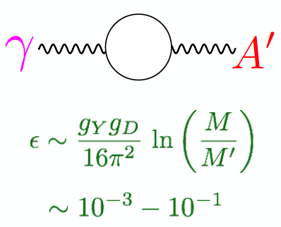
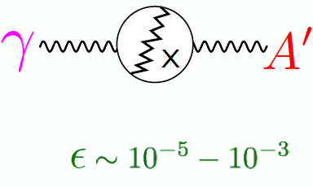
GUT: the coupling constant “ε”
Essig et al

Slide 19
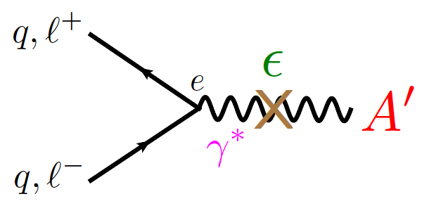
Coupling to SM particles via photon
Could be within experimental reach!
  Production
  Decay

Slide 20
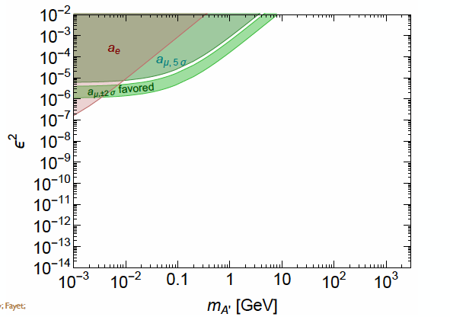
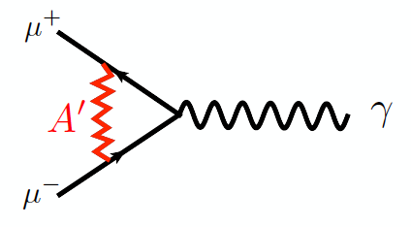
Muon (g-2) Anomaly ?
3.6 σ deviation
Boehm, Fayet
Pospelov

Slide 21
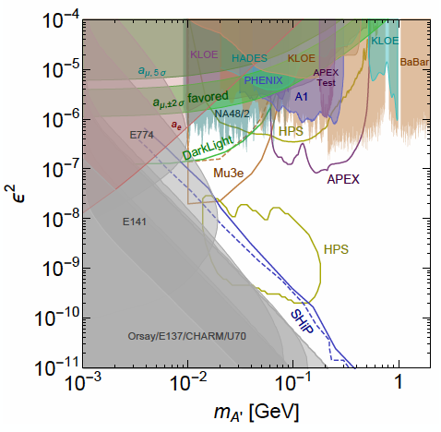
Dark Photon Today
Very Active!
- Many new results in recent years
Muon (g-2) region disfavored,
for A’ directly decay into SM
- Several new proposals!

Slide 22
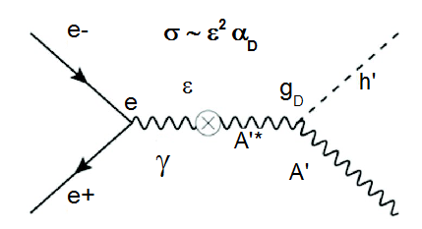
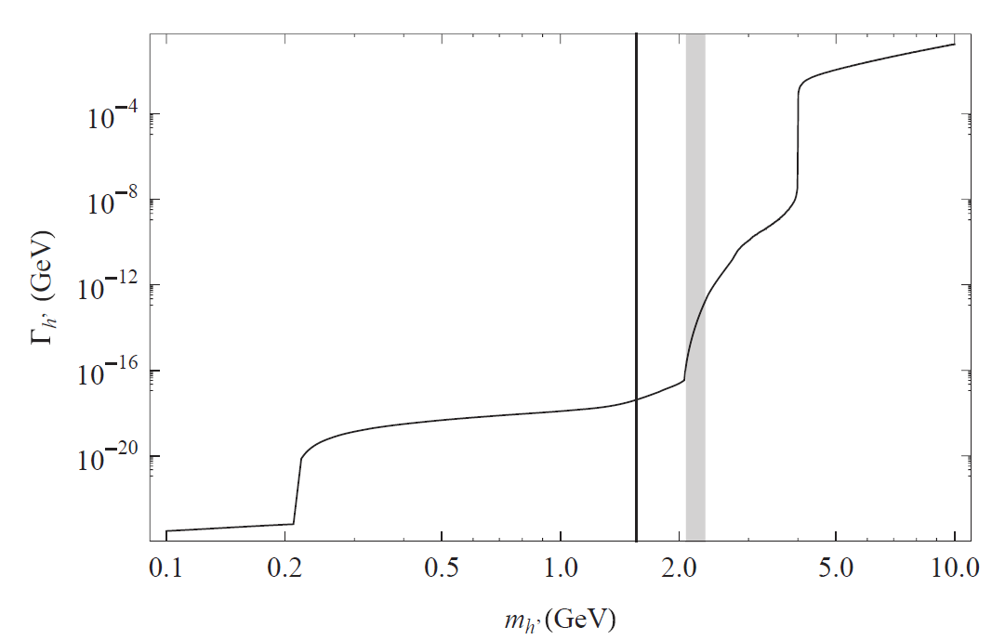
Dark Higgs
Dark photon mass is generated via the Higgs mechanism, adding a dark Higgs boson (h')
A minimal scenario has a single dark photon and a single dark Higgs boson.
Theoretical prejudice for dark Higgs mass at the MeV-GeV scale.
Dark Higgs decay model
m_{h} < m_{A’}
m_{h} > 2m_{A’}
Invisible decays
Prompt decays

Slide 23
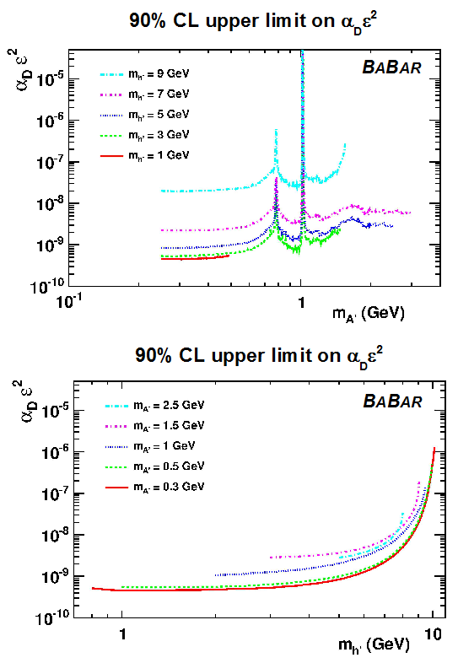
Dark Higgs Search at BaBar
PRL 108 (2012) 211801
The Higgsstrahlung process
e⁺e⁻ → A'* → h' A'
is very interesting, as it is only suppressed
by e² and should have low background
Also sensitive to the dark sector coupling constant a_{D} = g_{D}² / 4p
Search for prompt h’ decays at BABAR:
e⁺e⁻ → A'* → h' A‘, h’ → A’ A’

Slide 24
Dark Higgs Search in Hadronic Reactions
Fermilab p+A collisions

Slide 25
E-1067: Direct Productions of Dark Photons and Dark Higgs in p+Fe at Fermilab
Photon portal: “vector”
Higgs portal: “scalar”
θ = μ v/m_{h}²

Slide 26
Experimental Status at Fermilab

Slide 27

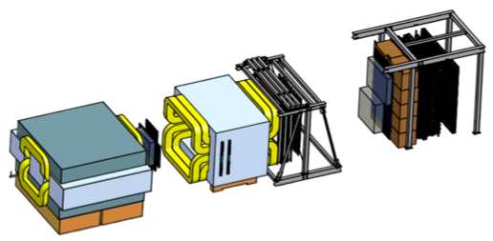
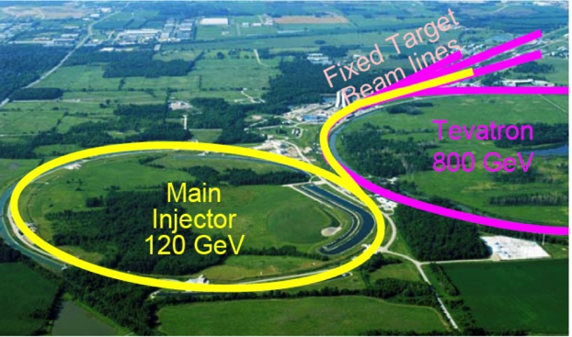
Intensity Frontier at Fermilab: 120 GeV Beam
World’s highest intensity high energy proton beam:
“beam dump mode” @SeaQuest/E906
35,000 fb⁻¹ (in 2 years of parasitic runs)
LHC-II: 300 fb⁻¹ (~2025), achieved 25fb⁻¹ in Run-I
B-factory@KEK: 50,000 fb⁻¹ (~2023)
Absorber wall and proportional
tube based Muon ID
Spectrometer magnet
Δpt = 0.4 GeV
Focusing magnet
and solid iron dump
Δpt = 2.9 GeV
Beam
120 GeV proton from Main Injector
19ns RF, 4s spill, 0.5×10¹³ protons per spill
25 m
Target system
Liquid H and D
Solid C, Fe, W
- Capture most beam in beam dump mode: p+Fe collisions!
- Parasitic run mode possible with other experiments, E1039/E1027

Slide 28
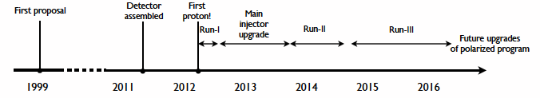
Schedules of SeaQuest Experiments
E-906 complete data taking in summer 2016
  E906 targets are located ~1.3m upstream of the beam-dump, ~10% λ_{I}.
E-1039 will replace current E906 targets with a polarized NH₃ target.
  No change to E906 spectrometer setup
  New target located about 3.5m upstream of the beam-dump, ~6% λ_{I}.
  Target/trigger installation: 2016 - 2017
  Data taking: 2017 – 2019
E1067 Timeline (New!)
  Phase-I (Parasitic run) with E1039: 2017-2019
  (Phase-II: detector upgrades and dedicated runs)
E-1027 polarized Main Injector (future)
E-1067
Dark photon(Higgs)
Search: 2017-2019
parasitic run, E-1039
E906 started
E-1039 starts

Slide 29
SeaQuest Schematic
Dump
KMAG
FMAG
4 scintillator hodoscope stations (x and y)
4 tracking stations (x and stereos) MWPC
Notes:
more details from p906 proposal

Slide 30
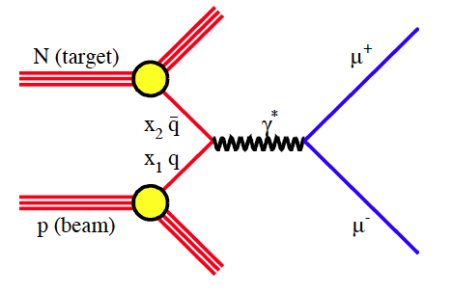
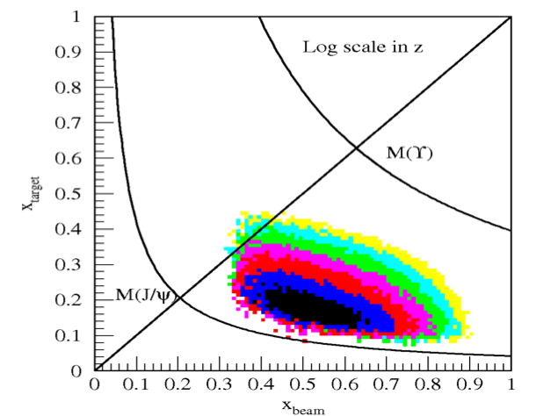
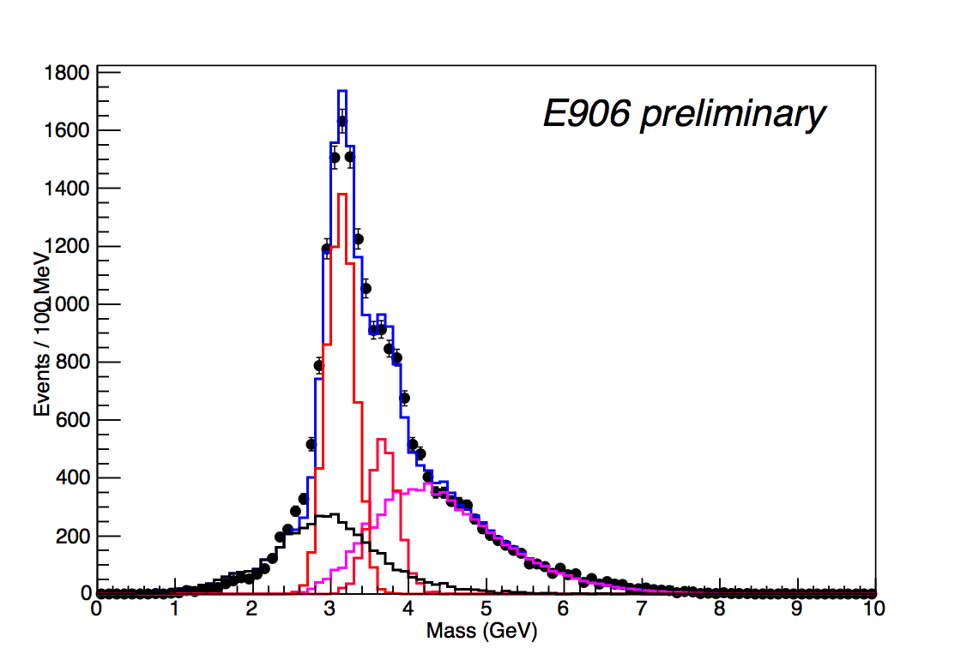
E-906 Drell-Yan Acceptance
Run-II data: 5% of total projected stat.
- J/ψ Monte Carlo
- ψ’ Monte Carlo
- Drell-Yan Monte Carlo
- Random Background
- Combined MC and bg

Slide 31
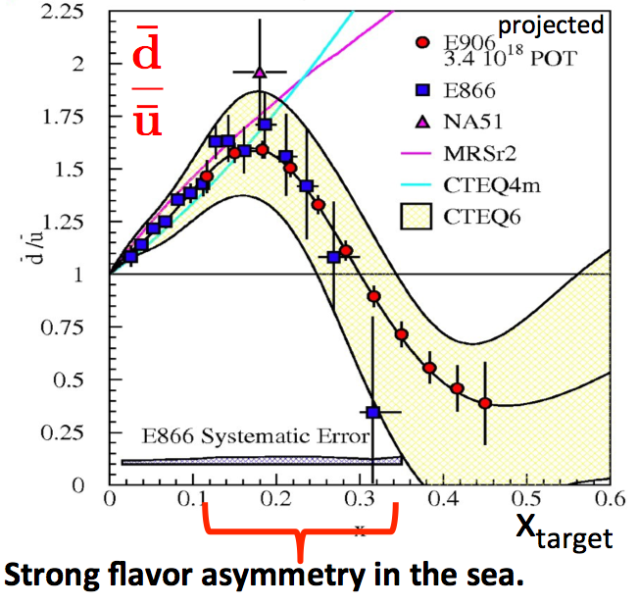
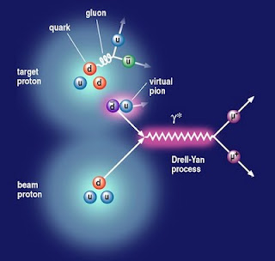

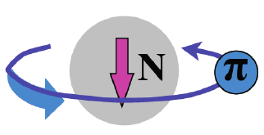
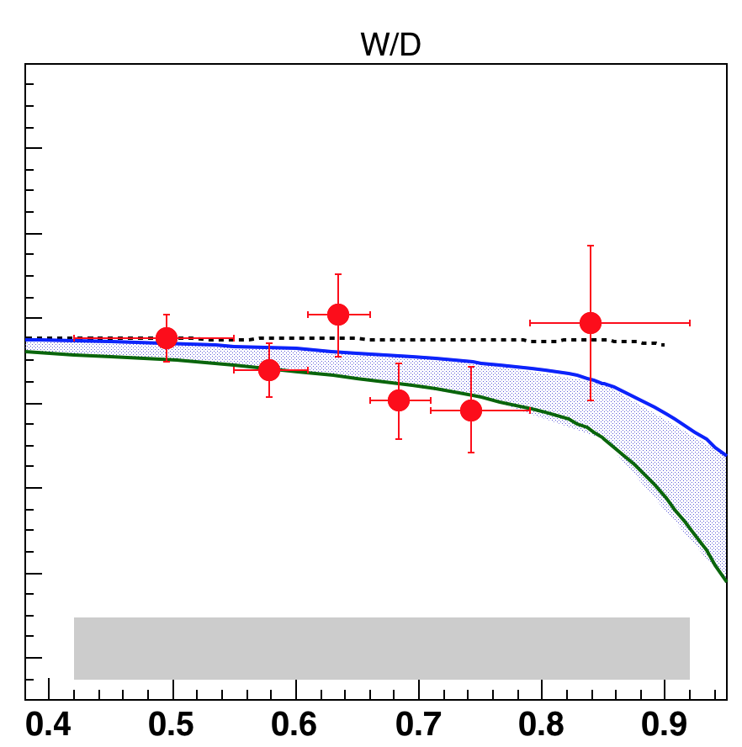

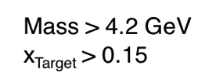
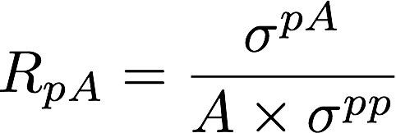
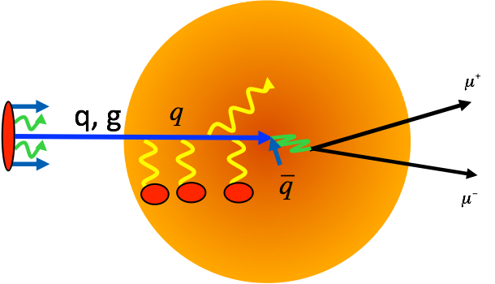
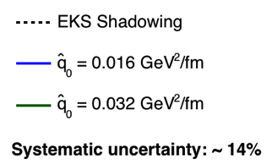
E906 Physics Programs: 2009-2016
Sea quark flavor asymmetry p+p
  Pion cloud model
Quark energy loss in p+A
π⁺

Slide 32
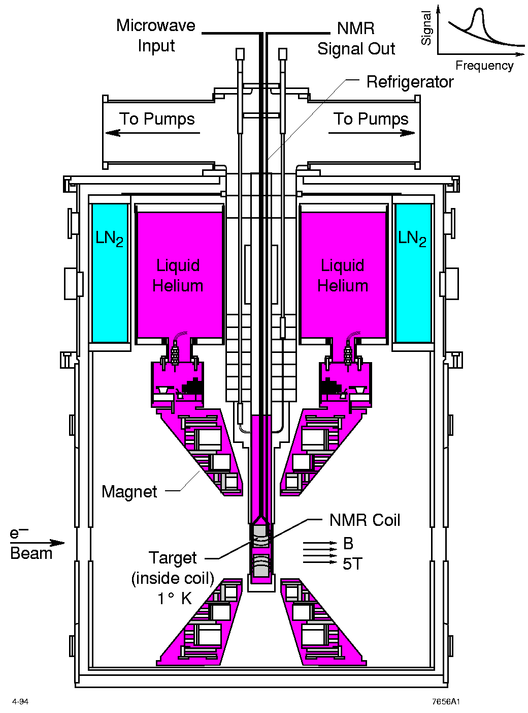
E1039 Physics Program: 2016-2019
Polarized Fixed Target Drell-Yan Experiment
Sea quark flavor asymmetry and OAM
  Pion cloud and OAM
  Non-zero Drell-Yan Sivers Transverse Spin Asymmetry
LANL polarized proton (NH₃) target

Slide 33
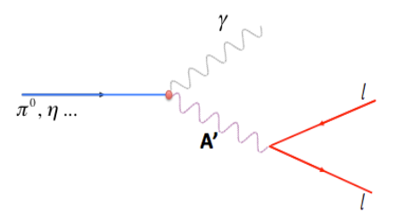
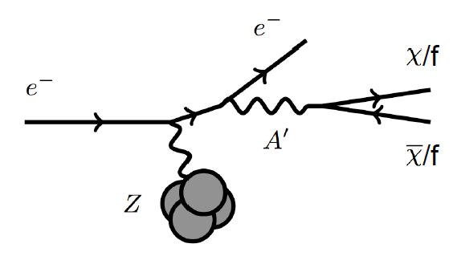
Dark Photon Search in Dimuon Channel at SeaQuest in Beam Dump Mode (p+Fe)
Drell-Yan like
π⁰, η, … decay
Bremsstrahlung
(DM)
MiniBooNE
Beam-dump
(DM)
p
l⁺
p
l⁻

Slide 34
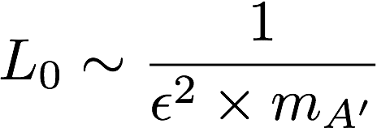

Dark Photon Decay Modes
“Minimal” Decay:
Dark photon is the lightest in the dark sector;
  SM final state particles only
Long proper decay length: L₀ ~ O(1m)
D. Curtin, et al, arXiv: 1312.4992
“General” Decay:
Decay into other dark particles,
dominant channel if allowed
  Dark -> Dark
  Dark -> SM particles
(GeV)

Slide 35


Current Limits on Dark Photon Search
Slide credit: Bertrand Echenard
BaBar (2014)

Slide 36
Proposed Experimental Measurements
Dark photon trigger upgrade
  Add a fine-granularity scintillating strip based trigger/tracking to tag dimuons from the same decay Z-vertex
  A new trigger for events with displaced down-stream dimuons
Unique signals
  Displaced dimuon decay vertex for long-lived particles
  Invariant mass peak in dimuon mass spectrum
  Mostly from beam dump (target ~6% λ_{I}.)
Beam time
  Run parasitically with E1039 (2017-2019)
  Possible dedicated runs later with upgraded (e^{+/-}, h^{+/-})
-- 2.5%
-- 6.0%
Dimuon mass resolution
Z (meter)

Slide 37
A New High-Granularity Displayed Dimuon Vertex Trigger
High rejection power, very low rate, << 1 kHz(E906 DAQ limit)
Y-Plane Trigger:
A quadrant panel: 40 x 40 cm², 1cm thinck
  40 x 1cm x 40 cm scintillating strips, SiPM readout
- Straight line projection, 30cm Z-vertex resolution
- Displaced z-vertex, mostly low mass < 3GeV
Coincident with St-4 Hodos(muons)
Quadrant-based triggers: 4 x V1495
Y-channels per quadrant:
- 1x V1495
40(St1) + 40(St2) + 8x2 (St4-Y1,2) = 96
96+64 = 160 possible
  72+72+16 = 160 (possible)
  (2NIM=RFCLK+ComSTOP )
St1
St2
Z
Coincident Z-vtx
window matched@L2
E906 Run2
J/Psi
Psi’
Drell-Yan
Rndm
E906 Run2
Dimuon Z-vertex (cm)

Slide 38

Search Mode (1): Long-lived Dark Photons
Reconstructed dimuons with downstream Z-vertex:
3m < Z-vertex < 6m
Very low trigger rate, << 1kHz
SM background free
Dimuon mass peak
- 5x10¹² ppp ( current E906)
200 days
1.4 x 10¹⁸ POT (recorded)
4 events contours (2-sigma)
2-sigma (95%) exclusion plots
Excellent coverage of uncharted region!

Slide 39



Search Mode (2): “Prompt” Dark Photons vs Drell-Yan
Z-vertx < 3m
Expected Drell-Yan like signal and backgrounds:
Excluded phi
resonance region
Dark photon
signal
Drell-Yan Background
Work in progress
Further optimization possible

Slide 40

Dark Photon Sensitivity: Summary
POT:1.4x10¹⁸ (parasitic w/ E1039)
Signals considered:
Drell-Yan like
Eta decays
Bremsstralung
Covers a wide range of unexplored parameter phase space
Displaced dimuons
- Minimal SM background
Prompt dimuons
- Excellent coverage over BELLE-II
projection
- Possible dedicated runs later to fully
restore mass < 3GeV (Phase-II)
Phase-II with upgrades
Access below 200MeV with di-electrons
( add EMCal)
(2017?)
(2016?)
(~2023)

Slide 41
E-1067: Dark Higgs Search at SeaQuest
Y. Zhang et al, arXiv:1502.06983
θ = μ v/m_{h}²
D. Curtin et al arXiv:1312.4992
e⁺e⁻
Phase-I:
High-mass: μ⁺μ⁻ and hadrons
Advantage of using hadron beams
with muon probes over electrons
Phase-II:
Low-mass: e⁺e⁻, <200MeV possible
μ⁺μ⁻

Slide 42
SeaQuest Dark Higgs Sensitivity
POT:1.4x10¹⁸ (Phase-I)
Y. Zhang (2015)
Dimuons with downstream displaced decay vertices
Limited sensitivity to “prompt” large mixing case due to small cross-section
Dark Higgs or dark photons?
  Dimuon kinematic and angular distributions
Phase-II
  Dedicated high luminosity runs optimized for low mass acceptance, mass<3GeV
1x
5x
25x

Slide 43

Summary and Outlook
Phase-I
  Great discovery potential!
  Add a new displayed vertex trigger
  Early parasitic data taking 2017-2019+
    A short dedicated run up to ~1 month if needed
  POT 1.4 x10¹⁸
Phase-II
  Possible detector upgrade later, add electrons and hadrons
  A new dedicated dark matter program at Intensity Frontier!
Dark Higgs
search
Preparation Phase-I (parasitic runs)
Phase-II
2015
2016
2017
2018
2019
2020+

Slide 44


2014 US P-5 Report
Great Opportunities at the Fermilab Intensity Frontier!!!
Notes:
P5 reprot highted the 5 sciecne driver …
We respond to the call of P5 report and identified a new opportunity to explore key physics at Femirlab intensity frontier

Slide 45
Backup slides

Slide 46

E-1067 Experiment: Phase-I

Slide 47

Sensitivity

Slide 48

Dark Matter Particles
Weakly coupled low mass particles in the dark sector
  Can be created in high luminosity high energy beam interactions, very small cross sections
  Weakly coupled, traverse through significant distance in ordinary matter
  Electrically neutral?
  sharp mass peak in the invariant mass spectrum

Slide 49

Electron Beam Fixed Target Experiments
APEX
@J-Lab12

Slide 50

APEX Experiment at J-Lab
Symmetric configuration to optimize S/B
Possible 4 beam energies: 1,2,3,4 GeV @Hall-A
Fall/2017 – Spring/2018: 1 month beam time

Slide 51

Typical Backgrounds

Slide 52

HPS at JLab
Slide from
Tim Nelson 4/2015

Slide 53

Slide from
Tim Nelson 4/2015

Slide 54
backup

Slide 55

Data from Run 2014 (Run-II)
Monte Carlo describe data well
  σM(J/ψ) ~ 180 MeV, σM(DY) ~ 220 MeV
  J/ψ ψ’ separation
  Cleaner DY sample
Good target/beam dump separation
~ 5% of expected final
total statistics
- J/ψ Monte Carlo
- ψ’ Monte Carlo
- Drell-Yan Monte Carlo
- Random Background
- Combined MC and bg
All “good” dimuons in data
Data with dump cut
Data with target cut
Beam quality worse than expected (instantaneous rate much higher than average)
  live time of spectrometer greatly reduced by the ‘super’ RF buckets
  Reconstruction efficiency lower than expected because of the high detector occupancy
Dump MC
Target MC
Zvtx (cm)

Slide 56

E906 Run-II and III Performance
Run-III
Run-II

Slide 57
Low Mass Prompt Dimuon Trigger Rate Study
Current E906 setup
Proposed 2-layer trigger upgrade (10x improvement)
Additional Y-trigger after ST-3 absorber, and also using existing E906 X-Plane trigger
(additional ~2x improvement)
Current E906 DAQ 1kHz, can be improved to 10kHz with small cost
200kHz possible in the future (reprograming trigger firmware etc.)
Parasitic mode: use up to ~10% DAQ bandwidth
(Prompt)Low mass dimuon trigger efficiency

Slide 58



Expected sensitivity of selected future experiments
Slide credit: Bertrand Echenard (2014)
C. Hearty
Taku Gunji talk
@ BNL workshop
1312.4992
Low mass region will be easily probed, but range above 500 MeV remains difficult to access

Slide 59

Comparison with SHiP Proposal
120 GeV@FNAL: 2017 -2019
1.4x10¹⁸ POT, future dedicated runs
400 GeV@SPS: 2025 -2030
4x10²⁰ POT

Slide 60
Scope and Compatibility
Preparation work: 2016 – 2017
  Displaced vertex dimuon trigger upgrade (LANL LDRD? $100K)
    Add a new trigger bit
    No change to existing trigger matrix
  Possible upgrade of DAQ bandwidth under consideration (external $$)
    1kHz (E906) -> 10+ kHz
  Commissioning with cosmic rays
Parasitic runs w/ E1039: 2017 – 2019
  Displaced vertex dimuon trigger upgrade
  Use up to ~10% DAQ bandwidth
  Achieve 1.44 x10¹⁸ POT
Possible parasitic runs w/ E1027 and/or dedicated runs later with upgrades: 2019+
  High luminosity goals:
    POT >> 1.4x10¹⁸
  DAQ
    10 – 100 kHz capability
  EMCAL/HCAL/PID
    Electrons
    charged hadrons
  Fully cover the accessible phase space
    Low mass “prompt photon” region, M < 3 GeV
  Possible parasitic runs with other proposals

Slide 61

Phase-II: Full Coverage with future detector “EMCal/HCal” upgrades
Projection: POT 1.4 x 10¹⁸
Detector upgrades
  EMCal: e^{+/-}
  HCal: π^{+/-}
  Recycle from other experiments, RHIC/JLab etc.
DAQ upgrade
  100 kHz
Timeline of dedicated runs
  2019+
Detector configuration
  Access low mass region with optimized Fmag settting

Slide 62


Phase-II: Access Low Mass Region with e⁺e⁻ with future detector “EMCal” upgrades
S. Gardner, R. Holt et al

Slide 63
Non Abelian Dark Sector with future detector “HCal” upgrades
non-Abelian dark sector process
S. Gardner and R. Holt
[Note: Batell, Pospelov, and Ritz, PRD 80 (2009) 095024 for a review re fixed target expts.]
Here we consider a non-Abelian (gluon) portal
[Baumgart et al., JHEP 0904, 014 (2009); Gardner and He, PRD 87 (2013) 116012]
The “shining through walls” design – unique to Seaquest – makes this possible ,
to yield, e.g., via a “minimal” decay….

Slide 64
Phase-II: Access Low Mass Region with e⁺e⁻ with future detector upgrades
S. Gardner, R. Holt et al
p
l⁺
p
l⁻

Slide 65

Cold Dark Matter “Small-scale” Challenges
Slide from
R. Essig 4/2015

Slide 66

Hints from WIMP Search

Slide 67


A’ Production

Slide 68

Dark Photon Current and Future Limit (2014 Projections)

Slide 69


Dark Light @JLab

Slide 70
Thanks many good discussions with
R. Holt, J-C. Peng, Z.-B. Kang, P. McGaughey, K. Liu, Y. Zhang, Y. Zhong, P. Reimer, C. Brown, R. van der Water, R. Essig, and more and the new E-1067 Collaboration at Fermilab

Slide 71


Sub ~O(10) GeV Dark Matter Interactions via A’
Invisible mode:
BaBar, BELLE-II, MiniBooNE
Direct detection
Indirect/invisible mode
Accelerator based search possible
Very rich phenomenology

Slide 72



Invisible Mode in Beam Dump Search

Slide 73





Beam dump experiment proposal at CERN
Using the CERN SPS e- beam
(arXiv:1312.3309)
The SHIP proposal at CERN
(http://ship.web.cern.ch/ship/)
preliminary
W. Bonivento

Slide 74






Dark matter
Lensing
CMB
68.3%
4.9%
26.8%
Planck
Structure
Rotation curve
We know dark matter exists, but its nature remains unknown !

