Slide 1
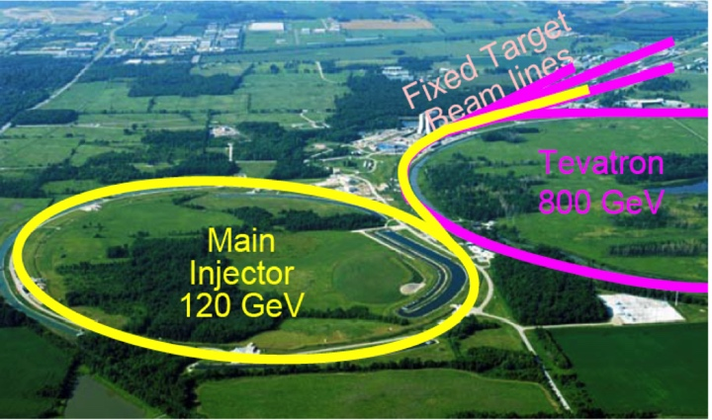
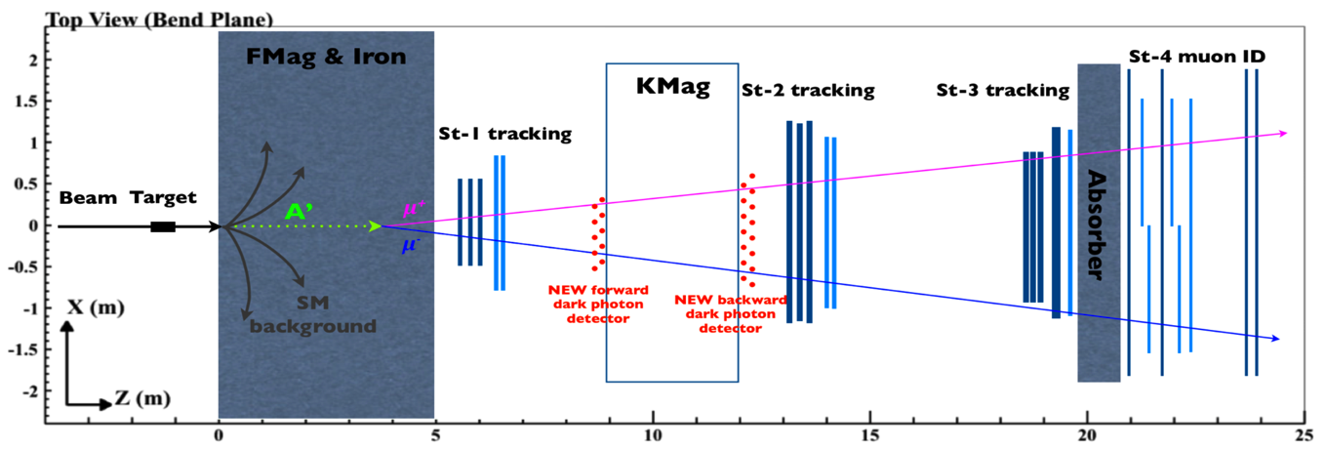
Direct Search for Dark Photons and Dark Higgs in p+A Collisions at Fermilab E-1067 Experiment
Ming Liu
Los Alamos National Laboratory

Slide 2

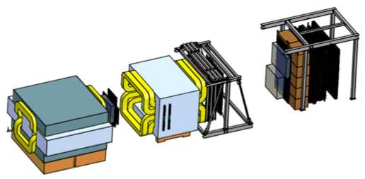
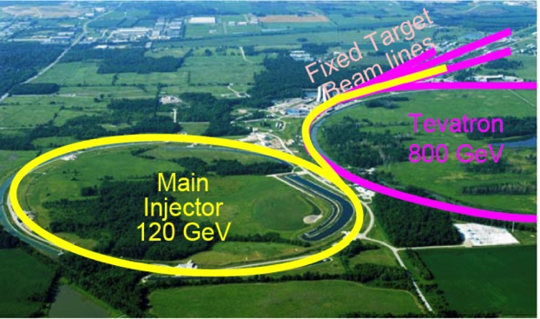
Intensity Frontier at Fermilab: 120 GeV Beam
World’s highest intensity high energy proton beam:
“beam dump mode” @E-1067
35,000 fb⁻¹ (in 2 years of parasitic runs)
LHC-II: 300 fb⁻¹ (~2025), achieved 25fb⁻¹ in Run-I
B-factory@KEK: 50,000 fb⁻¹ (~2023)
Absorber wall and proportional
tube based Muon ID
Spectrometer magnet
Δpt = 0.4 GeV
Focusing magnet
and solid iron dump
Δpt = 2.9 GeV
Beam
120 GeV proton from Main Injector
19ns RF, 4s spill, 0.5×10¹³ protons per spill
25 m
Target system
Liquid H and D
Solid C, Fe, W
- Capture most beam in beam dump mode: p+Fe collisions!
- Parasitic run mode possible with other experiments, E906/E1039

Slide 3
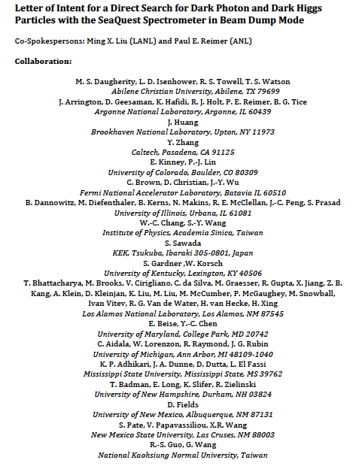
LOI submitted to Fermilab PAC
on May 20, 2015
A joint experimental and theoretical collaboration
(most E906/E1039 + new members, ~60)
---------------------------------------
Phase-I: (parasitic runs)
Addition of a new displaced dimuon trigger to tag long-lived downstream decayed dark photons (dark Higgs).
Parasitic data taking with E1039 in 2017-2019;
  A short dedicated run (up to ~1 month) if needed.
POT 1.44x10¹⁸
Phase-II: (upgrade)
Dedicated runs later with EMCal/HCal upgrades, e^{+/-} and h^{+/-} capabilities.
Cover the full parameter phase space allowed by beam energy and luminosity
POT: >> 1.4x10¹⁸
Phase-II request will be presented to PAC at a later time.
Notes:
Responding to P5 reprot, we submitted LOI last month .. And the membership is growing …

Slide 4
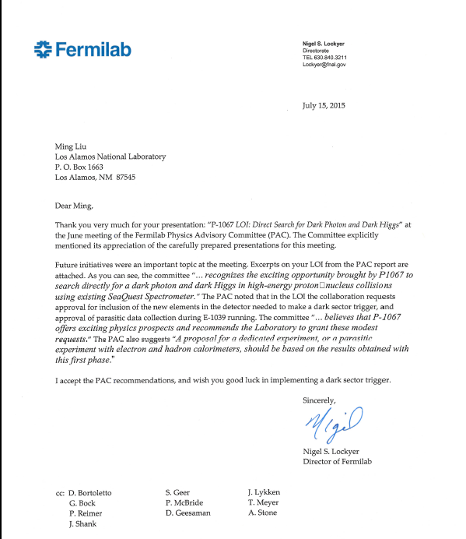
A heart-full endorsement
from Fermilab Director and PAC
July 15, 2015!
New experiment! E-1067

Slide 5
Outline
Motivation
  Dark Matter, dark photons and dark Higgs
Current SeaQuest/E906 at Fermilab
  Nucleon/Nuclear structures physic with Drell-Yan
E-1067: a new search of dark photons/Higgs
  Phase-I, 2017-2019 with a new trigger
  Phase-II, 2020+ with detector upgrade

Slide 6
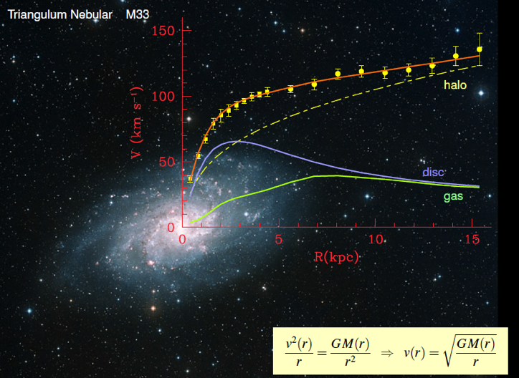
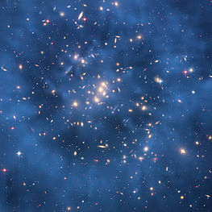
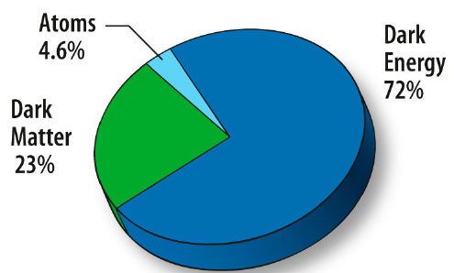
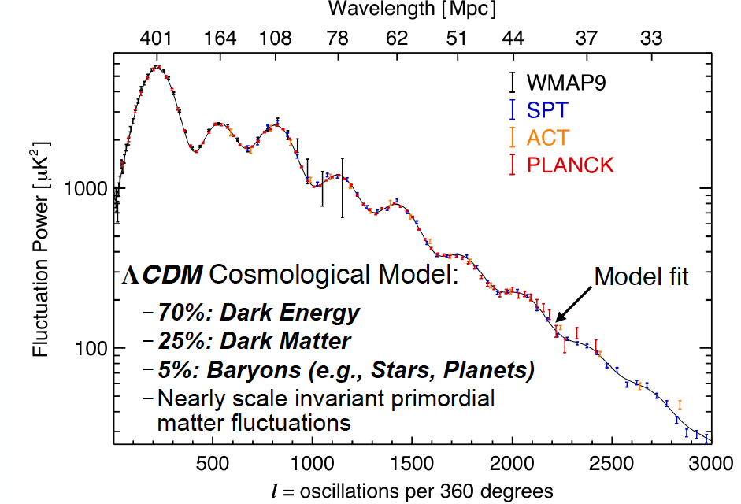
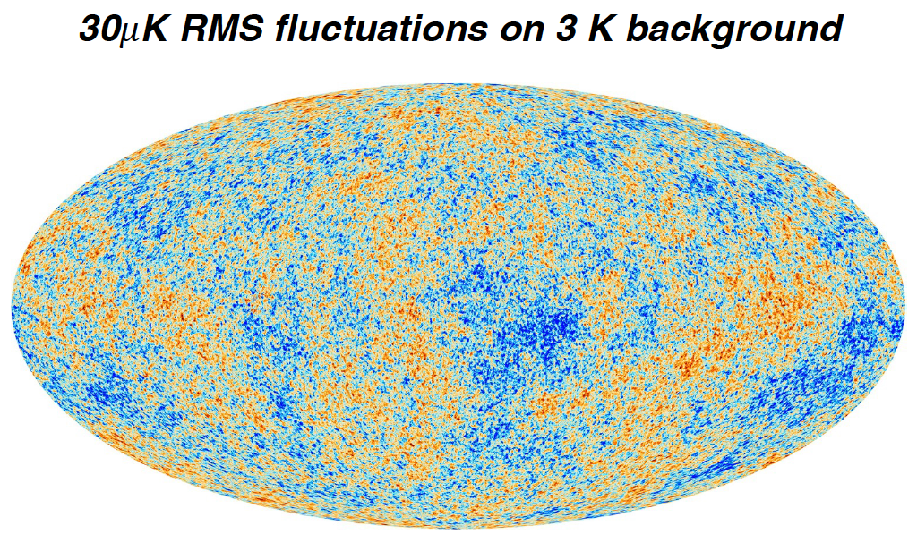
Dark Matter?
Galaxies’ rotation curve
Gravitational lensing (Hubble 2007)
F. Zwicky, ApJ 86 (1937) 217, V. Rubin et al, ApJ 238 (1980) 471
Planck: 2013
Benson’s talk @CIPANP 2015
Notes:
It is widely accepted today that visible matter only account for 5% of matter and energy, with 25% dark matter .. With many compelling experimental obseravtions , how ever the nature of dark matter and dark energy remtain as the biggest scientific challenges for hunam being … sa they only interactio with SM particels very weakly .. Only shown in gravitaiton sectors ..

Slide 7
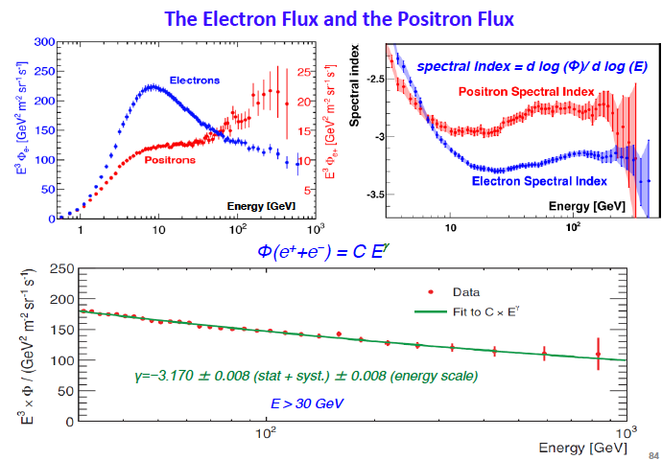
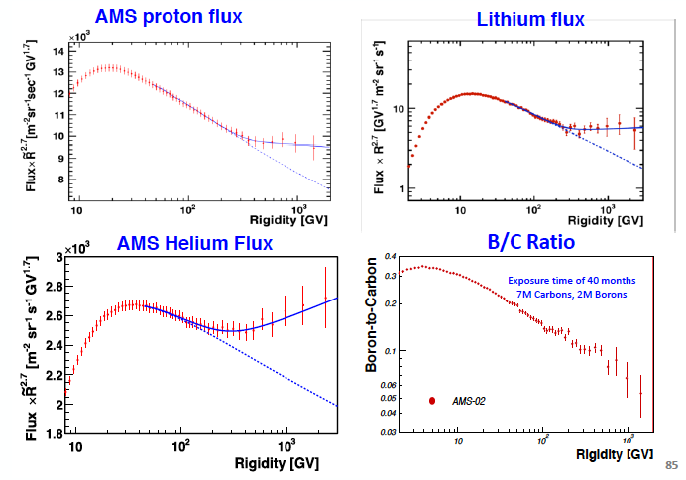
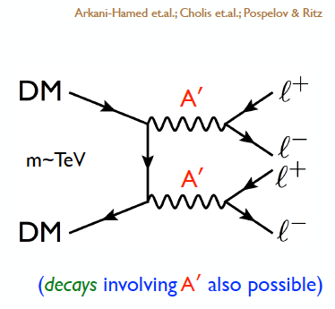
Cosmic-Ray Anomalies from AMS-02
Dark Matter Annihilation ?
Plots from Sam Ting 4/2015
Cosmic-ray excess of e⁻, e⁺, p, He, Li …

Slide 8
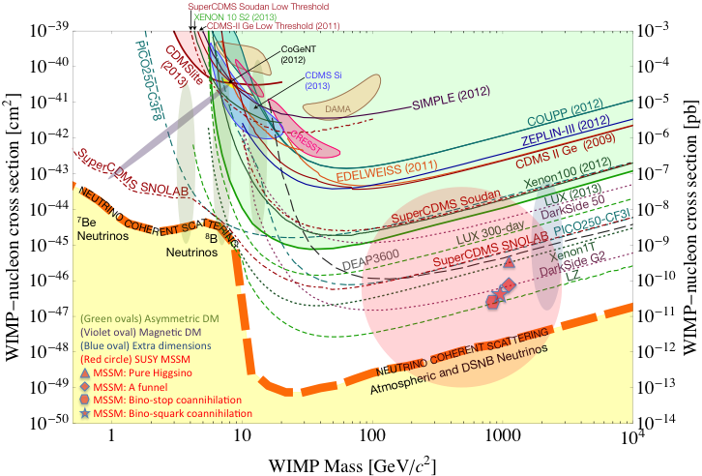
Direct Search for WIMP
Montgomery’s talk at CIPANP2015
“a vision of nuclear and particle physics”
WIMP being excluded?
Recent anomalies observed by satellite and terrestrial experiments have motivated dark matter models introducing a new “dark sector”
There are “portals” between the dark sector and the SM.
  “vector portal”: dark photon
  “scalar portal”: dark Higgs
  …
“Sub-GeV” low mass weakly-interacting dark particles become very interesting!
Mass: O(MeV ~ GeV)
In particular, high-intensity colliders (B-factories) and fixed target experiments (Fermilab, JLab, LHC etc.) offer an ideal environment to probe these new ideas.
- Imaginable space for these experiments is rapidly disappearing
- the “natural” theory space is also disappearing.
- I like to think that Dark Matter is on solid ground, maybe not!!!
Notes:
What are the DM? WIMP is considered one of the primary candidates of DM …

Slide 9
What is Dark Matter?
WIMP
…
Axion &
ALPs
Superheavy
DM
Dark Matter
Sterile neutrino
Extra dimension
Dark sector
Recent results from the LHC and direct detection experiments “challenge” the traditional WIMP paradigm and motivate the exploration of new ideas.

Slide 10
Portals to a Dark Sectors?
SM symmetries limit the allowed couplings
  scalar, vector, tensor interactions etc.
SM
g, W±,Z⁰,γ, H
Dark Sector
particles &
interactions
E-1067/SeaQuest: Dark photon (vector) and Dark Higgs (saclar) Portals

Slide 11
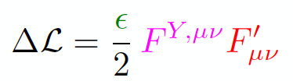
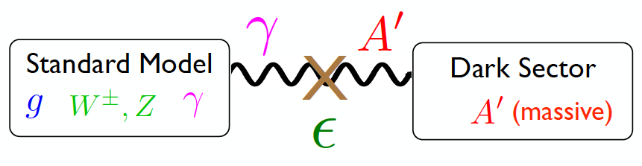
Vector Portal and Dark Photon
A simplest model of dark sector
An extra U(1)_{X}, kinetic mixing
Not suppressed by mass scale
Holdom
Galison, Manohar
SU(3)_{C} x SU(2)_{L} x U(1)_{Y} x U(1)_{X}

Slide 12
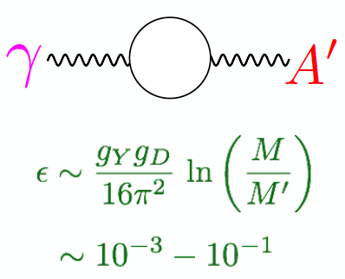
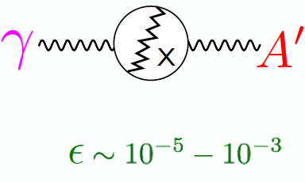
Expectations from GUT
After EWSB, there is a coupling ε between the dark photon and the photon (also the Z, less important at low energies).
Theoretical prejudice for a mass scale
m_{A}’ ~ √ε m_{EW} ~ (MeV – GeV)
e.g. Arkani-Hamed & Weiner;
Cheung, Ruderman, Wang, Yavin;
Morrissey, Poland, Zurek;
Essig, Schuster, Toro;

Slide 13
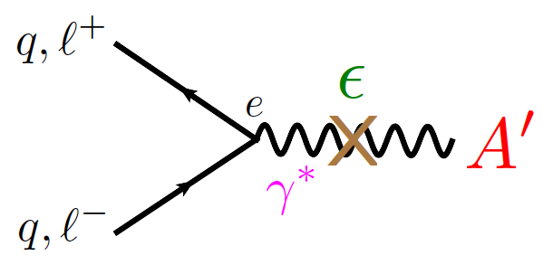
Coupling to SM particles via Photon/Z⁰
Try to explain some of anomalies observed recently
  AMS-02, muon (g-2) etc.
Could be well within accelerator-based experimental reach!
  Production:
    high intensity beam
  Decay:
    optimized S/B for weak signal

Slide 14
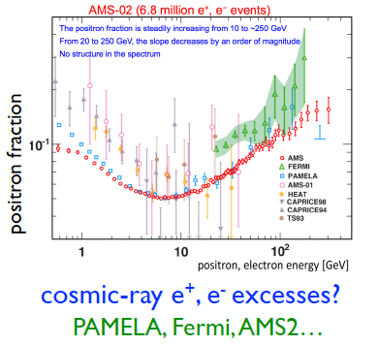
AMS-02 Anomalies and Dark Photons
Sparked a renewed interest in this class of models…
Phys. Rev. Lett. 110, 141102 (2013)

Slide 15
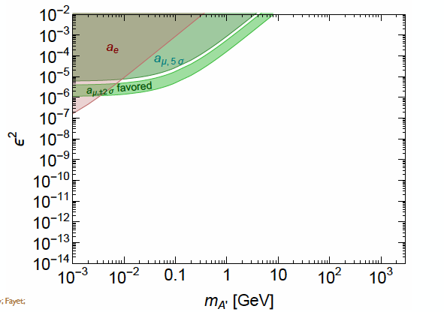
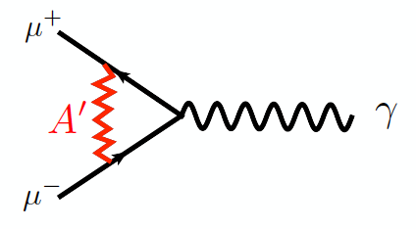
Muon (g-2) Anomaly
3.6σ deviation observed
Possible contributions from dark photon
Can be tested!
Boehm, Fayet
Pospelov

Slide 16
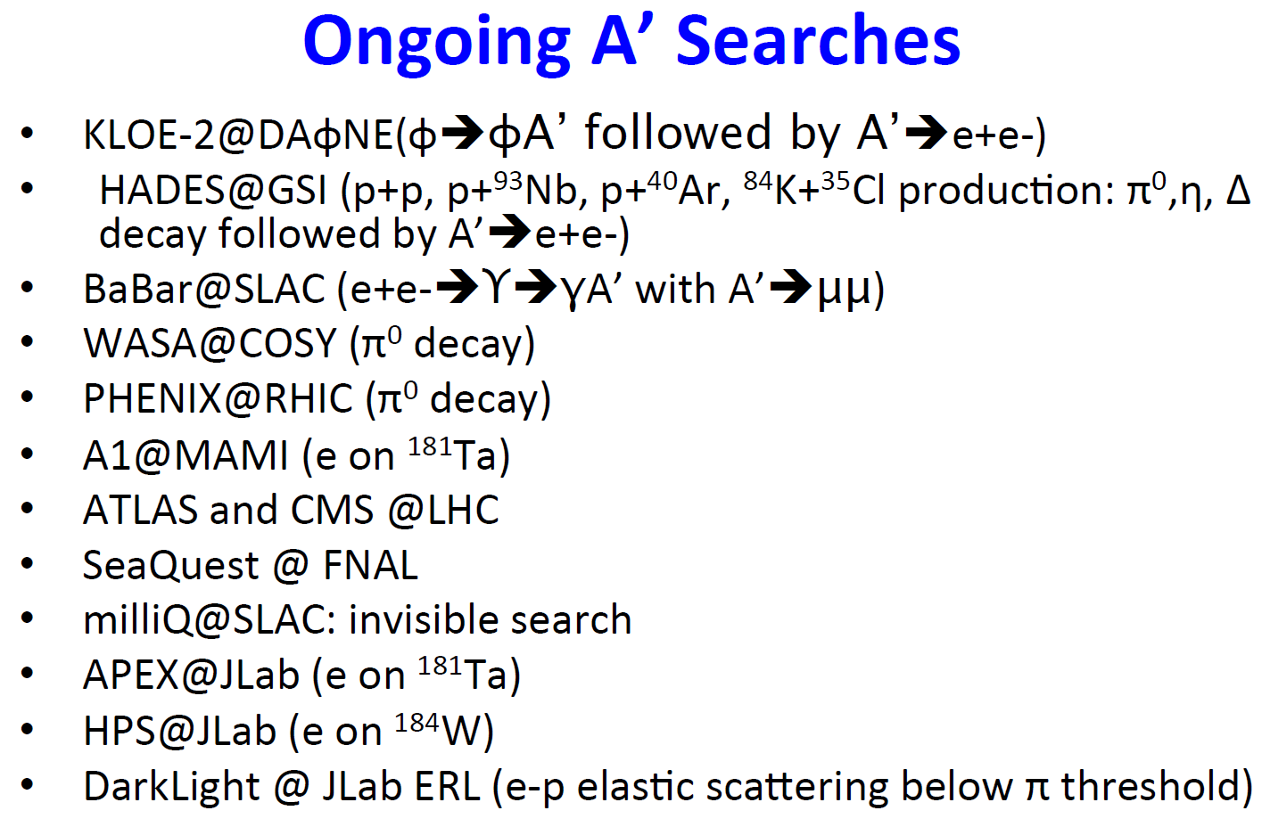
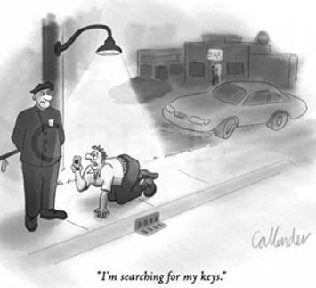
Very Active Field
Courtesy: R. Milner at the Fundamental Interactions Town Meeting, Chicago, Sept. 28-29, 2014

Slide 17
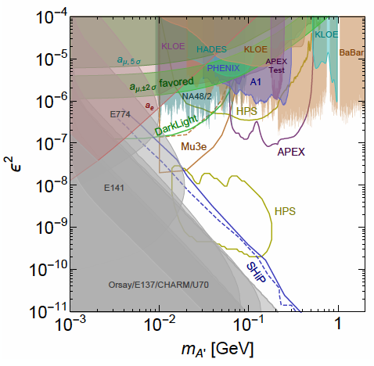
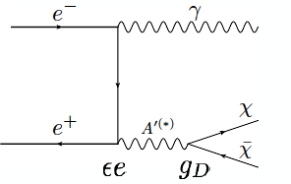
Dark Photon Current and Future Limits
Several new results in recent years
and more to come
Muon (g-2) region disfavored
- for A’ directly decay into SM;
- but allowed with some “invisible modes”
New experimental proposals
Fermilab E-1067 beam dump,
SHiP at CERN

Slide 18
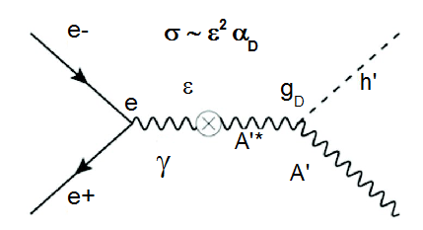
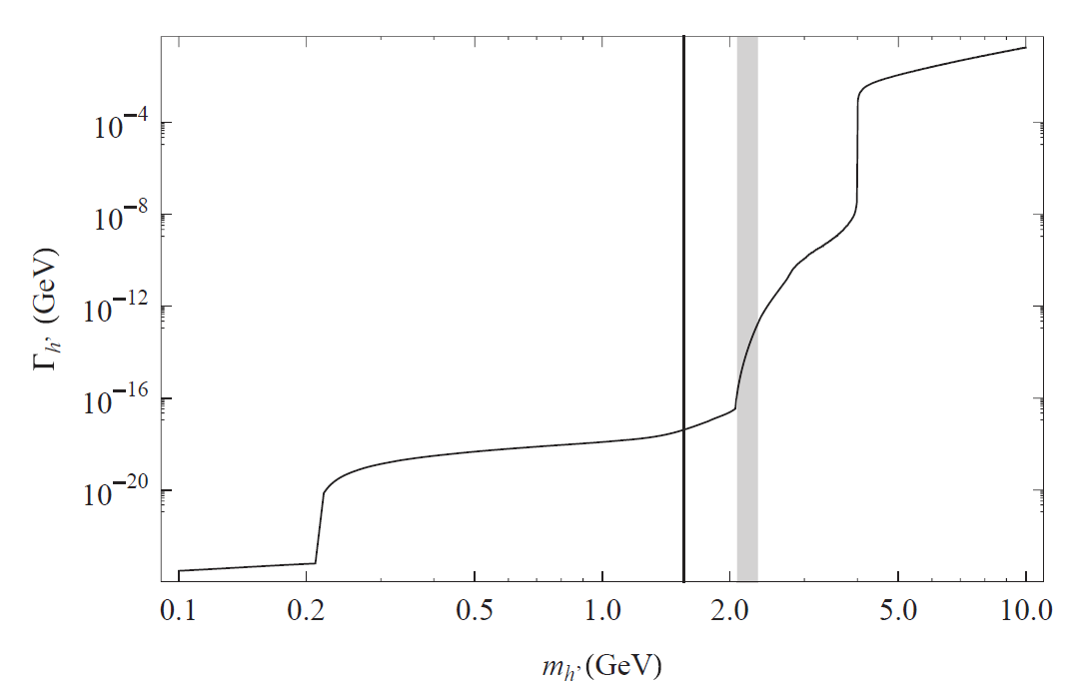
Add a Dark Higgs … very rich phenomenoloy
Dark photon mass is generated via the Higgs mechanism
  a dark Higgs boson (h')
A minimal scenario
  a single dark photon and a single dark Higgs boson.
Theoretical prejudice for dark Higgs mass at the MeV-GeV scale.
  Much rich structure could exist, QCD-like SU(3)_{X}
Dark Higgs decay model
m_{h} < m_{A’}
m_{h} > 2m_{A’}
Invisible decays
Prompt decays

Slide 19
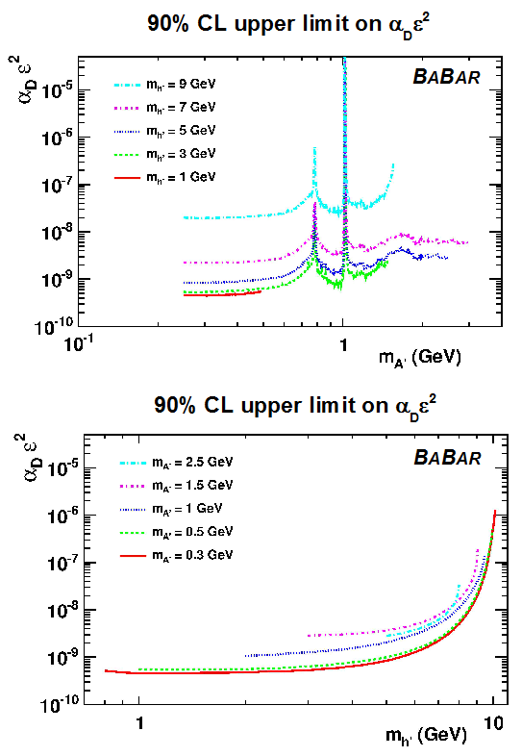
Dark Higgs Search at BaBar
PRL 108 (2012) 211801
The Higgsstrahlung process
e⁺e⁻ → A'* → h' A'
Very interesting, as it is only suppressed by ε² and should have low background
Also sensitive to the dark sector coupling constant α_{D} = g_{D}² / 4π
Search for prompt h’ decays at BABAR:
e⁺e⁻ → A'* → h' A‘, h’ → A’ A’

Slide 20
Intensity Frontier at Fermilab: 120 GeV Beam
World’s highest intensity high energy proton beam:
“beam dump mode” @SeaQuest/E906
35,000 fb⁻¹ (in 2 years of parasitic runs)
LHC-II: 300 fb⁻¹ (~2025), achieved 25fb⁻¹ in Run-I
B-factory@KEK: 50,000 fb⁻¹ (~2023)
Absorber wall and proportional
tube based Muon ID
Spectrometer magnet
Δpt = 0.4 GeV
Focusing magnet
and solid iron dump
Δpt = 2.9 GeV
Beam
120 GeV proton from Main Injector
19ns RF, 4s spill, 0.5×10¹³ protons per spill
25 m
Target system
Liquid H and D
Solid C, Fe, W
- Capture most beam in beam dump mode: p+Fe collisions!
- Parasitic run mode possible with other experiments, E906/E1039

Slide 21
SeaQuest Detector: Top View
Dump
KMAG
FMAG
4 scintillator hodoscope stations (x and y)
4 tracking stations (x and stereos) MWPC
Notes:
more details from p906 proposal

Slide 22
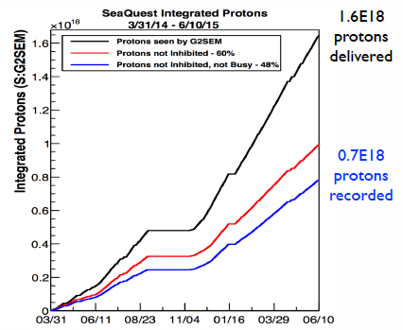
E906 Run-II and III Performance
Run-III
Run-II
~ 10¹⁸ POT
Run-IV just started

Slide 23
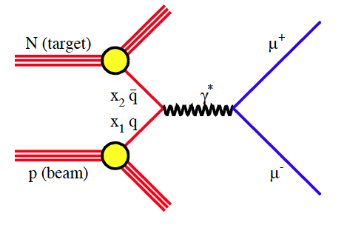
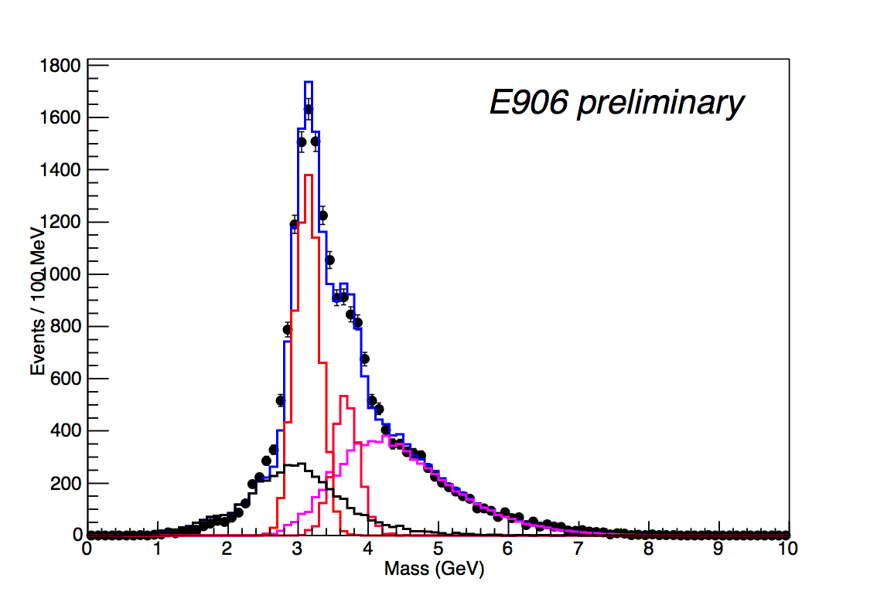
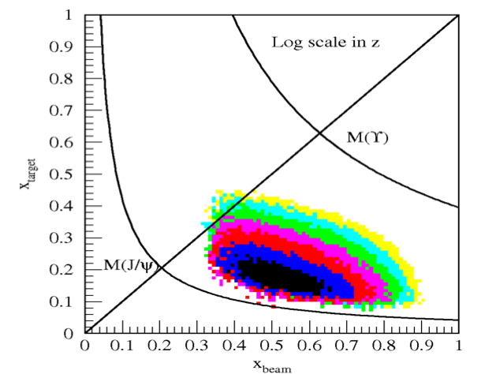
E-906 Drell-Yan Acceptance
Run-II data: 5% of total projected stat.
Run-III data: 30% of total proj. stat.
- J/ψ Monte Carlo
- ψ’ Monte Carlo
- Drell-Yan Monte Carlo
- Random Background
- Combined MC and bg

Slide 24
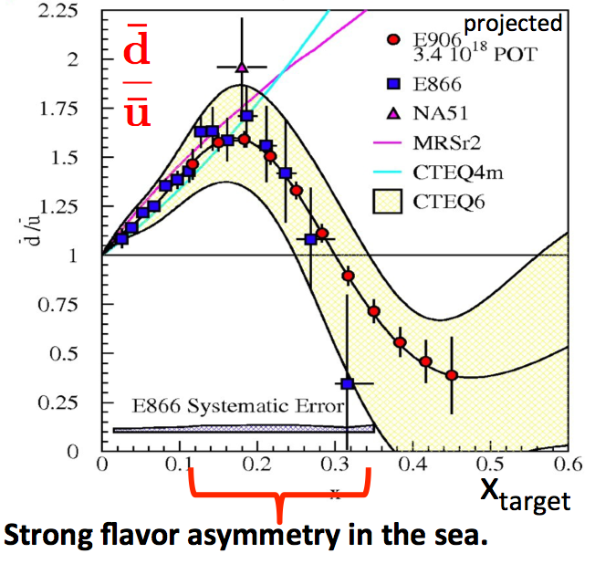
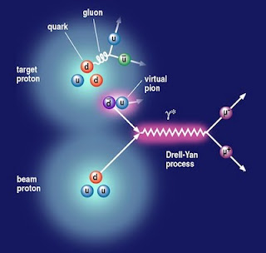

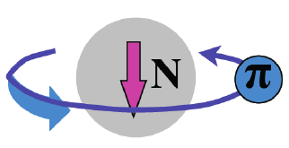
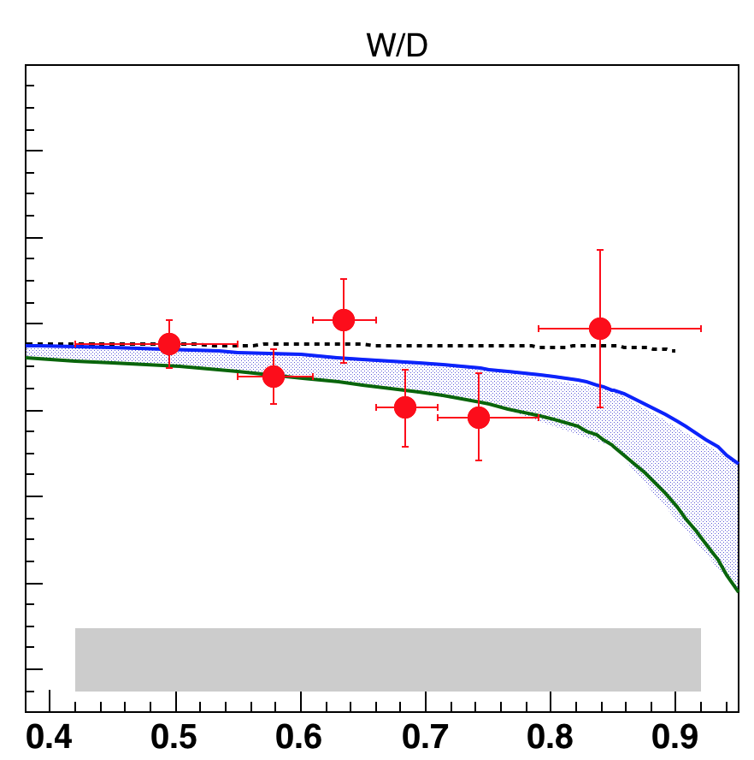

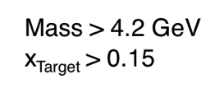
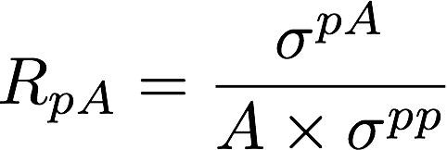
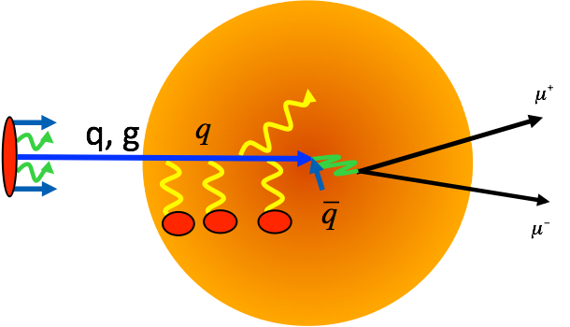
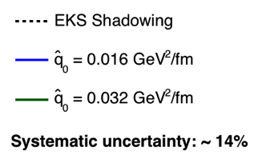
E906 Physics Programs: 2009-2016
Sea quark flavor asymmetry p+p
  Pion cloud model
Quark energy loss in p+A
π⁺

Slide 25
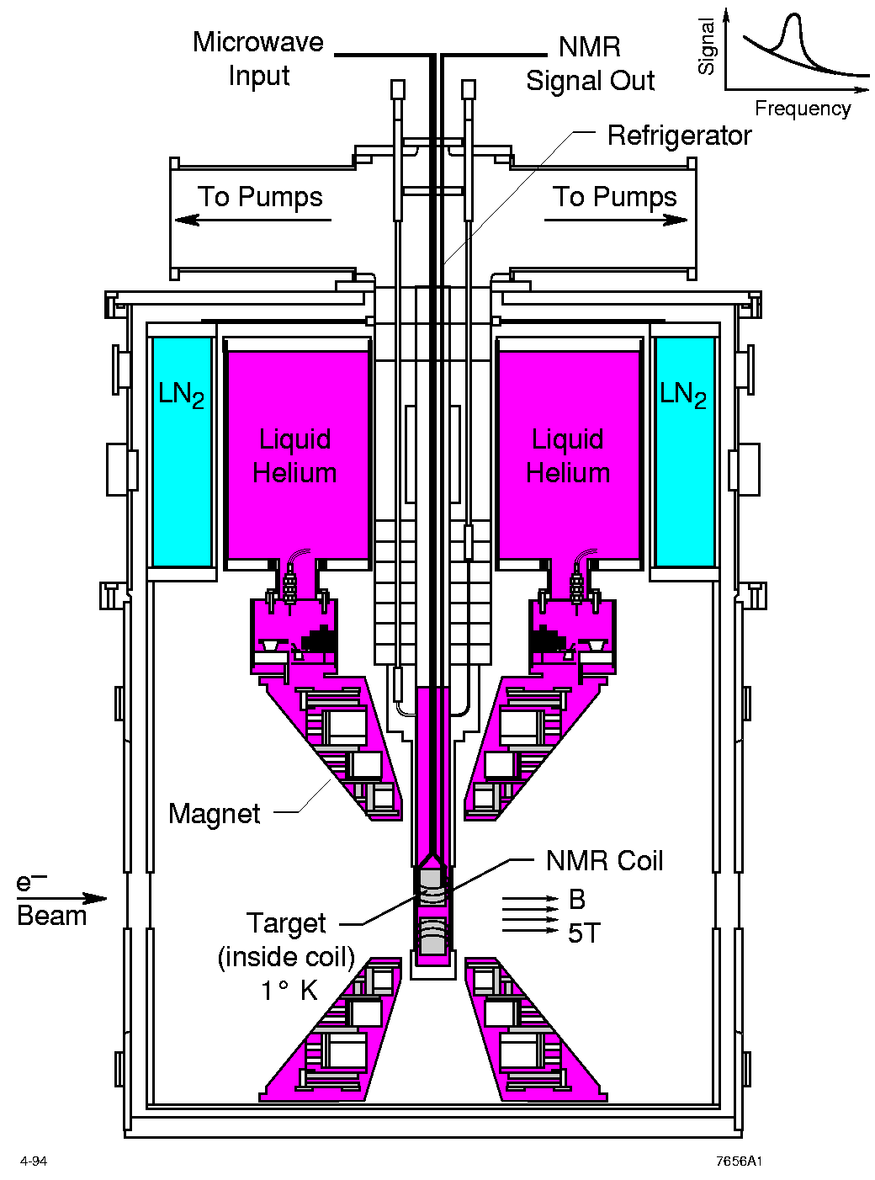
E1039 Physics Program: 2017-2019
Polarized Fixed Target Drell-Yan Experiment
Sea quark flavor asymmetry and OAM
  Pion cloud and OAM
  Non-zero Drell-Yan Sivers Transverse Spin Asymmetry
LANL polarized proton (NH₃) target

Slide 26
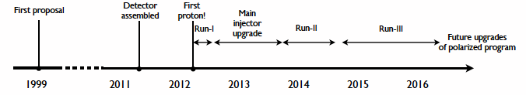
Schedules of SeaQuest Experiments
E-906 complete data taking in summer 2016
  E906 targets are located ~1.3m upstream of the beam-dump, ~10% λ_{I}.
E-1039 will replace current E906 targets with a polarized NH₃ target.
  No change to E906 spectrometer setup
  New target located about 3.5m upstream of the beam-dump, ~6% λ_{I}.
  Target/trigger installation: 2016 - 2017
  Data taking: 2017 – 2019
E-1067 Timeline – Dark photon/Higgs Search!
  Phase-I (Parasitic run) with E1039: 2017-2019
  (Phase-II: detector upgrades and dedicated runs)
E-1027 polarized Main Injector (future)
E-1067
Dark photon(Higgs)
Search: 2017-2019
parasitic run, E-1039
E906 started
E-1039 starts

Slide 27
E-1067: A New Program to Probe Dark Sector in Beam Dump Mode
E906/E1039: Targets ~10% λ_{I}

Slide 28
Dark Photons and Dark Higgs Productions in p+Fe Collisions at Fermilab
Photon portal: “vector”
Higgs portal: “scalar”
θ = μ v/m_{h}²

Slide 29
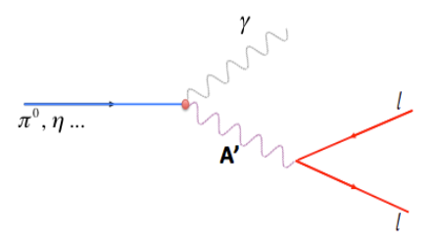
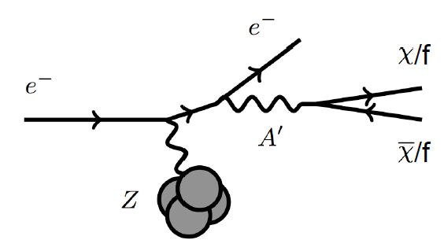
Dark Photon Detection in Dimuon Decay Channel
Drell-Yan like
π⁰, η, … decay
Bremsstrahlung
(DM)
MiniBooNE
Beam-dump
(DM)
p
l⁺
p
l⁻

Slide 30
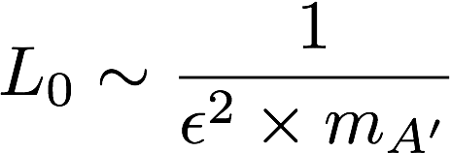
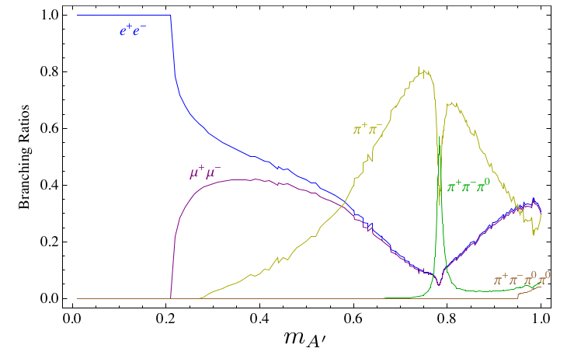
Dark Photon Decay Modes
“Minimal” Decay:
Dark photon is the lightest in the dark sector;
  SM final state particles only
Long proper decay length: L₀ ~ O(1m)
D. Curtin, et al, arXiv: 1312.4992
“General” Decay:
Decay into other dark particles,
dominant channel if allowed
  Dark -> Dark
  Dark -> SM particles
(GeV)

Slide 31
Detector Upgrades and Expected Signals
Dark photon trigger upgrade
  Add a fine-granularity scintillating strip based trigger/tracking to tag dimuons from the same decay Z-vertex
  A new trigger for events with displaced down-stream dimuons
Unique signals
  Displaced dimuon decay vertex for long-lived particles
  Invariant mass peak in dimuon mass spectrum
  Mostly from beam dump (target ~6% λ_{I}.)
Beam time
  Run parasitically with E1039 (2017-2019)
  Possible dedicated runs later with upgraded (e^{+/-}, h^{+/-})
-- 2.5%
-- 6.0%
Dimuon mass resolution
Z (meter)

Slide 32
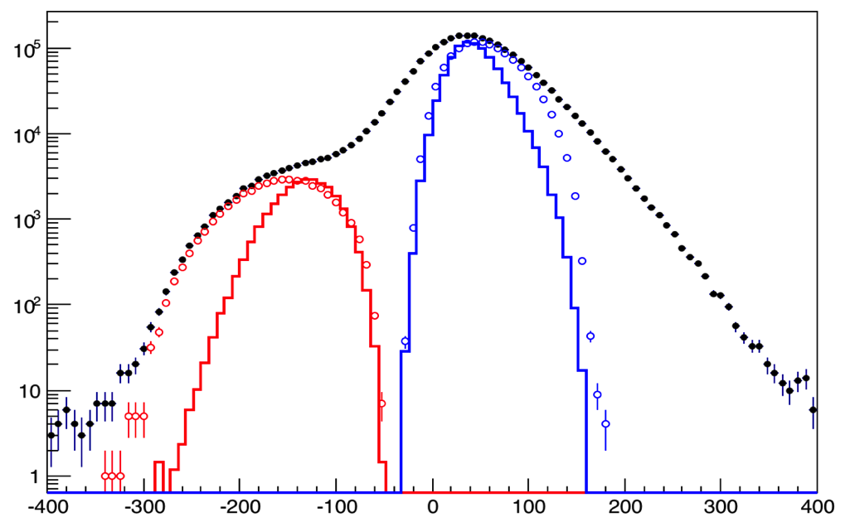
Background Study Using Run-II 2014 Data
Monte Carlo describe data well
  σM(J/ψ) ~ 180 MeV, σM(DY) ~ 220 MeV
  J/ψ, ψ’ separation
  Clean DY sample
Good target/beam dump separation
~ 5% of expected final
total statistics
- J/ψ Monte Carlo
- ψ’ Monte Carlo
- Drell-Yan Monte Carlo
- Random Background
- Combined MC and bg
All “good” dimuons in data
Data with dump cut
Data with target cut
Dump MC
Target MC
Zvtx (cm)

Slide 33
A New High-Granularity Displayed Dimuon Vertex Trigger
High rejection power, very low rate, << 1 kHz(E906 DAQ limit)
Y-Plane Trigger:
A quadrant panel: 50cm x 50cm, 1cm thick
  1cm x 1cm x 50 cm scintillating strips, SiPM readout
- Straight line projection, 30cm Z-vertex resolution
- Displaced z-vertex, mostly low mass < 3GeV
Coincident with St-4 Hodos(muons)
Y-channels per quadrant:
1x V1495
50(St1) + 50(St2) + 8x2 (St4-Y1,2) = 116
96+64 = 160 possible
  72+72+16 = 160 (possible)
  (2NIM=RFCLK+ComSTOP )
Y
X
St1
St2
Z
Coincident Z-vtx
window matched@L2
Dimuon Z-vertex (cm)

Slide 34
Displaced Dark Photon Trigger
DAQ/Data stream
LVDS cable 2x16ch bundle available
Q1 (LVL1)
DAQ Trigger
LVL2
(vtxZ matching)
Q2 (LVL1)
TS
(12 inputs total)
(1-free bit available)
Q3 (LVL1)
DP Trigger
1-bit
Q4 (LVL1)
4 x 16-bit from 4 Q1-4/V1495
(2 x 32LVDS cables)
Q1: 50(ST1’) + 50 (ST2’) + 2x8(ST4-Y1/2) = 116, FANOUT ST4
Up to 72(ST1) + 72 (ST2) + 2x8(ST4Y1/2) = 160

Slide 35
Low Mass Prompt Dimuon Trigger Rate Study in 2015
Current E906 setup
Proposed 2-layer trigger upgrade (10x improvement)
Additional Y-trigger after ST-3 absorber, and also using existing E906 X-Plane trigger
(additional ~2x improvement)
Current E906 DAQ 1kHz, can be improved to 10kHz with small cost
200kHz possible in the future (reprograming trigger firmware etc.)
Parasitic mode: use up to ~10% DAQ bandwidth
(Prompt)Low mass dimuon trigger performace

Slide 36
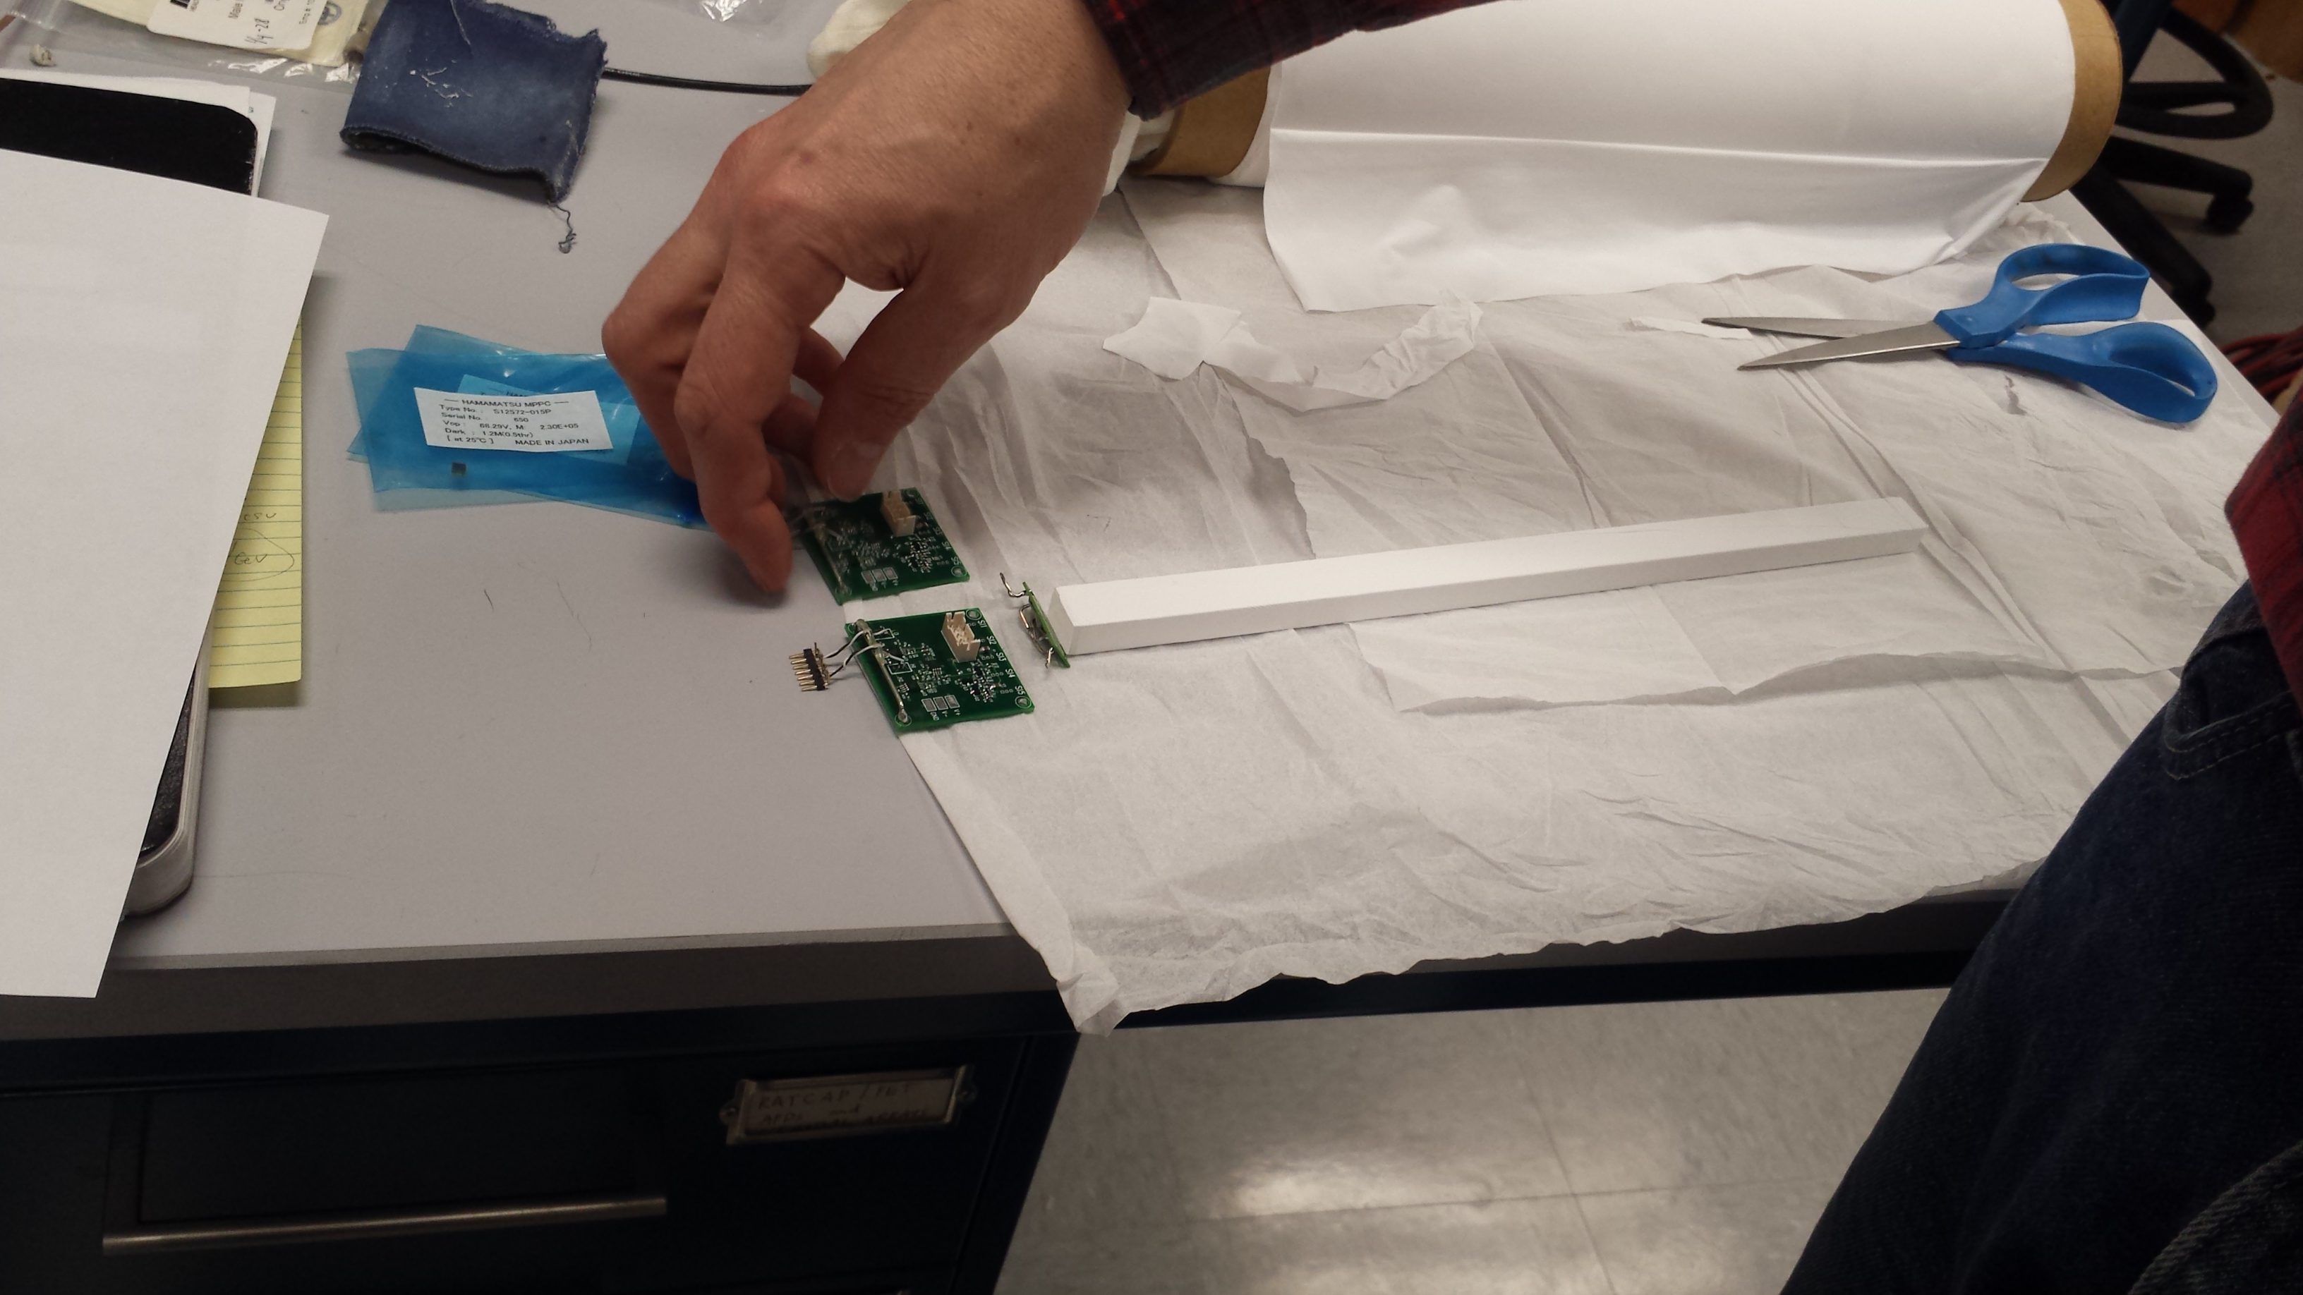



Scintillator-based Trigger R&D
Capable to operate in strong magnetic field
  SiPM, Scintillator, cost effective
  A joint R&D with BNL sPHENIX upgrade

Slide 37



Trigger Prototype R&D
- 10mm x 10mm x 500 mm
- Scintillators + SiPM readout
- Cosmic rays
- Fast <~ 10nS rising time

Slide 38


Fermilab Extruded Scintillators
- Extruded scintillators + WLSF
SiPM readout
Low cost, for large area
On-going R&D

Slide 39


E906 DAQ Improvement
PC/Linux: Jlab CODA, Ethernet Readout
CPU MVME5500: old VxWork (Jlab)
“TS” SIS3200
TDC-II
V1495 pulse generator
V1495 L1 Trigger “development brd”
Windows PC: Altara FPGA programing
-CNTRL
-SIS3200, as TS
-TDC-II (x)
-TDC-II (x)
-V1495, trigger inputs
at least 4
-V1495 as trigger
pattern emulator

Slide 40

Search Mode (1): Long-lived Dark Photons
Reconstructed dimuons with downstream Z-vertex:
3m < Z-vertex < 6m
Very low trigger rate, << 1kHz
Almost SM background free
Dimuon mass peak
- 5x10¹² ppp ( current E906)
200 days
1.4 x 10¹⁸ POT (recorded)
4 events contours (2-sigma)
2-sigma (95%) exclusion plots
Excellent coverage of uncharted region!

Slide 41



Search Mode (2): “Prompt” Dark Photons vs Drell-Yan
Z-vertx < 3m
Expected Drell-Yan like signal and backgrounds:
Excluded phi
resonance region
Dark photon
signal
Drell-Yan Background
Work in progress
Further optimization possible

Slide 42


Summary: Dark Photon Sensitivity
POT:1.4x10¹⁸ (parasitic w/ E1039)
Signals considered:
Drell-Yan like
Eta decays
Bremsstralung
Covers a wide range of unexplored parameter phase space
Displaced dimuons
- Minimal SM background
Prompt dimuons
- Excellent coverage over BELLE-II
projection
- Possible dedicated runs later to fully
restore mass < 3GeV (Phase-II)
Phase-II with upgrades
Access below 200MeV with di-electrons
( add EMCal)
(2017?)
(2016?)
(~2023)

Slide 43
Dark Higgs Search at E-1067
Y. Zhang et al, arXiv:1502.06983
θ = μ v/m_{h}²
arXiv:1312.4992
e⁺e⁻
Phase-I:
High-mass: μ⁺μ⁻ and hadrons
Advantage of using hadron beams
with muon probes over electrons
Phase-II:
Low-mass: e⁺e⁻, <200MeV possible
High-mass: hadrons
μ⁺μ⁻

Slide 44
E-1067 Dark Higgs Sensitivity
POT:1.4x10¹⁸ (Phase-I)
Y. Zhang (2015)
Dimuons with downstream displaced decay vertices
Limited sensitivity to “prompt” large mixing case due to small cross-section
Dark Higgs or dark photons?
  Dimuon kinematic and angular distributions
Phase-II
  Dedicated high luminosity runs optimized for low mass acceptance, mass<3GeV
1x
5x
25x

Slide 45

E-1067 Future Upgrade: Phase-II
2020 ~ 2025+ ?
Add tracking close to “target” to improve mass resolution
Add EMCal + Hcal, PID?
e^{+/-}, h^{+/-} , π^{+/-}

Slide 46

Phase-II: Access Low Mass Region with e⁺e⁻ with future detector upgrades
S. Gardner, R. Holt et al
p
l⁺
p
l⁻

Slide 47

Phase-II: Full Coverage with future detector “EMCal/HCal” upgrades
Projection: POT 1.4 x 10¹⁸
Detector upgrades
  EMCal: e^{+/-}
  HCal: π^{+/-}
  Recycle from other experiments, RHIC/JLab etc.
DAQ upgrade
  100 kHz
Timeline of dedicated runs
  2019+
Detector configuration
  Access low mass region with optimized Fmag settting

Slide 48
Phase-II: Probe Non Abelian Dark Sector with future detector “HCal” upgrades
non-Abelian dark sector process
S. Gardner and R. Holt
[Note: Batell, Pospelov, and Ritz, PRD 80 (2009) 095024 for a review re fixed target expts.]
Here we consider a non-Abelian (gluon) portal
[Baumgart et al., JHEP 0904, 014 (2009); Gardner and He, PRD 87 (2013) 116012]
The “shining through walls” design – unique to Seaquest – makes this possible ,
to yield, e.g., via a “minimal” decay….

Slide 49

Summary and Outlook
Phase-I
  Great discovery potential!
  Add a new displayed vertex trigger
  Early parasitic data taking 2017-2019+
    A short dedicated run up to ~1 month if needed
  POT 1.4 x10¹⁸
Phase-II
  Possible detector upgrade later, add electrons and hadrons
  A new dedicated dark matter program at Intensity Frontier!
Dark Higgs
search
Preparation Phase-I (parasitic runs)
Phase-II
2015
2016
2017
2018
2019
2020+

Slide 50
Many good discussions with
R. Holt, J-C. Peng, K. Liu, Z.-B. Kang, Y. Zhang, P. McGaughey, Y. Zhong, P. Reimer, C. Brown, R. van der Water, R. Essig, and more and the new E-1067 Collaboration at Fermilab

Slide 51


2014 US P-5 Report
Great Opportunities at the Fermilab Intensity Frontier!!!
Notes:
P5 reprot highted the 5 sciecne driver …
We respond to the call of P5 report and identified a new opportunity to explore key physics at Femirlab intensity frontier

Slide 52
Backup slides

Slide 53

Current Limits on Dark Photon Search
Slide credit: Bertrand Echenard
BaBar (2014)

Slide 54
Scope and Compatibility
Preparation work: 2016 – 2017
  Displaced vertex dimuon trigger upgrade (LANL LDRD $1.2M over FY2016-2018)
    Add a new trigger bit
    No change to existing trigger matrix
  Possible upgrade of DAQ bandwidth under consideration (external $$)
    1kHz (E906) -> 10+ kHz
  Commissioning with cosmic rays
Parasitic runs w/ E1039: 2017 – 2019
  Displaced vertex dimuon trigger upgrade
  Use up to ~10% DAQ bandwidth
  Achieve 1.44 x10¹⁸ POT
Possible parasitic runs w/ E1027 and/or dedicated runs later with upgrades: 2019+
  High luminosity goals:
    POT >> 1.4x10¹⁸
  DAQ
    10 – 100 kHz capability
  EMCAL/HCAL/PID
    Electrons
    charged hadrons
  Fully cover the accessible phase space
    Low mass “prompt photon” region, M < 3 GeV
  Possible parasitic runs with other proposals

Slide 55





Beam dump experiment proposal at CERN
Using the CERN SPS e- beam
(arXiv:1312.3309)
The SHIP proposal at CERN
(http://ship.web.cern.ch/ship/)
preliminary
W. Bonivento

Slide 56

Comparison with SHiP Proposal
120 GeV@FNAL: 2017 -2019
1.4x10¹⁸ POT, future dedicated runs
400 GeV@SPS: 2025 -2030
4x10²⁰ POT

Slide 57


A’ Production

Slide 58

Electron Beam Fixed Target Experiments
APEX
@J-Lab12

Slide 59

APEX Experiment at J-Lab
Symmetric configuration to optimize S/B
Possible 4 beam energies: 1,2,3,4 GeV @Hall-A
Fall/2017 – Spring/2018: 1 month beam time

Slide 60

Typical Backgrounds

Slide 61

HPS at JLab
Slide from
Tim Nelson 4/2015

Slide 62

Slide from
Tim Nelson 4/2015

Slide 63


Dark Light @JLab

Slide 64

Sub ~O(10) GeV Dark Matter Interactions via A’
Invisible mode:
BaBar, BELLE-II, MiniBooNE
Direct detection
Indirect/invisible mode
Accelerator based search possible
Very rich phenomenology

Slide 65



Invisible Mode in Beam Dump Search

Slide 66

Dark Photon Current and Future Limit (2014 Projections)

Slide 67

Cold Dark Matter “Small-scale” Challenges
Slide from
R. Essig 4/2015

Slide 68

Hints from WIMP Search

Slide 69
A New High-Granularity Displayed Dimuon Vertex Trigger
High rejection power, very low rate, << 1 kHz(E906 DAQ limit)
Y-Plane Trigger:
A quadrant panel: 50cm x 50cm, 1cm thick
  1cm x 1cm x 50 cm scintillating strips, SiPM readout
- Straight line projection, 30cm Z-vertex resolution
- Displaced z-vertex, mostly low mass < 3GeV
Coincident with St-4 Hodos(muons)
Quadrant-based triggers: 4 x V1495
Y-channels per quadrant:
1x V1495
50(St1) + 50(St2) + 8x2 (St4-Y1,2) = 116
96+64 = 160 possible
  72+72+16 = 160 (possible)
  (2NIM=RFCLK+ComSTOP )
St1
St2
Z
Coincident Z-vtx
window matched@L2
E906 Run2
J/Psi
Psi’
Drell-Yan
Rndm
E906 Run2
Dimuon Z-vertex (cm)

Slide 70
Current E906 Trigger & DAQ System
Pulse Gen.
V1495 @TB
DAQ
VME/CPU
Ethernet
Hodos
Hits/
Start
TDC (xx)
Threshold Discriminator
……
L1-Trigger
V1495 (4)
(96)
L0 Trigger: not “actively” used
- 4 V1495 boards available
L1 Trigger: in operation
- 4 V1495 boards
(2) for Y-plane, not used
(2) for X-Plane, in use
- 700nS latency
L2 Trigger: pass through
1 V1495
Could do simple look-up
TS: Trigger Supervisor
L2-Trigger
V1495 (1)
L2: limited I/O
1(O), 5(I), 32x
only 2 (I) used
Trigger Supervisor
Comm.
Stop/Trigger

Slide 71

V1495 Board
2 Altara FPGA Chips: Cyclone-V
Trigger lookup table

Slide 72



Experimental Hall

