Slide 1
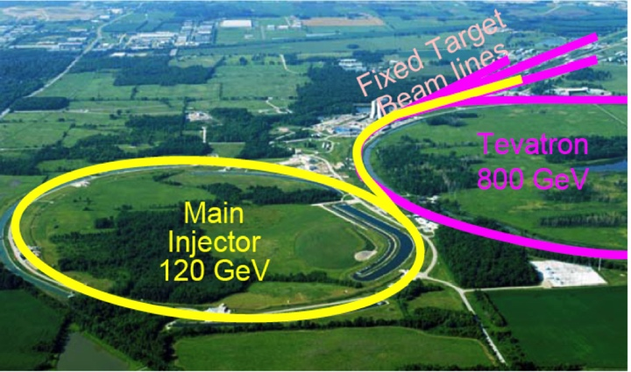
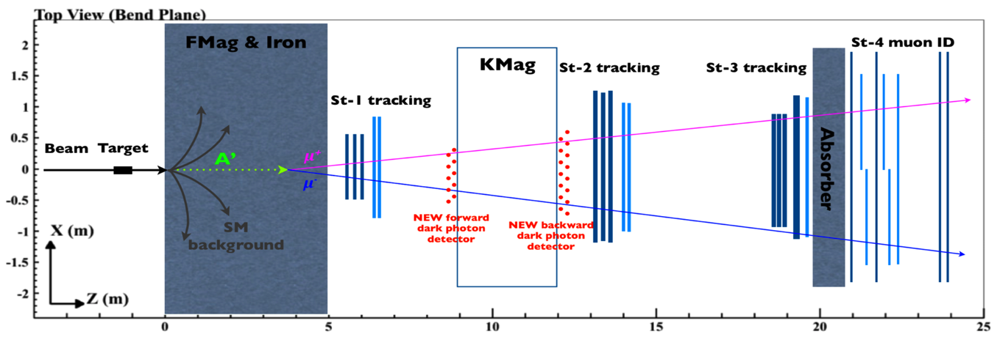
Direct Search for Dark Photons and Dark Higgs in p+A Collisions at Fermilab E-1067 Experiment
Ming Liu
Los Alamos National Laboratory

Slide 2

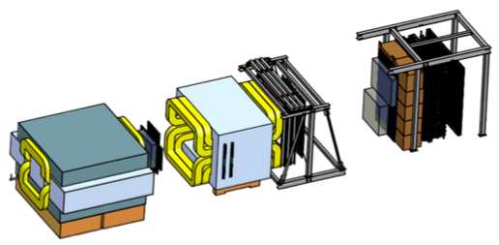
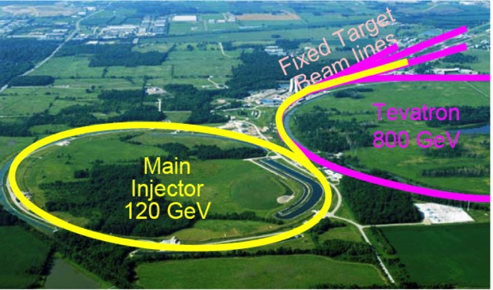
Intensity Frontier at Fermilab: 120 GeV Beam
World’s highest intensity high energy proton beam:
“beam dump mode” @E-1067
50,000 fb⁻¹ (in 200-day parasitic run)
LHC-II: 300 fb⁻¹ (~2025), achieved 25fb⁻¹ in Run-I
B-factory@KEK: 50,000 fb⁻¹ (~2023)
Absorber wall and proportional
tube based Muon ID
Spectrometer magnet
Δpt = 0.4 GeV
Focusing magnet
and solid iron dump
Δpt = 2.9 GeV
Beam
120 GeV proton from Main Injector
19ns RF, 4s spill, 0.5×10¹³ protons per spill
25 m
Target system
Liquid H and D
Solid C, Fe, W
- Capture most beam in beam dump mode: p+Fe collisions!
- Parasitic run mode possible with other experiments, E906/E1039

Slide 3
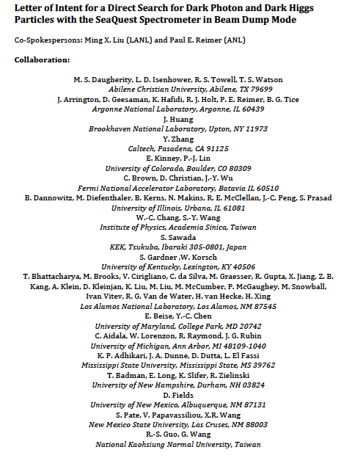
LOI submitted to Fermilab PAC
on May 20, 2015
A joint experimental and theoretical collaboration
(most E906/E1039 + new members, ~60)
---------------------------------------
Phase-I: (parasitic runs)
Addition of a new displaced dimuon trigger to tag long-lived downstream decayed dark photons (dark Higgs).
Parasitic data taking with E1039 in 2017-2019;
  A short dedicated run (up to ~1 month) if needed.
POT 1.44x10¹⁸
Phase-II: (upgrade)
Dedicated runs later with EMCal/HCal upgrades, e^{+/-} and h^{+/-} capabilities.
Cover the full parameter phase space allowed by beam energy and luminosity
POT: >> 1.4x10¹⁸
Phase-II request will be presented to PAC at a later time.
Notes:
Responding to P5 reprot, we submitted LOI last month .. And the membership is growing …

Slide 4
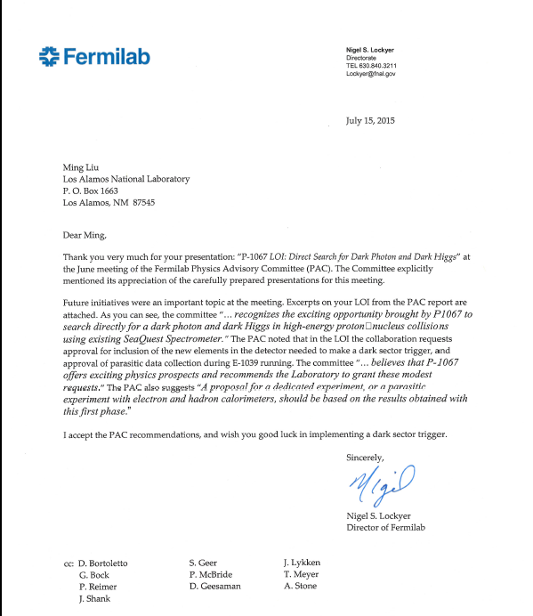
A heart-full endorsement
from Fermilab Director and PAC
July 15, 2015!
New experiment! E-1067

Slide 5
Outline
Motivation
  Dark Matter, dark photons and dark Higgs
Current SeaQuest/E906 at Fermilab
  Nucleon/Nuclear structures physic with Drell-Yan
E-1067: a new search of dark photons/Higgs
  Phase-I, 2017-2019 with a new trigger
  Phase-II, 2020+ with detector upgrade, see Kun Liu’s talk Friday

Slide 6
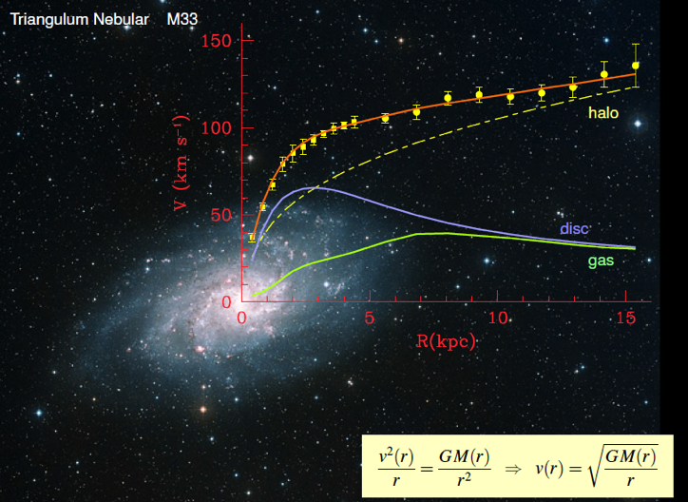
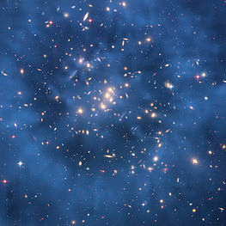
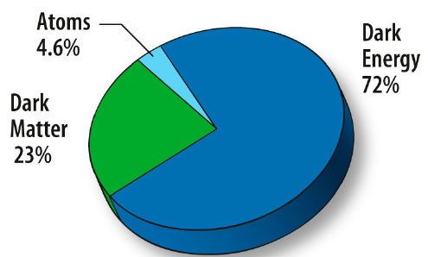
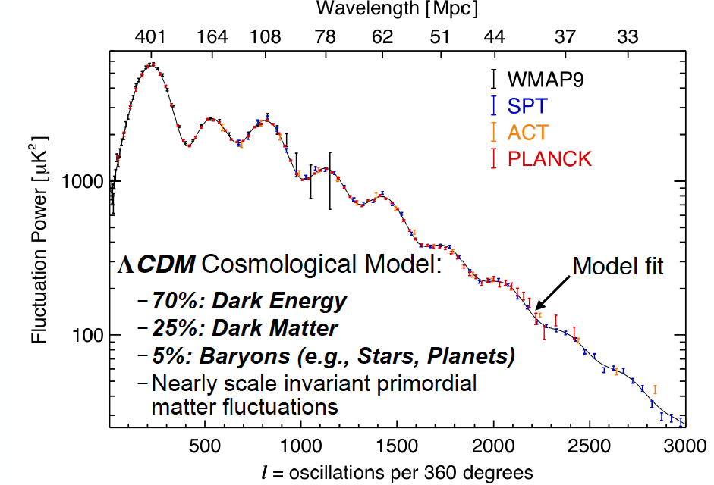
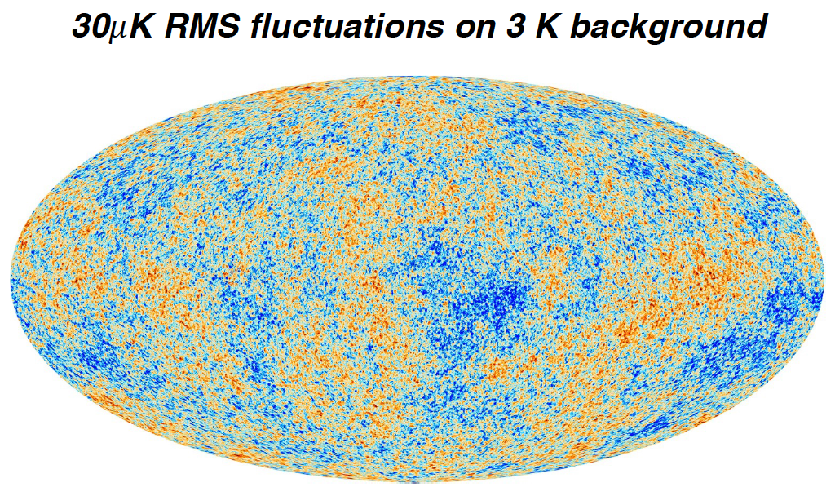
Dark Matter?
Galaxies’ rotation curve
Gravitational lensing (Hubble 2007)
F. Zwicky, ApJ 86 (1937) 217, V. Rubin et al, ApJ 238 (1980) 471
Planck: 2013
Benson’s talk @CIPANP 2015
Notes:
It is widely accepted today that visible matter only account for 5% of matter and energy, with 25% dark matter .. With many compelling experimental obseravtions , how ever the nature of dark matter and dark energy remtain as the biggest scientific challenges for hunam being … sa they only interactio with SM particels very weakly .. Only shown in gravitaiton sectors ..

Slide 7
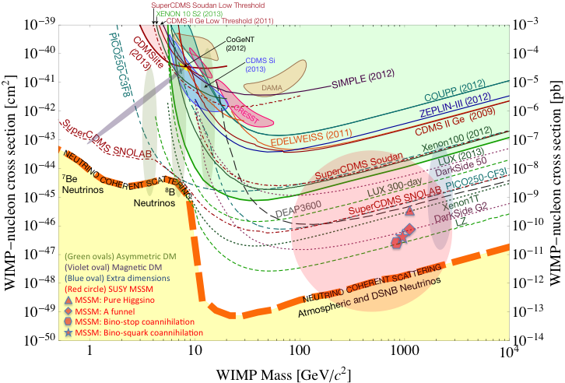
Direct Search for WIMP
WIMP being excluded?
Recent anomalies observed by satellite and terrestrial experiments have motivated dark matter models introducing a new “dark sector”
There are “portals” between the dark sector and the SM.
  “vector portal”: dark photon
  “scalar portal”: dark Higgs
  “neutrino portal” and more …
“Sub-GeV” low mass weakly-interacting dark particles become very interesting!
Mass: O(MeV ~ GeV)
In particular, high-intensity colliders (B-factories) and fixed target experiments (Fermilab, JLab, LHC etc.) offer an ideal environment to probe these new ideas.
Notes:
What are the DM? WIMP is considered one of the primary candidates of DM …

Slide 8
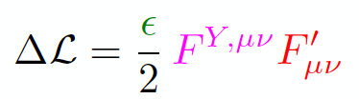
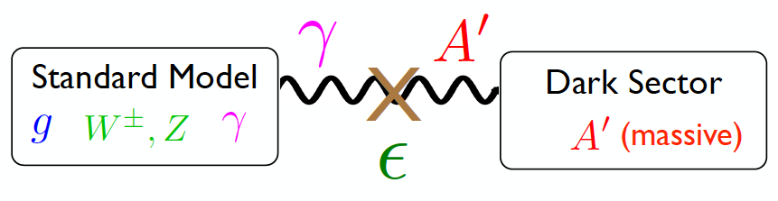
Vector Portal and Dark Photon
A simplest model of dark sector
An extra U(1)_{X}, kinetic mixing
Not suppressed by mass scale
Holdom
Galison, Manohar
SU(3)_{C} x SU(2)_{L} x U(1)_{Y} x U(1)_{X}

Slide 9
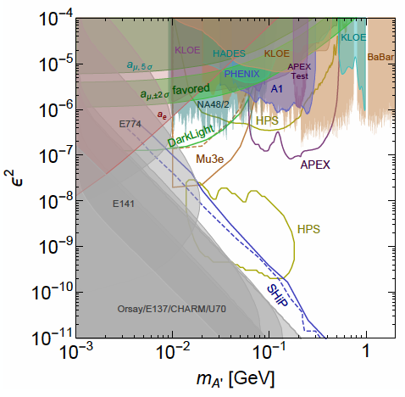
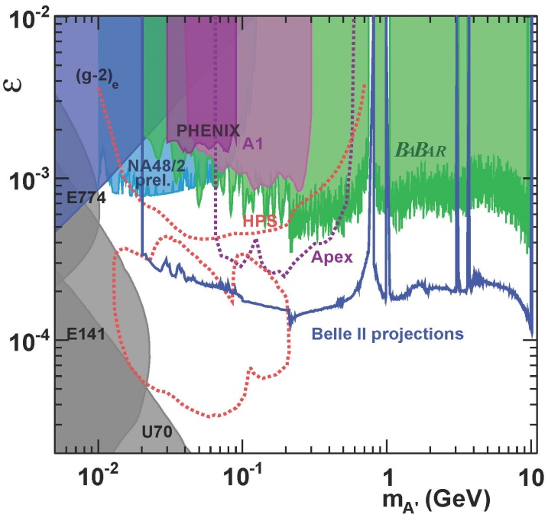

Dark Photon Current and Future Limits

Slide 10
Intensity Frontier at Fermilab: 120 GeV Beam
World’s highest intensity high energy proton beam:
“beam dump mode” @E-1067
50,000 fb⁻¹ (in 200-day parasitic run)
LHC-II: 300 fb⁻¹ (~2025), achieved 25fb⁻¹ in Run-I
B-factory@KEK: 50,000 fb⁻¹ (~2023)
Absorber wall and proportional
tube based Muon ID
Spectrometer magnet
Δpt = 0.4 GeV
Focusing magnet
and solid iron dump
Δpt = 2.9 GeV
Beam
120 GeV proton from Main Injector
19ns RF, 4s spill, 0.5×10¹³ protons per spill
25 m
Target system
Liquid H and D
Solid C, Fe, W
- Capture most beam in beam dump mode: p+Fe collisions!
- Parasitic run mode possible with other experiments, E906/E1039

Slide 11
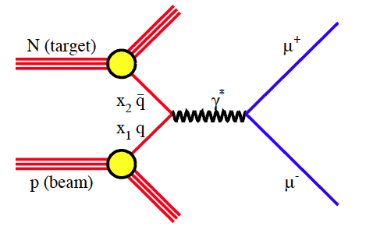
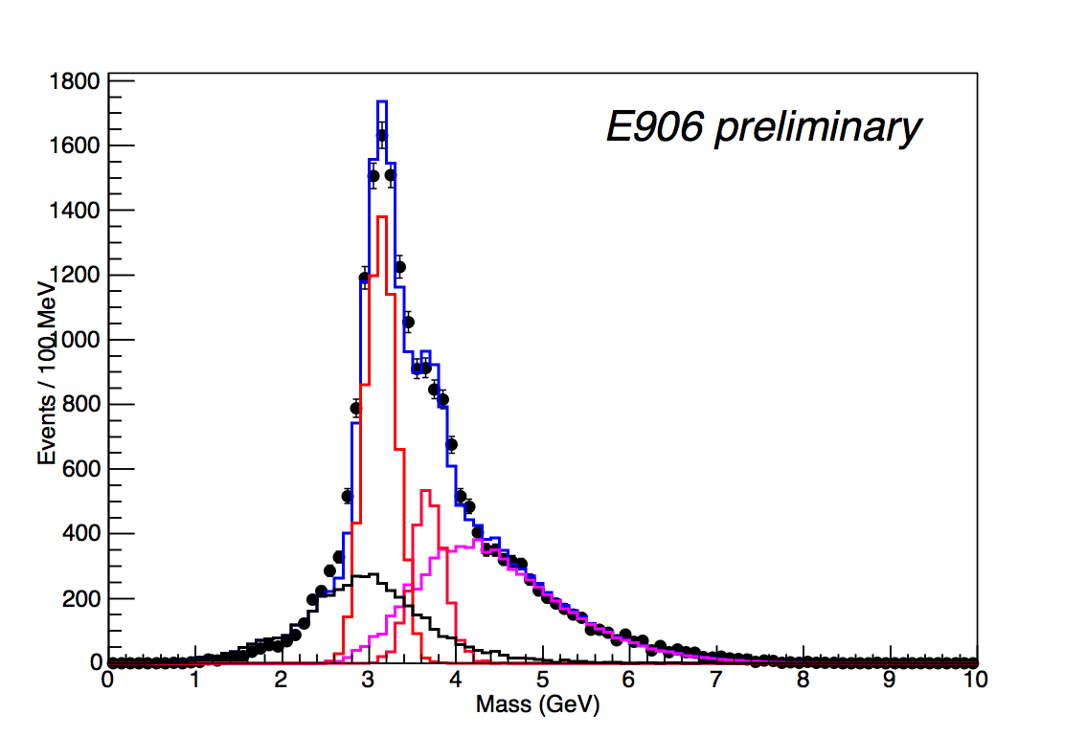
Current E-906
Drell-Yan Acceptance
Run-II data: 5% of total projected stat.
Run-III data: 30% of total proj. stat.
- J/ψ Monte Carlo
- ψ’ Monte Carlo
- Drell-Yan Monte Carlo
- Random Background
- Combined MC and bg
target
Beam
dump

Slide 12
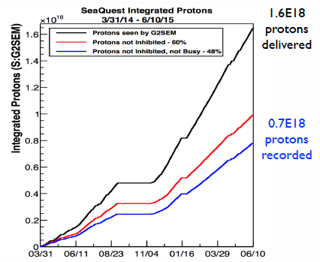
E906 Run-II and III Performance
Run-III
Run-II
~ 10¹⁸ POT/year
Run-4 on-going
~5% proton budget @MI

Slide 13
E-1067: A New Program to Probe Dark Sector in Beam Dump Mode
E906/E1039: Target thickness ~10% λ_{I}
~90% in beam dump!

Slide 14
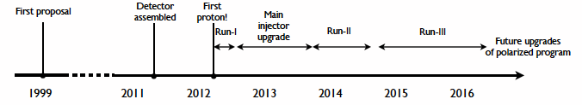
Schedules of SeaQuest Experiments
E-906 complete data taking in summer 2016
  E906 targets are located ~1.3m upstream of the beam-dump, ~10% λ_{I}.
E-1039 will replace current E906 targets with a polarized NH₃ target.
  No change to E906 spectrometer setup
  New target located about 3.5m upstream of the beam-dump, ~6% λ_{I}.
  Target/trigger installation: 2016 - 2017
  Data taking: 2017 – 2019
E-1067 Timeline – Dark photon/Higgs Search!
  Phase-I (Parasitic run) with E1039: 2017-2019
  (Phase-II: detector upgrades and dedicated runs)
E-1027 polarized Main Injector (future)
E-1067
Dark photon(Higgs)
Search: 2017-2019
parasitic run, E-1039
E906 started
E-1039 starts

Slide 15
Dark Photons and Dark Higgs Productions in p+Fe Collisions at Fermilab
Photon portal: “vector”
Higgs portal: “scalar”
θ = μ v/m_{h}²

Slide 16
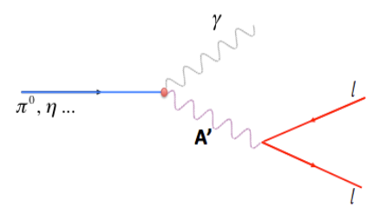
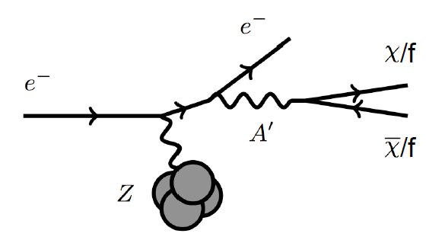
Dark Photon Detection in Dimuon Decay Channel
Drell-Yan like
π⁰, η, … decay
Bremsstrahlung
(DM)
MiniBooNE
Beam-dump
(DM)
p
l⁺
p
l⁻
Also see: S. Gori, S. Gardner and K Liu’s talks

Slide 17
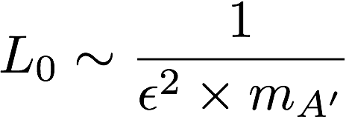
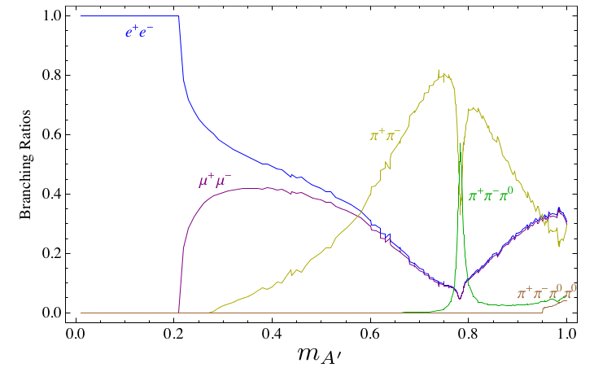
Dark Photon Decay Modes
“Minimal” Decay:
Dark photon is the lightest in the dark sector;
  SM final state particles only
Long proper decay length: L₀ ~ O(1m)
D. Curtin, et al, arXiv: 1312.4992
“General” Decay:
Decay into other dark particles,
dominant channel if allowed
  Dark -> Dark
  Dark -> SM particles
(GeV)

Slide 18
Detector Upgrades and Expected Signals
Dark photon trigger upgrade
  Add a fine-granularity scintillating strip based trigger/tracking to tag dimuons from the same decay Z-vertex
  A new trigger for events with displaced down-stream dimuons
Unique signals
  Displaced dimuon decay vertex for long-lived particles
  Invariant mass peak in dimuon mass spectrum
  Mostly from beam dump (target ~6% λ_{I}.)
Beam time
  Run parasitically with E1039 (2017-2019)
  Possible dedicated runs later with upgraded (e^{+/-}, h^{+/-})
-- 2.5%
-- 6.0%
Dimuon mass resolution
Z (meter)

Slide 19
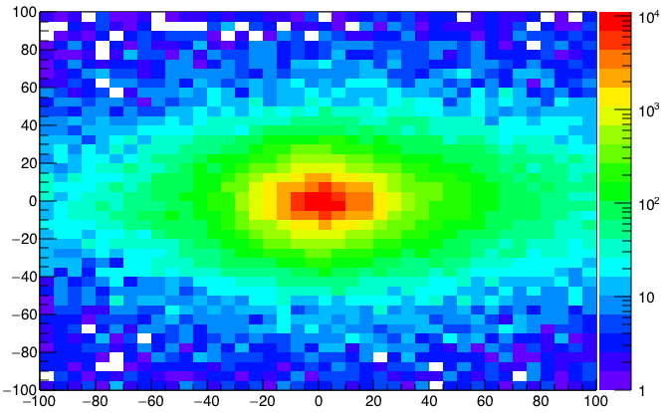
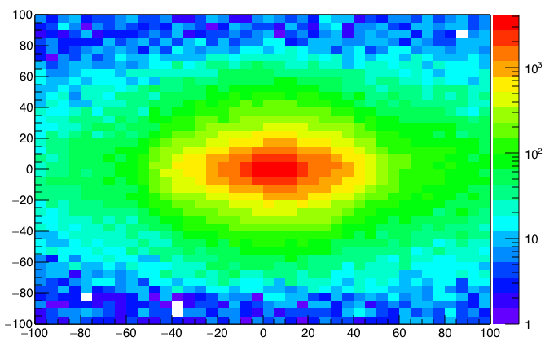
A New High-Granularity Displayed Dimuon Vertex Trigger
High rejection power, very low rate, << 1 kHz(current E906 DAQ limit)
Y-Plane (non-bending) Trigger:
A quadrant panel: 80cm x 80cm, 1cm thick/(100x100x2)
  ST1: 1cm x 1cm x 80 cm scintillating strips, SiPM readout
  ST2: 2cm x 2 cm x 100 cm strips
- Straight line projection, 30cm Z-vertex resolution
Displaced z-vertex, mostly low mass < 3GeV
Y
Dimuon Z-vertex (cm)
ST1
X
St1
St2
Z
Coincident Z-vtx
window matched@L2
ST2

Slide 20
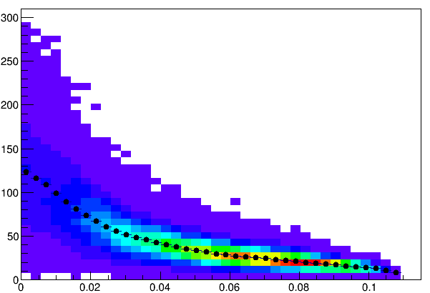
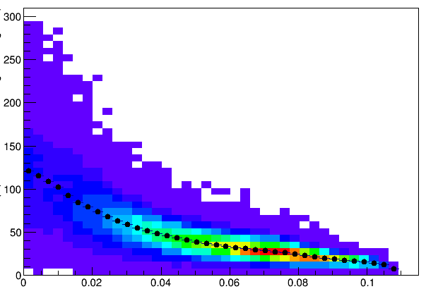
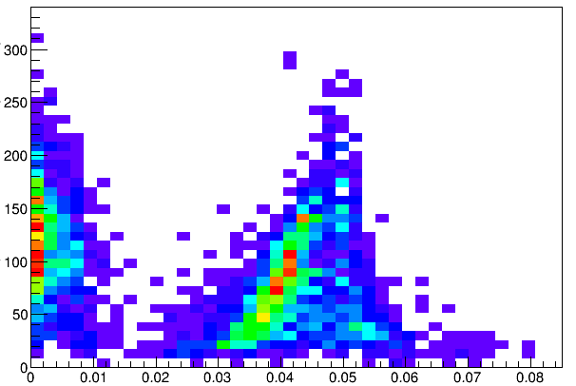
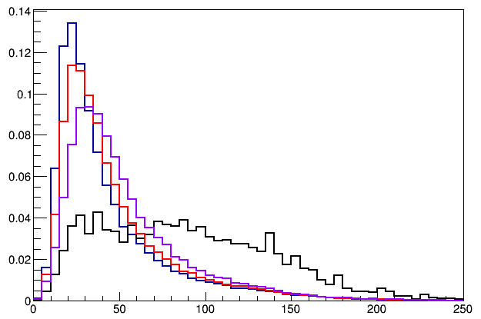
Muon Z-Vertex Resolutions
Forward: 1cm
Backward: 1cm
Forward: 1cm
Backward: 2cm
Forward: 1cm
Backward: 1cm
Forward: 1cm
Backward: 2cm
Forward: 2cm
Backward: 2cm
E906
Current
E906

Slide 21
Low Mass Prompt Dimuon Trigger Rate Study in 2015
Current E906 setup
Proposed 2-layer trigger upgrade (10x improvement)
Additional Y-trigger after ST-3 absorber, and also using existing E906 X-Plane trigger
(additional ~2x improvement)
Current E906 DAQ 1kHz, can be improved to 10kHz with small cost
100+kHz possible in the future (reprograming trigger firmware etc.)
Parasitic mode: use up to ~10% DAQ bandwidth
Expected (Prompt)Low mass dimuon trigger performance

Slide 22
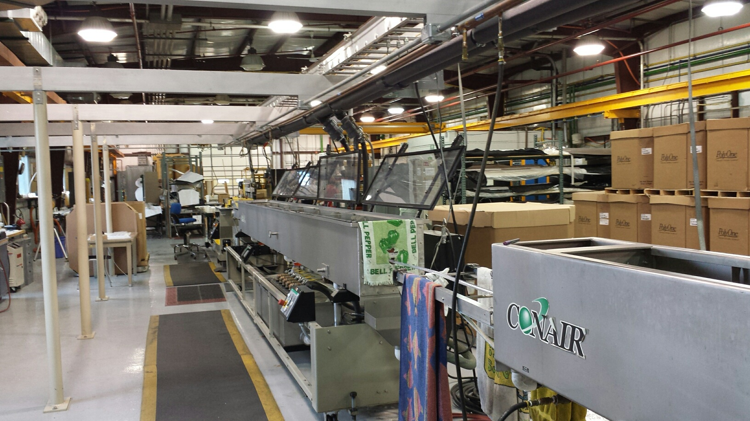
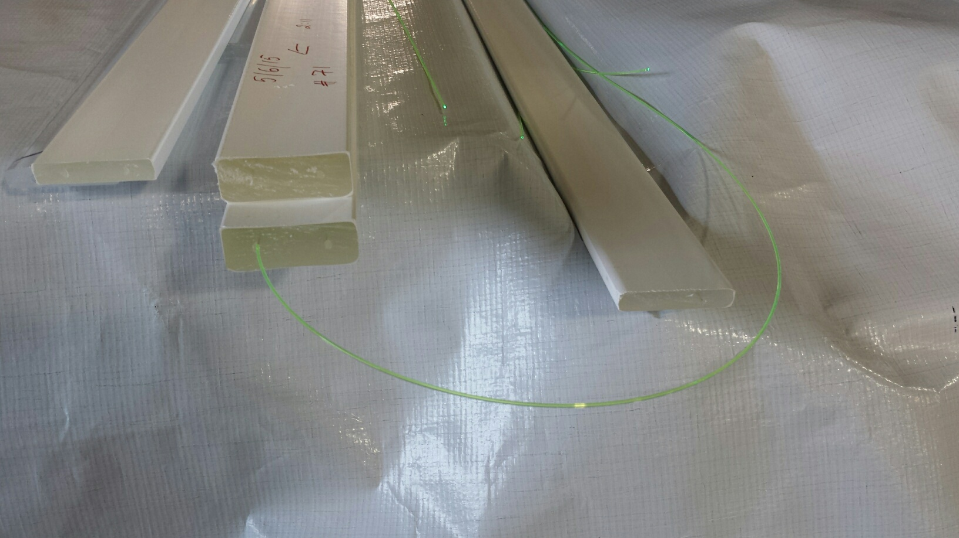
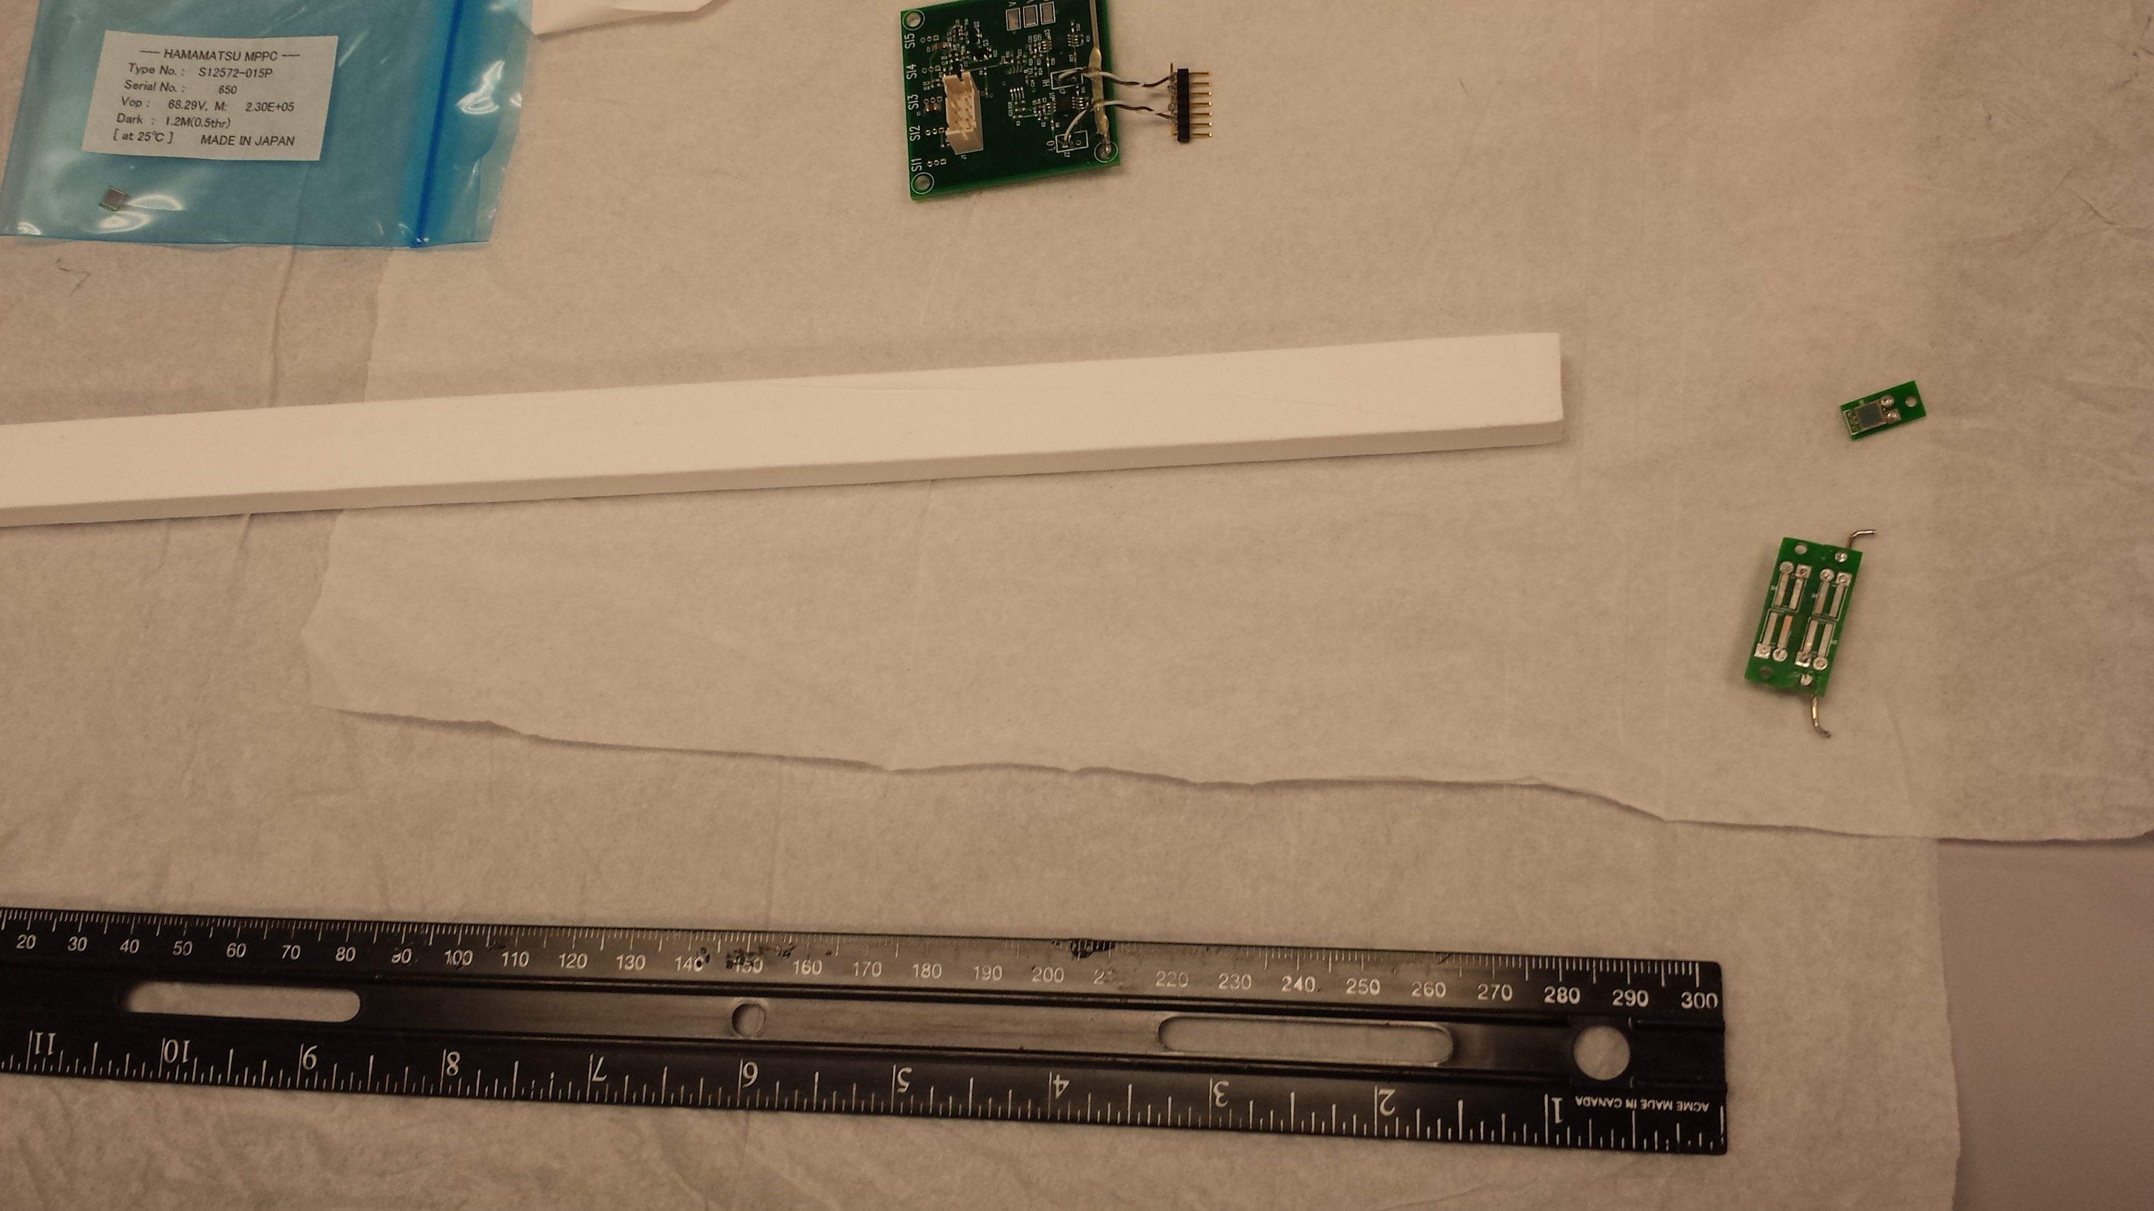
Fermilab Extruded Scintillators
Work in progress trigger upgrade
- Extruded scintillators + WLSF
SiPM readout
Low cost, large area

Slide 23
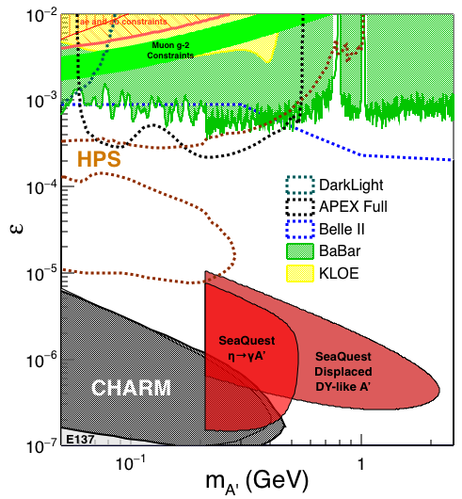
Search Mode (1): Long-lived Dark Photons
Reconstructed dimuons with downstream Z-vertex:
3m < Z-vertex < 6m
Very low trigger rate, << 1kHz
Almost SM background free
Dimuon mass peak
- 5x10¹² ppp ( current E906)
200 days
1.4 x 10¹⁸ POT (recorded)
4 events contours (2-sigma)
2-sigma (95%) exclusion plots
Excellent coverage of uncharted region!

Slide 24


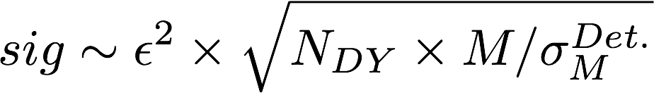
Search Mode (2): “Prompt” Dark Photons vs Drell-Yan
Z-vertx < 3m
Expected Drell-Yan like signal and backgrounds:
Excluded phi
resonance region
Dark photon
signal
Drell-Yan Background
Work in progress …

Slide 25
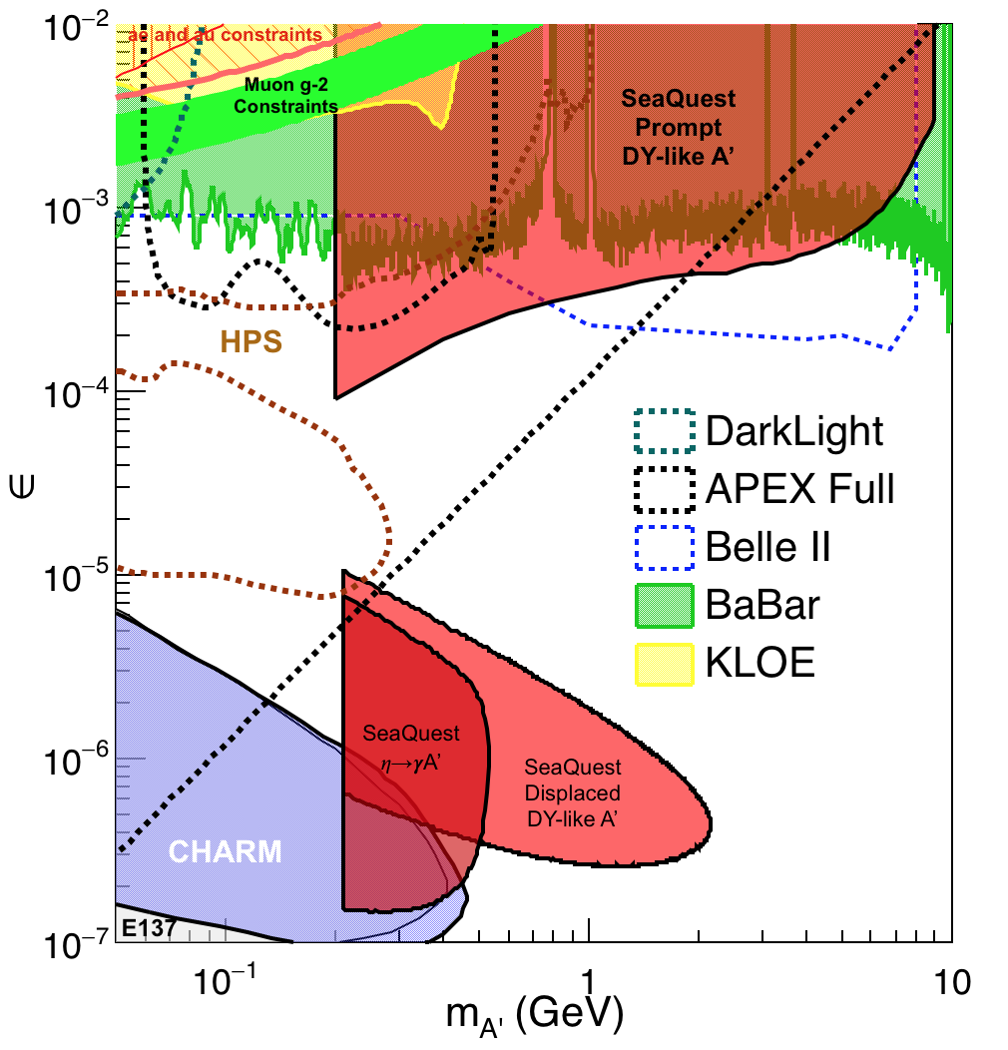
Summary: Dark Photon Sensitivity
(parasitic run w/ E1039)
Signals considered:
Drell-Yan like
Eta decays
Bremsstralung
Covers a wide range of unexplored parameter phase space
Displaced dimuons
- Minimal SM background
Prompt dimuons
- Excellent coverage over BELLE-II
projection
- Possible dedicated runs later to fully
restore mass < 3GeV (Phase-II)
Phase-II with upgrades
Access below 200MeV with di-electrons
( add EMCal)
Work in progress!

Slide 26
Dark Higgs Search at E-1067
Y. Zhang et al, arXiv:1502.06983
θ = μ v/m_{h}²
arXiv:1312.4992
e⁺e⁻
Phase-I:
High-mass: μ⁺μ⁻ and hadrons
Advantage of using hadron beams
with muon probes over electrons
Phase-II:
Low-mass: e⁺e⁻, <200MeV possible
High-mass: hadrons, (5x)
μ⁺μ⁻

Slide 27
E-1067 Dark Higgs Sensitivity
POT:1.4x10¹⁸ (Phase-I)
Y. Zhang (2015)
Dimuons with downstream displaced decay vertices
Limited sensitivity to “prompt” large mixing case due to small cross-section
Dark Higgs or dark photons?
  Dimuon kinematic and angular distributions
Phase-II
  Dedicated high luminosity runs optimized for low mass acceptance, mass<3GeV
1x
5x
25x

Slide 28
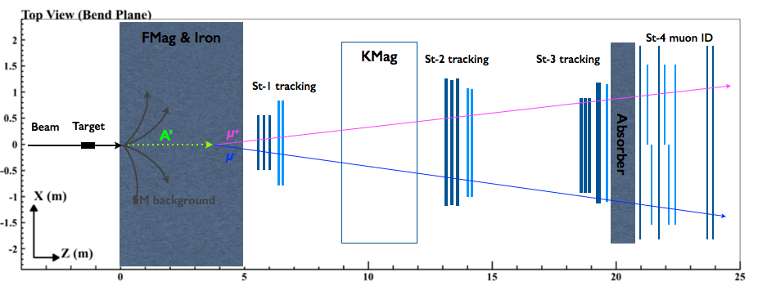
E1067/SeaQuest Upgrade Plan(2020+)
Fine-pitched vertex trigger
Efficiently trigger on the dilepton pairs generated from downstream while suppressing the background rate
Significantly enlarge the fiducial region from ~2m to ~6m
Supported by LANL LDRD
EMCal/HCal
Add e^{+/-} and 𝜋^{+/-} capabilities to SeaQuest spectrometer
Extend the physics reach to A’ from 𝜋⁰ decay, dark 𝝆, and hadronic decay mode for heavier A’
Re-commission the existing detectors (EMCal from PHENIX being considered)
Modest upgrades with significantly increased physics reach.
Data taking expected to start in summer 2017!

Slide 29
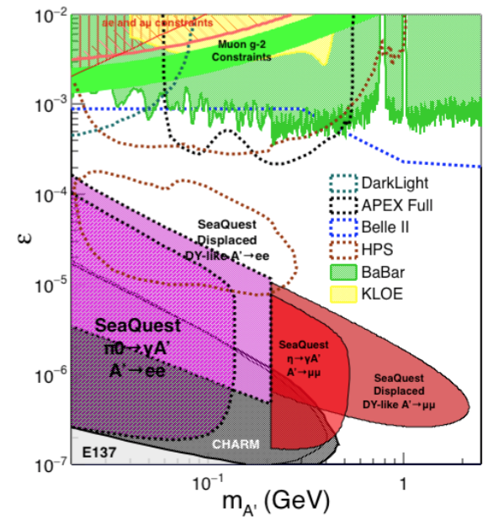
Phase-II: Displaced Dark Photons with future detector “EMCal/HCal” upgrades
Projection: POT 1.4 x 10¹⁸
Detector upgrades
  EMCal: e^{+/-}
  HCal: π^{+/-}
  Recycle from other experiments, PHENIX/RHIC etc.
DAQ upgrade
  100+ kHz
Timeline of dedicated runs
  2020+
Detector configuration
  Access low mass region with optimized Fmag settting

Slide 30
Phase-II: Probe Non Abelian Dark Sector with future detector “HCal” upgrades
non-Abelian dark sector process
S. Gardner and R. Holt
[Note: Batell, Pospelov, and Ritz, PRD 80 (2009) 095024 for a review re fixed target expts.]
Here we consider a non-Abelian (gluon) portal
[Baumgart et al., JHEP 0904, 014 (2009); Gardner and He, PRD 87 (2013) 116012]
The “shining through walls” design – unique to Seaquest – makes this possible ,
to yield, e.g., via a “minimal” decay….

Slide 31
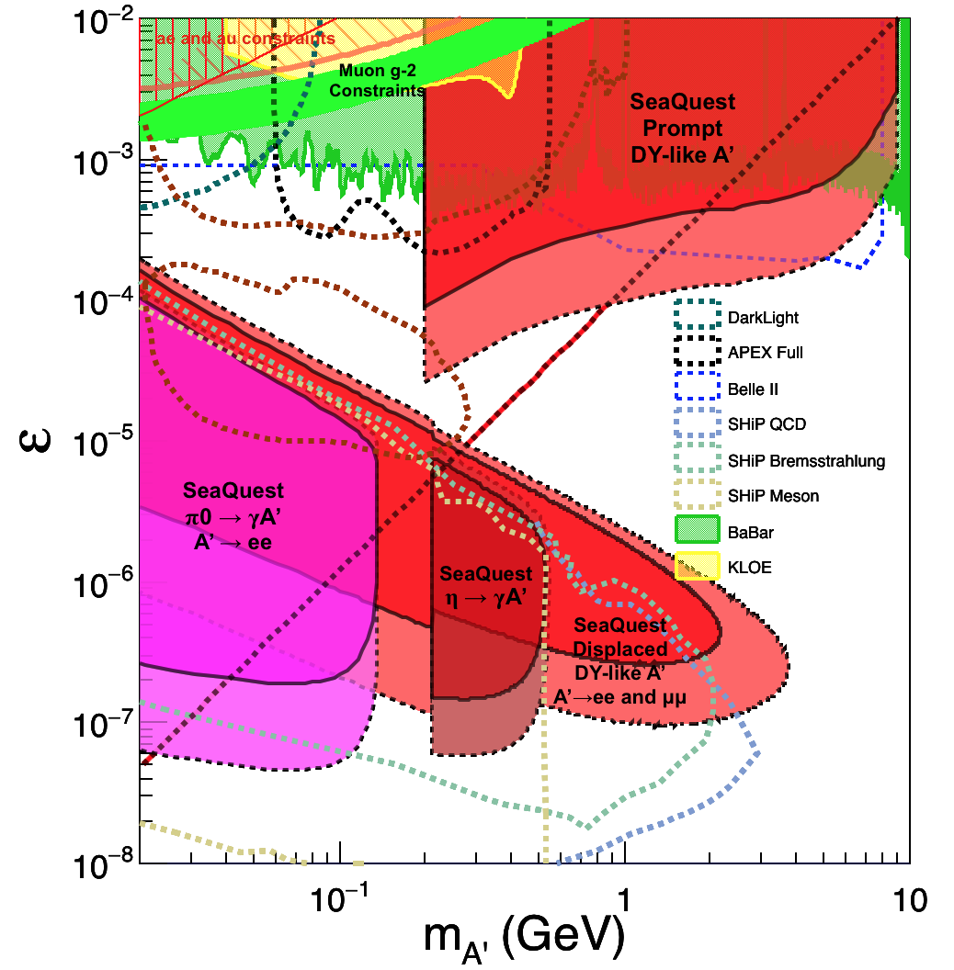
Comparison with SHiP Proposal
120 GeV@FNAL: 2017 -2019
1.4x10¹⁸ POT or more, future dedicated runs
400 GeV@SPS: 2025 -2030
4x10²⁰ POT

Slide 32
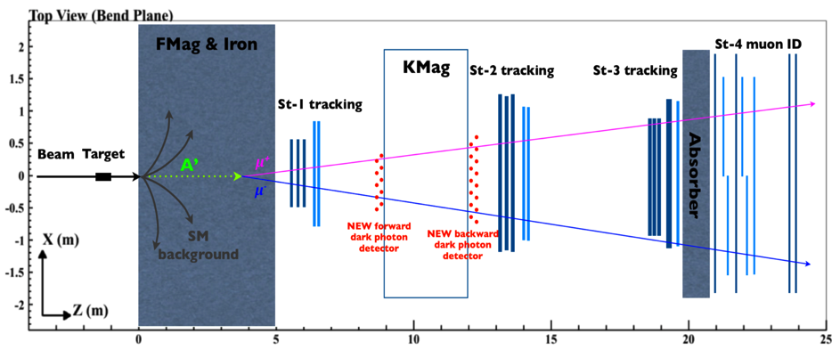
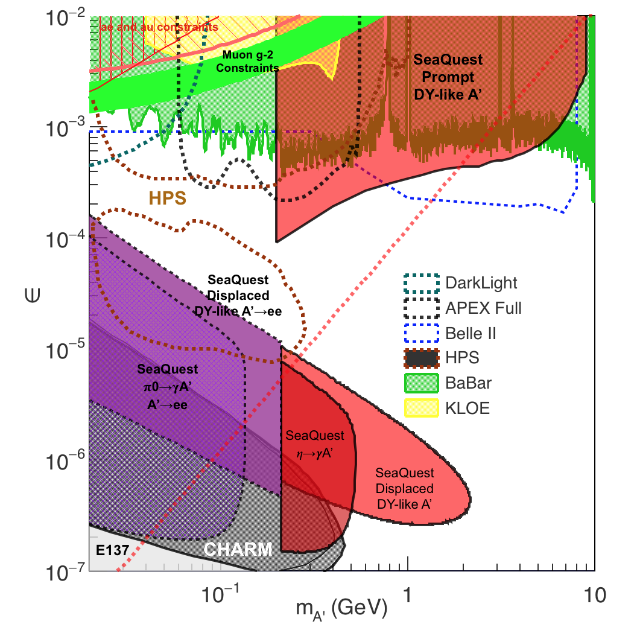
Summary and Outlook
Phase-I
  Great discovery potential!
  Add a new displayed vertex trigger
  Early parasitic data taking 2017-2019+
    A short dedicated run up to ~1 month if needed
  POT 1.4 x10¹⁸ or more
Phase-II
  Possible detector upgrade later, add electrons and hadrons
  A new dedicated dark matter program at Intensity Frontier!
Dark Higgs
search
Preparation Phase-I (parasitic runs)
Phase-II
2015
2016
2017
2018
2019
2020+

Slide 33
backup

Slide 34
Many good discussions with
K. Liu, Z.-B. Kang, S. Gori, N. Toro, R. Holt, J-C. Peng, Y. Zhang, P. McGaughey, Y. Zhong, P. Reimer, C. Brown, R. van der Water, P. Schuster, R. Essig, S. Gardner et al and the new/growing E-1067 Collaboration at Fermilab

Slide 35
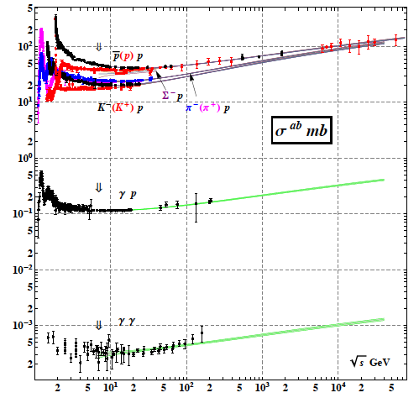
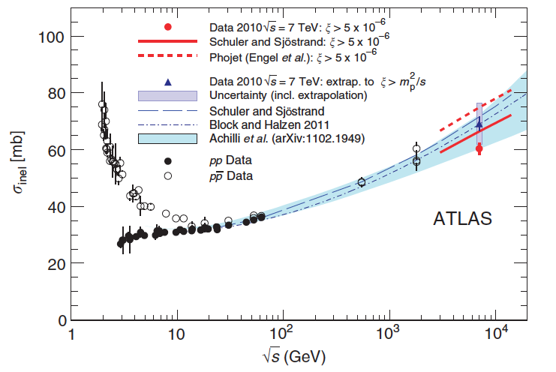
Inelastic Cross Section: pp
@SeaQuest sqrt(s) = 15GeV
Sig_tot = 40mb
Sig_inel = 30mb
Total_cross section

Slide 36
A New High-Granularity Displayed Dimuon Vertex Trigger
High rejection power, very low rate, << 1 kHz(E906 DAQ limit)
Y-Plane Trigger:
A quadrant panel: 50cm x 50cm, 1cm thick
  1cm x 1cm x 50 cm scintillating strips, SiPM readout
- Straight line projection, 30cm Z-vertex resolution
- Displaced z-vertex, mostly low mass < 3GeV
Coincident with St-4 Hodos(muons)
Quadrant-based triggers: 4 x V1495
Y-channels per quadrant:
1x V1495
50(St1) + 50(St2) + 8x2 (St4-Y1,2) = 116
96+64 = 160 possible
  72+72+16 = 160 (possible)
  (2NIM=RFCLK+ComSTOP )
St1
St2
Z
Coincident Z-vtx
window matched@L2
E906 Run2
J/Psi
Psi’
Drell-Yan
Rndm
E906 Run2
Dimuon Z-vertex (cm)

Slide 37
Displaced Dark Photon Trigger
DAQ/Data stream
LVDS cable 2x16ch bundle available
Q1 (LVL1)
DAQ Trigger
LVL2
(vtxZ matching)
Q2 (LVL1)
TS
(12 inputs total)
(1-free bit available)
Q3 (LVL1)
DP Trigger
1-bit
Q4 (LVL1)
4 x 16-bit from 4 Q1-4/V1495
(2 x 32LVDS cables)
Y
X
Q1: 50(ST1’) + 50 (ST2’) + 2x8(ST4-Y1/2) = 116, FANOUT ST4
Up to 72(ST1) + 72 (ST2) + 2x8(ST4Y1/2) = 160

Slide 38
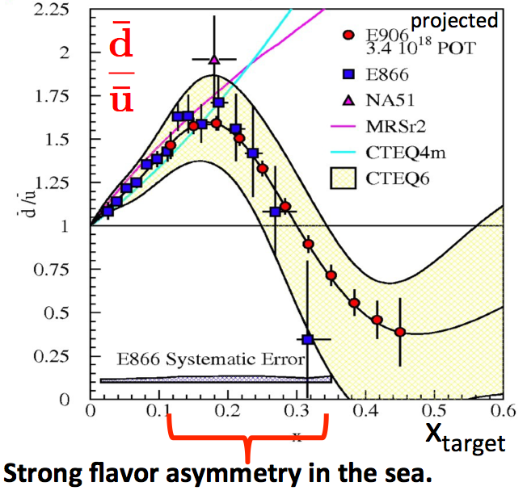
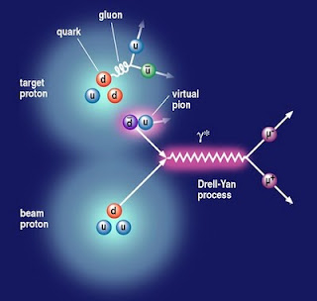

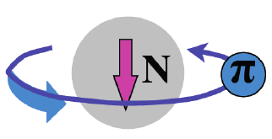
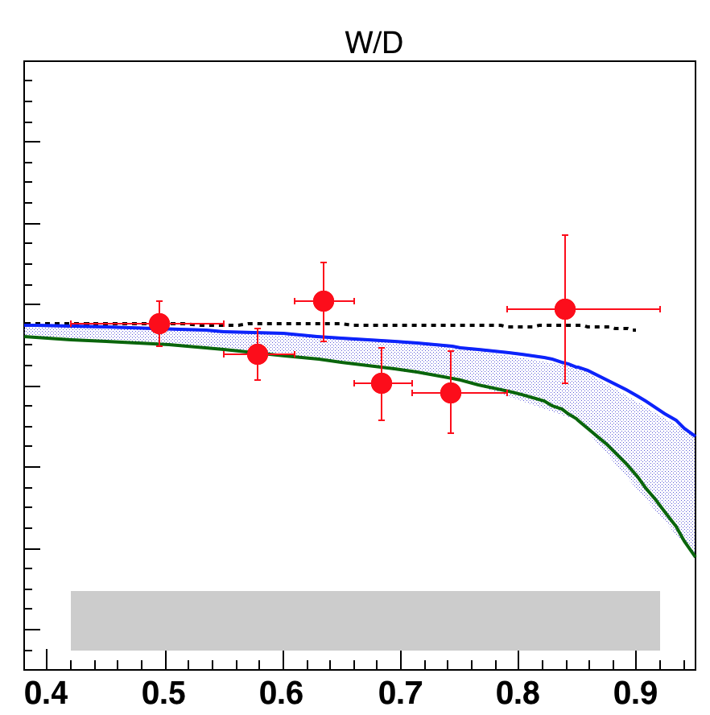

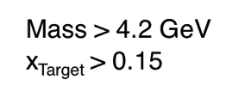
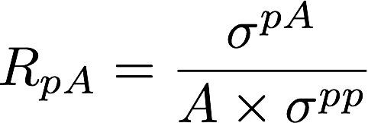
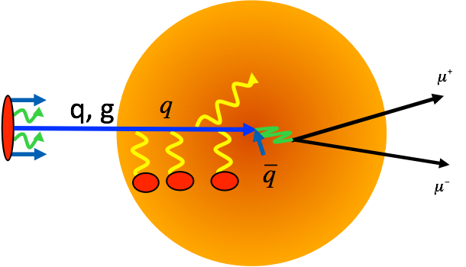

E906 Physics Programs: 2009-2016
Sea quark flavor asymmetry p+p
  Pion cloud model
Quark energy loss in p+A
π⁺

Slide 39

E1039 Physics Program: 2017-2019
Polarized Fixed Target Drell-Yan Experiment
Sea quark flavor asymmetry and OAM
  Pion cloud and OAM
  Non-zero Drell-Yan Sivers Transverse Spin Asymmetry
LANL polarized proton (NH₃) target

