Slide 1
Silicon Photomultiplier Pixels in Vacuum and Cryogenic Conditions
Steve Kerby
3 August 2015

Slide 2
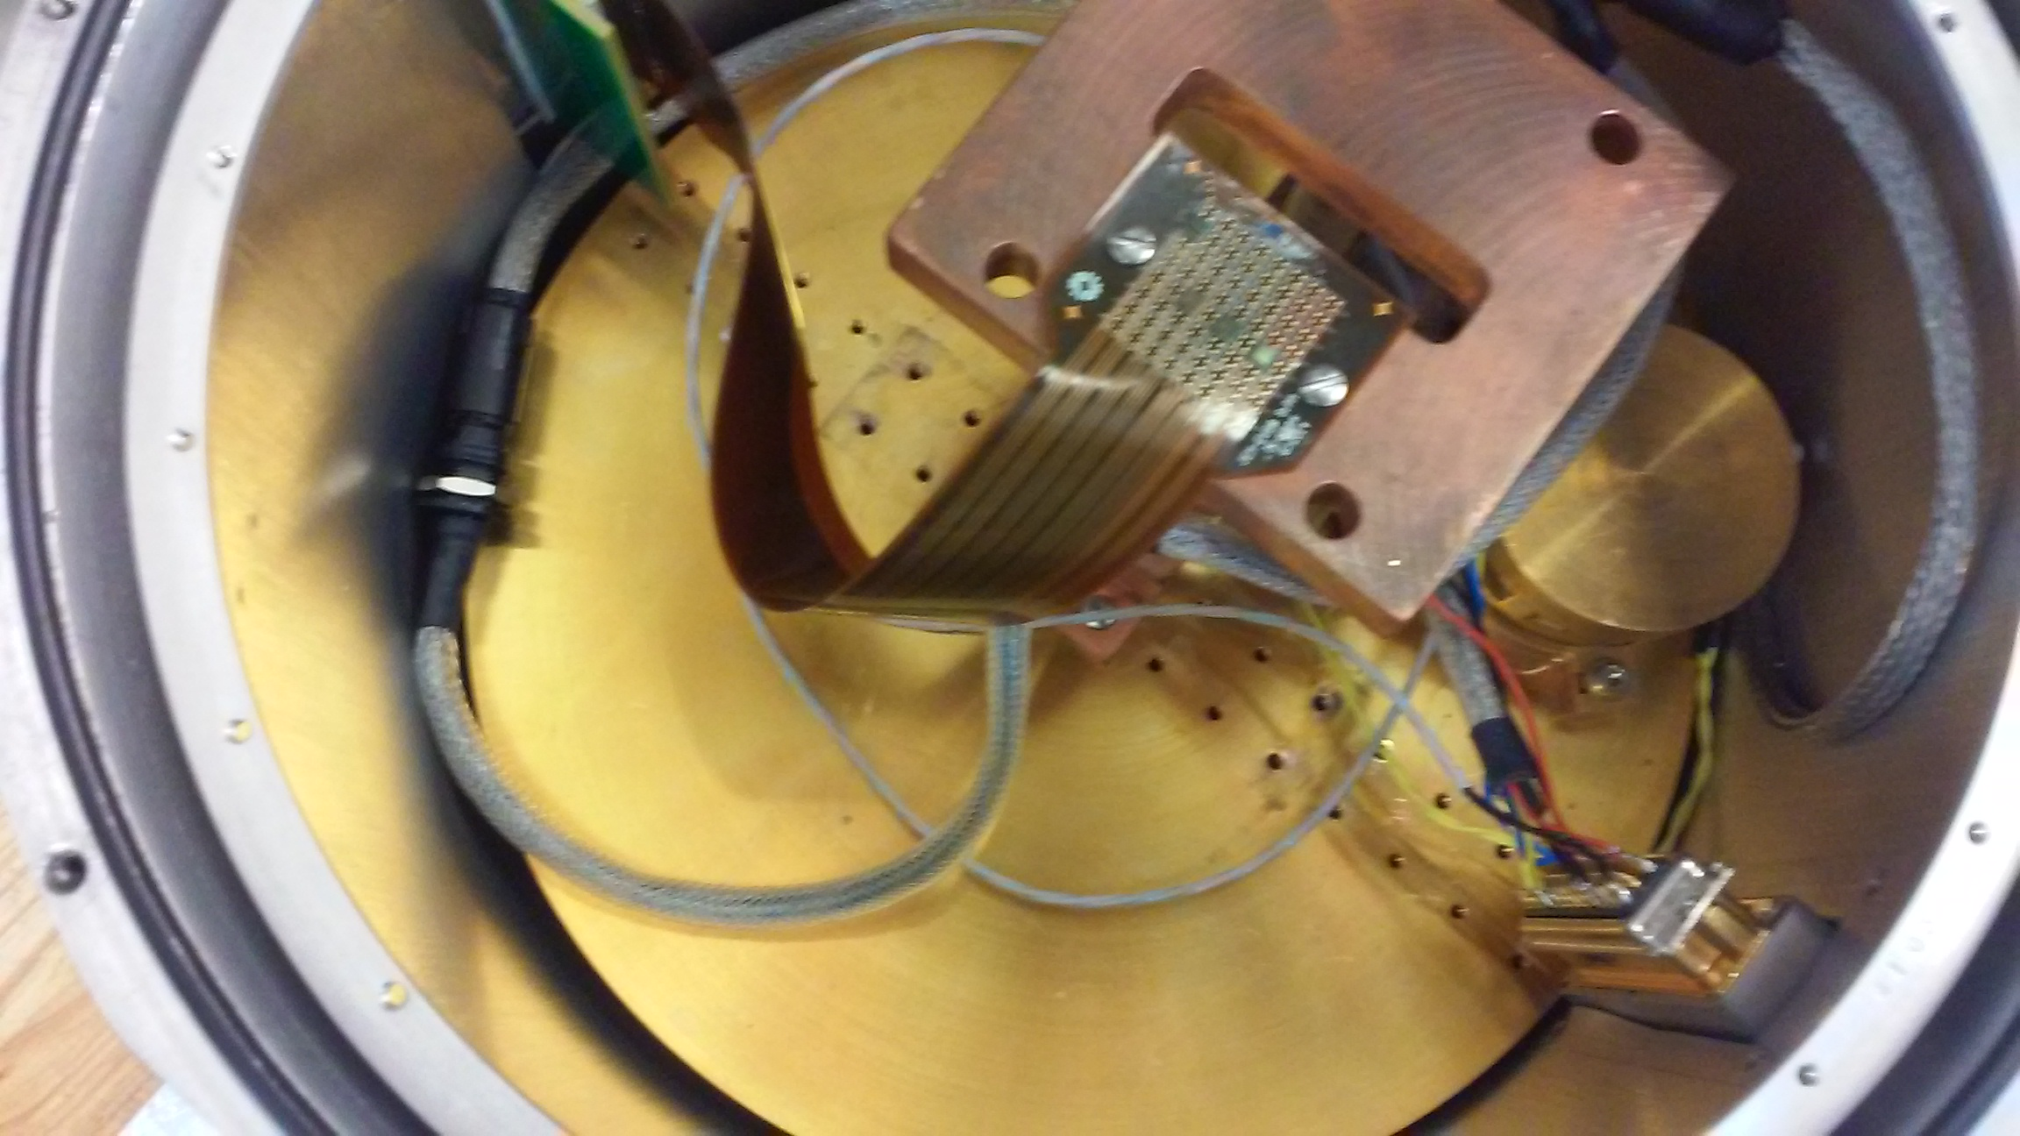
Contents
Bulb Photomultipliers vs SiPM pixels
Silicon Photomultiplier Pixels: Behavior and Characteristics
Experimental and Analysis Setup
Initial Results
Dark Current, Signal Size, Wavelength Response v Temperature
Conclusions and next steps

Slide 3
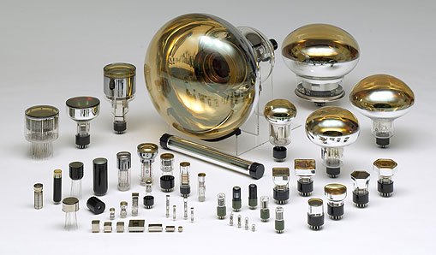
Bulb Photomultipliers
  Bulky
  Delicate
  1000+ V
  Damaged by large light leaks
Super-Kamiokande Accident (Nov 2001)
Hamamatsu

Slide 4
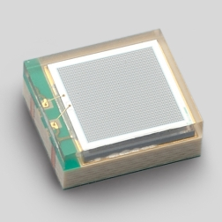
Silicon Photomultiplier Pixels (SiPMs)
Compact
  3 x 3 mm
Resilient
  Survives light overflow
Low voltage
  ≈70 V operating level
Useful for arrays
Hamamatsu

Slide 5
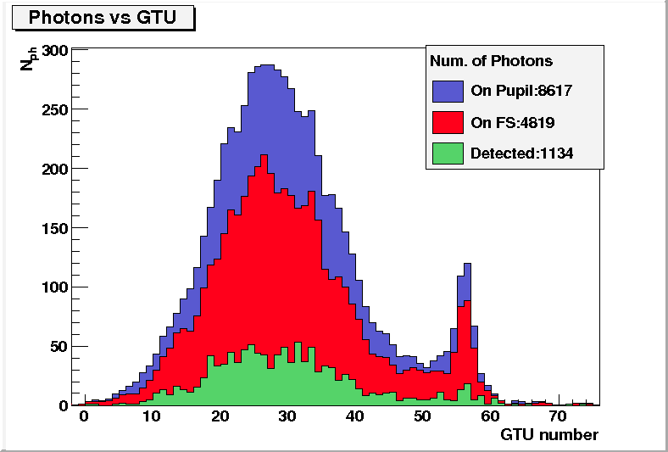
JEM-EUSO applications
Space-to-ground UHECP observation
Decreased background, increased efficiency, small pixel size
400 kHz dark current target

Slide 6
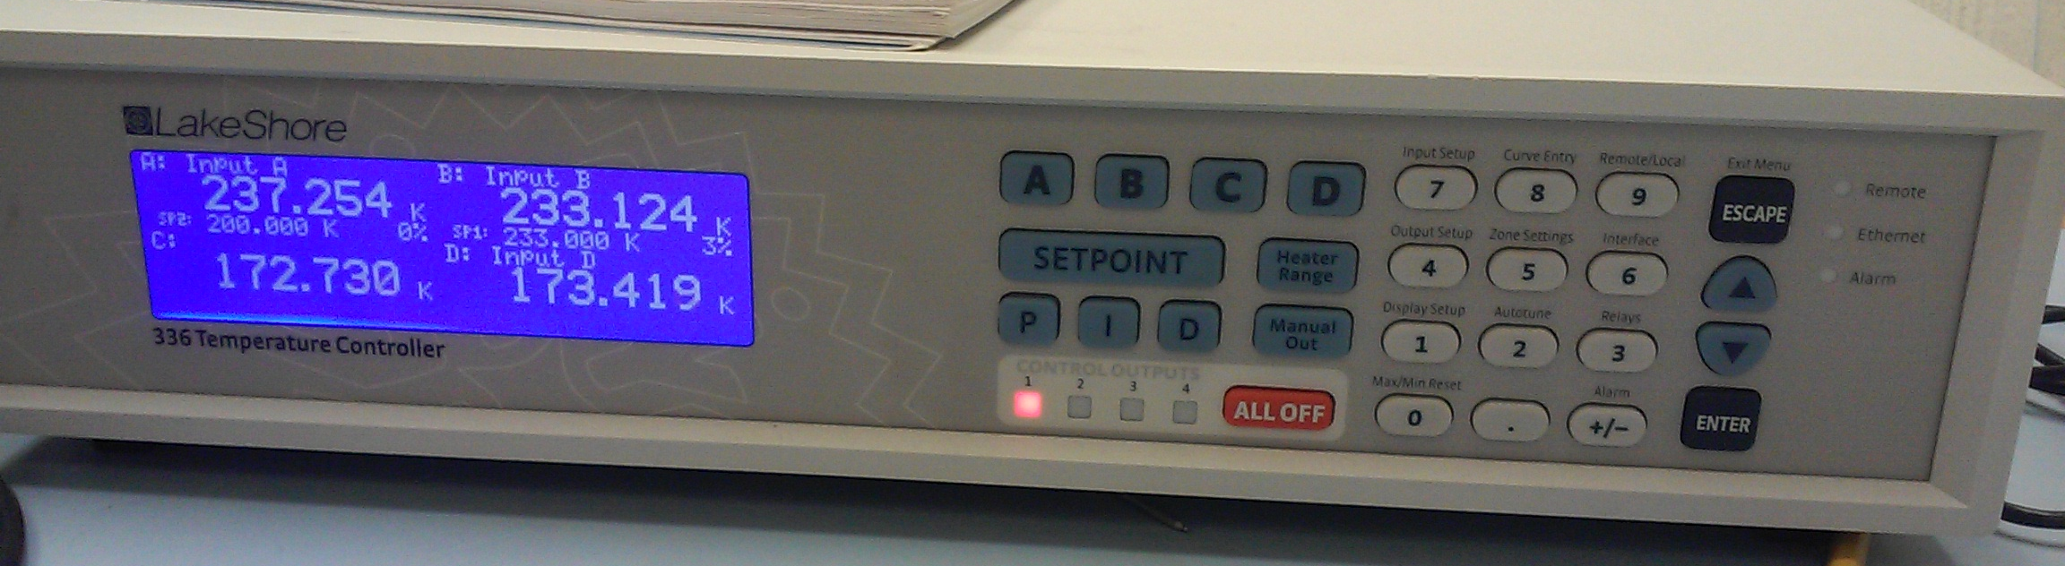
SiPMs: Goals
Behavior in vacuum, at lower temperatures?
  Survival? Response?
  Dark Current Rate
  Signal Rate
  Wavelength Response
  Voltage Range Response
Usefulness of low temperature operation?
Useful for imaging array?

Slide 7
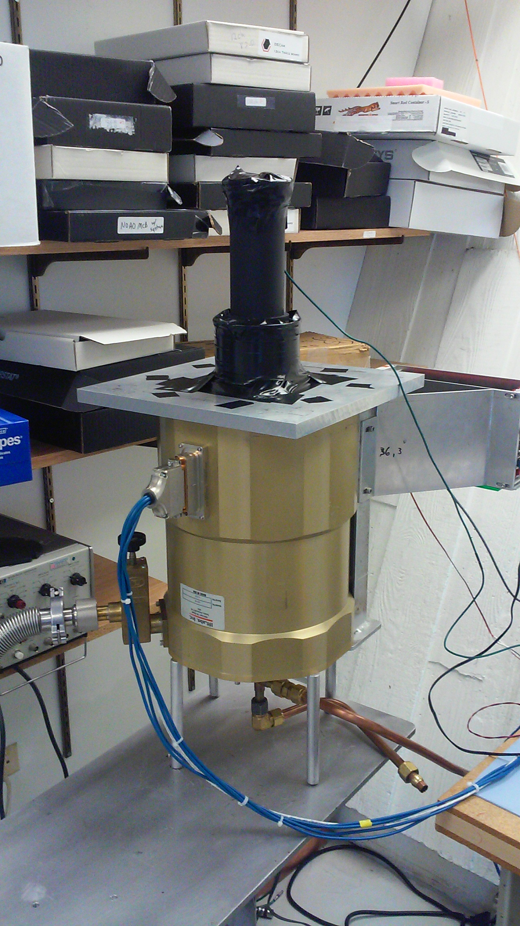
SiPMs: Baseline Knowledge
Behavior at room temperature (≈20°C) well documented
Wavelength response provided by Hamamatsu, verified
Rated for use from 0° to 40°C

Slide 8
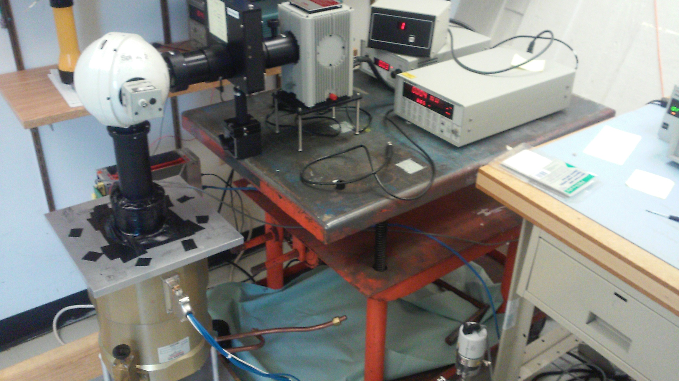
Experimental Setup
Wavelength Selector
Light Source
Light Output Regulator
Sapphire Lens
Vacuum tube with SiPM array, 5x10⁻⁵ millibar, LN2 cooled

Slide 9
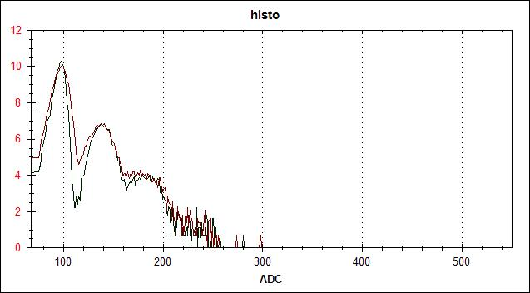
Anatomy of a Scan: Analyzing the location and size of Photoelectron (PE) peaks
Gain
0PE
1PE
Logarithmic scale (ln(counts))
2PE
etc.

Slide 10
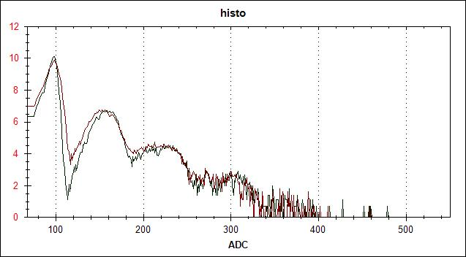
Signal Rate Measurements
Rate: (Number of counts above threshold) * 333 Hz (Frequency of data collection software)
Signal Rate includes counts above 0.5PE

Slide 11
Usable Voltages across SiPMs
Between Breakdown Voltage and Saturation Voltage
Lower range of voltages at lower temperatures
~4 V range at 20°C, 2 V range at -60°C
Different signal rates due to improved light source setup at low temperatures, shift in range of voltages independent of light source setup

Slide 12
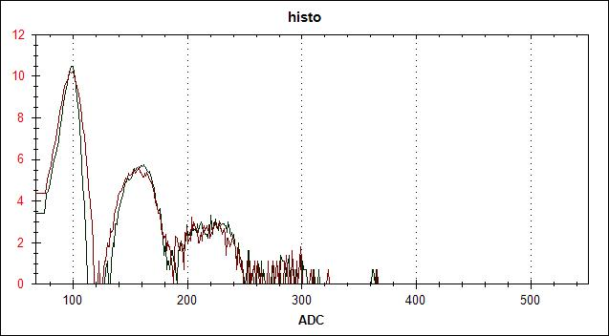
Room Temperature Behavior, 22°C
Vacuum conditions have no effects (fortunately)
Dark Count Rate ~ 1600 kHz
1+ PE peaks despite no light source
Noticeable 1+ PE rate with LED (1600 kHz => 2800 kHz)
Light Source Off
Light Source On
Logarithmic scale

Slide 13
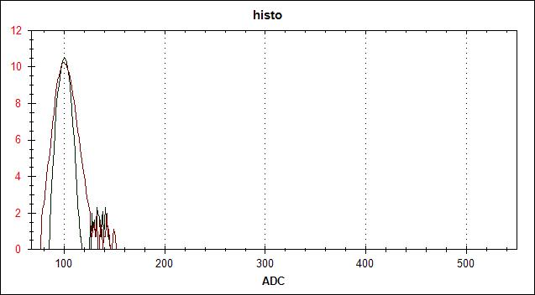
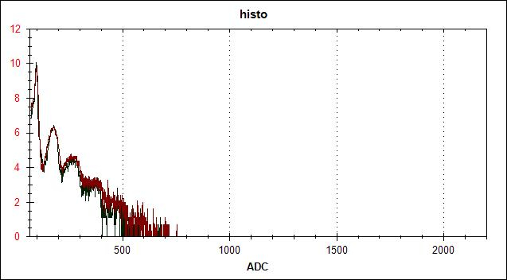
Cooled Behavior, -20°C
Dark Count Rate ~ 35 kHz
Visible addition of 1, 2, 3 PE peaks
Significant rate difference, 35 kHz => 7000 kHz*
*Different light source setup from room temperature measurements leads to higher signal rate
Light Source Off
Light Source On
Logarithmic scale
Note: Different ADC scales

Slide 14
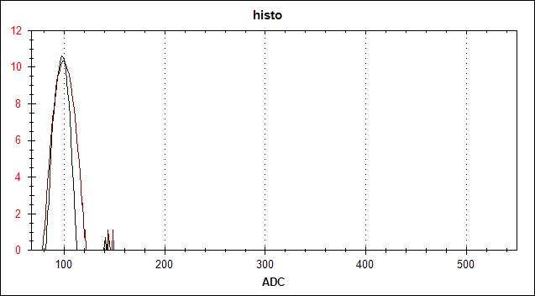
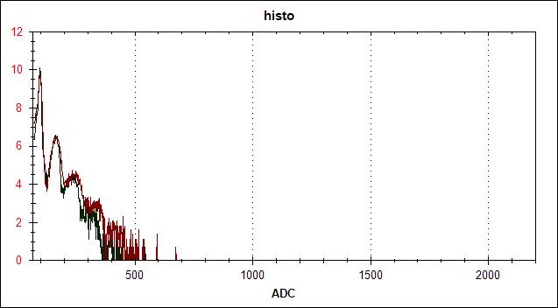
Cooled Behavior, -60°C
Dark Count/Signal Ratio more pronounced
Dark Count Rate ~ 6 kHz
6 kHz => 6000 kHz
Light Source Off
Light Source On
Logarithmic scale
Note: Different ADC scales

Slide 15
Dark Current vs. Temperature
20°C
Significant decreases in dark current
1600 kHz => 35 kHz => 7 kHz
-20°C
-60°C

Slide 16
Dark Counts vs. Temperature, Cont.
0.6V above breakdown voltage for each temperature
<400 kHz dark counts goal surpassed at 10°C
Slightly cooling SiPM pixels decreases Dark Counts significantly
400 kHz JEM-EUSO spec

Slide 17
Signal Rate vs. Temperature
Signal rate constant with decreasing temperature
Increased Signal/Noise ratio at lower temperatures
Decreasing temperature does not decrease signal receptivity
16000 kHz (In these conditions)

Slide 18
Wavelength Response v. Temperature
At -30°C, response spectrum resembles room temperature spectrum
Decreasing temperature does not change wavelength response spectrum

Slide 19
Conclusions
Room temperature behavior matches reported specs
Cooled behavior
  Significantly less dark current
  Consistent peak wavelength 400-500 nm
  Predictable, constant signal rate
  Extremely low temperatures not necessary

Slide 20
Conclusions, Cont.
  Relative ease of reducing dark current rate
  Consistency of wavelength response, signal rate
There are immediate benefits to SiPM operation at low temperatures
These benefits are accessible at only slightly cooled temperatures

Slide 21
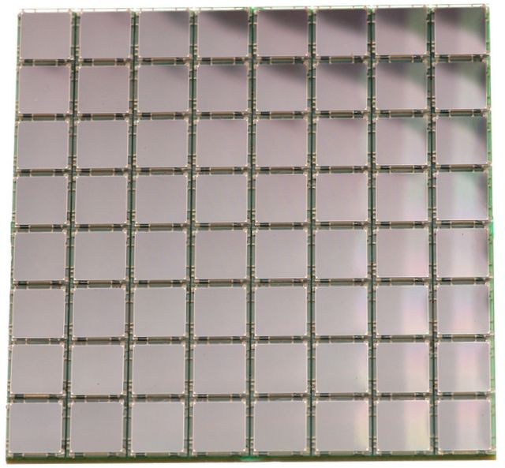
Next Steps: Imaging Array
Reducing dark current with cooling
Checking cross talk rates
Testing with precision light image sources
Precision software triggers and calculations
SenseL

Slide 22
Thanks for Listening!
Questions?
Special Thanks to Juan Estrada, Kevin Kuk, Lee Scott, Paul Rubinov
sekerby@fnal.gov or sek93@case.edu

