Slide 1
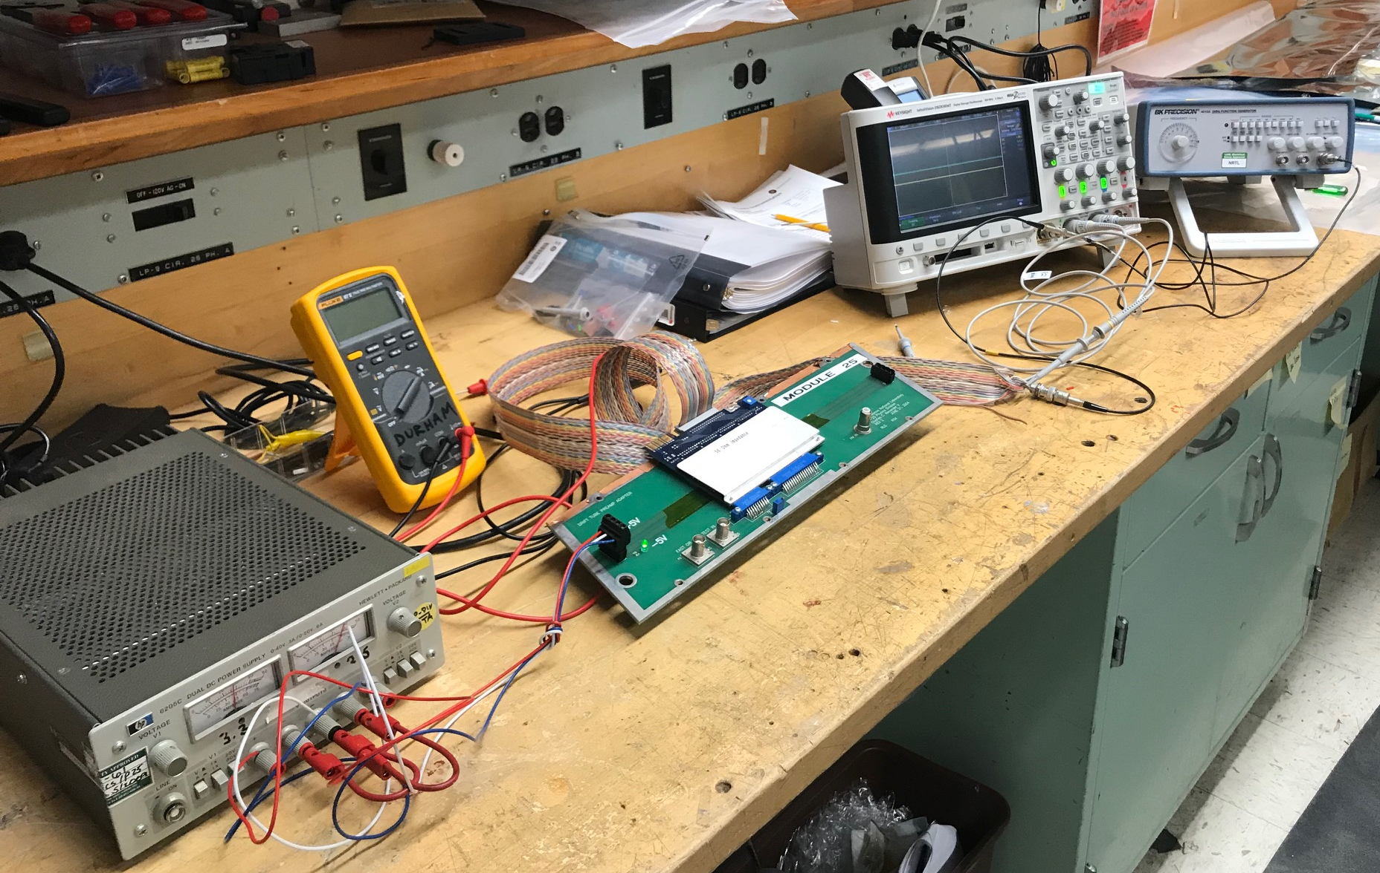
PropTube Electronics Testbench Setup@LANL 10/28/2019
External pulser
Scope
Pulser
Scope
16-ch OUT, ECL
+5V
PS
G
PreAmp
+/- 5V Power
PropTube Front Panel
with PreAmp Card
-5V
16-ch IN;
10~100 mV;
fast pulses, ~5nS;
1->16 fanout
Pulser

Slide 2
To Do’s
Adjust input pulsor amplitude
Get ECL-to-NIM module
Confirm the front-panel is Okey
Debug the pre-amp cards
….

