Slide 1
Dark Photon Updates
1/19/2017
Detector scintillator + WLSF assembly - Done
Fermilab safety document for detectors
  Work in progress, sample documents in hands, ~by the end of Jan
DAQ upgrade - done
  x10+ improvement, parasitical data taking with E906 possible
SiPM Readout
  Fermilab preamp cards test in B-field
    Pre-production 20 cards arrived, tested at LANL
    OK in high field, -10% loss in gain observed, no impact on rising time
Trigger firmware and lookup table
  V1495 I/O tested, using MC to develop lookup table
  Full trigger firmware under development, to be ready by ~mid Feb.
Progress in theory
  Cross check calculations, plan a joint paper
Project is on track
  New trigger system installed at Fermilab in March
Future E906 and SeaQuest schedule
  Lost ~2 weeks of beam time due to accelerator issues, restarted yesterday
  Likely to extend current run or more beam in the remaining run this year
  Updated propose to Fermilab PAC for dedicated dark photon search runs beyond E906, in case Pol Drell-Yan not funded in time

Slide 2
To-do and Plan
Preamp card production
  Release for the full production after testing at LANL, by this week
  Production completed by early Feb.
Safety document
  Engineering note for safety operation
  Draft by the end of Jan
Fully assembled detector shipped to Fermilab in mid Feb.
  Installation in early march
Work in progress at Fermilab
  CAMAC & LeCroy 4413 installation at Fermilab, spare CAMAC crates? (Kun)
  All hardware in hand and tested
  To be installed by the end of Jan
  Signal cables length and test (30’ tested, 50’? Need layout plan )
Standalone trigger crate and DAQ for commissioning at Fermilab in late Feb
  All hardware in hand at Fermilab/LANL, V1495 and VME crates, cables etc.
SeaQuest Collaboration meeting being planned for early March
  Future program and run plan
  In Santa Fe or Fermilab

Slide 3
backups

Slide 4
Excellent progress in the last a few weeks
Detector assembly, SiPM readout and calibration system
  Hubert, Alex, Sanghoon, Shaun, Pat et al
DAQ and Trigger firmware
  Kun, Sho and Andi et al
Dark photon project web page
https://p25ext.lanl.gov/darkphoton/

Slide 5
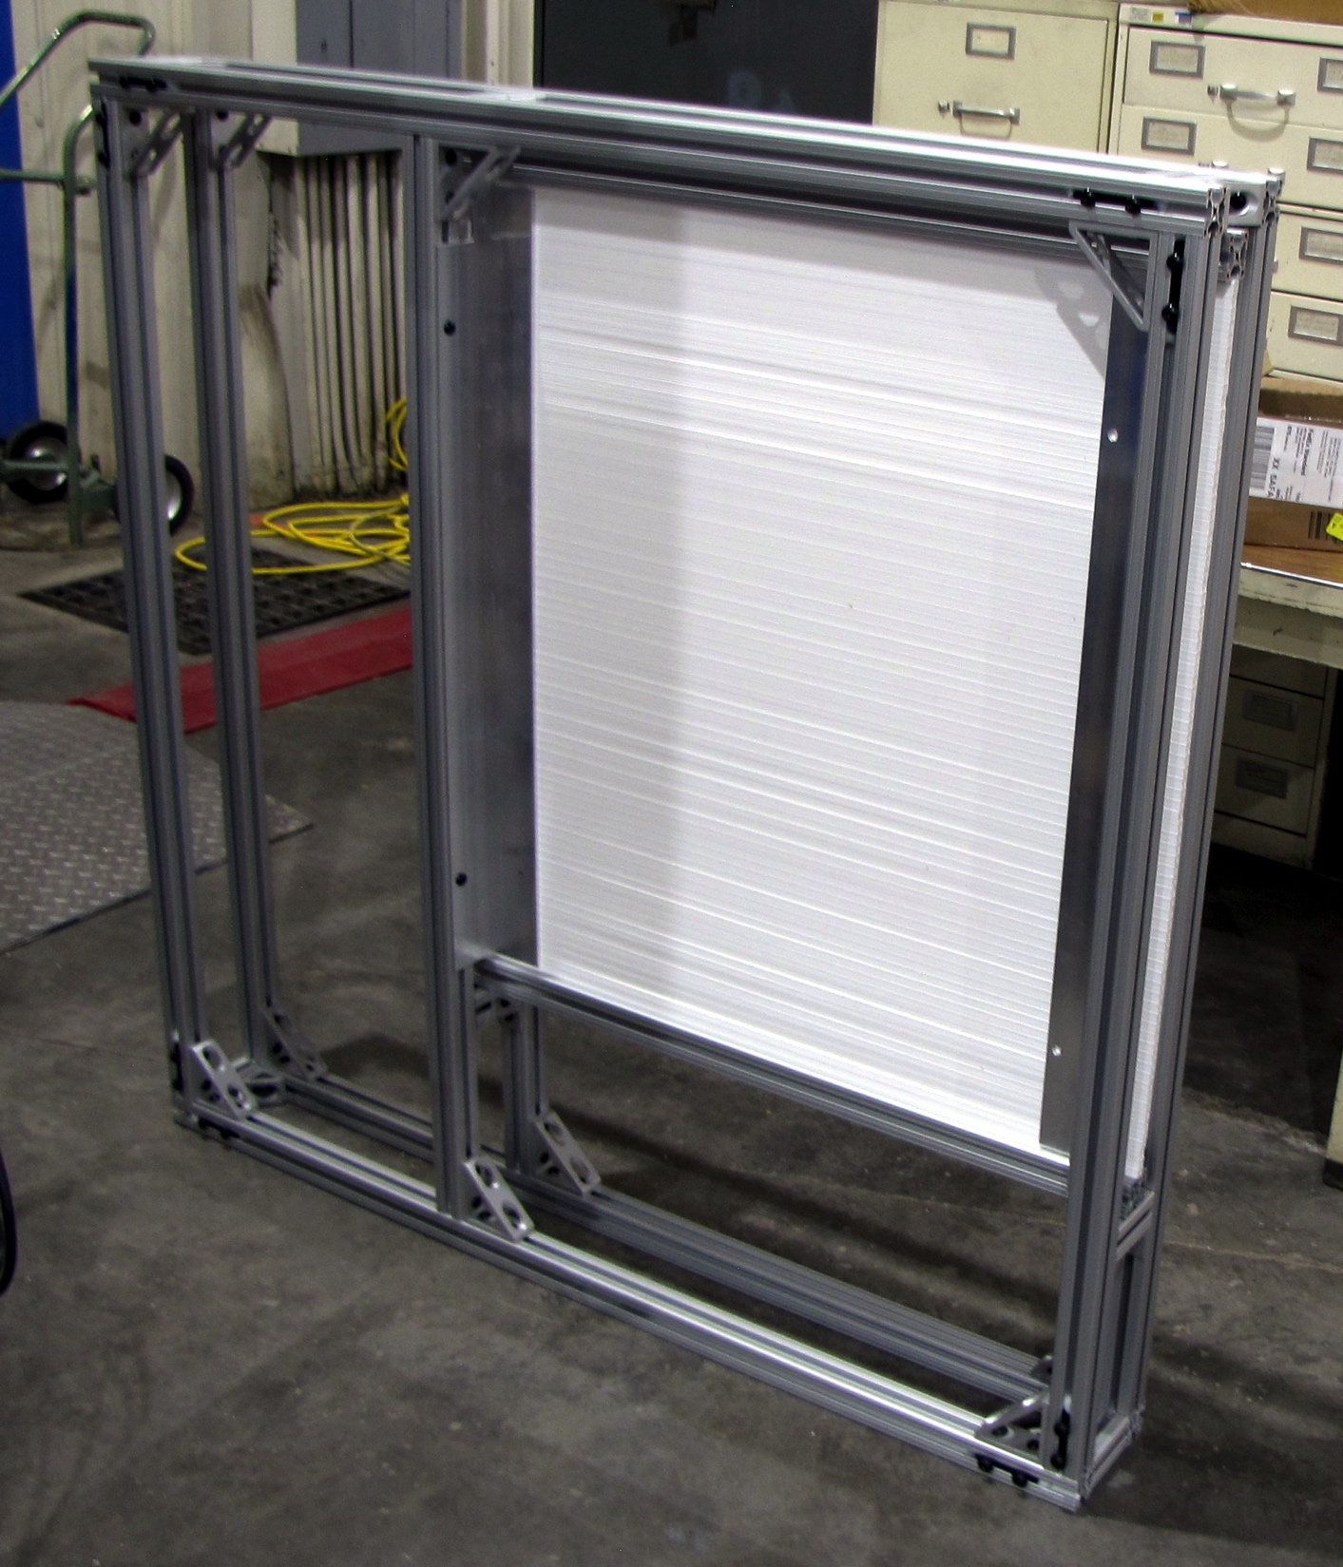
Trigger Detector Frames
4 frames for 1x1x80 cm bars
4 frames for 2x2x100 cm bars
Mostly finished
To be done:
Feedthroughs and/or patch panels for cables
Cooling air feedthroughs

Slide 6
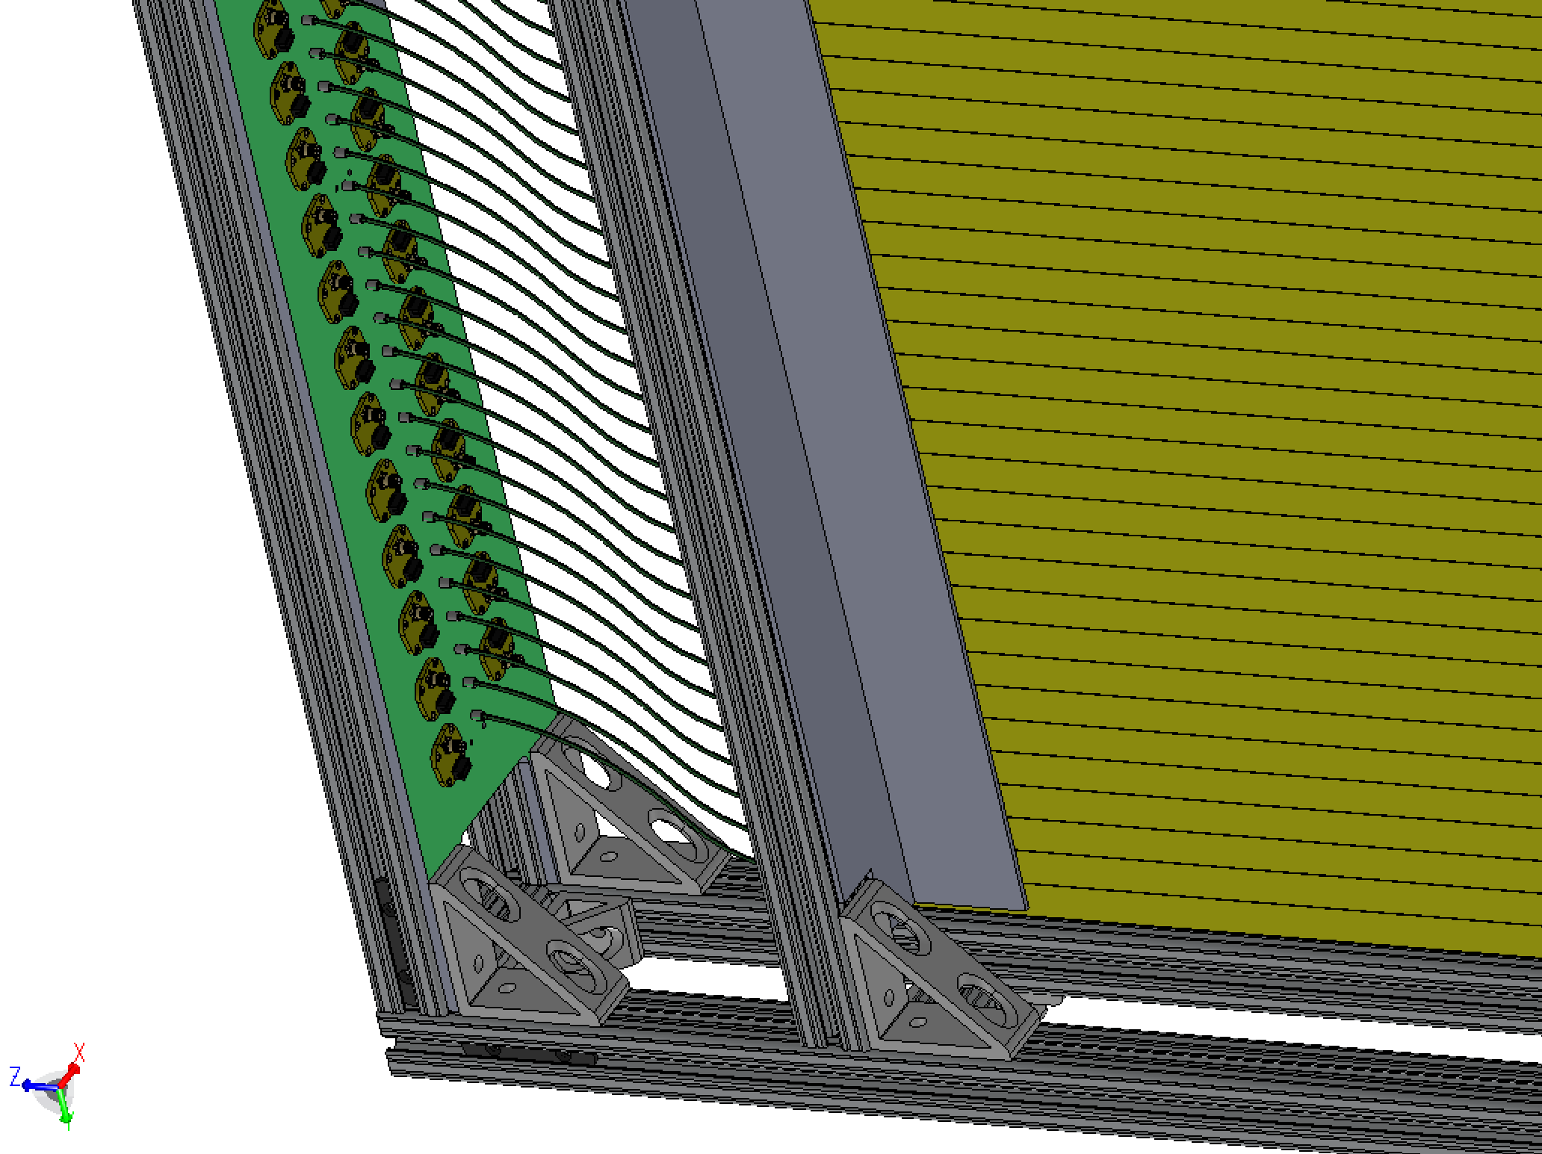
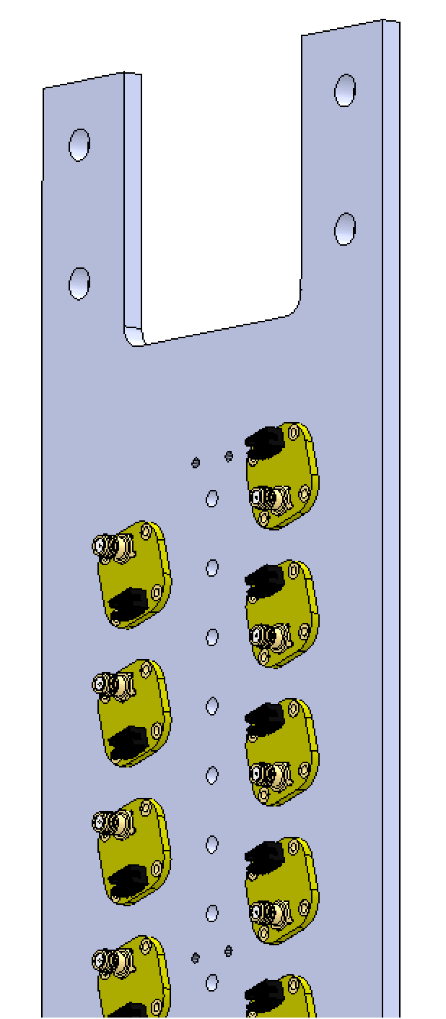
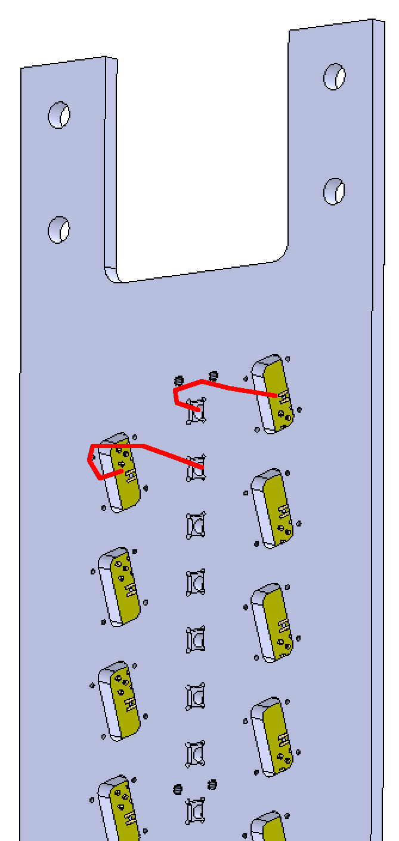
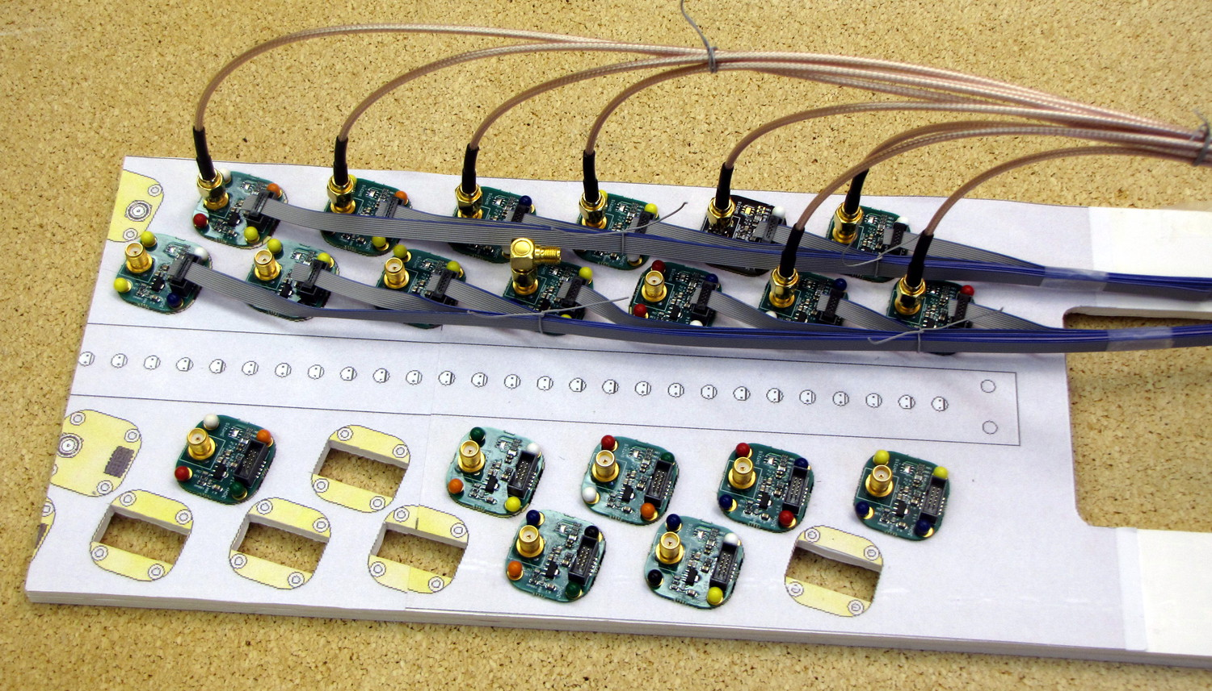
Readout plates
Fibers and preamps in the front
SiPMs connect with pigtails in the back
Fabrication bids are out; complete in ~2weeks
front
back
Full-scale mockup for cable routing and connector finger space

Slide 7
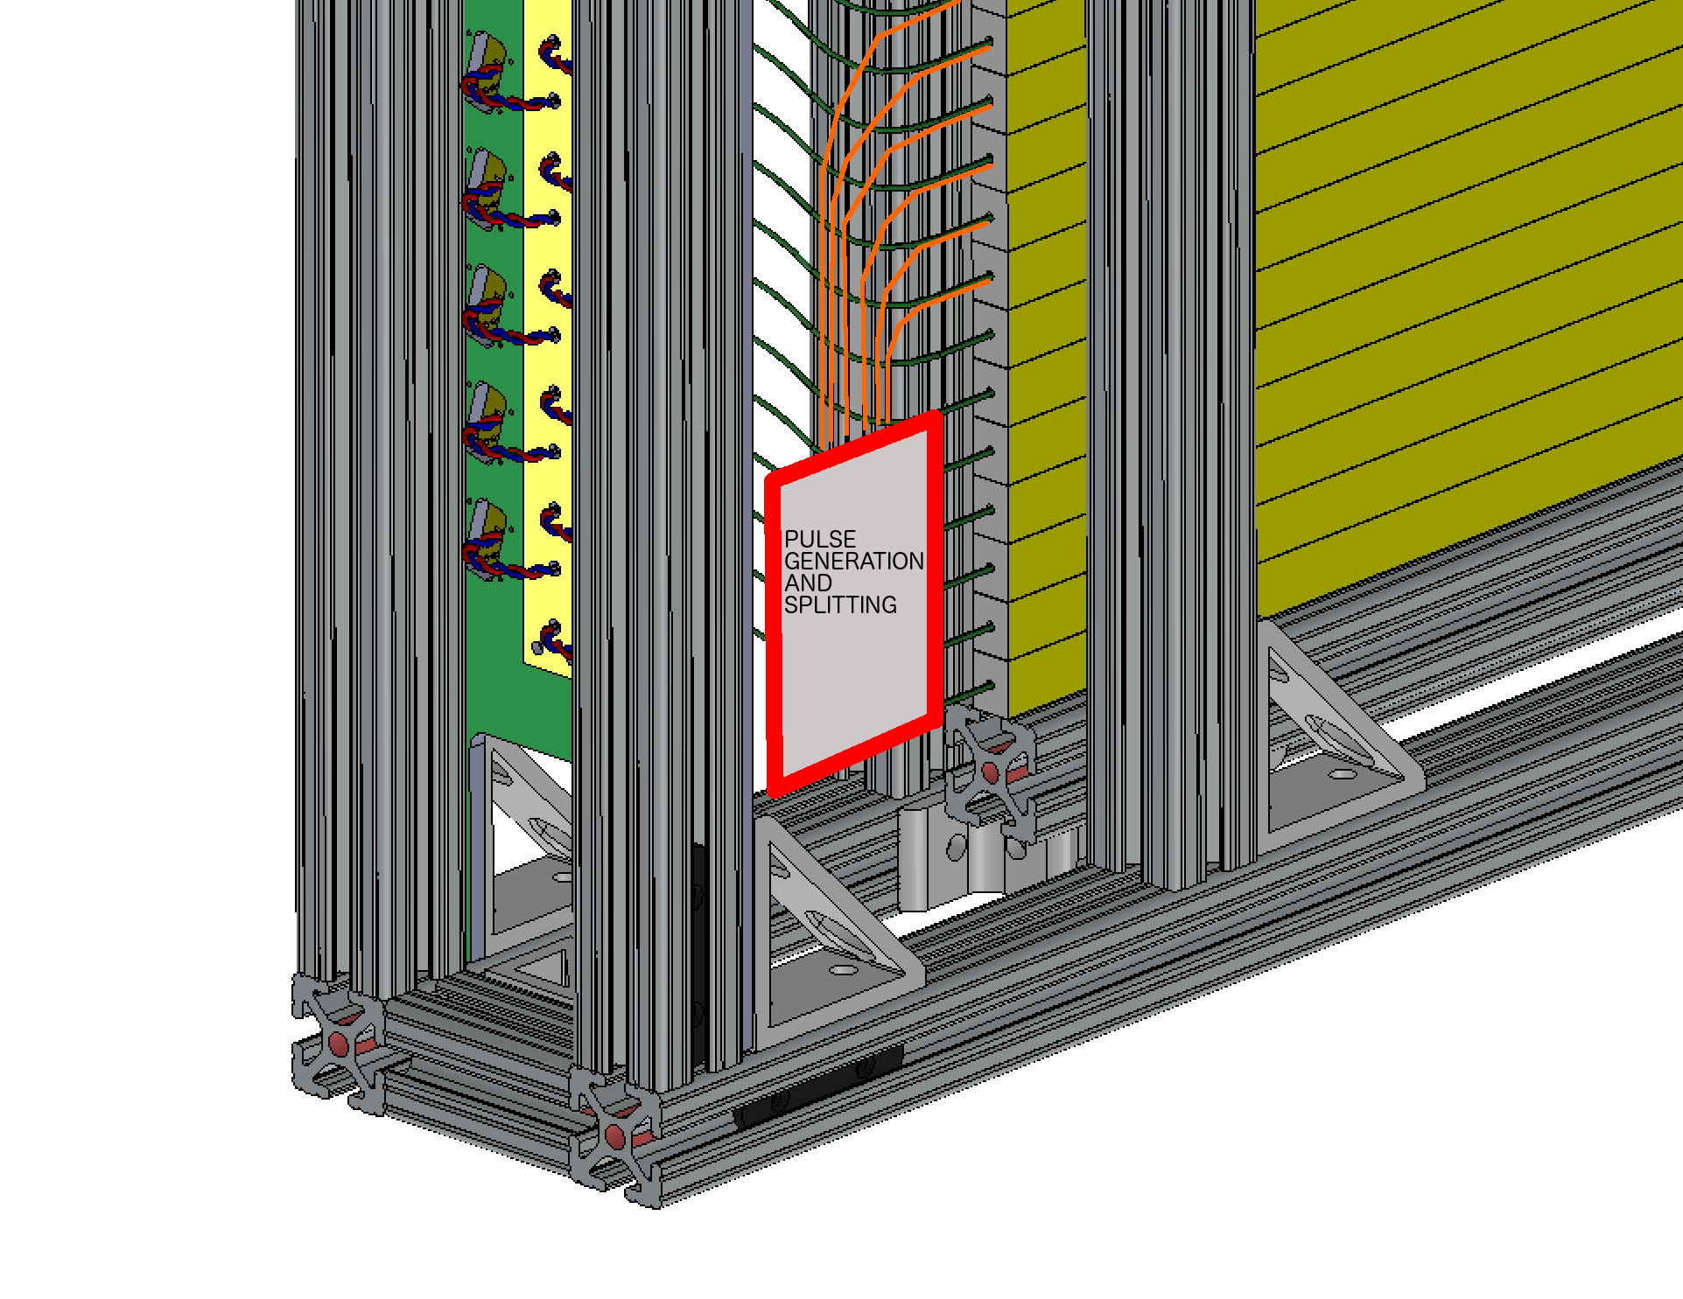
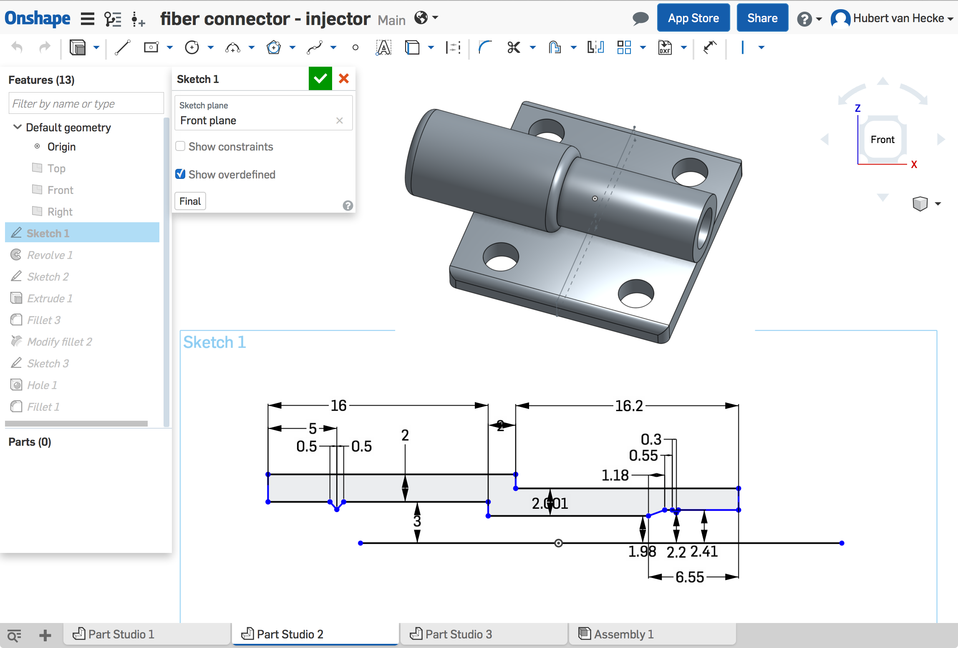
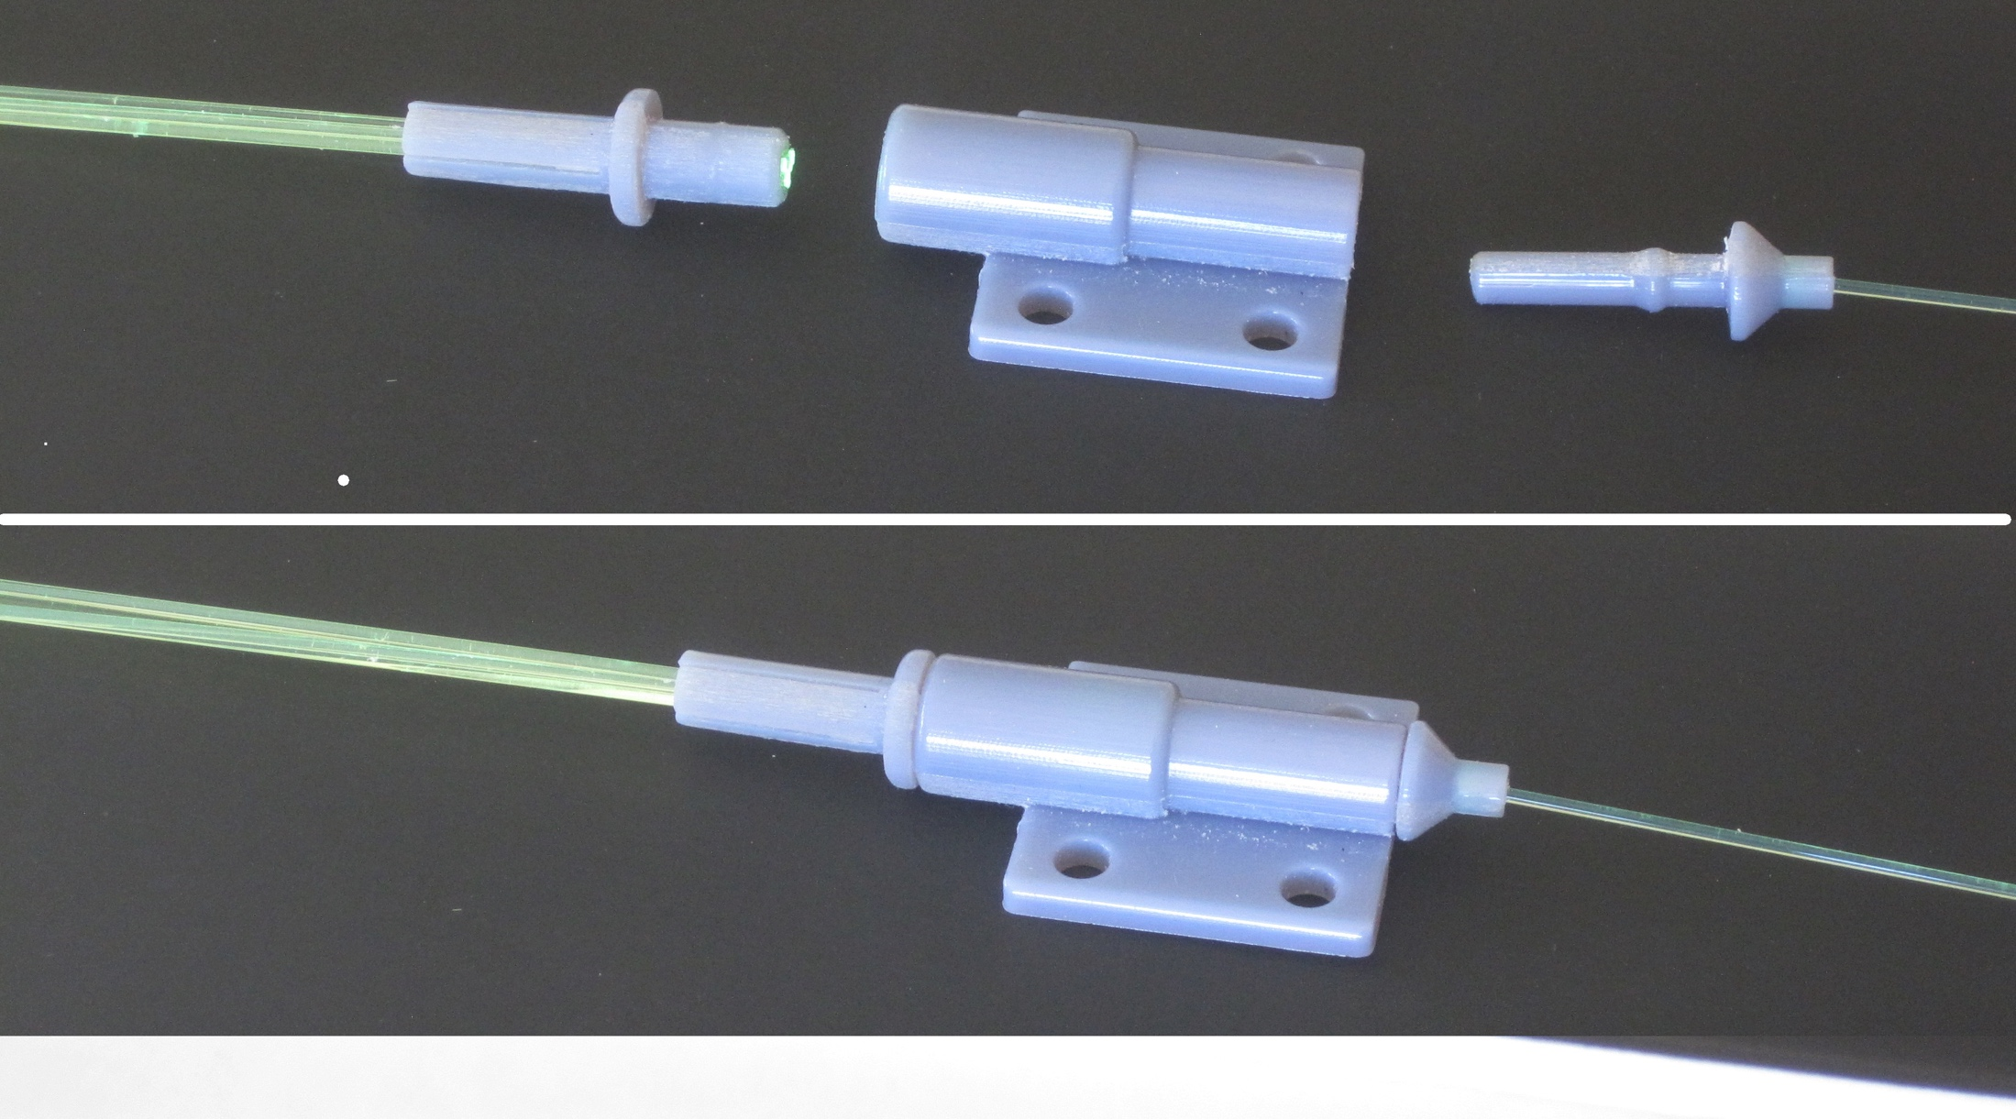
Calibration system designed and tested
Use existing pulser board design from Pat
  Two Drivers
1mm plastic fiber output
Fan out to 7 (19) clear 1mm fibers
Insert these into each scintillator bar
In progress:
Lay out pulser board with a few more pulsers, and build
Cut and polish pulser fibers
Design mounting
3D print
1->7 fanout

Slide 8
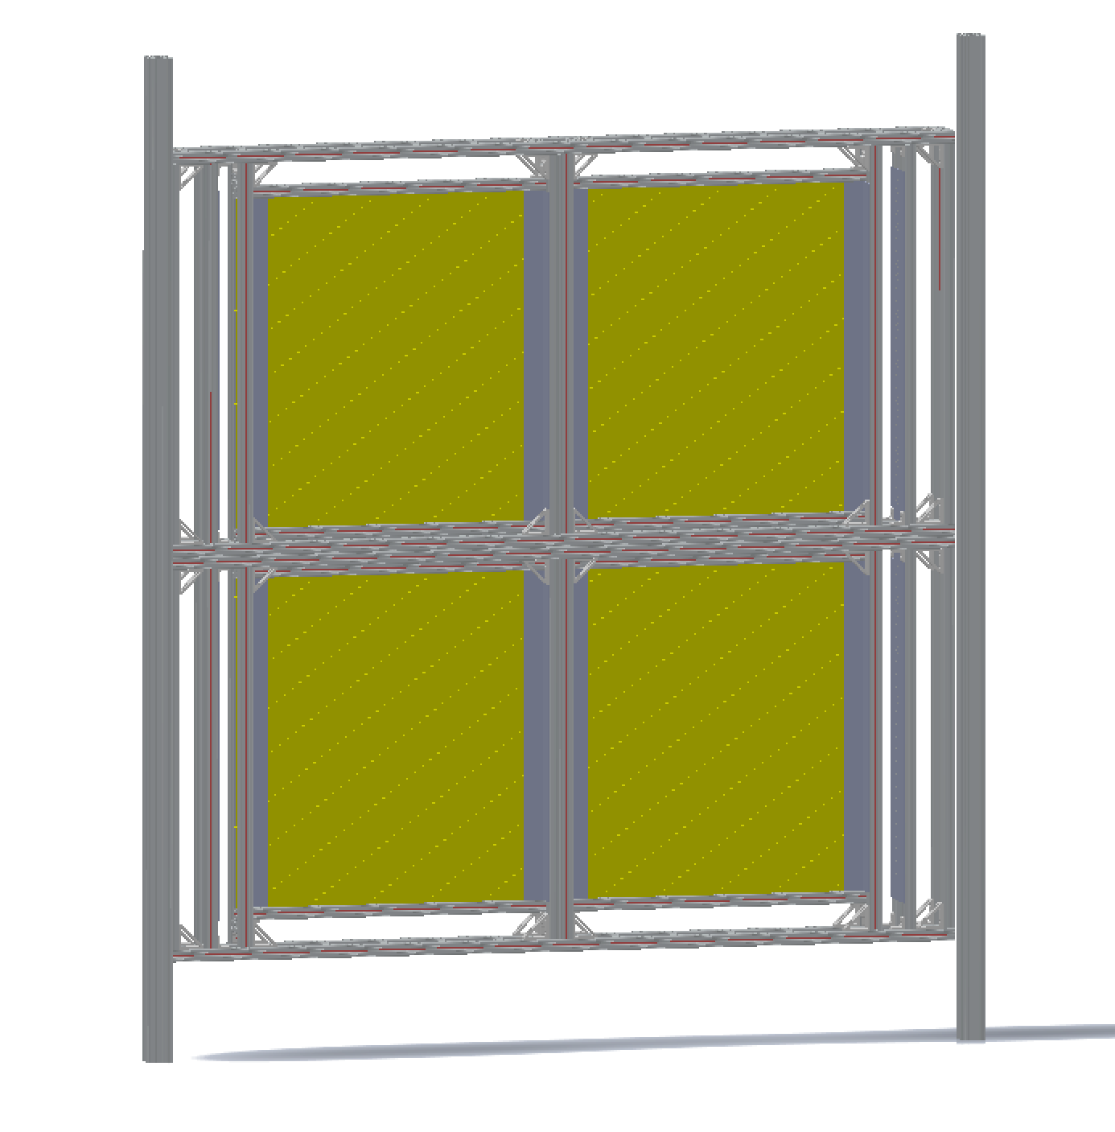
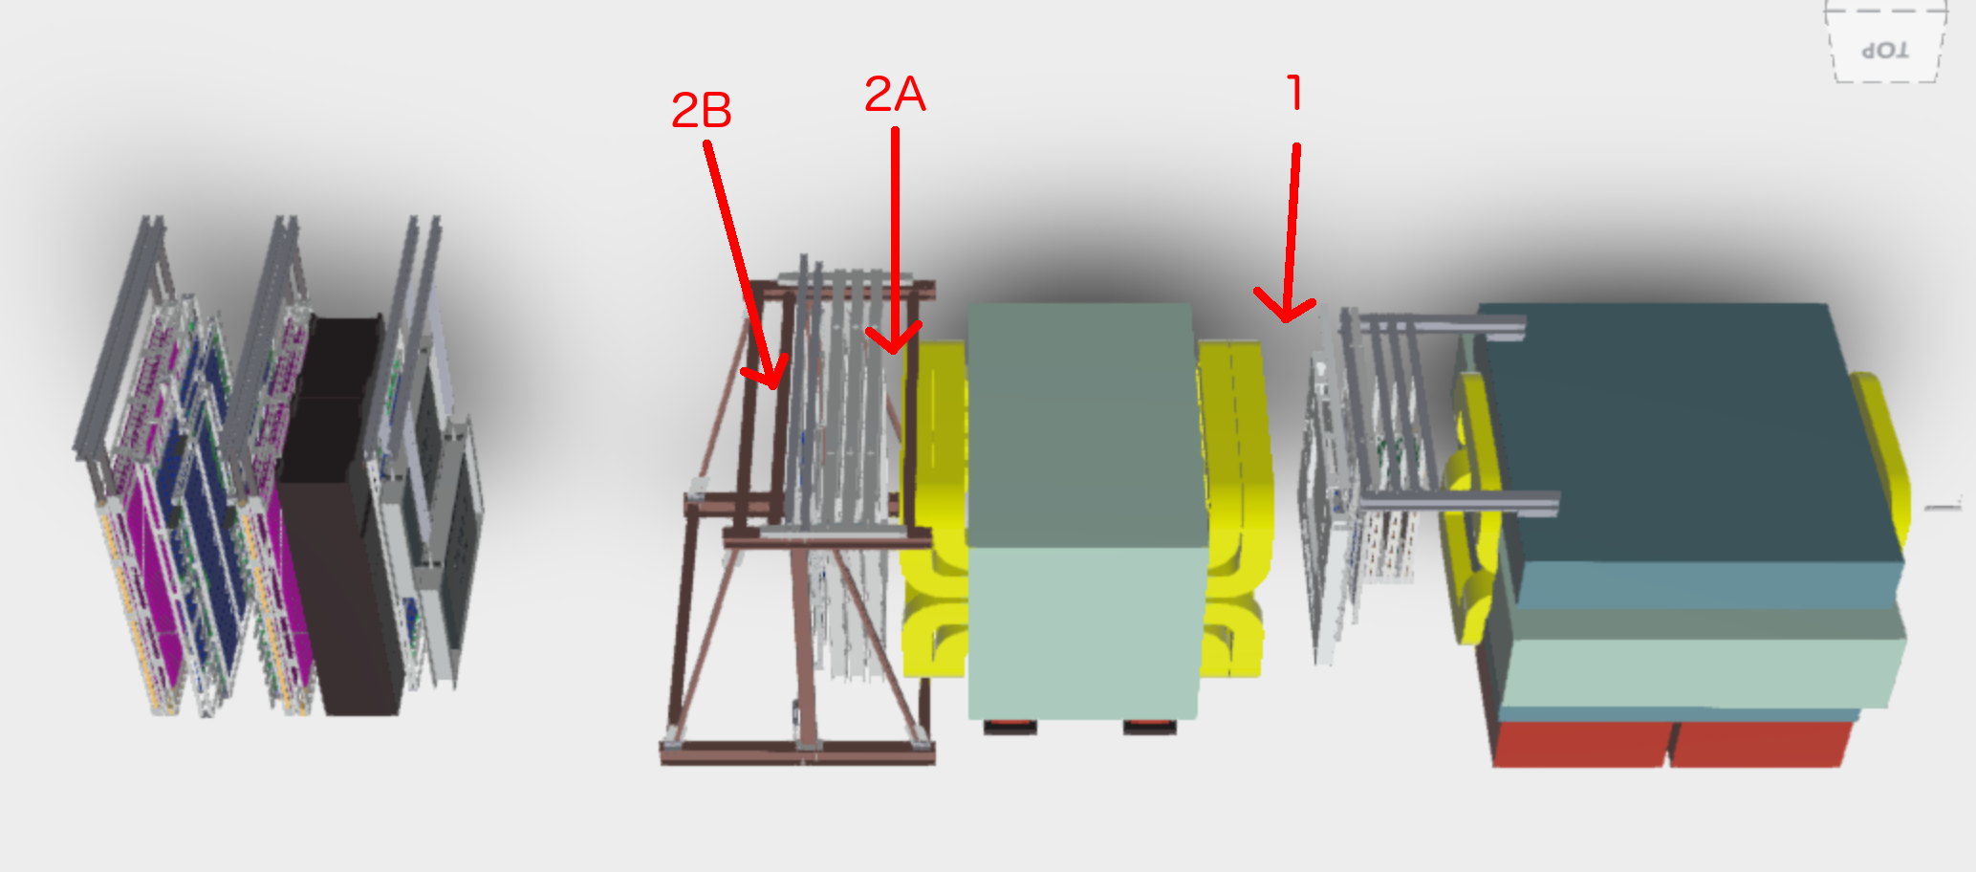
Installation Plan
4 boxes joined
2 vertical beams hold this assembly
Anchored to floor and overhead beams
In progress:
Details of mounting points
Safety review document in progress
Determine external cable routing
Cooling fans

Slide 9
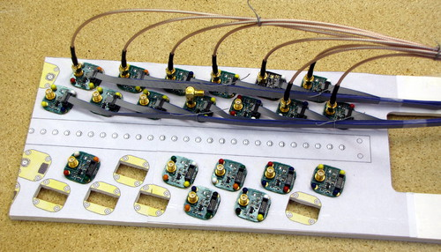
SiPM Readout
SiPM pigtail cables are ready for prototyping in the next week
  This is the last component of the readout frontend (SiPM, pigtail, preamp, signal cable) and enables tests of signal-to-noise and crosstalk
Fermilab preamp prototype has been tested at Fermilab
  20 pre-production units are at LANL and ready for QA, waiting on prototype pigtails
Preparing mockup of patch panel/bulkhead to bring preamp signals out of the detector box
Ferrite inductors may saturate in magnet fringe field - lab tests are planned to determine whether we should switch to inductors with nonmagnetic cores (already identified), ~complete test this week

Slide 10
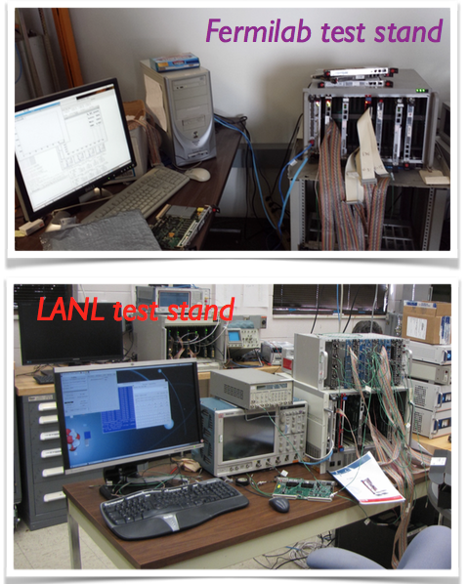
DAQ upgrade: goal and achievement
Improve the DAQ bandwidth by a factor of 10 to allow running ‘parasitically’ alongside E906’s main program
Three independent upgrades:
  MainDAQ: development of the FPGA and ARM microcode on the customized TDC
  TriggerDAQ: adding SDRAM to the CAEN v1495 and development of the FPGA control code
  BeamDAQ: development of the FPGA code of the dedicated beam intensity monitor readout
All three systems have been successfully tested with beam (before Fermilab Main Injector broke).
Now the upgraded DAQ is running continuously with cosmic rays to commission the rest of the spectrometer

Slide 11
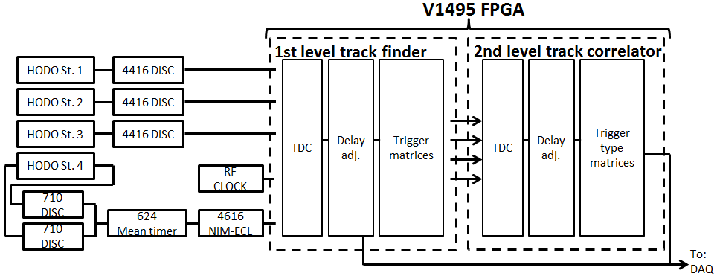
V1495 Trigger Firmware Development
Structure and building blocks of the existing firmware can be reused: TDCs, delay adjustment pipelines, trigger matrix lookup tables
  Input channels (TDC and delay pipeline) are generic and do not need tochange
  Lookup tables will have different content but operate in the same way
More V1495 inputs
  L1 trigger firmware must be modified to increase the number of supported input channels from 3*32=96 to 5*32=160
    Primary challenge is expanding the channel addressing scheme by one bit: work in progress
  FPGA utilization is not expected to be a problem: existing firmware uses roughly 40% of FPGA resources for input processing (should scale with input channels) and 20% for trigger lookup tables (should scale more slowly)
Plan is to develop in stages to simplify testing
  Modify the firmware blocks in a reverse-compatible way to support more input channels
  Build a version of the existing L1 firmware that uses these blocks but is functionally unchanged (compatible with existing readout drivers and tests)
  Modify readout drivers to support more input channels
  Build the new firmware and test, by mid Feb
New trigger inputs

Slide 12
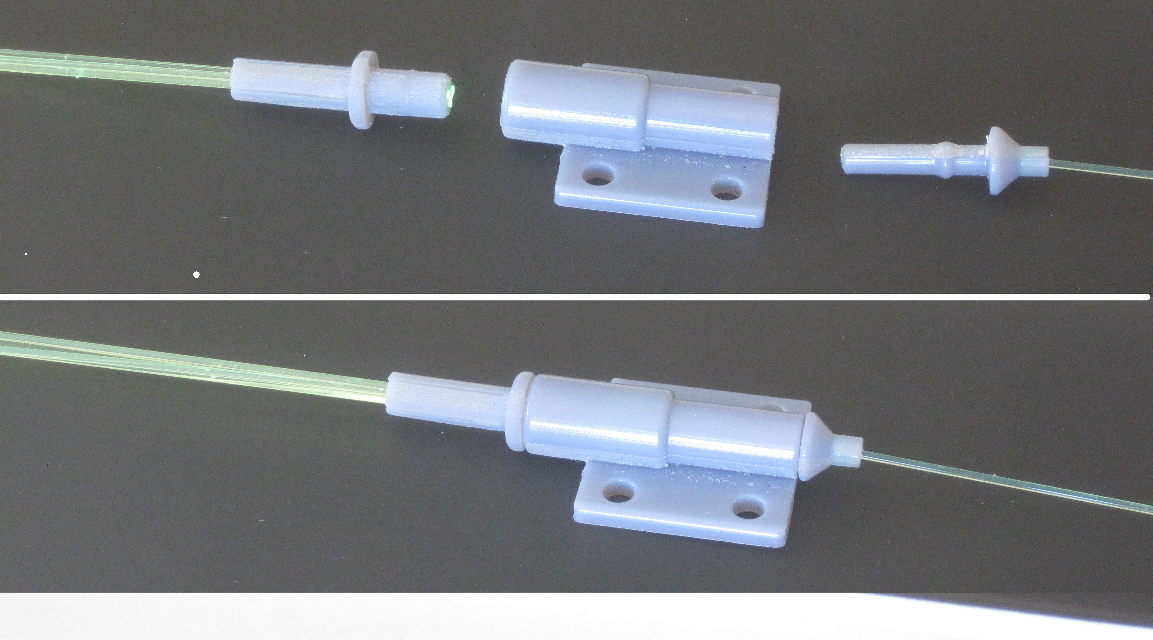
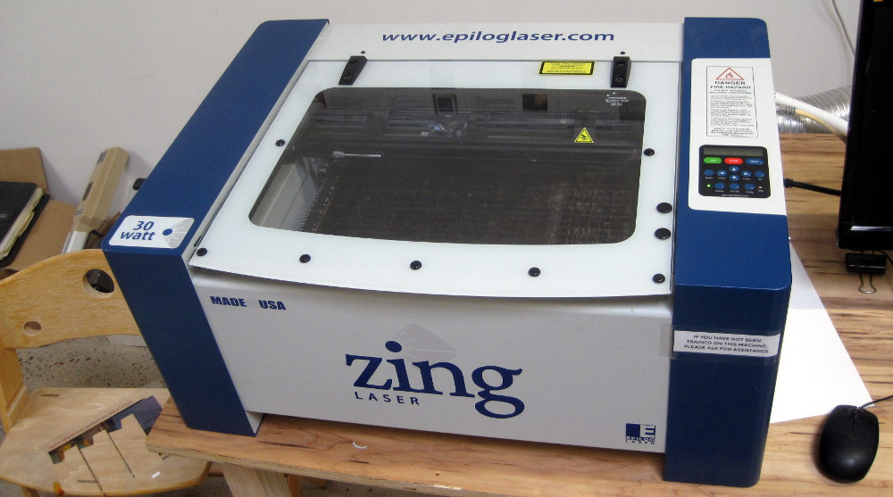
Calibration System Tested
Clear fiber with LED
Sharp raising edge
1->7 (more) split

Slide 13

Detector Assembly
All frames assembled
Mockup layout

Slide 14
Installation Plan being Developed
Detectors
Readout crates and modules
Cabling

Slide 16


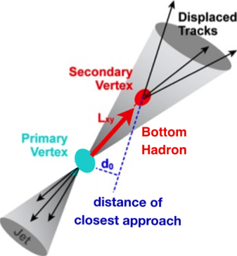
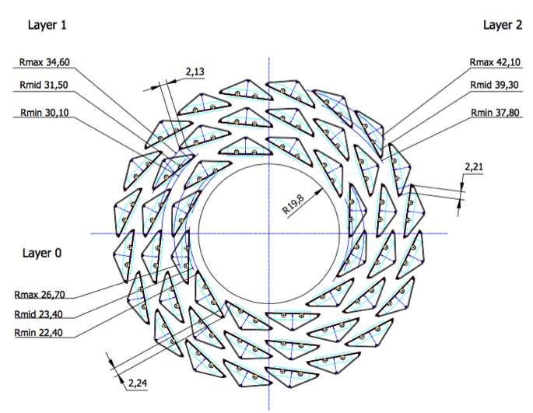
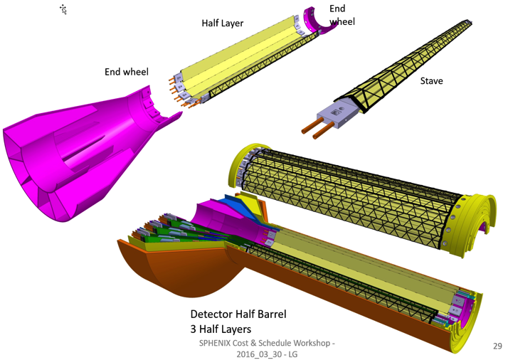
LANL Proposed sPHENIX MAPS Inner Tracker
2022+
ALICE ITS Upgrade (2021+);
Inner Tracker System
Key integration issues:
- Readout
- Mechanics
sPHENIX Inner Tracking
“Adopt” ALICE/ITS
Mini. risk,
Max. physics

Slide 17
LDRD Project Overview
Ming Liu, P-25
December 5th, 2016
LDRD Goals
  Develop a new QGP physics program with heavy flavor b-jet measurements in sPHENIX at RHIC
  Carry out key detector R&D and develop a new MIE proposal to DOE to build a state-of-the-art MAPS-based high precision vertex detector to support the b-jet physics program in sPHENIX
Project Scope, Plan and Milestones
  Experimental tasks
  Theoretical tasks
Cost, Schedule, Procurement and Risk Management
Organization
sPHENIX/MAPS Project Web page:
https://p25ext.lanl.gov/maps/

Slide 18
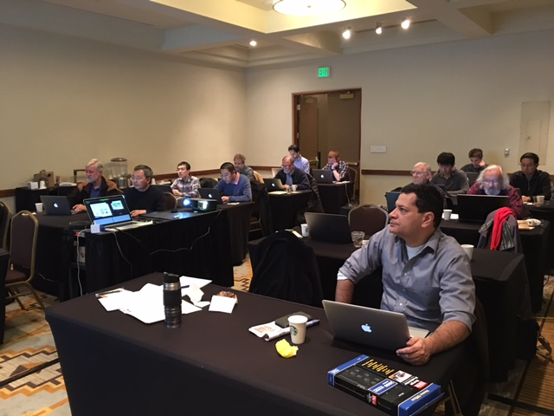
sPHENIX/MAPS LDRD Updates
Feasibility review, December 5th , 2016
  Waiting for feedback
Electronics and readout and mechanics
  Readout units: 10 V0 boards to be produced, 5 for LANL R&D
  2 High-speed readout test bench (MOSAIC boards): ordered and to be fabricated soon
  5 production version MAPS chips: ordered and fabricated (expected ~December),
  Altera evaluation boards ordered for CRU FPGA work, will be available soon
  Alternative Comm. RU being explored, ATLAS/FELIX boards @BNL/ATLAS
  Workshop @UT-Austin in March on readout
Simulations
  Multi-collision pileup effects studied
  Realistic geometry being tested
  2nd vertexing in p+p and Au+Au
MIE proposal development
  MIE writing workfest @Santa Fe, Jan 5-7, 2017
  Major tasks and lead institutes identified
  Key physics plots identified and being updated
  LBNL workshop to finalize the proposal, Jan 24-25
  DOE Feb. budget meeting
  Continue building collaboration, new institutions joined the effort
Good progress in Theory
Project is on track
  MIE writing workfest @Santa Fe, Jan 5-7, 2017

Slide 19
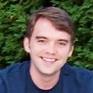

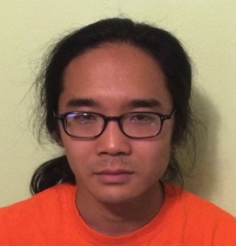
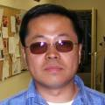

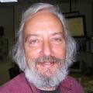
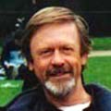
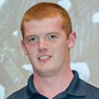
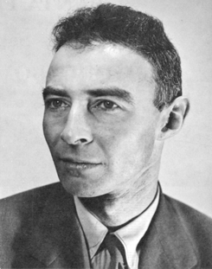
LANL LDRD Activities
MAPS is on LANL’s 10-year strategic plan for key S&T
LALN internal
  Simulations
  Electronics
  Mechanics
External collaboration
  CERN/ITS group
  ALICE US groups
Lead people identified for key tasks
  Team of experts
Job AD out for a new staff
  Several outstanding candidates
Mike McCumber
Sanghoon Lim
Sho Uemura
Pat McGaughey
Ming Liu
Mark Prokop
Walt Sondheim
Hubert van Hecke
Darren McGlinchey
A new
staff

Slide 20
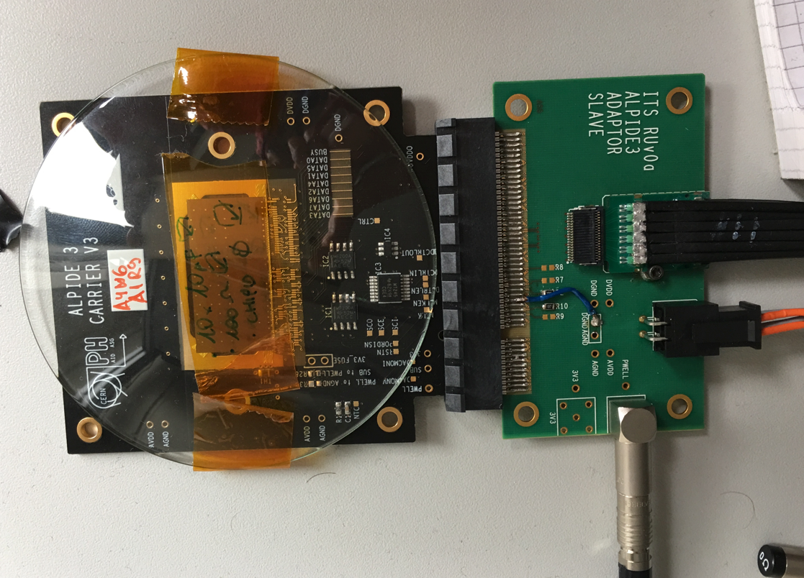
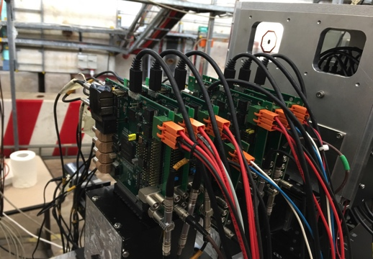
R&D at LANL:MAPS Chips
A 5-single-chip MAPS telescope
A single chip:
15 x 30 mm active area
- Have one chip with slow readout working;
- 5 more on the way to build a telescope at LANL

Slide 21
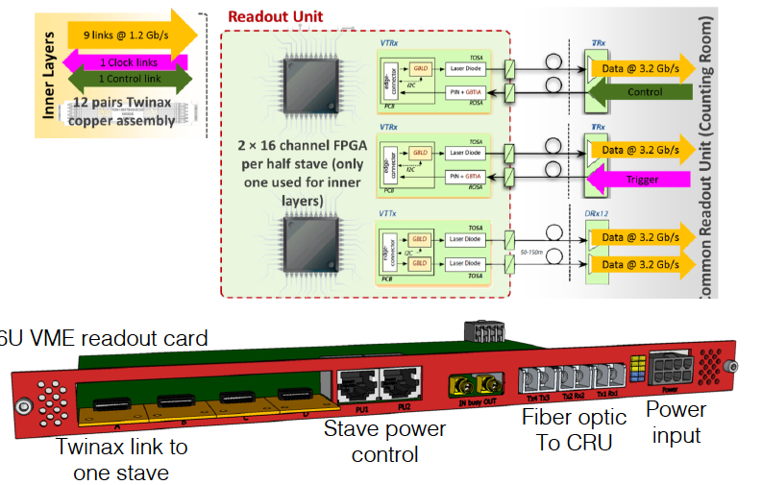
ALICE Readout Unit Design
CRU

Slide 22
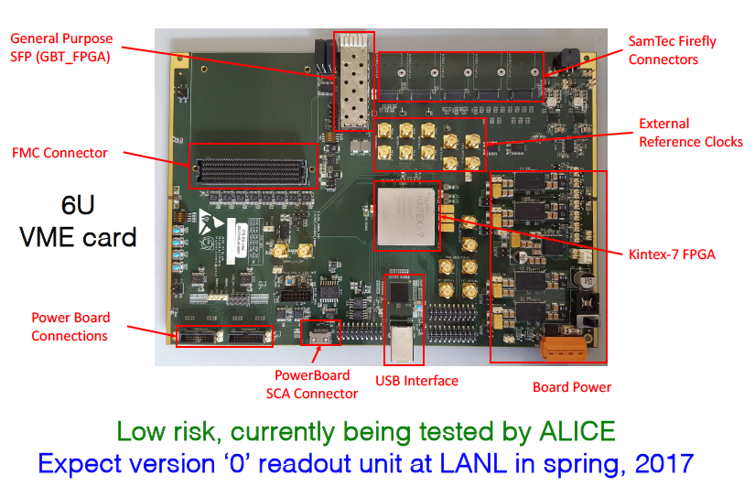
ALICE Readout Unit – Prototype 0
From Pat McGaughey

Slide 23
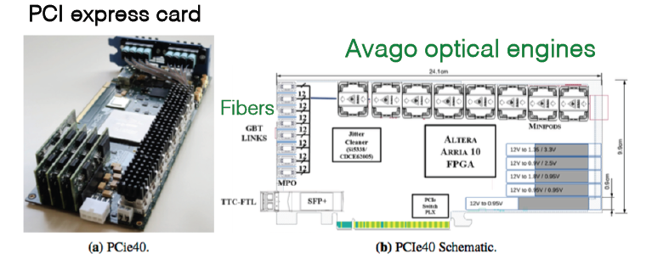
ALICE Common Readout Unit
From Pat McGaughey
Each CRU reads out 2 RUs
Expected at LANL summer 2017 for testing
Also exploring other options, commercial boards, ATLAS/FELIX boards etc.

Slide 24
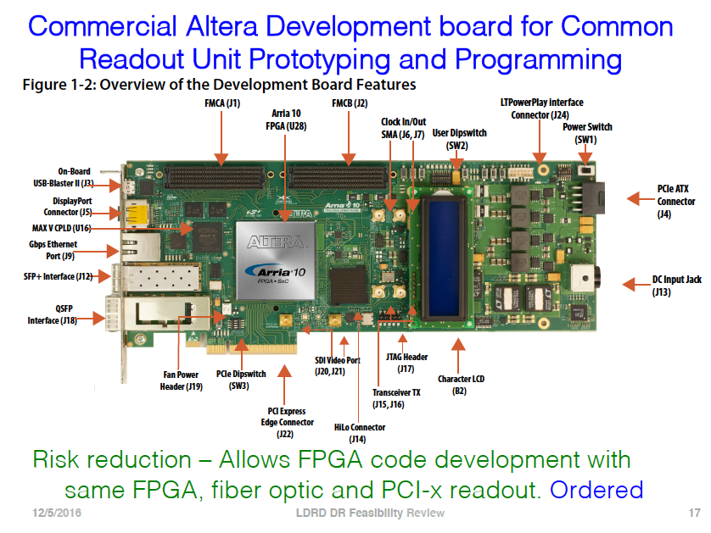
From Pat McGaughey

Slide 25
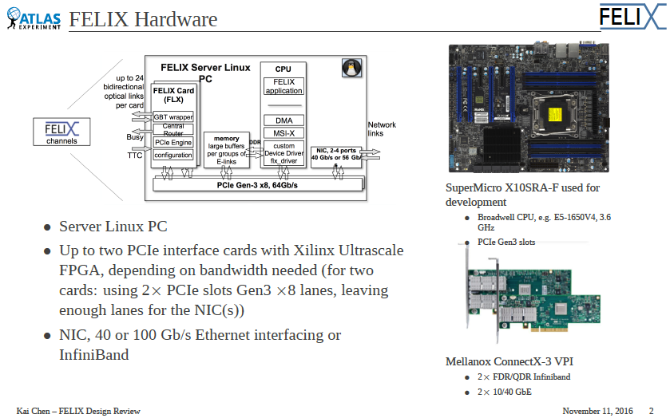
Joint Effort on “CRU”: TPC-MAPS
ALICE/CRU and ATLAS FELIX being studied
From Kai Chen

Slide 26
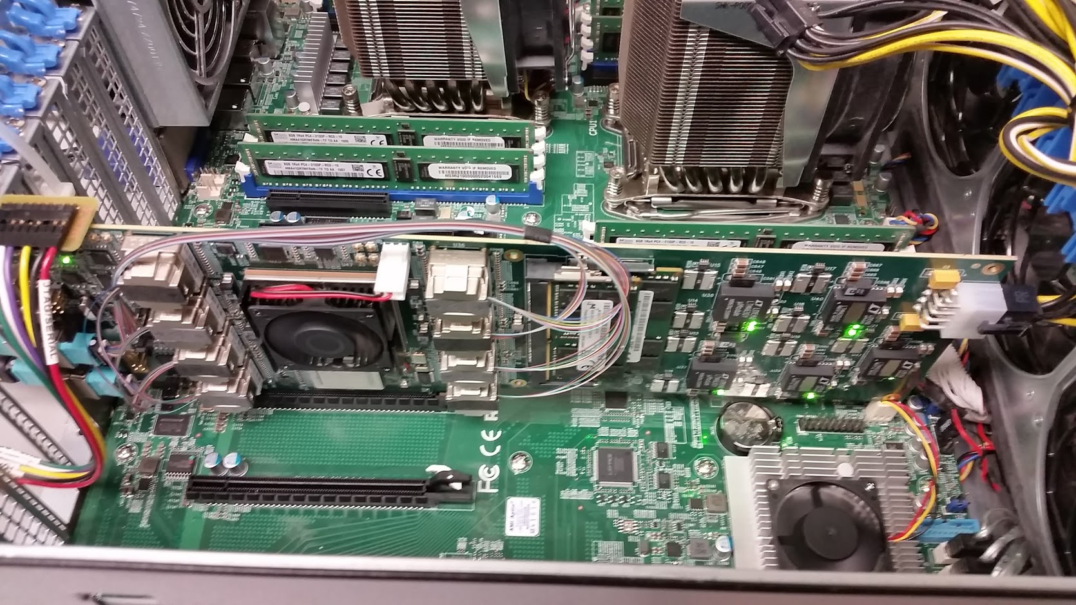
ATLAS/FELIX Card for sPHENIX?
Credit: Kai Chen (BNL), https://indico.bnl.gov/conferenceDisplay.py?confId=2653
Main features for FELIX PCIe Card
  Design: BNL/Omega group, Layout: BNL/Instrumentation, Goal: multiple users.
  A large Kintex Ultrascale FPGA, 1.5 M Logical Cells
  ( 24x Logical Cells of FVTX FEM card )
  48 bi-directional GBT link, PCIex16 Gen3, 101 Gbps demonstrated
  2x DDR4 memory slots (v1.0, v1.5), removed v2.0
  TTC-timing input (v1.0, v1.5), timing mezzanine card (v2.0)
Timeline and availability:
  Current version: v1.5 prototype, can be ordered now
  Next version: v2.0 pre-production, design starts now, expect available Oct 2017
  FELIX production system delivery expected end 2018 for ATLAS Phase-I upgrade. ATLAS needing 100+ card with various flavor of firmware depending on subsystem configurations.
BNL/Omega group, Local expert expressed willing for help us to adapt FELIX in sPHENIX
  Boards for initial evaluation test
  Support firmware software development, timing mezzanine card design
  The team is also help in possible use of FELIX card in proto-Dune.
  The FELIX team is open for inputs in guiding the design to be more generic to various users.
FELIX v1.5 Card in server
BNL ATLAS Group

Slide 27
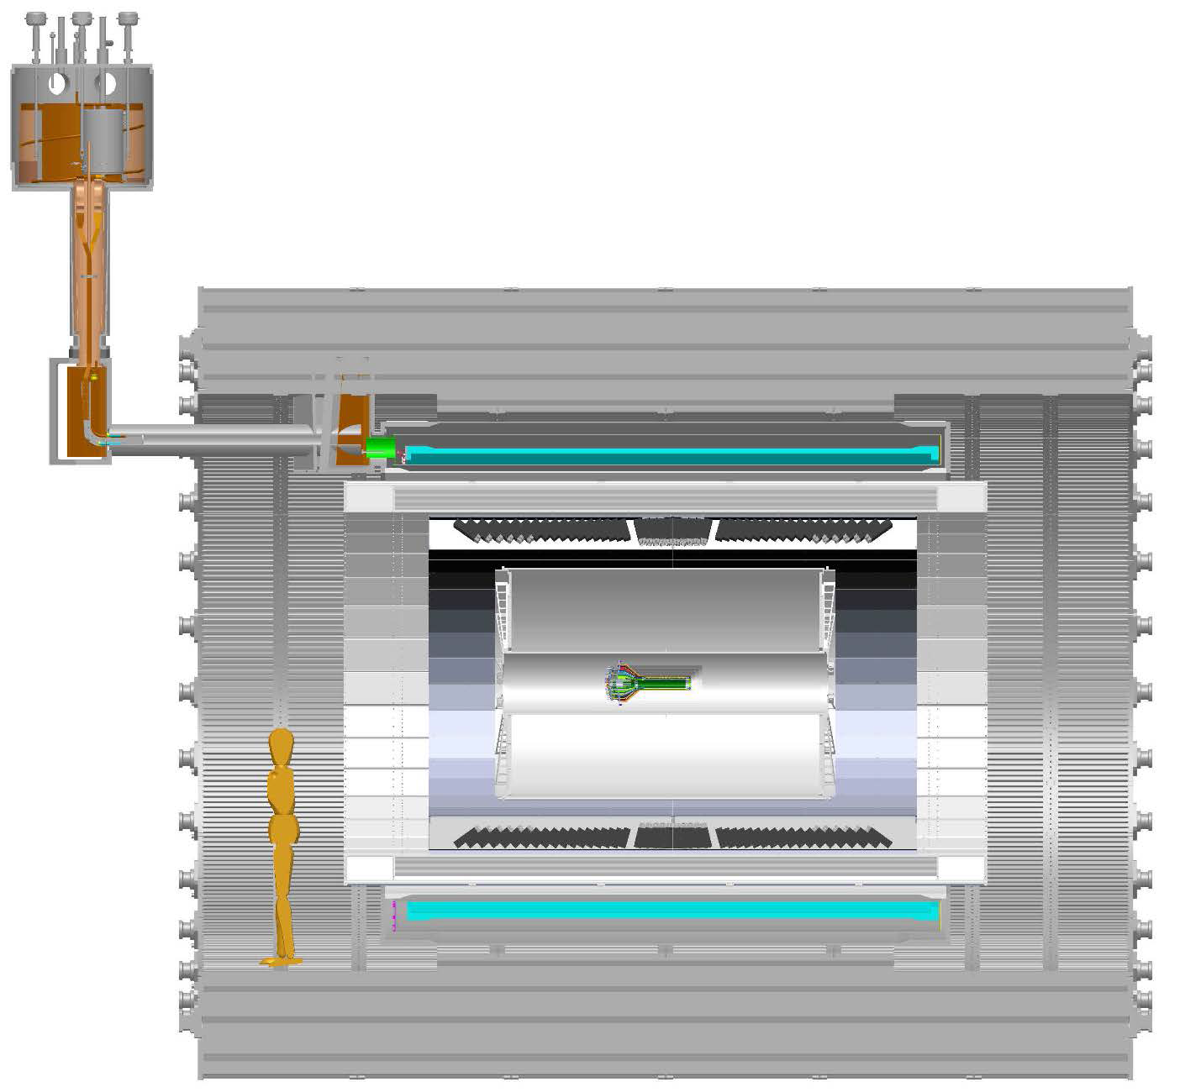
MAPS Services
MAPS->RU:
- “5m” copper wires
- 6U VME modules
- 48 modules
RU->CRU@CH:
30+m fibers

Slide 28
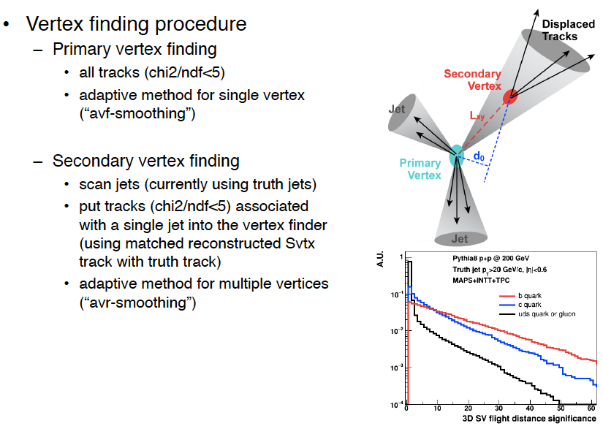
2nd Vertex Reconstruction and B-Tagging
Sanghoon

Slide 29
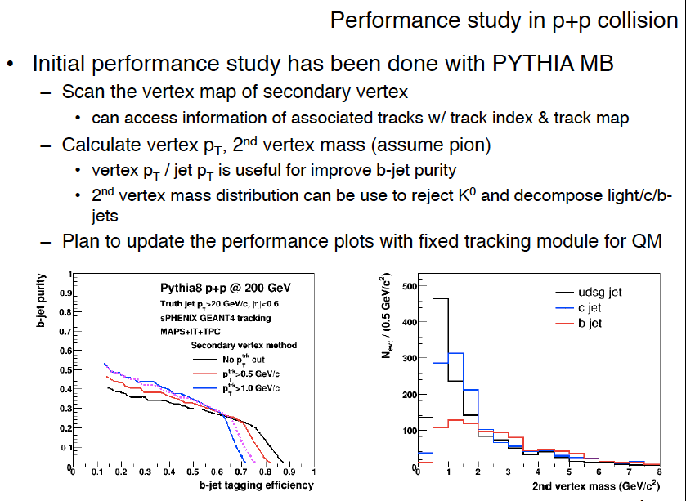

Slide 30
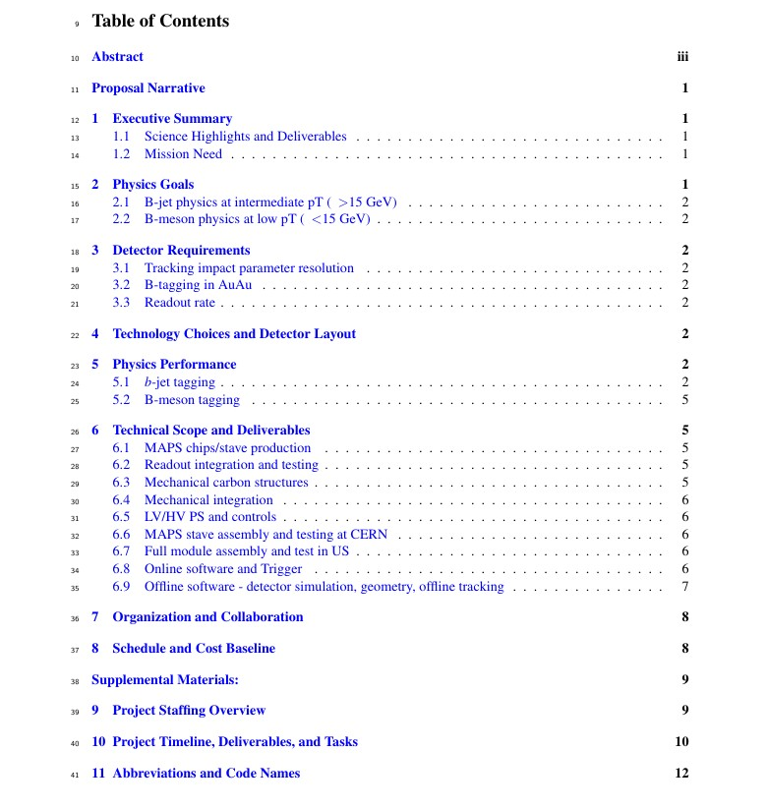
Editing/Proofreading – Dennis, Darren, Hubert et al
1. Ming, Mike, Gunther et al
2. Cesar, Xin et al
3. Jin, Darren, Haiwang et al
4. Giacomo et al
5. Tony, Haiwang, Jin et al
6.1 Cesar, Mike, Ming,
6.2 Grazyna/Leo, Ming et al
6.3 Walt, Grazyna/Eric et al
6.4 Bob, Gunther, Walt
6.5 Grazyna/Leo et al
6.6 Gunther etal
6.7 Grazyna/Leo
6.8 Xiaochun, Chris et al
6.9 Tony, Jin, Chris et al
7. Cesar, Gunther et al
8. Dave, Ming et al

Slide 31
Plots for MAPS MIE pre-proposal
Preliminary: HIJING
Place holder: Dijet asymmetry
Place holder for HIJING

Slide 32
Lattice QCD EoS and MD simulations
Incorporate the current state-of-the art EoS in hydrodynamic simulations, describe time, temperature evolution of the QGP
We chose a relativistic heavy-ion collision simulator that is publicly
available: iEBE-VISHNU (arXiv:1409.8164, written by Chun Shen)
We installed it, and are working on understanding the structures of the code and input parameters for the simulator.
Set up molecular dynamics (MD) simulations of strongly coupled systems using one component plasmas.
Begun simulations with tunable interaction strength to understand the relation between the transport properties of strongly-coupled plasmas and the coupling strength.

Slide 33
SCET and pQCD
Developed first-principles theory of heavy quark propagation in nuclear matter and the process of shower formation
It was possible to carry this simplification since we realized the sectors of the theory decouple, very explicit in the hybrid gauge
First recover the massive vacuum splittings. Evaluate the 3 massive in medium splittings
NLO calculation of open heavy flavor production
Set up evaluation of b-let substructure in the energy loss approach
Begin SCET work on the discrimination of b-jets and light quark jets

Slide 34
Near Term To-Do
Readout R&D and MIE
Study MAPS operation etc with existing MAPS chip at LANL
Procurement of R&D hardware from CERN
Study ALICE RU performance, v0
  UT-Austin meeting ~early March
Study CRU with Altera evaluation boards
Explore alternative option for CRU
  Joint R&D with BNL
MIE writing
Trainings
  FPGA programing etc.
Update project planning etc
  Feedback from feasibility review

Slide 35
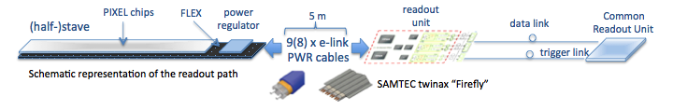
MAPS-sPHENIX Electronics Integration
Plan A:
reprogram
ALICE readout path
Plan B: sPHENIX readout path (held as contingency)
MAPS FEM
DCM2
EvB
existing ALICE design
New development:
- Joint TPC & MAPS readout R&D
ATLAS FELIX Readout Unit
vs ALICE/CRU?
trigger in
modified design,
starting with ALICE boards
busy out
existing design
existing sPHENIX design

