Slide 1
Dark Photon Updates
Detector scintillator + WLSF assembly
Almost done, ~by this week
Fermilab safety document for detectors
Work in progress, sample documents in hands, ~by the end of Jan
DAQ upgrade - done
x10+ improvement, parasitical data taking with E906 possible
SiPM Readout
Fermilab preamp cards
Pre-production 20 cards arrived, being tested at LANL
Trigger firmware and lookup table
V1495 I/O tested, using MC to develop lookup table
Full trigger firmware under development, to be ready by ~mid Feb.
Progress in theory
Cross check calculations, plan a joint paper
Project is on track
New trigger system installed at Fermilab in March
Future E906 and SeaQuest schedule
Lost ~2 weeks of beam time due to accelerator issues
Likely to extend current run or more beam in the remaining run this year
Propose to Fermilab PAC dedicated dark photon search runs beyond E906

Slide 2
Excellent progress in the last a few weeks
Detector assembly, SiPM readout and calibration system
Hubert, Alex, Sanghoon, Shaun, Pat et al
DAQ and Trigger firmware
Kun, Sho and Andi et al
Dark photon project web page
https://p25ext.lanl.gov/darkphoton/

Slide 3
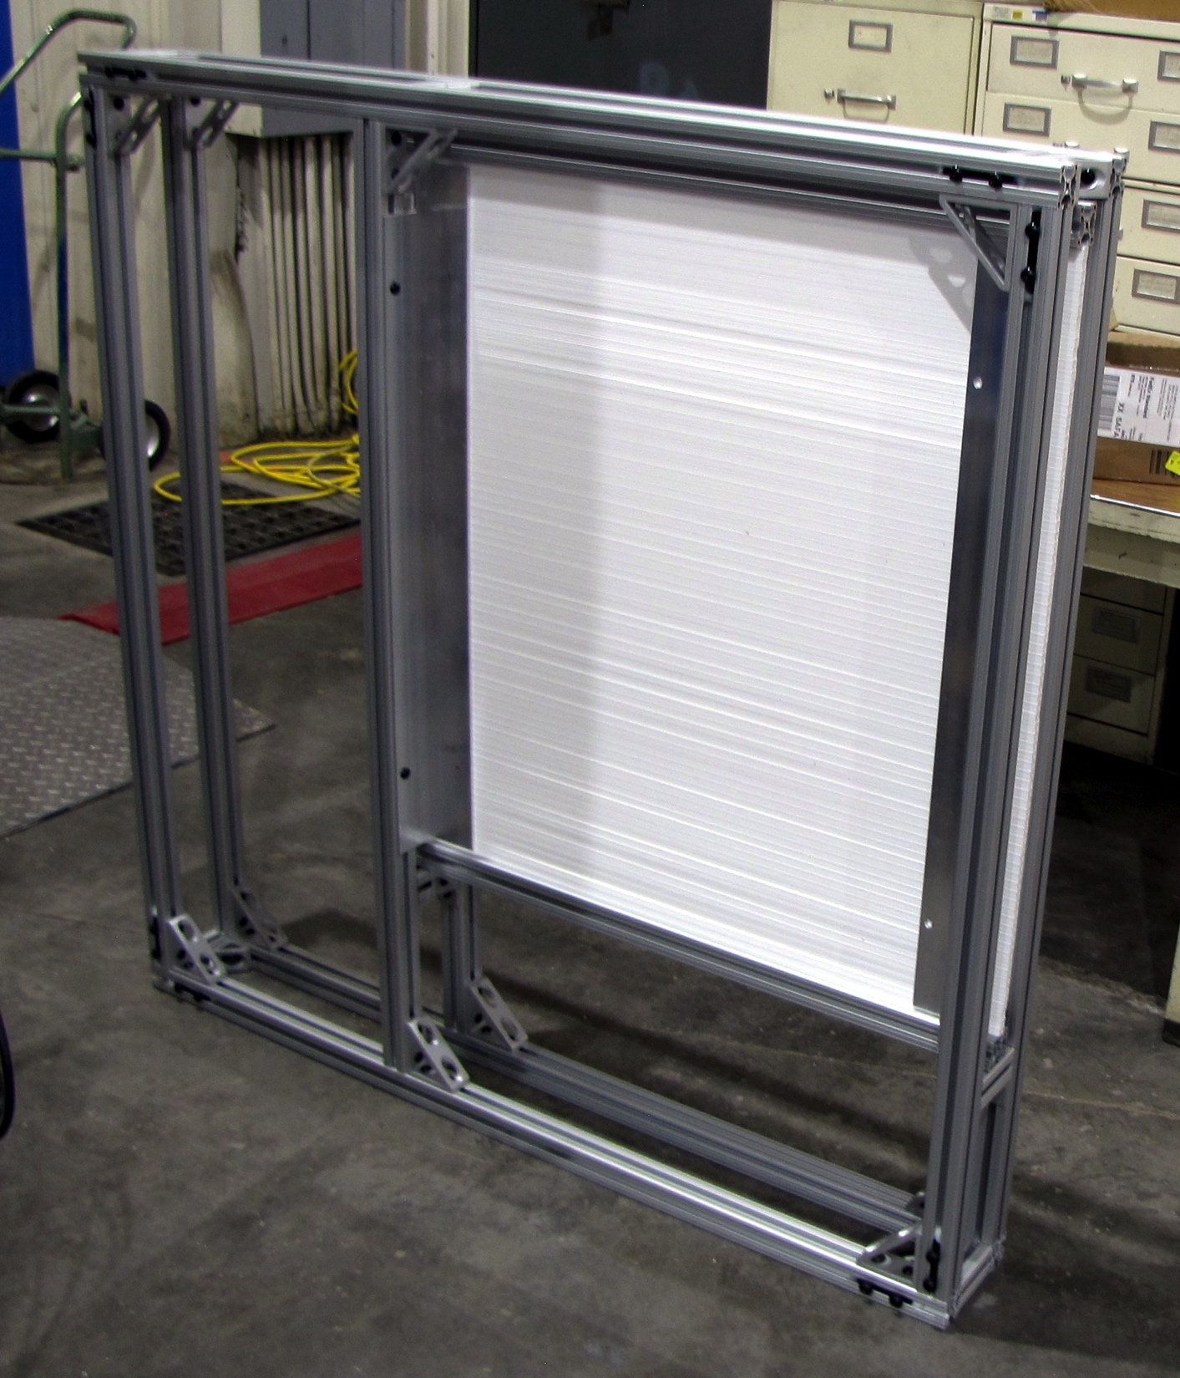
Trigger Detector Frames
4 frames for 1x1x80 cm bars
4 frames for 2x2x100 cm bars
Mostly finished
To be done:
Feedthroughs and/or patch panels for cables
Cooling air feedthroughs

Slide 4
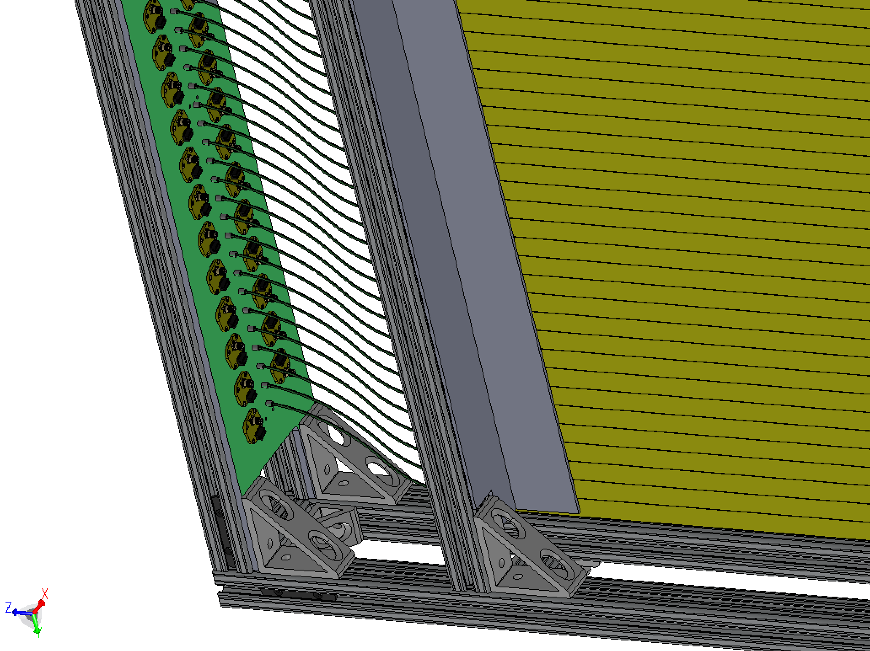
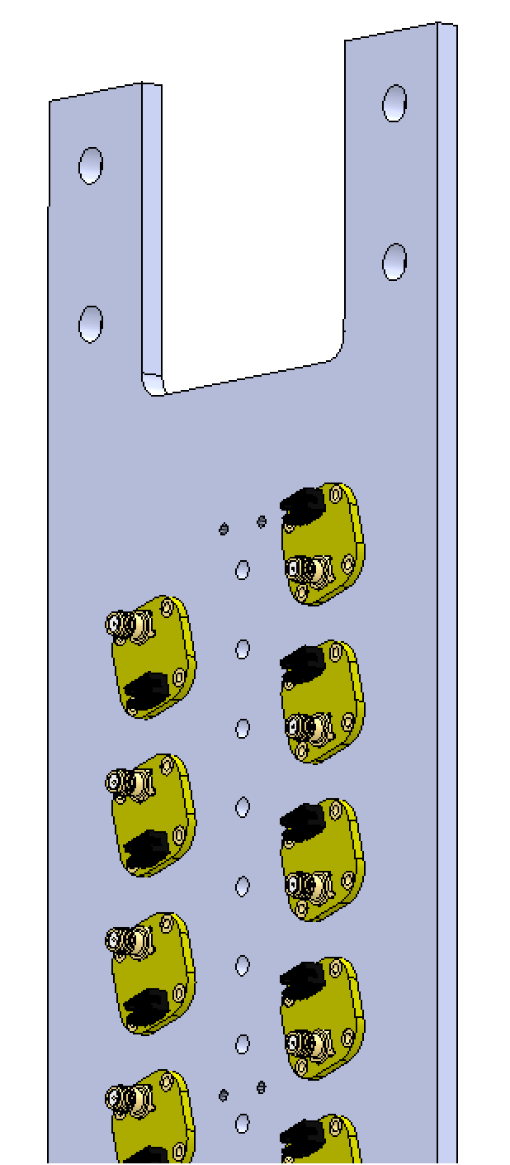
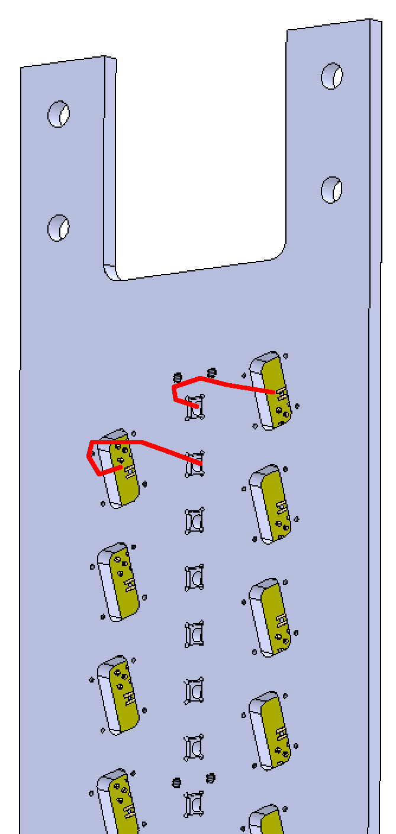
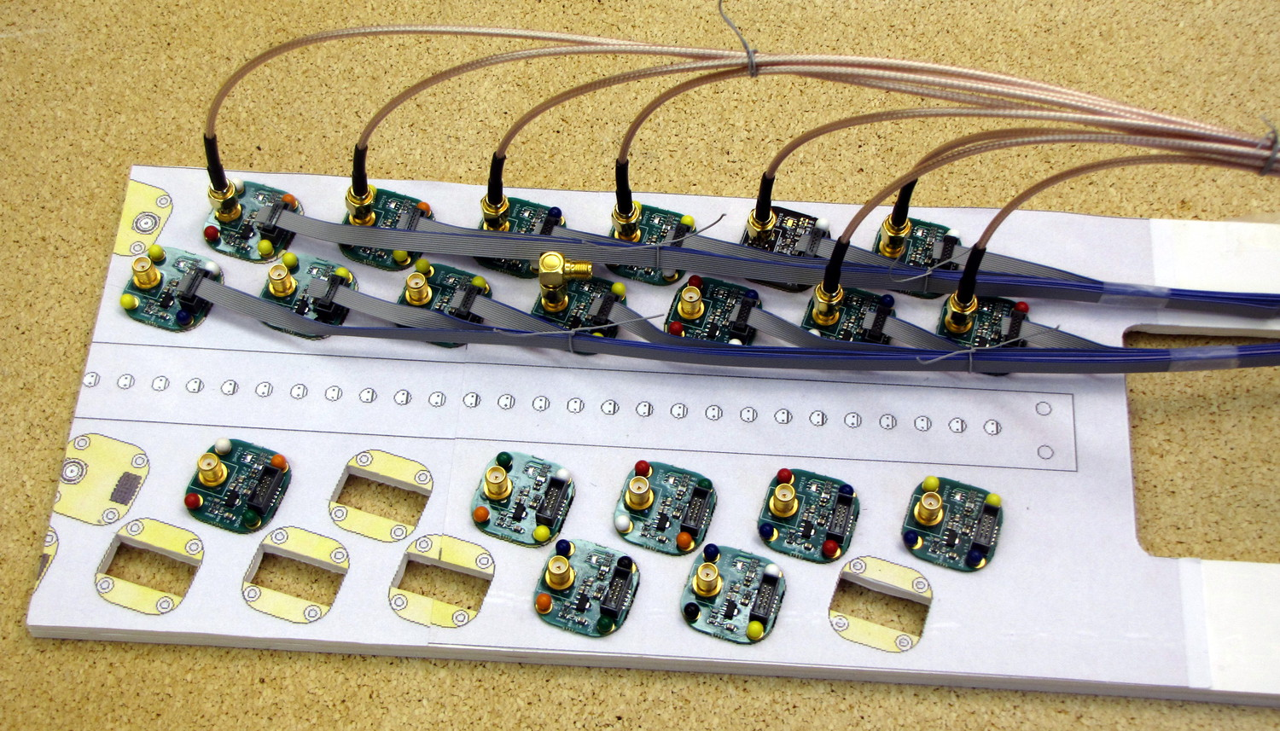
Readout plates
Fibers and preamps in the front
SiPMs connect with pigtails in the back
Fabrication bids are out; complete in ~2weeks
front
back
Full-scale mockup for cable routing and connector finger space

Slide 5
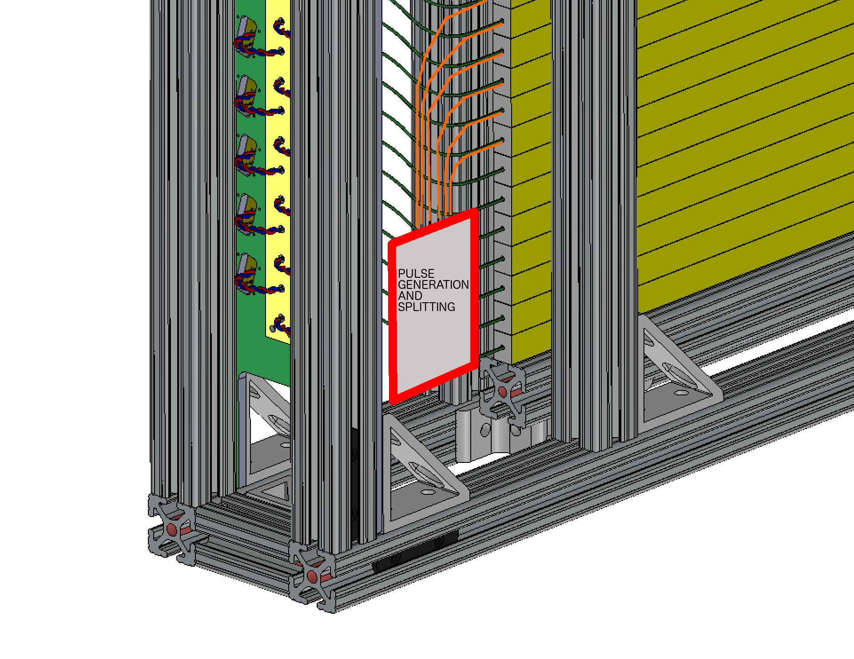
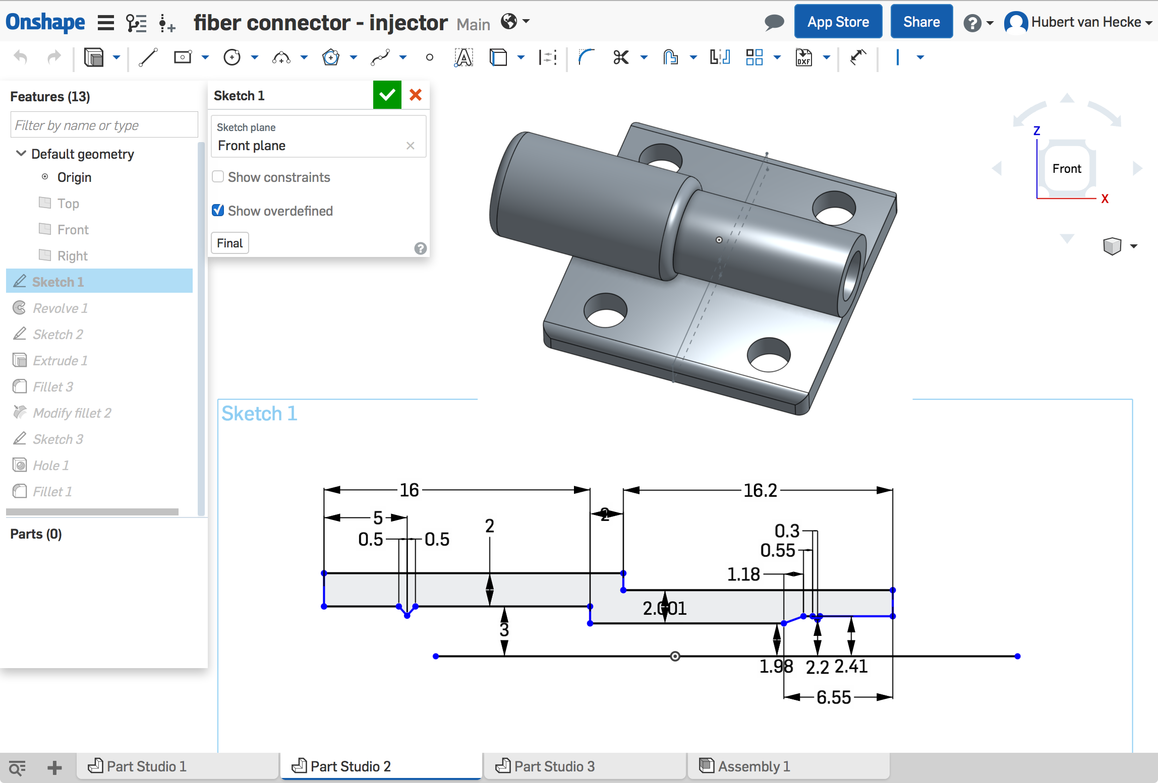
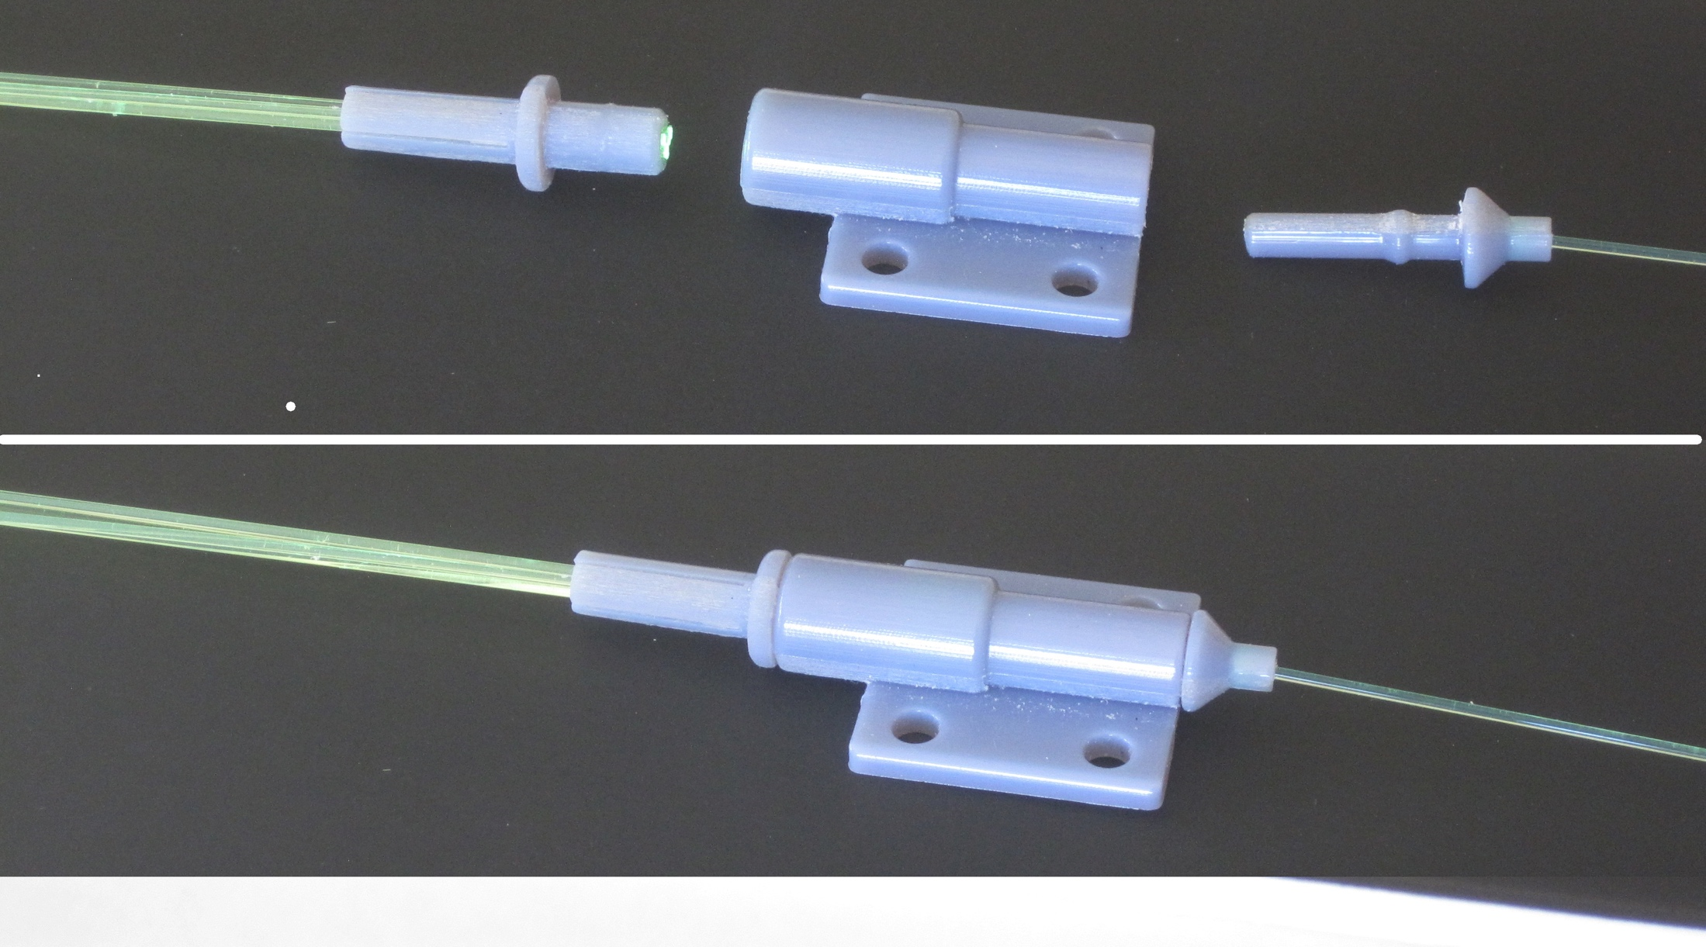
Calibration system designed and tested
Use existing pulser board design from Pat
Two Drivers
1mm plastic fiber output
Fan out to 7 (19) clear 1mm fibers
Insert these into each scintillator bar
In progress:
Lay out pulser board with a few more pulsers, and build
Cut and polish pulser fibers
Design mounting
3D print
1->7 fanout

Slide 6
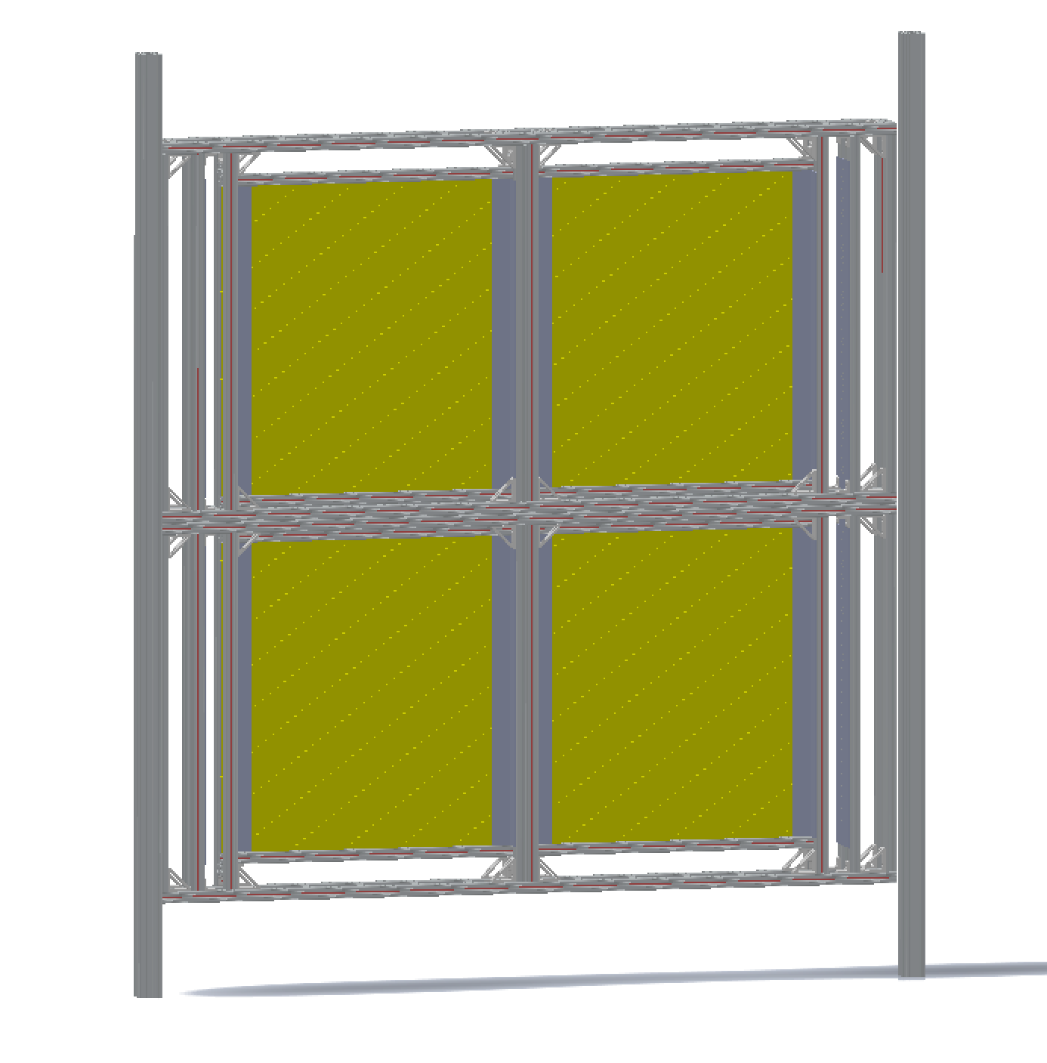
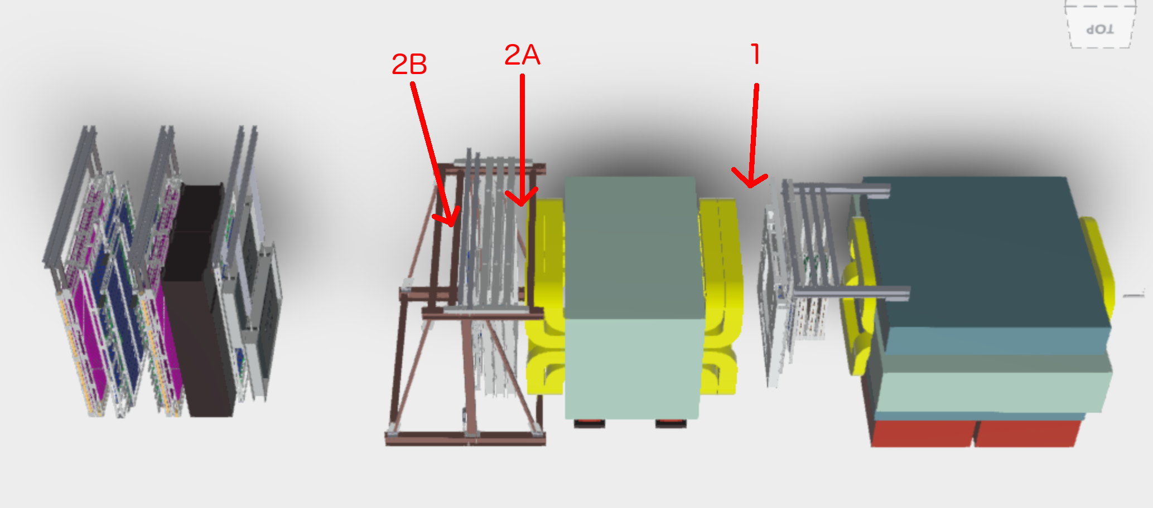
Installation Plan
4 boxes joined
2 vertical beams hold this assembly
Anchored to floor and overhead beams
In progress:
Details of mounting points
Safety review document in progress
Determine external cable routing
Cooling fans

Slide 7
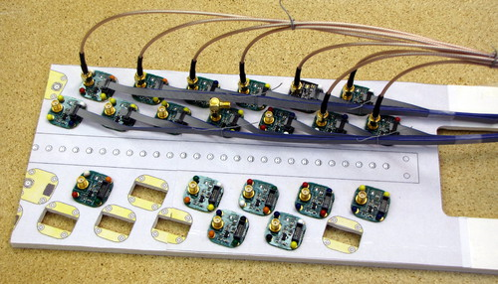
SiPM Readout
SiPM pigtail cables are ready for prototyping in the next week
This is the last component of the readout frontend (SiPM, pigtail, preamp, signal cable) and enables tests of signal-to-noise and crosstalk
Fermilab preamp prototype has been tested at Fermilab
20 pre-production units are at LANL and ready for QA, waiting on prototype pigtails
Preparing mockup of patch panel/bulkhead to bring preamp signals out of the detector box
Ferrite inductors may saturate in magnet fringe field - lab tests are planned to determine whether we should switch to inductors with nonmagnetic cores (already identified), ~complete test this week

Slide 8
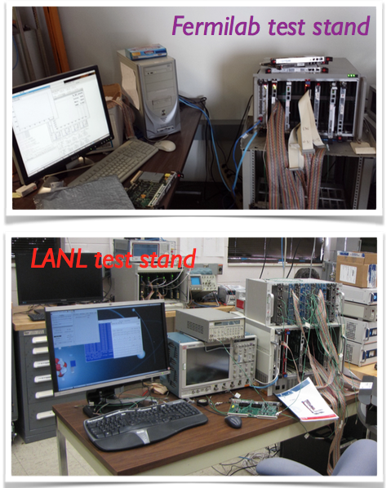
DAQ upgrade: goal and achievement
Improve the DAQ bandwidth by a factor of 10 to allow running ‘parasitically’ alongside E906’s main program
Three independent upgrades:
MainDAQ: development of the FPGA and ARM microcode on the customized TDC
TriggerDAQ: adding SDRAM to the CAEN v1495 and development of the FPGA control code
BeamDAQ: development of the FPGA code of the dedicated beam intensity monitor readout
All three systems have been successfully tested with beam (before Fermilab Main Injector broke).
Now the upgraded DAQ is running continuously with cosmic rays to commission the rest of the spectrometer

Slide 9
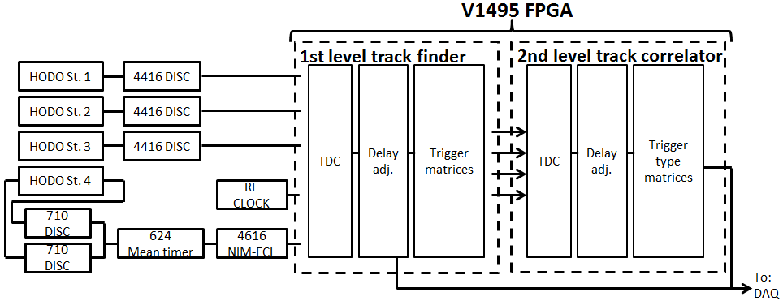
V1495 Trigger Firmware Development
Structure and building blocks of the existing firmware can be reused: TDCs, delay adjustment pipelines, trigger matrix lookup tables
Input channels (TDC and delay pipeline) are generic and do not need tochange
Lookup tables will have different content but operate in the same way
More V1495 inputs
L1 trigger firmware must be modified to increase the number of supported input channels from 3*32=96 to 5*32=160
Primary challenge is expanding the channel addressing scheme by one bit: work in progress
FPGA utilization is not expected to be a problem: existing firmware uses roughly 40% of FPGA resources for input processing (should scale with input channels) and 20% for trigger lookup tables (should scale more slowly)
Plan is to develop in stages to simplify testing
Modify the firmware blocks in a reverse-compatible way to support more input channels
Build a version of the existing L1 firmware that uses these blocks but is functionally unchanged (compatible with existing readout drivers and tests)
Modify readout drivers to support more input channels
Build the new firmware and test, by mid Feb
New trigger inputs

Slide 10
To-do and Plan
Preamp card production
Release for the full production after testing at LANL
Production completed by early Feb.
Safety document
Engineering note for safety operation
Draft by the end of Jan
Fully assembled detector shipped to Fermilab in mid Feb.
Installation in early march
Work in progress at Fermilab
CAMAC & LeCroy 4413 installation at Fermilab
All hardware in hand and tested
To be installed by the end of Jan
Standalone trigger crate and DAQ for commissioning at Fermilab in late Feb
All hardware in hand at Fermilab/LANL, V1495 and VME crates, cables etc.
SeaQuest Collaboration meeting being planned for early March
Future program and run plan
In Santa Fe or Fermilab

Slide 11
backups

Slide 12
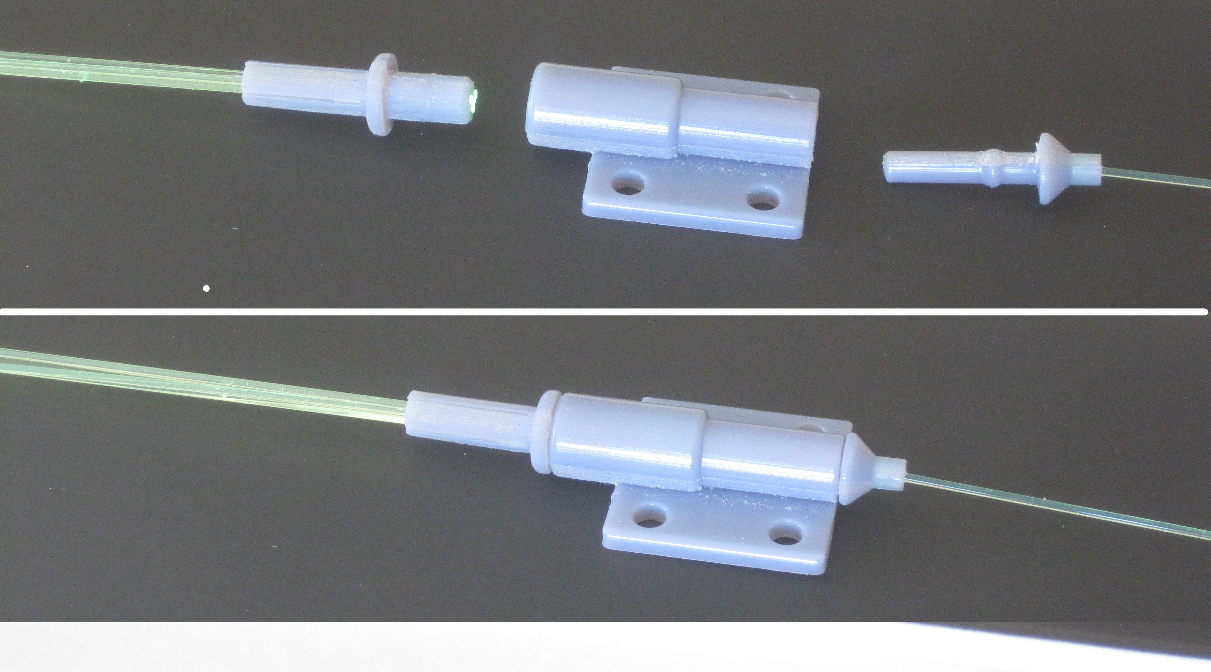
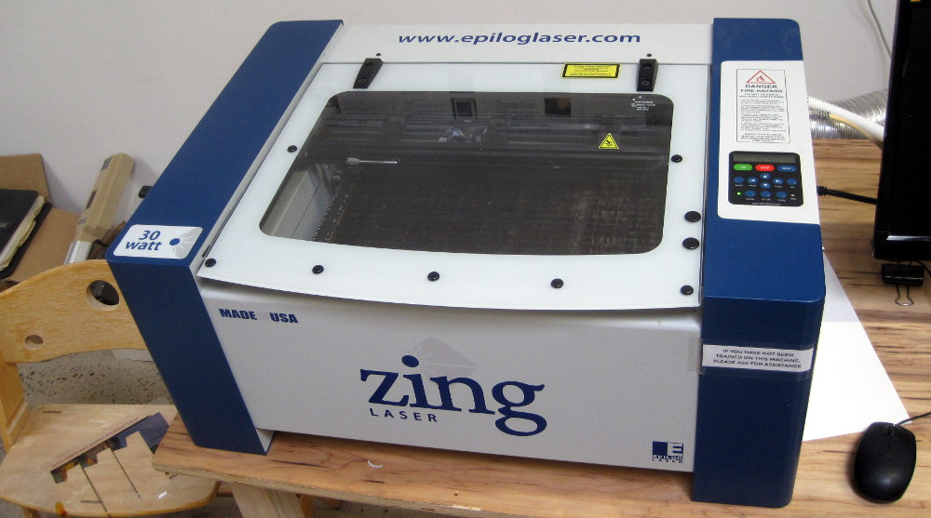
Calibration System Tested
Clear fiber with LED
Sharp raising edge
1->7 (more) split

Slide 13

Detector Assembly
All frames assembled
Mockup layout

Slide 14
Installation Plan being Developed
Detectors
Readout crates and modules
Cabling

