Slide 1
Dark Photon LDRD Progress Updates
Detector scintillator + WLSF assembly
All 8 modules assembled
SiPM readout preamp cards
All produced and tested, also in 1/4T B-field
To be installed this week
Full readout test with 7-channel completed and confirmed the design performance
Trigger firmware and lookup table
V1495 I/O tested, Initial trigger firmware developed
MC events produced, lookup tables and algorithm developed
DAQ upgrade completed
x10+ improvement, parasitical data taking with E906/E1039 possible
Fermilab safety document for detector installation
Work in progress, discussed installation details with Fermilab, to be completed ~2 weeks.
Full detectors to be shipped to Fermilab in the week of 3/12
Targeted date: 3/16 departure
Project is on track
New trigger system installed at Fermilab in March
Progress in theory and program development
Cross check calculations, plan a joint paper
An invited experimental review paper submitted to Modern Physics Letters A (MPLA, ~18 pages)
Invited for a presentation at the upcoming DOE/HEP new initiative small-medium scale dark matter workshop

Slide 2
Excellent progress in the last a few weeks
Detector assembly, SiPM readout and calibration system
Hubert, Alex, Sanghoon, Shaun, Pat et al
DAQ and Trigger firmware
Kun, Sho and Andi et al
Full system readout chain test at LANL
Sho, Xuan, Kun et al
More information at the Dark Photon project web page
https://p25ext.lanl.gov/darkphoton/

Slide 3
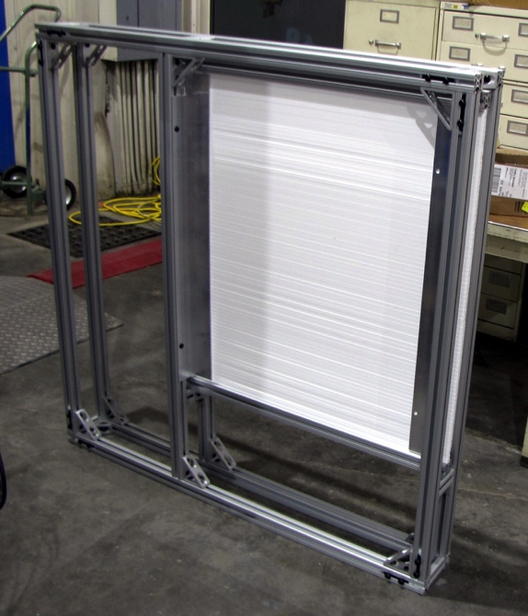
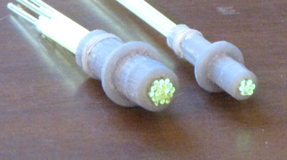
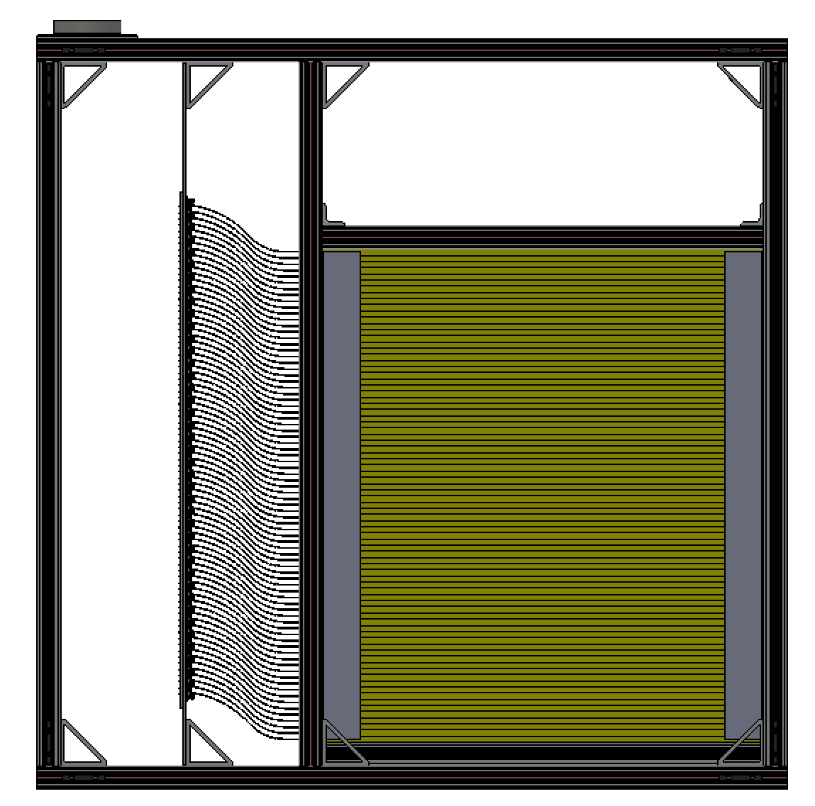
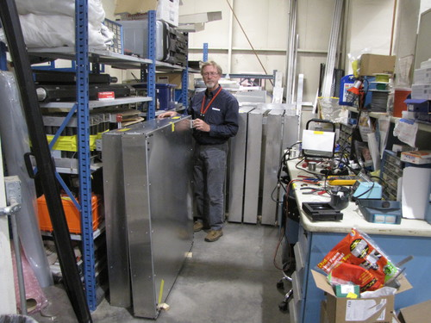
All 8 scintillator trigger modules assembled
Timing-calibration system
Fiber + LED pulsor

Slide 4
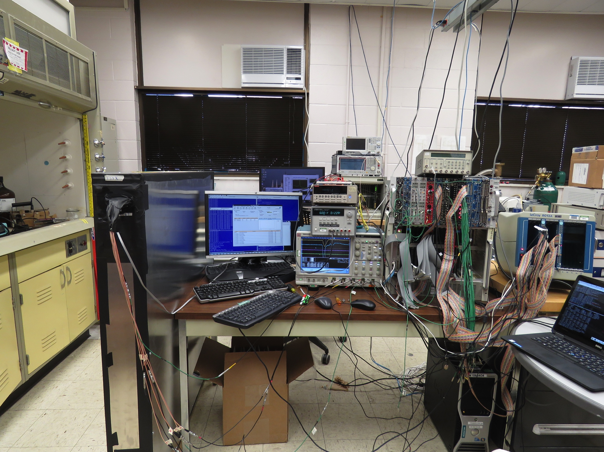
System test @LANL
Cosmic rays
A full detector
Module;
7-channel readout
E906 DQ
V1495 Trigger
Logic & TDC
LeCroy4413
discriminators
4-chan wave
form digitizer

Slide 5
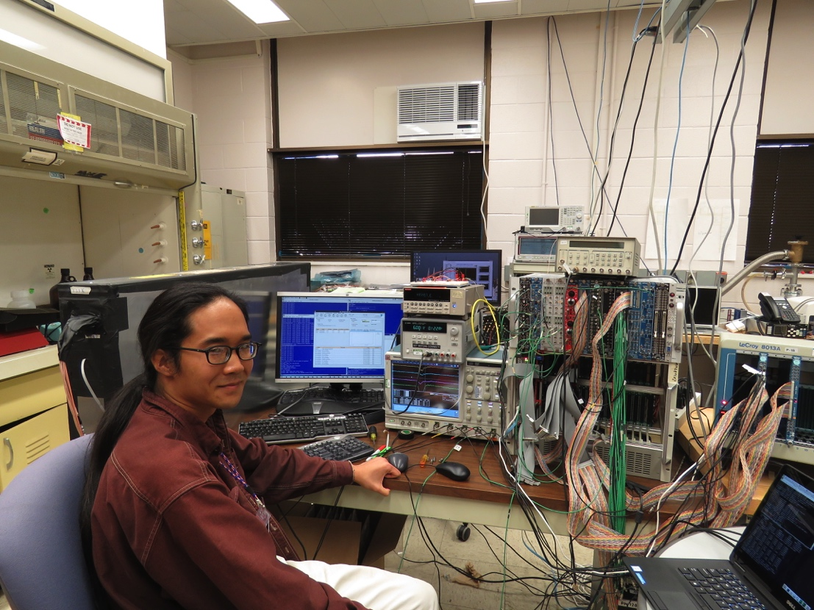
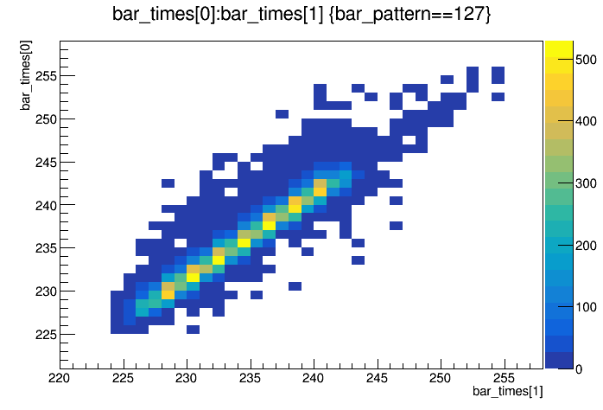
System test and analysis @LANL
Readout 7 channels from a full module
Cosmic rays
7-chan SiPM readout
LeCroy4413 discriminators
V1495 trigger logic + TDC read out
(also full 4-channel waveform readout with a scope)
E906 upgraded DAQ and firmware
Plan to move the whole standalone DAQ system to Fermilab for the commissioning
TDC_1
Also offline data analysis!
TDC_2

Slide 6
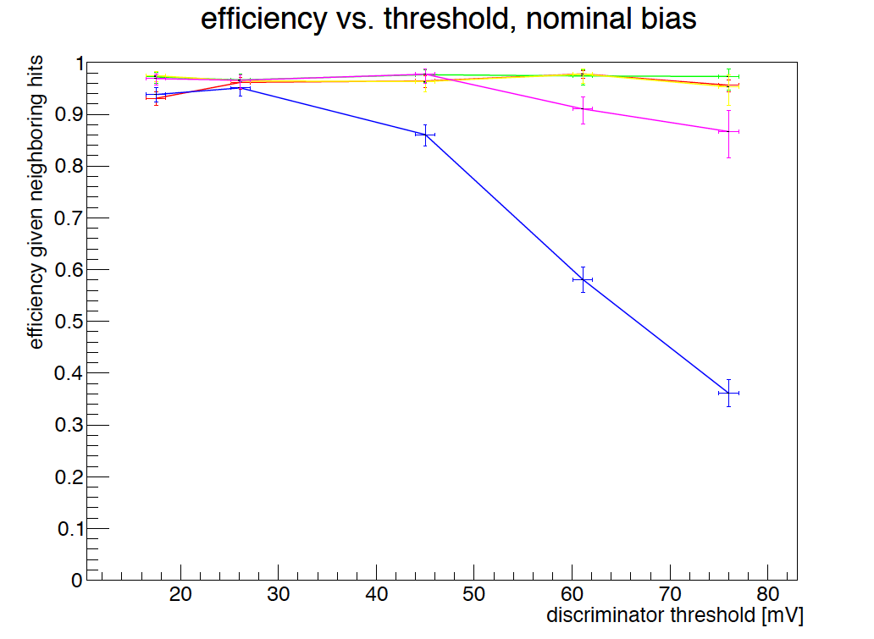
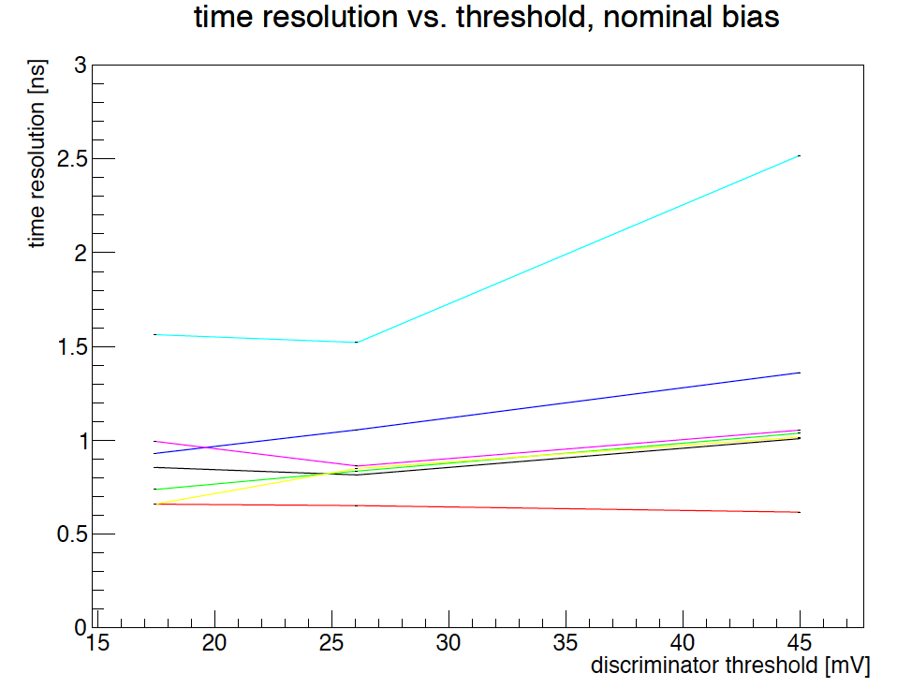
Results from system test Detector meets the design specs!
Efficiency vs threshold
Eff = 96~98% @20mV
Time resolution vs threshold
Better than 1nS @20mV
Fermilab RF = 19nS
Desired: Eff. > 95% (Eff_min > 90%)
Desired Time-resolution: better than 5nS
Low amplitude,
optical coupling problem?
Low amplitude,
optical coupling problem?
Threshold: ~ 20mV

Slide 7
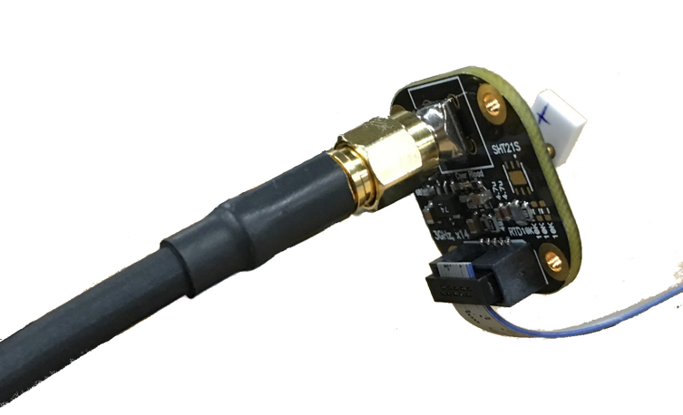
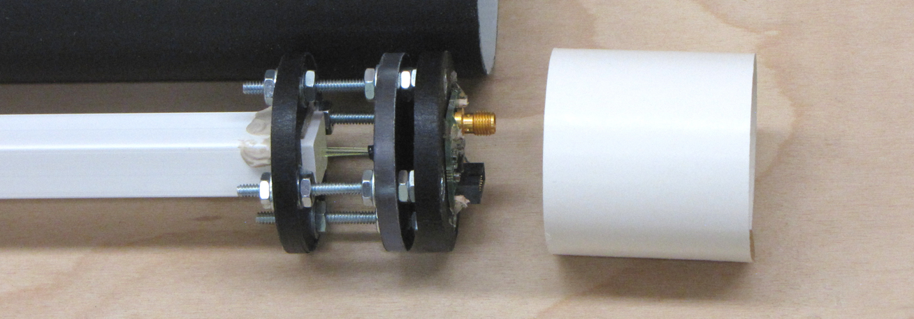
Pre-installation Test @Fermilab
Beam test of a single channel bar to check/confirm background rate etc.
Open access this week, Mon-Wed
Single channel readout integration and test in E906

Slide 8
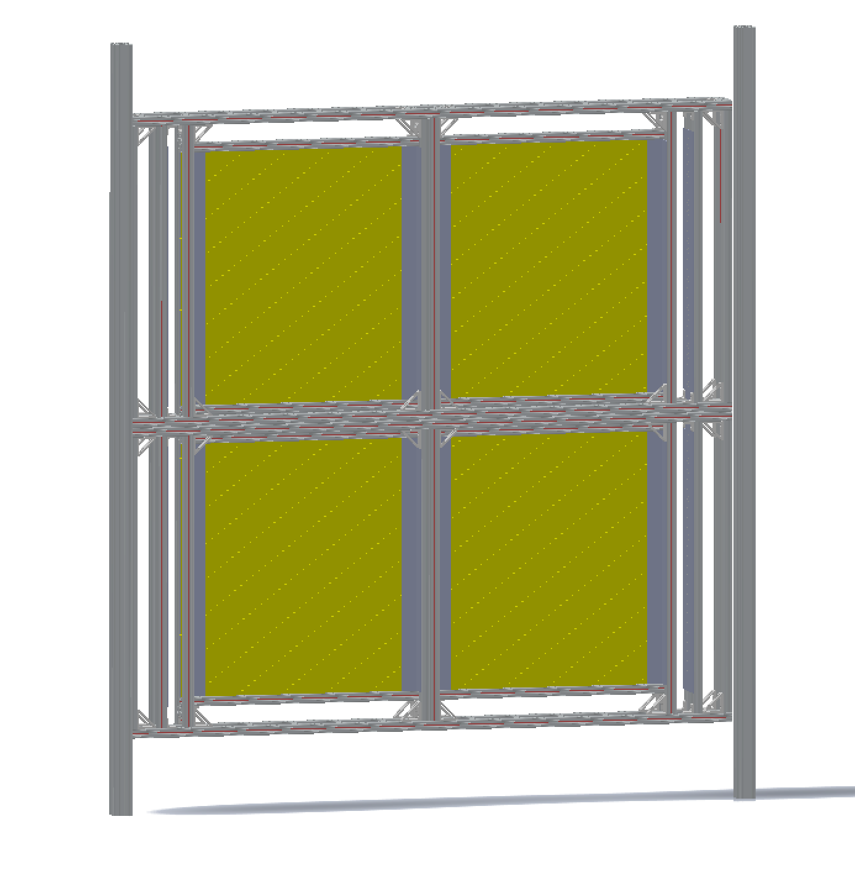
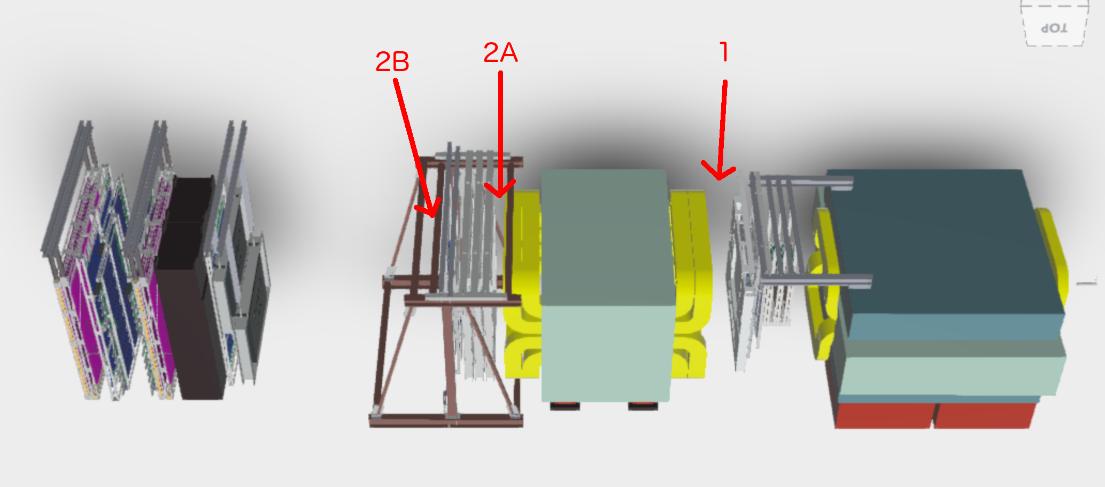
Installation Plan
Visited and discussed installation plan with Fermilab in Feb, 2017
4 boxes joined
2 vertical beams hold this assembly
Anchored to floor and overhead I-beams, details under analysis (St-1); default =2B
In progress:
Details of mounting points
Safety review document in progress

Slide 9
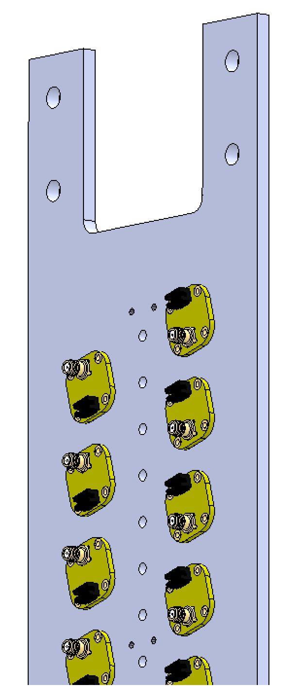
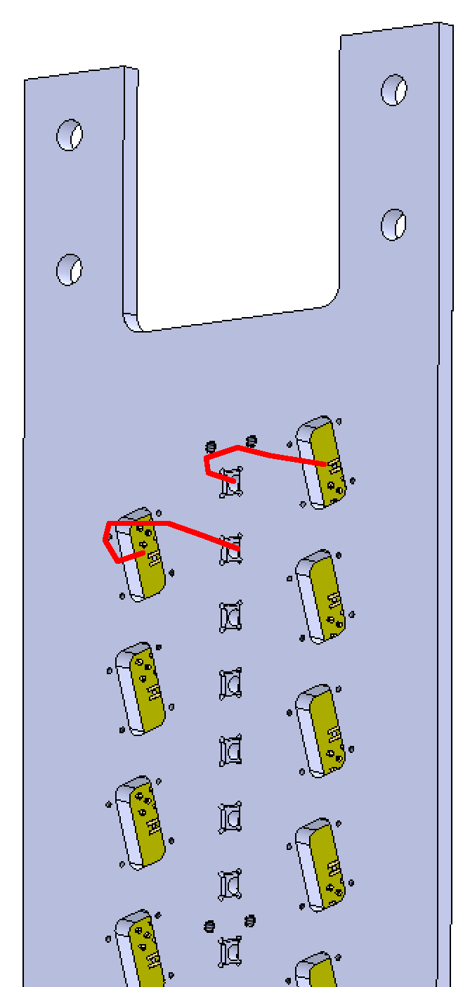
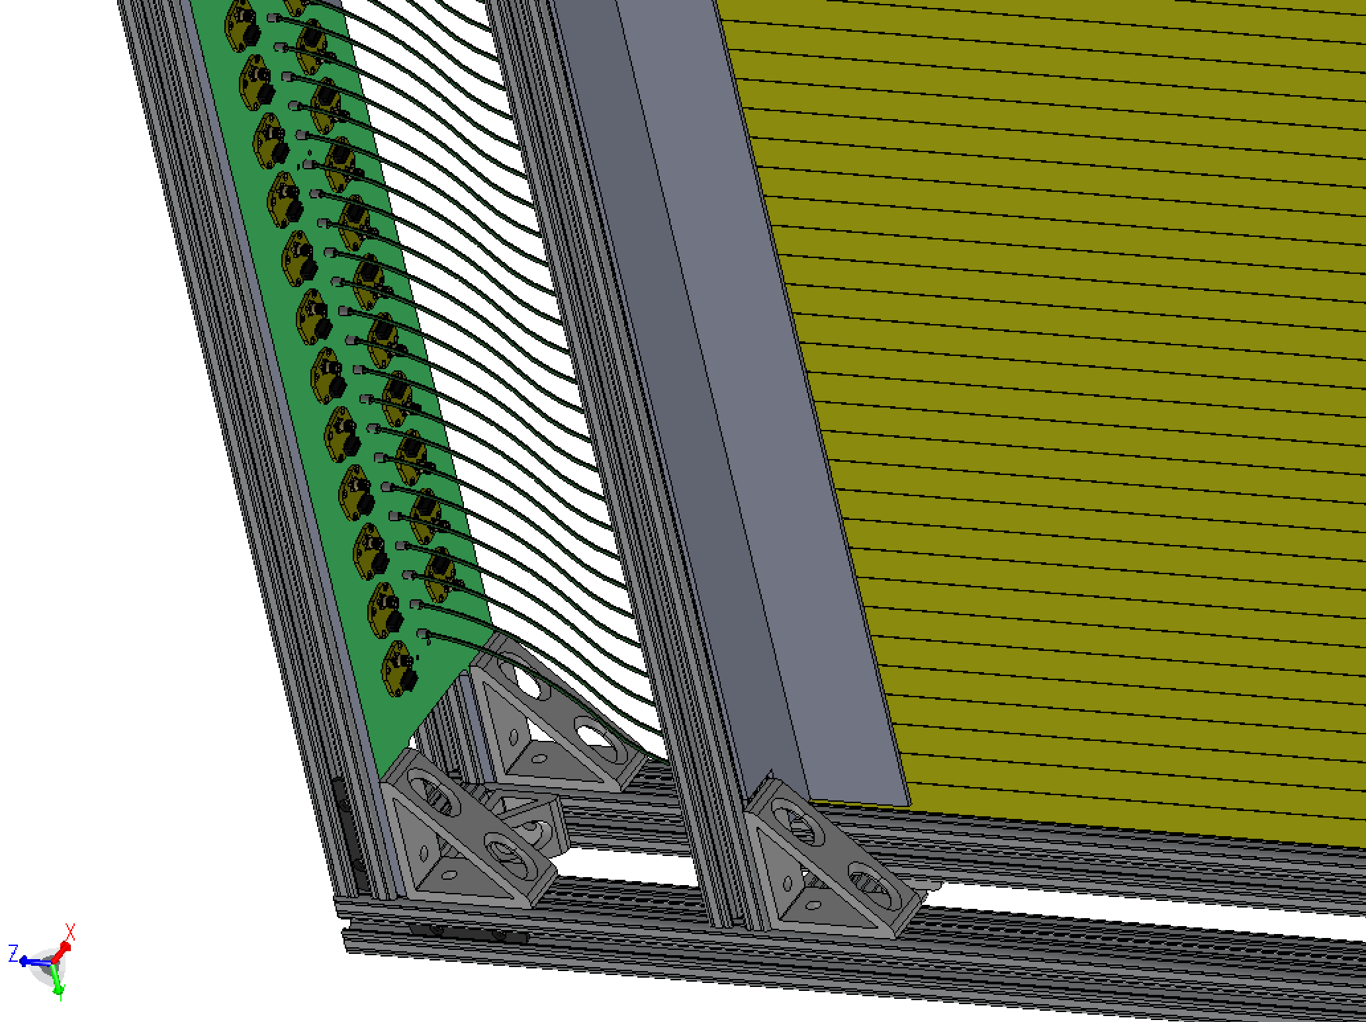
To-do and Plan
Complete SiPM installation this week
Readout plates available Monday
Install the calibration clear fibers
Fully assembled detector shipped to Fermilab for installation
Shipping in the week of March 12 (~3/16 departure)
Complete Fermilab safety document for review, to be ready for installation
Work in progress at Fermilab
CAMAC crates & LeCroy 4413 installation
Pre-installation beam test
LV/HV PS and distribution boards test & installation
To be ready for installation and commissioning

Slide 10
MAPS LDRD Progress Updates
MVTX Pre-proposal submitted to DOE through BNL
A milestone achieved early!
Build MVTX collaboration, and growing
Cost and schedule updated
BNL directors review planned, ~ mid April 2017
LDRD transition plan developed
Reviewed and discussed a plan, Jan 12, 2017
Readout Electronics R&D
Single chip MAPS evaluation board tested at LANL, low speed readout
High-speed readout MOSAIC test bench arrived @LANL, being installed
5 single-chip MAPS boards with high-speed readout adaptors ordered
Ordered 2 Readout Units (RUv1), will be available April/May, 2017
Obtained 2 Altera evaluation boards – CRU emulation
An EE postdoc candidate identified – Dr. Wei LU from BNL instrumentation
A joint R&D with TPC group to explore ATLAS FELEX readout option for sPHENIX
Mechanical integration
Conceptual design being developed
Interface to possible INTT intermediate tracker
MAPS staves and readout test @CERN
Send LANL staff/pd to work at CERN to assemble and test MPAS modules
Planned: April – September, 2017

Slide 11
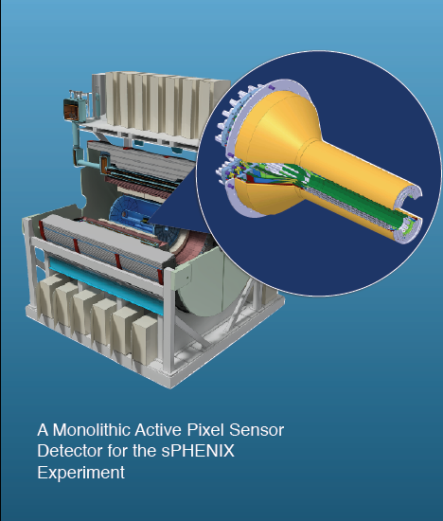
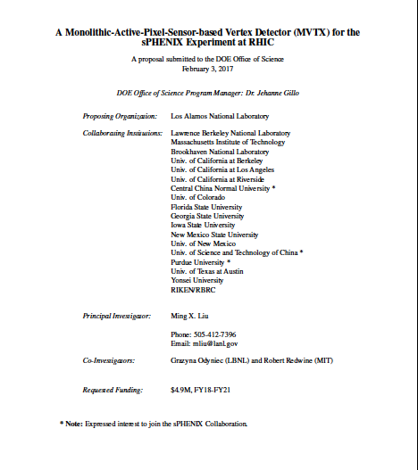
MVTX Pre-Proposal Submitted to DOE

Slide 12
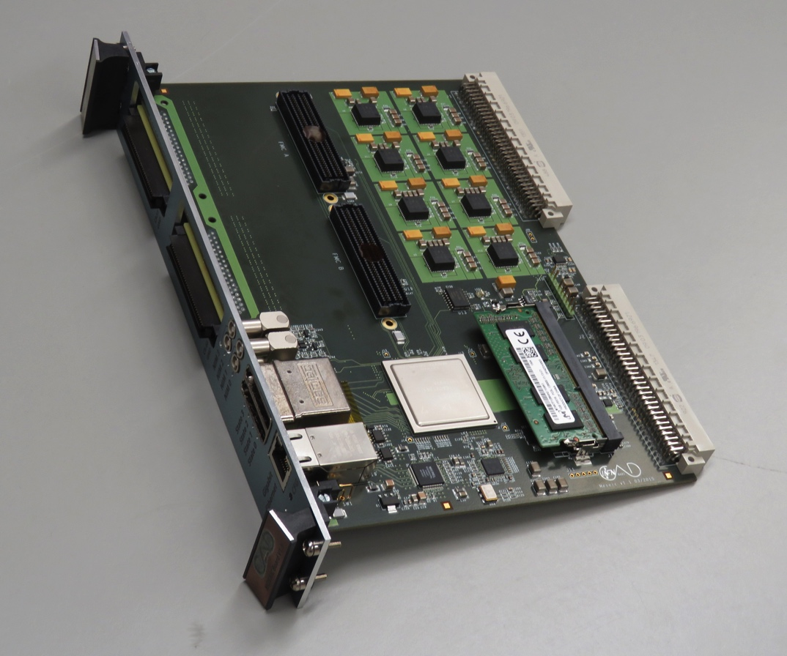
High-speed MAPS readout test bench @LANL
MOSAIC board
Readout two staves, 20 channels total
Will allow to test FireFly cables

Slide 13
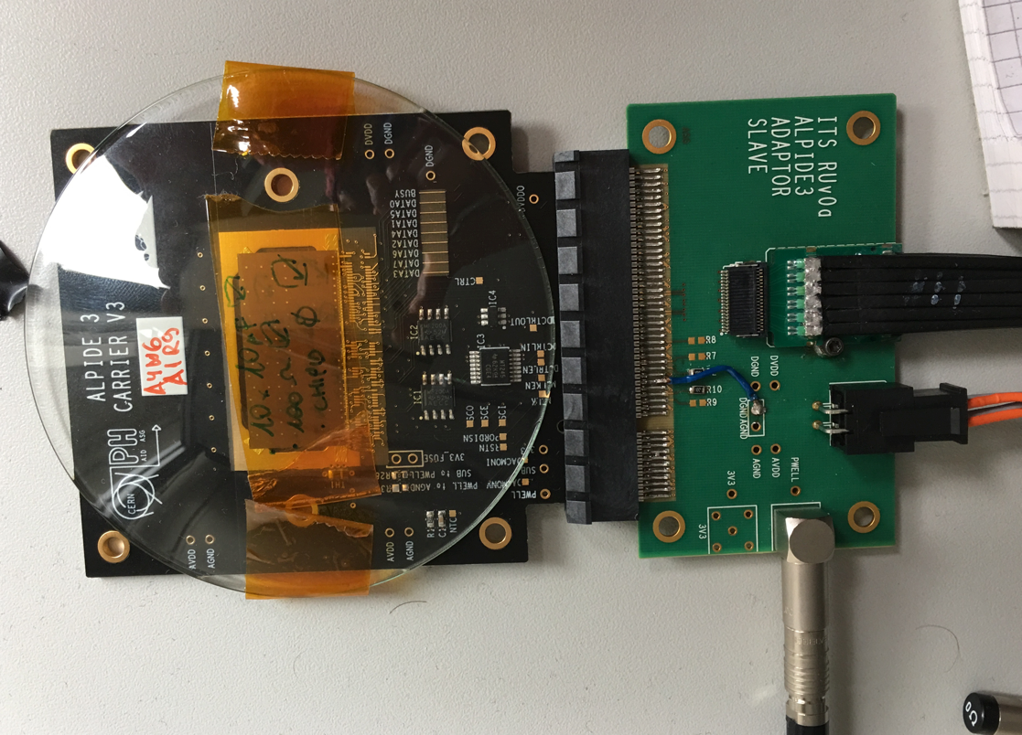
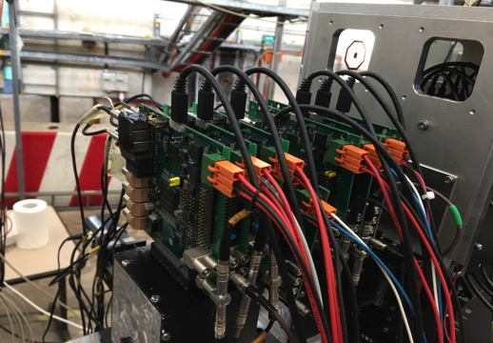
R&D at LANL:MAPS Chips
A 5-single-chip MAPS telescope
A single chip:
15 x 30 mm active area
- Have one chip with slow readout working;
- 5 more on the way to build a telescope at LANL

Slide 14
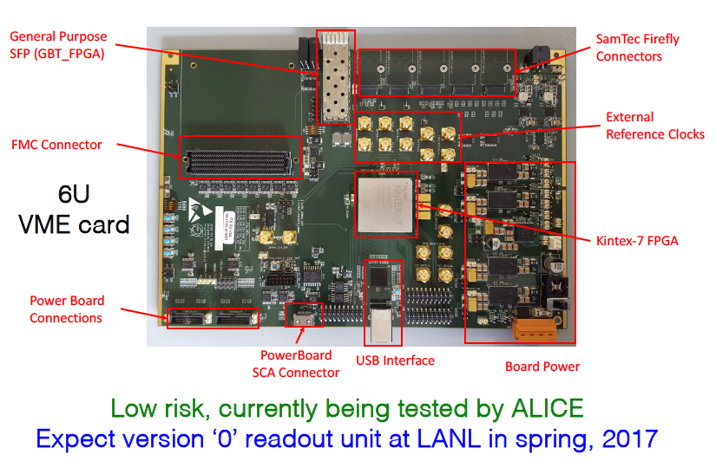
ALICE Readout Unit – Prototype 0
Expect to get 2 next version RUv1 ~April/May, 2017

Slide 15
From Pat McGaughey
Two being tested at LANL

Slide 16
sPHENIX Readout and Controls
RUv1: will be available ~April/May, 2017
CRU: available ?? 2 Altera Evaluation boards being used for R&D
UT-Austin and LBNL: on RU and slow controls, LV, HV

Slide 17
ALICE/ITS Current Status

Slide 18
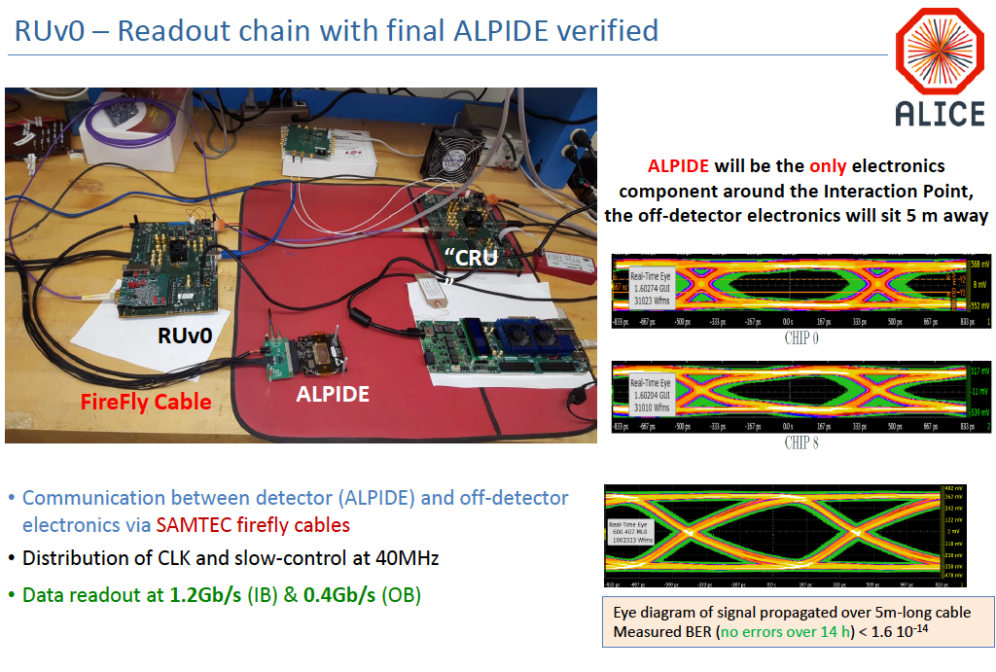
ALICE/ITS Current Status

Slide 19
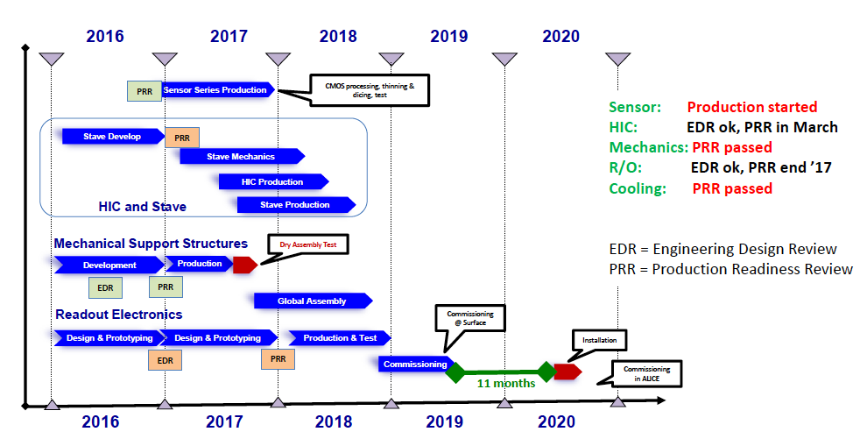
ALICE/ITS Current Status
LANL staff working at CERN to
produced and test staves: April – Sept. 2017
LANL@CERN
RUv1

Slide 20
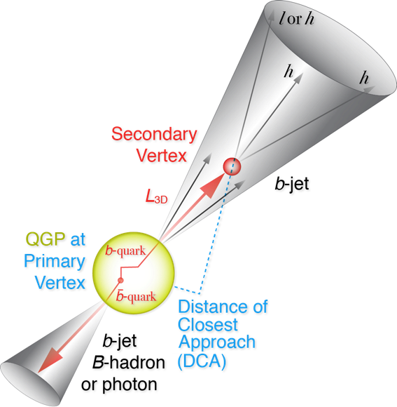
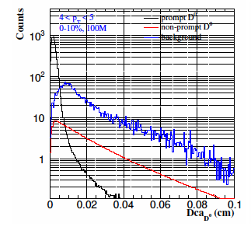
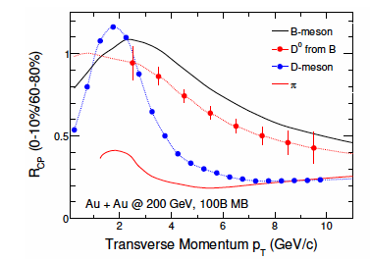
New Physics ideas and simulations
A new physics probe: beyond b-jet
B-hadron physics at low pT
low pT B interaction with QGP
B-hadron identification

Slide 21
To-do and Plan
Feasibility review report
Transition plan report
Readout R&D @LANL
MOSAIC test bench,
high-speed read out of multiple MAPS chips
Test Firefly cables, 5m, 10m etc.
Readout with RUv1 for single MAPS chip
LV, HV and slow controls with RUv1 on a single MAPS chip
CRU/Altera evaluation boards emulation
Follow up FELIX development
MAPS stave production and test at CERN
Produce 4 staves
April – Sept., 2017
Train LANL staff/postdoc
Physics simulations
B-jet and B-hadron identification
Pre-proposal review etc
BNL Directors review, ~mid April 2016
Develop a full proposal

Slide 22
LDRD Project Overview Ming Liu, P-25 December 5th, 2016
LDRD Goals
Develop a new QGP physics program with heavy flavor b-jet measurements in sPHENIX at RHIC
Carry out key detector R&D and develop a new MIE proposal to DOE to build a state-of-the-art MAPS-based high precision vertex detector to support the b-jet physics program in sPHENIX
Project Scope, Plan and Milestones
Experimental tasks
Theoretical tasks
Cost, Schedule, Procurement and Risk Management
Organization
sPHENIX/MAPS Project Web page:
https://p25ext.lanl.gov/maps/

Slide 23
MAPS-sPHENIX Electronics Integration
Plan A:
reprogram
ALICE readout path
Plan B: sPHENIX readout path (held as contingency)
MAPS FEM
DCM2
EvB
existing ALICE design
New development:
- Joint TPC & MAPS readout R&D
ATLAS FELIX Readout Unit
vs ALICE/CRU?
trigger in
modified design,
starting with ALICE boards
busy out
existing design
existing sPHENIX design

