Slide 1
Beam position and angular direction measurements 4/1/2015
Two sets of “position-sensitive diamond detector” ~2cm apart, better than 1mm spatial resolution
Quadrant Pattern
  (X,Y) and sigma
MC PYTHIA Sim
  MB to check rates
  Optimal detector locations

Slide 2
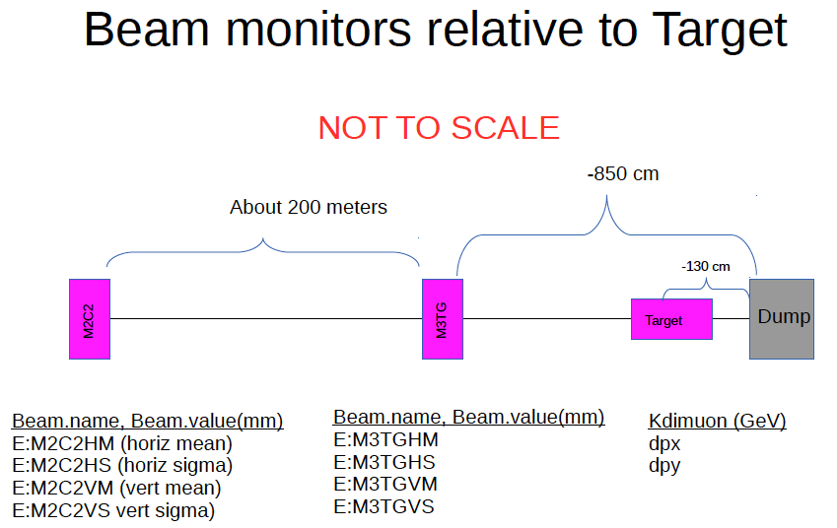
E906 Beam Line Layout
Dave K.

Slide 3
How to Measure Drell-Yan TSSA Raw Asymmetry at 10^-3 Level with a polarized proton target?
3/2015
The challenges of precision TSSA measurements
  Detector acceptance * efficiency varies >>1% level over a few hours of operation under a given “target polarization” configuration
  Very difficult to measure the relative beam on target(NH3) luminosity at ~10^-3 level
    Large beam x-y profile
    small target size
    Beam position/direction jitter (dX ~ 1-2mm),
      see https://p25ext.lanl.gov/elog/Hardware/12
    non-uniform DC responses to large beam intensity fluctuations (~O(10%))
    NH3 packing factor variation >~1% from target to target
    Target polarization known to ~O(3-4%) level through NMR
    Other variations, including target changes etc, ~O(1%)
  Frequent spin flip is hard/impossible
    can’t do what we are doing at RHIC and Jlab
    Takes time to reach a stable polarization
  We must be able to measure raw TSSA at 10^-3 level for a given target polarization configuration
A new approach needed

Slide 4


The Normal Approach in “collider-mode”: RHIC, JLab etc.
Spin UP(1) and DOWN(2):
A = <pol>*physics asymmetry, ~O(1%)
Relative luminosity,
for E1039, this is the luminosity of beam on target, which is very hard to measure to <<(0.1%)!
Need precision measurements of relative luminosity, better than ~O(0.1%)

Slide 5
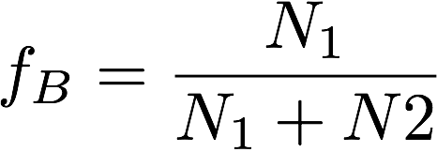
Reality: Not So Perfect Detector and Beam Controls
Not so perfect detectors (dt ~ minutes) without fast spin flip (dT << minutes)
  Polarized target spin-flip period ~ several hours
Acceptance varies within the time of a fixed “target spin config.”
  Time dependence
  Dead and hot space points
  Impossible to get to << O(0.1%)
If target is not a pure proton, for e.g. NH₃, another background fraction “f_{B}”, including all other supporting materials,
Background fraction:
Varies target to target
Target and time-dependent
DY events produced in “Target”
Target variation
(space,time) variation

Slide 6
False Detector Asymmetry Study
Run-2 data dimuons (Roadset 57)
Event selection:
  4< mass < 7
  Target events: -250 < z0 < -50cm
  Beam dump events: -50 < z0 < 200 cm
  Track quality cuts
Detector (relative) acceptance for DY events
  Raw “spin” asymmetries
  MC study need to correct target/beam dump acceptance difference
    Trigger road bias
    Detector acceptance corrections
  Further reduce raw asymmetry via target spin-flip and Fmag/kMag field directions
    Keep the same “target dipole field”, only change RF frequency to flip the direction of target polarization
    Change the FMag and kMag field directions
    Impact of Relative beam on target beam luminosity

Slide 7
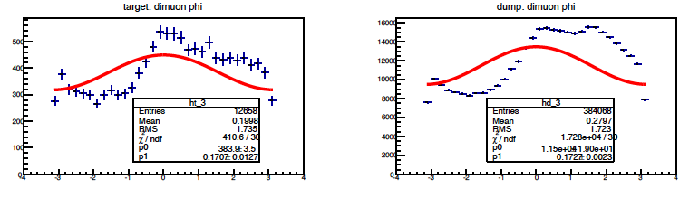
Run-2: Close Look of DY Phi Distributions
We need to get the false asymmetry << 0.1% ~ expected raw spin asymmetry
A = 0.171 +/- 0.013 --→ 100x too large!
Huge false asymmetry: >> X10 sigma

Slide 8
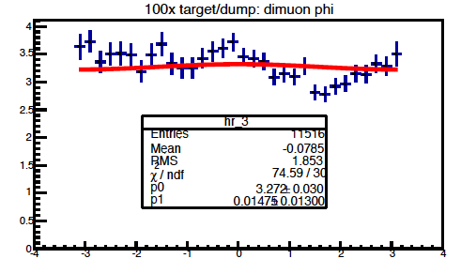
A New Approach
Using the same DY events from beam dump to normalize the detector acceptance effects
  Beam dump events, 100x statistics, similar muon acceptance
    the stat_err from reference << signal stat_err
  the beam dump asymmetry = 0
    Known physics
  normalize the beam intensity
    Can achieve O(1%) on relative luminosity of beam on target, with dedicated telescopes
  Identical timing and spatial variation of detector acceptance and efficiency for signal and background
    Can achieve O(0.1%) on raw asymmetry
False asymmetry after normalization:
~ 1 sigma, good!
Need to run ~100x more MC or data to prove we can reach 0.001 level!

Slide 9
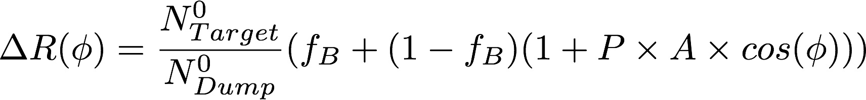
How it works?
If we use the same DY dimuon events
(mass, pT,xF etc) from Target and Dump:
the time-dependent detector acceptance variations are mostly canceled out
The small difference can be corrected with MC and data by using the muons measured in the same phase space
Much reduced requirements on relative lumi, background fraction, target polarization measurements
  sufficient at O(1%) level.

Slide 10
Run-2 DY Dimuon (Roadset 57): all targets
vtxZ
4 < m <7
phi
pT
target
dump

Slide 11
J/Psi MC at Production: Phi

Slide 12
Drell-Yan MC: H and Dump symmetric distributions

Slide 13
Future Work for improvements
Detailed MC simulation with the new polarized target position
  Prove the systematic error can be controlled to O(0.1%)
  Target/Dump DY acceptance correction study
  100x more MC events to reach O(0.1%) level precision
Run2 and Run3 data analysis to understand and correct the large asymmetry
  Beam axis, directions
  Detector response to instant beam fluctuations
  Systematic reduction of the false asymmetry
New beam position/direction monitoring instruments?
  Summer shutdown work 2015?
Beam on target luminosity telescope
  Summer shutdown work 2015?

Slide 15
Ming’s T&E on Pol. DY LDRD
T&E @20% level (for budget purpose)
  Joint effort of (Kun + Ming)
Focused efforts
  Integration and transition from E906 to E1039
  Simulations and optimization
  Polarized target related work
Progress
  2015 summer shutdown work plan
    New relative luminosity telescopes etc.
    Possible electrical and mechanical work in target area
  Identify and develop experimental approach to do high precision spin asymmetry measurements
    Simulations with optimal target positions
    Using E906 data and MC to test and confirm new approaches
Future work
  Target test and installation
    Pump and cryo
    NMR
    Calibration
  Design and build the target actuator
  Development of the target control and monitoring software
  Trigger/DAQ optimization

Slide 16
The Measured Asymmetry:
Xiaodong’s talk at LDRD meeting 3/12/2015
P_{T}=0.8 target polarization
~0.1
for pure NH₃ dilution factor:
In reality, need count all unpolarized material in beam’s path, f=0.12~0.14.
In JLab Hall B, deep-inelastic scattering data, f=0.14 (eg1-dvcs).
➔ Need to control systematic uncertainty on measured asymmetry to δ(A)_{meas} ≈ 0.1%
Extremely Challenging !!!

Slide 17
Xiaodong’s talk @LDRD meeting
Over two years of data collection, need to carefully monitor the changes of:
Beam pulse intensity, duty factor, charge profile, halo…
Target contents, Helium level, polarization…
Trigger Eff. detector responses, DAQ dead time…
Background. Track reconstruction Eff. …
➔Control raw false asymmetry:

Slide 18
Note from Andi and Pat
Dilution factor
Packing fraction
Empty target (what is it)
Study of background with distributed vs single target in E906
Study e906 empty vs hole target (david task)
background contributions
relative luminosity
beam monitoring (90 degree monitor) luminosity measurement (measure intensity * target mass)
synchronize beam spill with NMR measurements (random or regular)
  help us determine depol during spill
beam asymmetry on target determined by spectrometer:
  However: assumes symmetric response. Need to measure this.
  E906 data analyzed. (david kleinjan)
beam profile during spill
time sync between DAQ and pol target (fast control vs Slow control)
What do we need to record on spill by spill from target system.
Design Labview for target system.
Design interface between labview and DAQ; responsible for recording history
influence of changing beam profile; as an example go from symmetric profile to asymmetric. What would be the limits we could see. Also matters for non homogeneous polarization.
Rate dependence in spectrometer efficiency as a function of geometry. Does not cancel in 2nd order
polarization and intensity connected. Over time pol decreases so need to find a way to have same intensity * p product.
beam angle:

