Slide 1
FY17 Highlights of Dark Photon Search at Fermilab
Ming Liu, P-25
Dark Photon/Higgs Search @Fermilab LDRD/ER Team
Overview, 20’ – Ming
Theory Highlights, 10’ – Kang & Vincenzo
Experimental Highlights, 35’ – Sho & Kun

Slide 2
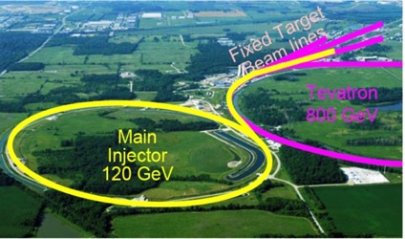
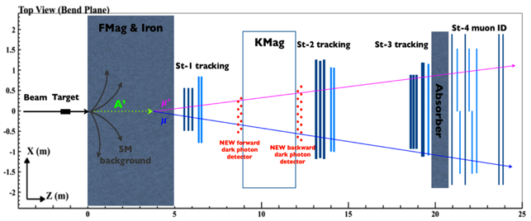
SeaQuest at the Intensity Frontier at Fermilab
SeaQuest
High intensity proton beam: “beam dump mode” @SeaQuest/E1067
35,000 fb⁻¹ (in a 2-year parasitic run, 1.4x10¹⁸ POT @5% beam)
LHC-II: 300 fb⁻¹ (~2025), achieved 25fb⁻¹ in Run-I

Slide 3
Goals and Scope of the Project (from Proposal)
Dark photon
sensitivity
projection
Pol. Drell-Yan E1039

Slide 4
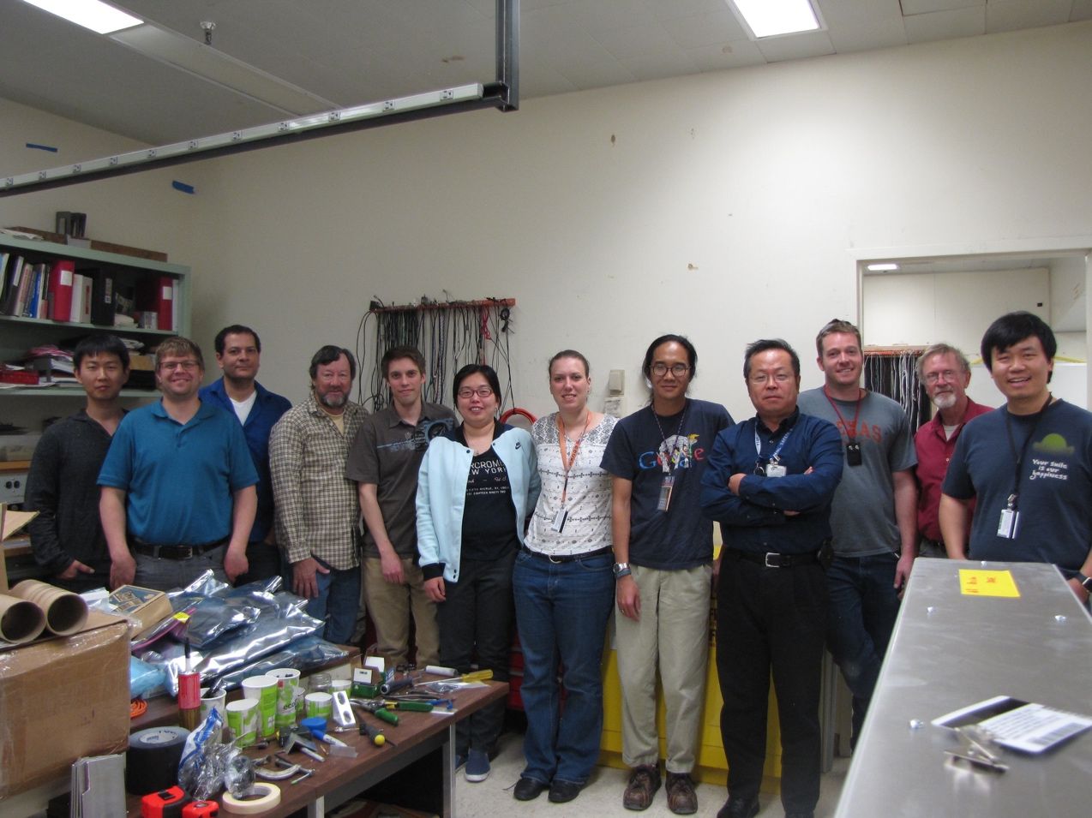
People Involved
Experimental efforts (P-25): ~8 staff + 8 PD/Students + 2 Engineer/Tech
  Ming Liu, Kun Liu(PD, Staff), Sho Uemura (PD, 11/2016-), Grass Wang(PD, 7-9/2016), Pat McGaughey, Hubert van Hecke, Andi Klein, Cesar da Silva, Matt Durham, Sanghoon Lim(PD), Shaun Newman(P-21, Mechanical Engineer), Xinkun Chu (Student, graduated 5/2017), Xuan Li (PD), Marie Boer (PD), Dave Kleinjan(PD), Alex Wickes(Student), Jeff Bacon, Richard Van de Water
Theoretical effort (T-2)
  Zhongbo Kang
  Vincenzo Cirigliano
External collaborators
  Fermilab/SeaQuest
  BNL/sPHENIX
  SLAC/N. Toro, P. Schuster
  Caltech/Y. Zhang
  Univ. Cincinnati/S. Gori
  And growing …
All 8 final trigger detector modules, calibration system, HV/LV and controls electronics were designed and built at LANL and shipped to Fermilab 4/03/2017

Slide 5
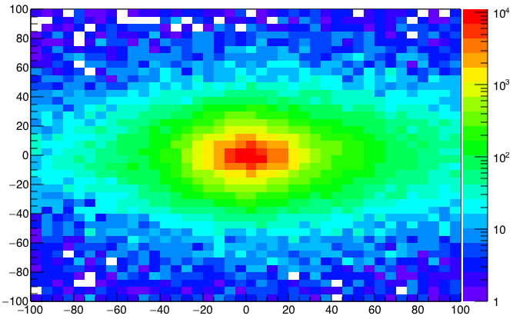
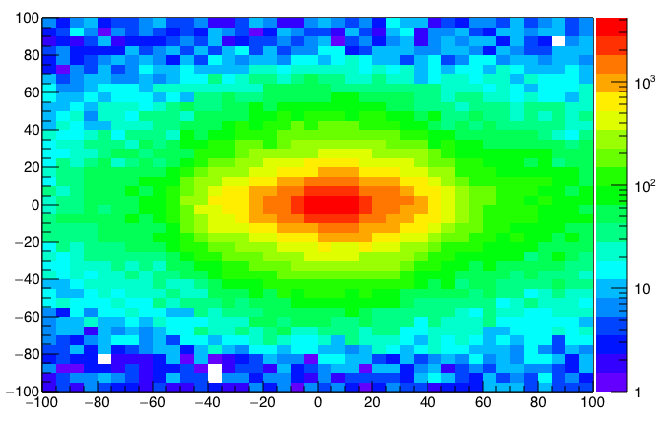
A New High-Granularity Displayed Dimuon Vertex Trigger
High rejection power, low rate, < 1 kHz (previous E906 DAQ limit)
Y-Plane (non-bending) Trigger:
A quadrant panel: 80cm x 80cm (100cmx100cm @ST-2)
  ST1: 1cm x 1cm x 80 cm scintillating strips, SiPM readout
  ST2: 2cm x 2 cm x 100 cm strips
- Straight line projection, σ_{Z} ~30cm
Displaced z-vertex, mostly low mass < 3GeV
Y
Dimuon Z-vertex (cm)
ST1
X
St1
St2
Z
Coincident Z-vtx
Matched @Lvl-2
Z1=9m
Z1=12m
ST2

Slide 6
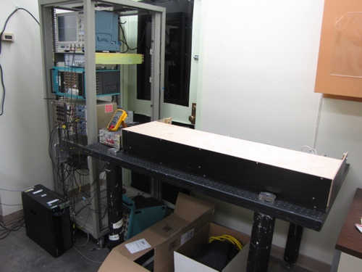
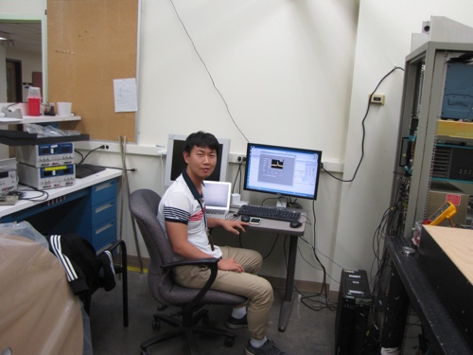
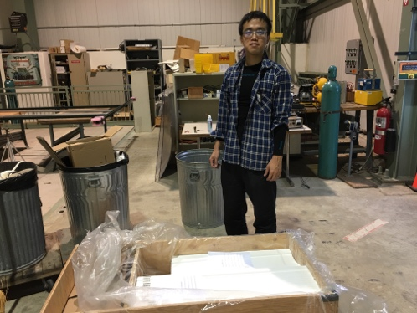
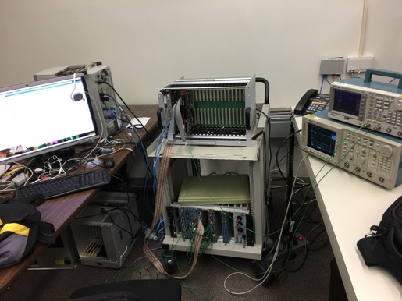
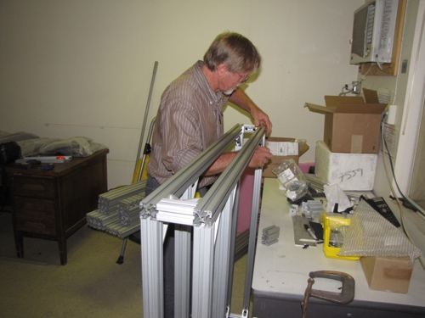
Achievements in the 1st Year (FY16)
Completed trigger detector R&D and technology down selection
  Extruded scintillators, produced at Fermilab
  WLSF, procured from Kuraray, Japan
  SiPM readout in strong magnetic field, procured from Hamamatsu, Japan
Completed preliminary design of the mechanical frame
  80-20 Al frame selected
  Assembled 4 (50%) 80-20 box-frames at LANL
Redesigned DAQ readout with a new architecture
  Take advantage of the beam spill structure: 4sec/60sec
  Preliminary new DAQ firmware developed and tested
Down selected trigger electronics
  CAEN V1495 logic boards for LVL-1 & LVL2
Developed a new GEANT detector simulation package
  Preliminary physics study
Completed LO and NLO calculations
  Provided Drell-Yan and Dark Photon event inputs for simulations
TB @LANL
Prototype R&D
Scintillators
New DAQ R&D
80-20 Al frame

Slide 7
Major Tasks and Accomplishments in FY17
Goals
Accomplishments
Successfully commissioned the new DAQ and integrated the dark-photon trigger system
  DAQ bandwidth improved by ~10
  A new displaced dimuon trigger electronics & firmware
Designed and built full trigger detectors at LANL
  Extruded scintillators + WLSF + SiPMs, 520-channel
  80-20 Al box frames + global supporting structures
  Station-1:
    4 quadrants, 80x80cm^2 each, 320 channels
  Station-2:
    4 quadrants, 100 x 100 cm^2 each, 200 channels
  Optical calibration system
  LV/HV power distribution and control boards
Installed and commissioned trigger detectors @Fermilab
  Timing resolution: < 1.5 nS (collision rate ~ 19nS)
  Track hit eff. > 96% (from cosmic)
Took production data parasitically with E906
  Detector calibration, performance and initial search
Completed DY & DP QCD resummation to all order
  Inputs to physics simulations
Complete DAQ Upgrade
Complete trigger detector construction
Trigger detector installation and commissioning
Take data with E1039(E906)
QCD resummation

Slide 8
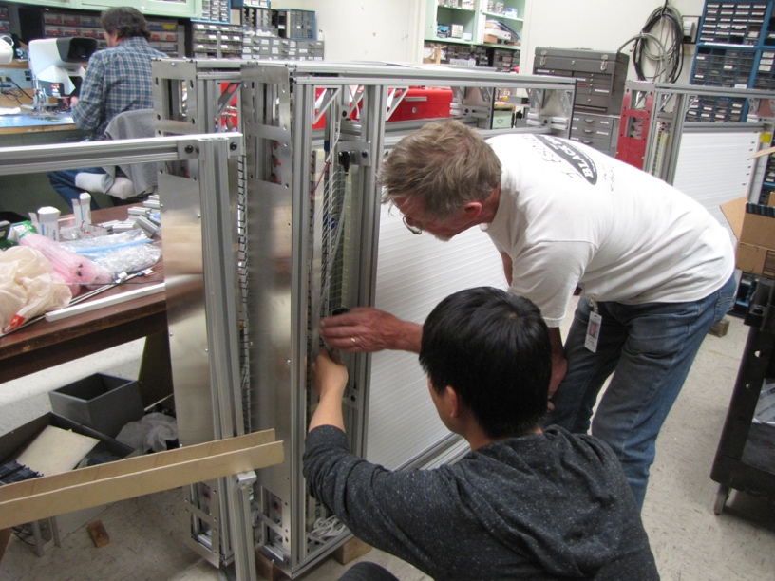
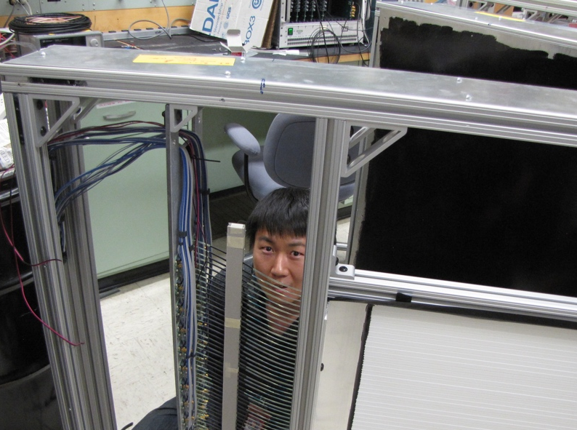
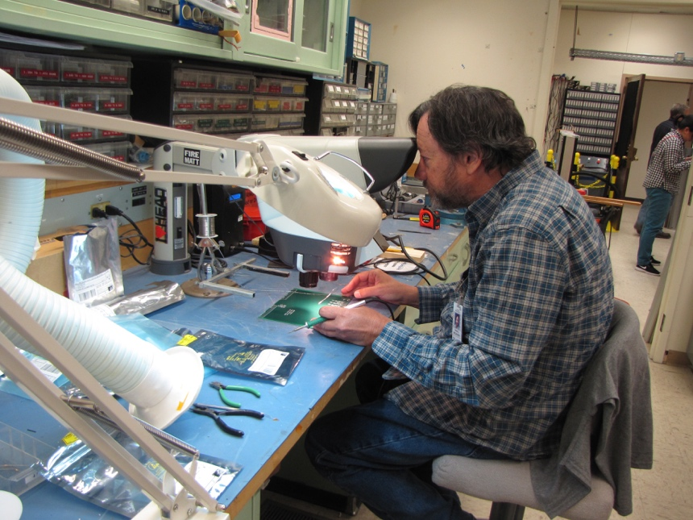
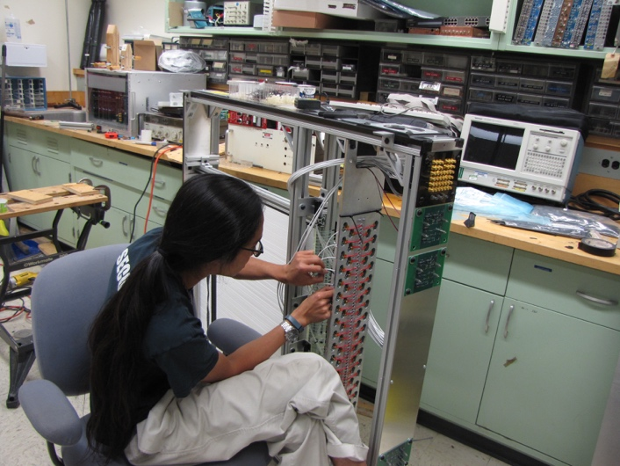
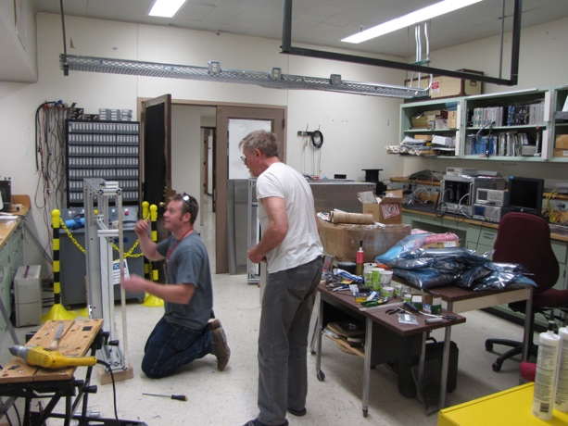
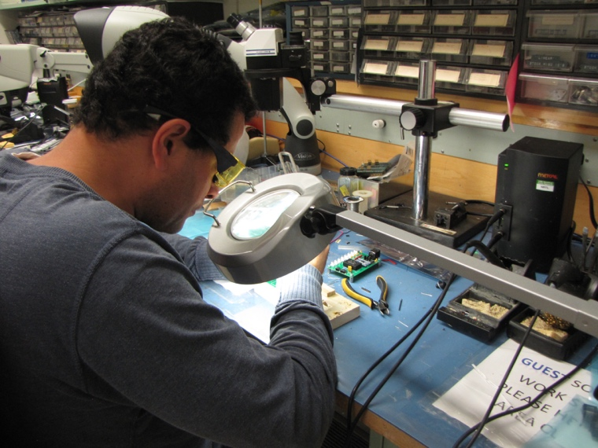
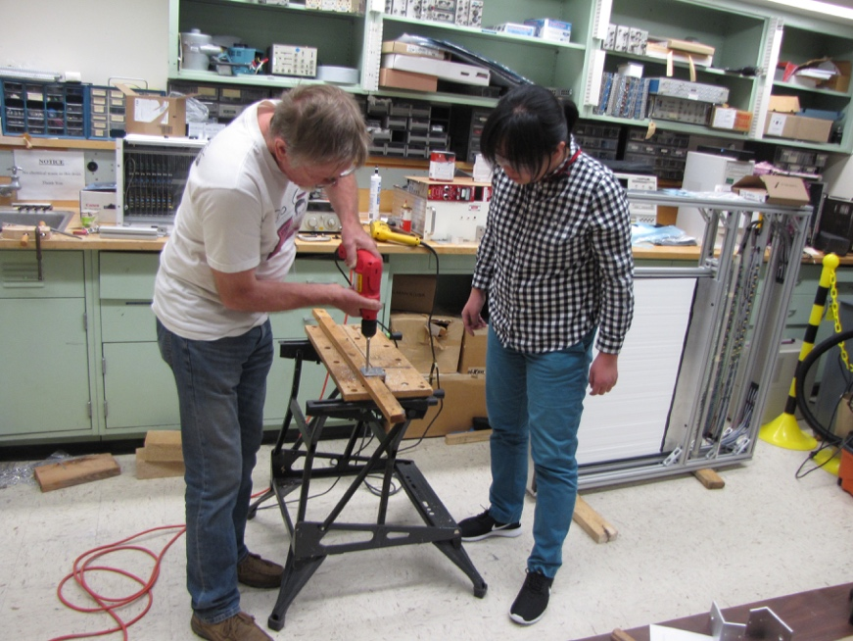
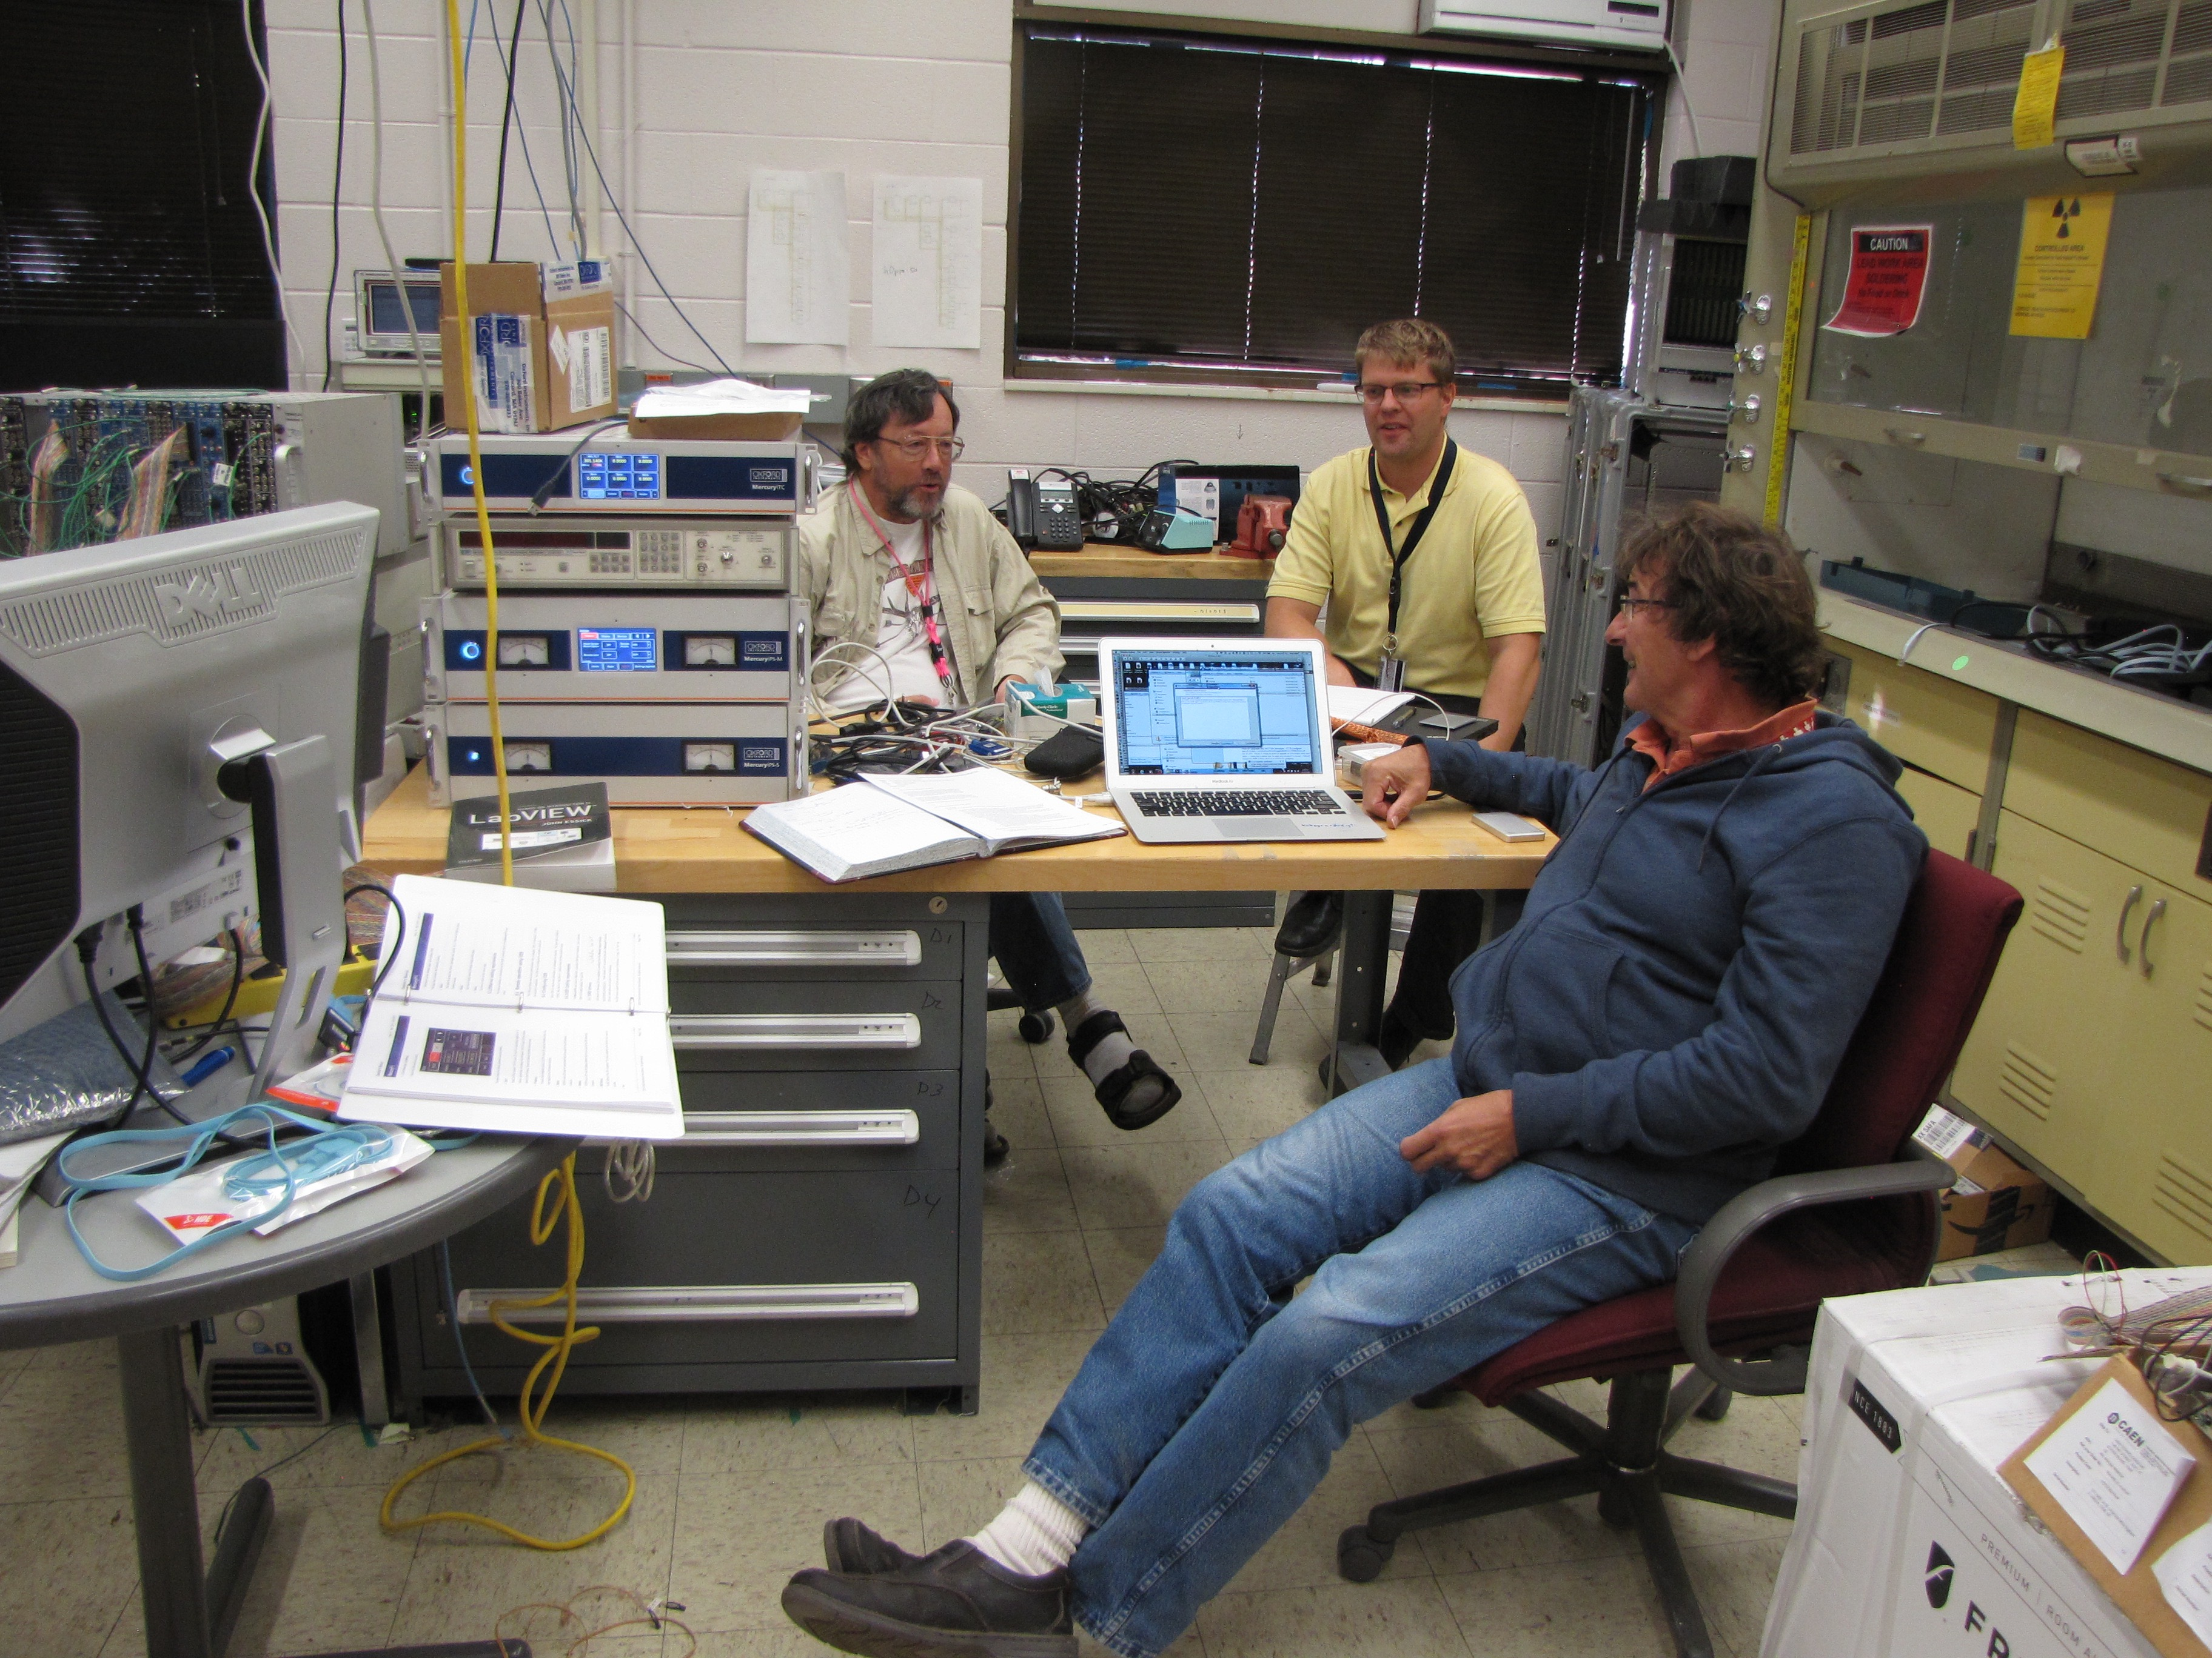
Very Successful Team Work!

Slide 9
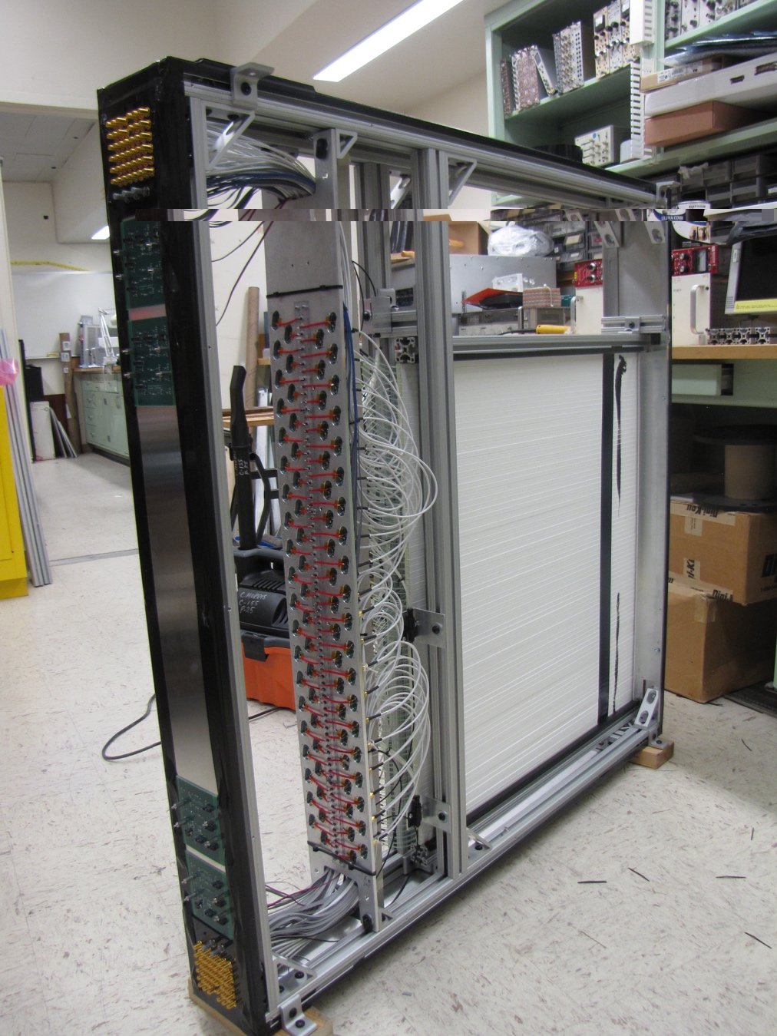
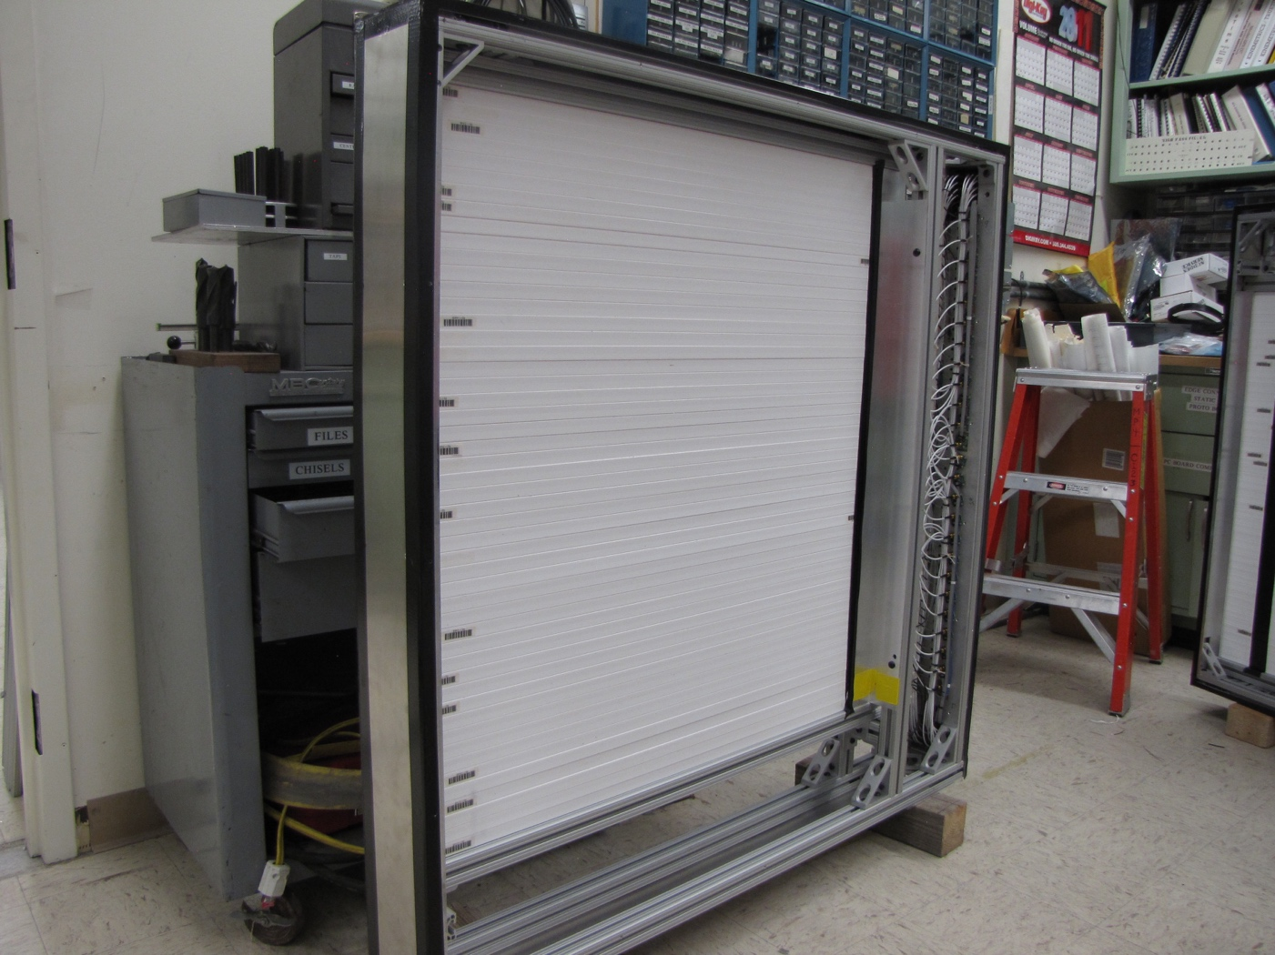
Completed modules, 8 of them in total!
Station-1: 80 x 80 cm², 80 channels
Station-2: 100 x 100 cm², 50 channels

Slide 10
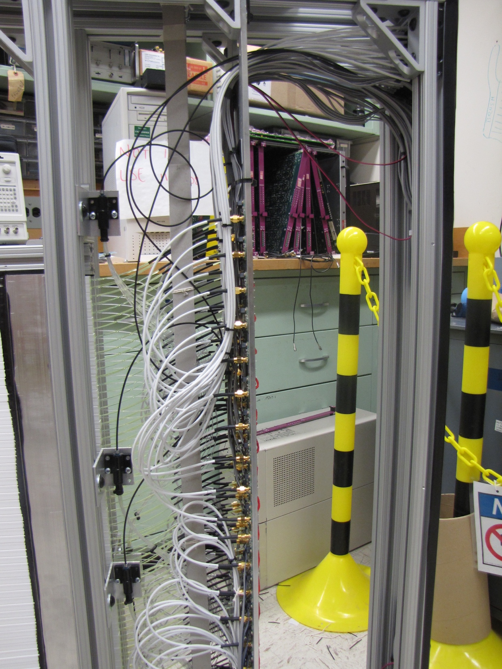
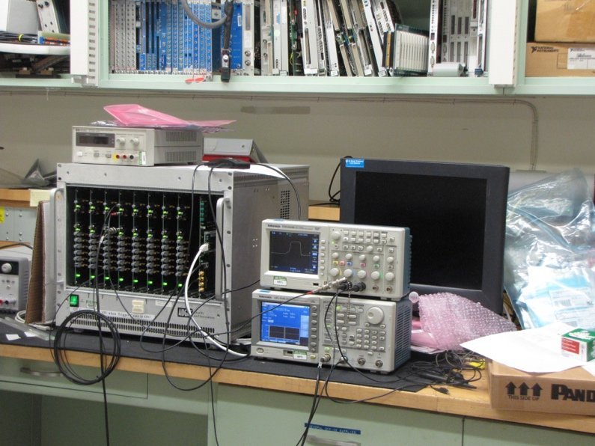
Optical Calibration, LV/HV Power Distribution and Controls Systems
All designed, built and
tested at LANL
Optical pulse generator
designed/built at LANL

Slide 11
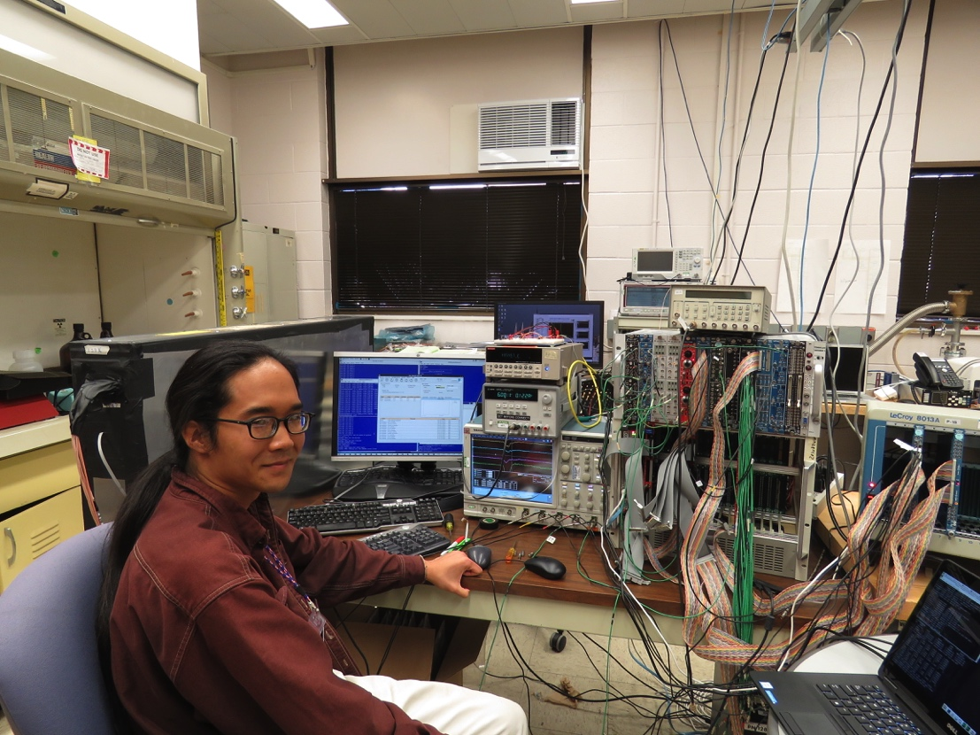
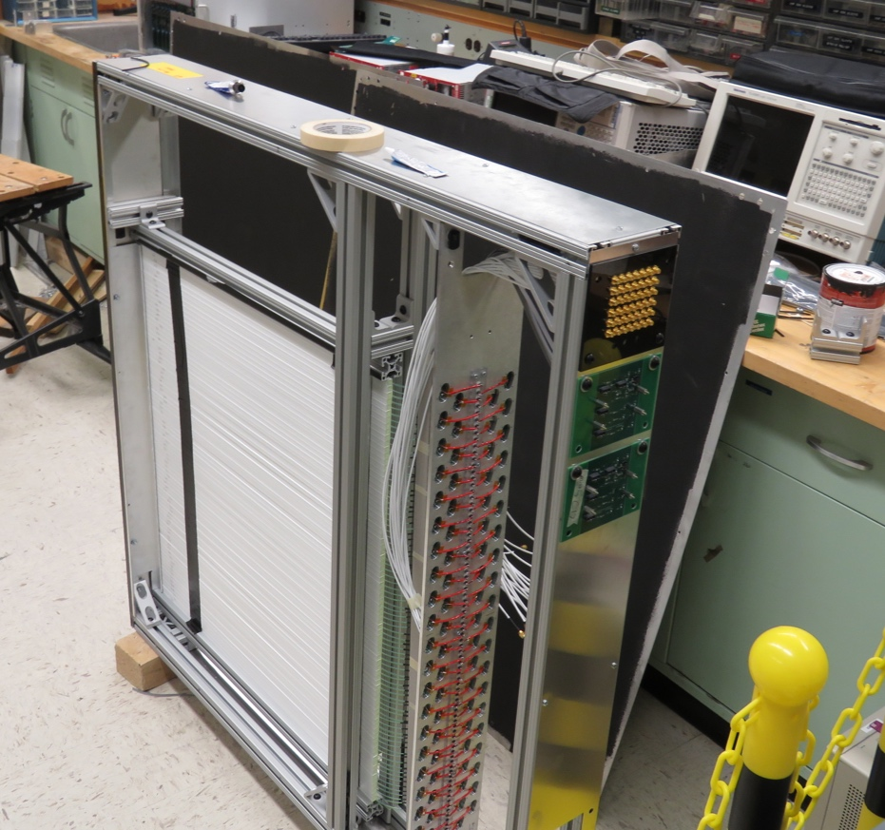
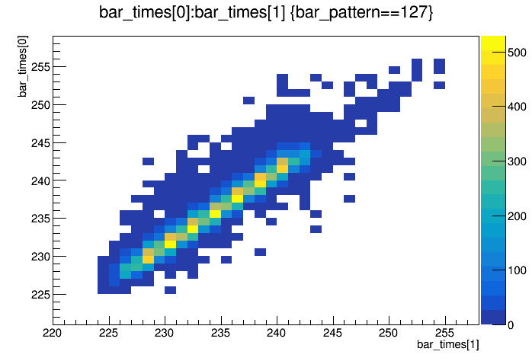
Trigger, DAQ R&D and Cosmic Test @LANL
Trigger & DAQ hardware and firmware designed and tested at LANL, in collaboration with Fermilab Engineers
Readout from a full module for cosmic test
  Full SiPM readout
  V1495 trigger logic + TDC read out
  E906 upgraded DAQ and firmware
Timing resolution, < 1.5nS (19nS RF)
Detector eff. > 96%
TDC_1
TDC_2

Slide 12
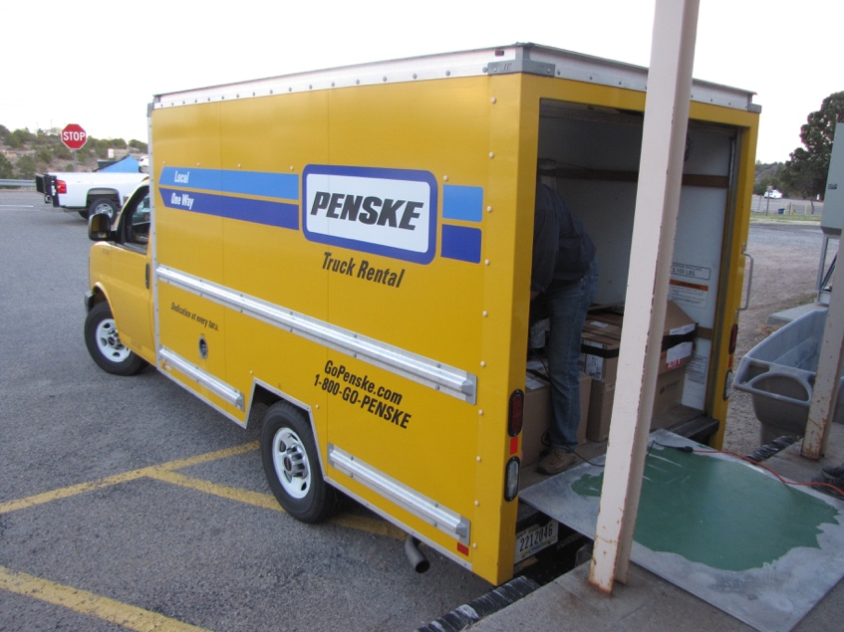
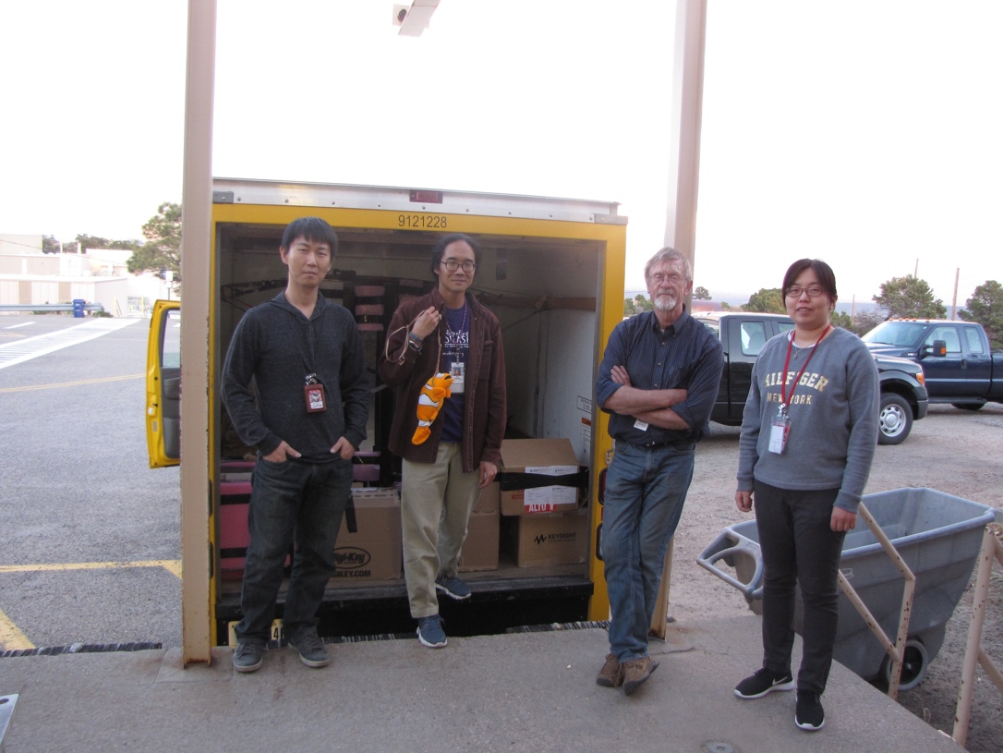
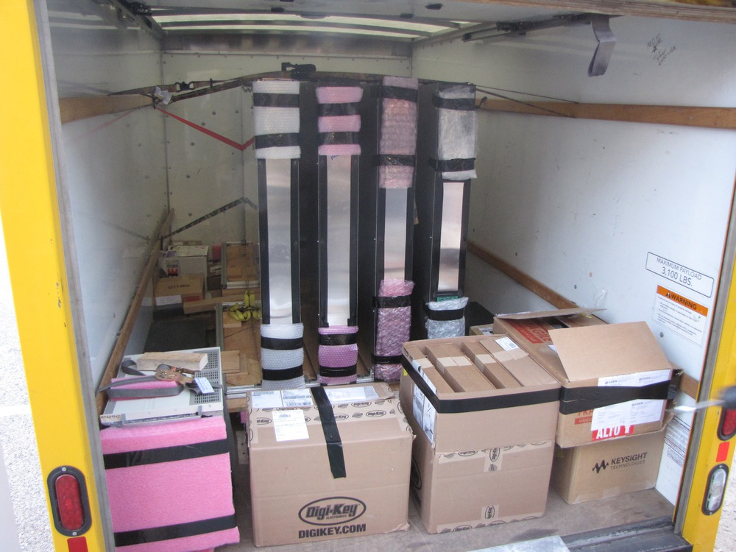
All Trigger Detectors Designed and Built at LANL, Truck loaded to Fermilab on 4/3/2017
Eight trigger detector modules
Electronics and Power supplies

Slide 13
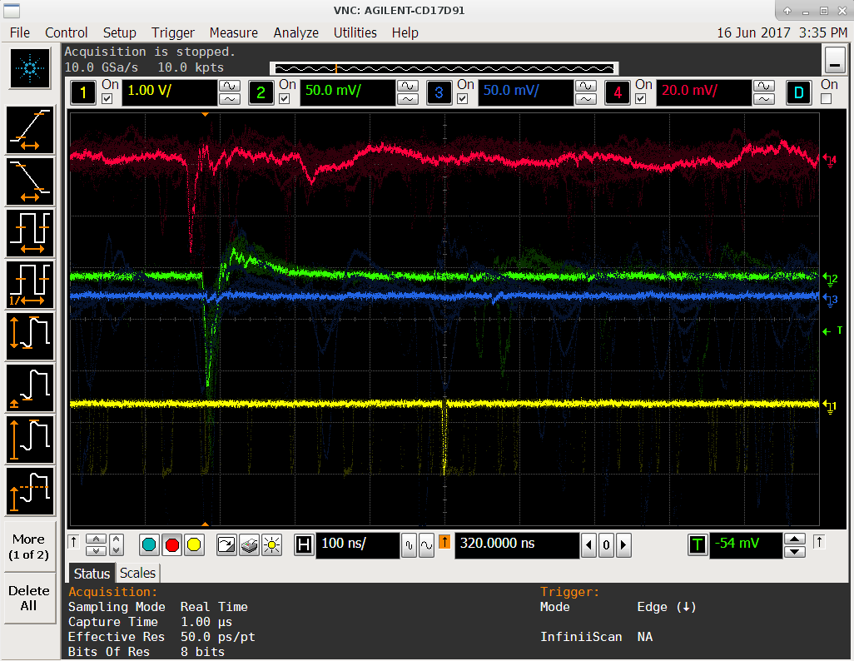
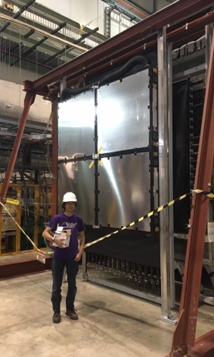
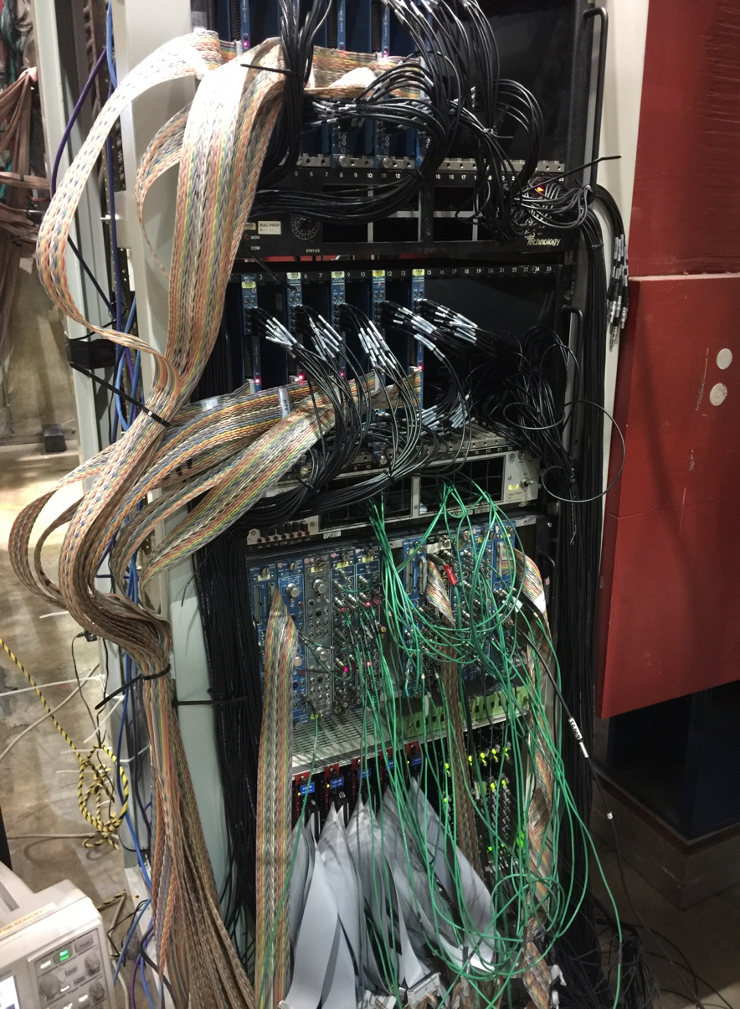
Trigger Detector Systems Installed and Commissioned @FNAL
Took Production Data with E906!
Station-2 Trigger Plane
LVL-1 + LVL-2
Trigger &
Calibration
Systems

Slide 14
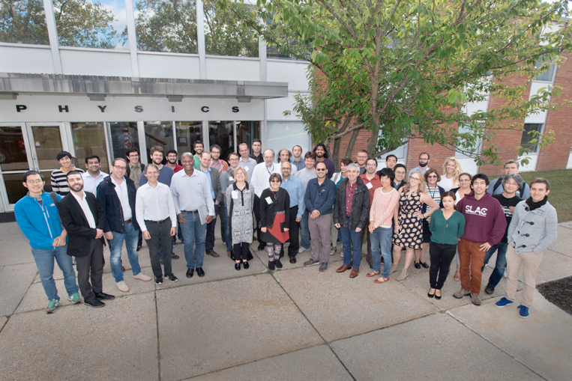

Publications and Presentations
Papers:
  Dark Sector Community Report, 2016, arXiv:1608.08632
  US DOE Cosmic Vision Whitepaper, 2017, arXiv:1707.04591
  An invited review paper on SeaQues/E1067, Mod. Phys. Lett. A, 2017, Vol. 32, Issue 10
  A phenomenology paper in preparation
Presentations:
  BNL Dark Sector Physics Workshop, 10/2016
  DOE Cosmic Vision Workshop, 3/2017
  Fermilab PAC discussion, 7/2017
  APS/DNP, 10/2017
  HPS Mini-Symposium, 10/2017, SLAC
  Light Dark World International Forum, 10/2017, Pittsburgh
Being recognized in the community as an important new player:
Our dark photon program highlighted at opening plenary talk, BNL Dark Interactions 2016
Invited talk at HPS mini-Symposium 2017
Invited plenary talk at Light Dark World 2017
BNL Dark Interactions 2016
Light Dark World 2017

Slide 15
Impacts of this LDRD
Two ECR Proposals
  A new LHCb forward tracking upgrade based on the detector technology developed here (funded, LANL/ECR FY17-19, Cesar da Silva)
  A new search for low mass dark matter in di-electron channel (a new proposal, FY18-20, Kun Liu)
Provided important hardware trainings for postdocs and young staff
  Refresh skills after many years of mostly data analyses and simulations
Development of a possible new HEP program of high P-5 impact
  A new dark sector physics program at Fermilab Intensity Frontier
Visibility of LANL’s scientific R&D to the outside world
  4 papers, 4 invited talks

Slide 16
Experimental Challenges: Plan vs Reality
Pol. Drell-Yan E1039
E1039 target
installation by
5/2018
E1039 commissioning
& data taking
5/2018 – 9/2018
SeaQuest Reality:
E906 operation continued to 7/2017
LDRD trigger detector construction, installation, commissioning and data taking; offline data analysis
LDRD data taking
w/ E1039, 5/2018
Much larger R&D: DAQ, detector, readout & control
Plan-A failed (“cheap copy” of sPHENIX EMCal system electronics)
  electronics changed and delayed, unavailable, cost increased
Took Plan-B, redesigned everything from scratch, much larger R&D
  Collaborated with Fermilab to reduce readout cost
SeaQuest schedule changes:
E1039 installation delayed by ~1.5 year
E906 continued data taking till 7/2017
No dedicated installation time, 2-month delay
5/3/2018
Tasks and Schedule | Planned for FY17 | Achieved in FY17 | Status in FY18
Trigger & DAQ upgrade completed | March 2017 | April 2017 | ready for beam
Data taking with E1039/E906 | May 2017 | June 2017, parasitic w/ E906 | Ready for beam w/ E1039

Slide 17
Plan for FY18 and Beyond
FY18:
  Analyze FY17 data
    Study detector performance and realistic projection
    Complete physics analysis package
  Take more data with E1039
    E1039 target installation: 11/2017 – 5/2018
    E0139 commissioning & data taking run: 5/4/2018 – 9/2018
    Analyze FY18 data
  Produce preliminary search results with full theoretical inputs
Beyond FY18
  Parasitic data taking with E1030 for two years: FY2019 - FY2020
  Much improved measurements, reaching the original sensitivity goal
  Possible EMCal upgrade with a new proposal
    Low mass dark photon search below 200MeV, with di-electrons

Slide 18
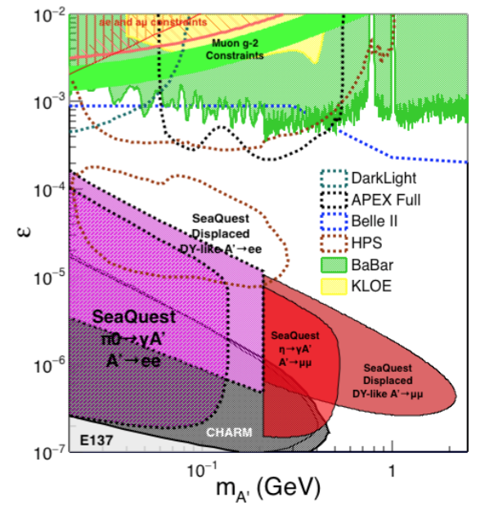
Beyond FY18 – Long Term Prospects
Low Mass Dark Photons in di-electron Channel with EMCal upgrade
Projection: POT 1.4 x 10¹⁸
Detector upgrades
  EMCal: e^{+/-}
  EMCal recycled from PHENIX/RHIC
  Data taking w/ E1039, 2019 - 2020
Timeline of dedicated runs
  After E1039 completion: 2020+ ~ 2025
  SHiP/CERN starts ~2025
Detector configuration optimization
  Access low mass region with optimized FMag settting etc.

Slide 19
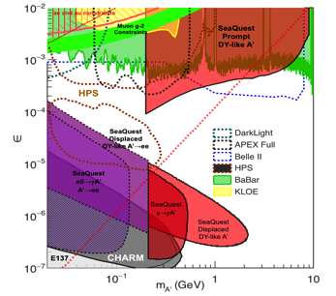
Summary and Outlook
FY17
  Successfully completed Trigger and DAQ Upgrade
  Successfully took data with E906
  Ready for full data taking with E1039
FY18
  Take more data with E1039 in FY18
  Data analysis and first preliminary search results
Fermilab dark sector physics program:
Phase-I (2017-2020)
  Great discovery potential!
  Parasitic data taking with E906/E1039, 2017-2020
  POT 1.4 x10¹⁸ or more
  Possible detector upgrade, add electron and hadron capability
Phase-II (2020-2025+)
  A new dedicated dark sector physics program at Intensity Frontier!
Dark Higgs
search
Preparation Phase-I (parasitic runs)
Phase-II
2015
2016
2017
2018
2019
2020+

Slide 20
backup

Slide 21
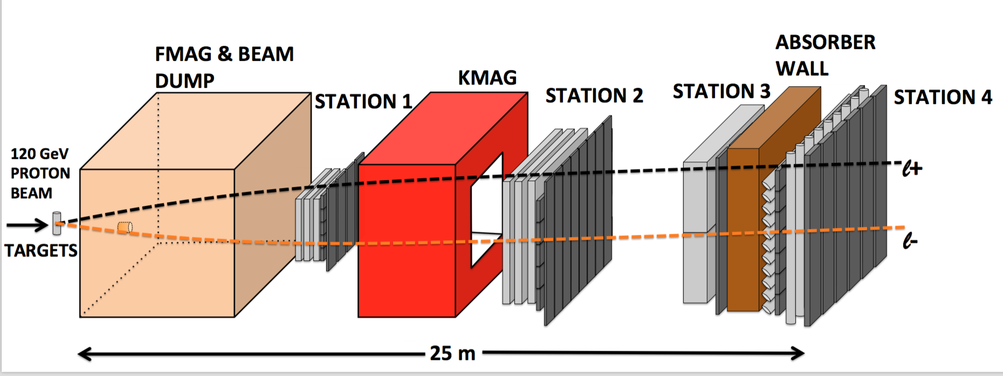
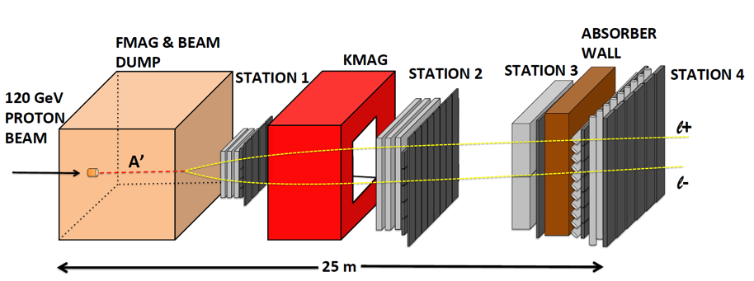
A target Drell-Yan event
E906/E1039
A beam-dump dark photon event --- parasitic run possible!
E1067

Slide 22
Developing a long term program at Fermilab
New ideas
  Low mass region with di-electroncs
  QCD-like Dark Sector physics
  EMCal upgrade (recycled from PHENIX)
Dedicated accelerator based beam-dump dark sector physics program
  Dark photon
  Dark Higgs
  Dark “QCD” mesons
  Complete major program by 2025, when SHiP@CERN is on line

Slide 23
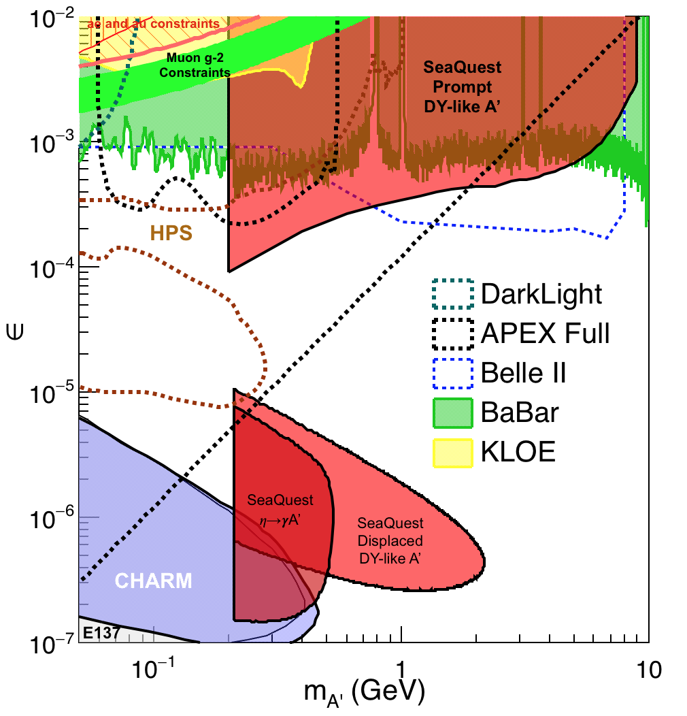
Phase-I Expectation: Dark Photons
(parasitic run w/ E1039)
Signals considered:
Drell-Yan like
Eta decays
Bremsstralung
Covers a wide range of unexplored parameter phase space
Displaced dimuons
- Minimal SM background
Prompt dimuons
- Good coverage
- Possible dedicated runs later to fully
restore mass < 3GeV (Phase-II)
Phase-II with upgrades
Access below 200MeV with di-electrons
( add EMCal)
Work in progress!

Slide 24
Projected Dark Higgs Sensitivity
POT:1.4x10¹⁸ (Phase-I)
Y. Zhang (2015)
Dimuons with downstream displaced decay vertices
Limited sensitivity to “prompt” large mixing case due to small cross-section
Dark Higgs or dark photons?
  Dimuon kinematic and angular distributions
Phase-II
  Dedicated high luminosity runs optimized for low mass acceptance, mass<3GeV
POT:4x10²⁰

Slide 25
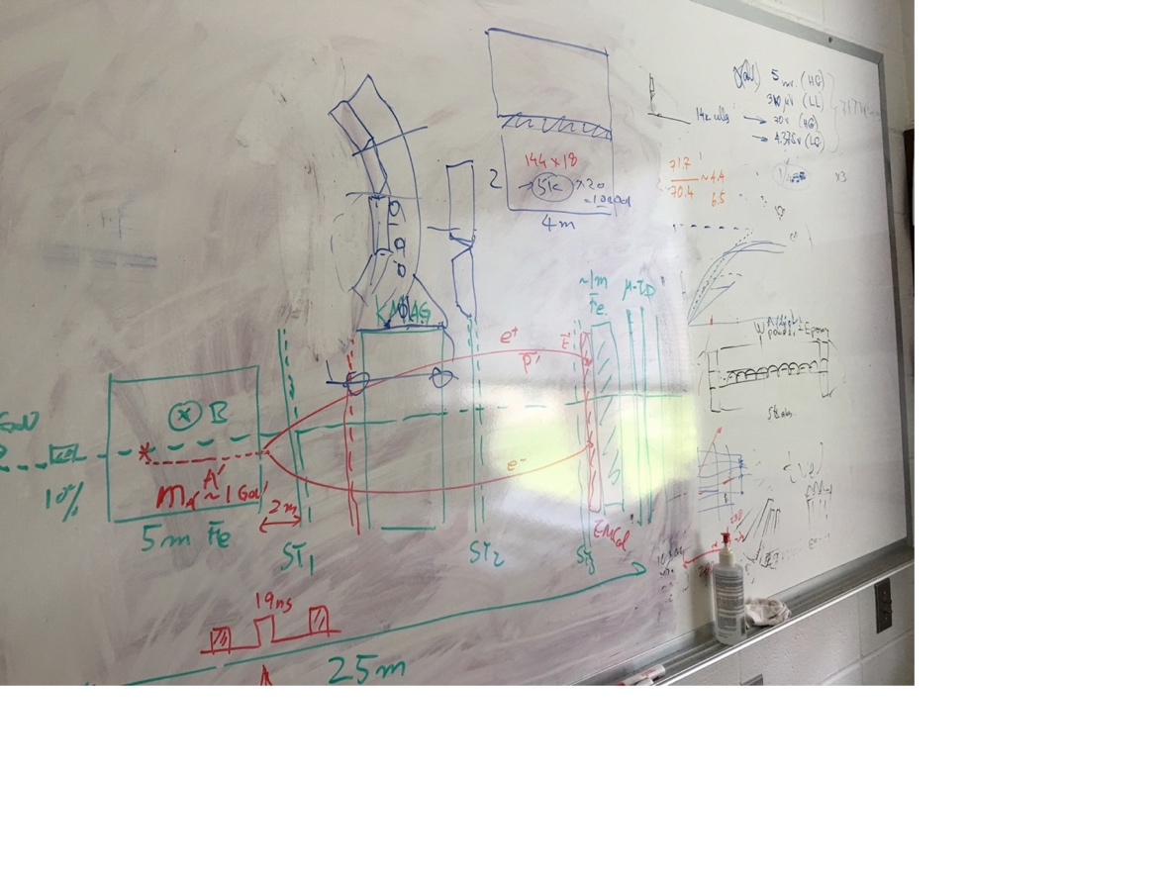
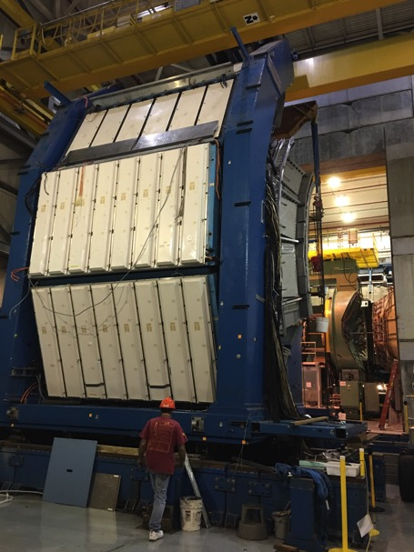
EMCal from PHENIX/RHIC
2 EMCal sectors are available from PHENIX experiment at RHIC, ~April of 2018
  One sector:
    2m x 4m, 18 (3x6)super modules
    Super module = 36 modules; Module = 4 towers
    36 x 4 x 18 = 2592 channels
    Could gang 2x2 (or 3x3) into one ADC/TDC readout
- dE/E = 8.1%/sqrt(E) + 2.1%
- dT < 200 ps
- Excellent e/pi separation

Slide 26
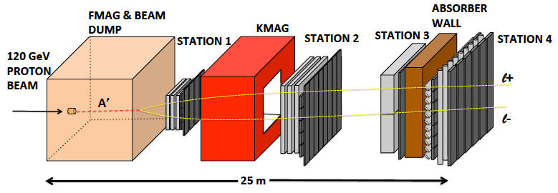

E-1067 Future Upgrade: Phase-II
2020 ~ 2025+
EMCal
Add tracking detectors close to “target” to improve mass resolution
Add EMCal, PID
e^{+/-}, h^{+/-} , π^{+/-}

Slide 27
A Great Opportunity
Dark Photons and Dark Higgs Search at SeaQuest
Photon portal: “vector”
Higgs portal: “scalar”
θ = μ v/m_{h}²

Slide 28
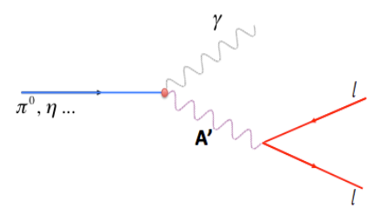
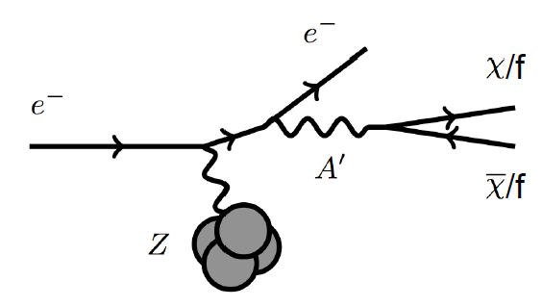
Dark Photon Detection in Dilepton Channel
Drell-Yan like
π⁰, η, … decay
Bremsstrahlung
(DM)
MiniBooNE
Beam-dump
(DM)
p
l⁺
p
l⁻
~ Fixed target w/
electron beams

Slide 29
Dark Higgs
Y. Zhang et al, arXiv:1502.06983
θ = μ v/m_{h}²
arXiv:1312.4992
e⁺e⁻
Phase-I:
High-mass: μ⁺μ⁻ and hadrons
Advantage of using hadron beams
with muon probes over electrons
Phase-II:
Low-mass: e⁺e⁻, <200MeV possible
High-mass: hadrons, (5x)
Electron ID
upgrade!
μ⁺μ⁻

