Slide 1
FY17 Highlights of Dark Photon Search at Fermilab
Ming Liu, P-25
Dark Photon/Higgs Search @Fermilab LDRD/ER Team

Slide 2

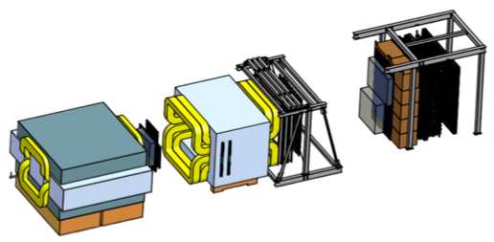
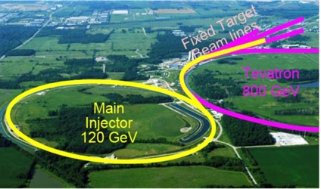
SeaQuest at the Intensity Frontier at Fermilab
High intensity proton beam: “beam dump mode” @SeaQuest/E1067
35K fb⁻¹ (in a 2-year parasitic run, 1.4x10¹⁸ POT @5% beam)
LHC-II: 300 fb⁻¹ (~2025), achieved 25fb⁻¹ in Run-I
B-factory@KEK: 50K fb⁻¹ (~2023)
Absorber wall and proportional
tube based Muon ID
Spectrometer magnet
Δpt = 0.4 GeV
Focusing magnet
and solid iron dump
Δpt = 2.9 GeV
Beam
120 GeV proton from Main Injector
19ns RF, 4s spill, 0.5×10¹³ protons per spill
25 m
Target system
Liquid H and D
Solid C, Fe, W
SeaQuest
- Beam dump mode: p+Fe collisions! Target ~ 10%λ_{I}
- Parasitic run mode possible with other experiments, E906/E1039

Slide 3
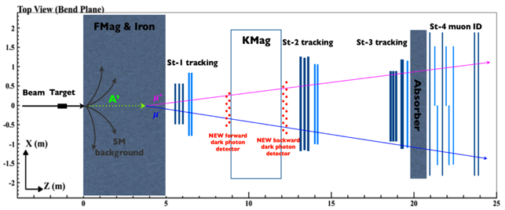
Goals and Scope of the Project (from Proposal)

Slide 4
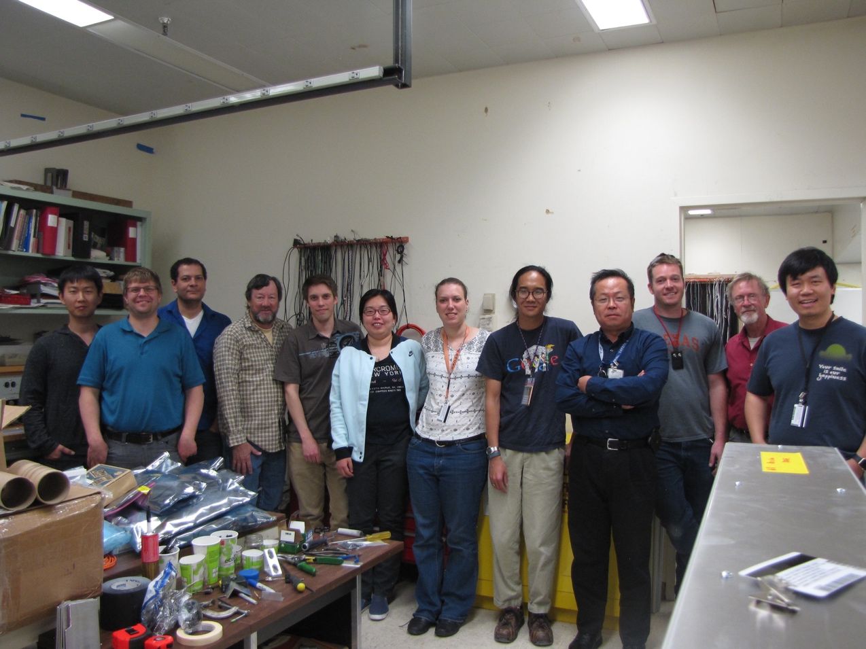
People Involved
Experimental efforts (P-25)
Ming Liu, Kun Liu(PD, Staff), Sho Uemura (PD, 11/2016-), Grass Wang(PD, 7-9/2016), Pat McGaughey, Hubert van Hecke, Andi Klein, Cesar da Silva, Matt Durham, Sanghoon Lim(PD), Shaun Newman(P-21, Mechanical Engineer), Xinkun Chu (Student, graduated 5/2017), Xuan Li (PD), Marie Boer (PD), Dave Kleinjan, Alex Wickes, Jeff Bacon, Richard Van de Water
Theoretical effort (T-2)
Zhongbo Kang
Vincenzo Cirigliano
External collaborators
Fermilab/SeaQuest
BNL/sPHENIX
SLAC/N. Toro, P. Schuster
Caltech/Y. Zhang
Univ. Cincinnati/S. Gori
And growing …
All 8 final trigger detector modules were constructed at LANL and shipped to Fermilab 4/2017

Slide 5
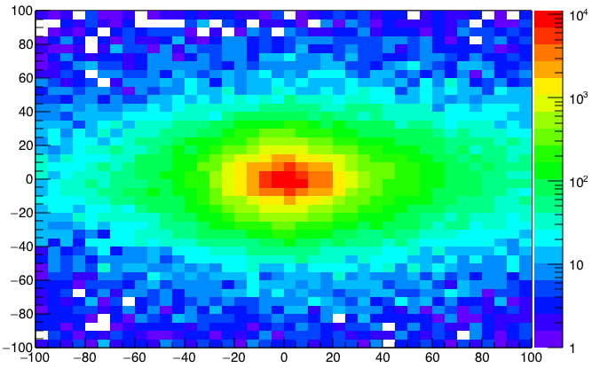
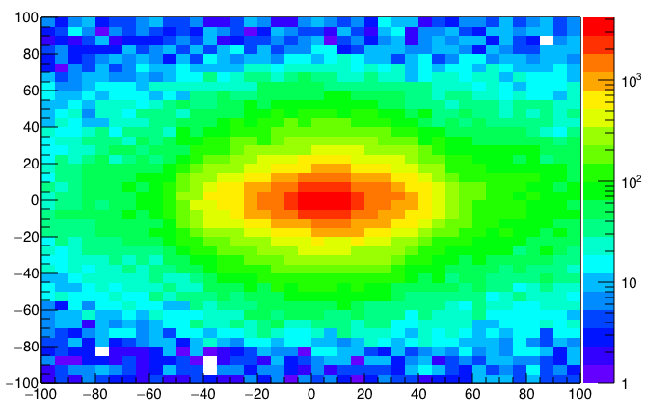
A New High-Granularity Displayed Dimuon Vertex Trigger
High rejection power, low rate, < 1 kHz(current E906 DAQ limit)
Y-Plane (non-bending) Trigger:
A quadrant panel: 80cm x 80cm (100cmx100cm @ST-2)
ST1: 1cm x 1cm x 80 cm scintillating strips, SiPM readout
ST2: 2cm x 2 cm x 100 cm strips
- Straight line projection, σ_{Z} ~30cm
Displaced z-vertex, mostly low mass < 3GeV
Y
Dimuon Z-vertex (cm)
ST1
X
St1
St2
Z
Coincident Z-vtx
window matched@L2
Z1=9m
Z1=12m
ST2

Slide 6
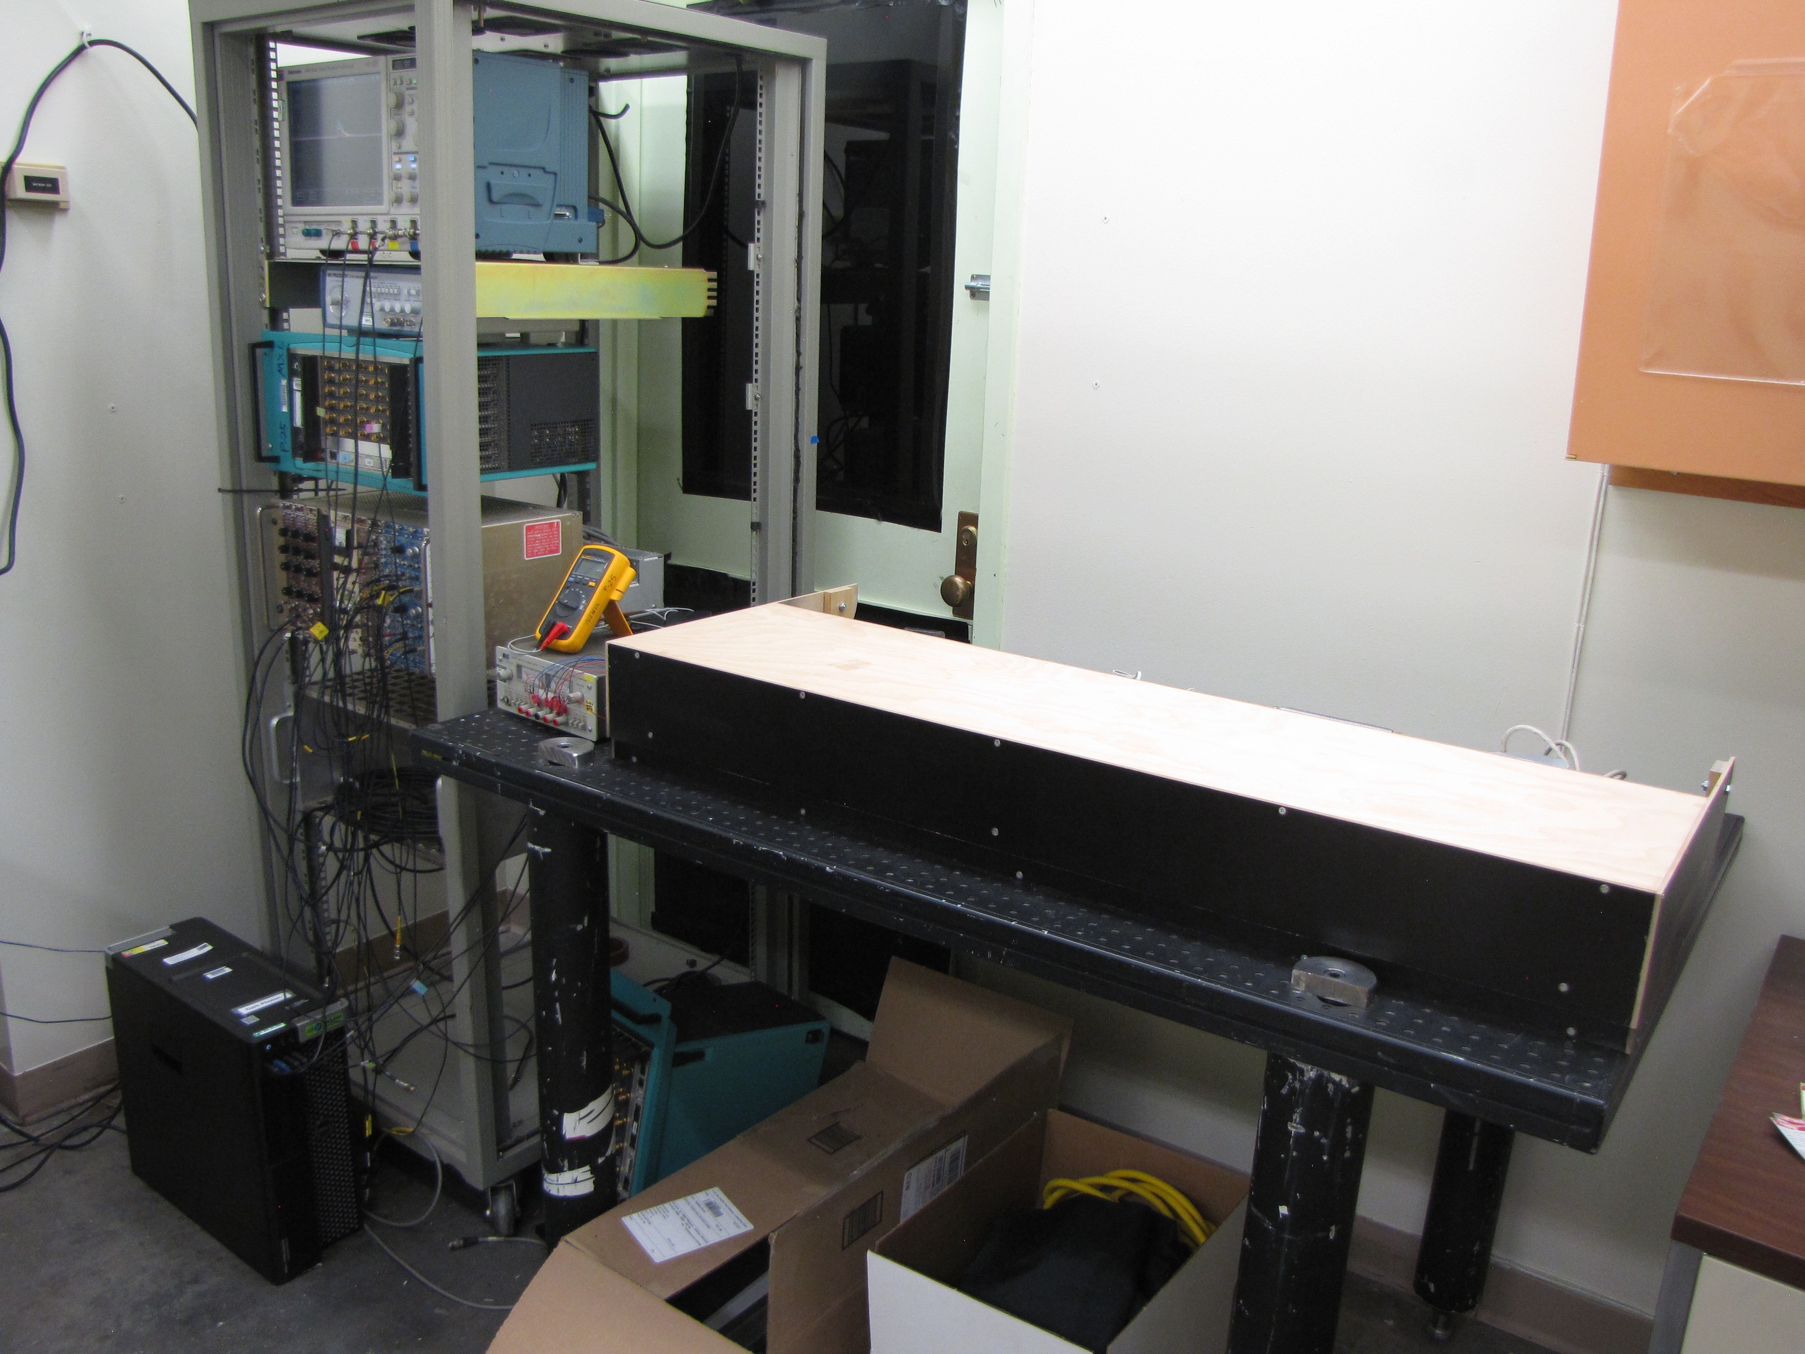
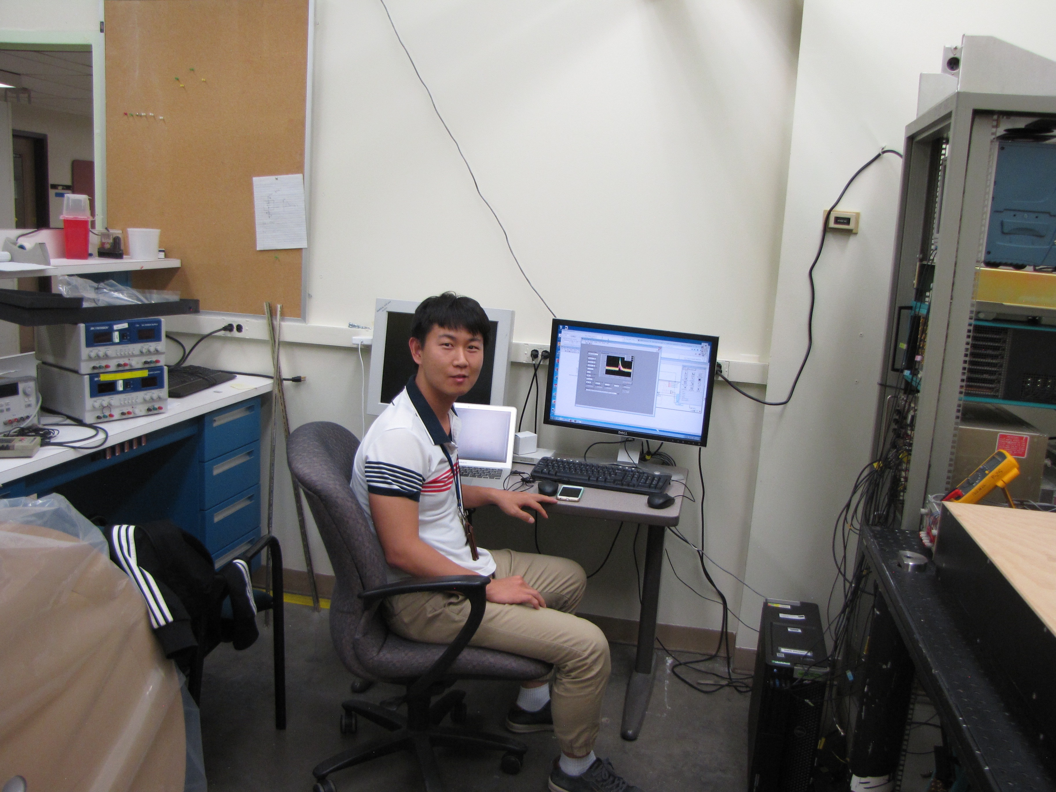
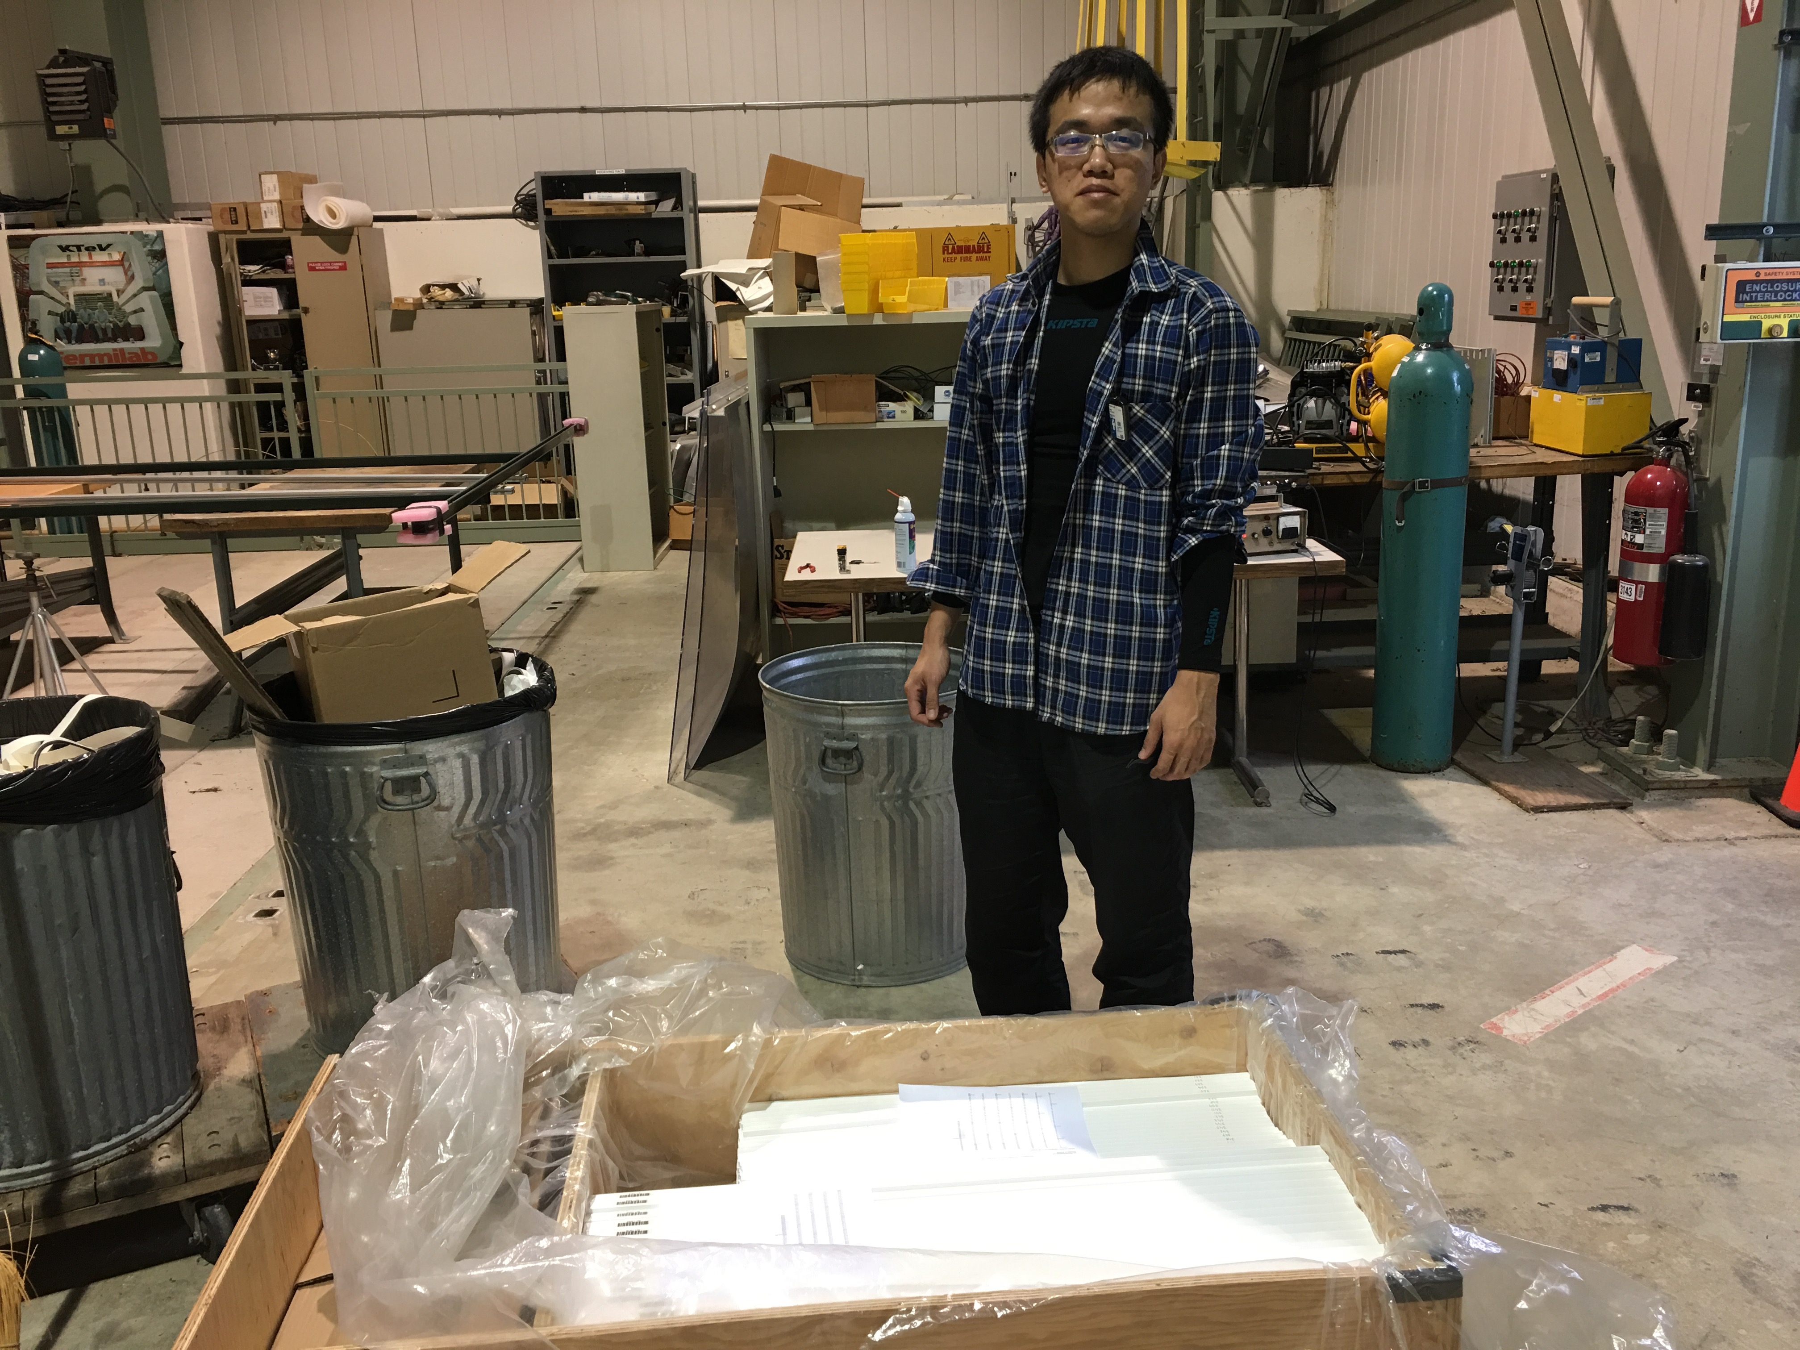
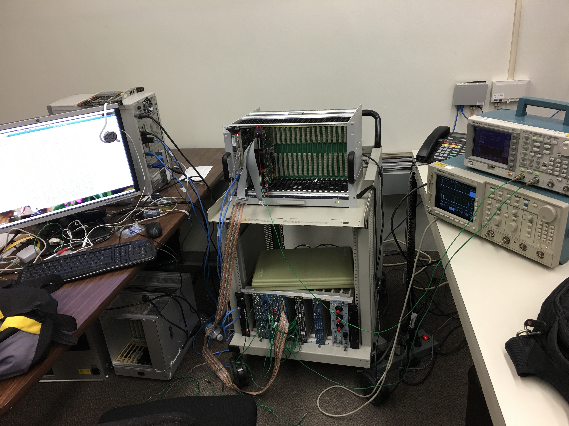
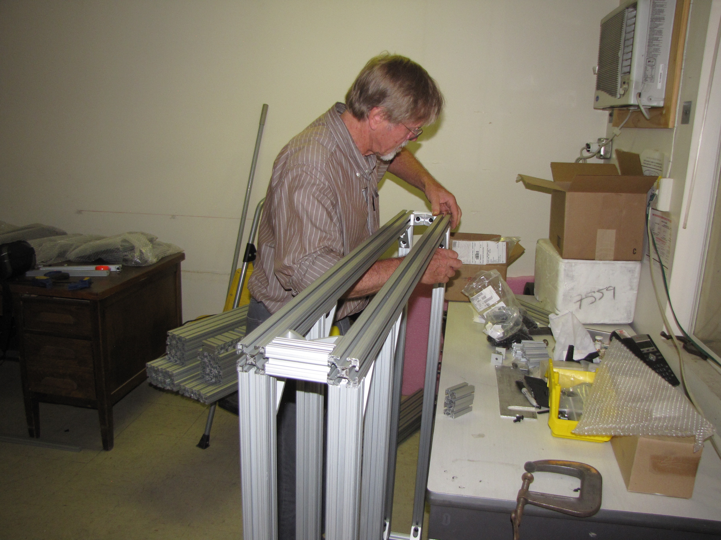
Achievements in the 1st Year (FY16)
TB @LANL
Completed trigger detector R&D and technology down selection
Extruded scintillators, produced at Fermilab
WLSF, procured from Kuraray, Japan
SiPM readout in strong magnetic field, procured from Hamamatsu, Japan
Completed preliminary design of the mechanical frame
80/20 AL frame selected
Assembled 4 out of 8 80/20 box-frames at LANL
Redesigned DAQ readout with a new architecture
Take advantage of the beam spill structure: 4sec/60sec
Preliminary new DAQ firmware developed and tested
Designed new trigger logic circuit and electronics
CAEN V1495 logic boards for LVL-1
Developed a new GEANT simulation package
Preliminary physics study
New DAQ R&D

Slide 7
Major Tasks and Accomplishments in FY17
Goals
Accomplishments
Complete DAQ Upgrade
Complete trigger detector construction
Trigger detector installation and commissioning
Take data with E1039(E906)
Successfully commissioned the new DAQ and integrated the dark-photon trigger system
DAQ bandwidth improved by ~10
A new displaced dimuon trigger electronics & firmeware
Designed and built full trigger detectors at LANL
Extruded scintillators + WLSF + SiPMs
80-20 Al box frames + global supporting structures
Station-1:
4 quadrants, 80x80cm^2 each, 320 channels
Station-2:
4 quadrants, 100 x 100 cm^2 each, 200 channels
Optical calibration system
LV/HV power distribution and control boards
Installed and commissioned trigger detectors
Timing resolution: < 1.5 nS (collision rate ~ 19nS)
Track hit eff. > 96% (from cosmic)
Took data parasitically with E906
E1039 delayed ~1.5y, scheduled to start in 2018
E906 data taking extended by 1 year, ended 7/2017

Slide 8
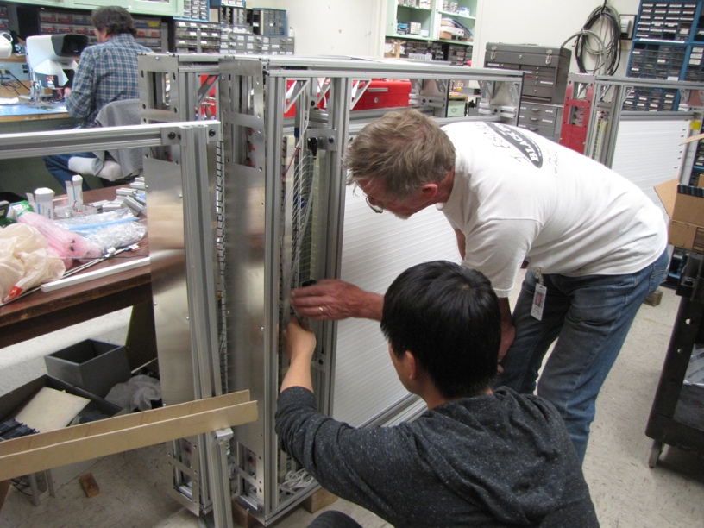
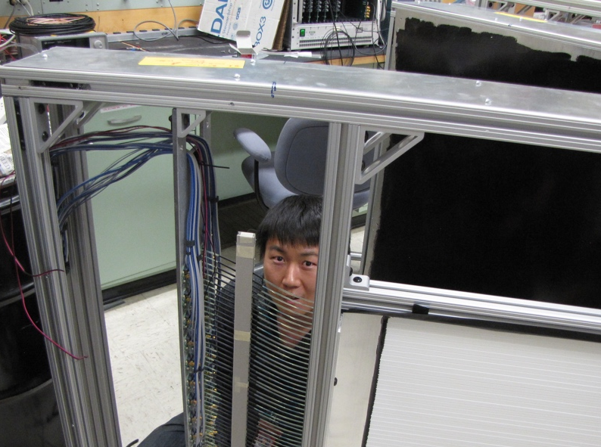
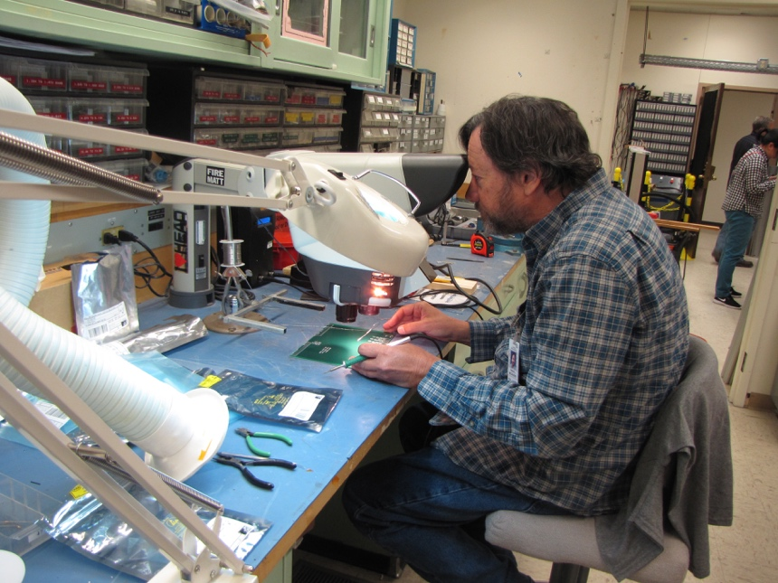
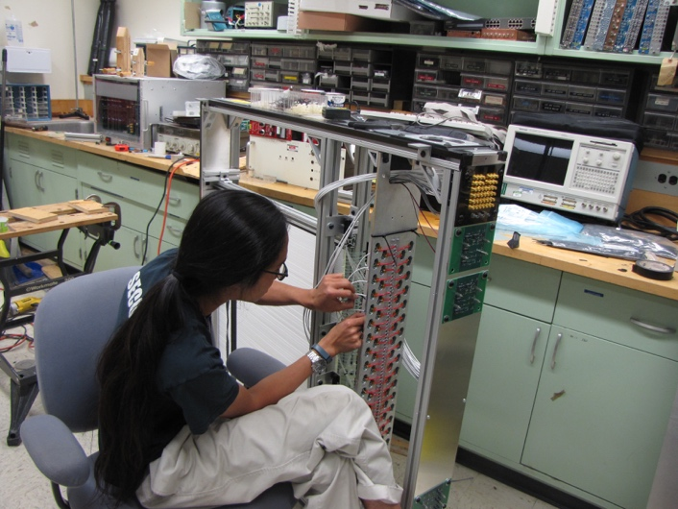
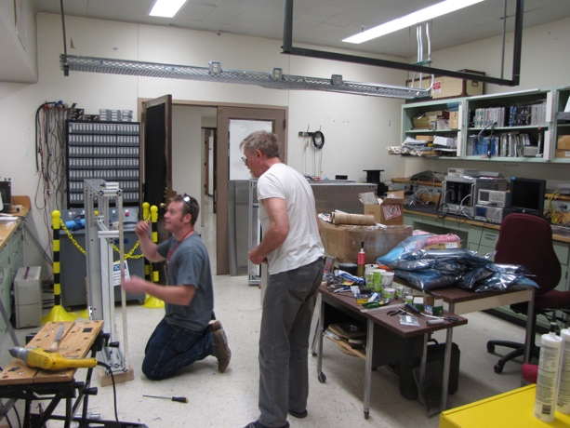
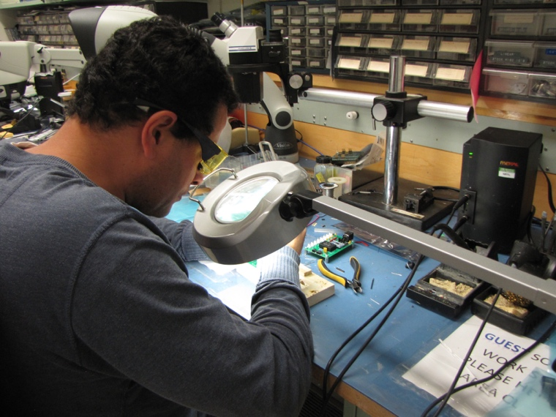
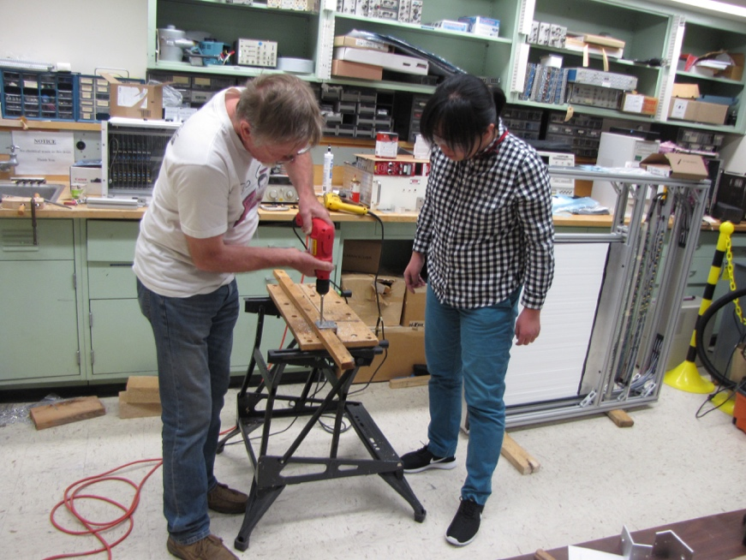
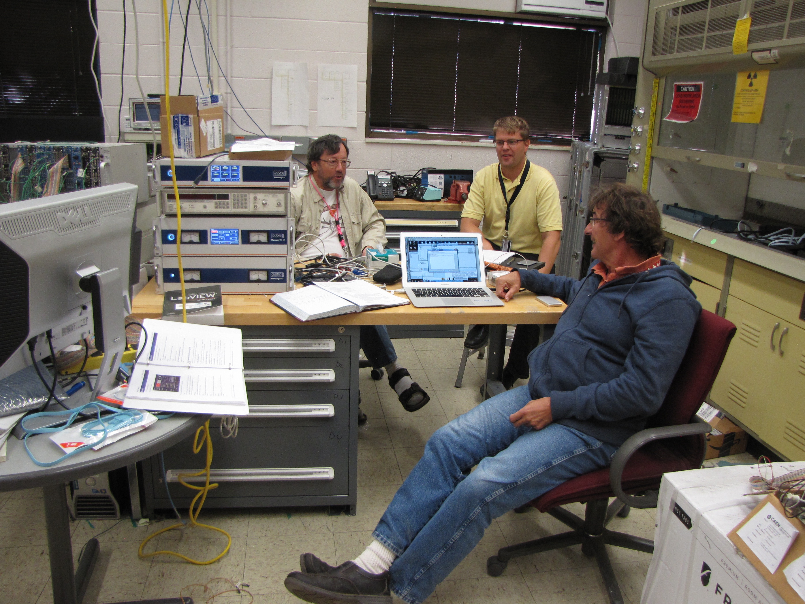
Very Successful Team Work!

Slide 9
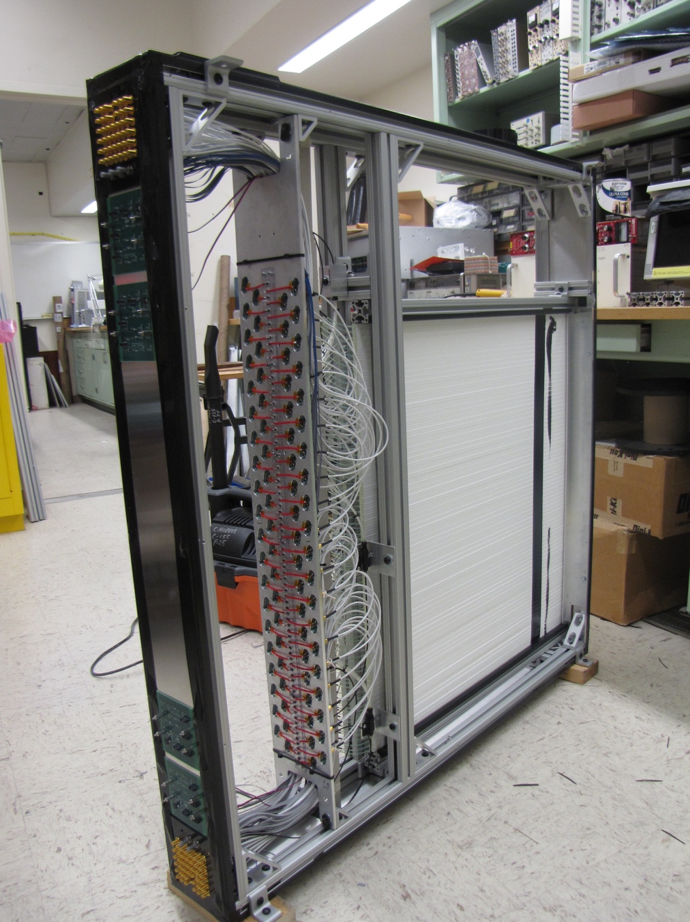
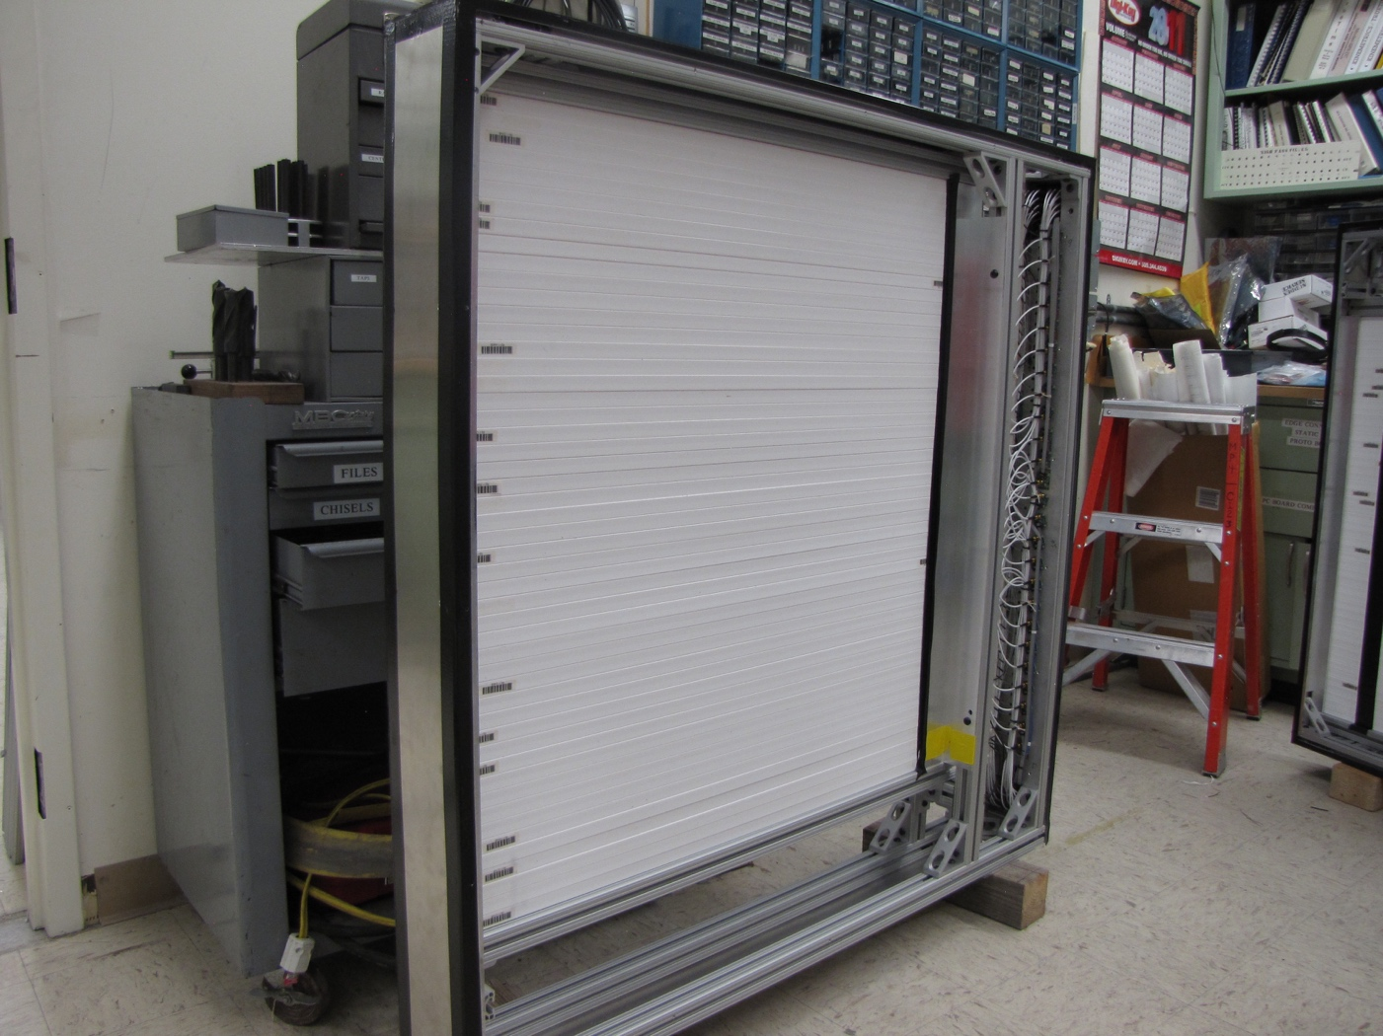
Completed modules, 8 of them in total!
Station-1: 80 x 80 cm², 80 channels
Station-2: 100 x 100 cm², 50 channels

Slide 10
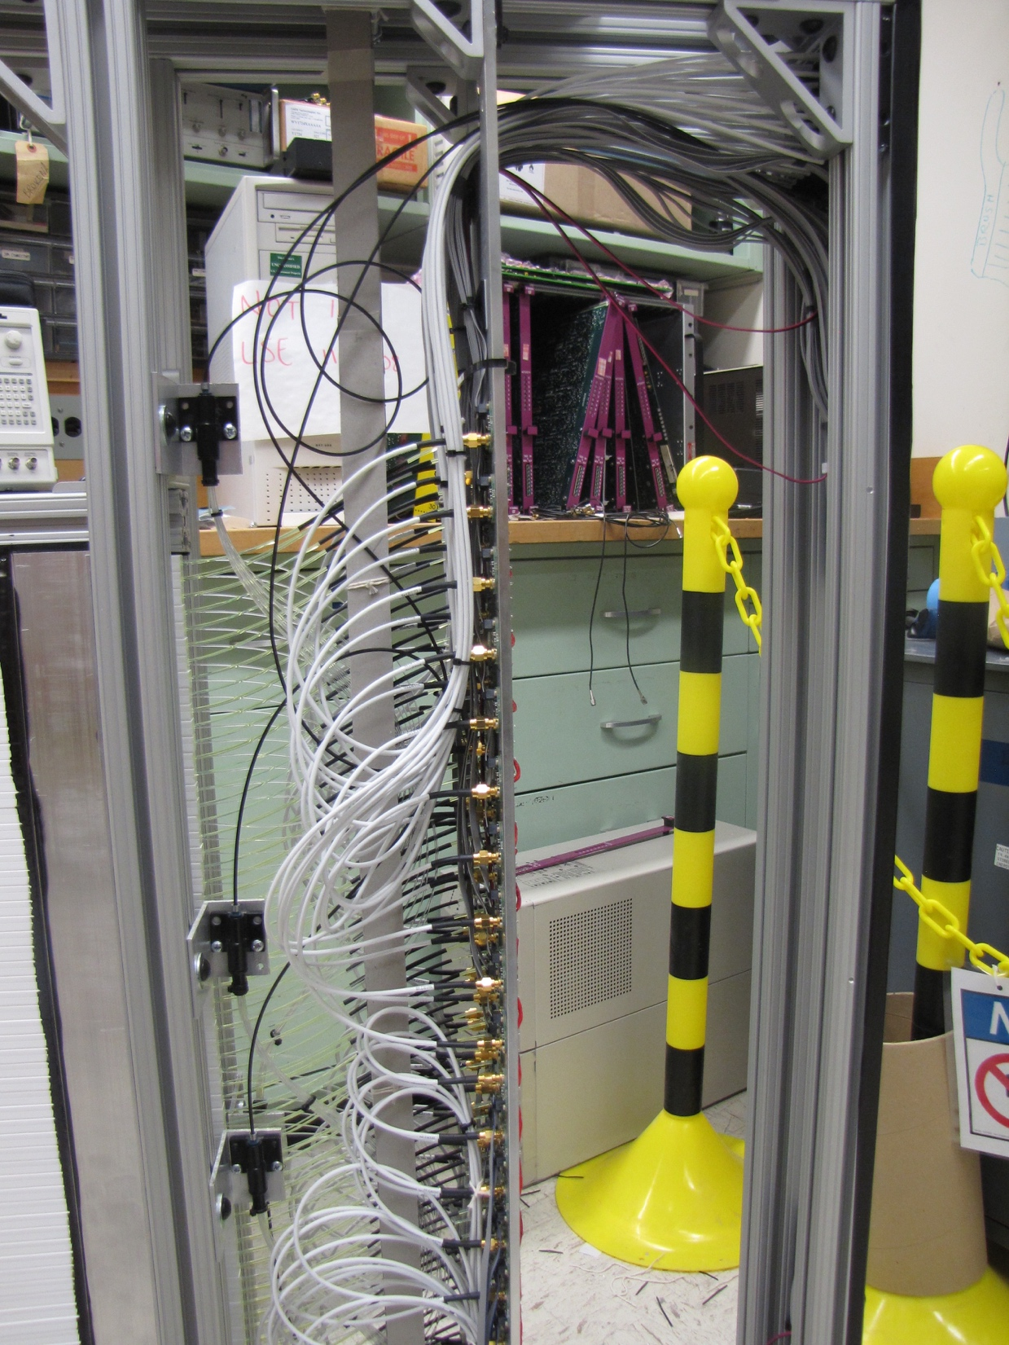
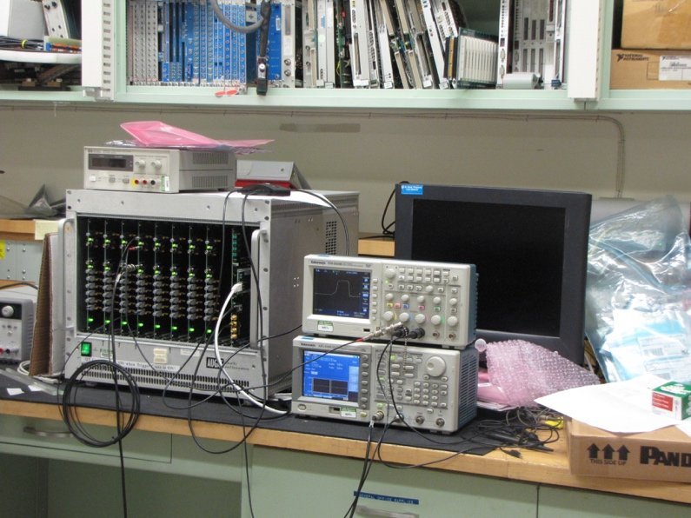
Optical Calibration, LV/HV Power Distribution and Controls Systems
Designed, built and
tested at LANL
3 x 8 optical outputs

Slide 11
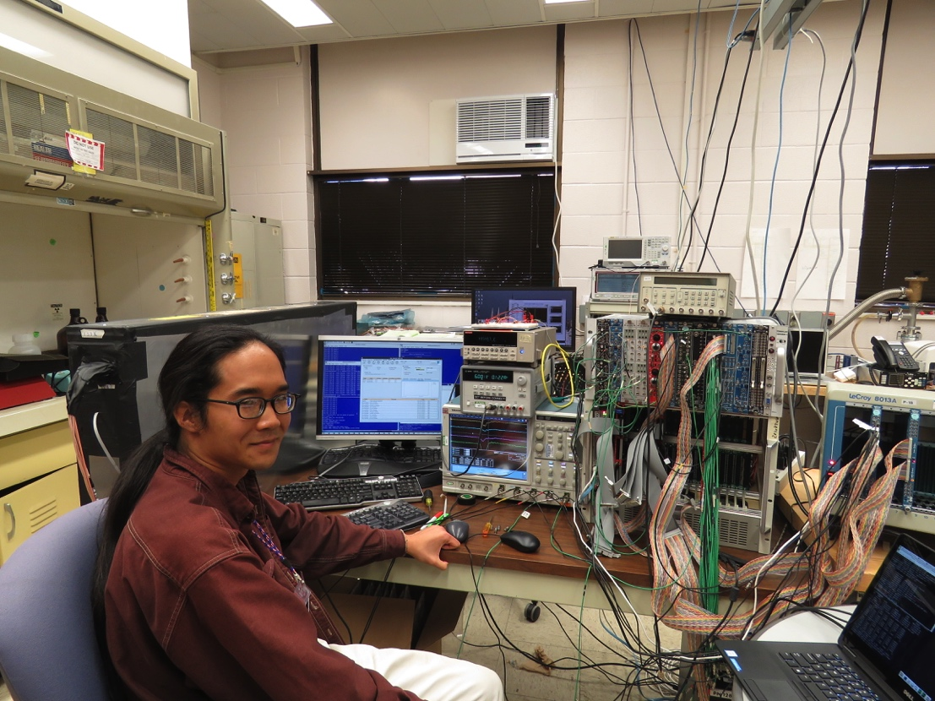
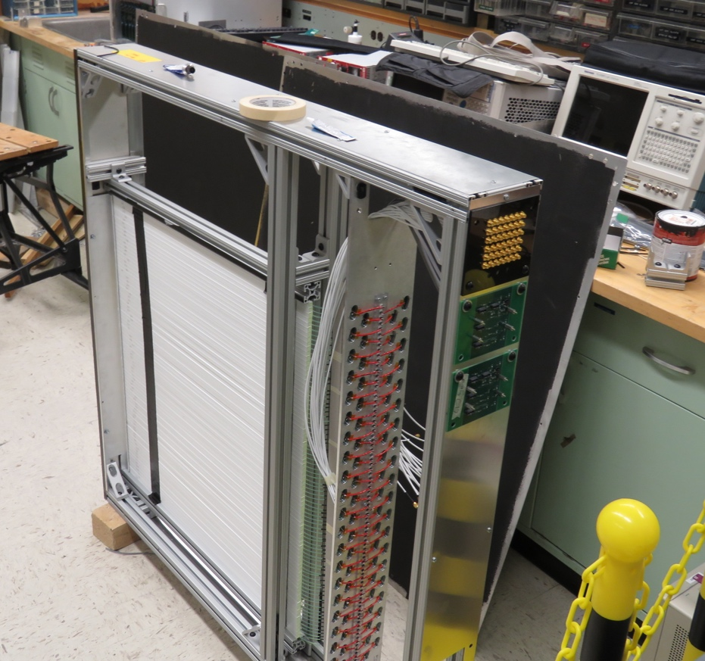
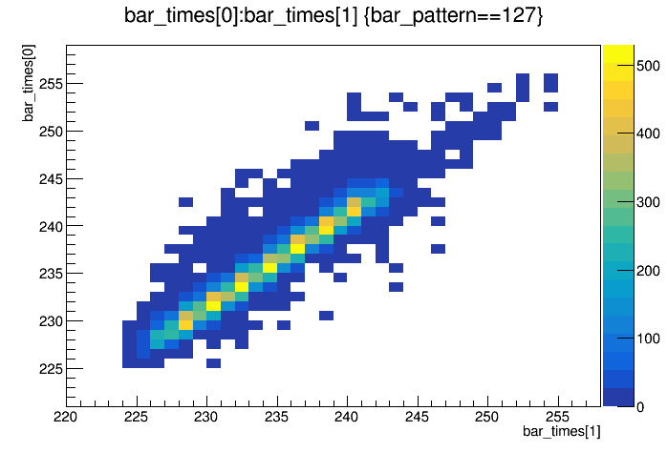
Trigger, DAQ R&D and Cosmic Test @LANL
Trigger & DAQ hardware and firmware designed and tested at LANL, in collaboration with Fermilab Engineers
Readout from a full module for cosmic test
Full SiPM readout
V1495 trigger logic + TDC read out
E906 upgraded DAQ and firmware
- Timing resolution, better than 1.5nS (19nS RF)
- Detector eff > 96%
TDC_1
TDC_2

Slide 12
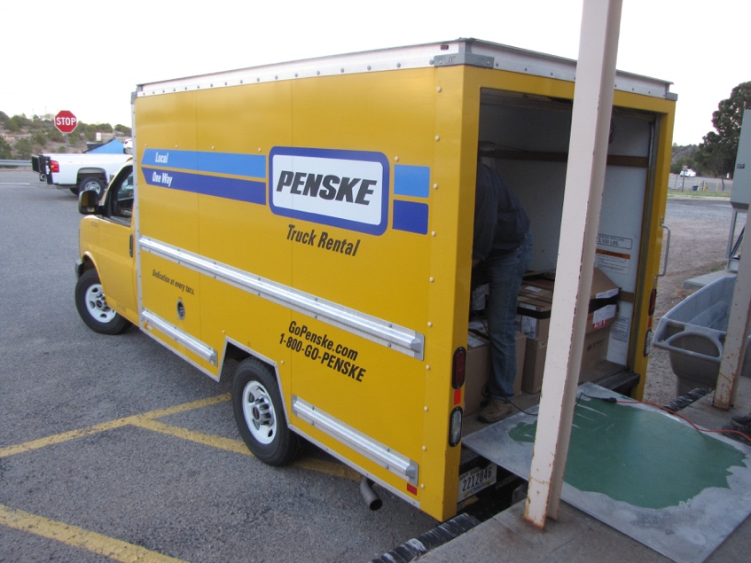
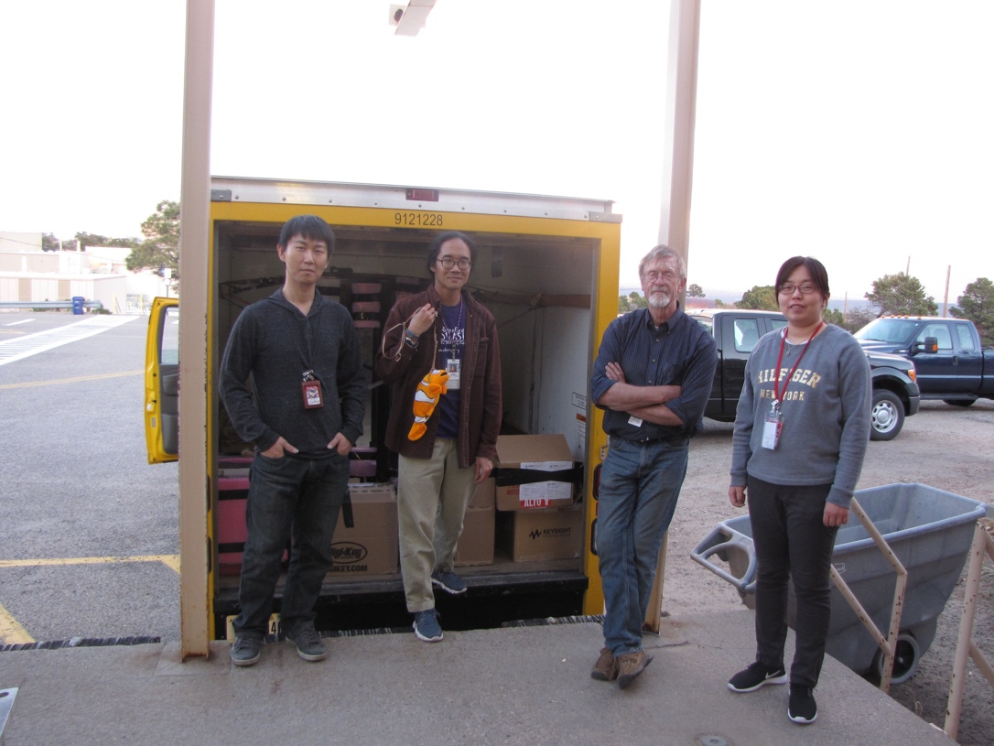
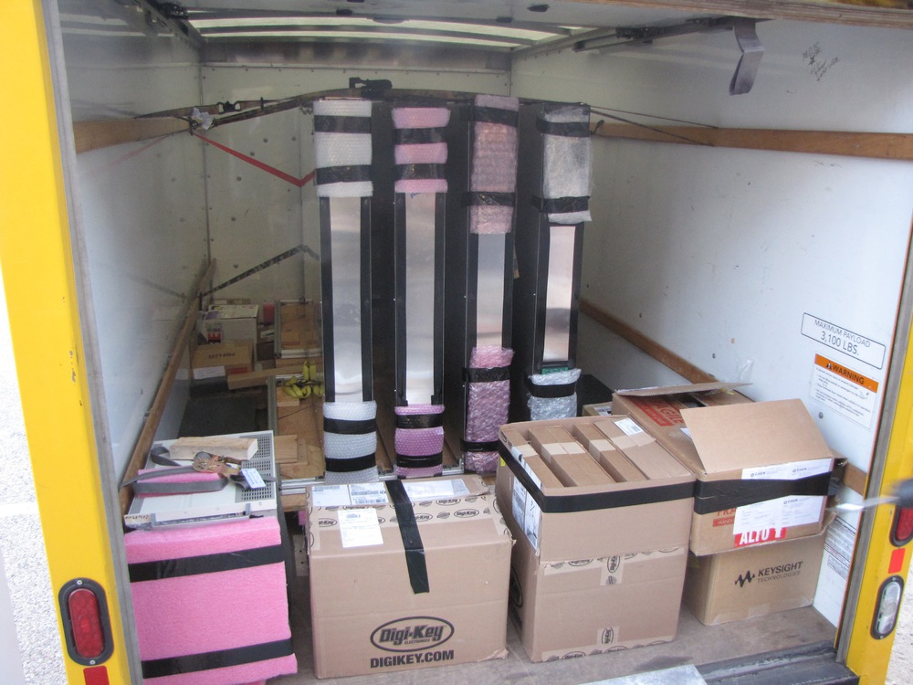
All 8 Trigger Detectors Designed and Built at LANL, Truck loaded to Fermilab
Eight trigger detector modules
Electronics and Power supplies

Slide 13
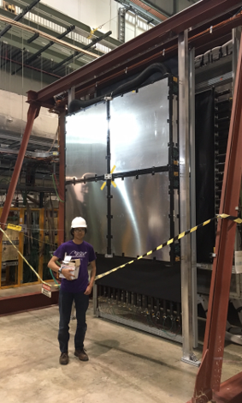
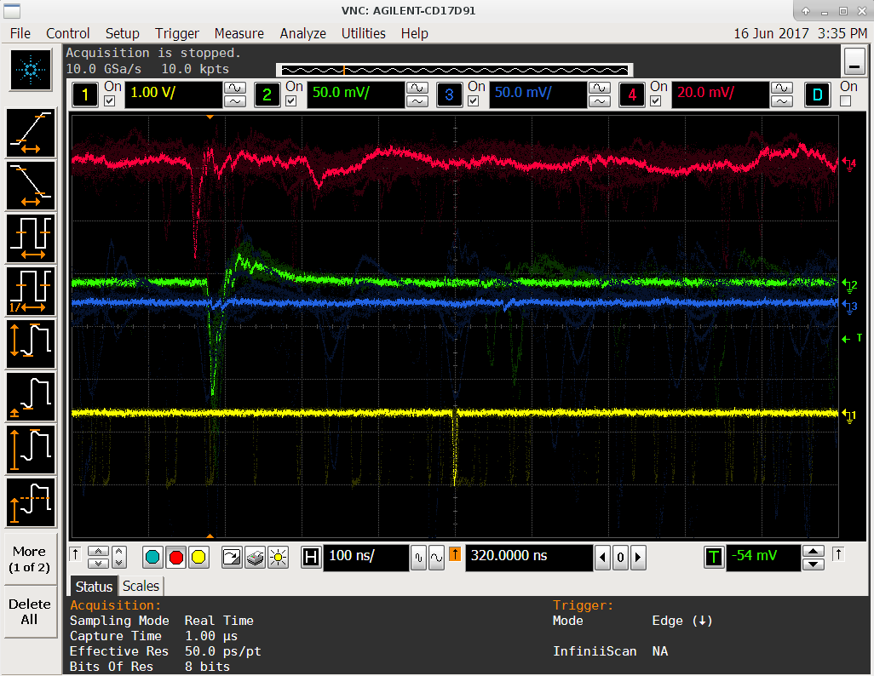
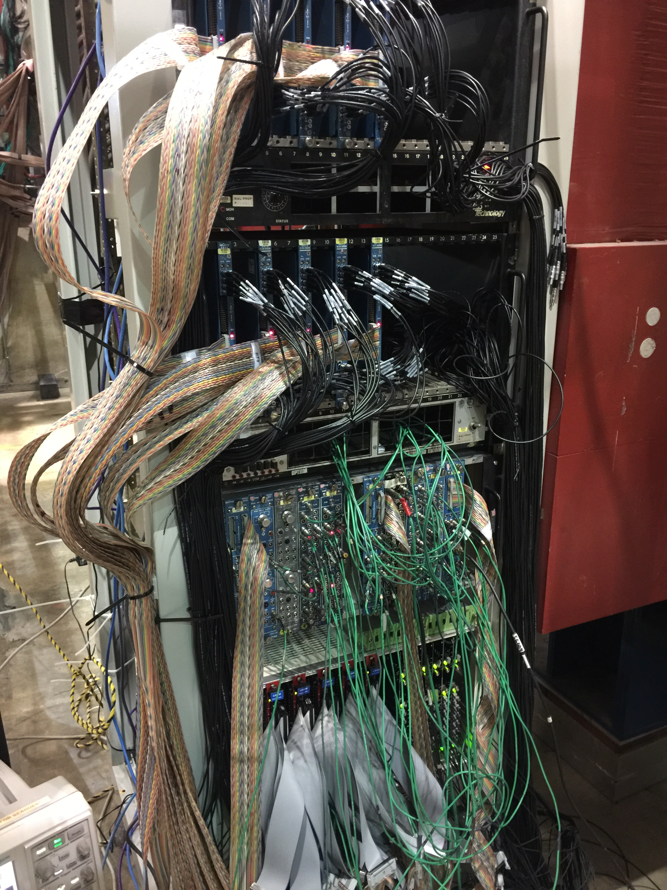
Trigger Detector Systems Installed and Commissioned @FNAL
Station-2 Trigger Plane
LVL-1 + LVL-2
Trigger &
Calibration
Systems

Slide 14
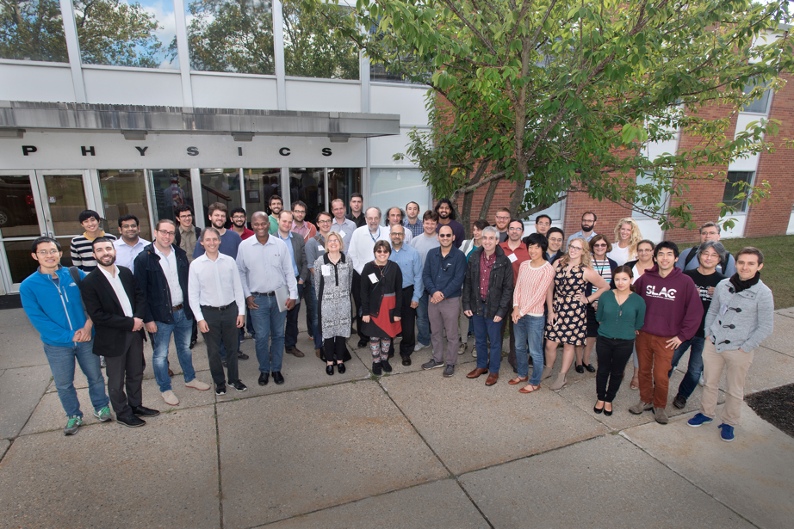

Publications and Presentations
Papers:
Dark Sector Community Report, 2016, arXiv:1608.08632
US DOE Cosmic Vision Whitepaper, 2017, arXiv:1707.04591
An invited review paper on SeaQues/E1067, Mod. Phys. Lett. A, 2017, Vol. 32, Issue 10
A phenomenology paper in preparation
Presentations:
BNL Dark Sector Physics Workshop, 10/2016
DOE Cosmic Frontier Workshop, 3/2017
Fermilab PAC discussion, 7/2017
APS/DNP, 10/2017
HPS Mini-Symposium, 10/2017, SLAC
Light Dark World International Forum 2017, 10/2017, Pittsburgh
Being recognized in the community as an important new player:
Our Fermilab dark photon/Higgs program highlighted at opening plenary talk, BNL Dark Interactions
Invited talk at HPS mini-Symposium 2017
Invited plenary talk at Light Dark World 2017
BNL Dark Interactions 2016
Light Dark World 2017

Slide 15
Impacts of this LDRD
Produced two ECR Proposals
A new LHCb forward tracking upgrade based on the detector technology developed here (funded, LANL/ECR FY17-19)
A new search for dark matter in di-electron channel (a new proposal, FY18-20)
Provided important hardware trainings for postdocs and young staff
After many years of mostly on data analyses and simulations
Possible new HEP program of high P-5 impact
Visibility of LANL to outside world in Science and Technology R&D

Slide 16
Experimental Challenges: Plan vs Reality
Reality:
E906 Operation
E1039 installation & operation
Much larger detector R&D project: DAQ, readout & control
SeaQuest schedule changes since proposal:
E1039 installation delayed by ~1.5 year
E906 continued data taking till ~7/2017
No dedicated installation time, 2-month delay
LDRD trigger construction, installation,
commissioning & data taking, analysis
Commissioning done in 2 weeks
LDRD data taking
& analysis

Slide 17
Plan for FY18
More data taking with E1039 in 2018
Data analysis and preliminary publication
Alignment and calibration
Tracking
Possible EMCal upgrade? New proposals?

Slide 18
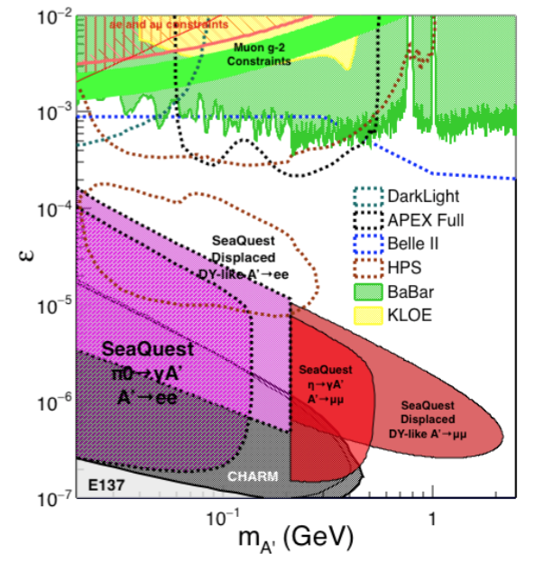
New Ideas Developed: Displaced Low Mass Dark Photons with EMCal upgrades
Projection: POT 1.4 x 10¹⁸
Detector upgrades
EMCal: e^{+/-}
HCal: π^{+/-}
Recycle from other experiments, PHENIX/RHIC etc.
Timeline of dedicated runs
2020+
Detector configuration
Access low mass region with optimized Fmag settting

Slide 19
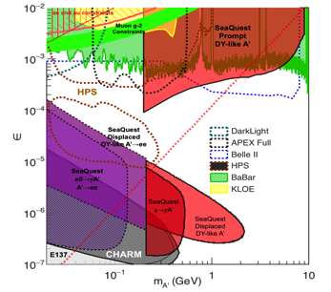
Summary and Outlook
Completed Trigger and DAQ Upgrade
Took data with E906 in FY17
Take more data with E1039 in FY18
Complete data analysis and publication
Phase-I
Great discovery potential!
A new vertex trigger & DAQ++
Early parasitic data taking 2017-2020+
POT 1.4 x10¹⁸ or more
Phase-II
Possible detector upgrade later, add electron and hadron capability
A new dedicated dark matter program at Intensity Frontier!
Dark Higgs
search
Preparation Phase-I (parasitic runs)
Phase-II
2015
2016
2017
2018
2019
2020+

Slide 20
backup

Slide 21
outline
Overview of the scope of LDRD
Achiements in FY16 ()
Major achievements in FY17
DAQ upgrade
Trigger detector construction, installation and commissioning
Data taking
Publications, invited talks, reviews etc – being recognized by the HEP community
New ideas developed for the future long-term program
Challenges faced in detector R&D, installation and commisionging
Uncertainties in E906 operation schedule and E1039 startup
Cost & schedule of detector/DAQ upgrade, much larger than original plan
Change of E906 operation schedule impacted detector upgrade, installation and commissioning
Plan for FY18 and beyond
Run17 data analysis, preliminary search results
Produce realistic projections based on Year 17 run, for future parasitic runs w/ E1039, and
More data taking with E1039 in FY18:
May 2018 – July 2018, followed by analysis
10/2018 – 10/2020 long run
Impacts on other programs
TWO ECRs developed, based on the detector technology and science developed in this ER, Kun-EMCal, Cesar - LHCb
new idea for future program – ECR for EMcal upgrade, develop a long term Dark Photon/Higgs program at Fermilab after E1039, 2020+
LHCb adopted this technology for the forward tracker upgrade
Highlight the scope of the project
Challenges
Technical challenges in hardware and software R&D
Experimental schedule uncertainty

Slide 22
Developing a long term program at Fermilab
New ideas
Low mass region with di-electroncs
QCD-like Dark Sector physics
EMCal upgrade (recycled from PHENIX)
Dedicated accelerator based beam-dump dark sector physics program
Dark photon
Dark Higgs
Dark “QCD” mesons
Complete major program by 2025, when SHiP@CERN is on line

Slide 23
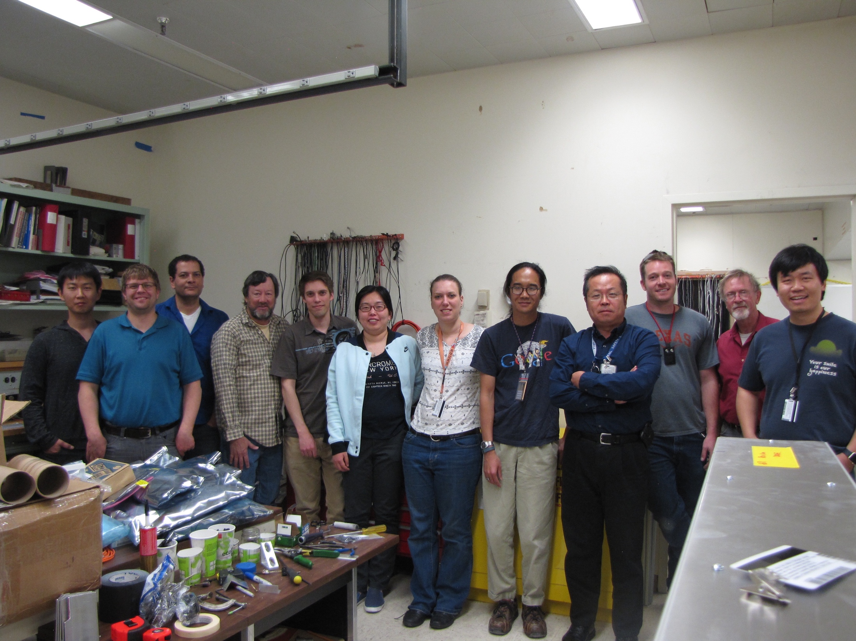
Trigger detectors completed at LANL and shipped to Fermilab 4/2017

Slide 24
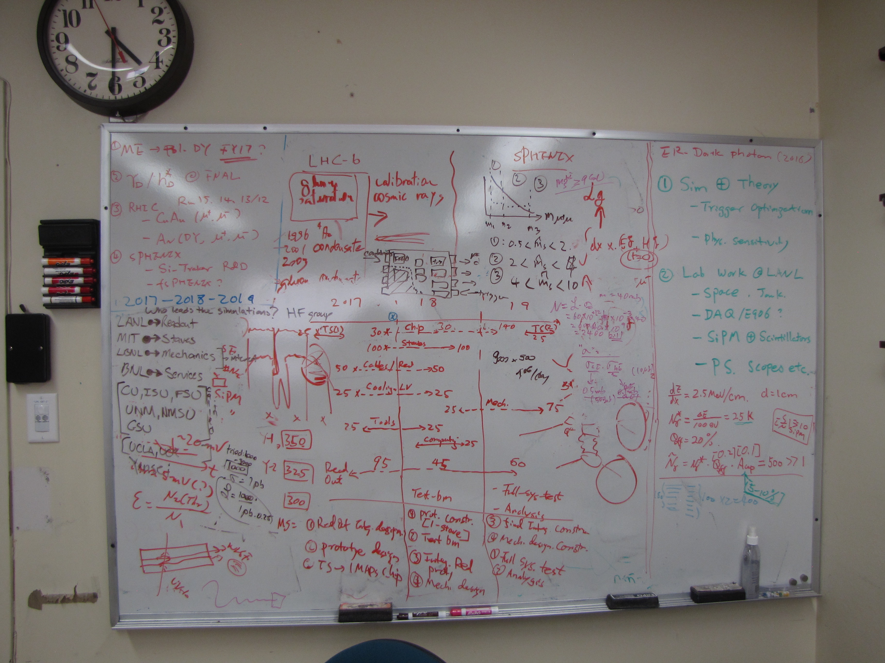
Dark Photon/ER
FY16 Goals
Ming’s whiteboard

Slide 25
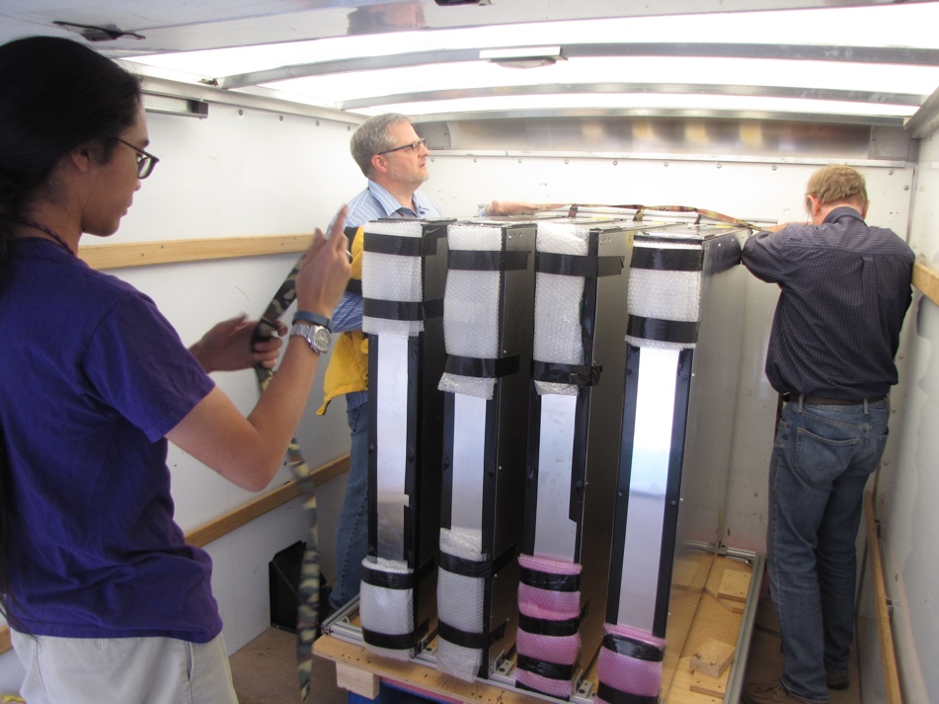

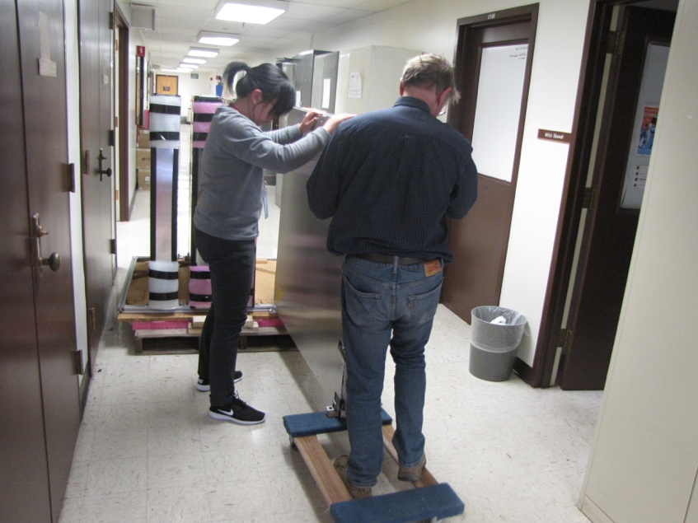
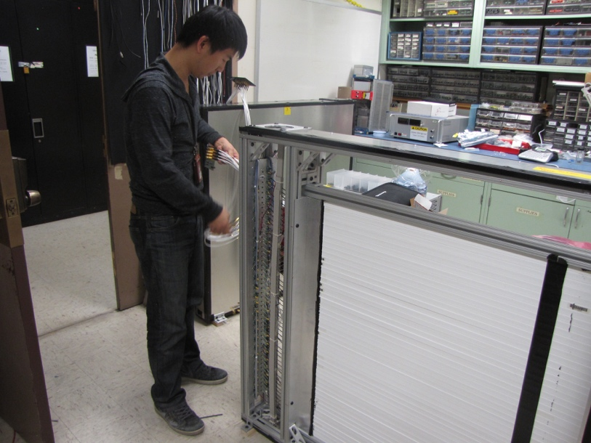
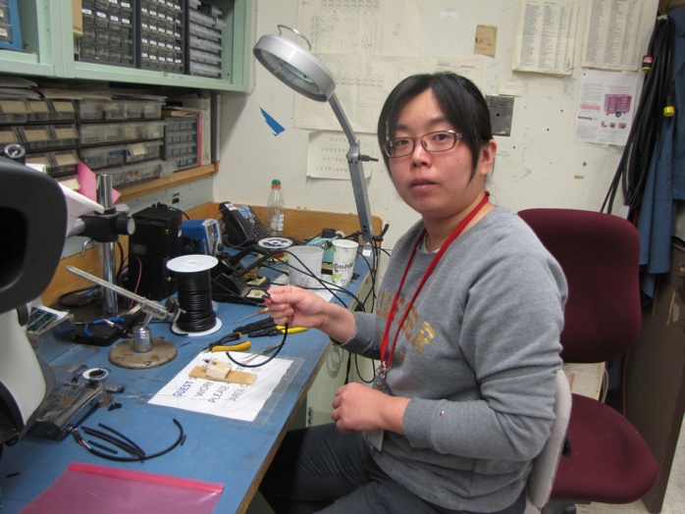
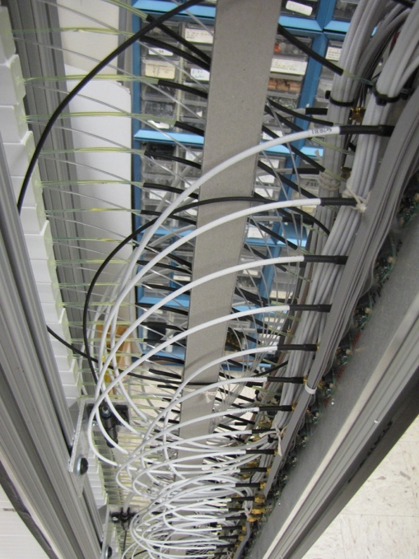

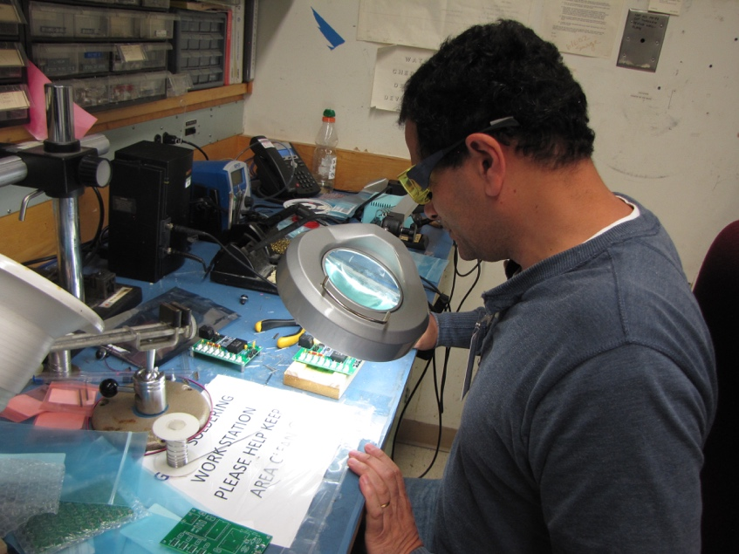


Slide 26
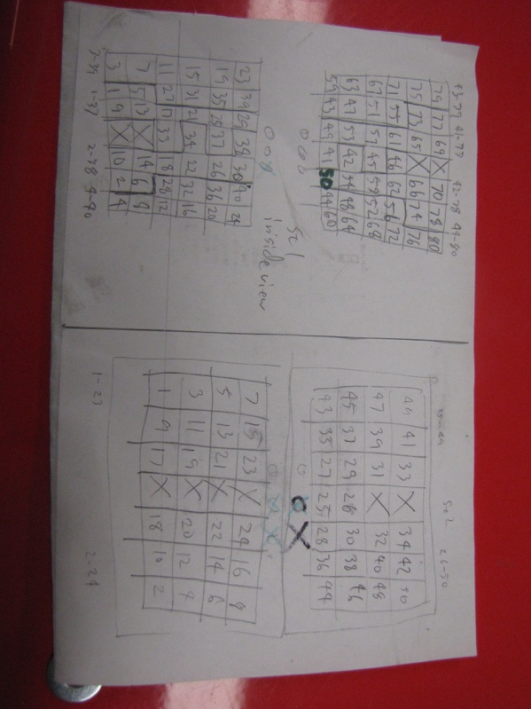
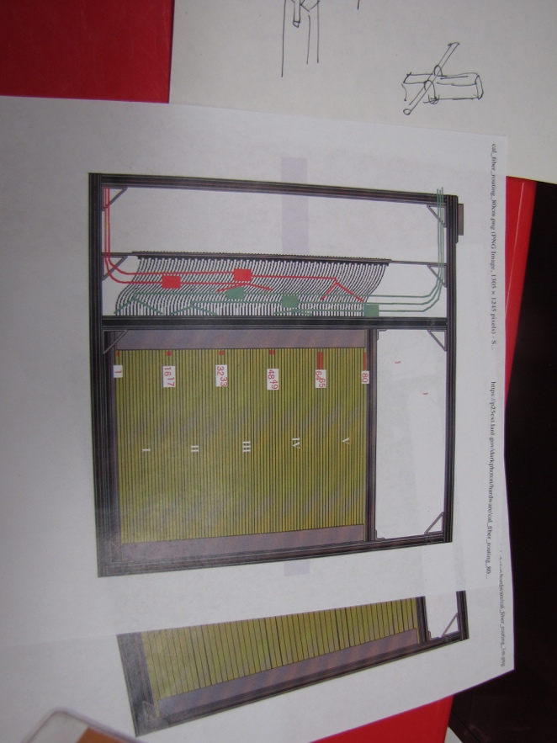
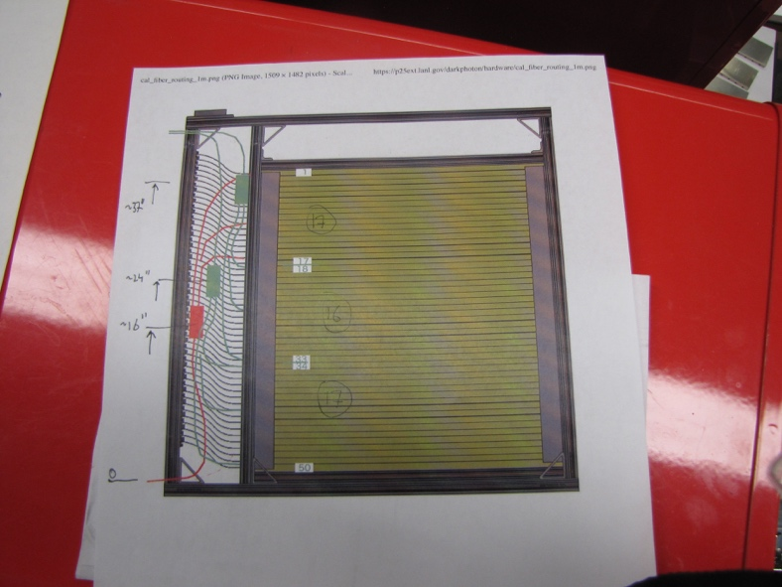
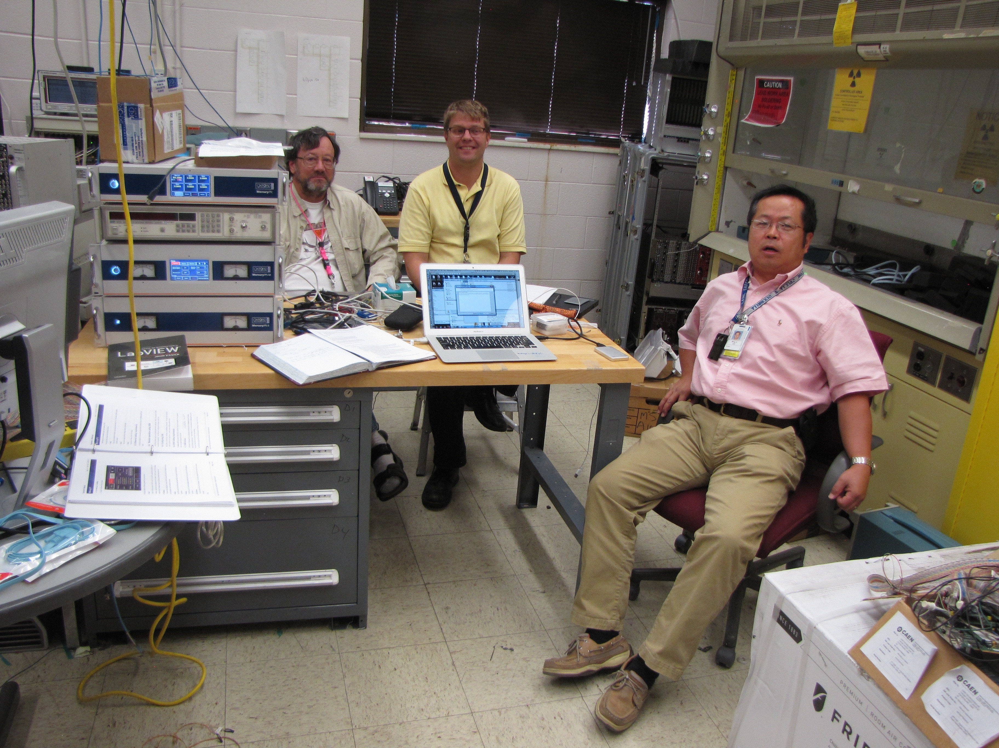
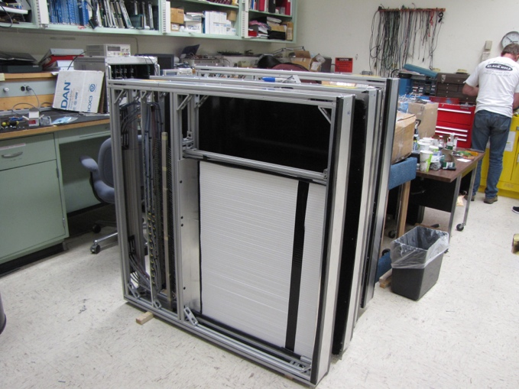
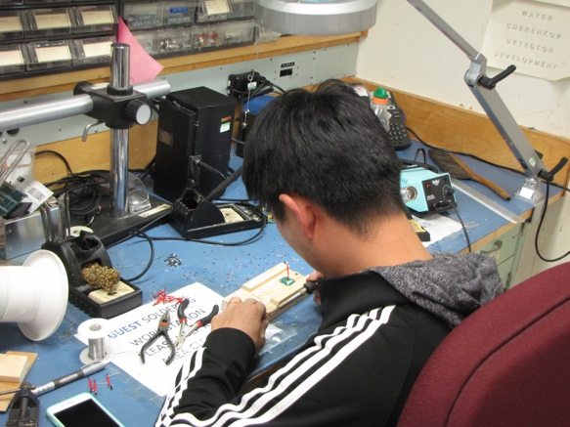
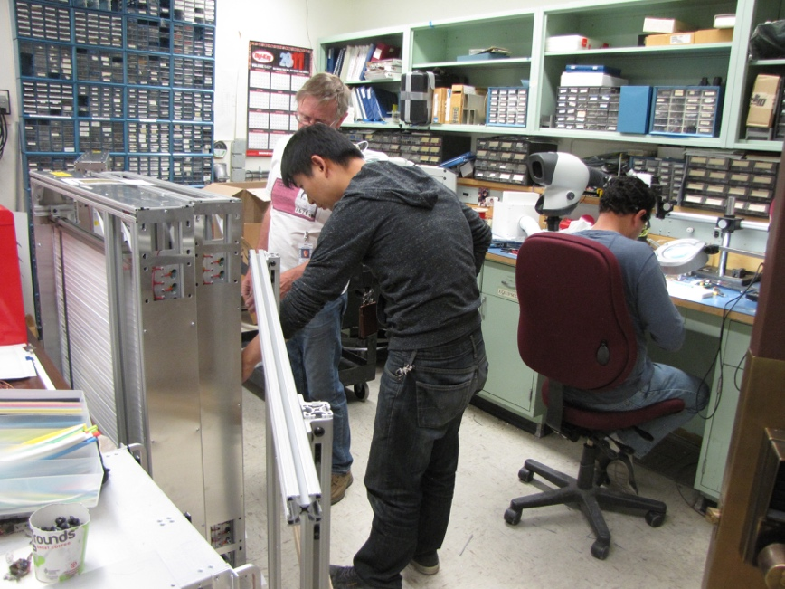






Slide 27











Slide 28


A target Drell-Yan event
E906/E1039
A beam-dump dark photon event --- parasitic run possible!
E1067

Slide 29
LDRD/ER leveraged on others’ contributions
Stimulated great interest from others
Leveraged expertise from external collaborators
Fermilab preamp
Theoretical study
A new NSF fund, Prof. S. Gori
New experimental collaborators
Russian collaborators, two new institutions
HEP groups: Univ. Kentakey,

Slide 30

Phase-I Expectation: Dark Photons (parasitic run w/ E906/1039)
Signals considered:
Drell-Yan like
Eta decays
Bremsstralung
Covers a wide range of unexplored parameter phase space
Displaced dimuons
- Minimal SM background
Prompt dimuons
- Good coverage
- Possible dedicated runs later to fully
restore mass < 3GeV (Phase-II)
Phase-II with upgrades
Access below 200MeV with di-electrons
( add EMCal)
Work in progress!

Slide 31
Projected Dark Higgs Sensitivity POT:1.4x10¹⁸ (Phase-I)
Y. Zhang (2015)
Dimuons with downstream displaced decay vertices
Limited sensitivity to “prompt” large mixing case due to small cross-section
Dark Higgs or dark photons?
Dimuon kinematic and angular distributions
Phase-II
Dedicated high luminosity runs optimized for low mass acceptance, mass<3GeV
POT:4x10²⁰

Slide 32


E-1067 Future Upgrade: Phase-II 2020 ~ 2025+
EMCal
Add tracking detectors close to “target” to improve mass resolution
Add EMCal, PID
e^{+/-}, h^{+/-} , π^{+/-}

Slide 33
A Great Opportunity Dark Photons and Dark Higgs Search at SeaQuest
Photon portal: “vector”
Higgs portal: “scalar”
θ = μ v/m_{h}²

Slide 34


Dark Photon Detection in Dilepton Channel
Drell-Yan like
π⁰, η, … decay
Bremsstrahlung
(DM)
MiniBooNE
Beam-dump
(DM)
p
l⁺
p
l⁻
~ Fixed target w/
electron beams

Slide 35
Dark Higgs
Y. Zhang et al, arXiv:1502.06983
θ = μ v/m_{h}²
arXiv:1312.4992
e⁺e⁻
Phase-I:
High-mass: μ⁺μ⁻ and hadrons
Advantage of using hadron beams
with muon probes over electrons
Phase-II:
Low-mass: e⁺e⁻, <200MeV possible
High-mass: hadrons, (5x)
Electron ID
upgrade!
μ⁺μ⁻

Slide 36


EMCal from PHENIX/RHIC
2 EMCal sectors are available from PHENIX experiment at RHIC, ~end of 2016
One sector:
2m x 4m, 18 (3x6)super modules
Super module = 36 modules; Module = 4 towers
36 x 4 x 18 = 2592 channels
Could gang 2x2 (or 3x3) into one ADC/TDC readout
- dE/E = 8.1%/sqrt(E) + 2.1%
- dT < 200 ps
- Excellent e/pi separation

Slide 37
FY17: Scientific Impact to the Community, Invited talks and Publications …
BNL Dark Interactions: 10/4-7, 2016
Our Fermilab dark photon/Higgs program
highlighted at opening plenary talk
- Two talks, by Arun, Ming
DOE HEP Cosmic Visions: New Ideas for Dark Matter, 3/2017
Showcased Fermilab dark photon/Higgs program
Contributed to Community Whitepaper

