Slide 1
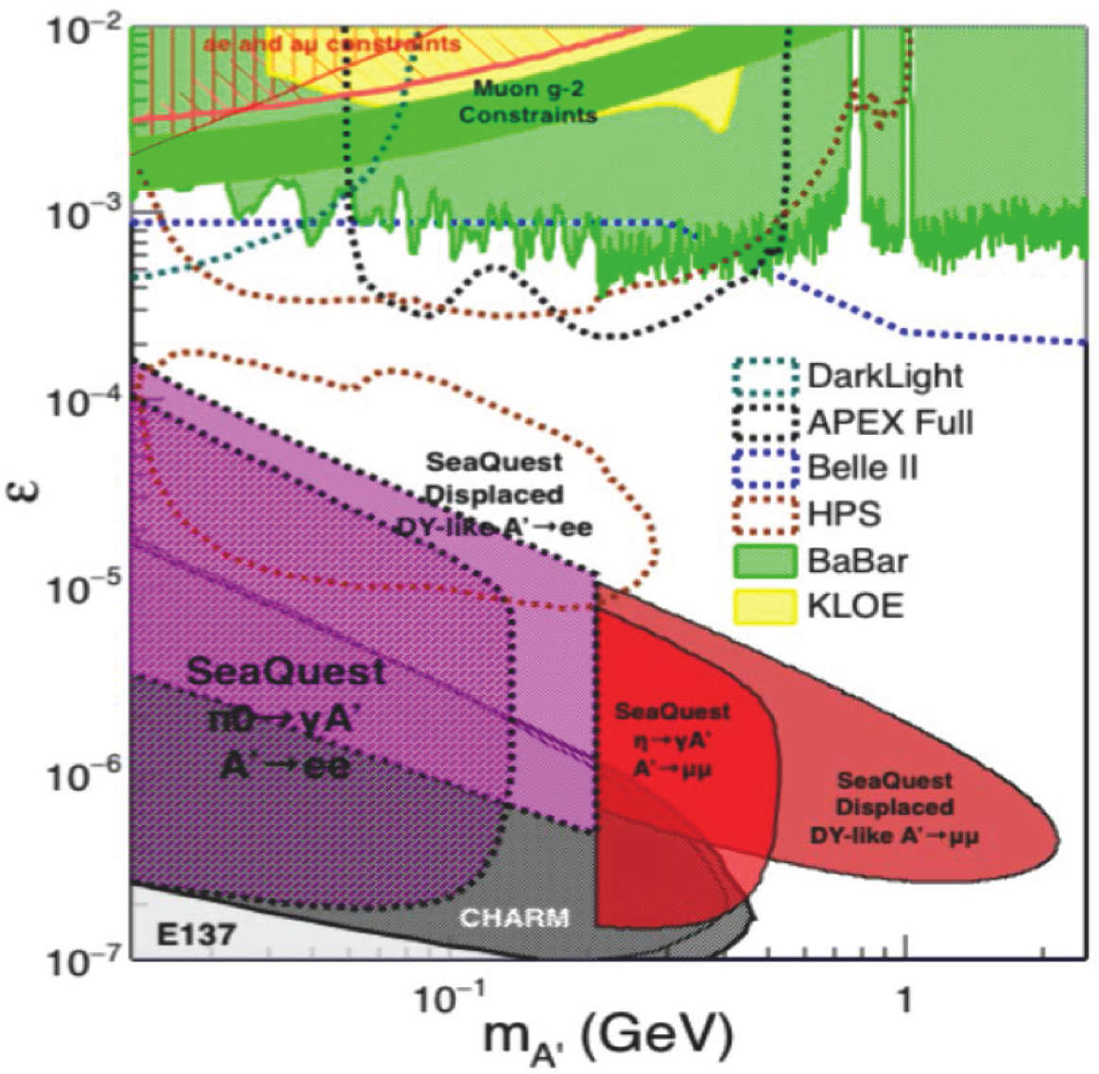
Update on Dark Photon LDRD
Detectors to be completed this week @LANL
  To be shipped to Fermilab for installation
  ~3/16 departure
  Safety document discussed, issues being addressed
Two bars timed in and integrated into E906 DAQ
  Installed and tested in E906, clear in-time signal seen
  understood the time-delay relative to E906 trigger
  Ready for full detector timing & commissioning
Future program development
  DOE Dark Matter Workshop: 3/23-25
  Additional collaborators from HEP community
  Spectrometer upgrade - EMCAL

Slide 2
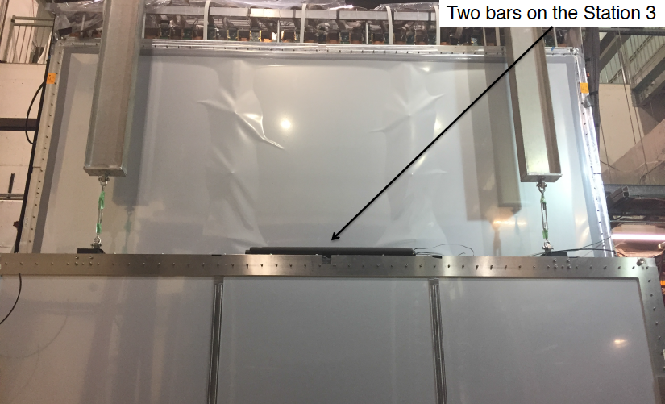
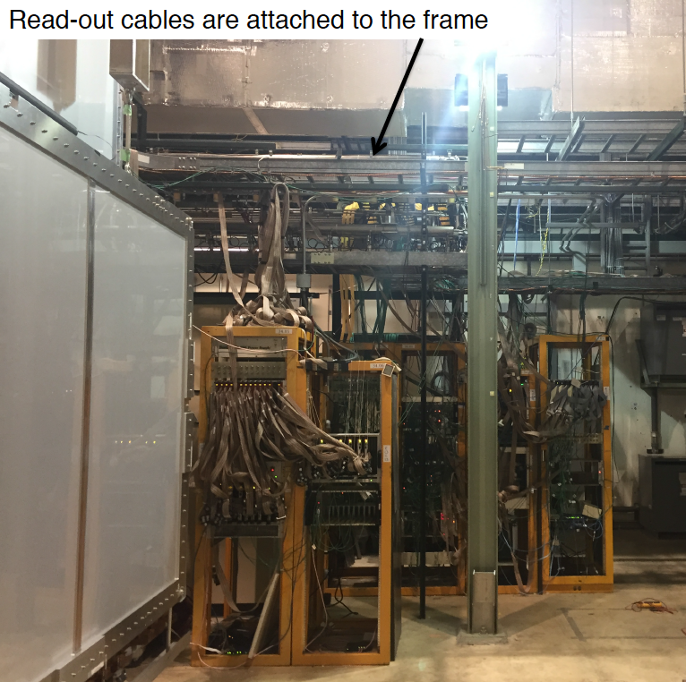
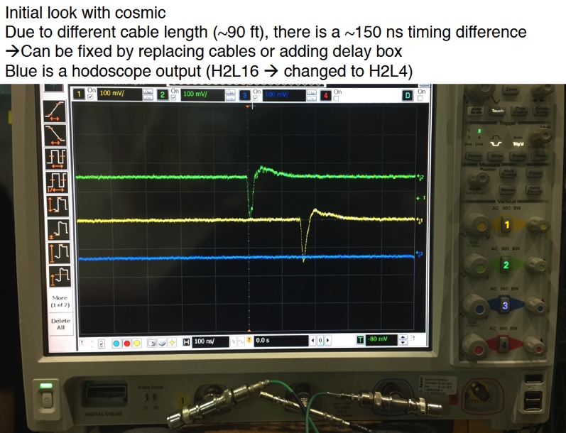
Timed in two bars and integrated into E906 DAQ

Slide 3
MAPS Updates
Obtained 5 MPAS chips with readout adaptors and cables
  To build a slow readout 4-chip telescope
  Fast readout with MOSAIC possible
MOSAIC test bench being installed @LANL
  Obtained libs and manuals
  For high speed readout of staves and single chips
  Test FireFly cables performance
  Data rate, cable length, error rates
RU v1 ordered
  Near final version, with all key components
  Available ~April/May
MAPS readout and control workfest at UT-Austin, 4/19-20
  RUv0, RUv1(?) + Altera-based protytype “CRU”
CRU
  2 Altera evaluation boards
  BNL FELIX option being explored
Update MVTX-preproposal
  Cost and Schedule, resources
    LBNL, MIT
  Expand physics program on open heavy physics
  Rapid progress in planning
  Discussion with LANL NP this week
Physics simulations
  Beyond b-jet physics
  Include B-hadrons
  Offline tracking and vertex finding
  B-tagging
Prepare for BNL Directors reviews
  May 1?
  Physics
  Cost and Schedule
Update MVTX proposal
  Late summer?
  More realistic end of 2017
Stave production and Test @CERN
  5/1 – 10/30, 2017
Postdoc and staff hiring in progress

Slide 4
Updates after MVTX pre-proposal submission
No MAPS-Telescope in the baseline
  MAPS strategy has evolved based on feedback from ALD. Baseline detector would not include MAPS at all.
  Continue to develop proposal for MAPS as an upgrade to baseline (doesn't necessarily imply that MAPS wouldn't be available on day-1).
Update physics goals/justification for MVTX
  Updated simulations needed to show broad HF MAPS-enabled program. New results at QM'17 (e.g., B's via displaced D's) may indicate targets for sPHENIX
  B-meson and b-jet physics in the pre-proposal, more physics simulations and algorithm development
  Likley 4+ years sPHENIX program
  sPHENIX baseline physics w/o MVTX? Very limited in open heavy flavor physics
Reviews
  Timeline of baseline CD-1 review is late summer.
  A BNL-convened Director's review of MVTX late spring (~ May 1?)
    physics simulation need more help, HF group
      may not be ready for the full sim, fast sim possible
    C&S OK, labor and cost profiles, work in progress
      confirm resource commitments from LANL, LBNL and MIT, + other institutions (manpower, facilities etc.)
  Updated MVTX pre-proposal by late summer (challenging, late 2017 more reasonable)
    Physics simulations requires more effort, full expanded heavy flavor physics enabled by MVTX
    C&S could be much improved in late 2017 after we achieve:
      LANL LDRD produce and test a few staves at CERN (May – Sept 2017).
      LANL LDRD initial readout R&D with RUv1 & “CRU” and/or FELIX late 2017 (9/2017?);

Slide 5
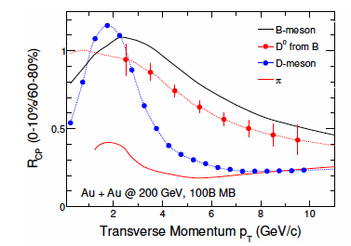
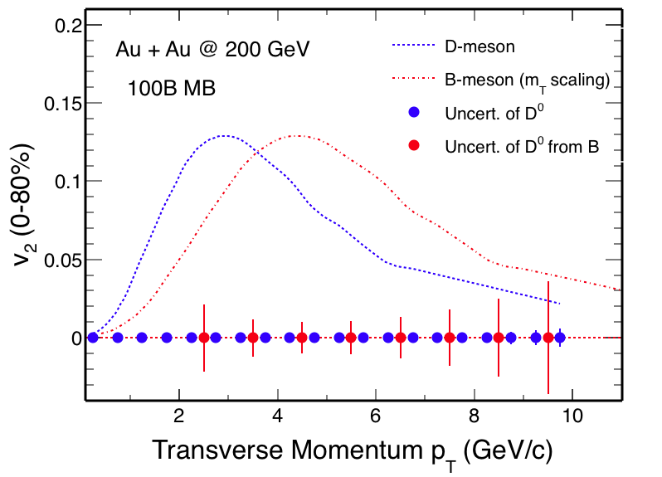
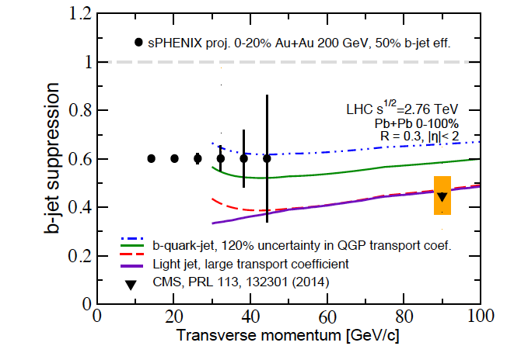
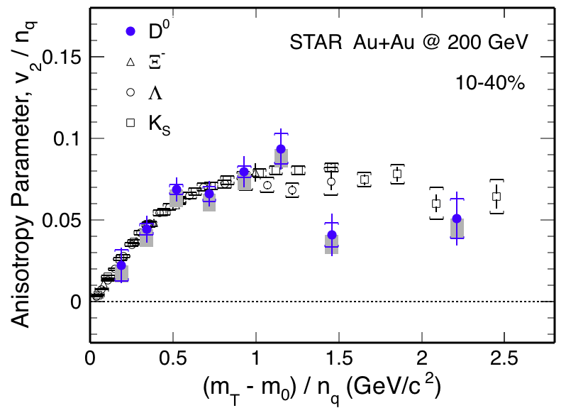
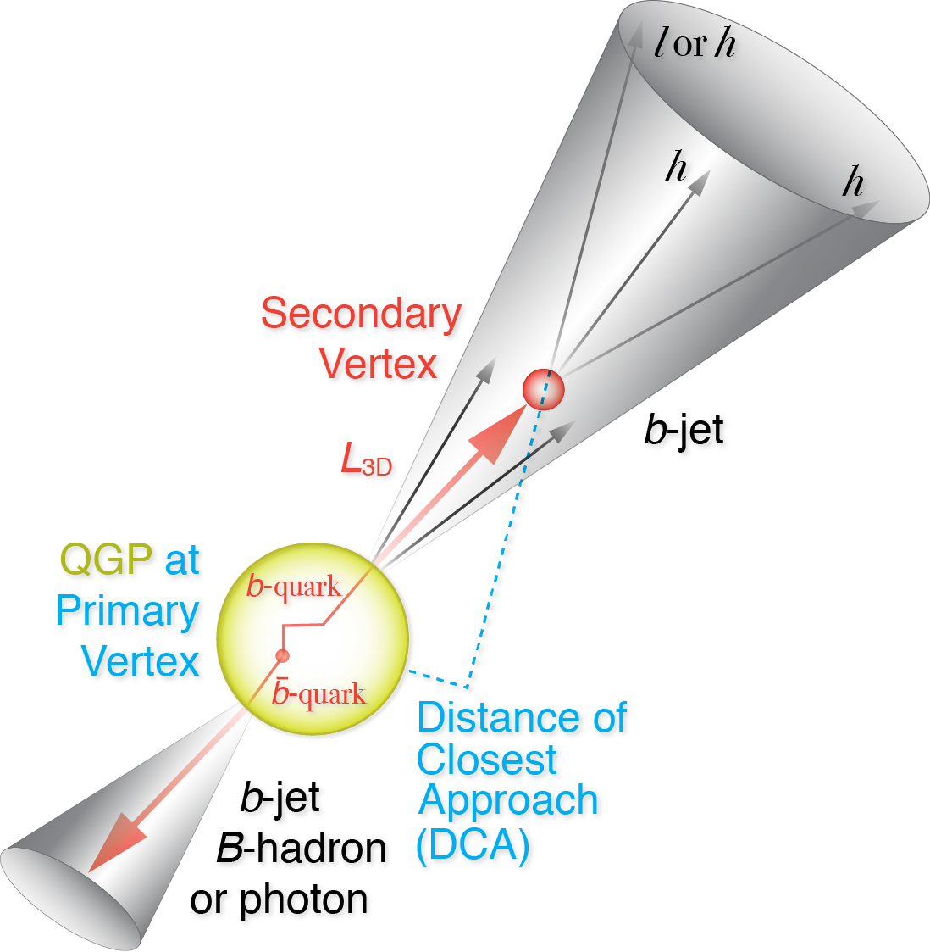
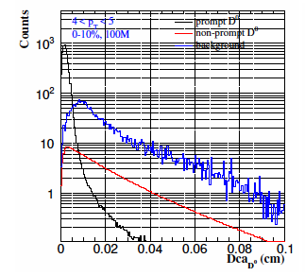
Physics for MVTX Proposal more new ideas being explored
B-hadrons (pT ~< 15GeV)
  R_AA
  V2, V3 vs pT
  pT range: 0-15GeV?
B-jets (pT >~ 15GeV)
  R_AA
  Jet fragmentation
  Di-b-jet correlation etc
  pT range: 15-50GeV?
  Update theory
Detector and Physics simulations: Money plots
  DCAs for light and heavy hadrons
  Full B or D-meson reconstruction
  Full b-jet reco
  Jet correlations
More discussions
  HF group, sPHENIX
  A workfest to make money plots
Positive impacts on other measurements
  Upsilons
  Muti-event pile up
  Ghost track rejection etc

