Slide 1
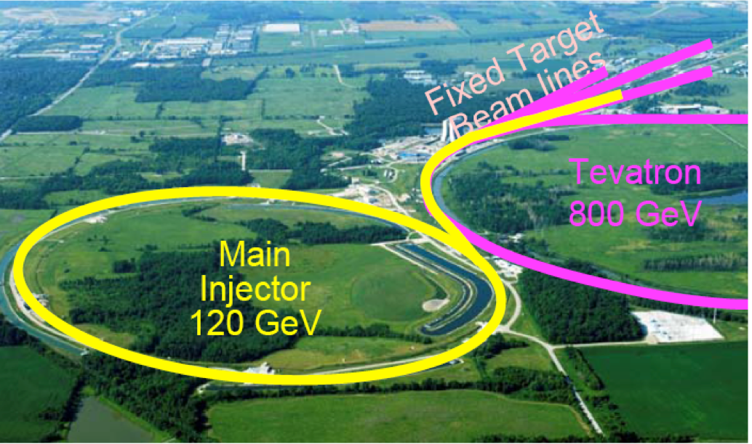
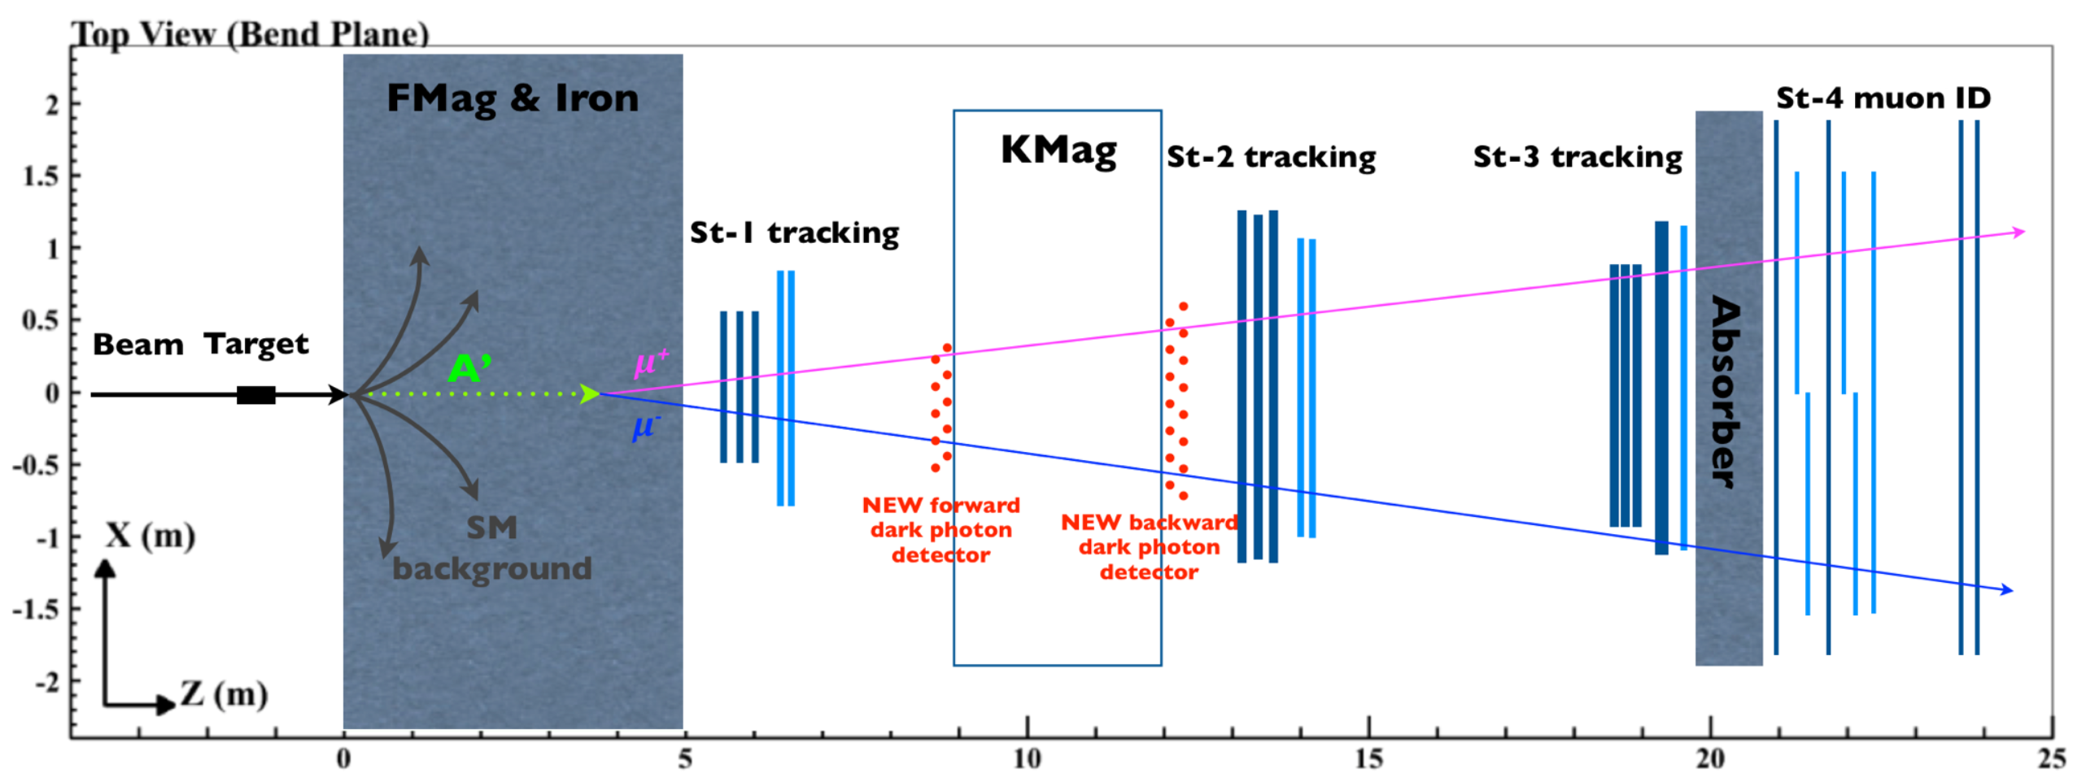
A Direct Search for Dark Photon and Dark Higgs Particles with the SeaQuest Spectrometer in Beam Dump Mode at Fermilab
Ming X. Liu (Los Alamos) and Paul E. Reimer (Argonne)
P-1067 Collaboration

Slide 2
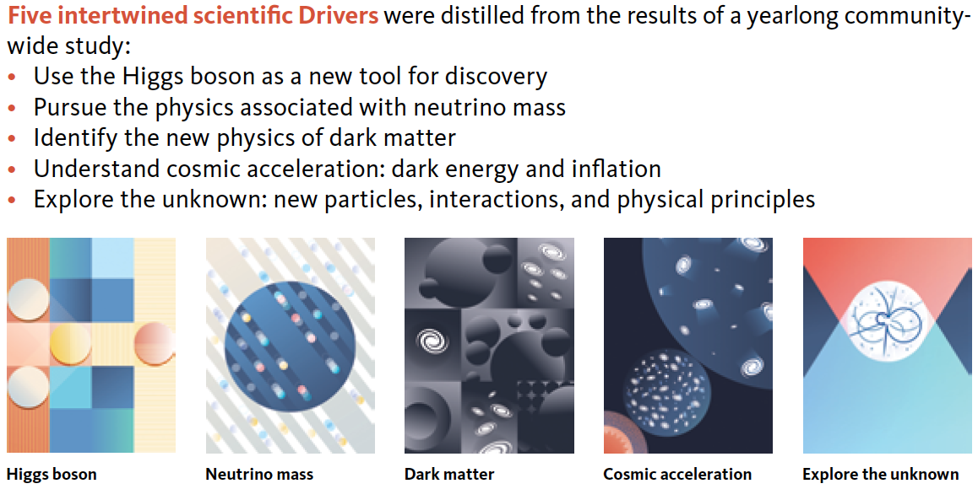
2014 US P-5 Report
Great Opportunities at the Fermilab Intensity Frontier!!!
Notes:
P5 reprot highted the 5 sciecne driver …
We respond to the call of P5 report and identified a new opportunity to explore key physics at Femirlab intensity frontier

Slide 3
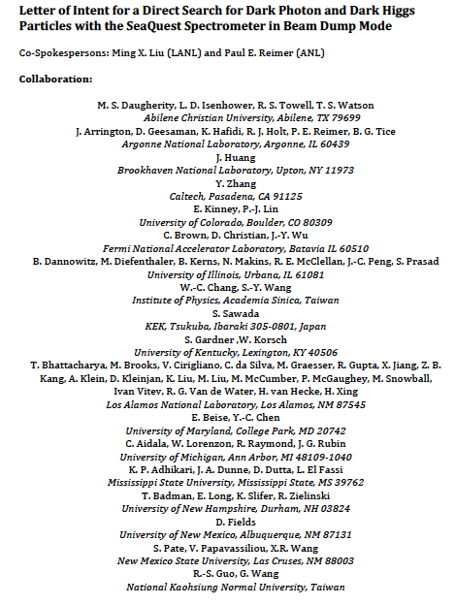
LOI submitted to Fermilab PAC
on May 20, 2015
A joint experimental and theoretical collaboration
(most E906/E1039 + new members)
---------------------------------------
Phase-I: (focus of this presentation)
Addition of a new displaced dimuon trigger to tag long-lived downstream decayed dark photons (dark Higgs).
Parasitic data taking with E1039 in 2017-2019;
  A short dedicated run (up to ~1 month) if needed.
POT 1.44x10¹⁸
Phase-II:
Dedicated runs later with EMCal/HCal upgrades, e^{+/-} and h^{+/-} capabilities.
Cover the full parameter phase space allowed by beam energy and luminosity
POT: >> 1.4x10¹⁸
Phase-II request will be presented to PAC at a later time.
Notes:
Responding to P5 reprot, we submitted LOI last month ..

Slide 4
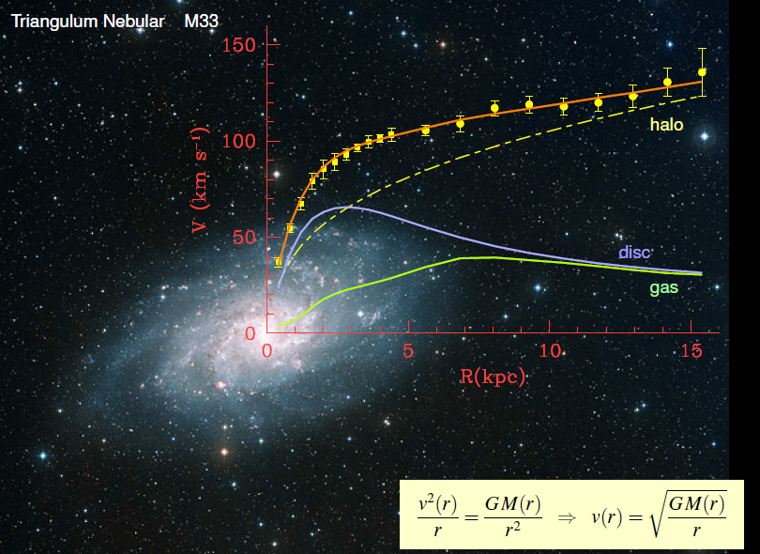
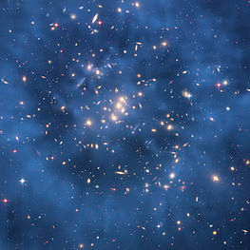
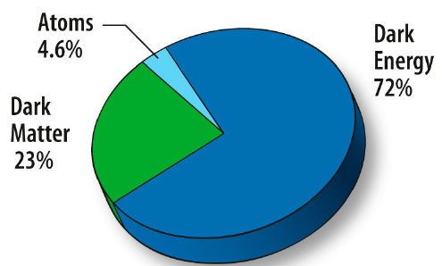
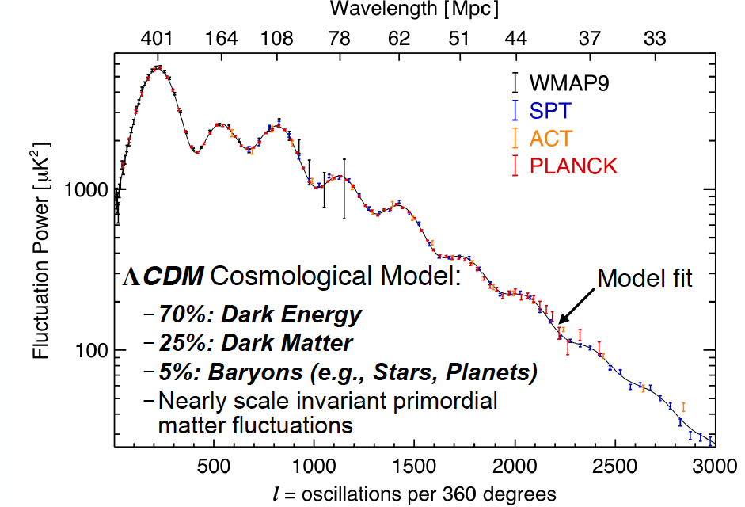
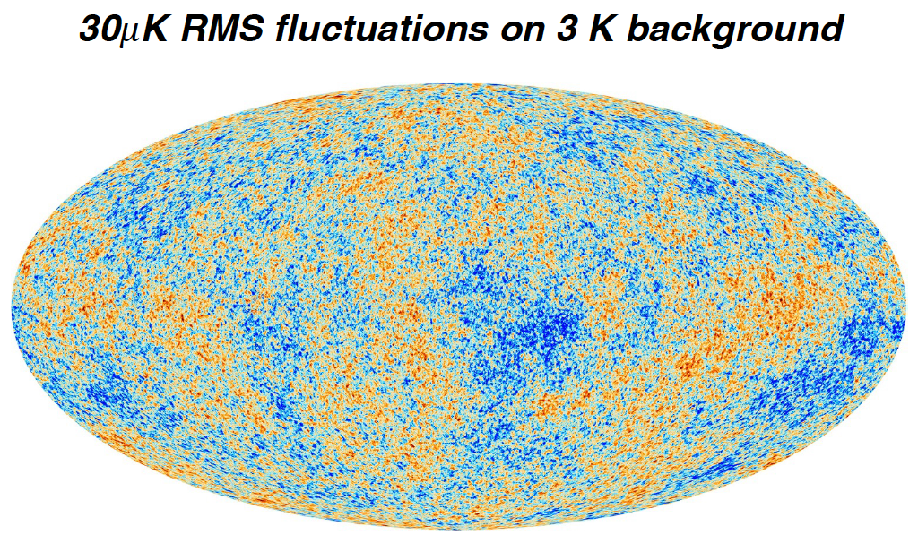
Dark Matter?
Galaxies’ rotation curve
Gravitational lensing (Hubble 2007)
F. Zwicky, ApJ 86 (1937) 217, V. Rubin et al, ApJ 238 (1980) 471
Planck: 2013
Benson’s talk @CIPANP 2015
Notes:
It is widely accepted today that visible matter only account for 5% of matter and energy, with 25% dark matter ..

Slide 5
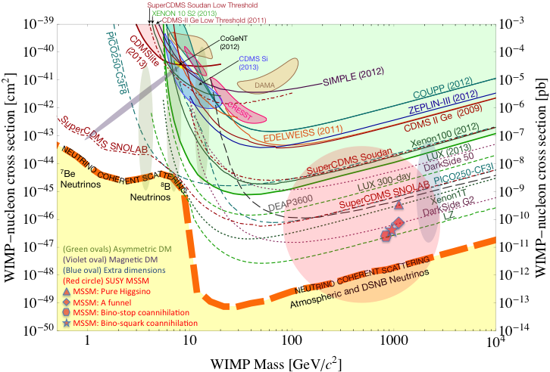
What Are the Dark Particles?
WIMP being excluded?
Recent anomalies observed by satellite and terrestrial experiments have motivated dark matter models introducing a new dark sector
“Sub-GeV” low mass weakly-interacting dark particles become very interesting!
Mass: O(MeV ~ GeV)
In particular, high-intensity colliders (B-factories) and fixed target experiments (Fermilab, JLab, LHC) offer an ideal environment to probe these new ideas.
Montgomery’s talk at CIPANP2015
“a vision of nuclear and particle physics”
- Imaginable space for these experiments is rapidly disappearing
- the “natural” theory space is also disappearing.
- I like to think that Dark Matter is on solid ground, maybe not!!!
Notes:
What are the DM? WIMP is considered one of the primary candidates of DM …

Slide 6

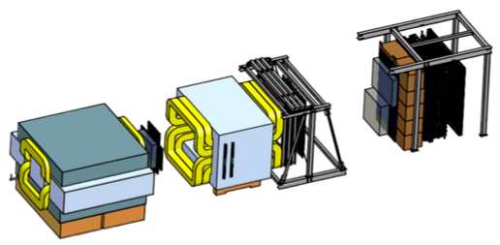
Intensity Frontier at Fermilab: 120 GeV Beam
World’s highest intensity high energy proton beam:
“beam dump mode” @SeaQuest/E906
35,000 fb⁻¹ (in 2 years of parasitic runs)
LHC-II: 300 fb⁻¹ (~2025), achieved 25fb⁻¹ in Run-I
B-factory@KEK: 50,000 fb⁻¹ (~2023)
Absorber wall and proportional
tube based Muon ID
Spectrometer magnet
Δpt = 0.4 GeV
Focusing magnet
and solid iron dump
Δpt = 2.9 GeV
Beam
120 GeV proton from Main Injector
19ns RF, 4s spill, 0.5×10¹³ protons per spill
25 m
Target system
Liquid H and D
Solid C, Fe, W
- Capture most beam in beam dump mode: p+Fe collisions!
- Parasitic run mode possible with other experiments, E1039/E1027

Slide 7
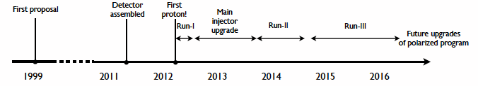
Schedule of SeaQuest Experiments
E906 complete data taking in summer 2016
  E906 targets are located ~1.3m upstream of the beam-dump
E1039 will replace current E906 targets with a polarized NH₃ target.
  No change to E906 spectrometer setup
  New target located about 3.5m upstream of the beam-dump
E1039 Timeline
  Target/trigger installation: 2016 - 2017
  Data taking: 2017 – 2019
P1067 Timeline
  Phase-I (Parasitic run) with E1039: 2017-2019
  (Phase-II: detector upgrades and dedicated runs)
P-1067
Dark photon(Higgs)
Search: 2017-2019
parasitic run, E1039
E906 started
E1039 starts

Slide 8
Direct Productions of Dark Photons and Dark Higgs in p+Fe at Fermilab
Photon portal: “vector”
Higgs portal: “scalar”
θ = μ v/m_{h}²

Slide 9
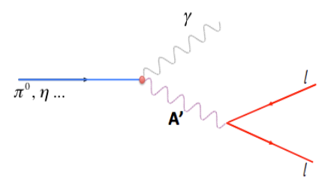
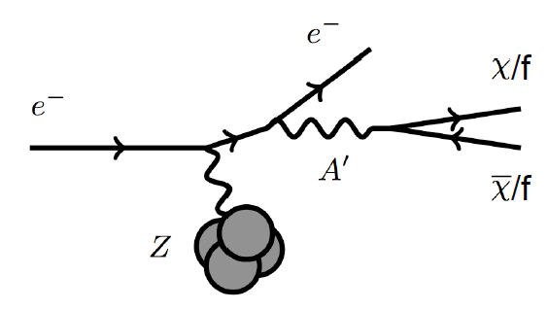
Dark Photon Search in Dimuon Channel at SeaQuest in Beam Dump Mode (p+Fe)
Drell-Yan like
π⁰, η, … decay
Bremsstrahlung
(DM)
MiniBooNE
Beam-dump
(DM)
p
l⁺
p
l⁻

Slide 10
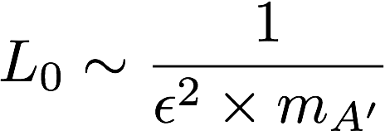
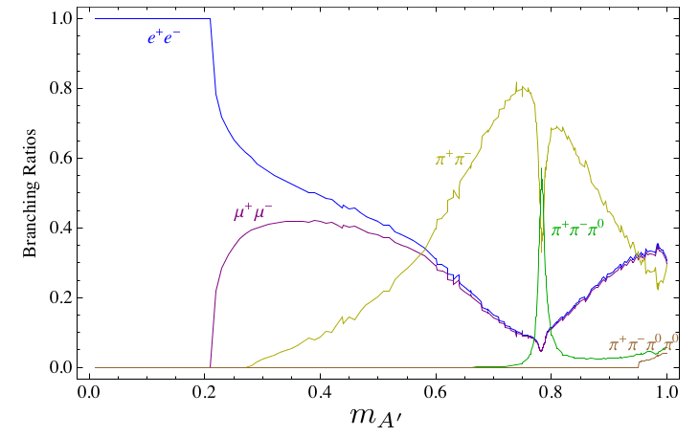
Dark Photon Decay Modes
“Minimal” Decay:
Dark photon is the lightest in the dark sector;
  SM final state particles only
Long proper decay length: L₀ ~ O(1m)
D. Curtin, et al, arXiv: 1312.4992
“General” Decay:
Decay into other dark particles,
dominant channel if allowed
  Dark -> Dark
  Dark -> SM particles
(GeV)

Slide 11
Proposed Experimental Measurements
Dark photon trigger upgrade
  Add a fine-granularity scintillating strip based trigger/tracking to tag dimuons from the same decay Z-vertex
  A new trigger for events with displaced down-stream dimuons
Unique signals
  Displaced dimuon decay vertex for long-lived particles
  Invariant mass peak in dimuon mass spectrum
Beam time
  Run parasitically with E1039 (2017-2019)
  Possible dedicated runs later with upgraded (e^{+/-}, h^{+/-})
-- 2.5%
-- 6.0%
Dimuon mass resolution
Z (meter)

Slide 12
A New High-Granularity Displayed Dimuon Vertex Trigger
High rejection power, very low rate, << 1 kHz(E906 DAQ limit)
Y-Plane Trigger:
A quadrant panel: 40 x 40 cm², 1cm thinck
  40 x 1cm x 40 cm scintillating strips, SiPM readout
- Straight line projection, 30cm Z-vertex resolution
- Displaced z-vertex, mostly low mass < 3GeV
Coincident with St-4 Hodos(muons)
Quadrant-based triggers: 4 x V1495
Y-channels per quadrant:
- 1x V1495
40(St1) + 40(St2) + 8x2 (St4-Y1,2) = 96
96+64 = 160 possible
  72+72+16 = 160 (possible)
  (2NIM=RFCLK+ComSTOP )
St1
St2
Z
Coincident Z-vtx
window matched@L2
E906 Run2
J/Psi
Psi’
Drell-Yan
Rndm
E906 Run2
Dimuon Z-vertex (cm)

Slide 13
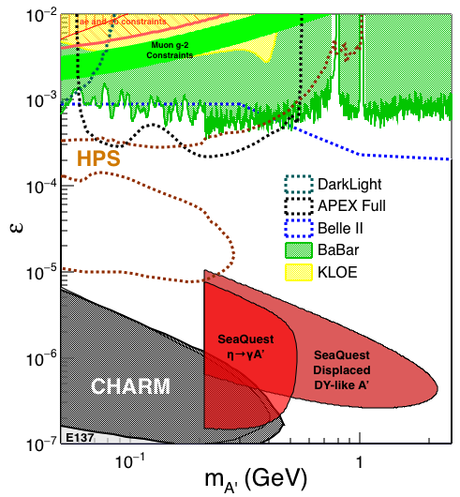
Search Mode (1): Long-lived Dark Photons
Reconstructed dimuons with downstream Z-vertex:
3m < Z-vertex < 6m
Very low trigger rate, << 1kHz
SM background free
Dimuon mass peak
- 5x10¹² ppp ( current E906)
200 days
1.4 x 10¹⁸ POT (recorded)
4 events contours (2-sigma)
2-sigma (95%) exclusion plots
Excellent coverage of uncharted region!

Slide 14


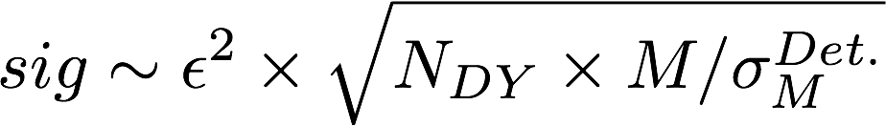
Search Mode (2): “Prompt” Dark Photons vs Drell-Yan
Z-vertx < 3m
Expected Drell-Yan like signal and backgrounds:
Excluded phi
resonance region
Dark photon
signal
Drell-Yan Background
Work in progress
Further optimization possible

Slide 15
Low Mass Prompt Dimuon Trigger Rate Study
Current E906 setup
Proposed 2-layer trigger upgrade (10x improvement)
Additional Y-trigger after ST-3 absorber, and also using existing E906 X-Plane trigger
(additional ~2x improvement)
Current E906 DAQ 1kHz, can be improved to 10kHz with small cost
200kHz possible in the future (reprograming trigger firmware etc.)
Parasitic mode: use up to ~10% DAQ bandwidth
(Prompt)Low mass dimuon trigger efficiency

Slide 16
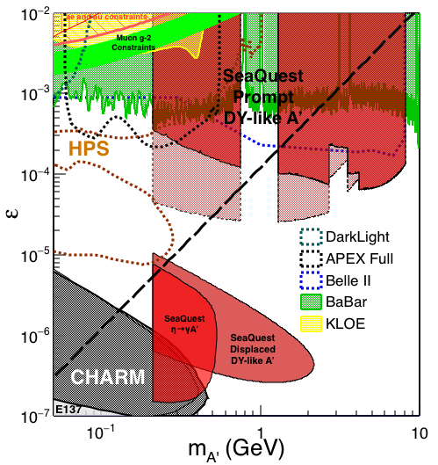

Dark Photon Sensitivity: Summary
POT:1.4x10¹⁸ (parasitic w/ E1039)
Signals considered:
Drell-Yan like
Eta decays
Bremsstralung
Covers a wide range of unexplored parameter phase space
Displaced dimuons
- Minimal SM background
Prompt dimuons
- Excellent coverage over BELLE-II
projection
- Possible dedicated runs later to fully
restore mass < 3GeV (Phase-II)
Phase-II with upgrades
Access below 200MeV with di-electrons
( add EMCal)
(2017?)
(2016?)
(~2023)

Slide 17
Dark Higgs Search at SeaQuest
Y. Zhang et al, arXiv:1502.06983
θ = μ v/m_{h}²
D. Curtin et al arXiv:1312.4992
e⁺e⁻
Phase-I:
High-mass: μ⁺μ⁻ and hadrons
Advantage of using hadron beams
with muon probes over electrons
Phase-II:
Low-mass: e⁺e⁻, <200MeV possible
μ⁺μ⁻

Slide 18
SeaQuest Dark Higgs Sensitivity
POT:1.4x10¹⁸ (Phase-I)
Y. Zhang (2015)
Dimuons with downstream displaced decay vertices
Limited sensitivity to “prompt” large mixing case due to small cross-section
Dark Higgs or dark photons?
  Dimuon kinematic and angular distributions
Phase-II
  Dedicated high luminosity runs optimized for low mass acceptance, mass<3GeV
1x
5x
25x

Slide 19
Scope and Compatibility
Preparation work: 2016 – 2017
  Displaced vertex dimuon trigger upgrade (LANL LDRD? $100K)
    Add a new trigger bit
    No change to existing trigger matrix
  Possible upgrade of DAQ bandwidth under consideration (external $$)
    1kHz (E906) -> 10+ kHz
  Commissioning with cosmic rays
Parasitic runs w/ E1039: 2017 – 2019
  Displaced vertex dimuon trigger upgrade
  Use up to ~10% DAQ bandwidth
  Achieve 1.44 x10¹⁸ POT
Possible parasitic runs w/ E1027 and/or dedicated runs later with upgrades: 2019+
  High luminosity goals:
    POT >> 1.4x10¹⁸
  DAQ
    10 – 100 kHz capability
  EMCAL/HCAL/PID
    Electrons
    charged hadrons
  Fully cover the accessible phase space
    Low mass “prompt photon” region, M < 3 GeV
  Possible parasitic runs with other proposals

Slide 20
Summary and Outlook
Phase-I (this LOI)
  Great discovery potential!
  Add a new displayed vertex trigger
  Early parasitic data taking 2017-2019+
    A short dedicated run up to ~1 month if needed
  POT 1.4 x10¹⁸
Phase-II (future request)
  Possible detector upgrade later, add electrons and hadrons
  A new dedicated dark matter program at Intensity Frontier!
Dark Higgs
search
Preparation Phase-I (parasitic runs)
Phase-II
2015
2016
2017
2018
2019
2020+

Slide 21
Backup slides

Slide 22
Work in Progress Sensitivity Study
2-year parasitic run and more
With 10kHz DAQ bandwidth,
the accepted low mass “prompt” dimuons, M<3GeV, are statistically limited by DAQ throughput and detector acceptance (assuming only uses 10% DAQ).
100kHz DAQ bandwidth is needed to
fully cover the phase space (assuming 10% usage of DAQ bandwidth) and dedicated dark photon run.
In the first two-year parasitic runs with E1039, our focus is on 1)the displaced dimuons for low mass; 2)prompt high mass dimuons M> 3GeV.
We can still cover more phase space than what BELLE-II can achieve in ~2023.
Full coverage of low mass (M<3GeV) can be achieved later through dedicated runs with much improved DAQ bandwidth after E1039.

Slide 23
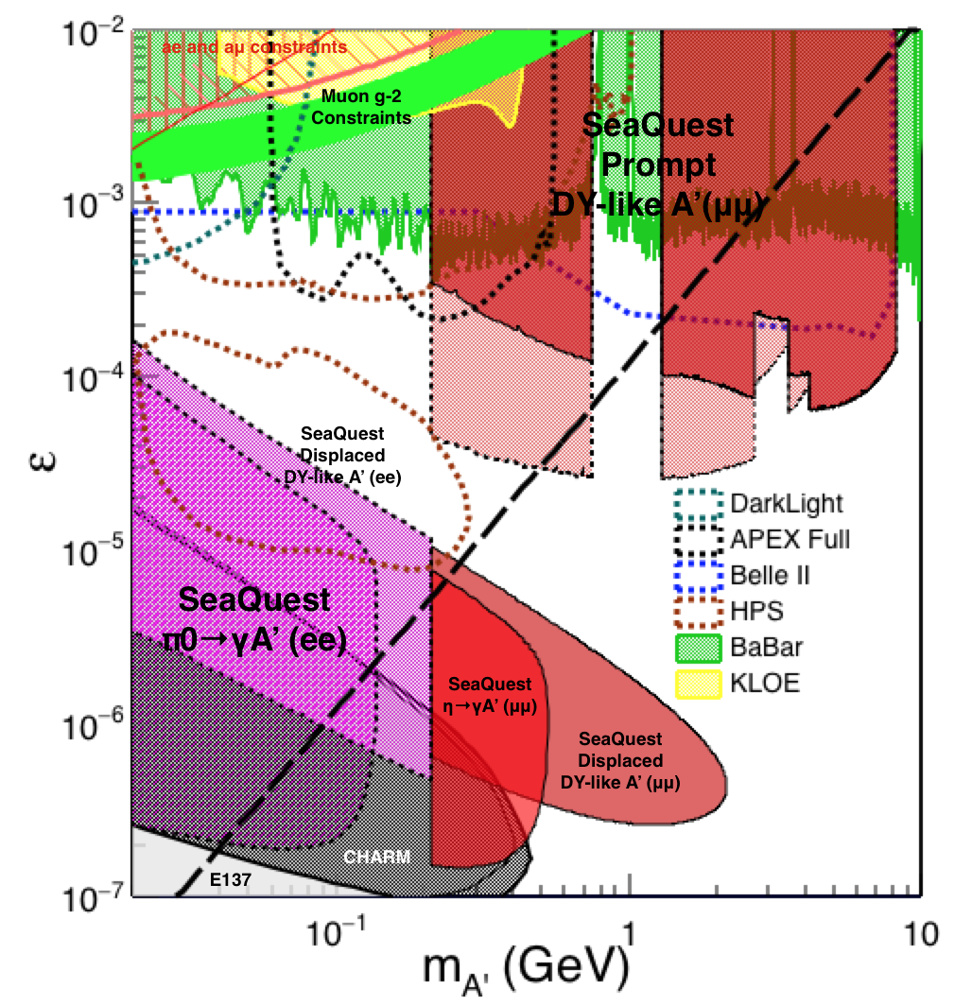
Phase-II: Full Coverage with future detector “EMCal/HCal” upgrades
Projection: POT 1.4 x 10¹⁸
Detector upgrades
  EMCal: e^{+/-}
  HCal: π^{+/-}
  Recycle from other experiments, RHIC/JLab etc.
DAQ upgrade
  100 kHz
Timeline of dedicated runs
  2019+
Detector configuration
  Access low mass region with optimized Fmag settting

Slide 24
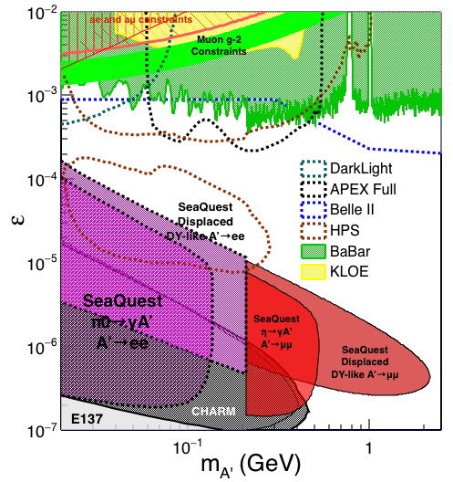
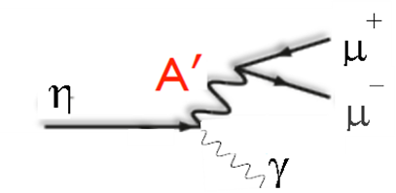
Phase-II: Access Low Mass Region with e⁺e⁻ with future detector “EMCal” upgrades
S. Gardner, R. Holt et al

Slide 25
Non Abelian Dark Sector with future detector “HCal” upgrades
non-Abelian dark sector process
S. Gardner and R. Holt
[Note: Batell, Pospelov, and Ritz, PRD 80 (2009) 095024 for a review re fixed target expts.]
Here we consider a non-Abelian (gluon) portal
[Baumgart et al., JHEP 0904, 014 (2009); Gardner and He, PRD 87 (2013) 116012]
The “shining through walls” design – unique to Seaquest – makes this possible ,
to yield, e.g., via a “minimal” decay….

Slide 26
Phase-II: Access Low Mass Region with e⁺e⁻ with future detector upgrades
S. Gardner, R. Holt et al
p
l⁺
p
l⁻

Slide 27
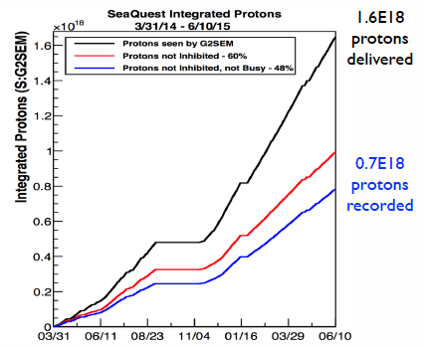
E906 Run-II and III Performance
Run-III
Run-II

Slide 28
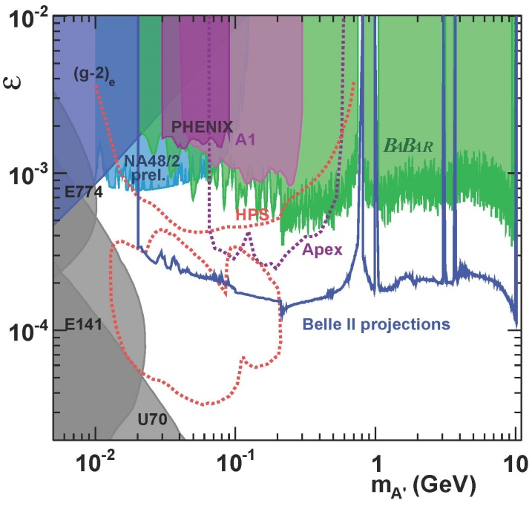
Current Limits on Dark Photon Search
R. Essig et al arXiv:1309.5084

Slide 29
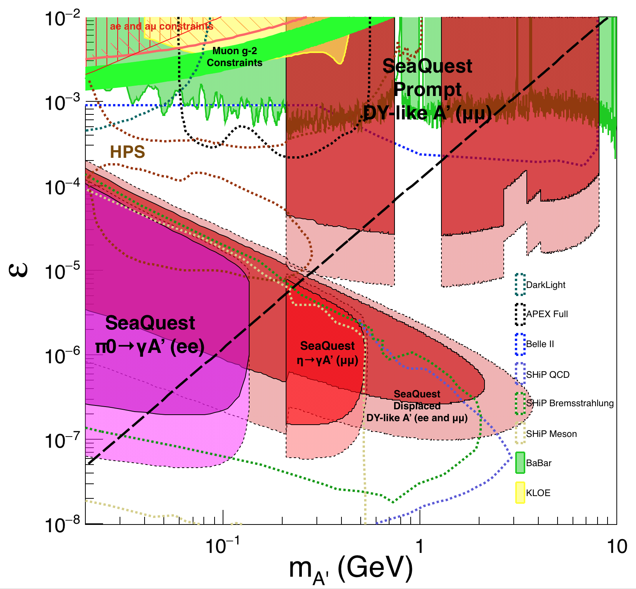
Comparison with SHiP Proposal
120 GeV@FNAL: 2017 -2019
1.4x10¹⁸ POT, future dedicated runs
400 GeV@SPS: 2025 -2030
4x10²⁰ POT

Slide 30
Integrated theory efforts
Signal: detailed calculation for dark photon (dark Higgs) cross section
To provide expected dimuon signal from dark photon decay as function of decay length L and model parameters (ε, m_{A’}), theory team will
  Compute Dark photon production cross section at both LO and NLO
  Derive the branching ratio of dark photon to dimuon
  Theory team: expertise in perturbative QCD and effective field theory for resummation
Dimuon signal
Drell-Yan background
Background: detailed calculation for Drell-Yan cross section
Main background is DY dimon production: reliable computation of the cross section is essential to calculate our experimental sensitivity to (ε, m_{A’}), and understand implication of dark photon search
  We have a NLO DY code that works well in the required energy range
  Calculations will be performed in the necessary energy and kinematic regions

Slide 31
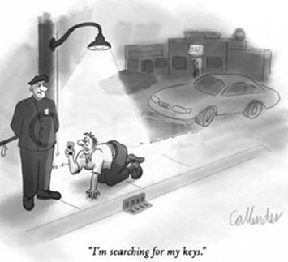
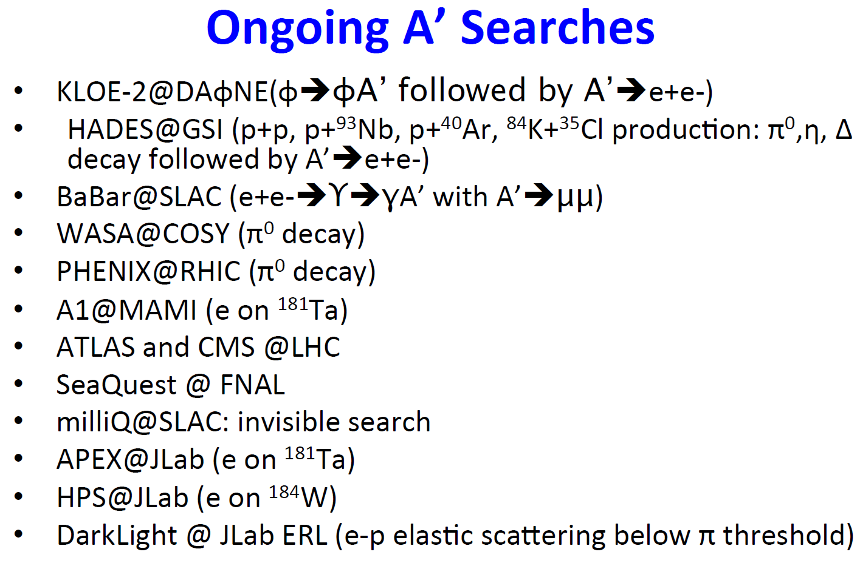
  How important are dark photons in current models of new physics ?
2014 US High-Energy Physics Report (P5)
  Top 5 science drivers:
  “Identify the New Physics of Dark Matter”
  Dark photons
  “one of the key search area for physics beyond the SM”
  One of the two most important portals to “dark sector”:
  Vector coupling, kinetic mixing
  (scalar coupling, dark Higgs)
On-going and/or proposed experimental programs in all major accelerator facilities in the world!
  World wide competitions!
Courtesy: R. Milner(MIT) at the Fundamental Interactions Town Meeting, Chicago, Sept. 28-29, 2014

Slide 32
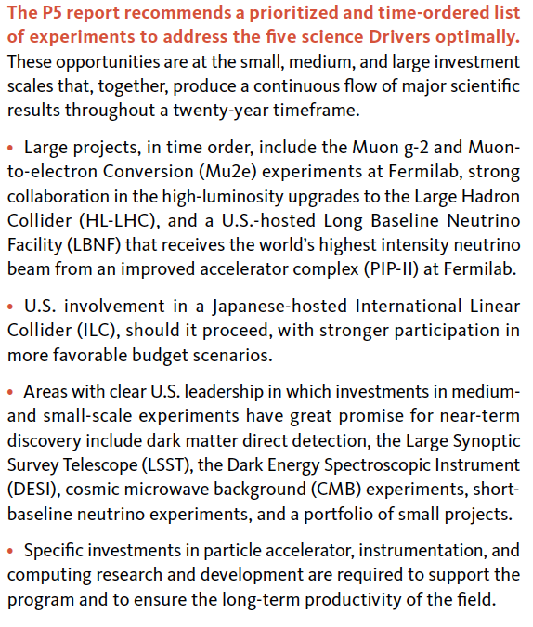
P-5 Recommndations

Slide 33
Probe-1: Drell-Yan Like sensitive to both prompt and long-lived decay

Slide 34
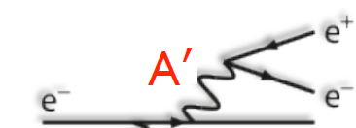


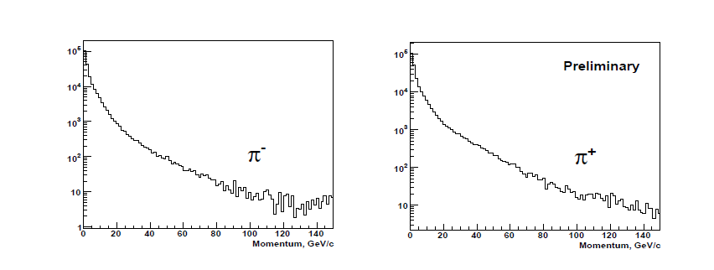
Probe-2: η Meson Production at 120 GeV
= 2.2 b for all charged particle production
Assume that π’s represent 90% of charged particles,
and η production is ~1/10 of this value.
μ⁺
η
Resonance production
μ⁻
γ
S. Mahajan, R. Raja, arXiv:1311.2258; FNAL E907, MIPP

Slide 35
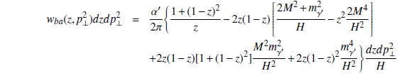

Probe-3: Proton Bremsstrahlung
Generalized Fermi-Williams-Weizsacker approximation
J. Blumlein, J.Brunner, PLB 731 (2014) 320
p’
l⁺
p
γ + p -> Α’ + p’
l⁻
z = (E_{p} – E_{p}’)/E_{p}; s = 2ME_{p}; s’ = 2M(E_{p} – E_{A’})

Slide 36
Proton Bremsstralung Flux
ε = 1

Slide 37
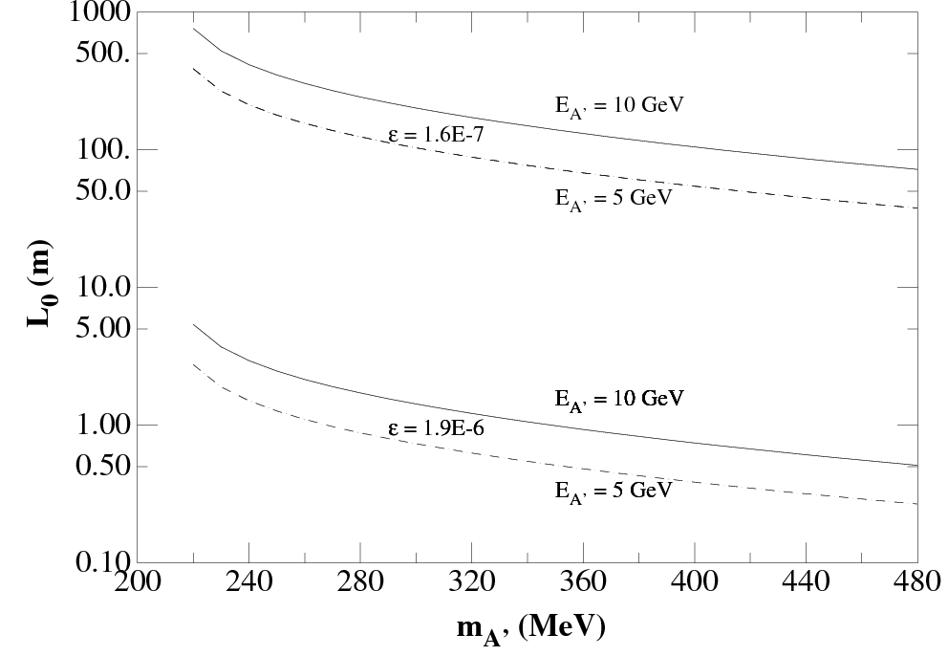
Dark Photon Decay Modes
“Minimal” Decay:
Dark photon is the lightest in the dark sector;
SM final state particles only
Same mixing parameter
  Long proper decay length, ~O(1m)

Slide 38
Toward Improving E906 DAQ Bandwidth
Working with E906 DAQ group to improve DAQ bandwidth from 1kHz to 10kHz(or more)
  TDC board FPGA reprogramming
    Taiwan group
    Fermilab engineer
  Two options considered:
    Directly readout each TDC with Ethernet instead of reading serially through VME backplane
      ~10kHz possible
    Store all raw data in onboard RAM chips (already built in on Taiwan TDC boards, but not used yet!) during the 4-sec spill and read them out during the remaining 56-sec.
      ~200kHz possible

Slide 39
E906 Trigger & DAQ System
Pulse Gen.
V1495 @TB
DAQ
VME/CPU
Ethernet
Hodos
Hits/
Start
TDC (xx)
Threshold Discriminator
……
L1-Trigger
V1495 (4)
(96)
L0 Trigger: not “actively” used
- 4 V1495 boards available
L1 Trigger: in operation
- 4 V1495 boards
(2) for Y-plane, not used
(2) for X-Plane, in use
- 700nS latency
L2 Trigger: pass through
1 V1495
Could do simple look-up
TS: Trigger Supervisor
L2-Trigger
V1495 (1)
L2: limited I/O
1(O), 5(I), 32x
only 2 (I) used
Trigger Supervisor
Comm.
Stop/Trigger

Slide 40
Dark Photon Q-Trigger
DAQ/Data stream
LVDS cable 2x16ch bundle available
Q1 (LVL1)
DAQ Trigger
LVL2
(vtxZ matching)
Q2 (LVL1)
TS
(12 inputs total)
(1-free bit available)
Q3 (LVL1)
DP Trigger
1-bit
Q4 (LVL1)
MC simulation
Dummy pattern
A test stand at LANL
To check FPGA
Logic
Timing
4 x 16-bit from 4 Q1-4/V1495
(2 x 32LVDS cables)
Q1: 40(ST1’) + 40 (ST2’) + 2x8(ST4-Y1/2) = 96, FANOUT ST4
Upto 72(ST1) + 72 (ST2) + 2x8(ST4Y1/2) = 160

Slide 41
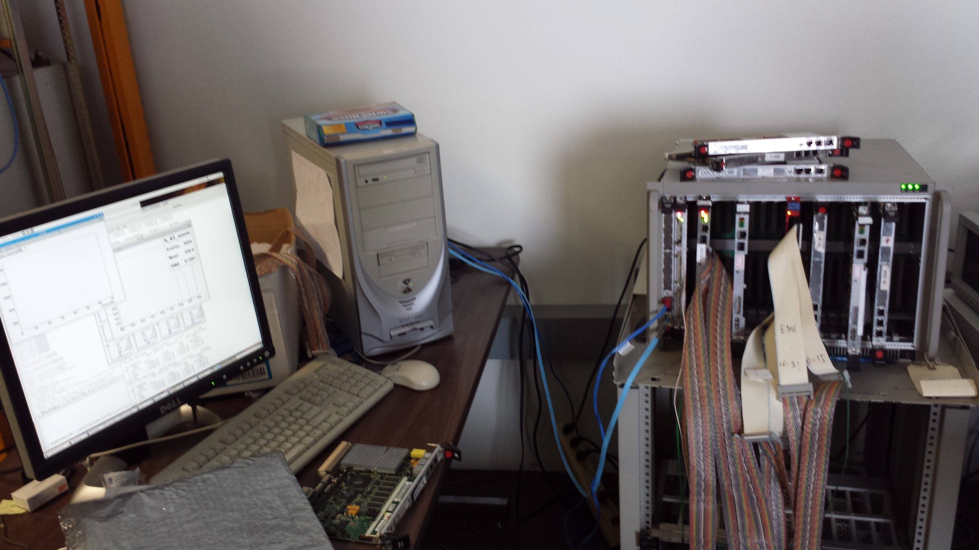
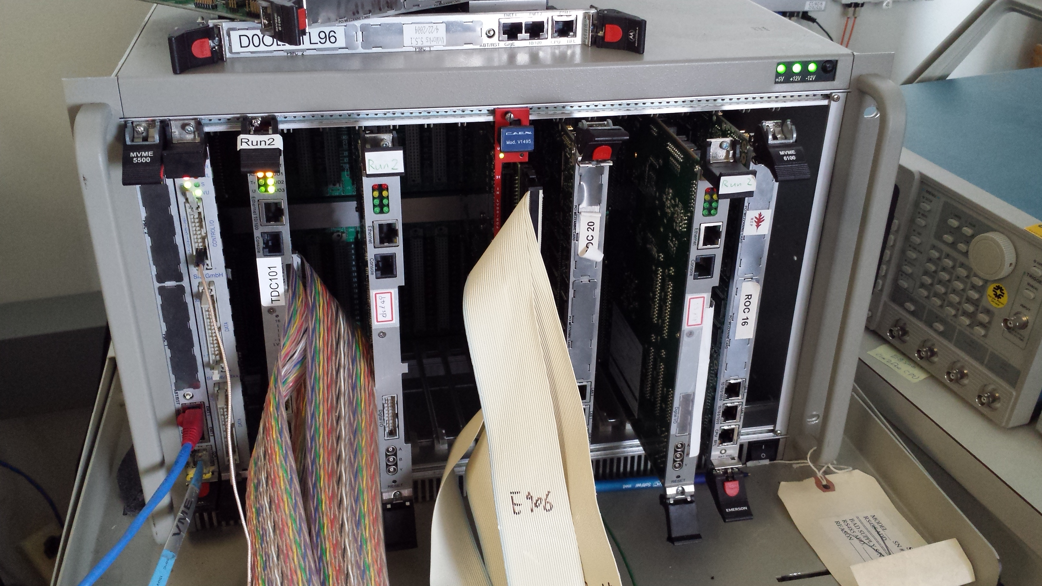
E906 DAQ Test Stand
PC/Linux: Jlab CODA, Ethernet Readout
CPU MVME5500: old VxWork (Jlab)
“TS” ?
TDC-II
V1495 pulse generator
V1495 L1 Trigger “development brd”
Windows PC: Altara FPGA programing

Slide 42
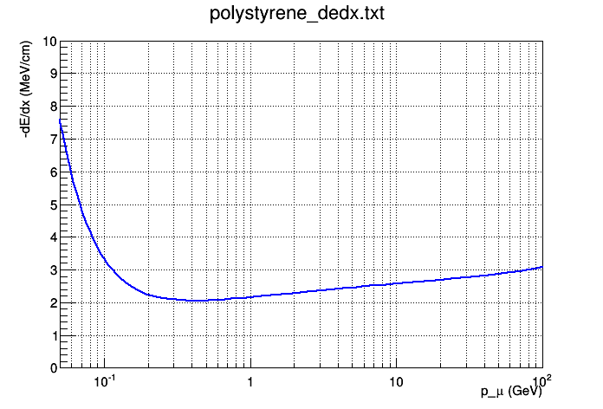
Plastic Scintillator dE/dx and
Particle Identification
Using polystyrene as example (same as FNAL scintillator factory)
Muon dE/dx = 2.41 MeV/cm @ 4 GeV, and 2.69 MeV/cm @ 20 GeV
  11.5% difference
For 4 GeV Kaon vs 20 GeV muon it’s an even bigger difference, 26.5%

Slide 43
Minimal Thickness for Light Yields
For thickness = 1.0cm, P > 5GeV
  dE/dx = 2.5MeV/cm
  Light yield = 2.5MeV / 100eV ~ 25K photons
  SiPM Eff = 20%
  Scintillating strip light collection Eff = 10%
  Total “light yield” = 25K x 20% x 10% = 500 >>1
Required light output
  Photon detecting eff > 99%

Slide 44
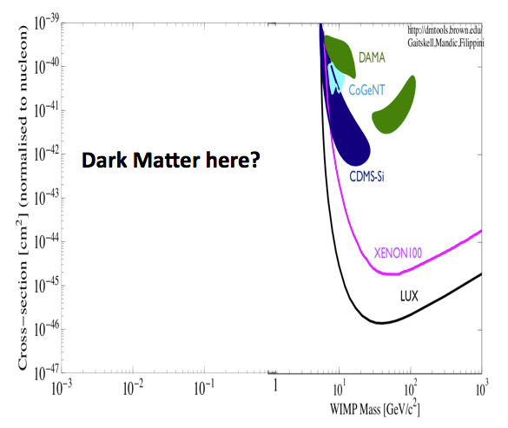
MiniBooNE Dark Matter Search
Invisible decay mode, search for “sub-GeV” particles
“Sub-GeV”

Slide 45
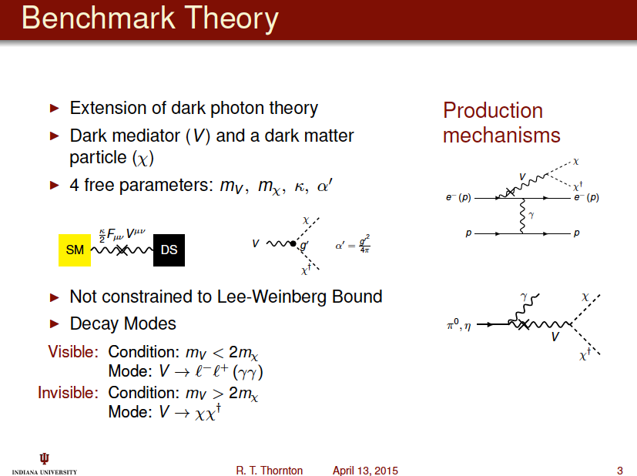

Slide 46
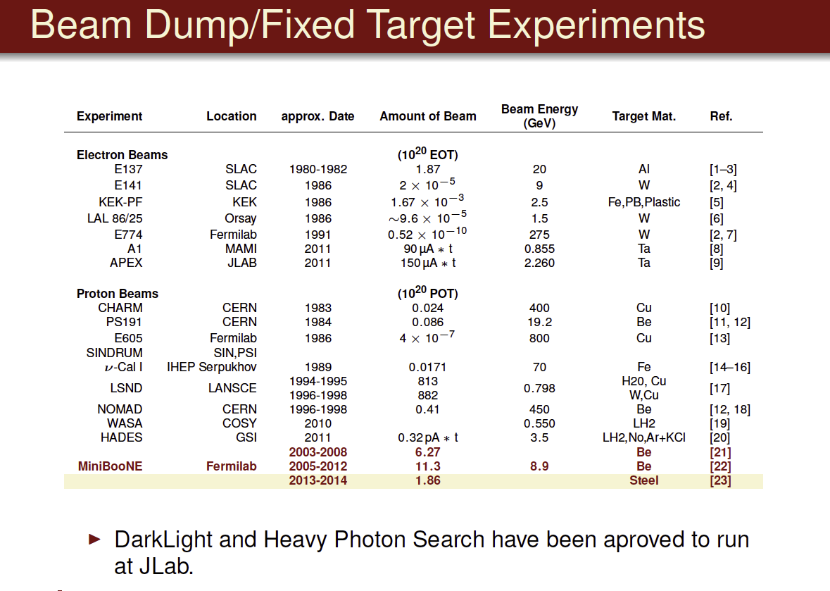

Slide 47
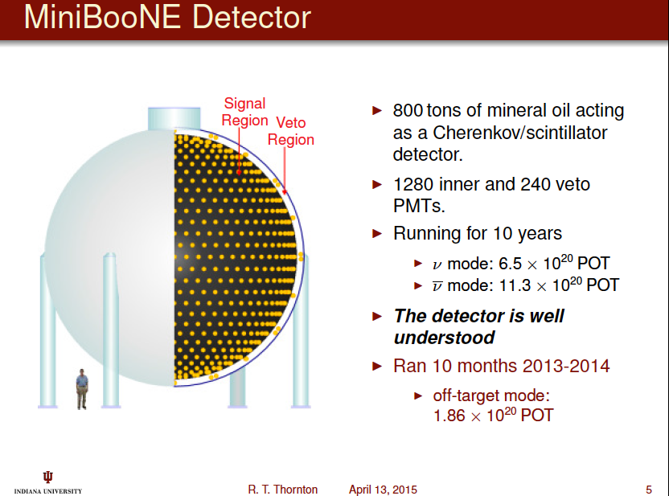

Slide 48
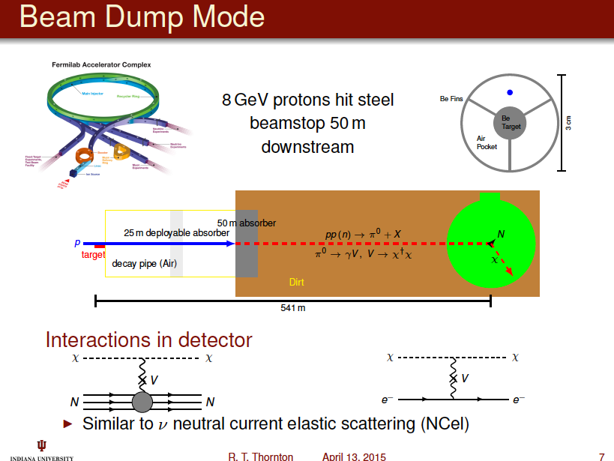

Slide 49
