Slide 1
Dark Photon Trigger Upgrade
Detector
  Extruded scintillators
  Y11 WLSF (two fibers per channel; d=1mm and 1.5mm)
  Fermilab preamp readout, from one end only
  SMA-Lemo patch panel
Lemo cables from preamp to LeCroy 4413 discriminators
  About 520 channels in total
  To TDCs and V1495 boards
V1495 based trigger logic
  LVL-1: determine muon road per quadrant
  LVL-2: determine dimuon road from common vertex (within +/- 20cm or so)

Slide 2
E906 Trigger & DAQ System
(LV0/Pulse Gen.
V1495)
DAQ
VME/CPU
Ethernet
Hodos
Hits/
Start
TDC (xx)
Threshold Discriminator
……
L1-Trigger
V1495 (4)
(24x4)
L0 Trigger: not “actively” used
- 4 V1495 boards available
L1 Trigger: in operation
- 4 V1495 boards
(2) for Y-plane, not used
(2) for X-Plane, in use
- 700nS latency
L2 Trigger: pass through
1 V1495
Could do simple look-up
Trigger pattern
TS: Trigger Supervisor
L2-Trigger
V1495 (1)
L2: limited I/O
1(O), 5(I), 32x
only 2 (I) used
Trigger Supervisor
Comm.
Stop/Trigger

Slide 3
Low Mass Dark Photon Displayed Vertex Trigger
Y-Plane Trigger:
- No mass cut
- Displaced z-vertex
Coincident with St-4 Hodos(?)
Quadrant triggers? 4 x V1495
Y-channels per quadrant:
1x V1495
80(St1) + 50(St2) + 8x2 (St4-Y1,2) = 146
96+64 = 160 inputs possible
  72+72+16 = 160 ( input possible)
  (2NIM=RFCLK+ComSTOP )
  32 outputs
Coincident Z-vtx
window matched@L2
St1
St2

Slide 4
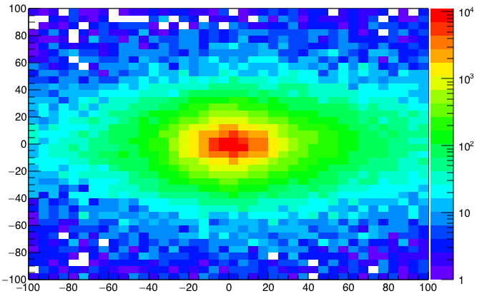
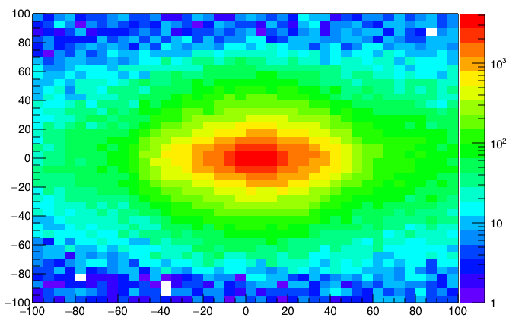
A New High-Granularity Displayed Dimuon Vertex Trigger
High rejection power, low rate, << 1 kHz(current E906 DAQ limit)
Y-Plane (non-bending) Trigger:
A quadrant panel: 80cm x 80cm (100cmx100cm @ST-2)
  ST1: 1cm x 1cm x 80 cm scintillating strips, SiPM readout
  ST2: 2cm x 2 cm x 100 cm strips
- Straight line projection, σ_{Z} ~30cm
Displaced z-vertex, mostly low mass < 3GeV
Y-channels per quadrant:
1x V1495
80(St1) + 50(St2) + 8x2 (St4-Y1,2) = 146
96+64 = 160 inputs possible
  (2NIM=RFCLK+ComSTOP)
ST1: beam view
Y
80x80cm
Dimuon Z-vertex (cm)
Q4
Q1
X
ST1
ST2
Q1: track
ST1
Q3
Q2
Z
Coincident Z-vtx
window matched@L2
ST2
Q3: track
Trigger fired: Q1 & Q3 & VTX
Z1=9m
Z1=12m

Slide 5
Trigger Detector Layout Schematics beam view
http://kuraraypsf.jp/psf/ws.html
WLSF Y-11(200):
Att_L>3.5m
SiPMs (80/50)
Readout Fermilab
preAMscards
Y
80[ST01]
or 50 (ST2)
80[ST01]
or 50 (ST2)
Lemo-> LeCroy4413;
LVL-1 & TDC
Fremilab extruded
scintillators
Leave ~20cm Gap T to B in Y
(8’ = 2.44m
above floor)
X
80[ST01]
or 50 (ST2)
80[ST01]
or 50 (ST2)
(X= -120cm)
Y = -50cm
Being tested for
SiPM Radhard
Minimal gap <~ 1cm L to R in X

Slide 6
Displaced Dark Photon Trigger Logic
DAQ/Data stream
Trigger fired: Q1 & Q3 & VTX
Q1 (LVL1)
DAQ Trigger
LVL2
(vtxZ matching)
Q2 (LVL1)
VTX Match
TS
(12 inputs total)
(1-free bit available)
Q3 (LVL1)
DP Trigger
1-bit
Q4 (LVL1)
4 x 16-bit from 4 V1495 boards
(2 x 32LVDS cables)
V1495
- Per quadrant Q(1-4): 80(ST1) + 50 (ST2) + 2x8(ST4-Y1/2) = 146, FANOUT ST4 Hodo
- Up to 72(ST1) + 72 (ST2) + 2x8(ST4Y1/2) = 160

Slide 7
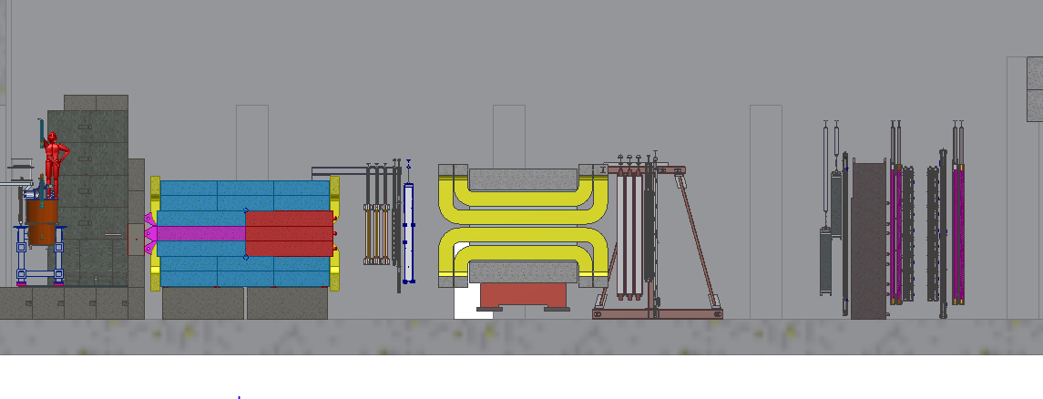
Side View of the Proposed Experimental Setup
F Mag
K Mag
LDRD:
St-1 trigger plane, 160 x 160 cm
Made of 4 1cm x 1cm x 80cm
scintillator planes
St-2 trigger plane, 200 cm x 200 cm
Made of 4 2cm x 2cm x 100cm
scintillator planes

Slide 8
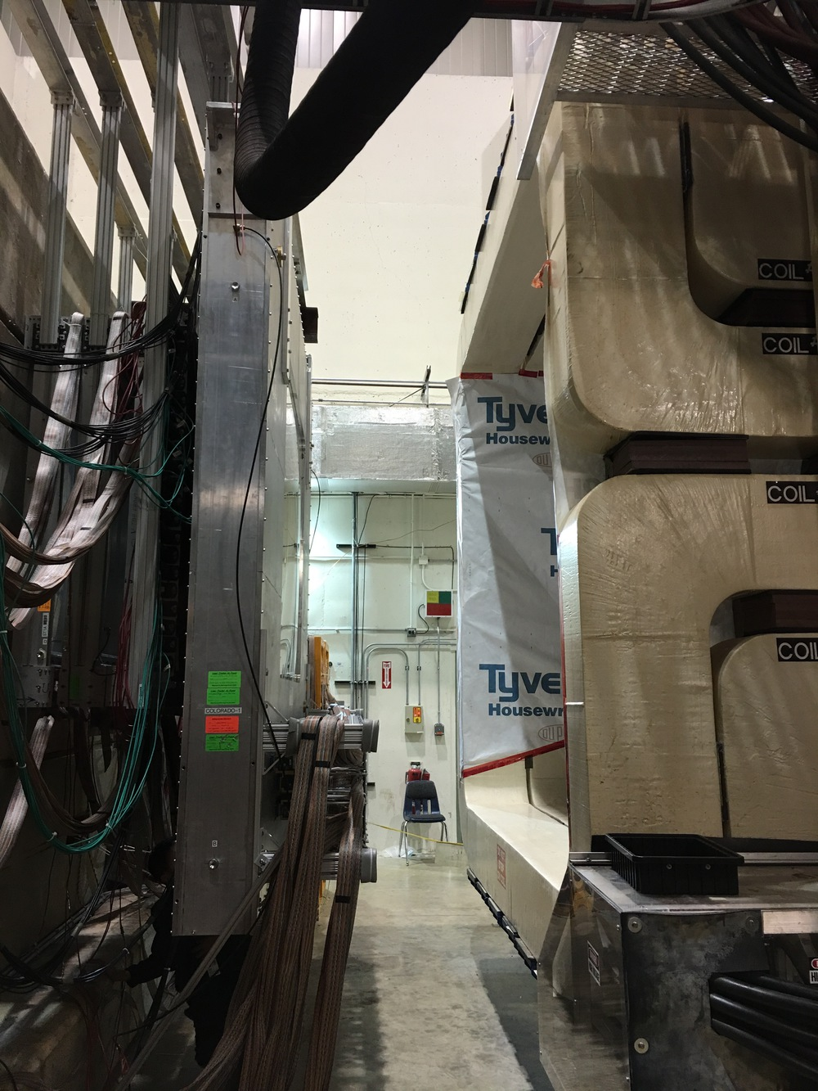
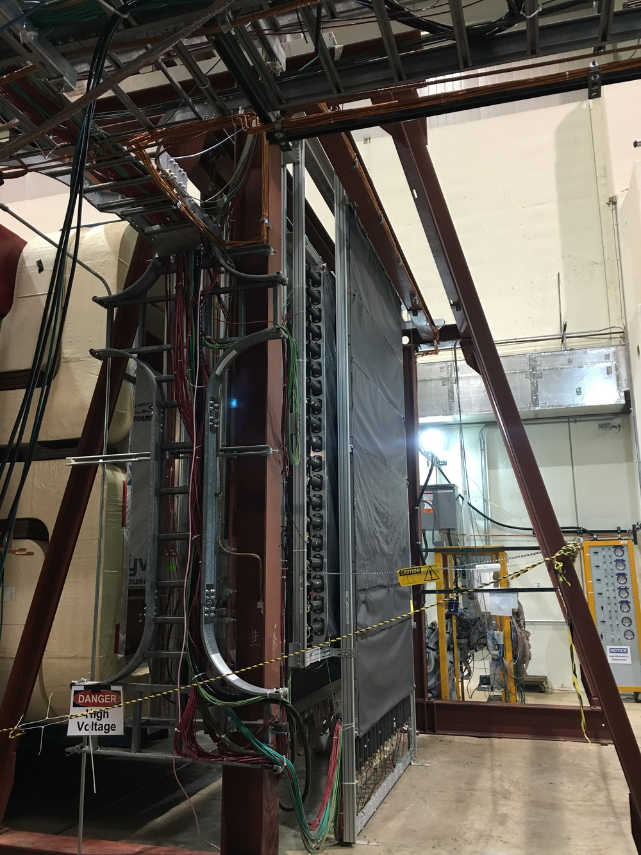
Final Trigger Detector Installation Locations and Structures: TBD
ST-1
ST-2
More pictures: https://p25ext.lanl.gov/darkphoton/images/hall/index.html

Slide 9
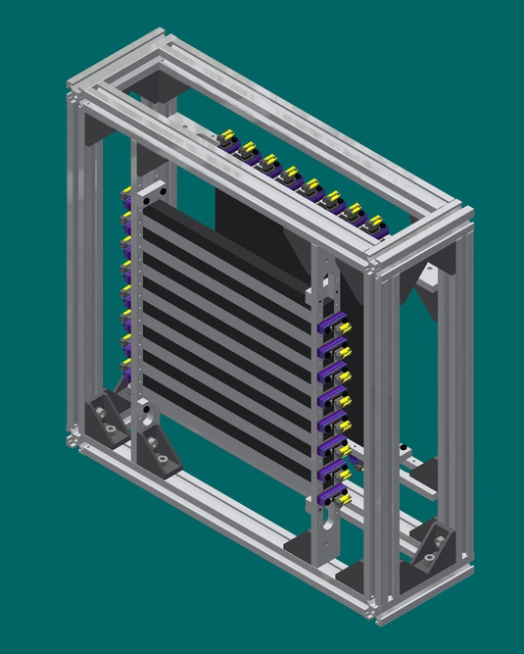
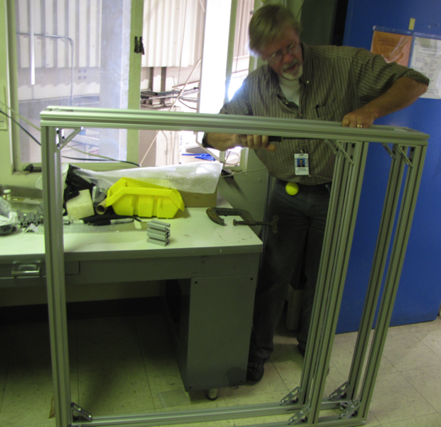
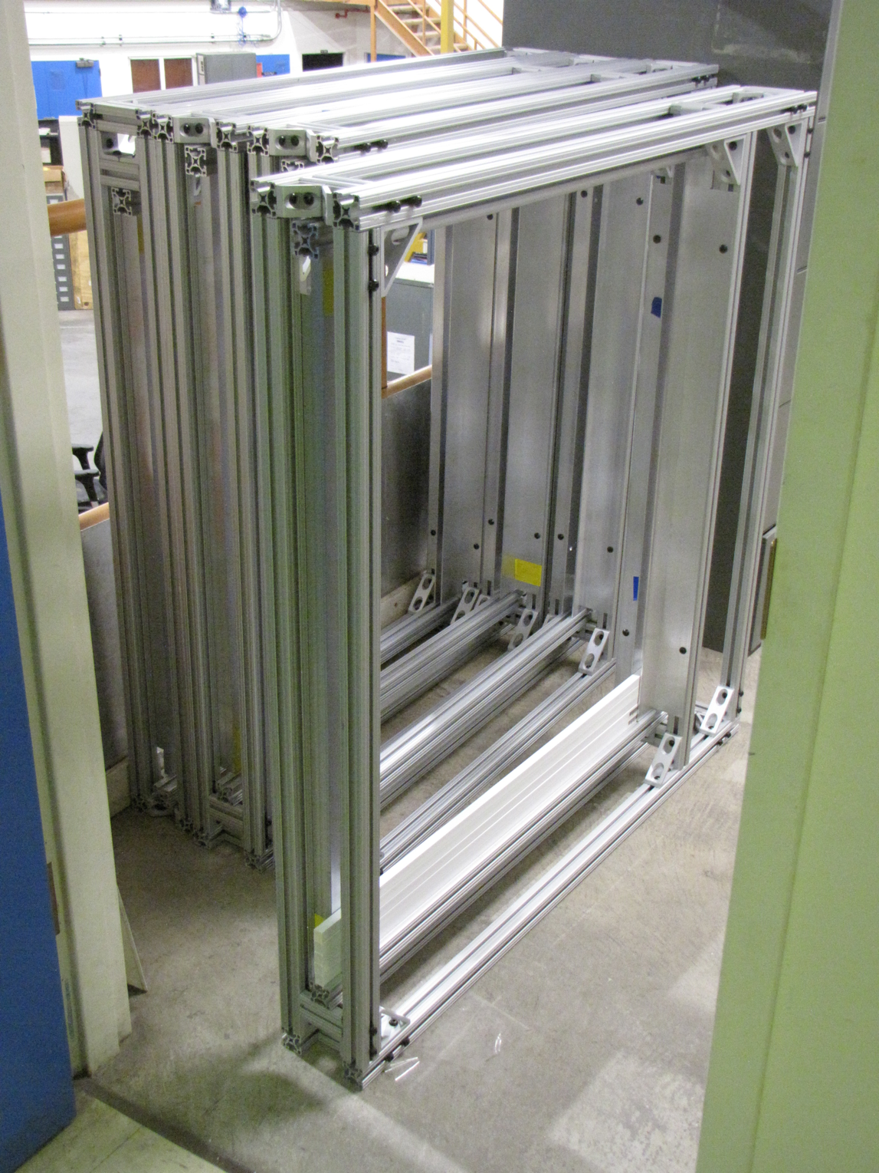
Frames and Installation
4 identical box per plane
Two planes, St1 and St2
More pictures: https://p25ext.lanl.gov/darkphoton/images/frames/index.html

