Slide 1
FY17 Detector Effort
Nov
Dec
Jan
Feb
Mar
Apr---Jul+
DAQ
Upgrade
Electronics work
V1495 trigger algo implementation & Integration into DAQ
Trigger
Commissioning
and
Offline analysis
- Data taking,
- Offline analysis,
- Full proposal
writing
80/20 Al frame and detector assembly & testing
@LANL
Safety review and detector installation
@FNAL
SiPM readout
Integration;
Manpower needs: (estimated from experts, Kun, Hubert, Andi, Pat and Ming)
DAQ and V1495 work: 2 FTE*Month
Mechanical work: 1 FTE*Month
Commissioning: 1.5 FTE*Month
Add 25% contingency on labor
Total Labor needs ~5.5 FTE * Month (in the project, ~10 FET*Month in Exp effort)
Available people:
Electronics work: Kun, Andi, PostDoc/Sho, Student/Alex, Ming & Fermilab Engineer/collaborators (1 student + other postdocs)
Mechanical work: Hubert, Pat, Ming, Sho, Alex, Fermilab collaborators (1 student + other postdocs)
Additional Engineer & Tech support (w/ $$) could help to reduce the schedule risk

Slide 2
FY-17 Work Plan Summary
Goal: Complete DAQ and Trigger upgrade for a large fraction of E906 Run in FY17
  Installed and commissioned by the end of March 2017
  Parasitic data taking with E906 April – July, 2017
  Lead people: Kun, PD(Sho), Hubert, Andi, Pat, Ming and Fermilab collaboration (Engineer and students/postdocs)
Trigger scintillator detector construction at LANL and Fermilab
  Mechanical structure safety calculation and documentation (LANL student Kenie+Walt)
  Fermilab safety review, started, on-going discussion, to be completed by the end of 12/2016
  Ship 8 assembled frames to FNAL late December 2016
  Installation of detectors by mid of January 2017
  Lead people: Hubert, Ming, PD, Fermilab students/collaborators
Readout electronics & LV/HV services
  FNAL preamps production, received a quote, under $23K, done by mid January 2017.
  LeCroy 4413 from Fermilab, tested by mid Dec, 2017
  Lemo cables (520) and 17-ch ribbon cables (35), tested by mid of January 2017
  Trigger detector installation and commissioning by mid of Feb 2017)
  Lead people: Ming, PD(Sho), Pat and collaboration (Fermilab and ANL)
V1495 trigger look-up table implementation
  MC simulation, Collaboration (Univ. Of Michigan)
  PD (Sho), Kun, Andi
Integration and commissioning trigger electronics system
  Feb – March, 2017
  PD(sho), Kun, Andi, Ming and collaboration
Data taking and physics analysis
  April – Sep, 2017
Full proposal writing to Fermilab PAC for dedicated runs in 2017+
  Full physics and detector simulation with optimized setup
  Electron and hadron identification
  Full mass range coverage with di-electron and di-muons
  Expanded physics program, including Dark-Higgs, missing-Energy dark matter etc
Manpower on the project:
  Kun(20%), PD(50%), Hubert(10%), Ming(10%)
  Help from Andi(20%), Pat (10%), Alex (30%) and other PDs from the team during the construction
  Fermilab student(50%) and Fermilab collaborators(Engineer, Tech and postdoc/student)

Slide 3
FY-17+ Plan (Cont.)
  Whenever available, parasitic data taking with polarized Drell-Yan (E-1039) experiment in FY18 – FY19 as originally proposed.
Carry out the first physics analysis using 2017 data and publish preliminary results
Develop, submit and defend a full Dark Photon and Dark Higgs Search proposal to Fermilab PAC for future dedicated runs with upgraded detector for many years to come
  Include adding Electro Magnetic Calorimeter (EMCal) to measure low mass dark photons below dimuon mass threshold (200MeV, current lower mass limit on dark photon search)
  Dedicated long runs with much higher integrated luminosity beyond 2017
  Obtained two “free” EMCal sectors from PHENIX experiment at RHIC
  Future effort much depending on the outcome from first year’s preliminary results
Received strong support from Fermilab PAC, Director and the Dark Sector Physics community on such proposal
Note on Fermilab future beam schedule:
E1039 was originally planned to start data taking in ~May 2017, for two years.
Recent changes of Fermilab’s run plan due to limited budget requires us to bring in additional external fund to install the polarized target and run the experiment.
There is an on-going discussion between DOE–Fermilab to run E-1039 after summer 2017. A decisions will be made by DOE in January 2017.
Regardless of the outcome of DOE’s decision on the polarized Drell-Yan running at Fermilab, we plan to write a full proposal to have a dedicated dark photon and dark Higgs program beyond 2017 using Fermilab High Intensity Frontier Facility, also seeking additional fund from DOE NP and HEP

Slide 4
Projected Sensitivities from 2017 E906 Trial Run:
2-mo, 4-mo and full 2-year parasitic run
April – July 2017, assuming 4-month of parasitic running (middle dashed-line)
  Also included projections for 2-month (dot-dashed-line) and 2-year long run (solid-line)
  Even for 2-month run, we can still have significant measurements
For prompt-DY-like dark photon search, the lowest 𝜺 reach is proportional to 1/sqrt(Lumi) (Lumi, the integrated luminosity)
For displaced dark photon search, the case is more complicated:
  The upper limit is primarily limited by the decay length (kinematics) as most data statistics will be in this region, and not very sensitive to the change of statistics
  The lower bound is primarily limited by the cross section/statistics and thus is proportional to 1/sqrt(Lumi)

Slide 5
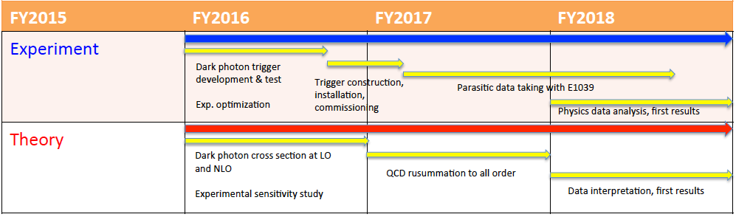
LDRD Tasks & Schedules
FY16: Accomplished all milestones and more!
QCD resummation to all orders
Today, good work in progress

Slide 6
Back up slides

Slide 7
FY-17 DAQ & Trigger Boards V1495 Integration and Commissioning
DAQ upgrade
  By the end of November
V1495 and DAQ integration
  By Early Feb 2017
Trigger commissioning
  By mid March 2017
Data taking
  April – July 2017
Lead persons:
  Kun, PostDoc (Sho), Andi, Alex, Ming and help from E906 collaboration and other postdocs

Slide 8
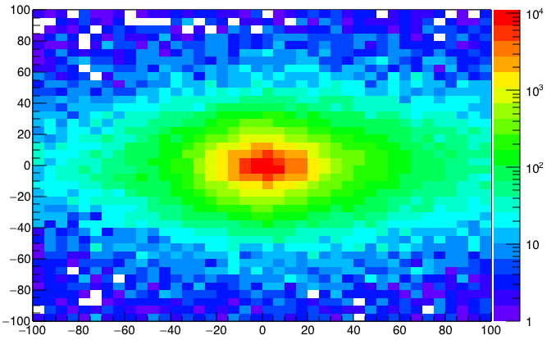
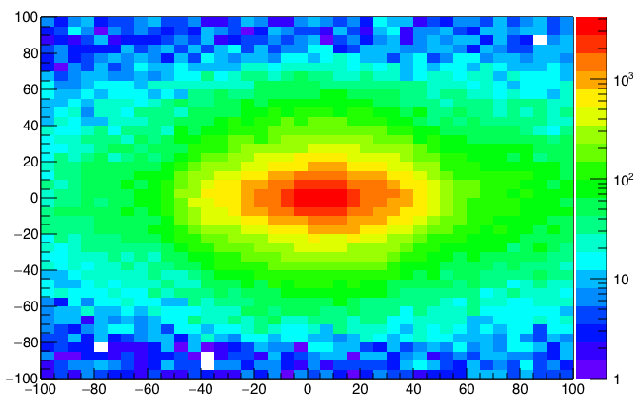
A New High-Granularity Displayed Dimuon Vertex Trigger
High rejection power, low rate, << 1 kHz(current E906 DAQ limit)
Y-Plane (non-bending) Trigger:
A quadrant panel: 80cm x 80cm (100cmx100cm @ST-2)
  ST1: 1cm x 1cm x 80 cm scintillating strips, SiPM readout
  ST2: 2cm x 2 cm x 100 cm strips
- Straight line projection, σ_{Z} ~30cm
Displaced z-vertex, mostly low mass < 3GeV
Y-channels per quadrant:
1x V1495
80(St1) + 50(St2) + 8x2 (St4-Y1,2) = 146
96+64 = 160 inputs possible
  (2NIM=RFCLK+ComSTOP)
ST1: beam view
Y
80x80cm
Dimuon Z-vertex (cm)
Q4
Q1
X
ST1
ST2
Q1: track
ST1
Q3
Q2
Z
Coincident Z-vtx
window matched@L2
ST2
Q3: track
Trigger fired: Q1 & Q3 & VTX
Z1=9m
Z1=12m

Slide 9
Displaced Dark Photon Trigger Logic
DAQ/Data stream
Trigger fired: Q1 & Q3 & VTX
Q1 (LVL1)
DAQ Trigger
LVL2
(vtxZ matching)
Q2 (LVL1)
VTX
TS
(12 inputs total)
(1-free bit available)
Q3 (LVL1)
DP Trigger
1-bit
Q4 (LVL1)
4 x 16-bit from 4 V1495 boards
(2 x 32LVDS cables)
V1495
Per quadrant Q(1-4): 80(ST1) + 50 (ST2) + 2x8(ST4-Y1/2) = 146, FANOUT ST4 Hodo

Slide 10
FY-17 Trigger Detector Construction & Installation
Complete assembly and installed by end of January 2017
All major hardware in hand
  Scintillators (at Fermilab)
  WLSF (at LANL)
  All 80/20 Al frames at LANL
    4 frames completed, 4 more (identical) to go
Frames assembled at LANL, ship to Fermilab for final assembly in December-January 2016
Fermilab mechanical structure safety review before installation
  Student/Kenie initial design, Walt to confirm
  Hubert, Ming working with Fermilab Safety office
  On-going progress as part of E906 startup, to be reviewed and approved for final installation by the end of Dec 2016
Lead persons:
  Hubert, Ming, Alex, PD and help from Fermilab Collaboration

Slide 11
SiPM readout and Services
Fermilab premap cards production
  Obtained a quote, cost: ~$30/each, 700 total, under $25K, good for credit card order
  Done by early January 2017
Discriminator and LV/HV PS
  LeCroy 4413 and NIM crates available from Fermilab pool
  Tested by the end of December
  Reuse Fermilab HV PS and the 48-ch distribution cards (50~60V, I <500 x 10uA )
Cables
  Recycle from previous Fermilab experiments
    Lemo cables, 550
    34-ch ribbon cables
    By mid of January 2017
V1495 and VME crate and Controller CPU
  In hand, need to update firmware based on E906 trigger code
  Integration starts early December, complete by mid Feb 2017
New Production of Taiwan TDCs
  Being produced in Taiwan, for future upgrade of SeaQuest
  Needs 8 for trigger upgrade, 15 delivered to Fermilab already
Lead persons:
  Ming, PD/Sho, Kun, Pat and Fermilab Engineer/Collaborators

Slide 12
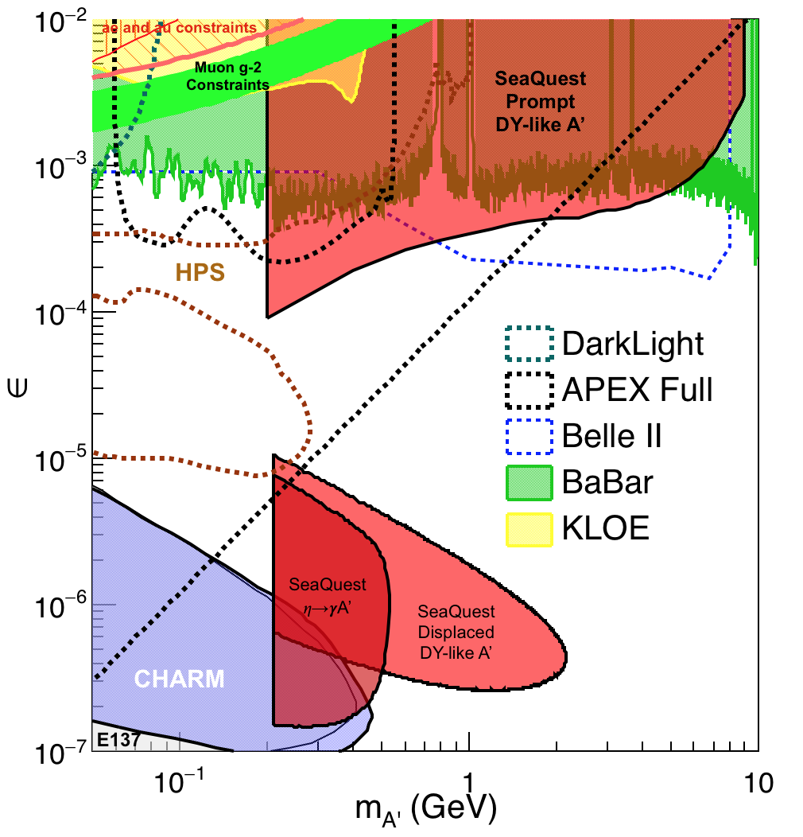
Projected Sensitivity with 2-year Parasitic Run with Polarized Drell-Yan E-1039 Experiment
Parasitic run with polarized Drell-Yan
  2018-2019
Assuming 2-yr (400 days) of parasitic running

Slide 13
If additional fund available in FY17…
Given the uncertainty of future run beyond 2017 at Fermilab, it would be very helpful to have additional $$ and technical resource support to speed up the DAQ/trigger upgrade to take maximal amount of data out of current 2017 E906 run
More manpower could be used to speed up assembly, trigger algorithm development, testing readout and installation, in particular in the following tasks:
  Trigger logic FPGA programing support
  Electronic tech to help SiPM readout and LV/HV installation and debugging
  Mechanical engineer to prepare the Fermilab safety document
Procurements of small items
  Fiber-SiPM adaptors
  Lemo and ribbon cables
  Big frame to hold 4-frames per plane, detector pre-installation safety review
Move PHENIX two EM Calorimter sectors from BNL to Fermilab, installed at SeaQuest after the end of E906 run in summer 2017.
  Free from PHENIX, a ~$2M detectors, with PMTs and HV PS
  Shipping cost ~$10K

Slide 14
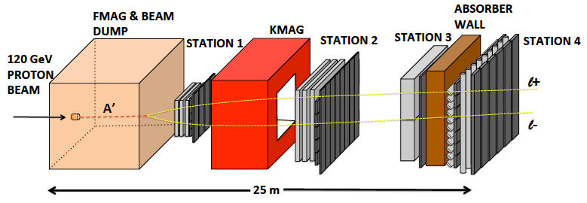

E-1067 Future Upgrade: New Idea
2018 ~ 2025+
Add tracking detectors close to “target” to improve mass resolution
Add EMCal (recycled from PHENIX at RHIC) to identify
e^{+/-}, h^{+/-} , π^{+/-}

Slide 15
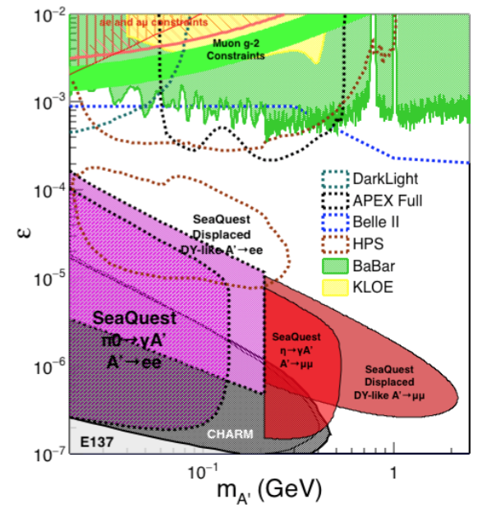
Displaced Low Mass Dark Photons with EMCal upgrades
Projection: POT 1.4 x 10¹⁸
Detector upgrades
  EMCal: e^{+/-}
  HCal: π^{+/-}
  Recycle from other experiments, PHENIX/RHIC etc.
DAQ upgrade
  100+ kHz
Timeline of runs
  2018+
Detector configuration
  Access low mass region with optimized Fmag settting

Slide 16
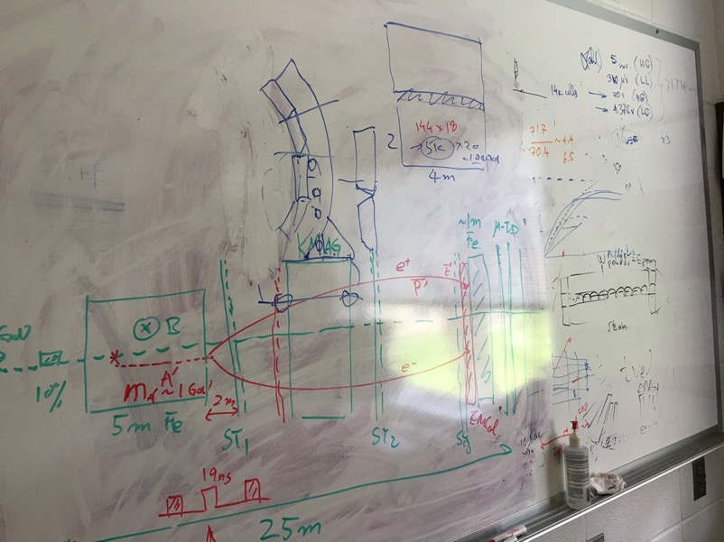
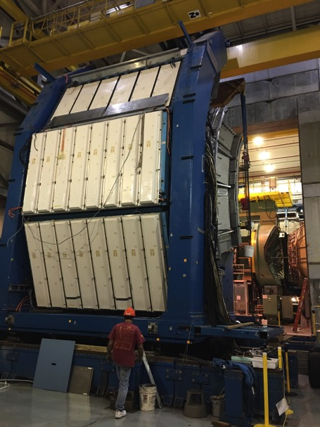
EMCal Identified from PHENIX/RHIC
2 EMCal sectors are available from PHENIX experiment at RHIC, ~end of 2016
  one EMCal sector is made of:
    2m x 4m, 18 (3x6)super modules
    Super module = 36 modules; Module = 4 towers
    36 x 4 x 18 = 2592 channels
    Could gang 2x2 (or 3x3) into one ADC/TDC readout
Available in summer 2017 for
installation at Fermilab
- dE/E = 8.1%/sqrt(E) + 2.1%
- dT < 200 ps
- Excellent e/pi separation

Slide 17
Projected Dark Higgs Sensitivity
POT:1.4x10¹⁸ (Phase-I)
Y. Zhang (2015)
Dimuons with downstream displaced decay vertices
Limited sensitivity to “prompt” large mixing case due to small cross-section
Dark Higgs or dark photons?
  Dimuon kinematic and angular distributions
Phase-II
  Dedicated high luminosity runs optimized for low mass acceptance, mass<3GeV
1x
5x
25x

