Slide 1
Direct Search for Dark Photon and Dark Higgs at SeaQuest/E1067
Ming Liu
Los Alamos National Laboratory
U.S. Cosmic Vision: New Ideas in Dark Matter
Workshop at Univ. of Maryland
March 24, 2017

Slide 2
Outline
Dark sector physics @SeaQuest
  Mass: MeV ~ GeV
Detector upgrade @SeaQuest
  DAQ & Displaced dimuon trigger
  Expected sensitivity
Future opportunity
  Electron/hadron ID w/ EMCal upgrade
  Dedicated dark photon program @Fermilab

Slide 3
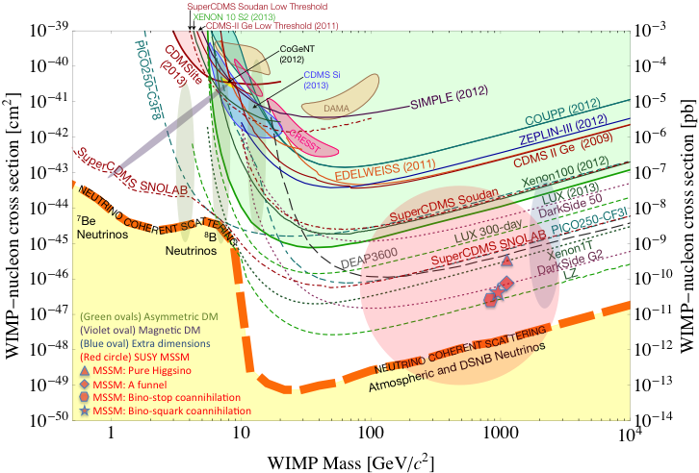
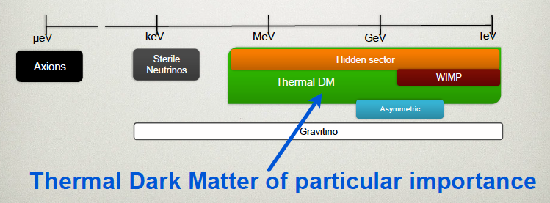
Physics of Dark Matter @SeaQuest
Current and near future high-intensity colliders and fixed target experiments offer an ideal environment to probe dark sector physics in MeV ~ GeV
Philip Schuster’s talk

Slide 4

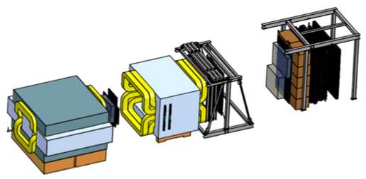
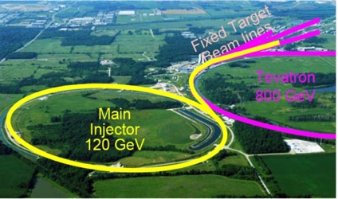
SeaQuest at the Intensity Frontier at Fermilab
High intensity proton beam: “beam dump mode” @SeaQuest/E1067
35K fb⁻¹ (in a 2-year parasitic run, 1.4x10¹⁸ POT @5% beam)
LHC-II: 300 fb⁻¹ (~2025), achieved 25fb⁻¹ in Run-I
B-factory@KEK: 50K fb⁻¹ (~2023)
Absorber wall and proportional
tube based Muon ID
Spectrometer magnet
Δpt = 0.4 GeV
Focusing magnet
and solid iron dump
Δpt = 2.9 GeV
Beam
120 GeV proton from Main Injector
19ns RF, 4s spill, 0.5×10¹³ protons per spill
25 m
Target system
Liquid H and D
Solid C, Fe, W
SeaQuest
- Beam dump mode: p+Fe collisions! Target ~ 10%λ_{I}
- Parasitic run mode possible with other experiments, E906/E1039

Slide 5
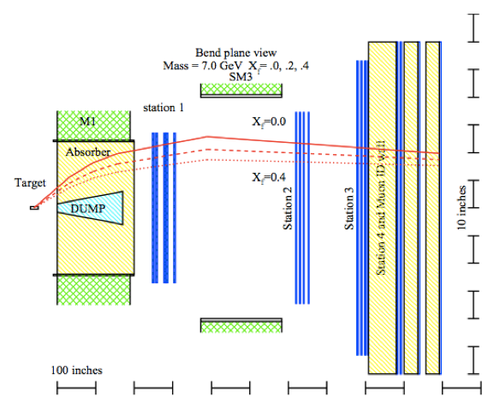
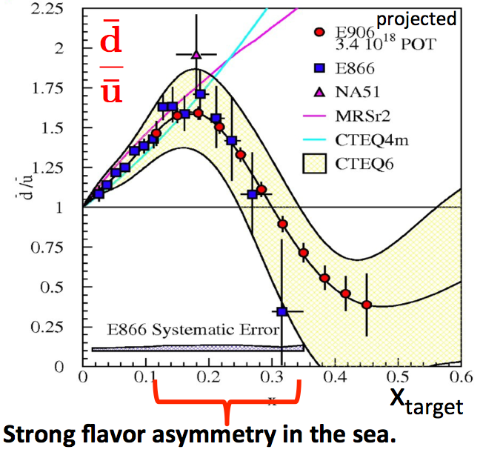
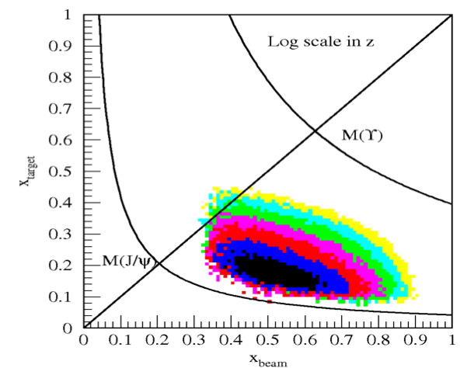
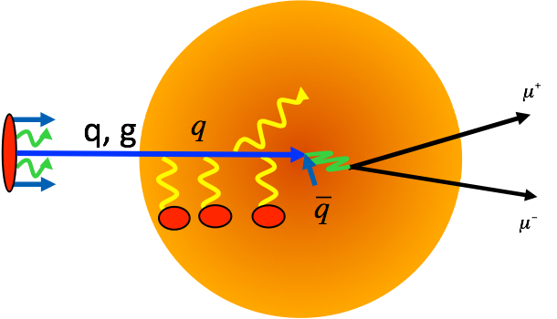
SeaQuest/E906: Nuclear Physics with Drell-Yan
2012-2017
Drell-Yan
Acceptance
Quark Energy Loss dE/dx in pA

Slide 6
A Great Opportunity
Dark Photons and Dark Higgs Search at SeaQuest
Photon portal: “vector”
Higgs portal: “scalar”
θ = μ v/m_{h}²

Slide 7
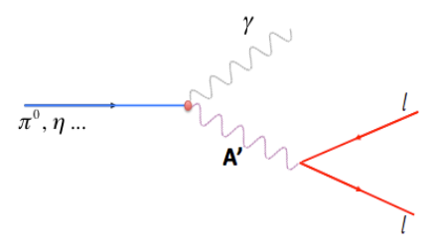
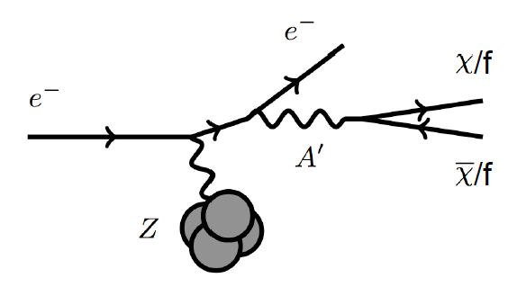
Dark Photon Detection in Dilepton Channel
Drell-Yan like
π⁰, η, … decay
Bremsstrahlung
(DM)
MiniBooNE
Beam-dump
(DM)
p
l⁺
p
l⁻
~ Fixed target w/
electron beams

Slide 8
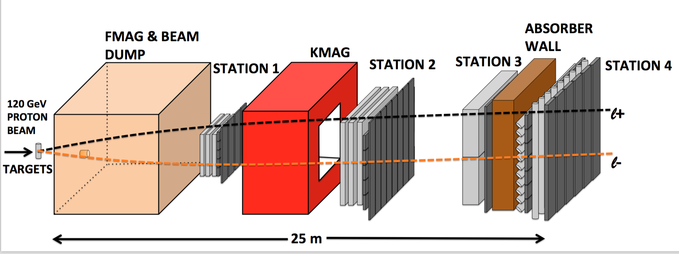
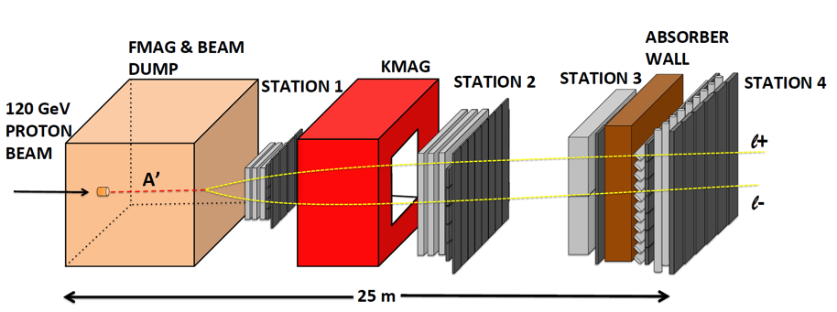
A target Drell-Yan event
A beam-dump dark photon event --- parasitic run possible!

Slide 9
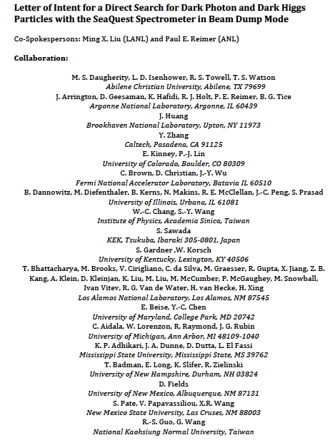
LOI submitted to Fermilab PAC
May 20, 2015
A joint experimental and theoretical collaboration
(most E906/E1039 + new members, ~60)
---------------------------------------
Phase-I: (parasitic runs)
Addition of a new displaced dimuon trigger to tag long-lived downstream decayed dark photons (dark Higgs).
Parasitic data taking with E1039 in 2017-2019;
  A short dedicated run (up to ~1 month) if needed.
POT 1.44x10¹⁸
Phase-II: (upgrade)
Dedicated runs later with EMCal/HCal upgrades, e^{+/-} and h^{+/-} capabilities.
Cover the full parameter phase space allowed by beam energy and luminosity
POT: >> 1.4x10¹⁸
Phase-II request will be presented to PAC at a later time.
Notes:
Responding to P5 reprot, we submitted LOI last month .. And the membership is growing …

Slide 10
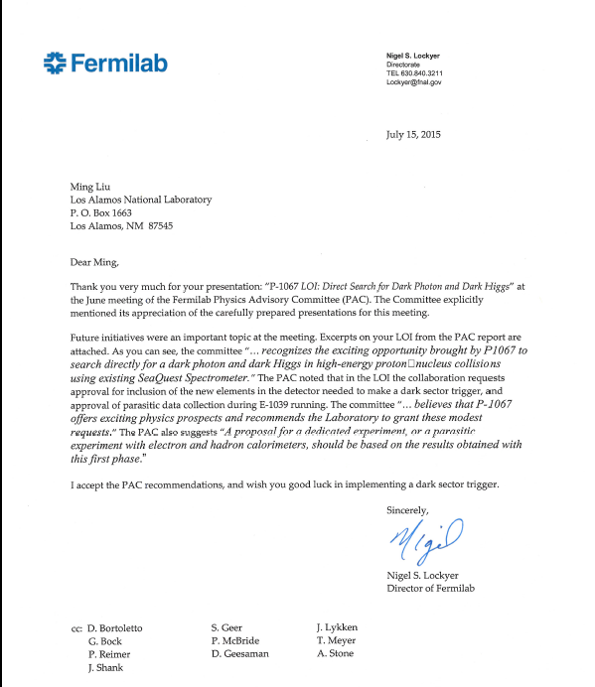
A heart-full endorsement
from Fermilab Director and PAC
July 15, 2015!
A New experiment! SeaQuest/E-1067
LANL LDRD support:
- FY16-18
- $1M to implement
the trigger/DAQ upgrade and theory development
Goals:
Trigger installed, 2017
Physics run, 2017-20
Preliminary results 2018!

Slide 11
Detector Upgrades and Expected Signals
Dark photon trigger upgrade
  Add a fine-granularity scintillating strip based trigger/tracking to tag dimuons from the same decay Z-vertex
  A new trigger for events with displaced down-stream dimuons
Unique signals
  Displaced dimuon decay vertex for long-lived particles
  Invariant mass peak in dimuon mass spectrum
  Mostly from beam dump (target ~10% λ_{I}.)
Planned beam time
  Run parasitically with E906/E1039 (2017-2020)
  Possible dedicated runs later with further upgrade (e^{+/-}, h^{+/-})
-- 2.5%
-- 6.0%
Dimuon mass resolution
Z (meter)

Slide 12
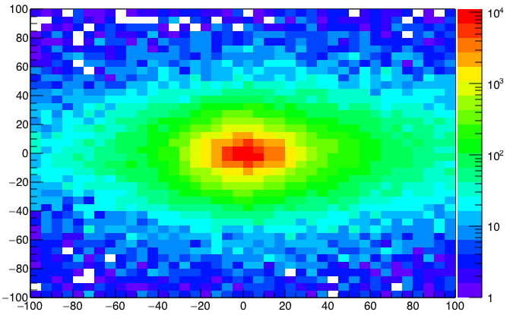
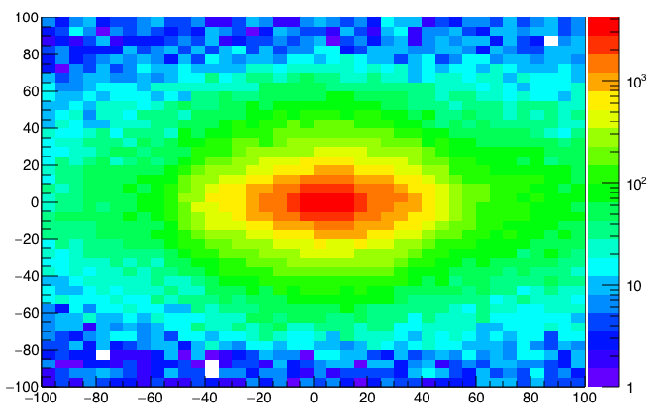
A New High-Granularity Displayed Dimuon Vertex Trigger
High rejection power, low rate, < 1 kHz(current E906 DAQ limit)
Y-Plane (non-bending) Trigger:
A quadrant panel: 80cm x 80cm (100cmx100cm @ST-2)
  ST1: 1cm x 1cm x 80 cm scintillating strips, SiPM readout
  ST2: 2cm x 2 cm x 100 cm strips
- Straight line projection, σ_{Z} ~30cm
Displaced z-vertex, mostly low mass < 3GeV
Y
Dimuon Z-vertex (cm)
ST1
X
St1
St2
Z
Coincident Z-vtx
window matched@L2
Z1=9m
Z1=12m
ST2

Slide 13
Low Mass Prompt Dimuon Trigger Rate Study
Current E906 setup
Proposed 2-layer trigger upgrade (10x improvement)
Additional Y-trigger after ST-3 absorber, and also using existing E906 X-Plane trigger
(additional ~2x improvement)
DAQ upgrade completed
  Previous E906 DAQ 1kHz
  Now 10+ kHz
  Can take all dark photon events of interest
4s spill, 60s cycle
Expected (Prompt) Low mass dimuon trigger performance
time

Slide 14
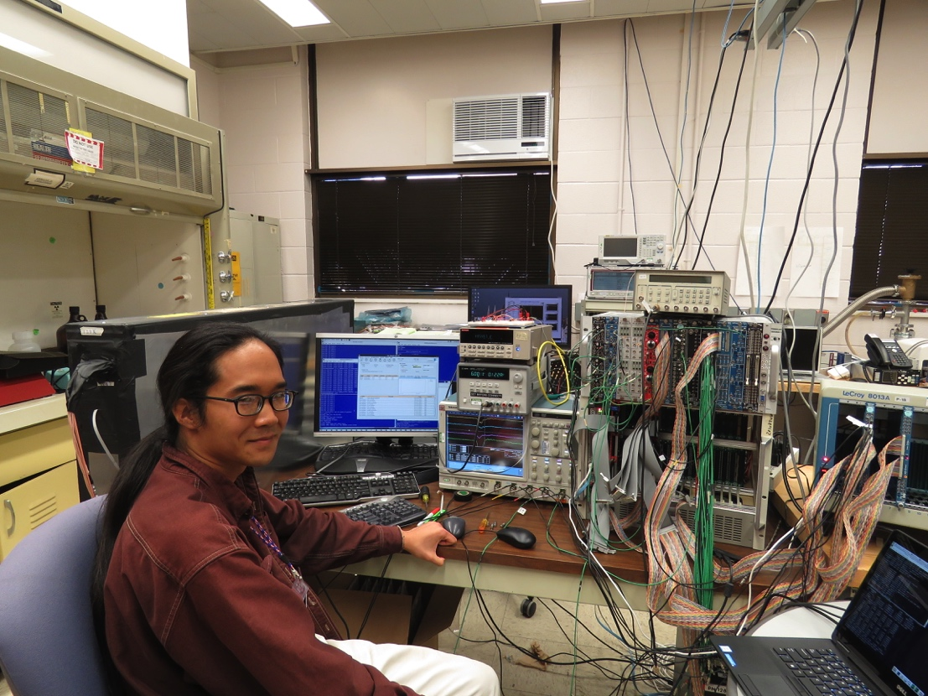
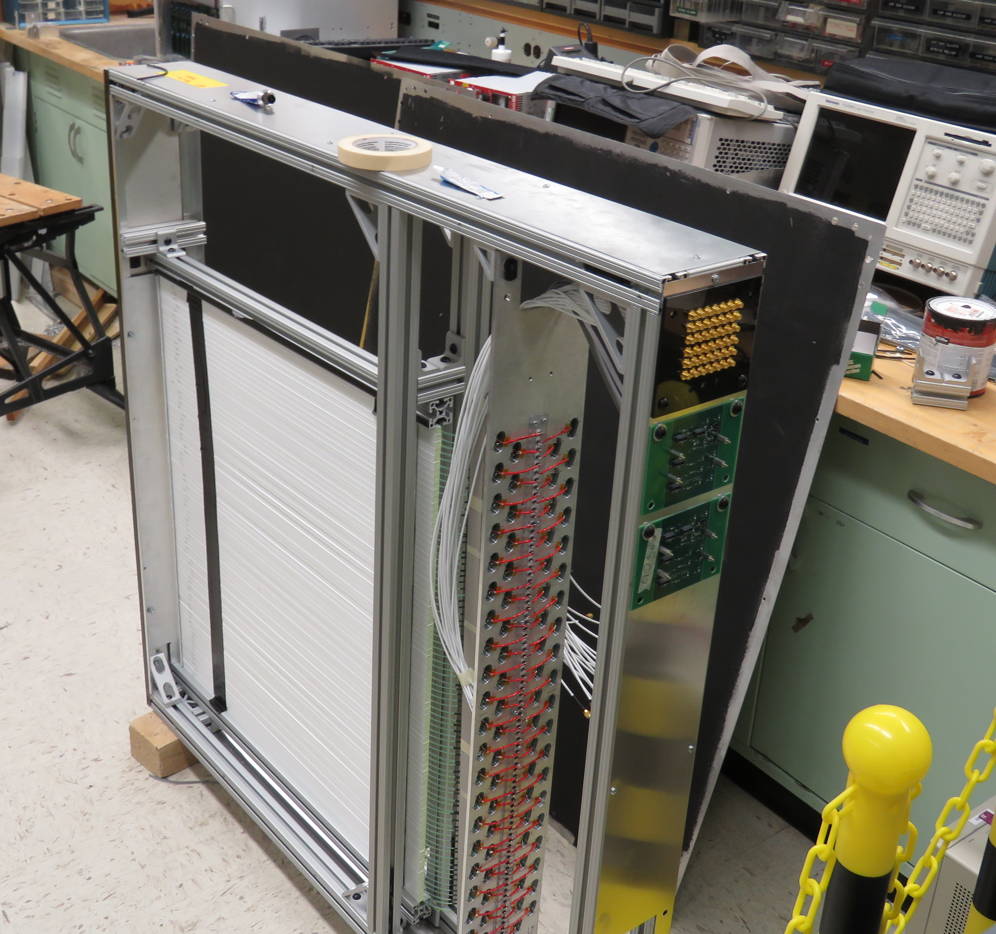
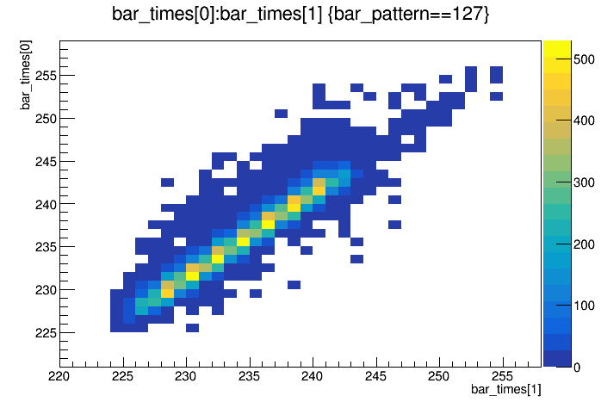
Trigger and DAQ System Test @LANL
Readout from a full module
  Cosmic rays
  Full SiPM readout
  V1495 trigger logic + TDC read out
  E906 upgraded DAQ and firmware
  Timing resolution, better than 1nS
  Detector eff > 96%
TDC_1
TDC_2

Slide 15
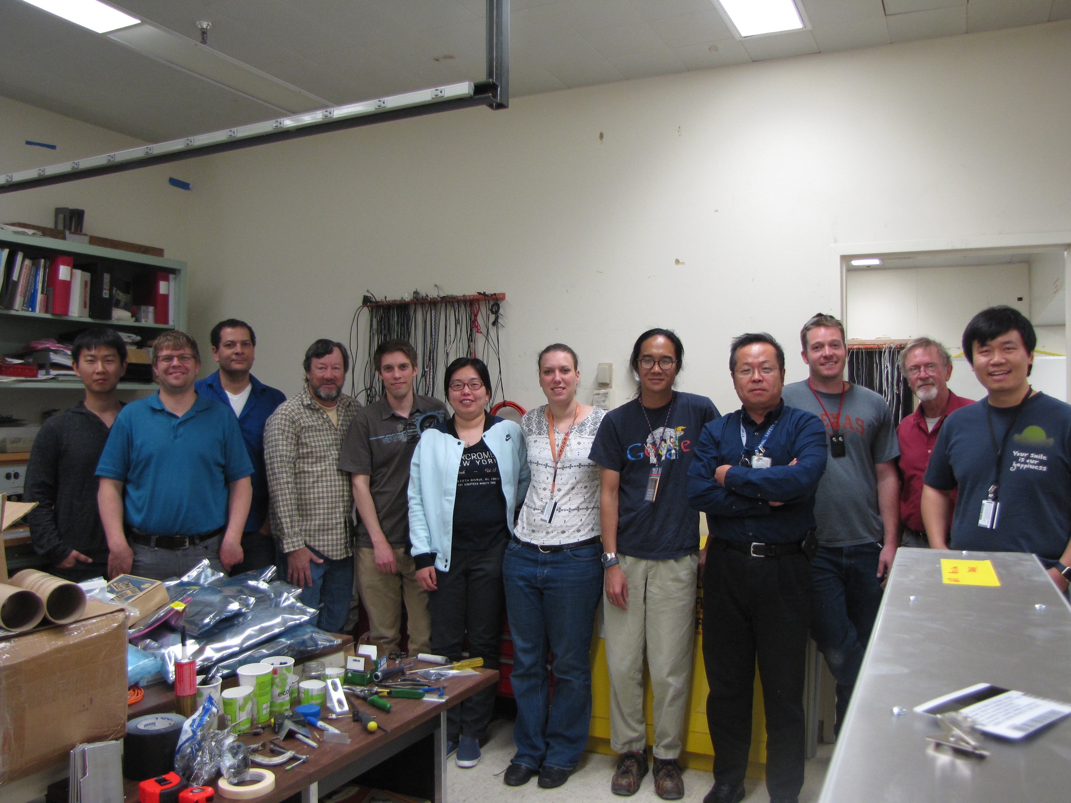
Excellent work by LANL team!
Ready to ship the detectors to Fermilab for installation

Slide 16

Current Status and Future Opportunity
Commissioning run with E906
  With upgraded DAQ and Dark Photon Trigger
  April – July, 2017
Parasitic run with SeaQuest/E1037
(polarized target run, NP program)
  2 years of data taking, 2018-2020
  POT: 1.4 x 10¹⁸
Future upgrade opportunities
  Di-electrons with EMCal upgrade
    PHNEIX EMCal available, need readout electronics
  Installation of EMCal in 2018 possible
Dedicated dark photon runs after 2020
  High luminosity runs, POT >> 1.4 x10¹⁸
Very important to run the beam beyond 2017
- A joint NP-HEP effort needed!
- Invite you from HEP to join us!

Slide 17
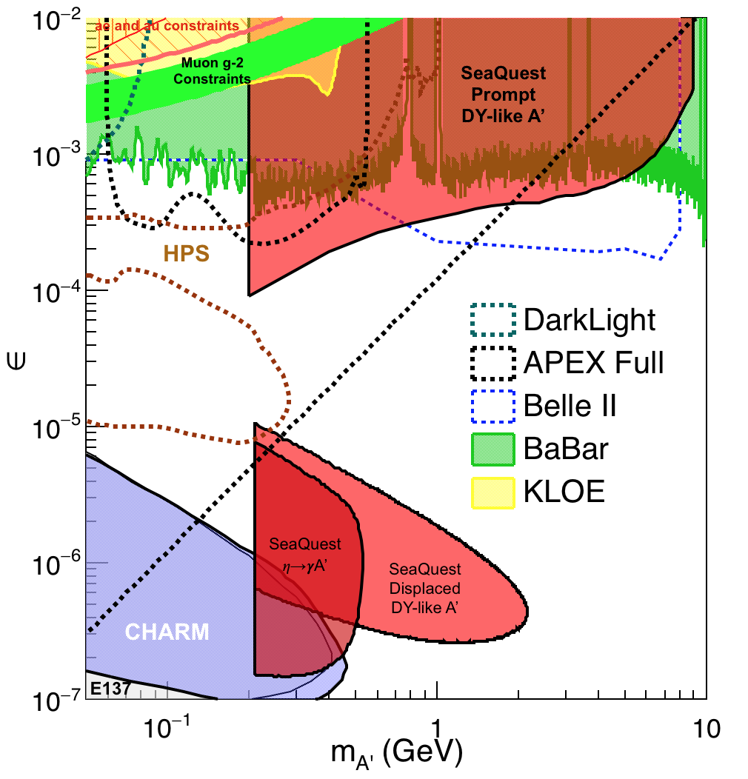
Phase-I Expectation: Dark Photons
(parasitic run w/ E906/1039)
Signals considered:
Drell-Yan like
Eta decays
Bremsstralung
Covers a wide range of unexplored parameter phase space
Displaced dimuons
- Minimal SM background
Prompt dimuons
- Good coverage
- Possible dedicated runs later to fully
restore mass < 3GeV (Phase-II)
Phase-II with upgrades
Access below 200MeV with di-electrons
( add EMCal)
Work in progress!

Slide 18
Dark Higgs
Y. Zhang et al, arXiv:1502.06983
θ = μ v/m_{h}²
arXiv:1312.4992
e⁺e⁻
Phase-I:
High-mass: μ⁺μ⁻ and hadrons
Advantage of using hadron beams
with muon probes over electrons
Phase-II:
Low-mass: e⁺e⁻, <200MeV possible
High-mass: hadrons, (5x)
Electron ID
upgrade!
μ⁺μ⁻

Slide 19
Projected Dark Higgs Sensitivity
POT:1.4x10¹⁸ (Phase-I)
Y. Zhang (2015)
Dimuons with downstream displaced decay vertices
Limited sensitivity to “prompt” large mixing case due to small cross-section
Dark Higgs or dark photons?
  Dimuon kinematic and angular distributions
Phase-II
  Dedicated high luminosity runs optimized for low mass acceptance, mass<3GeV
POT:4x10²⁰

Slide 20
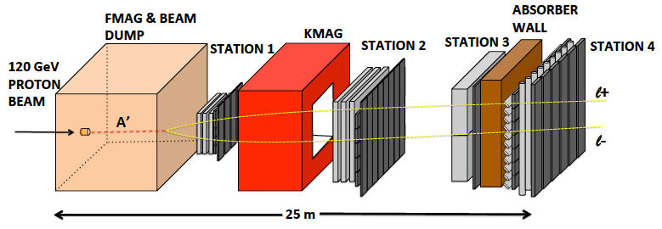

E-1067 Future Upgrade: Phase-II
2020 ~ 2025+
EMCal
Add tracking detectors close to “target” to improve mass resolution
Add EMCal, PID
e^{+/-}, h^{+/-} , π^{+/-}

Slide 21
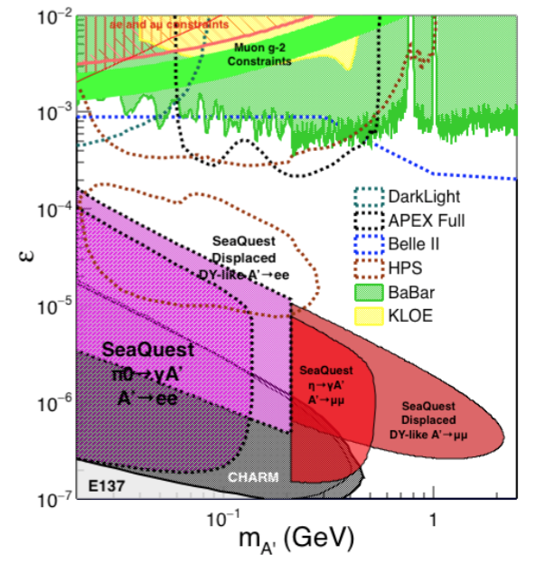
Phase-II: Displaced Low Mass Dark Photons with EMCal upgrades
Projection: POT 1.4 x 10¹⁸
Detector upgrades
  EMCal: e^{+/-}
  HCal: π^{+/-}
  Recycle from other experiments, PHENIX/RHIC etc.
Timeline of dedicated runs
  2020+
Detector configuration
  Access low mass region with optimized Fmag settting

Slide 22
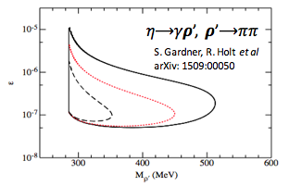
EMCal Upgrade: More Physics
2 sectors (4×4 m² coverage) PHENIX EMCal are available, need readout eletronics for SeaQuest
With EMCal installed, we will also be able to access:
  dark 𝝆 decays to 𝛑𝛑
  enhanced dark higgs sensitivity
Potential bonus of better background rejection on trigger level (studies underway).

Slide 23
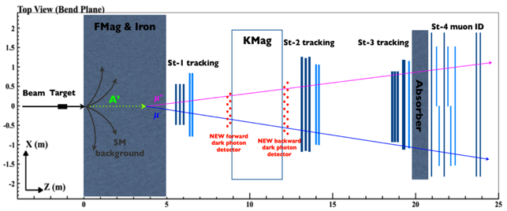
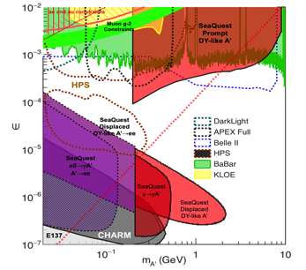
Summary and Outlook
Phase-I
  Great discovery potential!
  A new vertex trigger & DAQ++
  Early parasitic data taking 2017-2020+
  POT 1.4 x10¹⁸ or more
Phase-II
  Possible detector upgrade later, add electron and hadron capability
  A new dedicated dark matter program at Intensity Frontier!
Dark Higgs
search
Preparation Phase-I (parasitic runs)
Phase-II
2015
2016
2017
2018
2019
2020+

Slide 24
Important to have a joint NP+HEP Effort

Slide 25

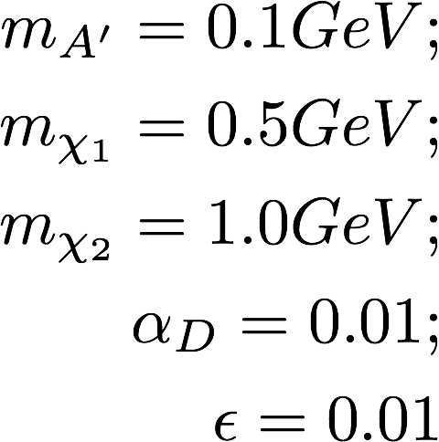
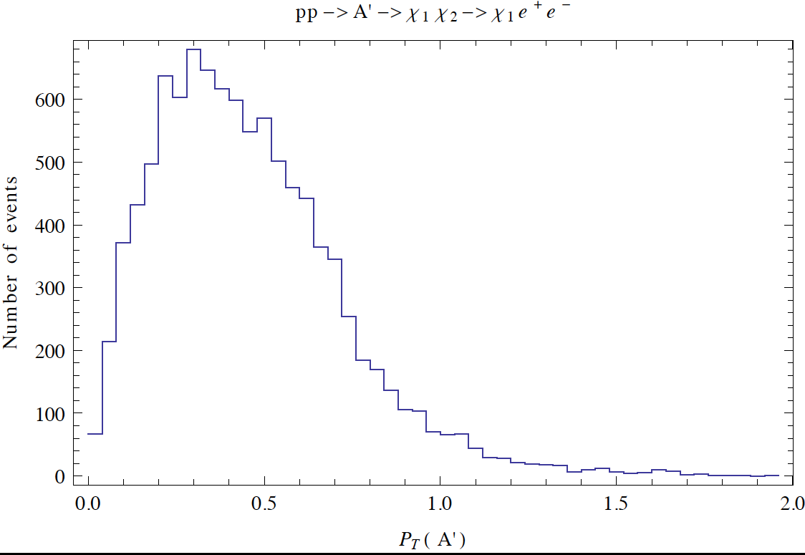
Beyond Exclusive Channels possible missing pT measurements being explored
Chien-Yi Chen, 2017

Slide 26
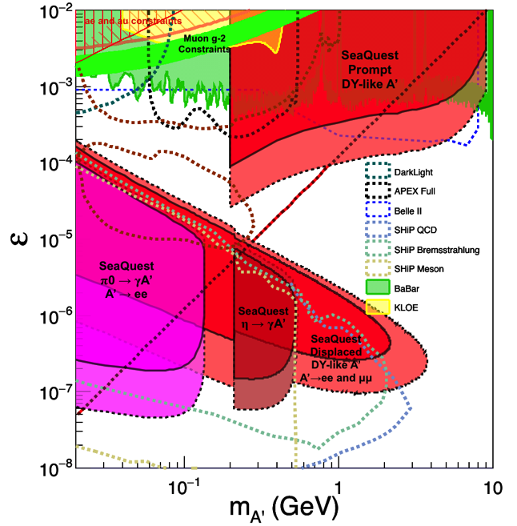
Comparison with SHiP Proposal
120 GeV@FNAL: 2017 -2019
1.4x10¹⁸ POT or more, future dedicated runs
400 GeV@SPS: 2025 -2030
4x10²⁰ POT
POT:4x10²⁰

Slide 27
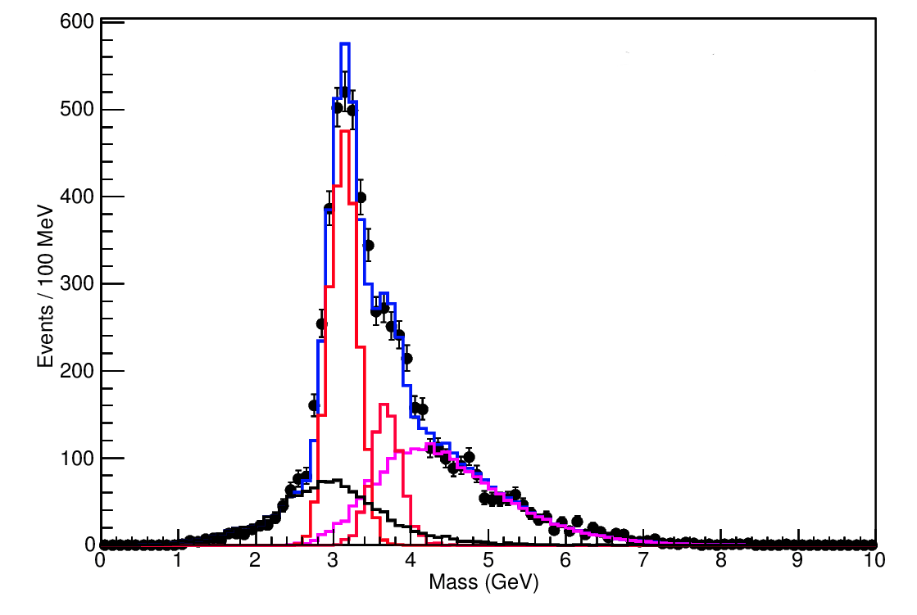

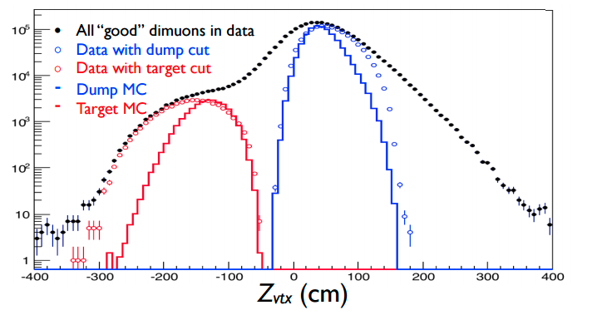
Event selection and reconstruction
Invariant mass spectrum for FY 2015 data
30% of anticipated data
Data agrees well with Monte Carlo (spectrometer works as expected)
Data with Mass > 4.2 GeV are mostly dimuons coming from the Drell-Yan process
E906 preliminary
J/ψ Monte Carlo
ψ’ Monte Carlo
Drell-Yan Monte Carlo
Random Background
Combined MC and bg

Slide 28



Search Mode (2): “Prompt” Dark Photons vs Drell-Yan
Bump hunt at Z-vertx < 3m
Expected Drell-Yan like signal and backgrounds:
Excluded phi
resonance region
Dark photon
signal
Drell-Yan Background
Work in progress:
- optimization …,
- understand BG ...

Slide 29
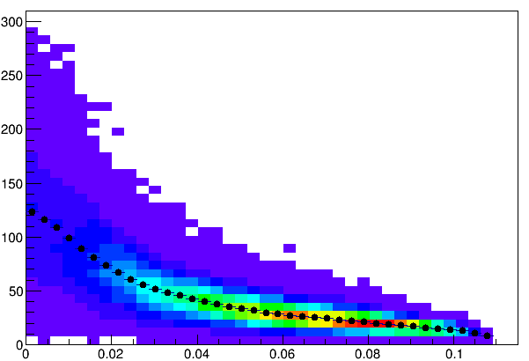
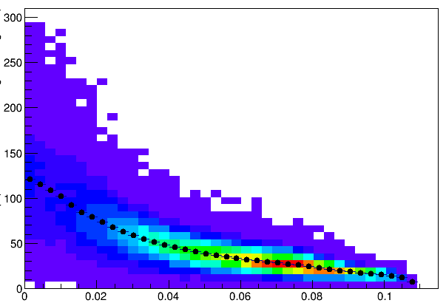
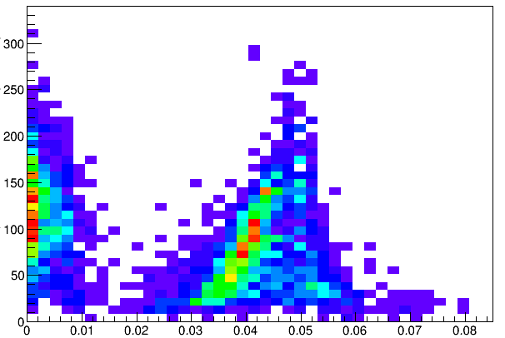
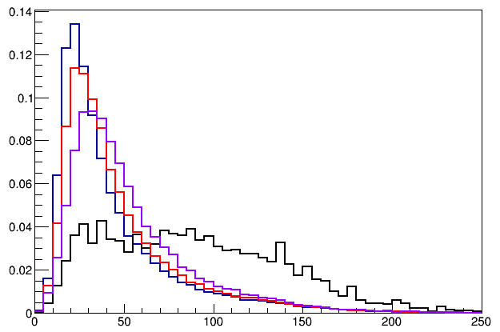
Trigger Detector Optimization
Single Muon Z-Vertex Resolutions
Forward: 1cm
Backward: 1cm
Forward: 1cm
Backward: 2cm
Sigma_Z ~ 30cm
Forward: 1cm
Backward: 1cm
Forward: 1cm
Backward: 2cm
Forward: 2cm
Backward: 2cm
E906
Current
E906

Slide 30
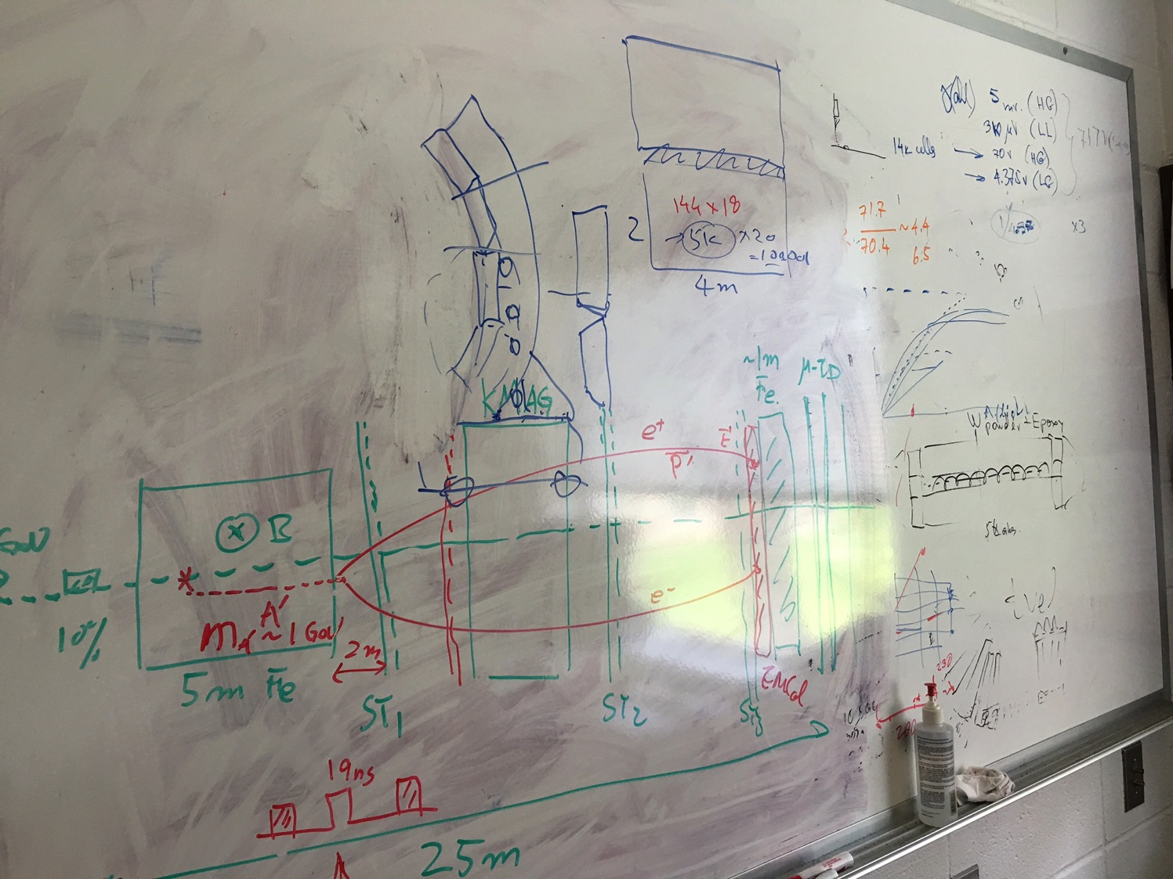
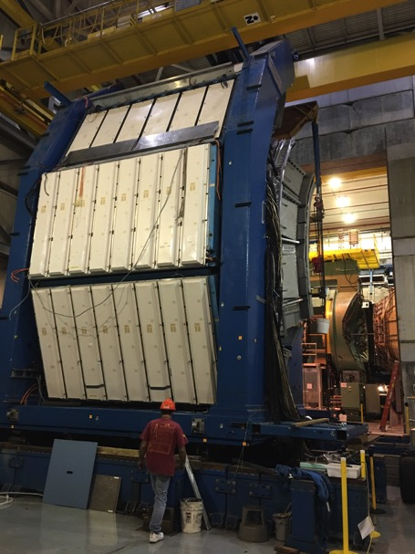
EMCal from PHENIX/RHIC
2 EMCal sectors are available from PHENIX experiment at RHIC, ~end of 2016
  One sector:
    2m x 4m, 18 (3x6)super modules
    Super module = 36 modules; Module = 4 towers
    36 x 4 x 18 = 2592 channels
    Could gang 2x2 (or 3x3) into one ADC/TDC readout
- dE/E = 8.1%/sqrt(E) + 2.1%
- dT < 200 ps
- Excellent e/pi separation

Slide 31
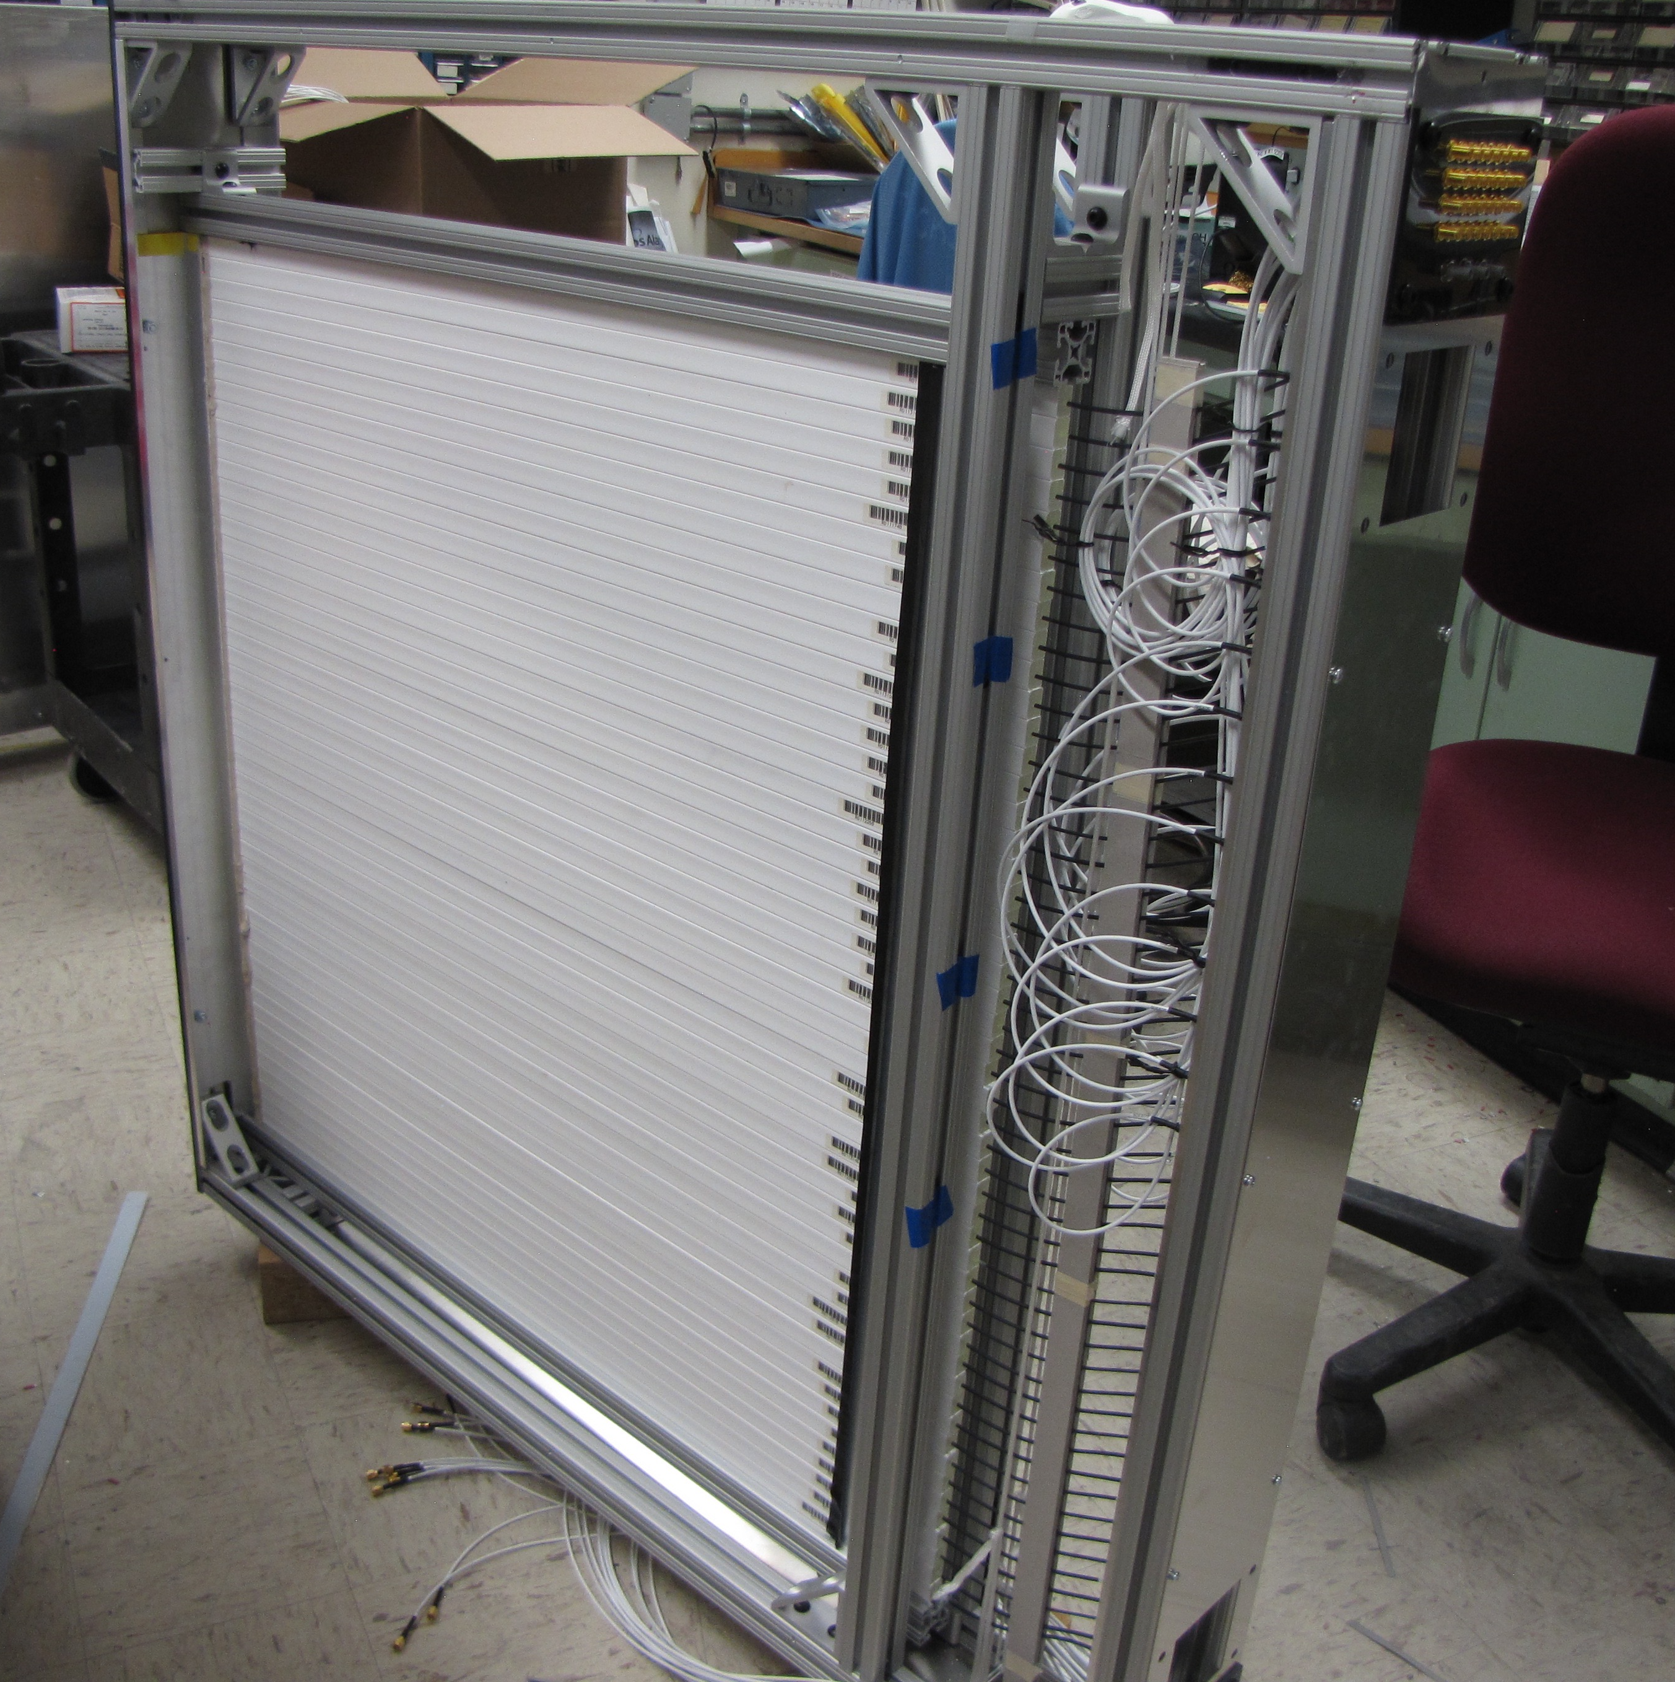
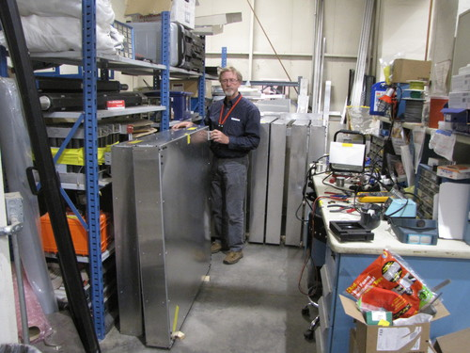
All 8 trigger modules assembled

