Slide 1
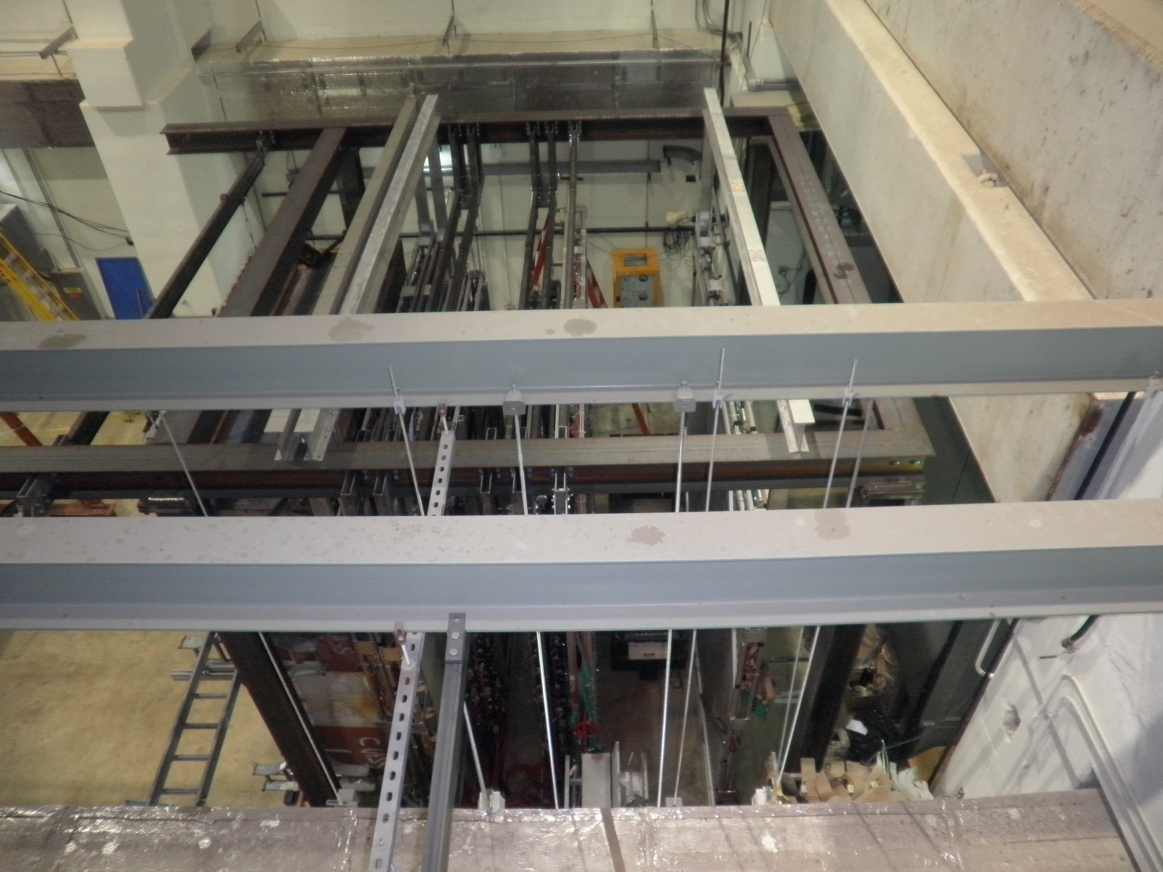

Slide 2
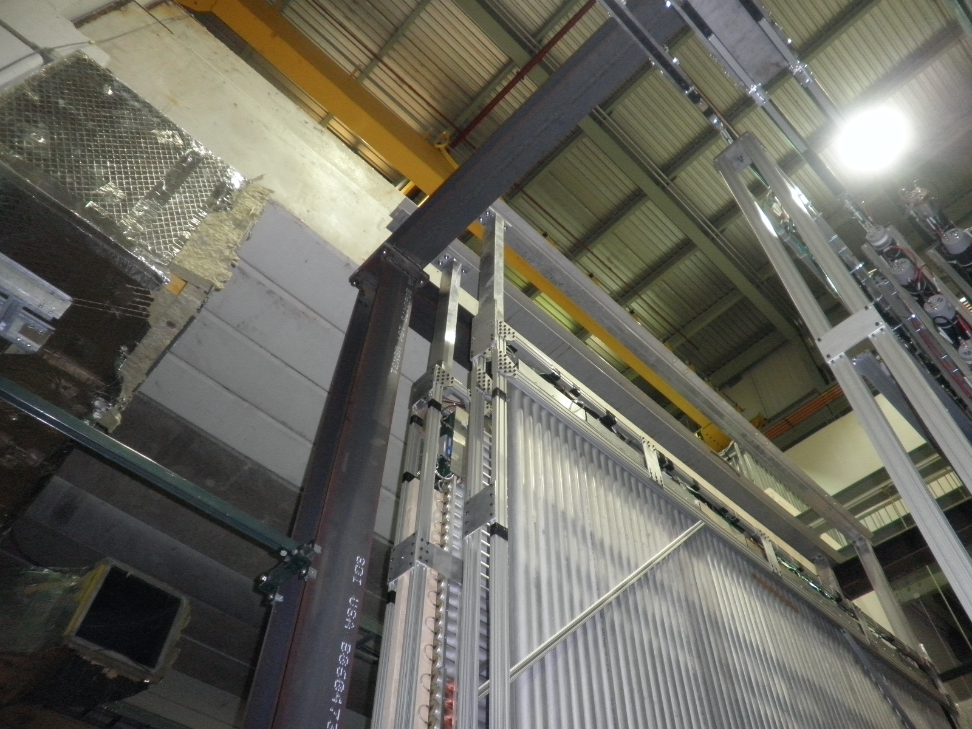

Slide 3
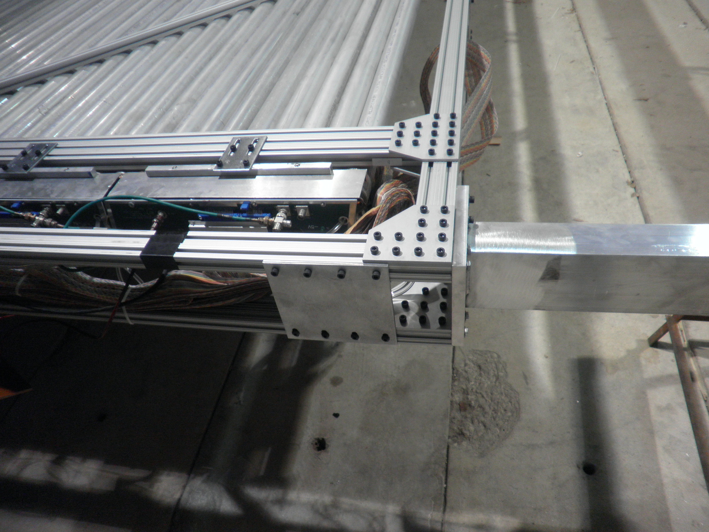

Slide 4
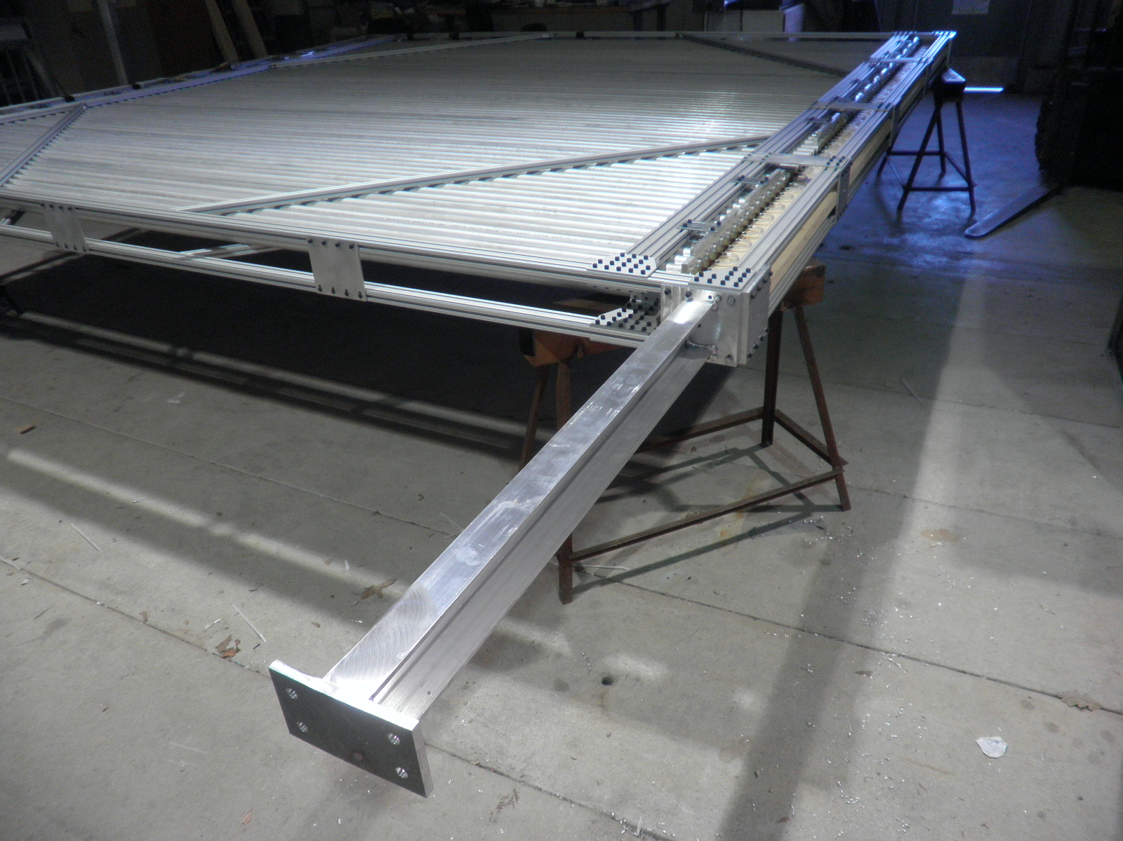

Slide 5
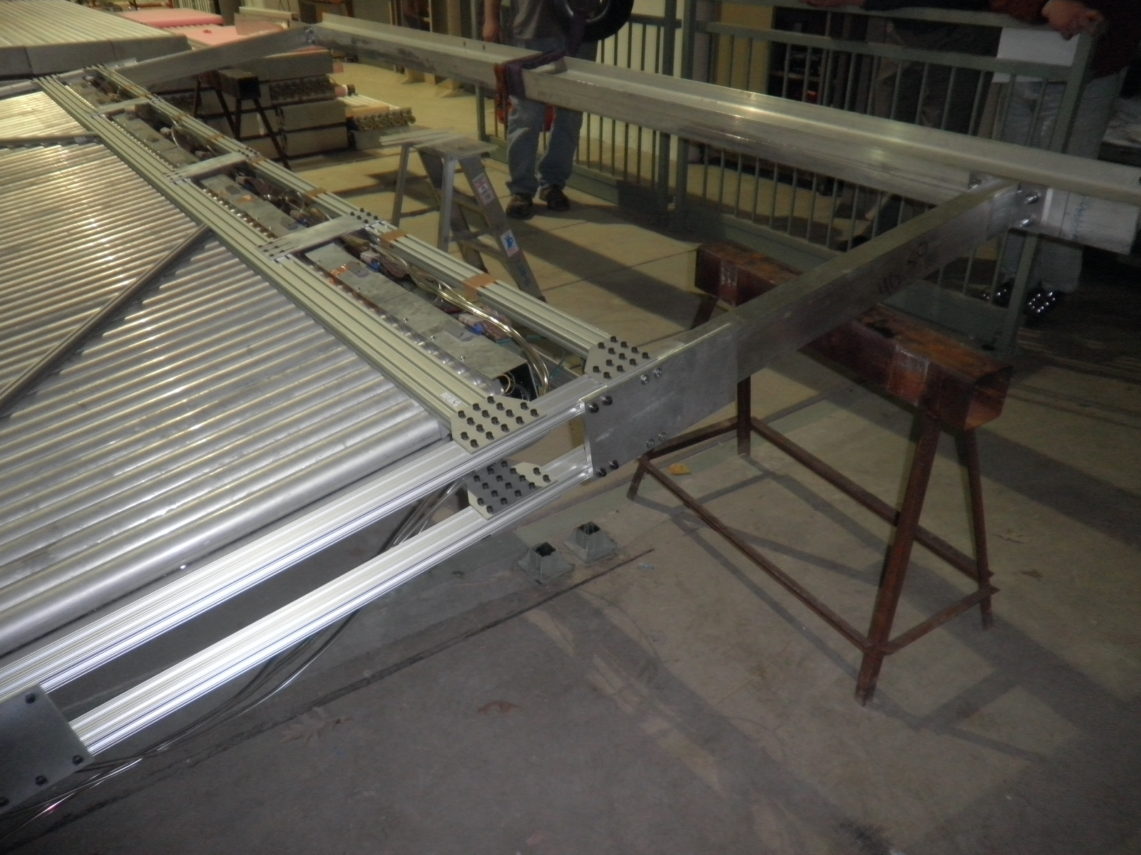

Slide 6
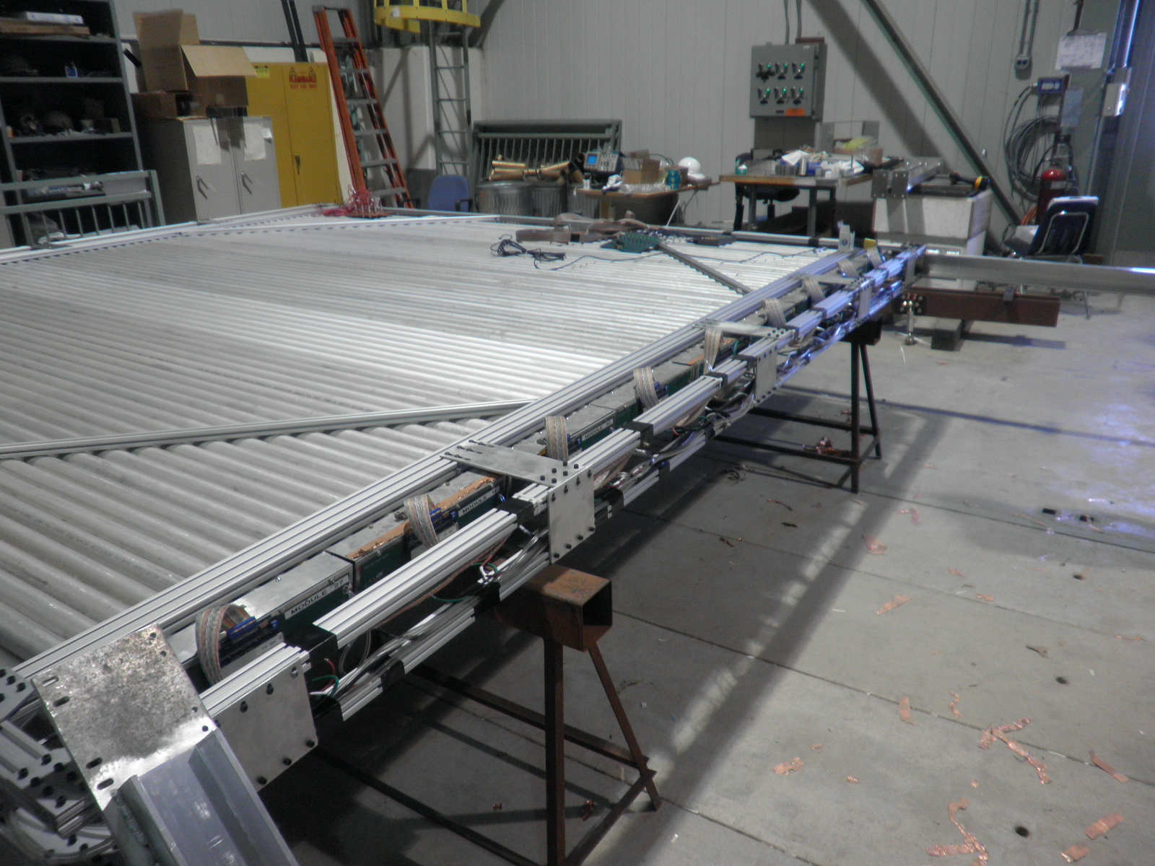

Slide 7
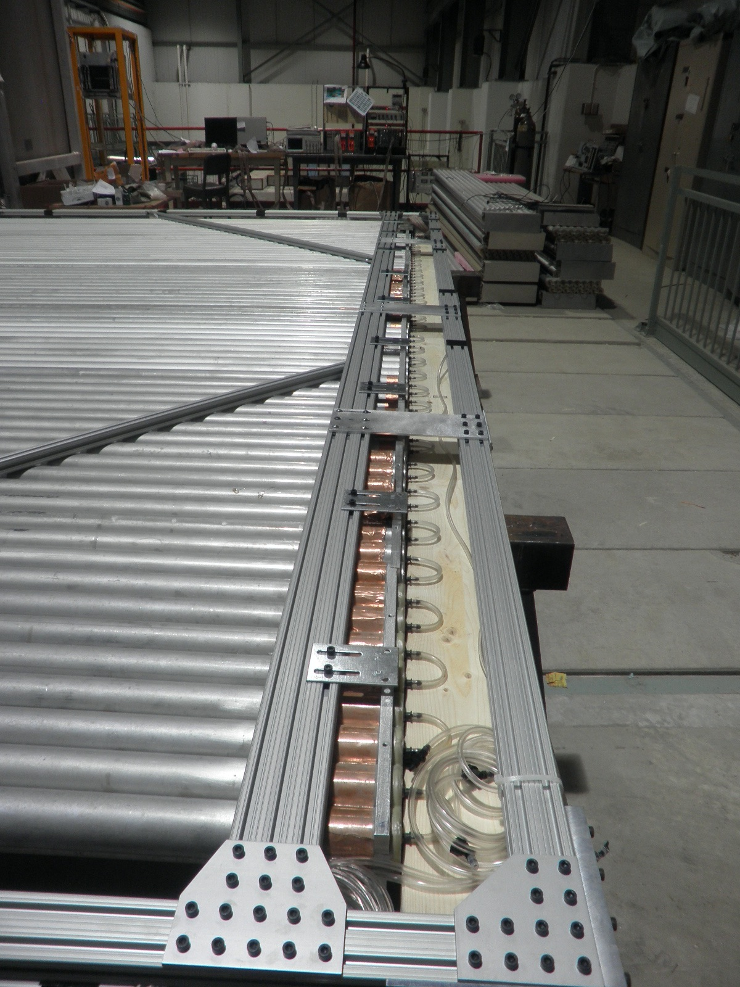

Slide 9
½” thick Al plate
12”
¼” thick C-Channel
4”(W) x 2.5” (H) x 40.5”(L)
5 ½”
4”
40 ½”

Slide 10
Design

Slide 12
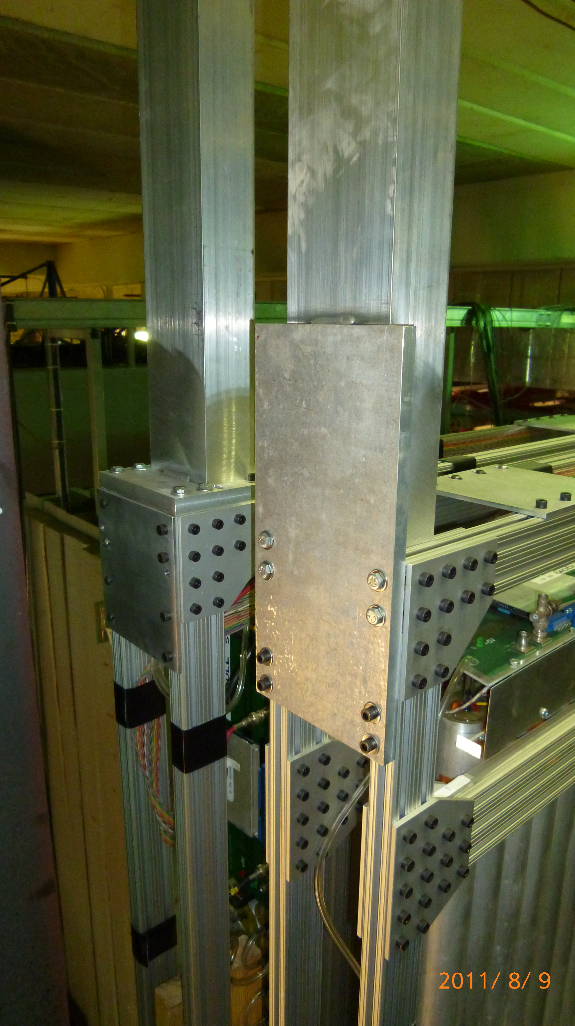
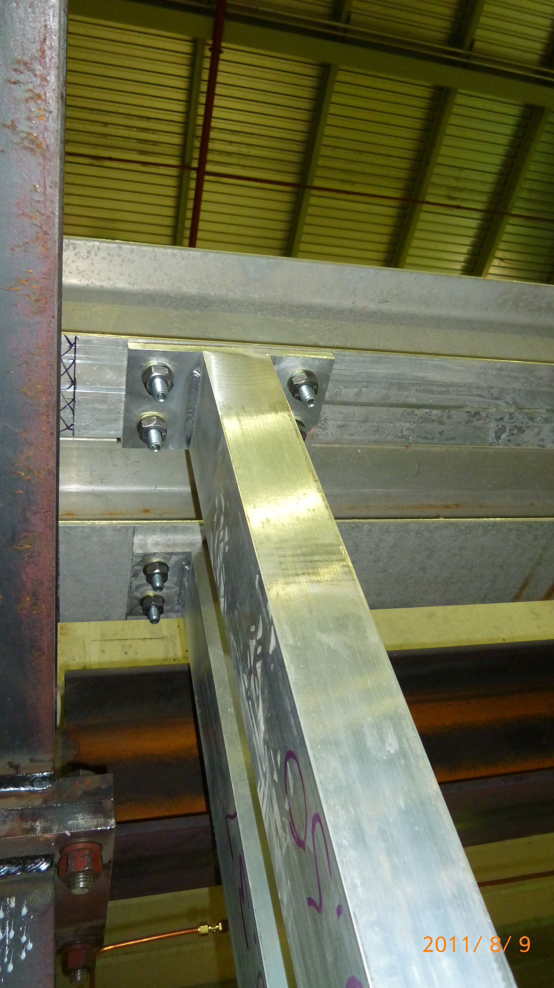
C-Channel Frames

Slide 13
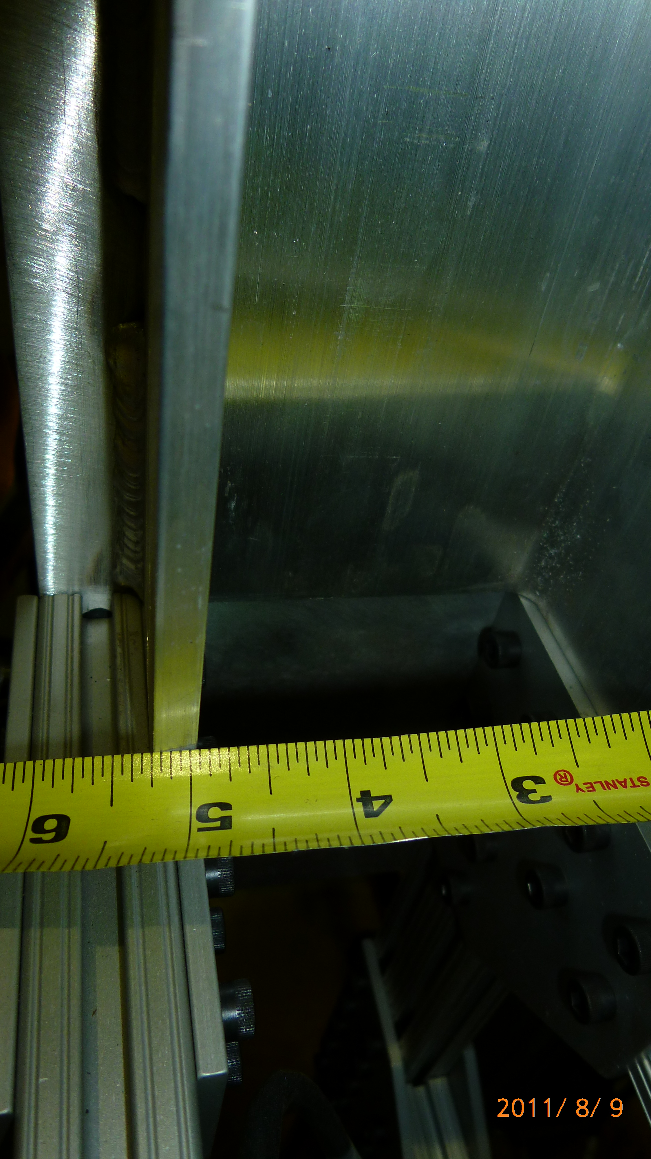
C-Channel frames
¼” thick C-channel
4” (W) x 2 ½” (H) x 40 ½”(L) for 4X
4” (W) x 2 ½” (H) x 40.375”(L) for 4Y
AL materials: 6061 alloy
Attached to cross I-beam with
Grade 5 fasteners, followings are from Tom’s email (1/13/2011)
Beveled Washers for 1/2" bolt, McMaster Carr Part # 91152A033 (box of ten)
Hex Head Screws 1/2"-13x2" long, McMaster Carr Part # 91247A722 (box of ten)
Hex Nuts 1/2"-13, McMaster Carr Part # 95045A033 (box of 25) Washers for 1/2 inch bolts

Slide 14
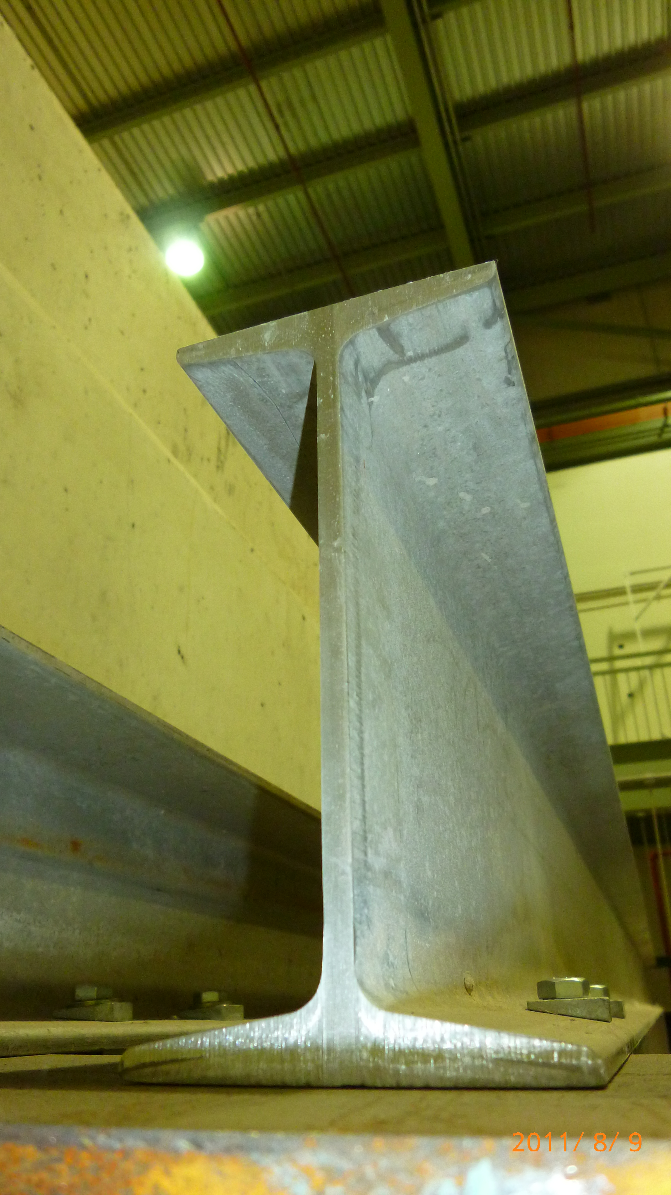
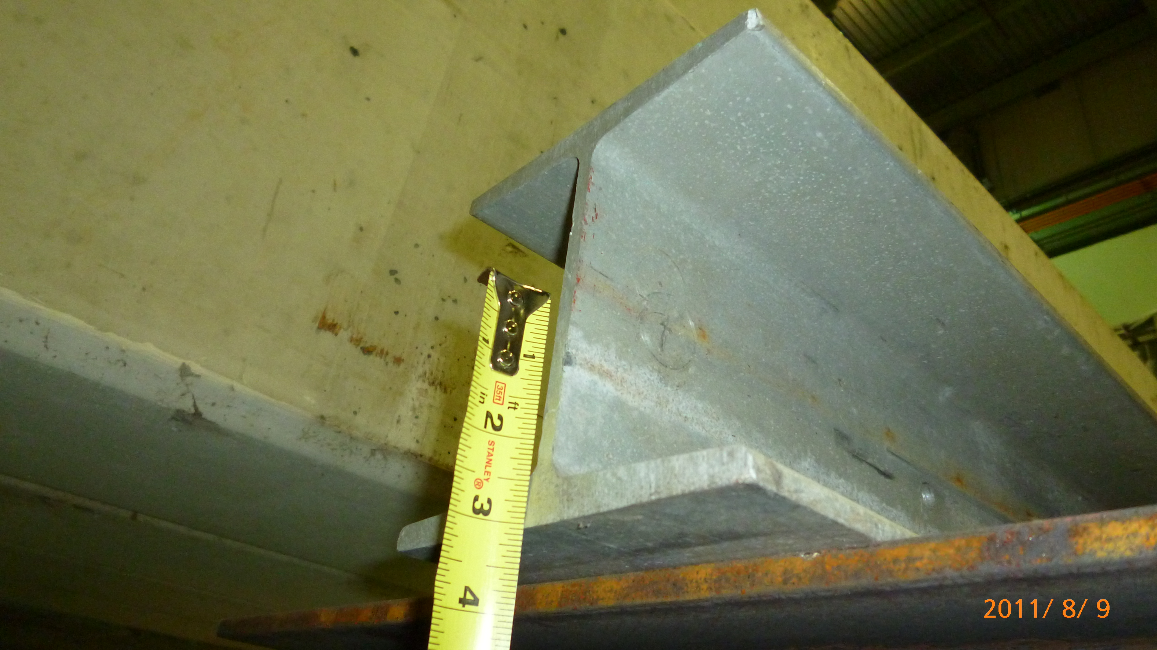
Al Cross I-beams
6”(W) x 6”(H) ¼” thick I-breams (Left)
4”(W) x 8” (H) ¼” thick I-beams (Right)
4” x 8”
½” thick
6” x 6”
½” thick

Slide 15
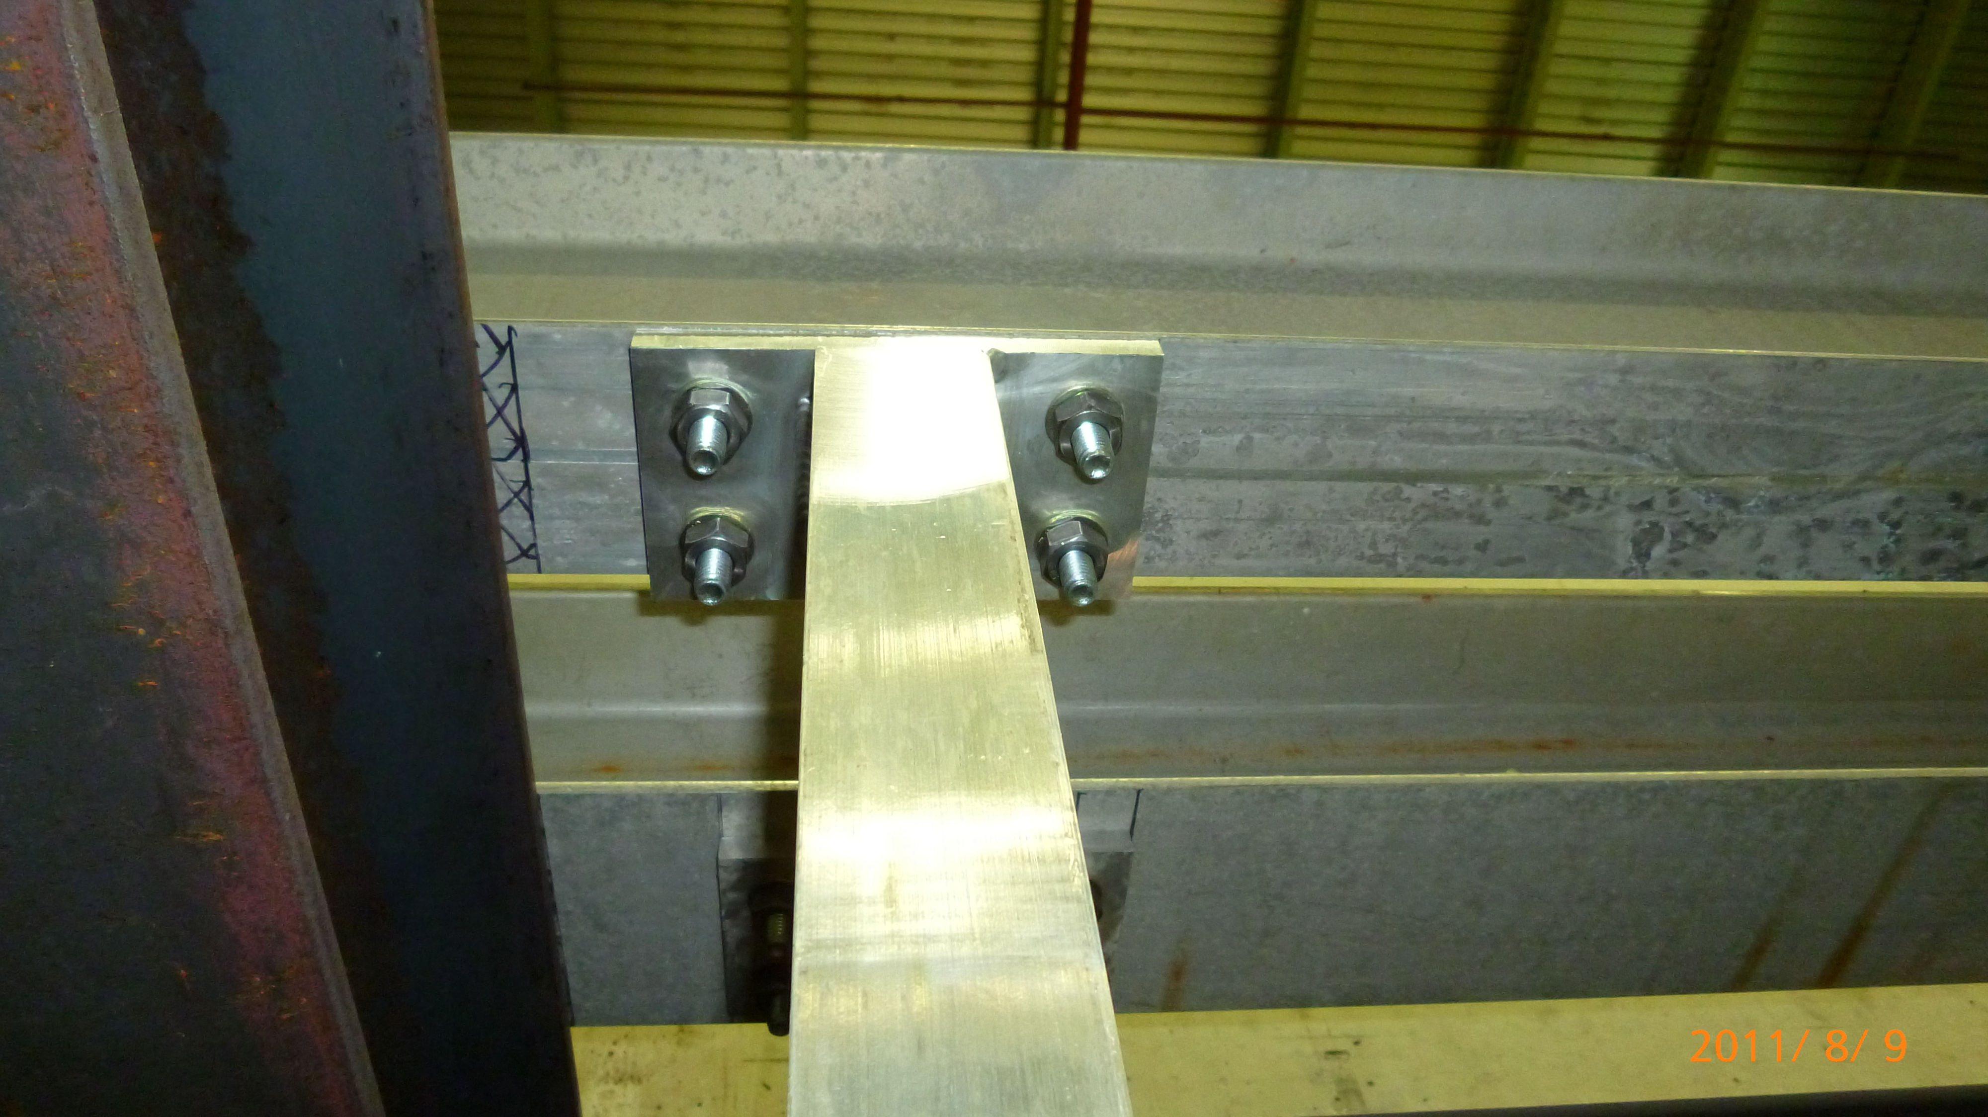
C-Channel to Cross I-beam
5”
2”

Slide 16
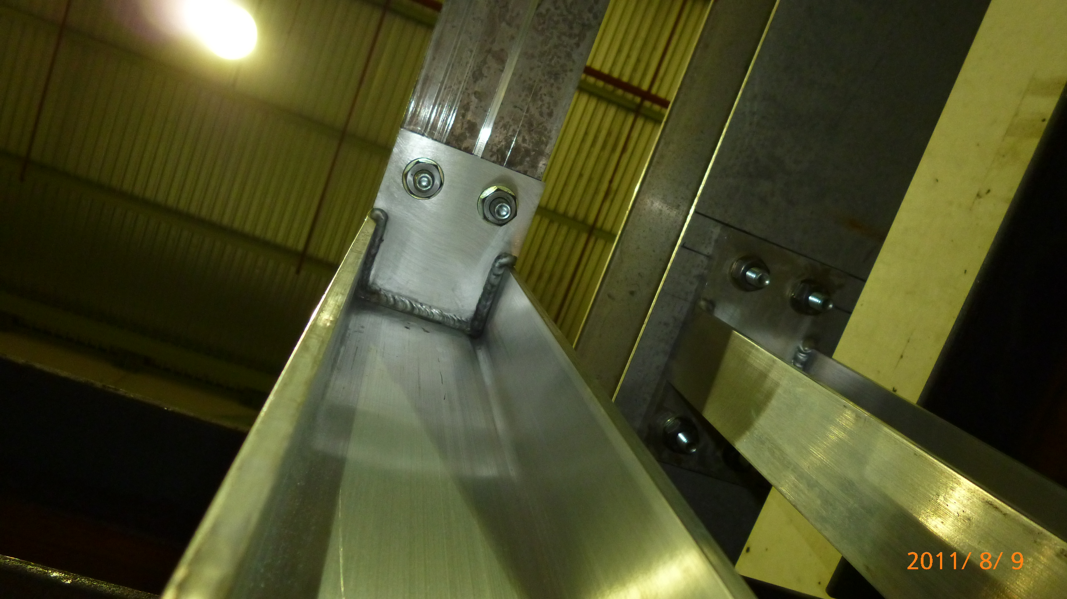
C-Channel to Cross I-Beam

Slide 17
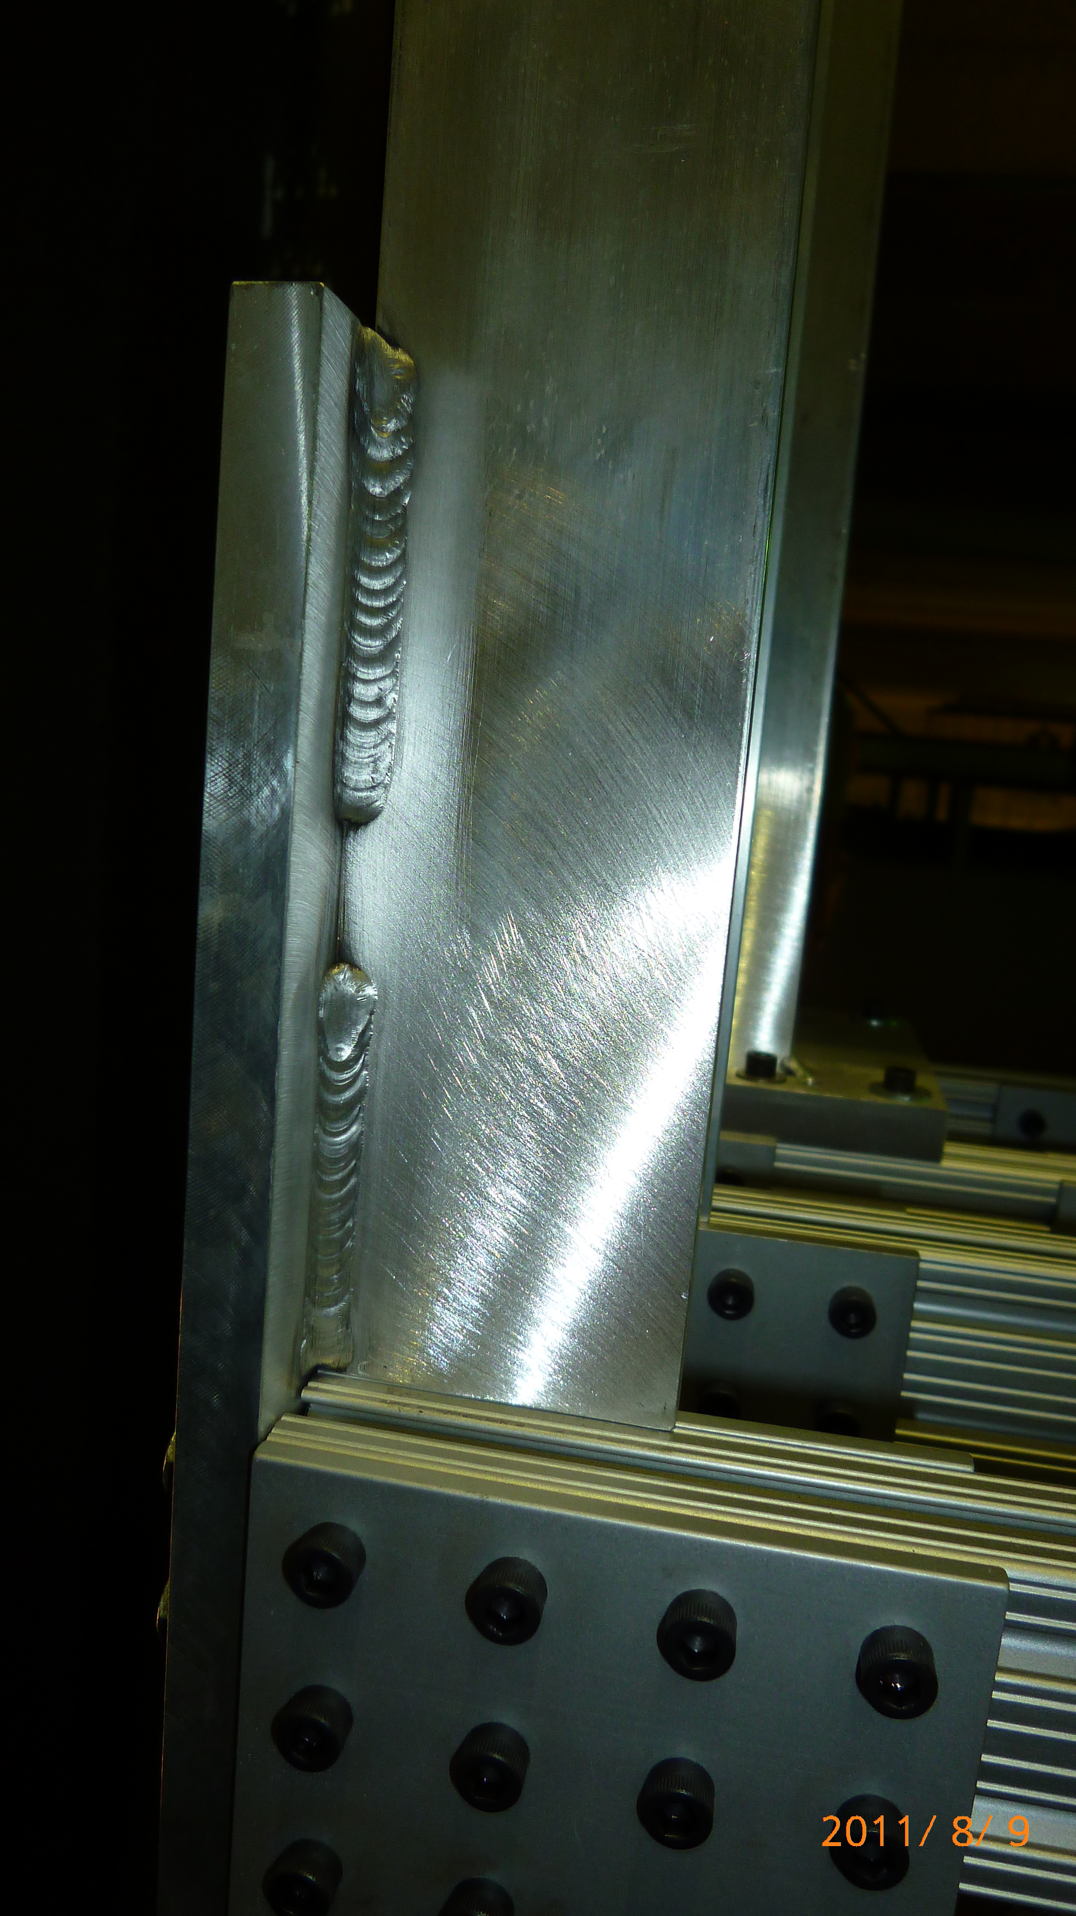
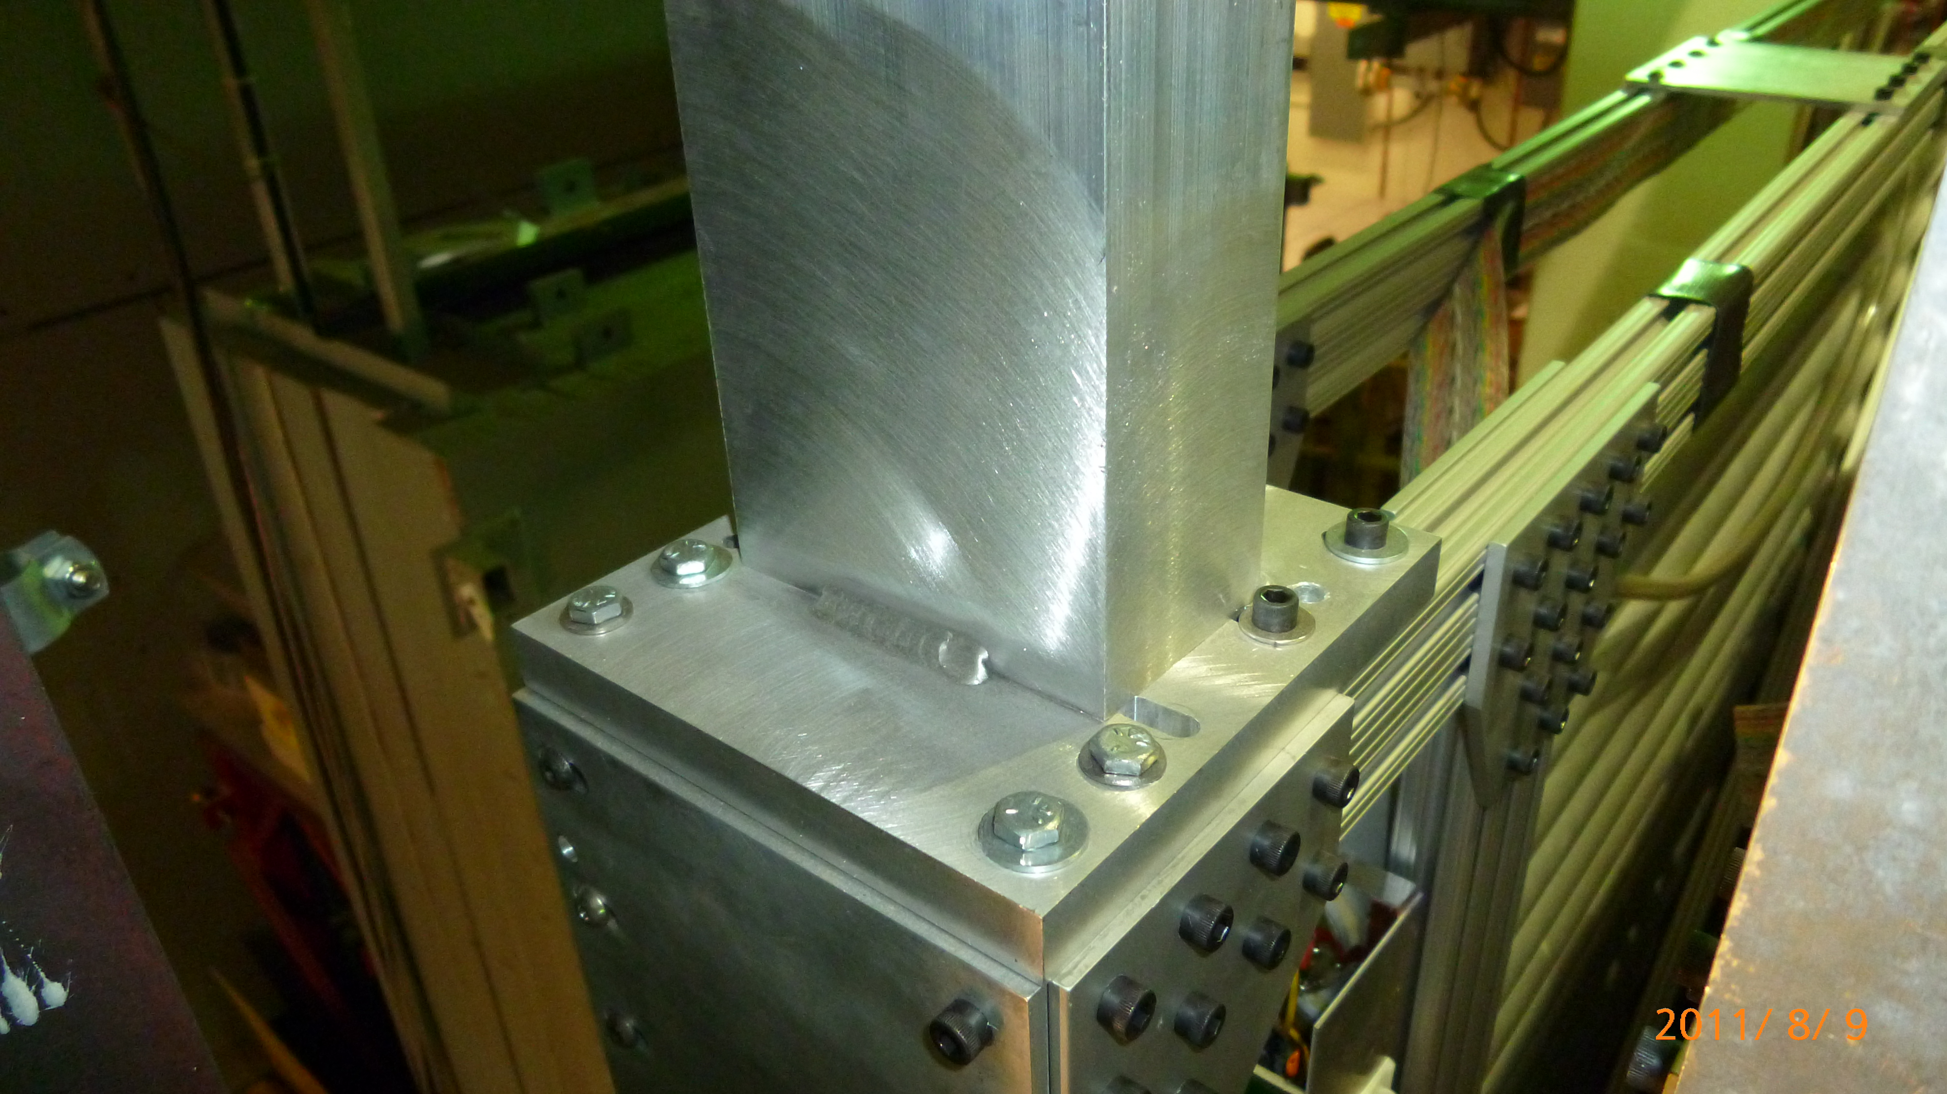
C-Channel to 80/20

Slide 18
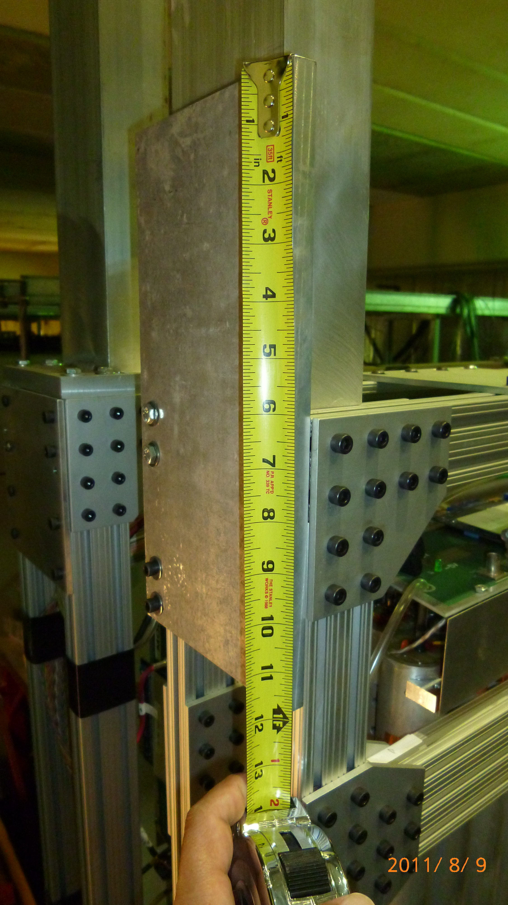
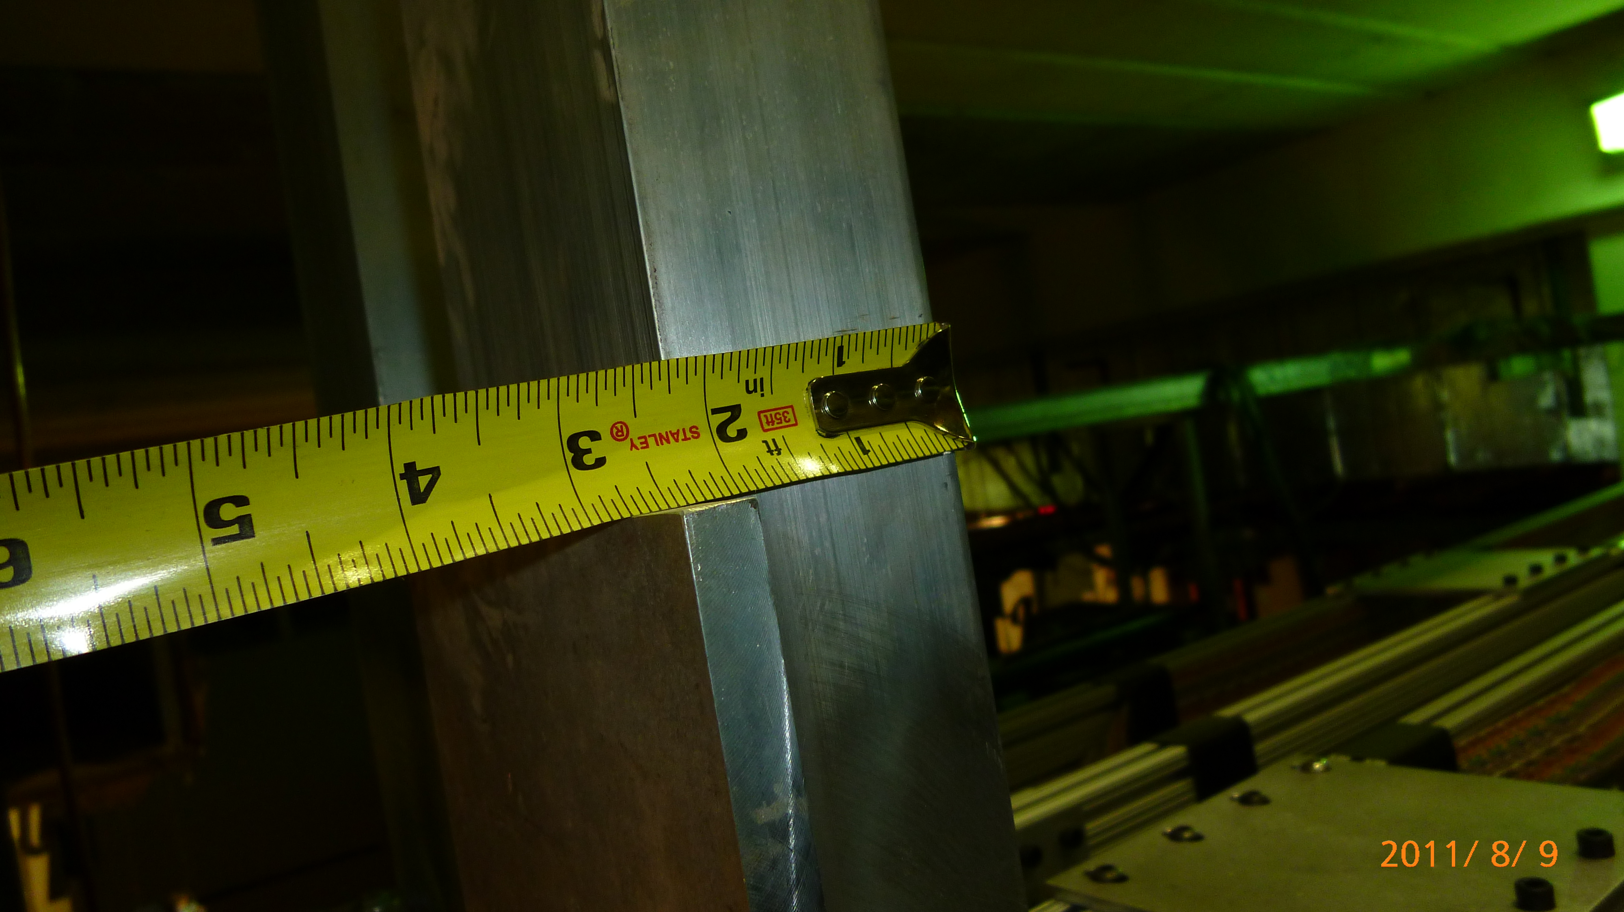

Slide 19
