Slide 1
Proposal for a Dedicated Dark Sector Physics Search in SeaQuest at the Fermilab Intensity Frontier
06/22/2018

Slide 2
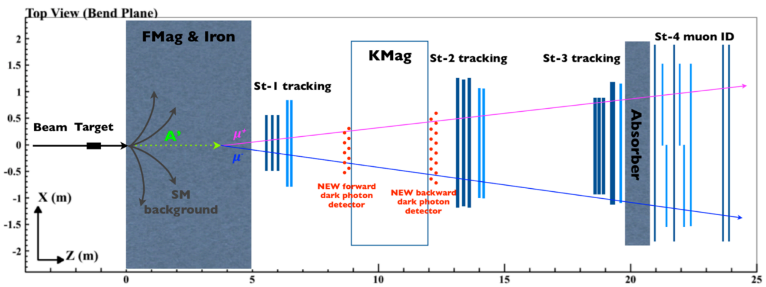
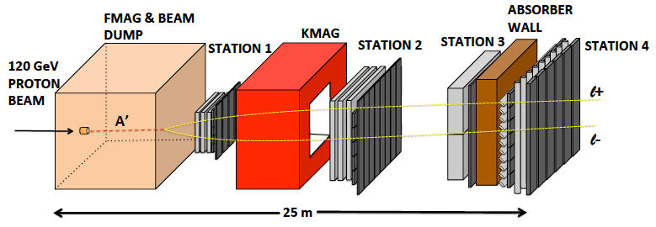
Proposal for a Dedicated Dark Sector Physics Program at SeaQuest
PAC endorsement is essential
attract new members;
start EMCal work at Fermilab in 2018
2019-2021: Parasitic Dark Sector physics program with E1039
  Attract and build up HEP groups in SeaQuest
    Carry out DP physics program with dimuons: dark photon, dark Higgs etc.
    EMCal refurbishment and preparation for integration at Fermilab, 2018-2021
  New HEP members develop SeaQuest detector expertise for the future experiment operation and data analysis
    Also help E1039 operation and maintenance of spectrometer and DAQ
  Transition into HEP DP program after E1039
    Develop new proposals, seek HEP DOE/NSF and other external fund
    Parasitic data taking with E1039 for DP search, further explore new opportunities
    Develop online/offline analysis, study DAQ and triggers capability for future DP experiment
    Background study, test small prototype in SeaQuest, w/ minimal impact on E1039
  E1039 2-year data taking: summer 2019 – summer 2021
2022-2024: first dedicated dark sector physics run @NM4
  Install EMCal for electron and hadrons ID, explore new phase space below dimuon mass (200MeV)
  Further develop dark sector physics program
  Possible NP parasitic physics program under discussion
  POT = a few 10¹⁸
2024-2025: major detector upgrade during the long shutdown
  Upgrade tracking chambers
  Add di-photon capability with preshower detectors
  Add tracking station-0 near target, more shielding
  Possible PID with TOF etc
  And more
2026-2030+: high luminosity dark sector physics program
  Full physics program with upgrade detectors, POT =10¹⁹~10²⁰
  Carry out an extensive (SHiP-like) HEP experimental program at NM4
  Possible NP parasitic physics program under discussion (~US EIC physics era)
SeaQuest in 2017 with displaced dark photon trigger
PAC endorsement is essential to develop this program
SeaQuest in 2021+ with EMCal upgrade

Slide 3
Dark Sector Physics Search Program at Fermilab SeaQuest
2018 2019 2020 2021
2022 2023 2024 2025
2026 2027 … 2030+
E1039 installation
& commissioning
Planned
Parasitic Dark Sector
Physics with E1039
Proposed
PHENIX EMCal refurbishment at Fermilab,
HEP dark sector physics program development
EMCal installation
& commissioning
Long shutdown,
detector upgrade
High luminosity dark sector physics
program at Fermilab Intensity Frontier
DP search w/ EMCal upgrade
Parasitic Nuclear Physics program possible
Parasitic Nuclear Physics program possible

Slide 4
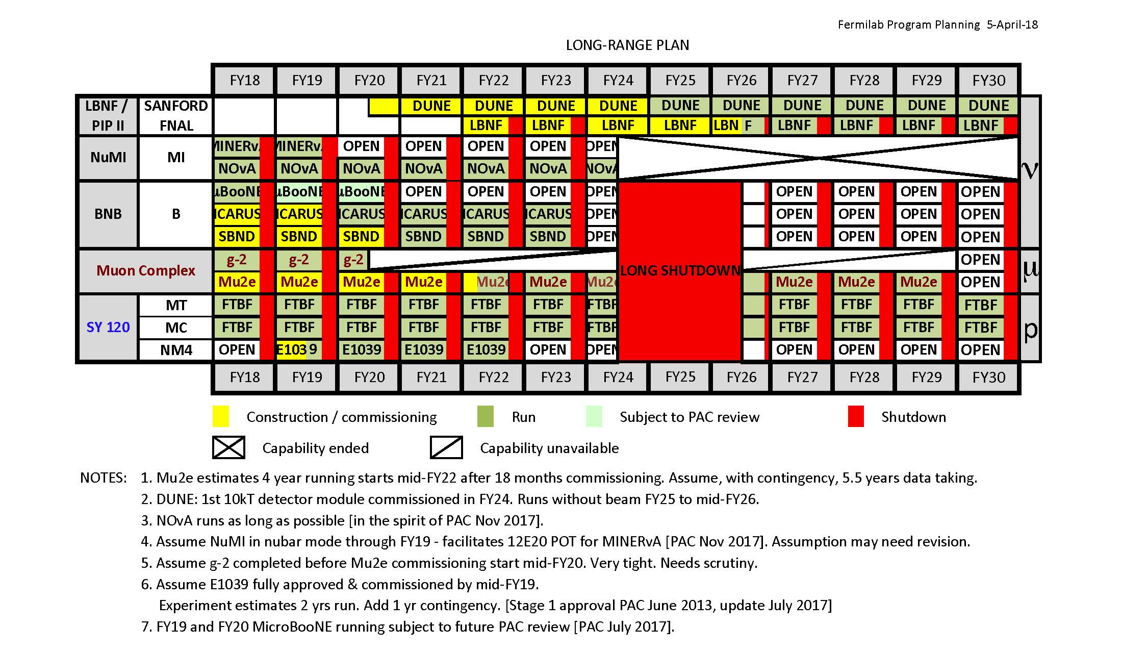
Fermilab Long Range Plan

Slide 5
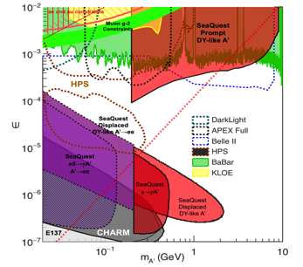
Money Plots (I) to include all other experimental searches up to year ~2025+
Phase space covered by SeaQuest:
2019 ~2021 – dimuon channel (POT = 10^18)
2022-2024 – add di-electron (POT = 10^18)
2026 – 2030+ --- all channels (POT > 10^19)
SeaQuest dark photon coverage:
Dimuons (current capability)
Di-electrons (w/ EMCal upgrade)
Detailed SeaQuest coverage in various production channels with
di-electrons and di-photons
17MeV
arXiv:1804.00661

Slide 6
Money Plots (II) - with all Future Projections

Slide 7
Supporting Slides

Slide 8
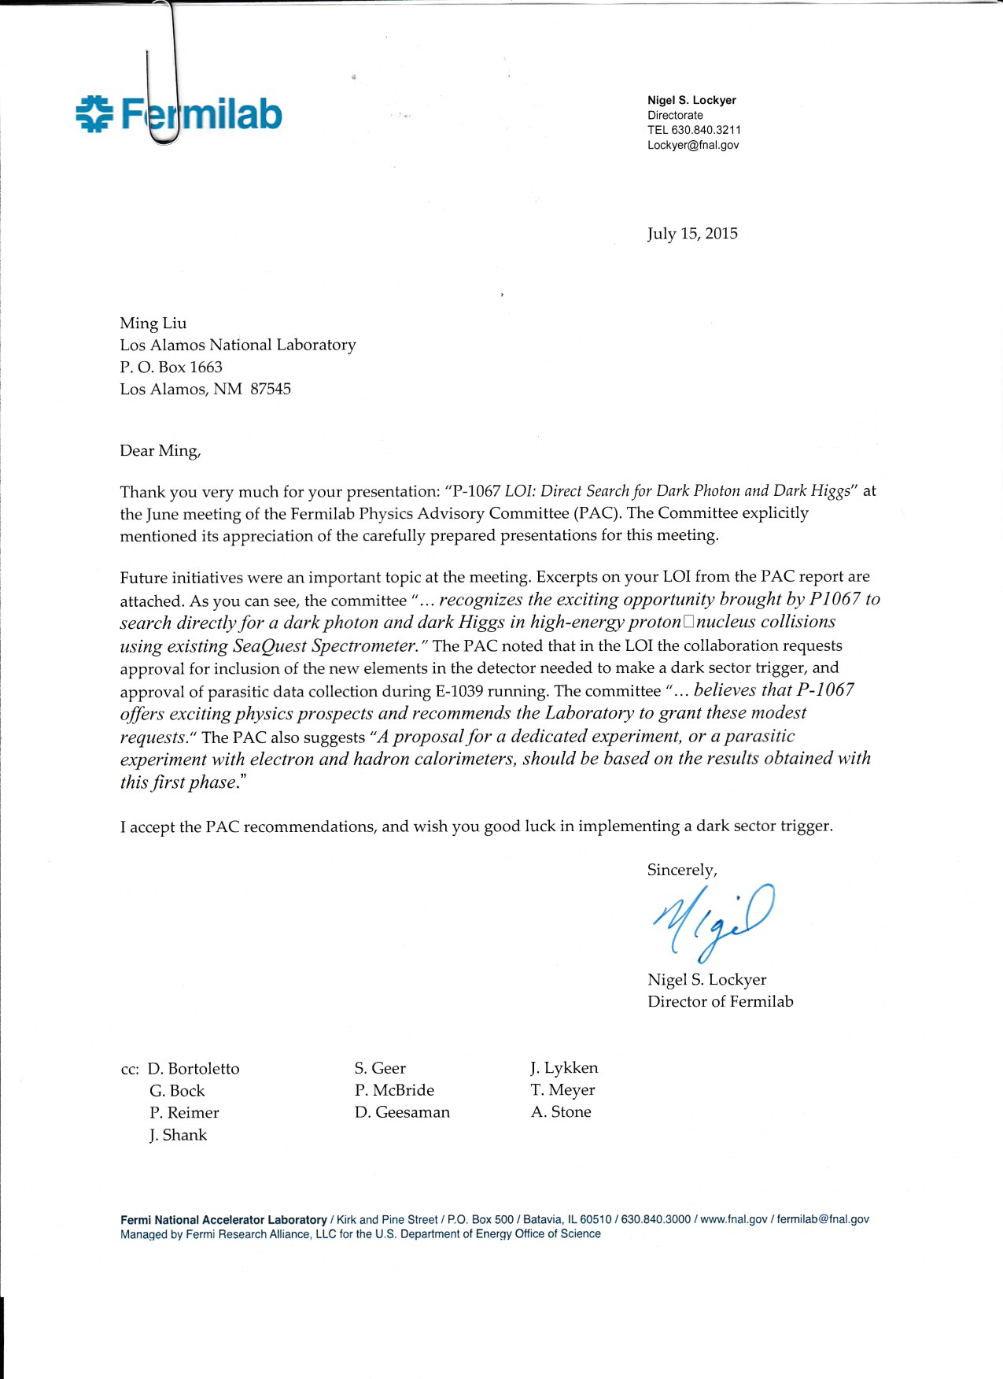
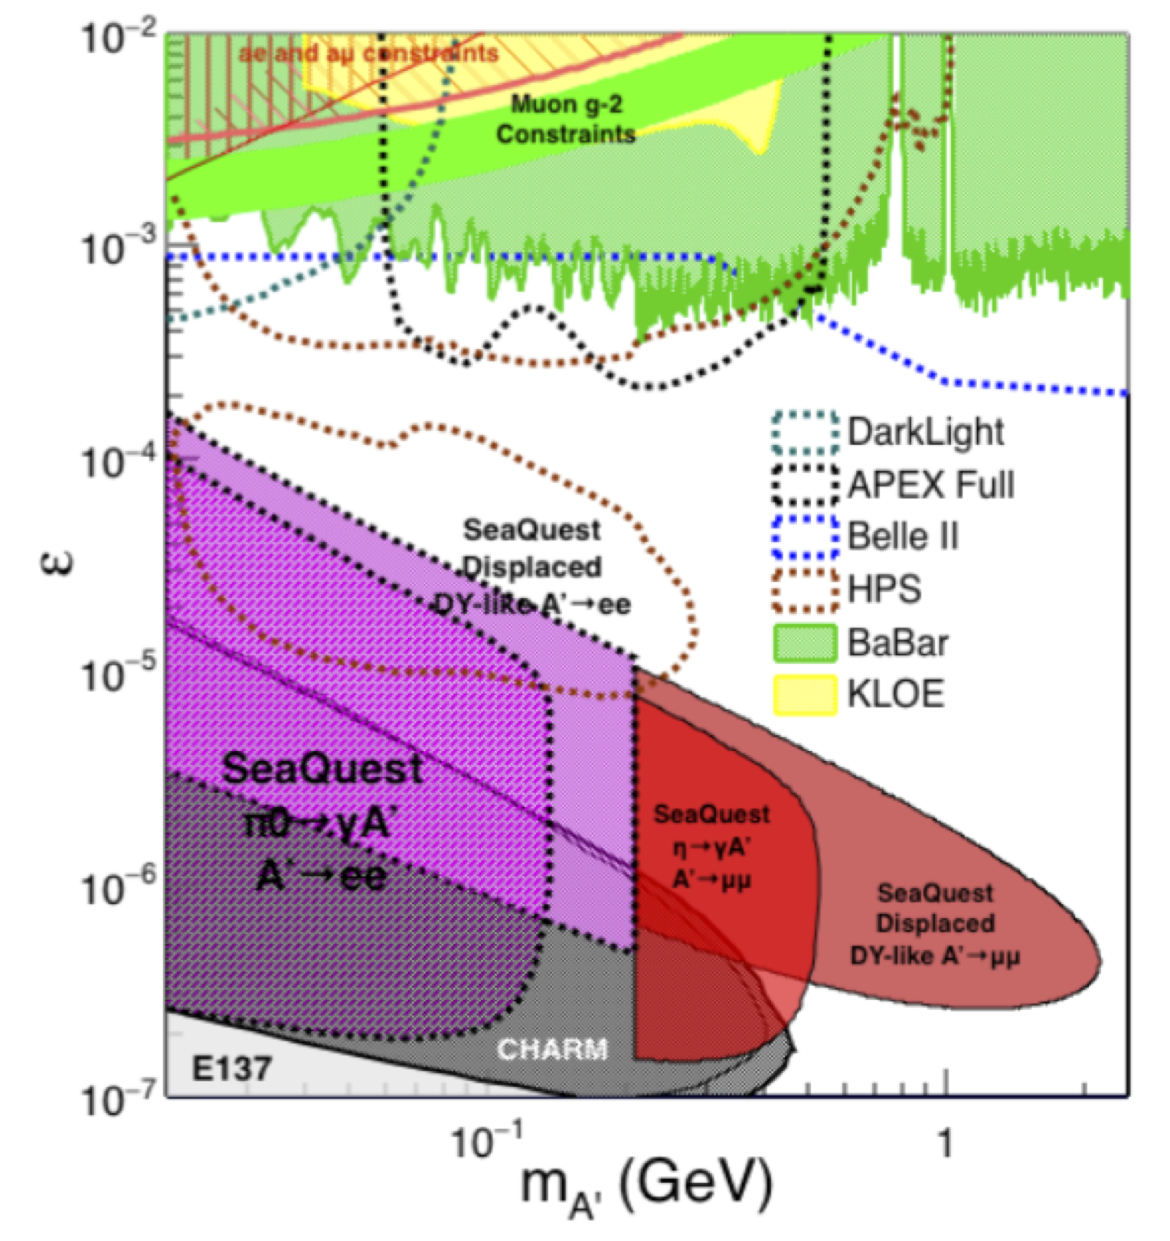
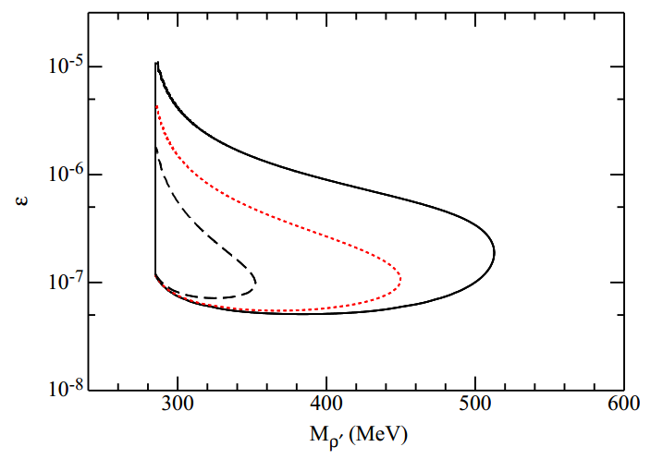
Physics goals and recent accomplishments
LOI of dark matter search in dimuon channel was presented to PAC in June 2015. Obtained very positive feedbacks.
A phase-II of EMCal and possibly HCal upgrade was also mentioned. PAC suggested we submit a new proposal based on the results obtained from the phase-I study
The detector proposed in the phase-I was successfully installed and accumulated one week worth of data before E906 shuts down in July 2017
We will continue to take the dimuon data parasitically with E1039

Slide 9

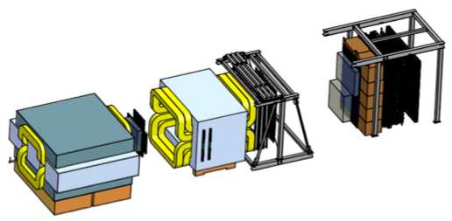
SeaQuest at the Intensity Frontier at Fermilab
High intensity proton beam: “beam dump mode” @SeaQuest/E1067
35,000 fb⁻¹ (in a 2-year parasitic run, 1.4x10¹⁸ POT @5% beam)
LHC-II: 300 fb⁻¹ (~2025), achieved 25fb⁻¹ in Run-I
B-factory@KEK: 50K fb⁻¹ (~2023)
Absorber wall and proportional
tube based Muon ID
Spectrometer magnet
Δpt = 0.4 GeV
Focusing magnet
and solid iron dump
Δpt = 2.9 GeV
Beam
120 GeV proton from Main Injector
19ns RF, 4s spill, 0.5×10¹³ protons per spill
25 m
LDRD/ER: 2016-2018
Trigger upgrade, parasitic runs
Target system
Liquid H and D
Solid C, Fe, W
- Beam dump mode: p+Fe collisions! Target ~ 10%λ_{I}
- Parasitic run with other fixed target experiments, E906/E1039

Slide 10
Displaced Dark Photon Trigger Detectors Work Well!
-Detector and trigger system installed and commissioned during the last SeaQuest/E906 run in 2017
- Physics analysis in progress
From E906 2017 run
<det_eff> ~>95%
Schematic of displaced dimuon trigger

Slide 11
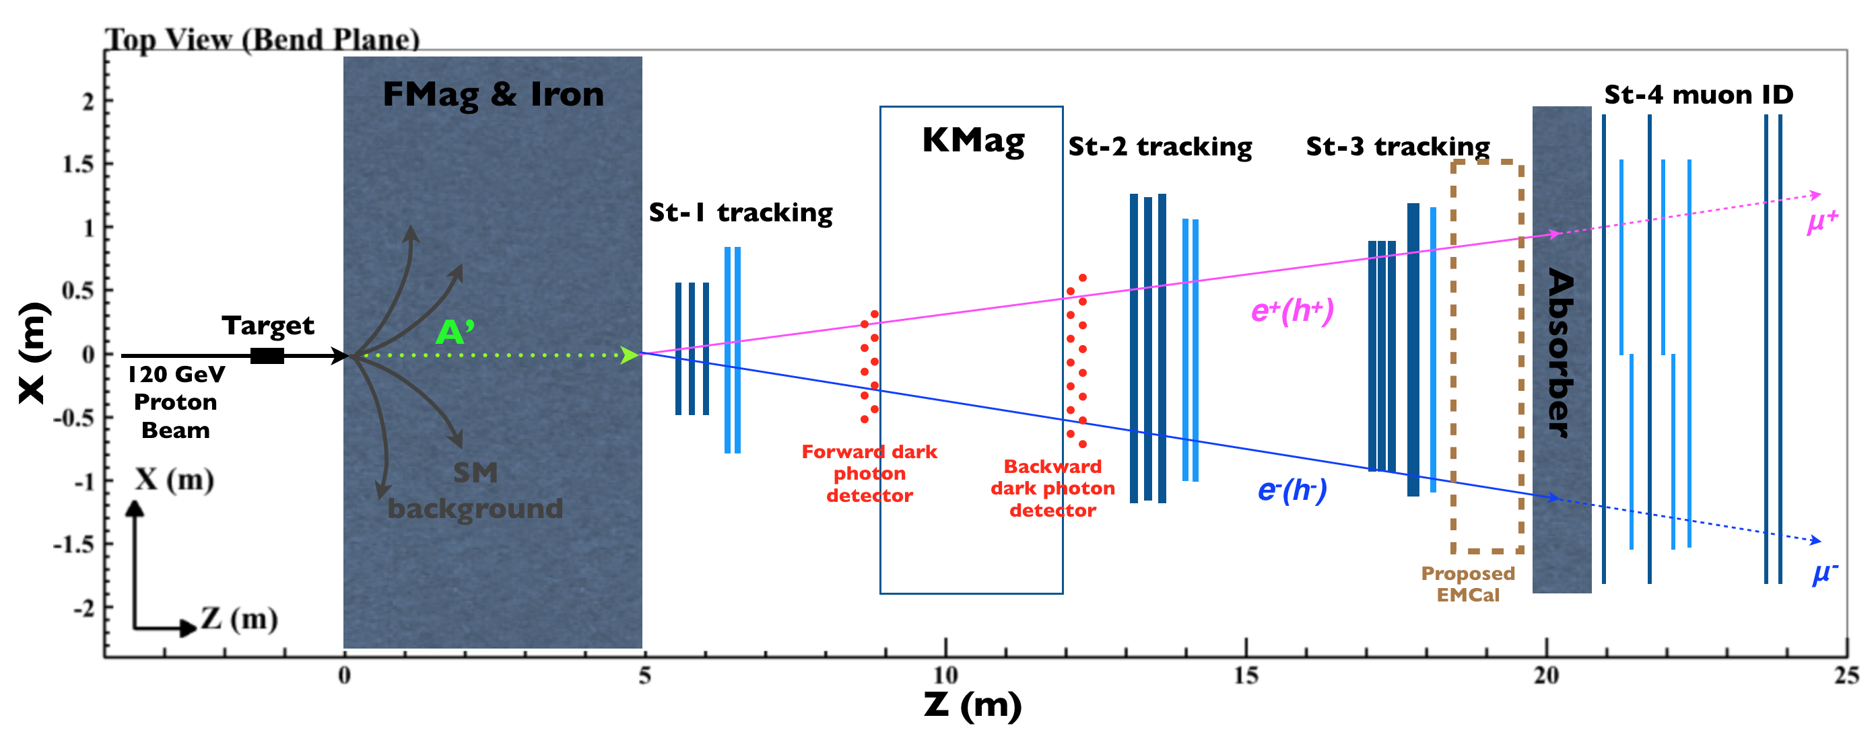
EMCal Upgrade in 2021
An EMCal detector recycled
from PHENIX at RHIC

Slide 12
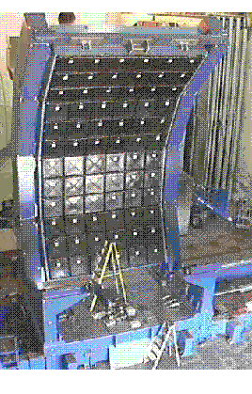
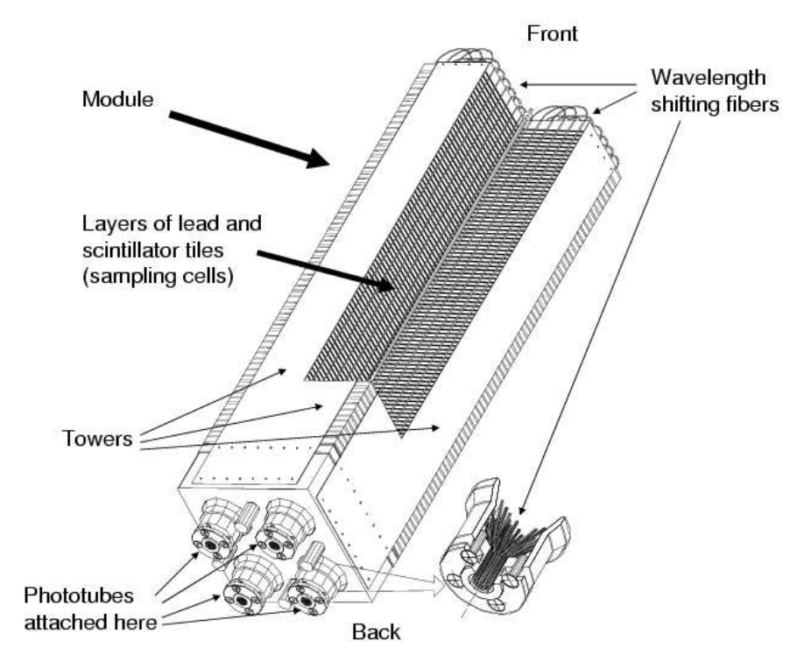
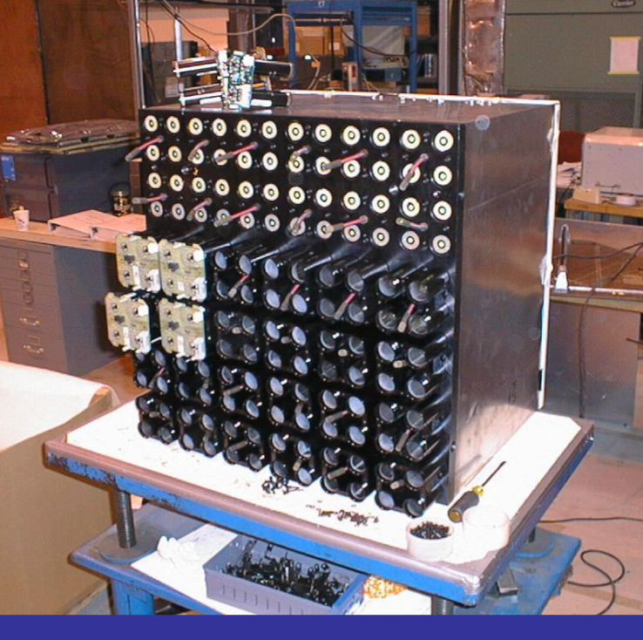
Details of PHENIX EMCal
(we will get 2 sectors)
2m
Shashlik-type Pb scintilator
1 tower is 5.52*5.52*33 cm³
4 towers make a module
Total # of readout channels if
gang 4-”PMTs”:
36 x 3 x 6 = 648 (2592)
6x6 modules make a super module
3x6 supermodules make a sector
1 sector covers 2x4 m², weights about 22t(std)
4m

Slide 13
Proposed EMCal Work and Possible Timeline
2018: ship EMCal to Fermilab for initial testing and evaluation
2019-2020: refurbishment and readout integration
Summer 2021: installation in SeaQuest
Data taking: 2021+
Bring in new HEP collaborators to work on EMCal upgrade and also other detector upgrade activities
Immediate goal:
Ship the detector from BNL to Fermilab in summer 2018, ready for refurbishment and testing
Identify onsite space at Fermilab with crane support and basic utilities for the EMCal test work
Ultimate goal:
Have the full detector ready for installation by the end of E1039
Install the detector during the summer shutdown in 2021, after the E1039 completion; commissioning in later part of 2021
Ready for dedicated HEP DP physics run early 2022

Slide 14
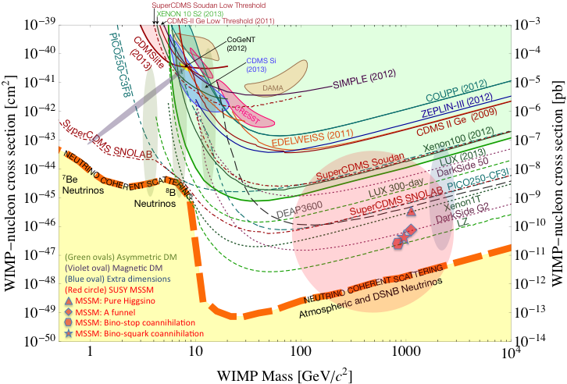

Dark Photon/Higgs Search at Beam Dump Experiments @Fermilab
SeaQuest/E1067 search for low mass dark particles:
- mass =1 MeV – 10GeV
- WIMP search – mass > 10GeV,
- Needs low mass coverage, mass < 10GeV

Slide 15
CIPANP18 – Update on Physics
arXiv:1804.00661
A possible way to access larger
coupling, by using shorter “FMag”,
drill a longer hole inside the FMAG –
background could increase
17 MeV dark photon candidate
NA64, arXiv:1803.07748
Possible at SeaQuest
17MeV

Slide 16
17MeV
17MeV

