Slide 1
Proposal for a Dedicated Dark Sector Physics at SeaQuest 06/20/2018

Slide 2
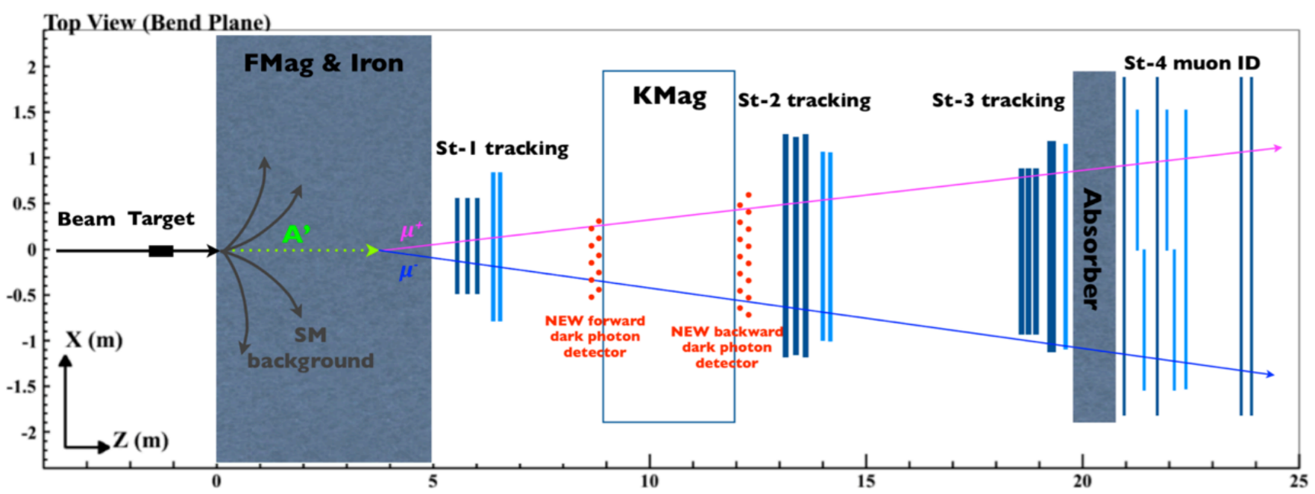
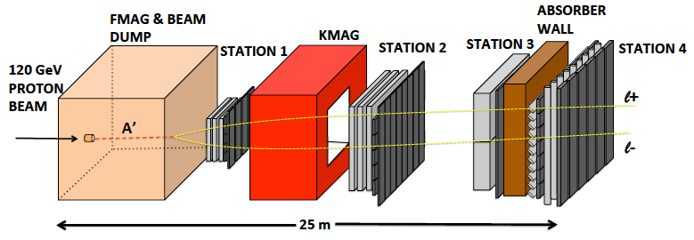
Proposal for a Dedicated Dark Sector Physics Program at SeaQuest
PAC endorsement highly desired!
2019-2021: Parasitic Dark Sector physics program with E1039
Attract and build up HEP groups in SeaQuest
Operate spectrometer and DAQ
Carry out DP physics program with dimuons: dark photon, dark Higgs etc.
EMCal refurbishment and preparation for integration at Fermilab
Transition into HEP DP program after E1039
Seek HEP and other external fund
Parasitic data taking with E1039 for DP search and further explore parameter space “money plots”
Develop online/offline analysis, study DAQ and triggers capability for future DP experiment
Background study, test small prototype in SeaQuest, w/ minimal impact on E1039
Develop SeaQuest detector expertise for the future HEP DP experiment operation and data analysis
E1039 2-year data taking: Summer 2019 – summer 2021
2022-2024: first dedicated dark sector physics run
Install EMCal for electron and hadrons ID, explore DP physics below dimuon mass limit
Further develop dark sector physics program
Possible NP parasitic physics program under discussion
POT = a few 10¹⁸
2024-2025: major detector upgrade during the long shutdown
Add di-photon capability with preshower detectors
Add tracking station-0 near target, more shielding
PID with TOF/MRPC
2026-2030+: high luminosity dark sector physics
Full physics program with upgrade detectors, POT =10¹⁹~10²⁰
Carry out an extensive (SHiP-like) HEP experimental program at NM4
SeaQuest in 2017 with displaced dark photon trigger
SeaQuest in 2021 with EMCal upgrade

Slide 3
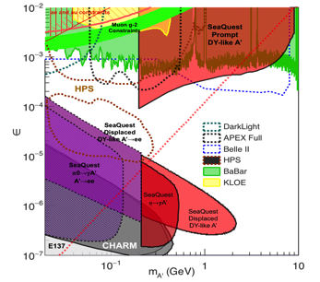
Money Plots – needs update
Phase space will be already covered by other experiments:
2019 ~2021 – dimuon channel (POT = 10^18)
2022-2024 – add di-electron (POT = 10^18)
2026 – 2030+ --- all (POT > 10^19)
17MeV

Slide 4
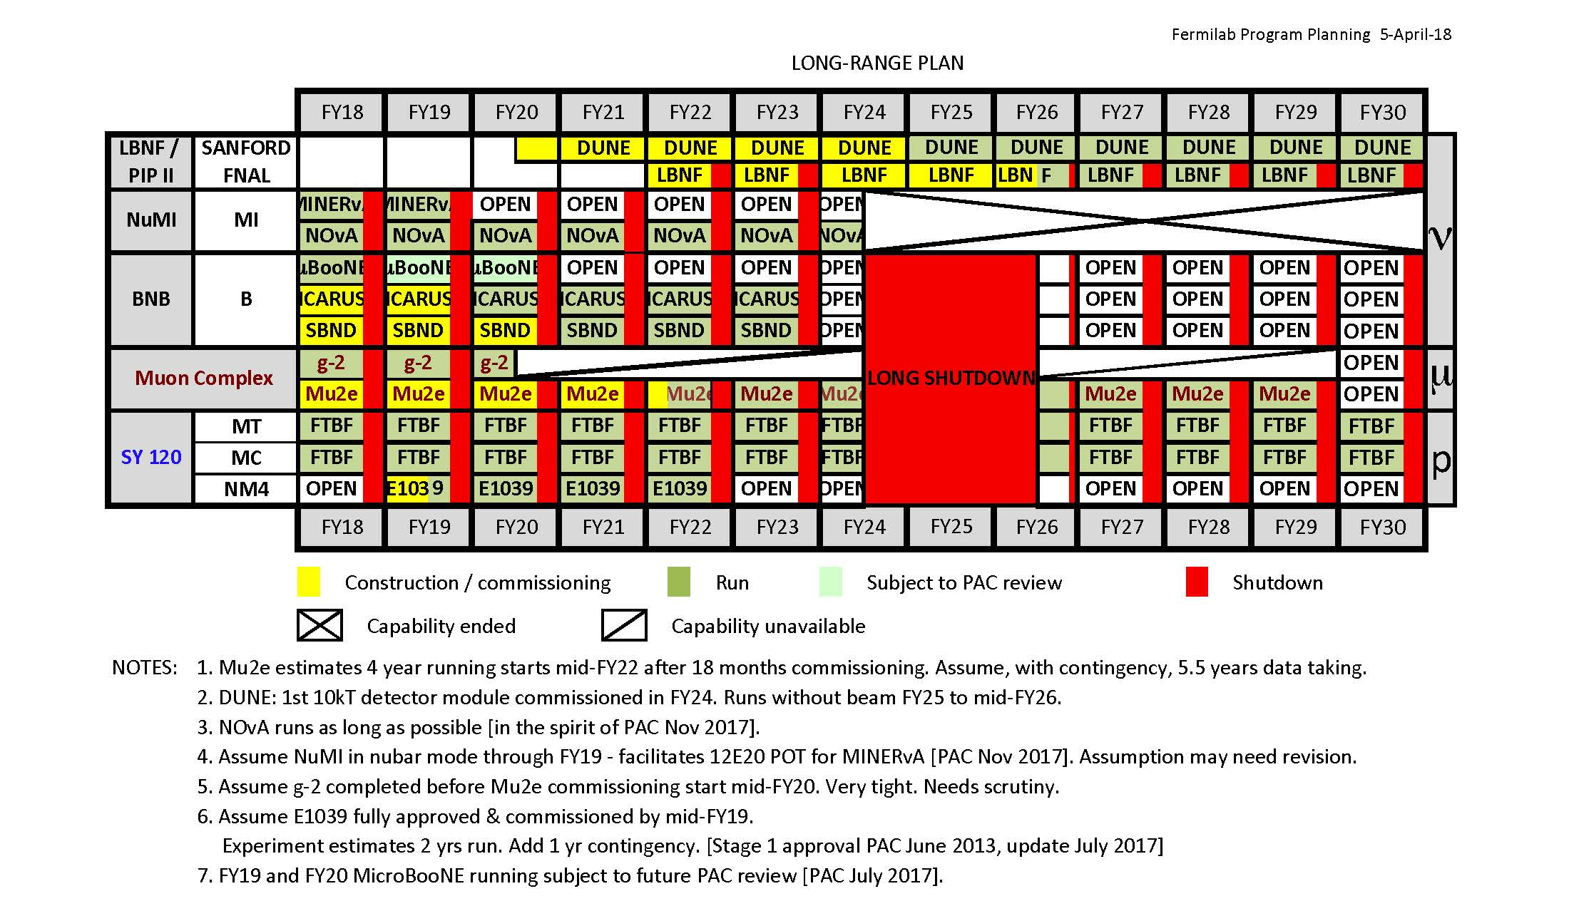
Fermilab Long Range Plan

Slide 5
backup

Slide 6
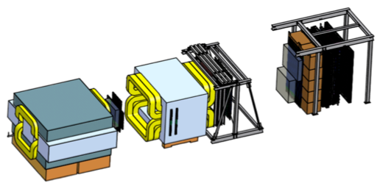
SeaQuest at the Intensity Frontier at Fermilab
High intensity proton beam: “beam dump mode” @SeaQuest/E1067
35,000 fb⁻¹ (in a 2-year parasitic run, 1.4x10¹⁸ POT @5% beam)
LHC-II: 300 fb⁻¹ (~2025), achieved 25fb⁻¹ in Run-I
B-factory@KEK: 50K fb⁻¹ (~2023)
Absorber wall and proportional
tube based Muon ID
Spectrometer magnet
Δpt = 0.4 GeV
Focusing magnet
and solid iron dump
Δpt = 2.9 GeV
Beam
120 GeV proton from Main Injector
19ns RF, 4s spill, 0.5×10¹³ protons per spill
25 m
LDRD/ER: 2016-2018
Trigger upgrade, parasitic runs
Target system
Liquid H and D
Solid C, Fe, W
- Beam dump mode: p+Fe collisions! Target ~ 10%λ_{I}
- Parasitic run with other fixed target experiments, E906/E1039

Slide 7
Displaced Dark Photon Trigger Detectors Work Well!
Physics analysis in progress
<eff> ~>95%

Slide 8
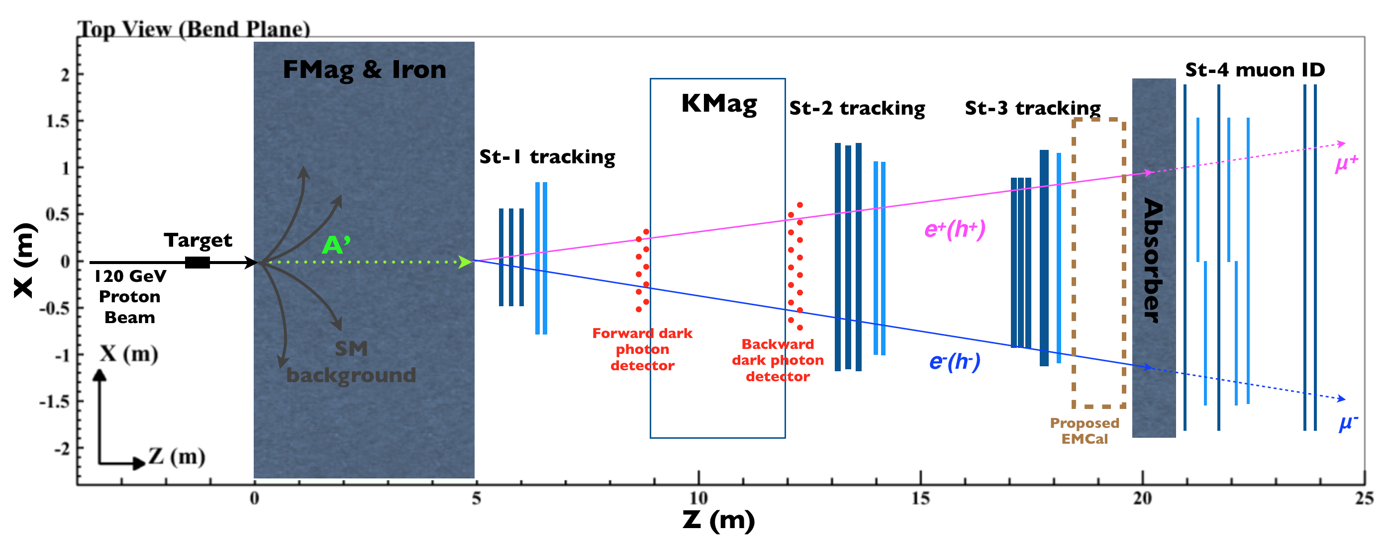
EMCal Upgrade Proposal

Slide 9
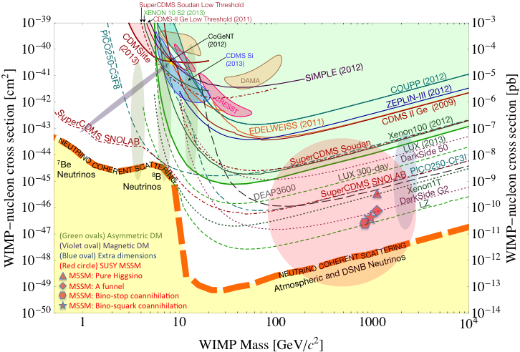
Dark Photon/Higgs Search at Beam Dump Experiments @Fermilab
E1067/SeaQuest search for low mass dark particles:
- mass =1 MeV – 10GeV
- WIMP search – mass > 10GeV,
- Needs low mass coverage, mass < 10GeV

Slide 10
CIPANP18 – Update on Physics
Gori et al, arXiv:1804.00661
A possible way to access larger
coupling, by using shorter “FMag”,
drill a longer hole inside the FMAG –
background could increase
17 MeV dark photon candidate
NA64, arXiv:1803.07748
17MeV

Slide 11
17MeV
17MeV

Slide 12
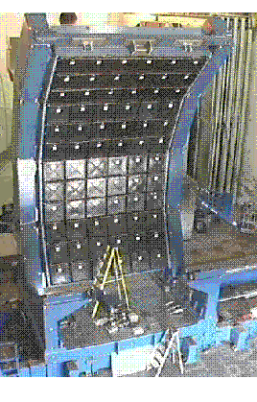
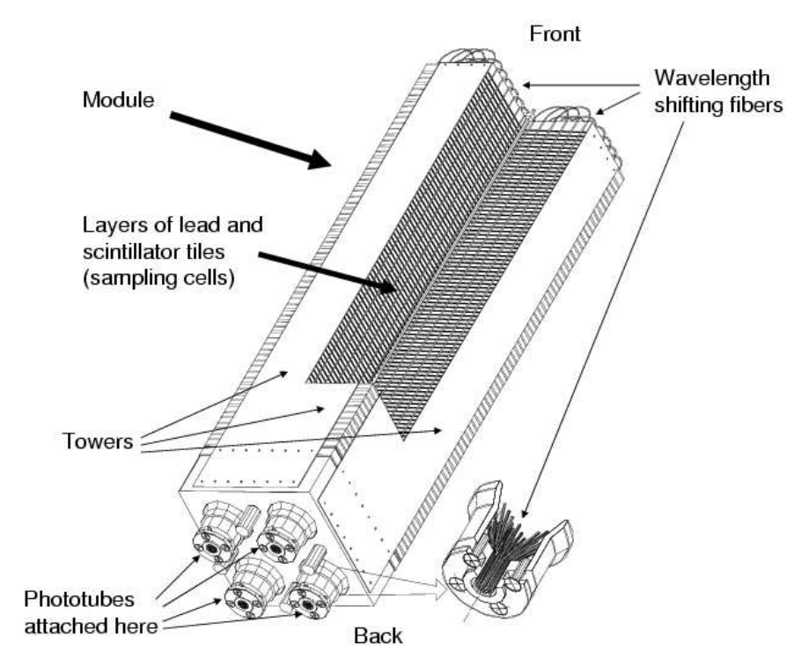
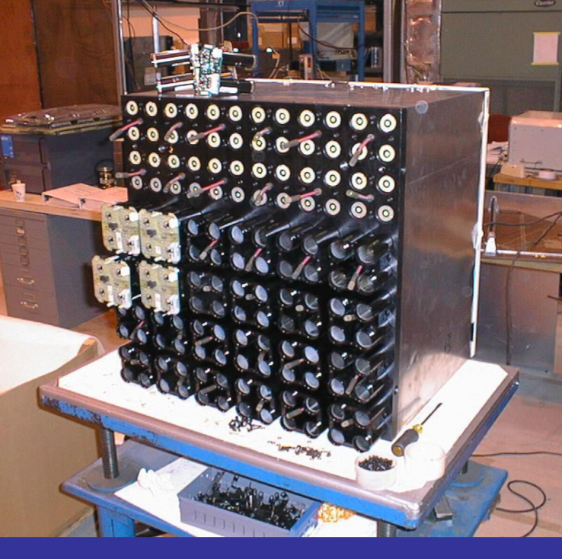
Details of PHENIX EMCal
Weight = (5.5x5.5x33)x11g/cm^3x4(per module)x36(per super-module)x18(per sector)
= 28,500 kg/sector, if 100% Pb; reality < 20,000kg.
2m
Shashlik-type Pb scintilator
1 tower is 5.52*5.52*33 cm³
4 towers make a module
Total # of readout channels if
Gang 4-”PMTa” with one SIPM:
One sector = 36 x 3 x 6 = 648 (2592)
6*6 modules make a super module
3*6 supermodules make a sector
1 sector is about 2*4 m², weights about 22t(std)
4m

Slide 13
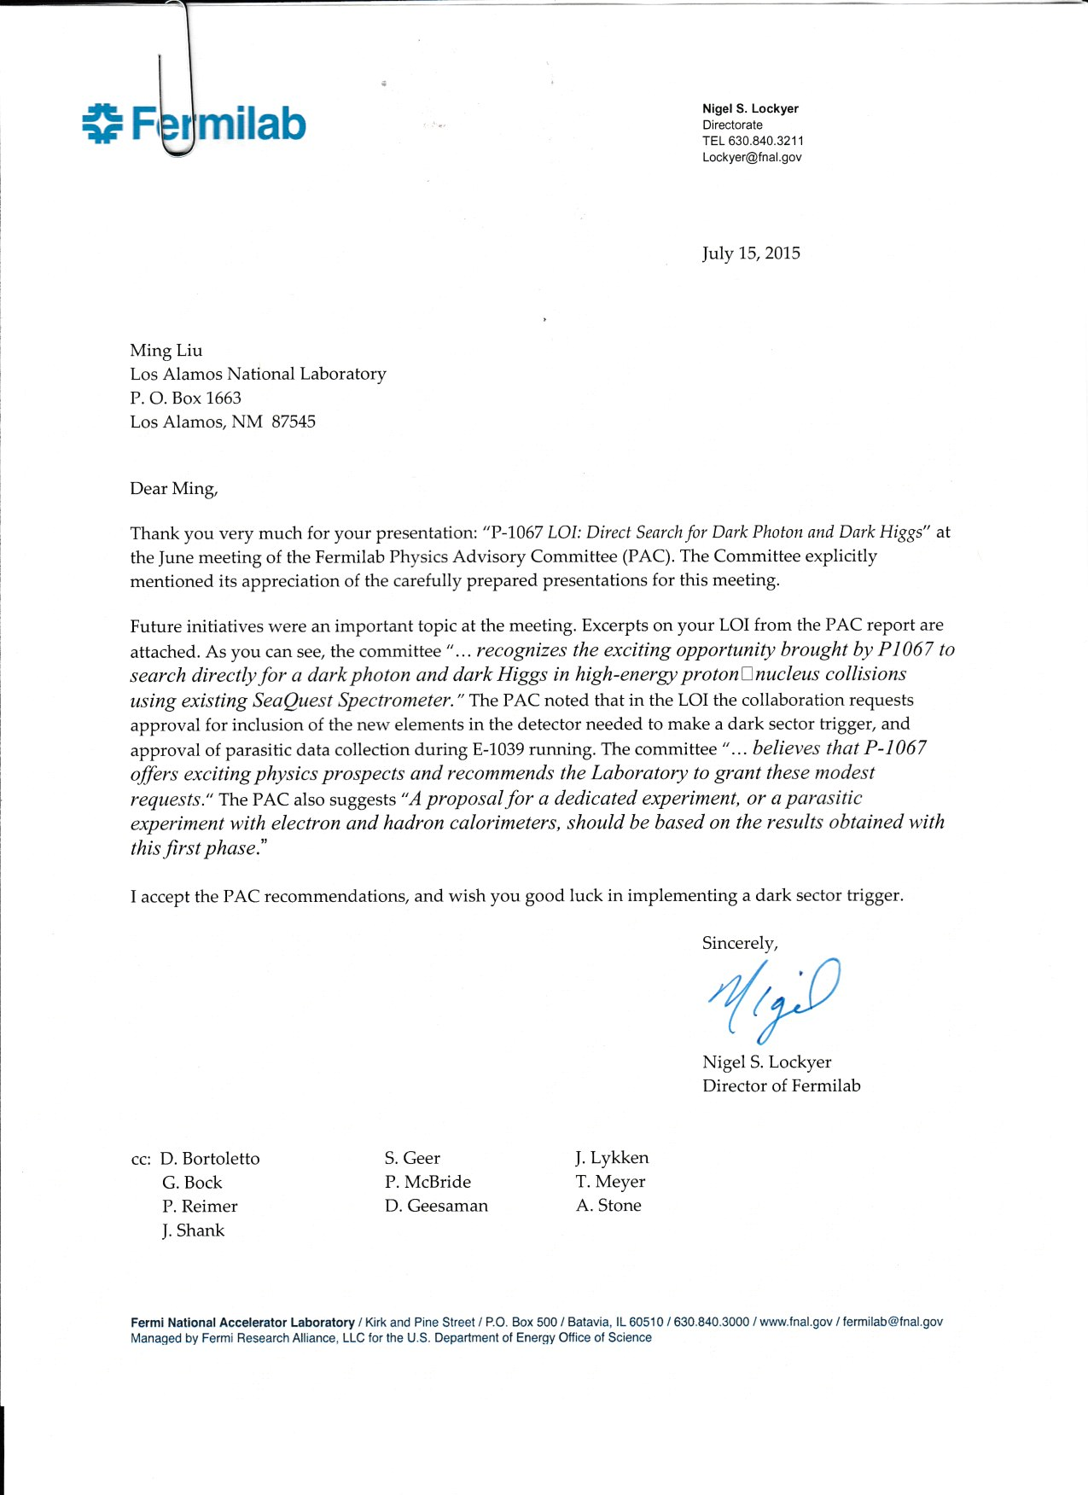
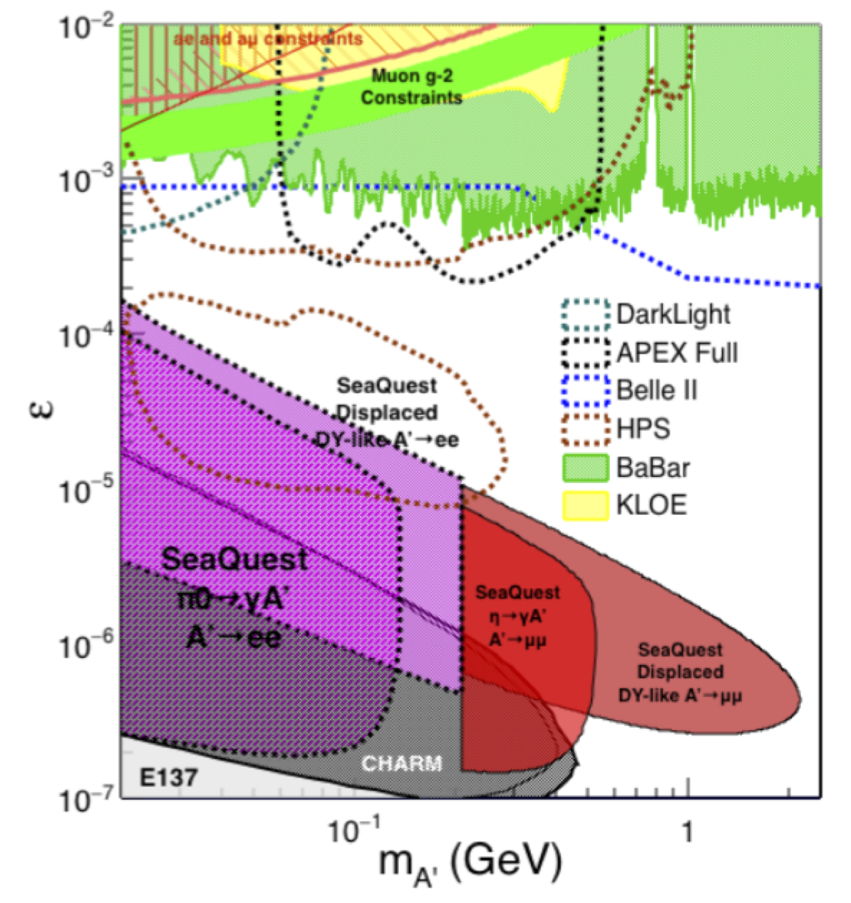
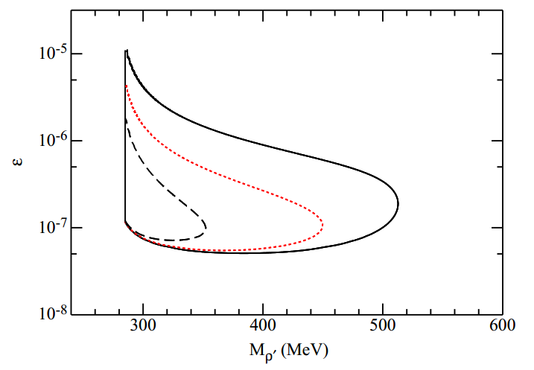
Physics goals and recent work
LOI of dark matter search in dimuon channel was presented to PAC in June 2015. Obtained very positive feedbacks.
A phase-II of EMCal and possibly HCal was also mentioned. PAC suggested we submit the new proposal based on the results obtained from this first phase
The detector proposed in the first phase was successfully installed and accumulated one week worth of data before E906 shuts down
We will continue to take the dimuon data parasitically with E1039

Slide 14
Ongoing and potential collaboration/support
Ongoing support from LANL LDRD: $300k for FY-18
Submitted joint proposal with KEK/RIKEN/TokyoTech: $270k for FY-18 if supported
Collaboration with PHENIX/sPHENIX EMCal group and STAR forward upgrade groups on detector support
New DOE/NSF HEP proposals

Slide 15
Proposed EMCal Work and Timeline
Ultimate goal:
Have the full detector ready for installation by the end of E1039
Install the detector the summer shutdown in 2021, after the E1039 completion; commissioning in later part of 2021
Ready for dedicated HEP DP physics run early 2022
2018: ship EMCal to Fermilab and test
2019-2020: refurbishment and readout integration
Summer 2021: installation in SeaQuest
Immediate goal:
Ship the detector from BNL to Fermilab in summer 2018, ready for refurbishment and testing
Find some onsite space at Fermilab with crane support and basic utilities for the EMCal test work

