Slide 1
A Telescope with EMCal Modules:3/5/2020
Goals – to trigger and measure the energy of
High energy electrons:
- (Trig-1 & large dE)
High energy photons:
-(NOT Trig-1) & Trig-2 & large dE
trigger/or hit rates
Energy spectra
4 x 4 = 16 SiPM readout channels
2 x 11 cm
2x2 SiPM
readout
2x2 SiPM
Trig-1
Trig-2
EMCal: dE
2x2 SiPM
2x2 SiPM
4 EMCal modules;
16 SiPM channels
beam
2 x 11 cm
1cm Pb

Slide 2
Readout with CAEN DT5702
Event Trigger for
High energy electrons
High energy photons
Trig-1 OR Trig-2
C0&C1
C2&C3
C4 … C19 [16]
Trig-1
Trig-2
EMCal: dE
EMCal Energy:
Sum of C4 + … C19
4 EMCal modules;
16 SiPM channels
beam
1cm Pb

Slide 3
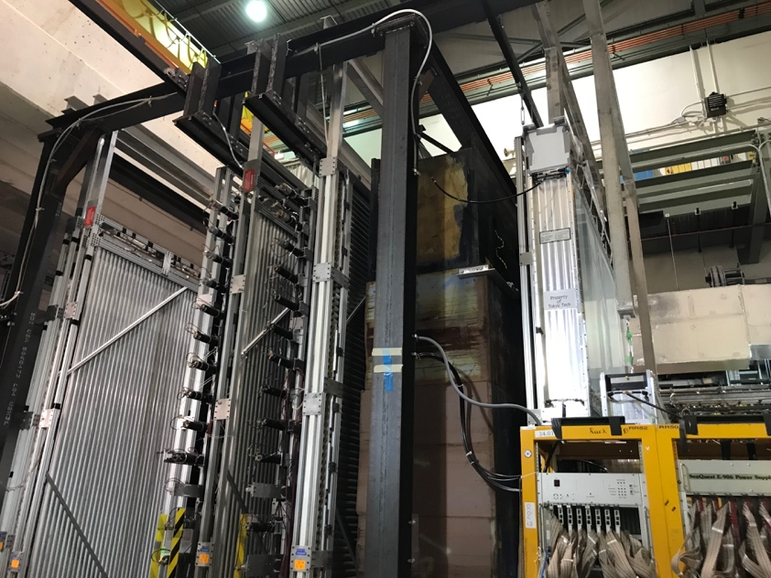
DarkQuest Layout, 02/18/2020
e^{+/-}, gamma
Iron absorber
~10m(?)
tracker
2nd EMCal
DarkQuest : FY23 – 25+, one EMCal behind ST-3 tracker
LongQuest: FY25+, add 2nd EMCal + one Tracker behind the St-4 Muon ID

Slide 4
Fermilab Beam Schedule Update: 2/18/2020
DarkQuest
LongQuest

Slide 5
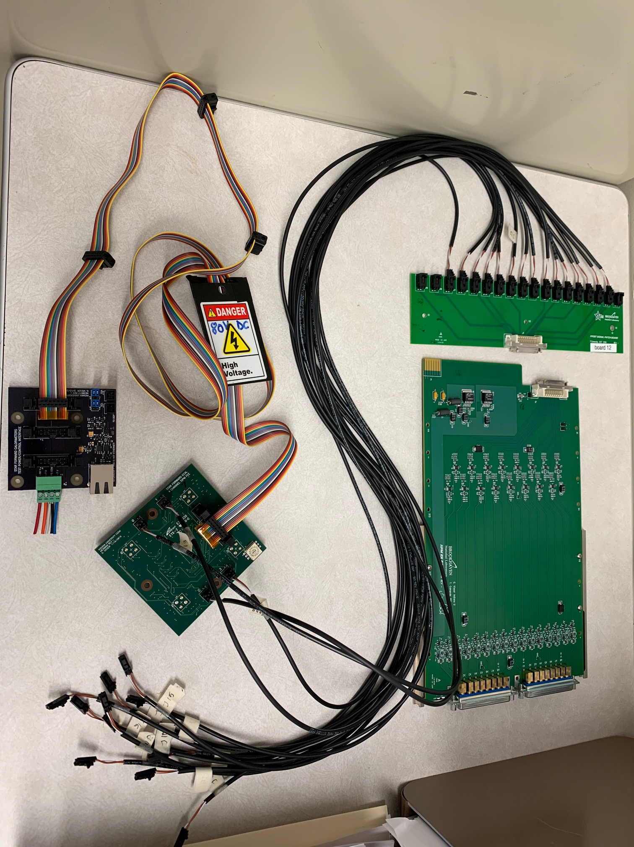
STAR Forward EMCal Readout Electronics from Fermilab Test Beam in 2019
Electronics boards available at LANL:
Power board:
Inputs: +80V, +/-7V
How to control the bias HV for each SiPM?
Control software?
LinkUSB (NOT Ethernet)?
2. SiPM 4-chan FEE board
Inputs: power and bais
Output: SiPM analogy signal?
Gain=?
SiPM model #?
3.SiPM signal patch panel
4. SiPM RX board
interface to STAR DAQ?
For SpinQuest background study:
Just readout from board SiPM FEE “2”
4-chan per module
4 modules, total 16 channels
@LANL Lab
4
3
2
1

Slide 6
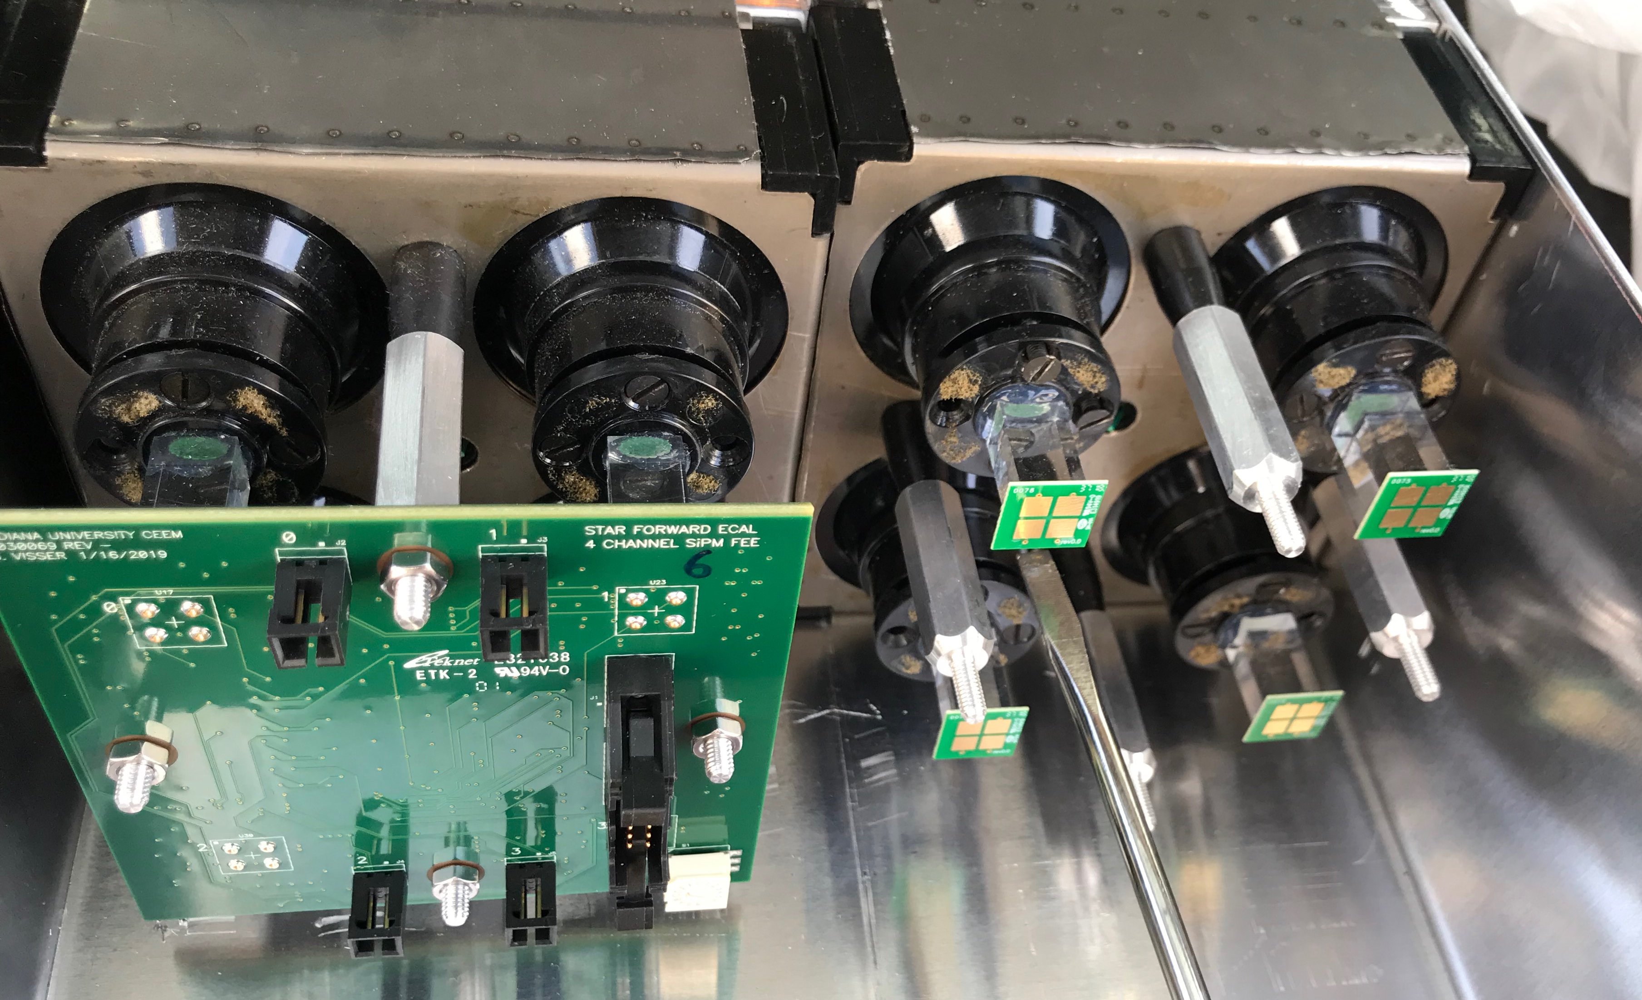
4 EMCal Modules at Fermilab: SiPM Readout
1 or 2 SiPM s
Per channel ?

Slide 7
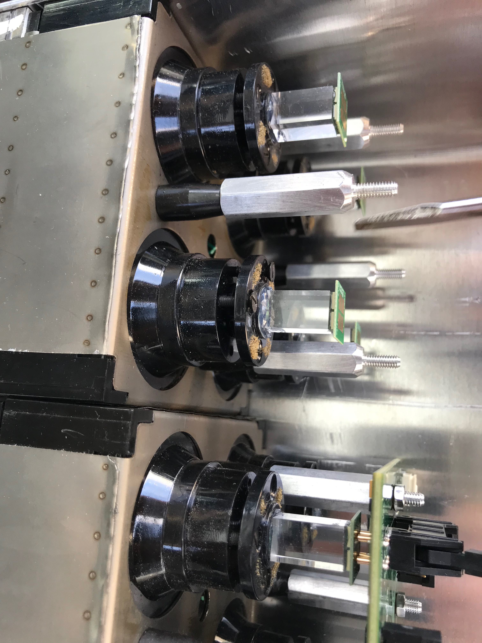
EMCal Module at Fermilab

Slide 8
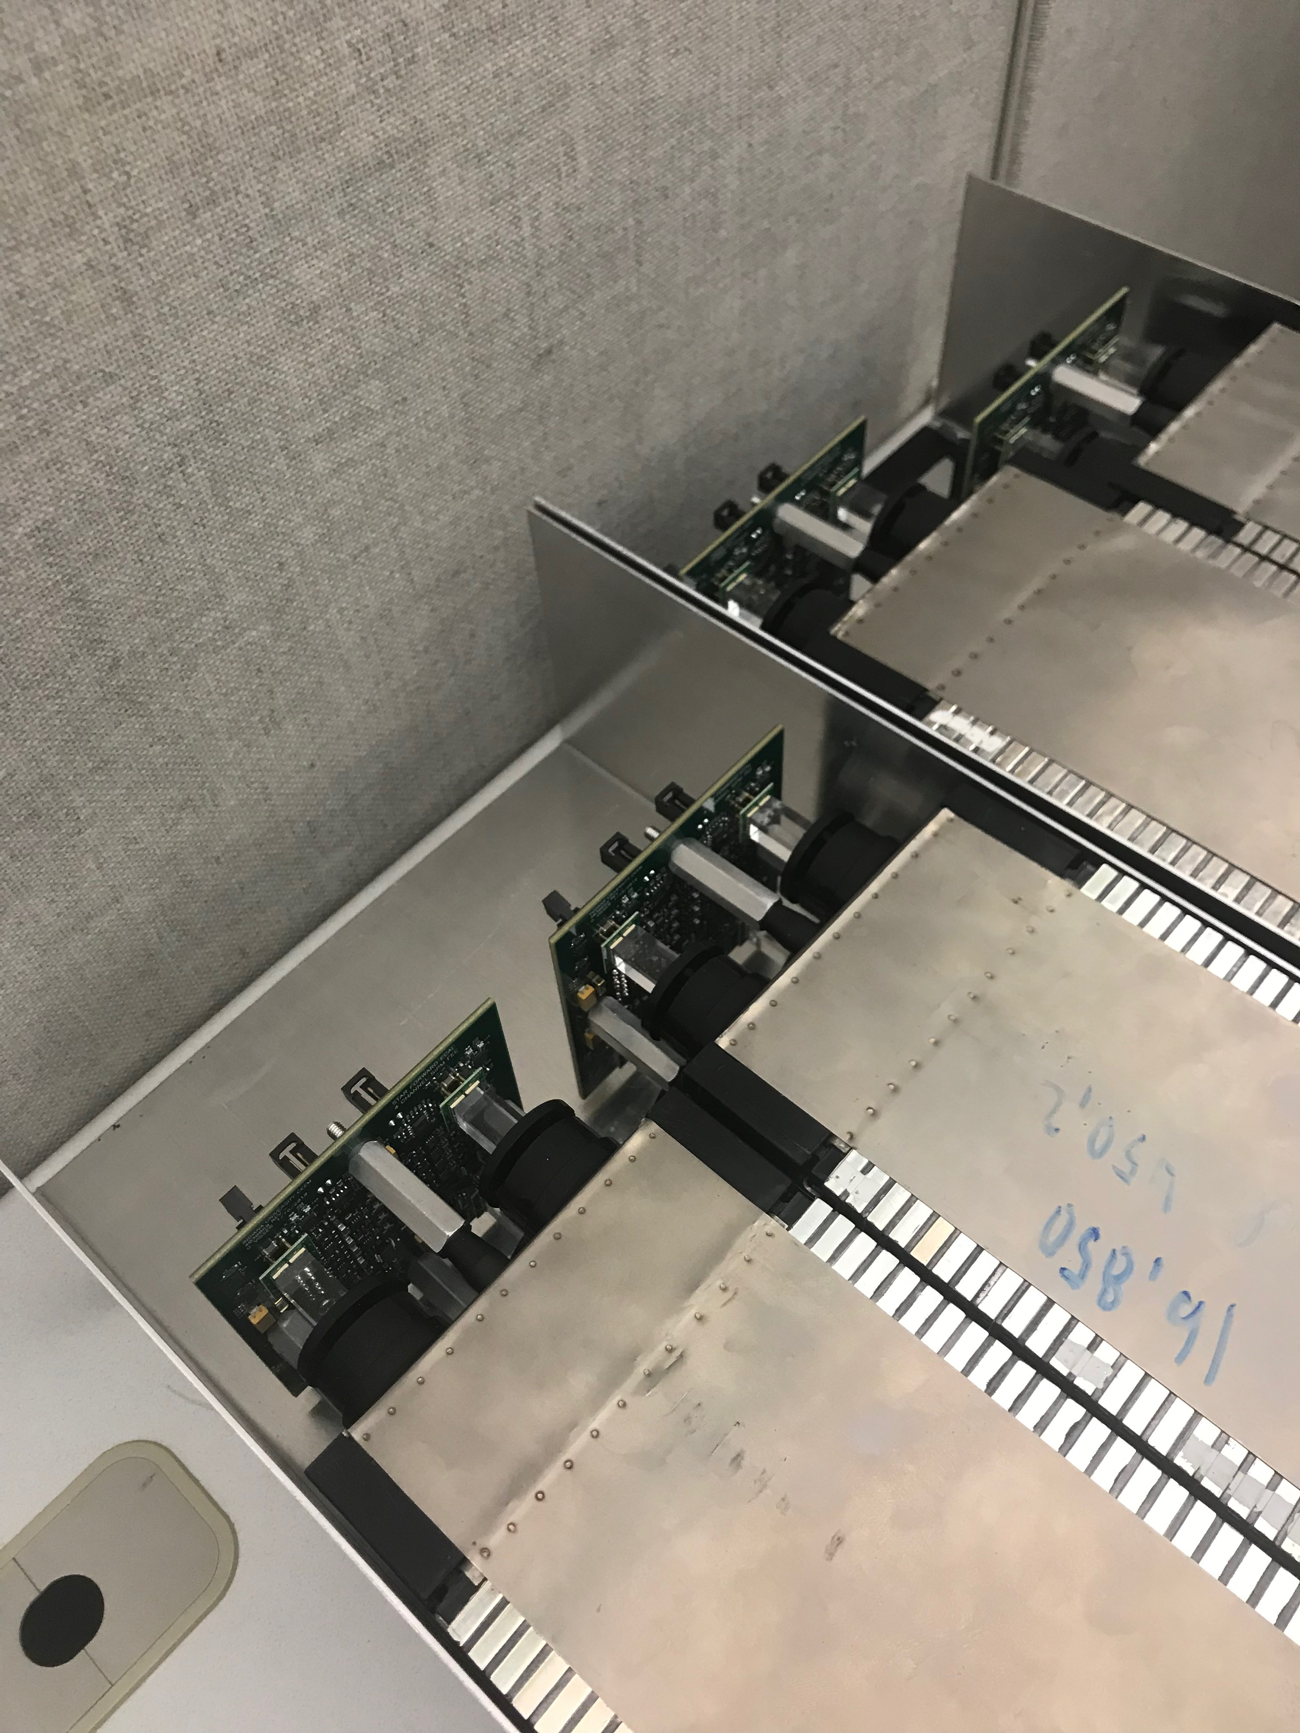
4 PHENIX EMCal Modules at Fermilab

