Slide 1
Prospects of the SeaQuest Dark Sector Physics Search at the Fermilab Intensity Frontier
Ming Liu, Sho Uemura, Kun Liu (LANL),
Paul Reimer (ANL), Stefania Gori (Th., UCSC)
4/17/2019
Fermilab Precision Science WG - 2nd Planning Meeting for June 14 2019 Retreat https://indico.fnal.gov/event/20512/

Slide 2
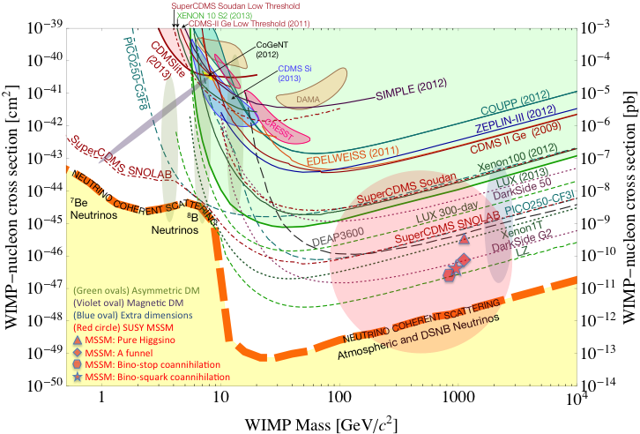
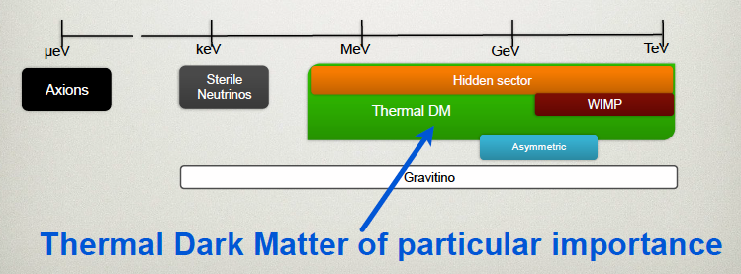
Dark Sector Physics @SeaQuest
Current and near future high-intensity colliders and fixed target experiments offer an ideal environment to probe dark sector physics in MeV ~ GeV
Schuster et al
(2017)

Slide 3

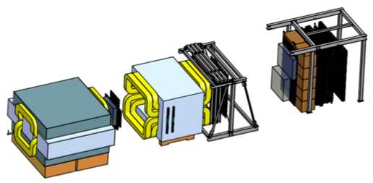
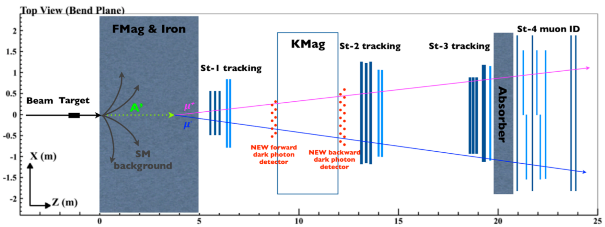
SeaQuest Spectrometer at Fermilab
High intensity proton beam: “beam dump mode” @SeaQuest/E1067
35,000 fb⁻¹ (in a 2-year parasitic run, 1.4x10¹⁸ POT @5% beam)
LHC-II: 300 fb⁻¹ (~2025), achieved 25fb⁻¹ in Run-I
B-factory@KEK: 50K fb⁻¹ (~2023)
Absorber wall and proportional
tube based Muon ID
Spectrometer magnet
Δpt = 0.4 GeV
Focusing magnet
and solid iron dump
Δpt = 2.9 GeV
Beam
120 GeV proton from Main Injector
19ns RF, 4s spill, 0.5×10¹³ protons per spill
25 m
Displaced DP Trigger upgrade completed in 2017;
Allow parasitic runs with E-1039 in 2019-2021
Target system
Liquid H and D
Solid C, Fe, W
E-1039: 2019-2021+
Polarized NH3 Target
- Beam dump mode: p+Fe collisions! Target ~ 10%λ_{I}
- Parasitic run with other fixed target experiments, E906/E1039

Slide 4
Status of SeaQuest Experiments
E906 fixed target experiment: 2012 – 2017
  H, D, C, Fe, W targets
  High mass Drell-Yan, mass > 4GeV
E1039 polarized proton (NH3) fixed target experiment: 2018 - 2021
  Approved by DOE HP/HEP and Fermilab, May 2018
  Install polarized NH3 target by summer 2019
  Polarized target commissioning run: ~ June 2019
  Physics data taking for two years: ~10/2019 - 7/2021+ (or longer)
  POT: 1.4 x 10^18
Parasitic E1067 Dark Photon program approved in 2015
  Parasitic run to search for dark photon/Higgs/ALP etc.
    E906, E1039, dimuon channel
    Displaced dimuon dark photon trigger upgrade completed in 2017
  Propose dedicated dark sector physics beyond E1039, 2022+ ~
    Additional detector upgrade possible → muons, electrons, photons, hadrons
E906
dimuons

Slide 5
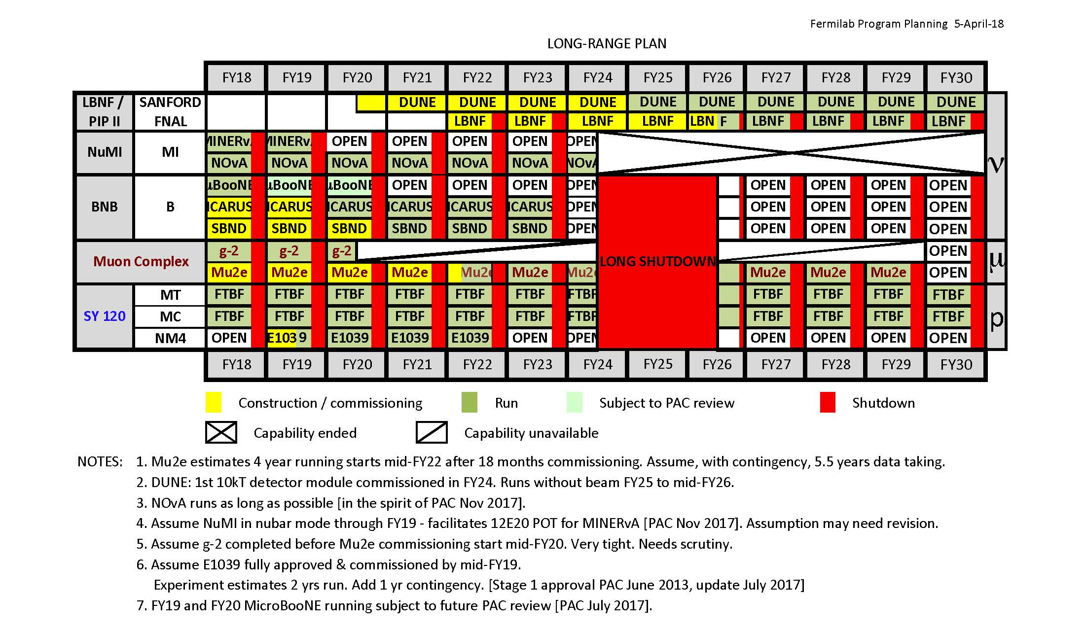
Fermilab Long Range Plan: 04/2018
Dark sector
physics program:
Run-I, II
Run-I
2019-2021+
Run-II:
2022 - 2030

Slide 6
Dark Sector Physics – Dark Photon as an Example
Mass range:
~1MeV - 10GeV

Slide 7
Dark Photon Detection @SeaQuest

Slide 8
Displaced Dark Photon Trigger Detectors Commissioned
-Detector and trigger system installed and commissioned during the last SeaQuest/E906 run in 2017
Physics analysis in progress
Bad channels all fixed in 2018
From E906 2017 run
<det_eff> ~>95%
Schematic of displaced dimuon trigger

Slide 9
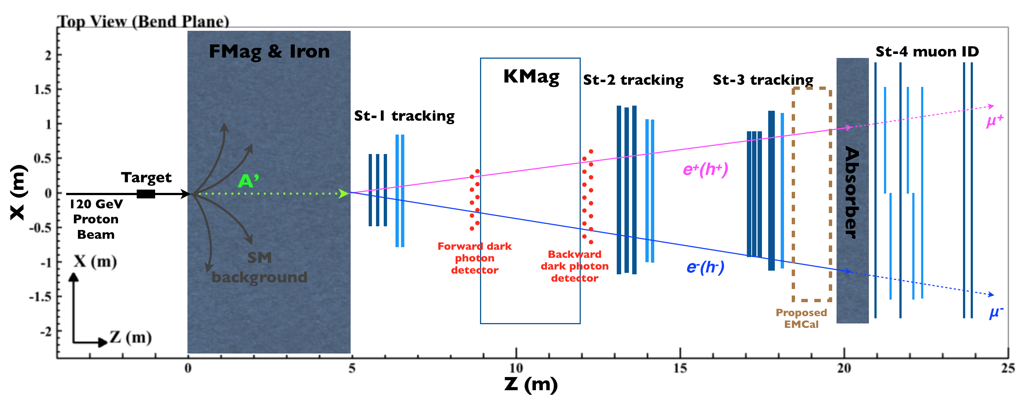
Near Term Upgrade Plan - EMCal Upgrade in 2021
An EMCal detector recycled
from PHENIX at RHIC: 2m x 4 m
- Signal mostly from beam dump;
- Other parasitic targets operation possible

Slide 10
EMCal Upgrade Status
4 x 4 EMCal modules being tested @FTBF
this week (STAR forward upgrade R&D)
- available for SeaQest

Slide 11
EMCal Upgrade Plans

Slide 12
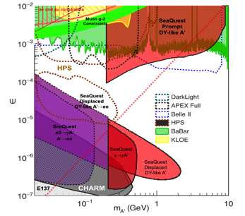
Money Plots (I)
- to include all other experimental searches up to year ~2025+
Phase space covered by SeaQuest:
2019 ~2021 – dimuon channel (POT = 10^18)
2022-2024 – add di-electron (POT = 10^18)
2026 – 2030+ --- all channels (POT > 10^19)
SeaQuest dark photon coverage:
Dimuons (current capability)
Di-electrons (w/ EMCal upgrade)
Detailed SeaQuest coverage in various production channels with
di-electrons and di-photons
17MeV
arXiv:1804.00661, Berlin, Gori, Schuster and Toro;
1801.05805, Berlin, Blinov, Gori, Schuster and Toro

Slide 13
Money Plots (II) - with all Future Projections

Slide 14
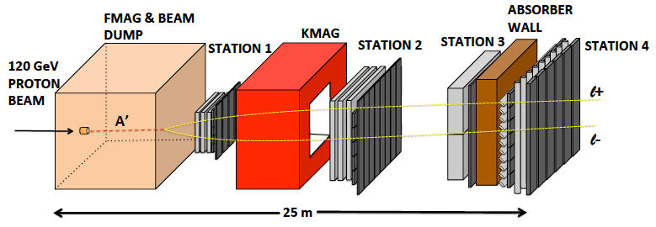
Long Term Prospects of Dark Sector Physics Program at SeaQuest
2019-2021: Parasitic Dark Sector physics program with E1039
  Attract and build up HEP groups in SeaQuest
    Carry out DP physics program with dimuons: dark photon, dark Higgs etc.
    EMCal refurbishment and preparation for integration at Fermilab, 2018-2021
  New HEP members develop SeaQuest detector expertise for the future experiment operation and data analysis
    Also help E1039 operation and maintenance of spectrometer and DAQ
  Transition into HEP DP program after E1039
    Develop new proposals, seek HEP DOE/NSF and other external fund
    Parasitic data taking with E1039 for DP search, further explore new opportunities
    Develop online/offline analysis, study DAQ and triggers capability for future DP experiment
    Background study, test small prototype in SeaQuest, w/ minimal impact on E1039
  E1039 2-year data taking: summer 2019 – summer 2021
2022-2024: first dedicated dark sector physics run @NM4
  Install EMCal for electron and hadrons ID, explore new phase space below dimuon mass (200MeV)
  Further develop dark sector physics program
  Possible NP parasitic physics program under discussion
  POT = a few 10¹⁸
2024-2025: major detector upgrade during the long shutdown
  Upgrade tracking chambers
  Add di-photon capability with preshower detectors
  Add tracking station-0 near target, more shielding
  Possible PID with TOF etc
  And more
2026-2030+: high luminosity dark sector physics program
  Full physics program with upgrade detectors, POT =10¹⁹~10²⁰
  Carry out an extensive (SHiP-like) HEP experimental program at NM4
  Possible NP parasitic physics program under discussion (~US EIC physics era)
SeaQuest in 2017 with displaced dark photon trigger
EMCal
SeaQuest in 2021+ with EMCal upgrade

Slide 15
Schedule @SeaQuest
2018 2019 2020 2021
2022 2023 2024 2025
2026 2027 … 2030+
E1039 installation
& commissioning
Planned
Parasitic Dark Sector
Physics with E1039
Proposed
PHENIX EMCal refurbishment,
HEP dark sector physics program development
EMCal installation
& commissioning
Long shutdown,
detector upgrade
High luminosity dark sector physics
program at Fermilab Intensity Frontier
DP search w/ EMCal upgrade
Parasitic Nuclear Physics program possible
Parasitic Nuclear Physics program possible

Slide 16
Summary and Outlook
Phase-I
  Great discovery potential!
  A new vertex trigger & DAQ++
  Early parasitic data taking 2019-2021+
  POT 1.4 x10¹⁸ or more
Phase-II: beyond E1039, 2021+
  Possible detector upgrade later, add electron, photon and hadron capability
  A new dedicated dark matter program at Intensity Frontier!
SeaQuest in 2021+ with EMCal upgrade
Dark Higgs
search
Preparation Phase-I (parasitic runs)
Phase-II
2015
2016
2017
2018
2019
2021+

Slide 17
Supporting Slides

Slide 18

Dark Photon/Higgs Search at Beam Dump Experiments @SeaQuest
SeaQuest search for low mass dark particles:
mass ~ 1 MeV – 10GeV
- WIMP search – mass >~ 10GeV,
- Needs low mass coverage, mass < 10GeV

Slide 19
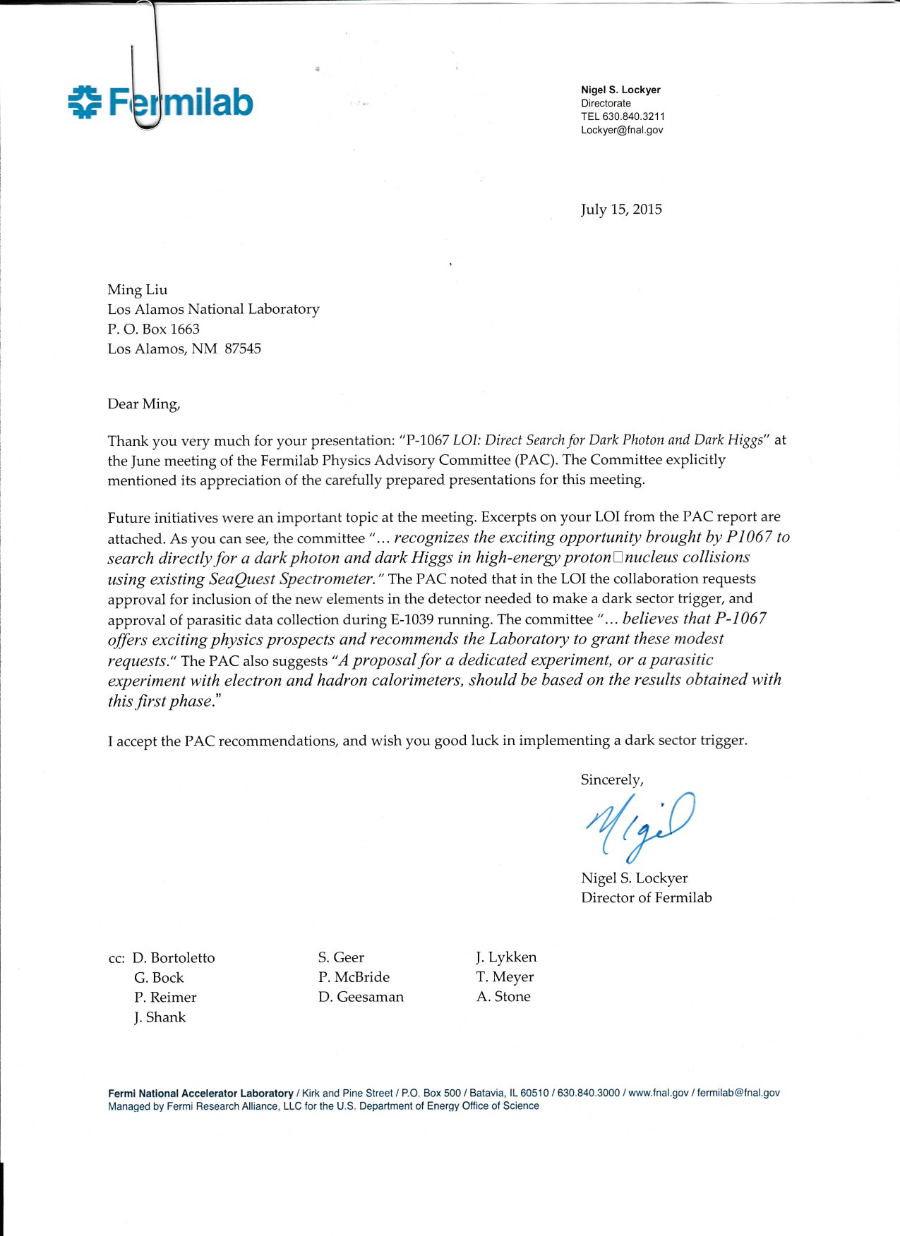
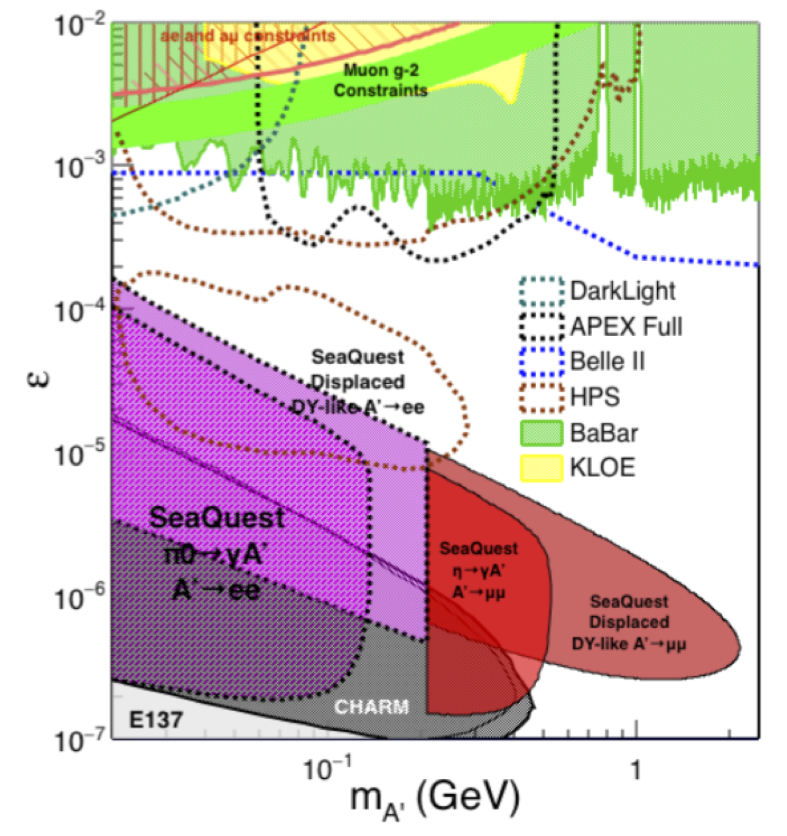
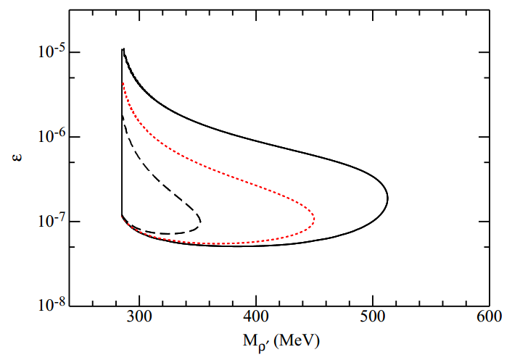
Physics goals and recent accomplishments
LOI of dark matter search in dimuon channel was presented to PAC in June 2015. Obtained very positive feedbacks.
A phase-II of EMCal and possibly HCal upgrade was also mentioned. PAC suggested we submit a new proposal based on the results obtained from the phase-I study
The detector proposed in the phase-I was successfully installed and accumulated one week worth of data before E906 shuts down in July 2017
We will continue to take the dimuon data parasitically with E1039

Slide 20
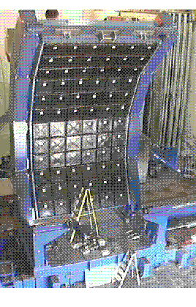
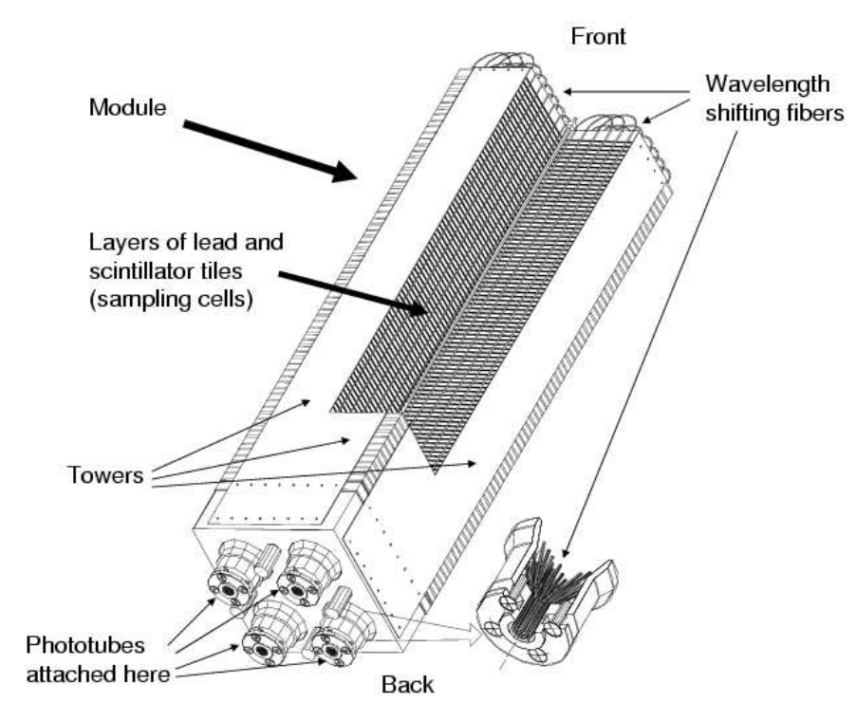
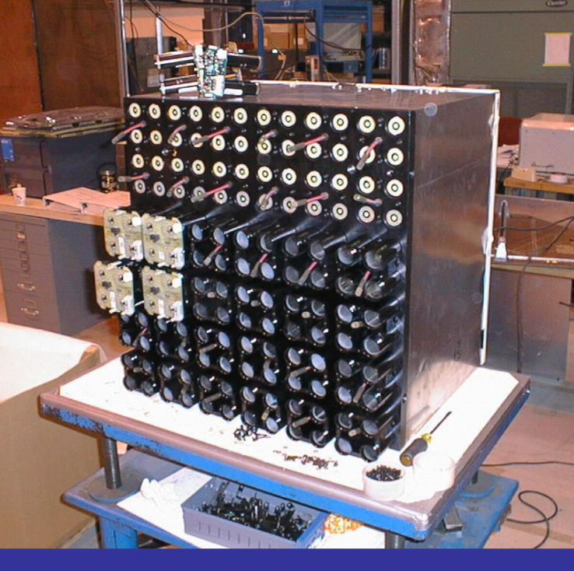
Details of PHENIX EMCal
(we get 2 best sectors)
2m
Shashlik-type Pb scintilator
1 tower is 5.52*5.52*33 cm³
4 towers make a module
Total # of readout channels if
gang 4-”PMTs”:
36 x 3 x 6 = 648 (2592)
6x6 modules make a super module
3x6 supermodules make a sector
1 sector covers 2x4 m², weights about 22t(std)
4m

