Slide 1
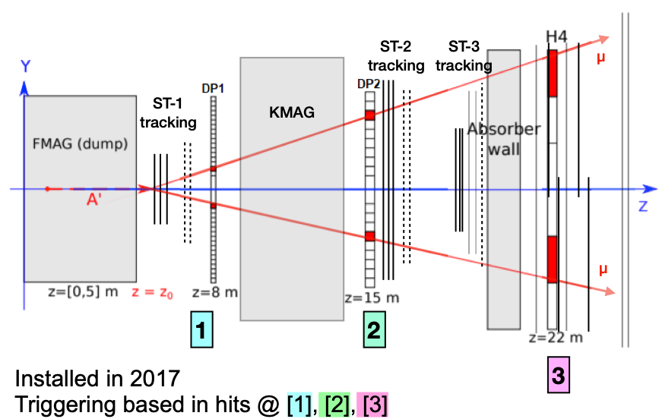
SpinQuest Layout + LongQuest Upgrade
8.7m
5.5m
Ion Absorber
Blocks
Effective Thickness:
5.1m
(200”)
Space for detectors
PHENIX EMCal:
2m(H) x 4m(W)
~1m thick;
Long-lived A’
decay:
A’ -> e⁺ + e⁻
EMCal
f.v.
Z=33-37m
Z=24m
A’ decay fiducial volume:
Z = 33 ~ 37m
To measure di-electrons
(or di-photons)
w/ EMCal + pre-Shower Det.

Slide 2
Put A PHENIX EMCal Detector in the Back Room
Trig-1
Trig-2
Long-lived decay:
A’ -> e⁺ + e⁻
Z = 33 ~37m
EMCal:
- E > 1 GeV
- dE/E = 11%/sqrt(E)
EMCal Detector
beam
Physics + Detector Simulation
Needed for acceptance study
1cm Pb
Trigger & PreShower detectors
Provide hit position information (x,y,z), dx=dy ~1cm

Slide 3
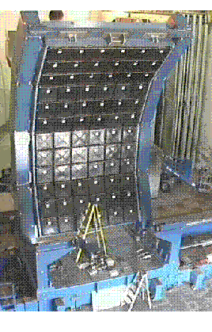
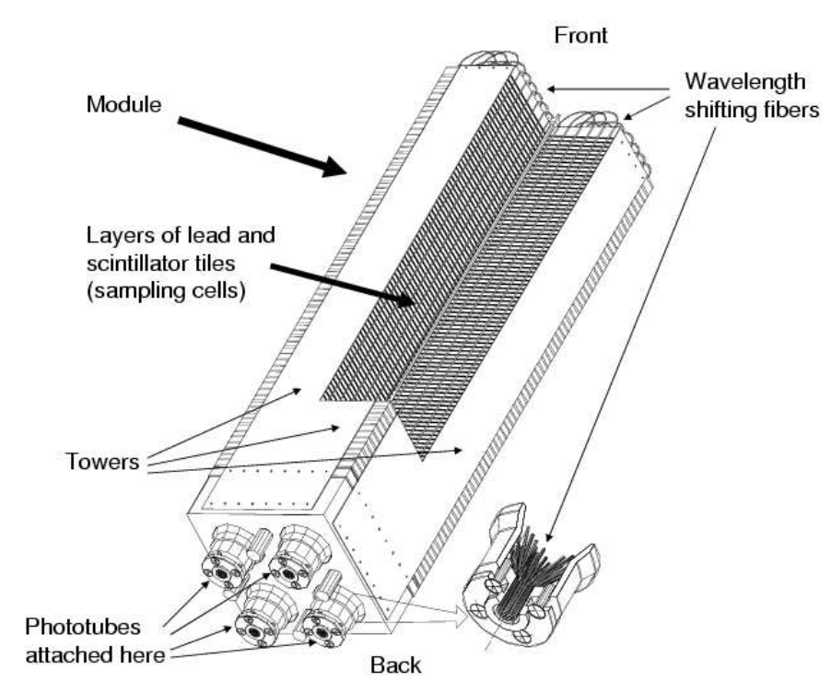
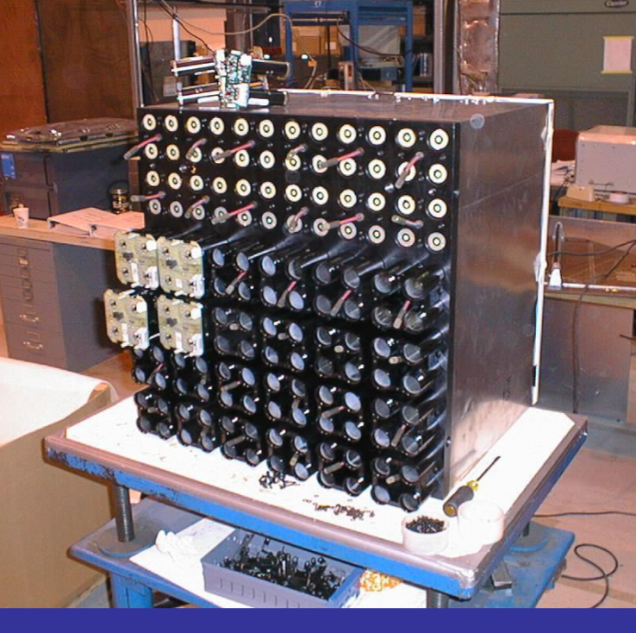
Details of PHENIX EMCal (we will get 2 sectors)
2m
Shashlik-type Pb scintilator
1 tower is 5.52*5.52*33 cm³
4 towers make a module
Total # of readout channels if
gang 4-”PMTs”:
36 x 3 x 6 = 648 (2592)
6x6 modules make a super module
3x6 supermodules make a sector
1 sector covers 2x4 m², weights about 22t(std)
4m

Slide 4
Details of the Back Room for LongQuest
Space available in the back room
LongQuest
218” (554 cm)
41” (104 cm)
41”
(104 cm)
20”
Gap
118”
(300 cm)
64” (163 cm)
51”
Trig-2
Trig-1
Last Station-4 PropTube MuID
60”
Depleted Uranium, 16 plates
25 meter down stream from the target
4 EMCal modules;
16 SiPM channels
beam
Hole
EMCal: dE
1 cm Pb: (e/photon shower
detection/tracking)
75”
EMCal + Pre-Shower Detectors
Overhead Loading Dock
Crane Access
Battleship Steel
22”
12”
Optimal design pending
Supporting Frames Available for new detectors
12”
DarkQuest Biweekly

Slide 5
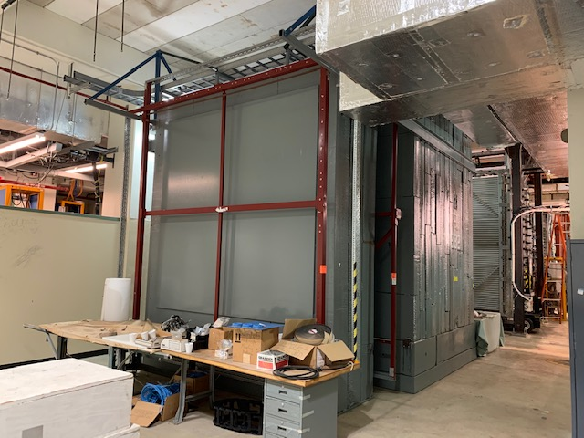
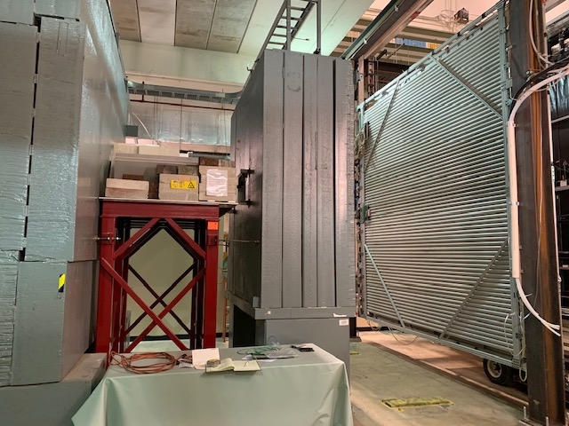
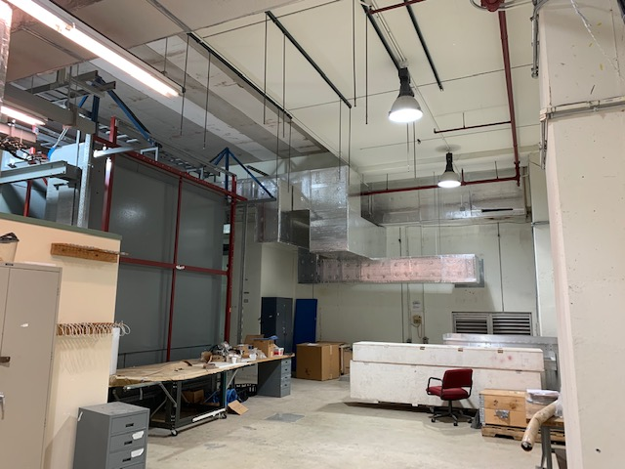
LongQuest
beam
ST4-MuID
Last detector
E1039
ST4-MuID
Last detector
E1039
Room for additional
detectors

Slide 6
A Telescope with EMCal Modules:3/5/2020
Goals – to trigger and measure the energy of
High energy electrons:
- (Trig-1 & large dE)
High energy photons:
-(NOT Trig-1) & Trig-2 & large dE
trigger/or hit rates
Energy spectra
4 x 4 = 16 SiPM readout channels
2x2 SiPM
readout
2x2 SiPM
Tower Size:
5.5 x 5.5 cm^2
(one channel)
2 x 11 cm
Trig-1
Trig-2
2x2 SiPM
2x2 SiPM
EMCal: dE
4 EMCal modules;
16 SiPM channels
beam
2 x 11 cm
1cm Pb

Slide 7
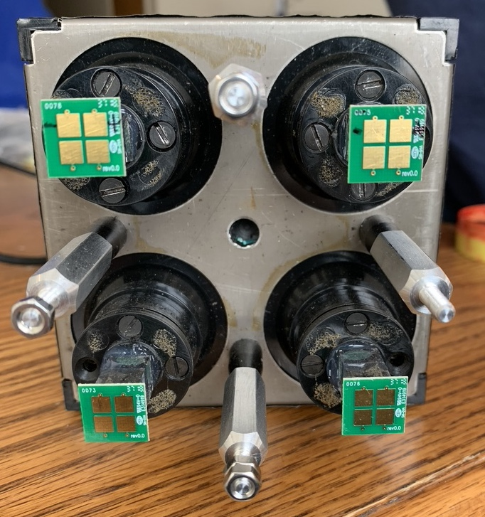
EMCal Shower Energy and Spatial Resolutions
- One EMCal Module = 4 Readout Towers
Electron position resolution: dX=dY ~1cm possible
with pre-shower detector (scintillator bars)
STAR Fermilab Test Beam Result with SiPM Readout (2019)
11cm

