Slide 1


DarkQuest and LongQuest at the 120GeV Fermilab Main Injector
LongQuest
Ming X. Liu
Los Alamos National Laboratory
For the (growing) DarkQuest/LongQuest Collaboration
Rare Processes and Precision Frontier Townhall Meeting
October 2, 2020

Slide 2
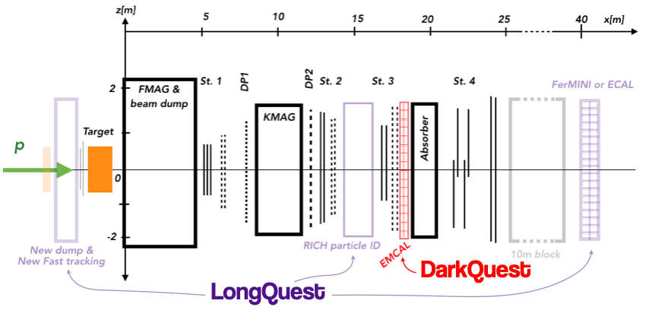
DarkQuest/LongQuest: The Idea
- Dark Sector Search at Fermilab Main Injector
LongQuest
A series of fixed target beam dump experiments based on the SeaQuest/SpinQuest dimuon spectrometer with 120GeV proton beam to search for low mass dark sector particles - Dark Photon (vector portal), Dark scalar (Higgs portal) etc.
SeaQuest: (2012 – 2017), nuclear targets (H, D, C, Fe, W); Dark Photon displaced vertex trigger (DP) commissioned in 2017;
SpinQuest: 2020 - 2022, polarized proton target; DP trigger allows parasitic dark sector search in dimuon channel, POT: 1.4 x 10^18
DarkQuest-I: 2023 - 2024, EMCal upgrade; dimuon and dielectron channels, POT ~10^18
DarkQuest-II/LongQuest: 2026+, additional detectors for long-lived BSM particles, POT ~10^20
SpinQuest setup, with future
DarkQuest and LongQuest
A’

Slide 3
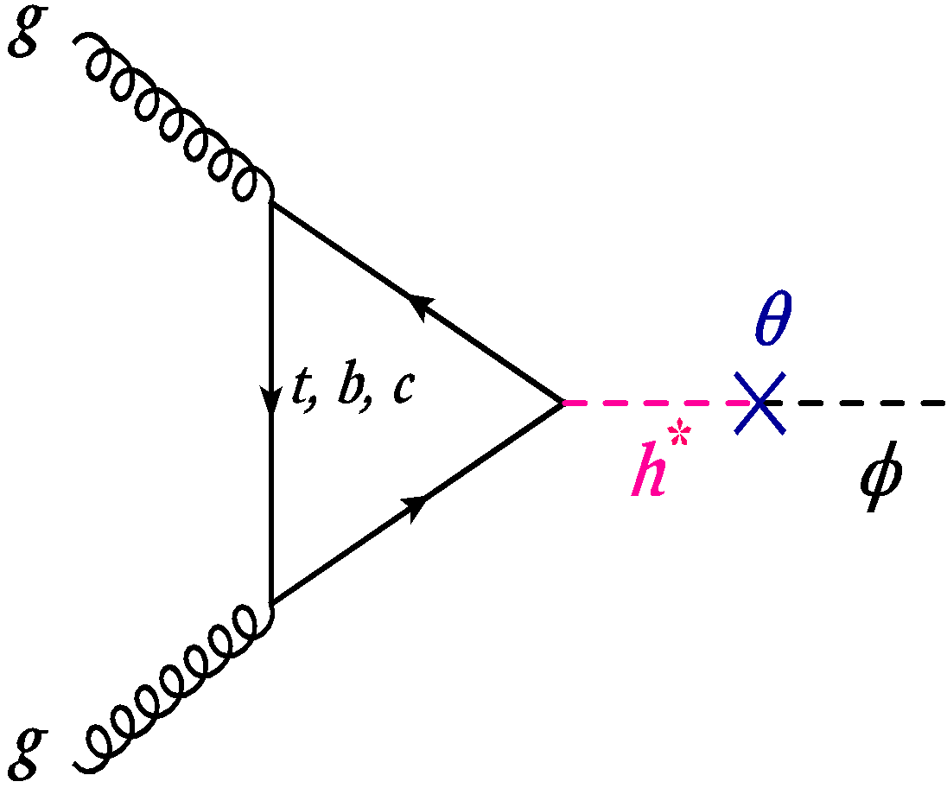

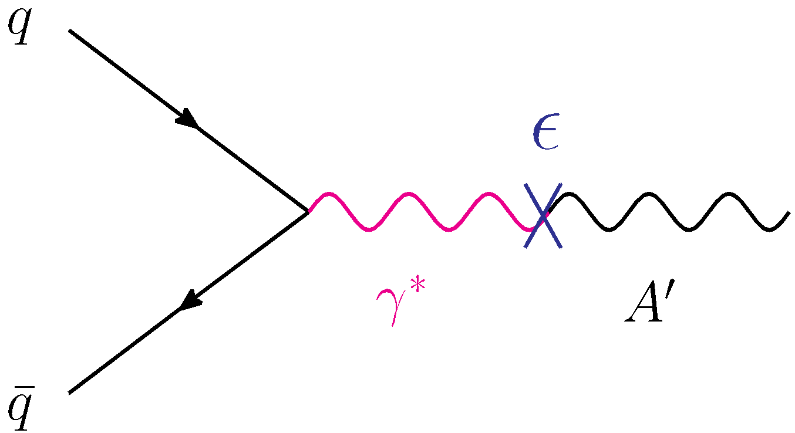
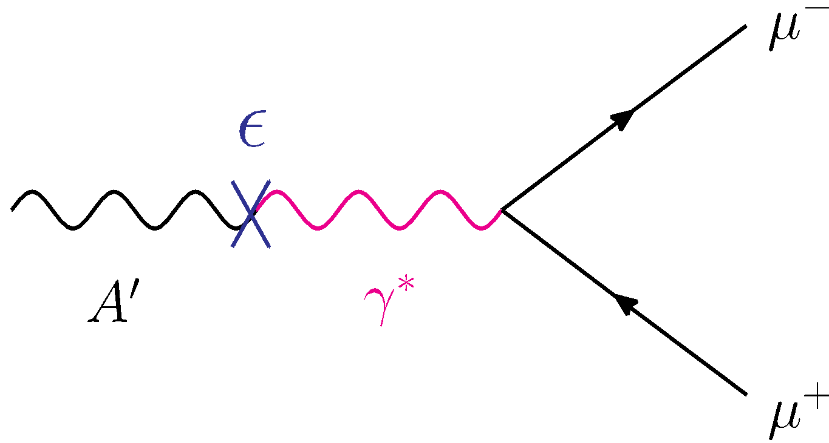
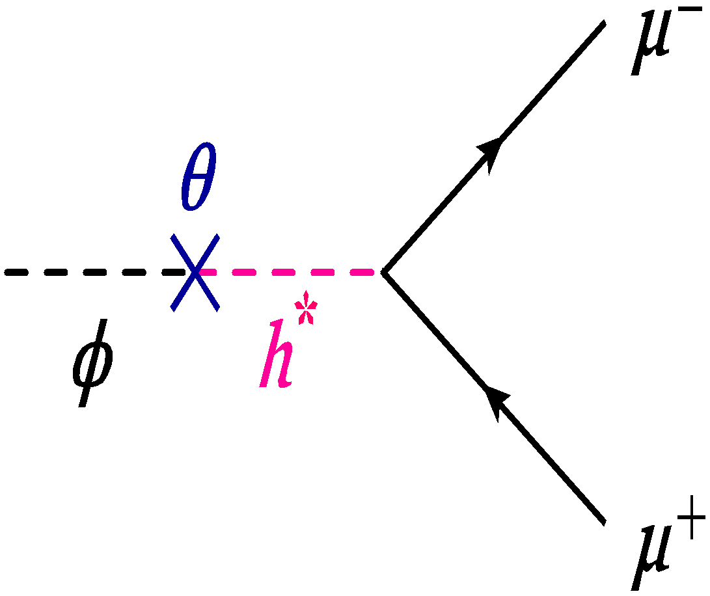

Physics of the DarkQuest Experiment
A broad dark sector physics search program
  Dimuons (current)
  Di-electrons
  Di-photons, ALP
  Hadrons, pi, K etc.
  and more …
SIMPs
Vector portal: dark photon
Higgs portal: dark scalar

Slide 4

Projected Sensitivity: Dark Photons as an Example
Updated based on
arXiv: 1804.00661
SpinQuest:
dimuon channel only,
m_{A’} > 200MeV
DarkQuest:
extension with EMCal upgrade,
will probe lower mass region,
m_{A’} < 200MeV with di-electrons;
also other signals like ALP, SIMPs
Berlin, Blinov, Evans, Gori
Berlin, Blinov, Evans, Gori
DarkQuest:
Di-electrons | Dimuons

Slide 5
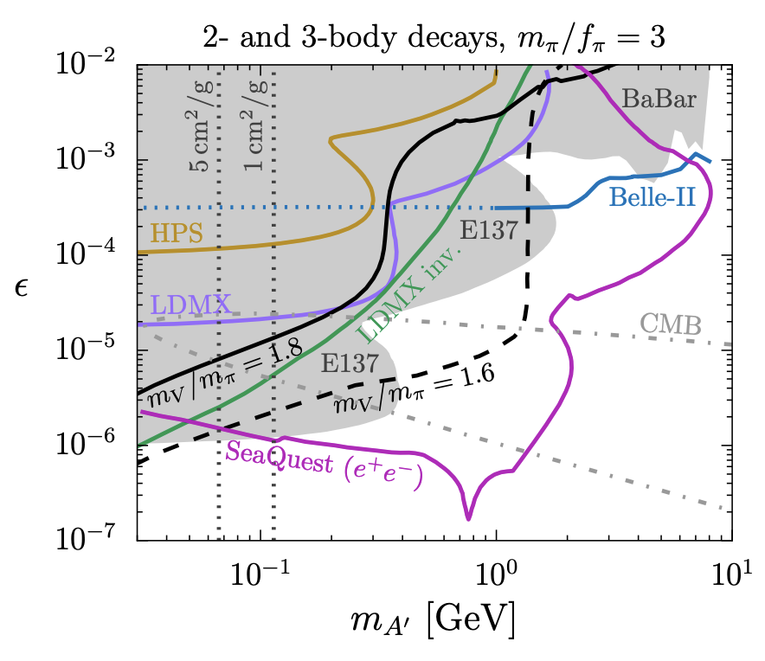
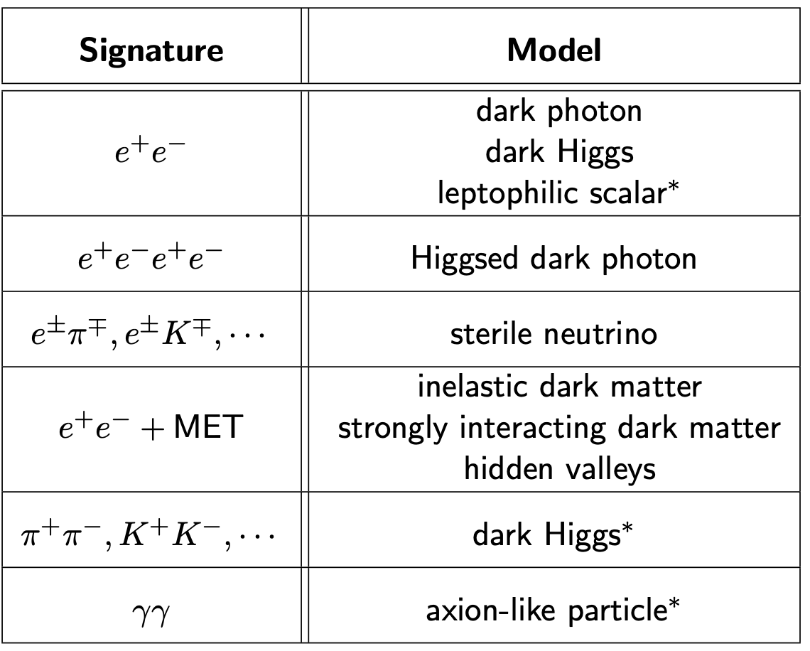
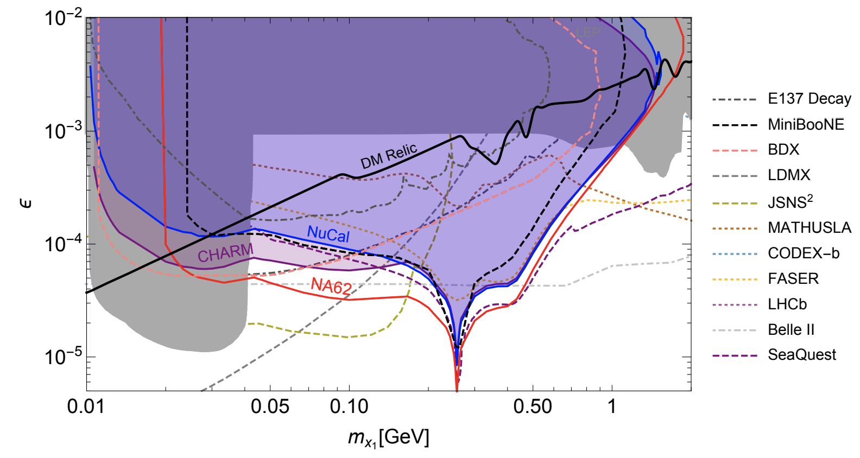
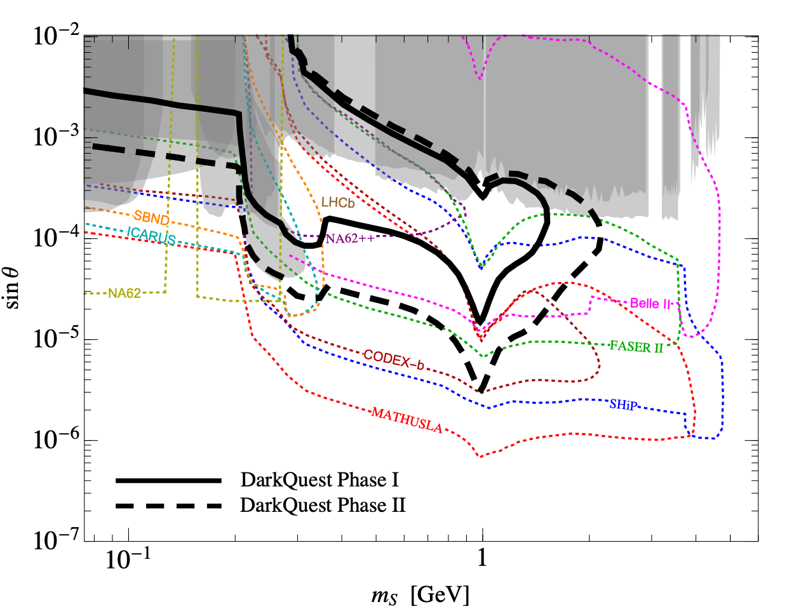
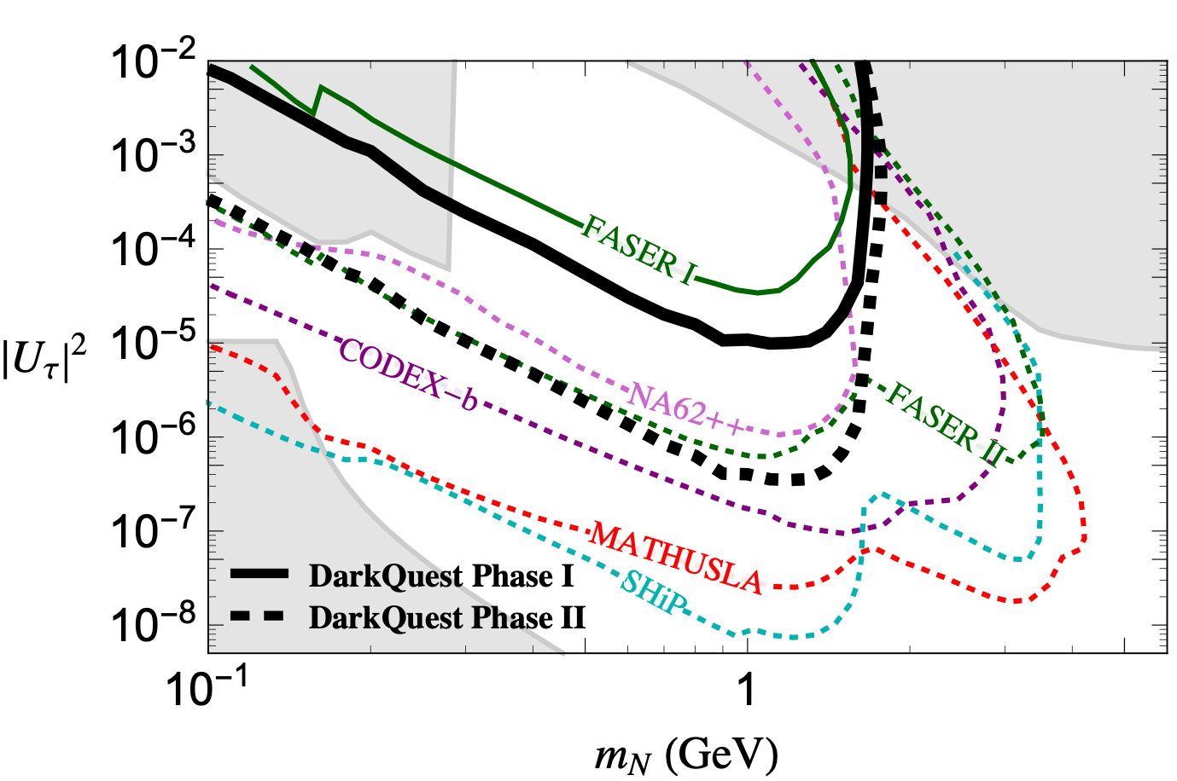
More Dark Sector Signatures
SIMP
Inelastic DM
Plots from various sources:
Batell, Berlin, deNiverville, Blinov, Evans, Gori,
Toro, Tsai, Schuster et al.
Higgs Portal
Heavy Tau Neutrino
Exploring several benchmark scenarios in full simulation for Snowmass:
DarkQuest-I: 2023-2024, POT ~ 10^18
DarkQuest-II: 2026+, POT ~ 10^20
Welcome to join us!
10/02/2020

Slide 6
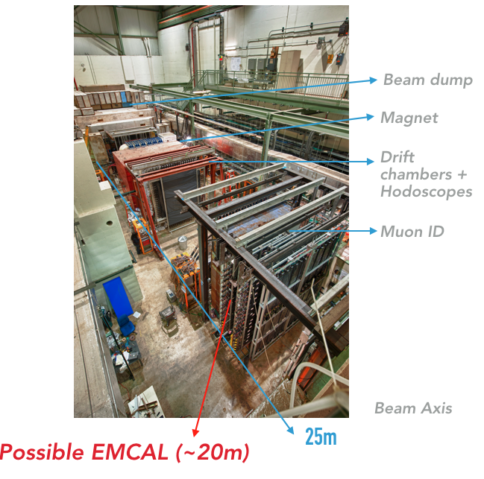
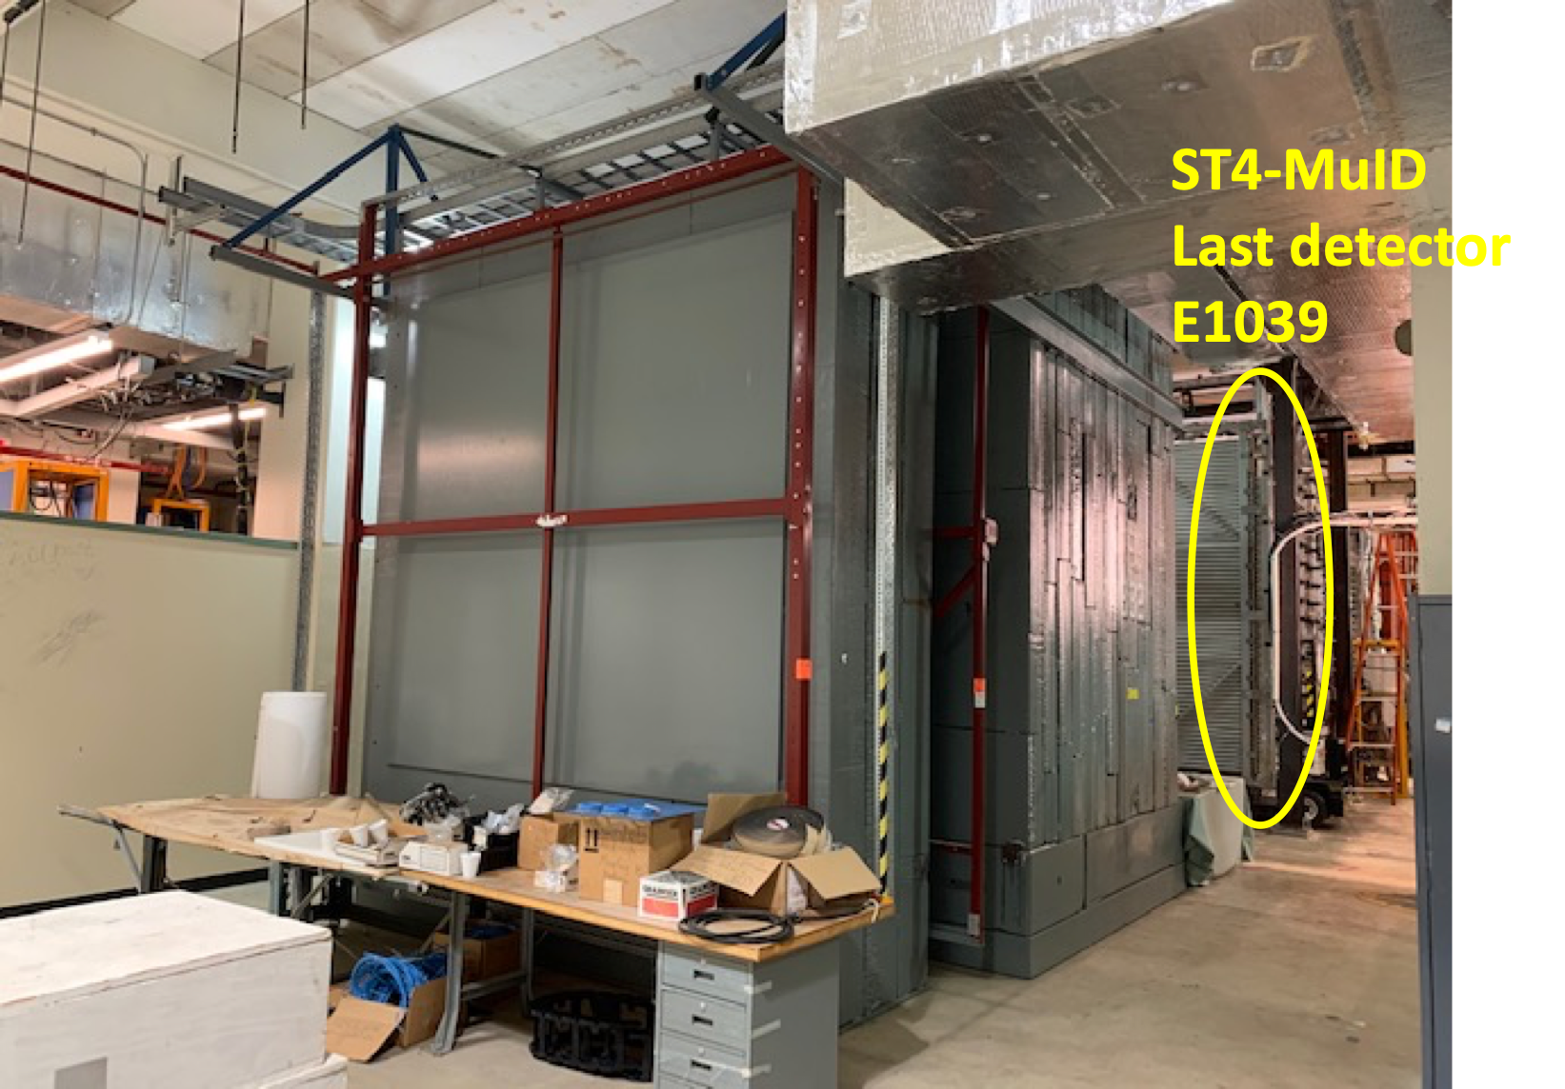
Readiness: Fully Working SpinQuest @NM4
ST-4
MuID
ST-3
ST-2
ST-1
LongQuest
120 GeV
Proton beam
NM4
Back Room
120 GeV
protons
additional detectors
possible for LongQuest
10/02/2020
Ming Liu, DarkQuest/LongQuest @Fermilab

Slide 7
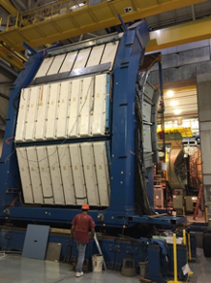
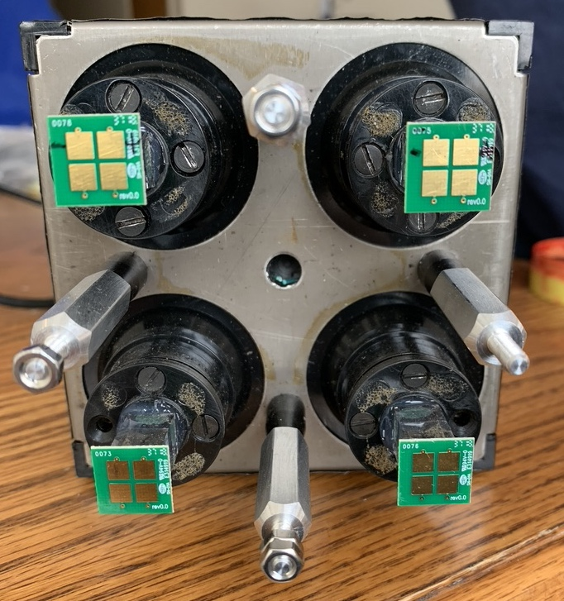

EMCal R&D Status and Plan
Recycle PHENIX EMCal detectors:
2 sectors available, 2m x 4m each
One for DarQuest
One for LongQuest in the backroom
Test beam results from STAR (2019) confirmed performance
Recycled PHENIX EMCal modules in hand
Build a prototype EMCal (2 x 2 modules or larger ) to measure background in SPinQuest in 2021
PHENIX EMCal module
2019 Test Beam @Fermilab (STAR)
11cm
2m
4m
11cm

Slide 8
Things to do for Snowmass
LongQuest
Simulation of signal acceptance and reconstruction
  Dark photons, dark Higgs, ALP, RH-neutrino etc.
  Exploration of signatures of new dark sector models and their connections to cosmology
  Produce experimental sensitivity plots
Simulation of rare SM backgrounds
  e.g., K⁰_{L} for electron dark sector backgrounds
Study detector background with real data
  2017 SeaQuest data for DP trigger and detector hit rates
Evaluate EMCal background for DarkQuest
  Build an EMCal telescope to study background rate in situ during SpinQuest run in 2021
Complete first LongQuest conceptual design
  e.g., milli-charged particles
Produce a technical report for the Snowmass Whitepaper

Slide 9

How Can Snowmass Help Us?
LongQuest
Build community support around (semi)visible dark sectors program
  Define benchmark models to provide good program coverage with potential milestones in parameter space
Further explore physics opportunities
  New ideas, new search channels and technologies
Join our effort on simulation and detector R&D
  Full GEANT detector simulations
  Rare SM background study
  EMCal integration – mechanical, readout and trigger
  Additional detectors for new opportunities, PID etc.
DarkQuest/LongQuest

Slide 10
Backup slides

Slide 11

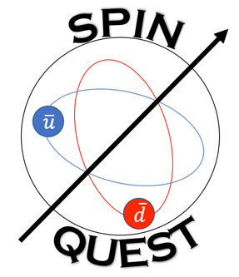
Terminology
Mod.Phys.Lett.A 32 (2017) 10, 1730008; Phys. Rev. D 98, 035011 (2018); https://arxiv.org/abs/1908.07525
SeaQuest: (2012-2017)
Official name for the unpolarized fixed target Drell-Yan experiment E906 at NM4 building. The primary physics goal is to study sea quark flavor asymmetry inside the nuelon, dbar/ubar.
SpinQuest: (2020-2022)
A new official name for the polarized fixed target Drell-Yan experiment E1039 at NM4 building (using the previous SeaQuest/E906 dimuon spectrometer setup). The primary physics goal is to study the sea-quarks’ Sivers transverse single spin asymmetry
DarkQuest-I: (2023-2024+)
Add an Electromagnetic Calorimeter (EMCal) in the main SpinQuest detector to search for Dark Sector Particles in both dimuon and di-electron channels, as well as di-photons
(shorter target-detector distance comparing to LongQuest)
DarkQuest-II/LongQuest: (2025+)
Add a 2nd EMCal behind a 10 m iron block behind the SpinQuest main detector + other supporting detector/upgrades, including PID and tracking near the target
(longer target-detector distance, but low background + not interfering SpinQuest operation, possibly lower cost
LongQuest
Strong collaborative effort between experimental and theoretical groups to further develop the physics program

