Slide 1
EMCal for DarkQuest
Ming Liu, Kun Liu
LANL
12/09/2020

Slide 2
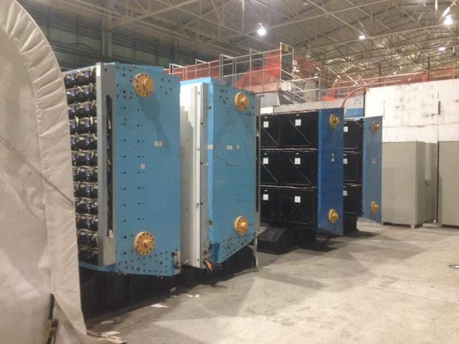
Two PHENIX EMCal Detectors Available
We built two stands to hold them up vertically at BNL storage area;
May need additional support to bring them
up to the right height. → budget low cost (free ~ $20K)
One EMCal sector: 2 m x 4 m
1 module: 11cm x 11cm x (~30cm), 4 towers(readout)
1 super module = 6 x 6 = 36 modules
3 x 6 = 18 super modules = 1 EMCal Sector
Total 648 modules per sector for readout:
4 towers (readout) per module;
Module timing resolution < 0.1ns
2592 readout channels: ADC & TDC
EMCal, #1 and #2
2m
4m

Slide 3
EMCal Readout Requirements
ADC dynamic range: 8/10/12 bits (256/1028/4096)
  EMCal energy resolution:
    dE/E ~10%/sqrt(E)
  Electron energy range
    E = 1 ~ 10 (?) GeV, need inputs from simulation - p distributions
  e/p match for electron ID
    need inputs from simulation –
    e/p distributions
    e-shower profile etc. (gang-4 SiPMs together or not)
  Tracking @SpinQuest: dp/p ~ 2%
TDC timing resolution:
  Desired timing resolution < 19ns, beam RF structure (56MHz)
  But for low detector occupancy, dT ~20ns reasonable for e/p track matching
Some commercial/other experiments options available:
CAEN SiPM readout modules
PHENIX(PMT)/sPHENIX(SiPM)/STAR-forward(SiPM) readout
Other existing EMCal readout electronics

Slide 4
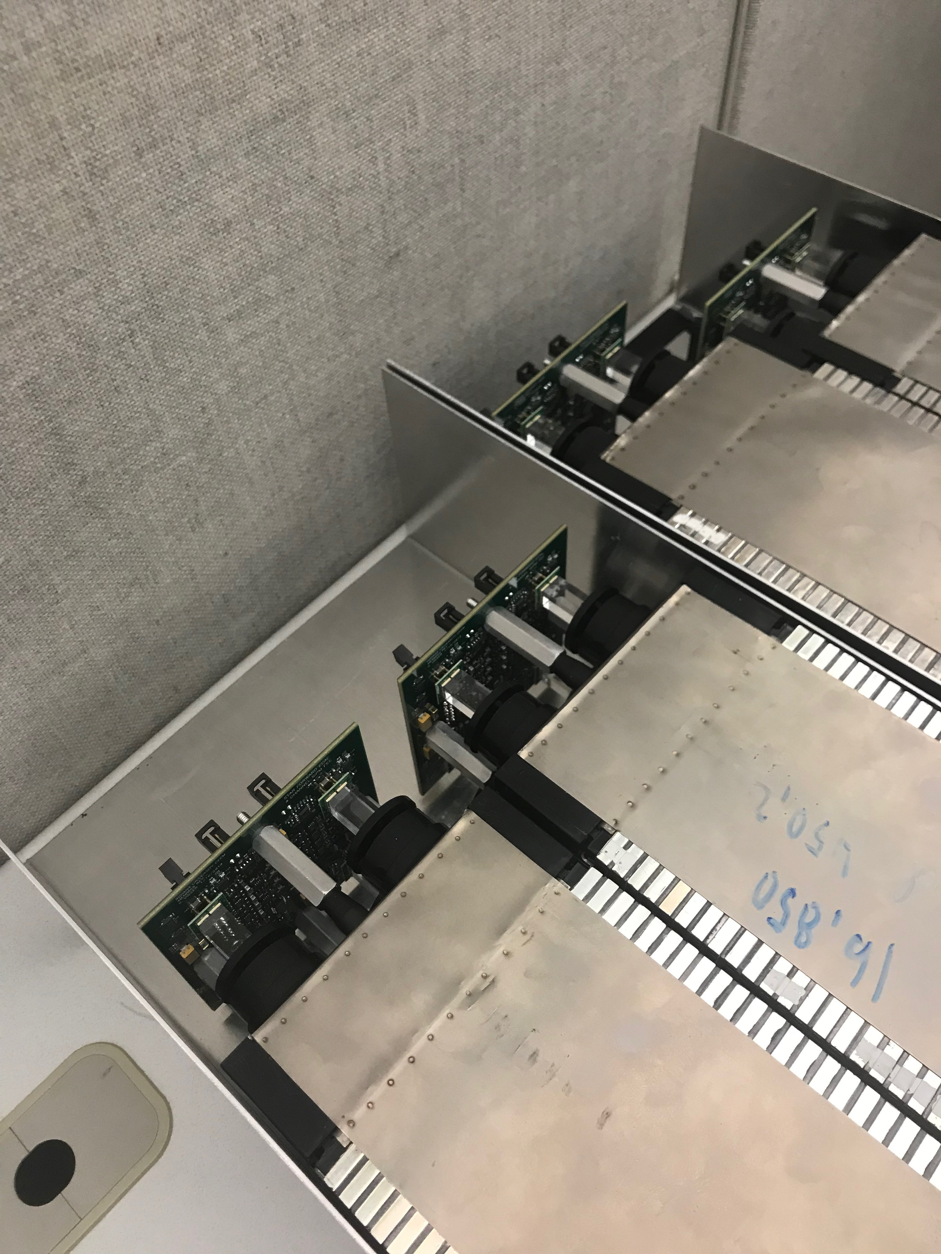
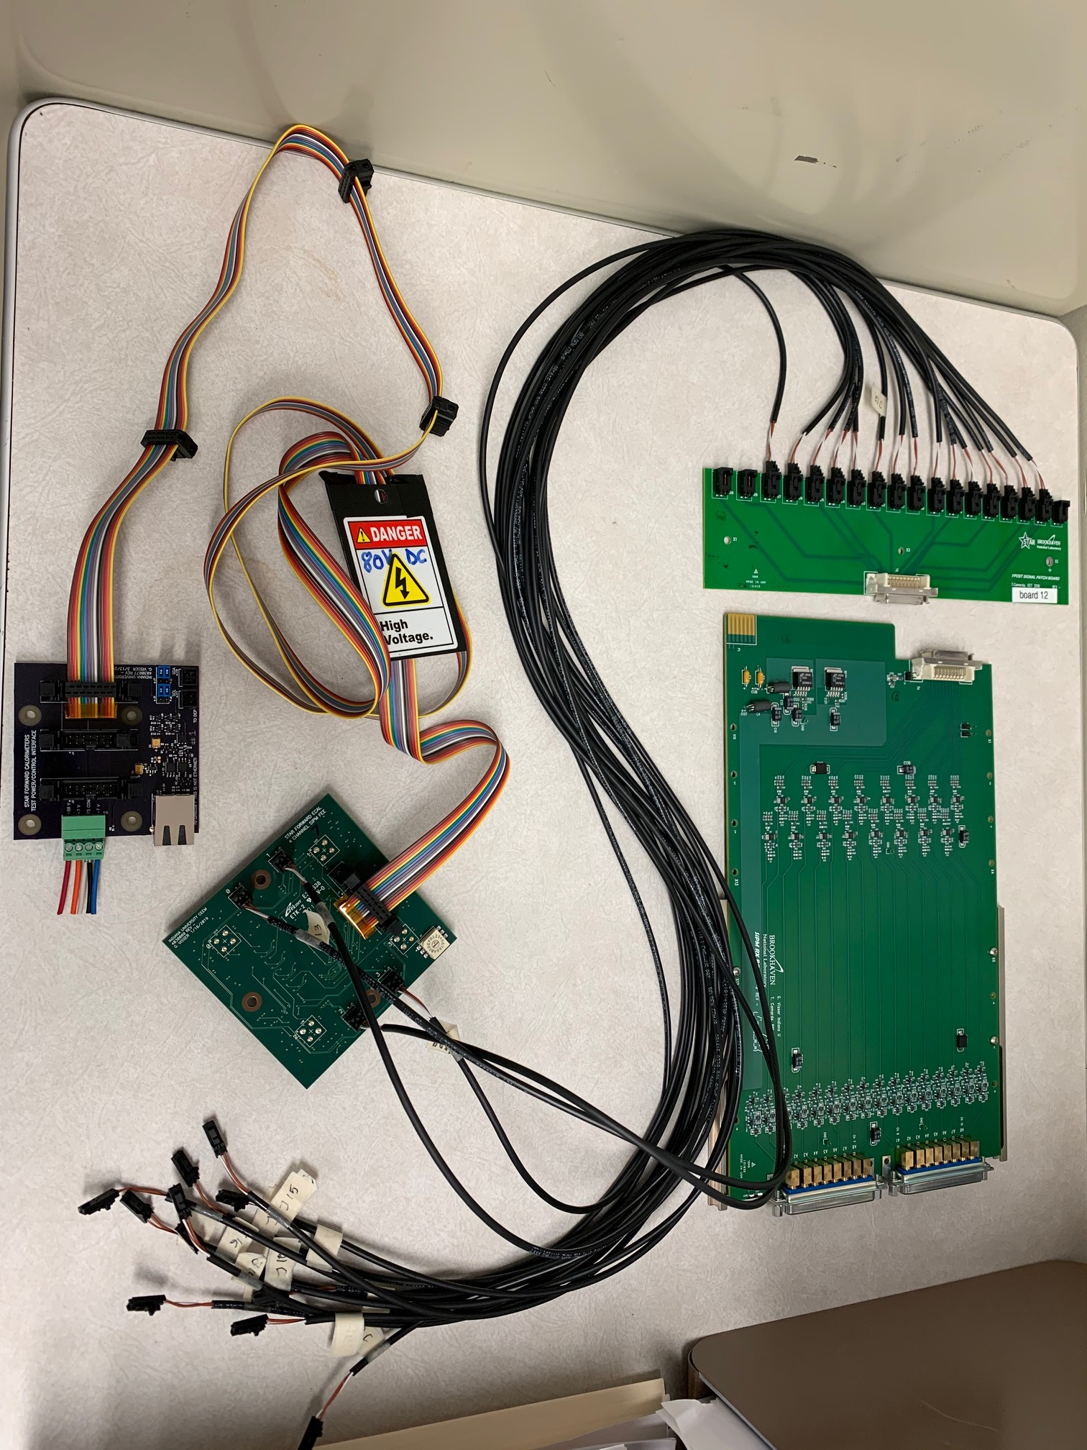
4 EMCal Modules with SiPMs @Fermilab
STAR Forward Upgrade FEE: 4 x 4 = 16 channels;
No backend electronics
4-SiPM readout per module;
4 modules @Fermilab
Will be used for background study @PsinQuest

Slide 5
Test Beam Data from 2019 Run
6GeV pi^{+/-} and e⁻
Light output: MIP vs E-shower
dE(e)/dE(MIP) = 785/33 = 24
MIP = 6GeV /24 = 0.25GeV
MIP energy resolution:
- 5.08/32.8 = 15.5%
Energy resolution @6GeV, e-shower
- dE/E = 43.3/785 = 5.5%

Slide 6
PHENIX EMCal Module Study @Fermilab
STAR Test Beam Run in 2019
https://www.phenix.bnl.gov/WWW/publish/mxliu/SeaQuest/EMCal_Upgrade/STARNote-EMCal-TestBeam-2019.pdf
- EMCal E will be used to tag electron candidates by E/P matching
Minimal goal: identify EM Shower over MIP signal
For photon measurements , one needs good dynamic range for photon energy E = 0.5~5GeV
MIP dE ~ 0.25GeV;
E_e_photon > 0.5GeV, 2-sigma separation

Slide 7
FEE & SIPM Gain
STAR 2019 TB Note
Vertical vs horizontal muons:
~1/6 in signal (H)

Slide 8
E-Shower Energy Resolution: Test Beam Data
- E1039: tracking dP/P ~1%, position resolution ~<1mm
EMCal dE/E = 11%/sqrt(E)
  used for pID
  background rejection

Slide 9
MIP Signal in EMCal: independent of E, up to E~120GeV dE ~ 250MeV in EMCal
E-Shower/MIP = 4 x E (in GeV): ~20 for 5GeV e⁻
Uniform response to MIP
(GEANT Sim/STAR)

Slide 10
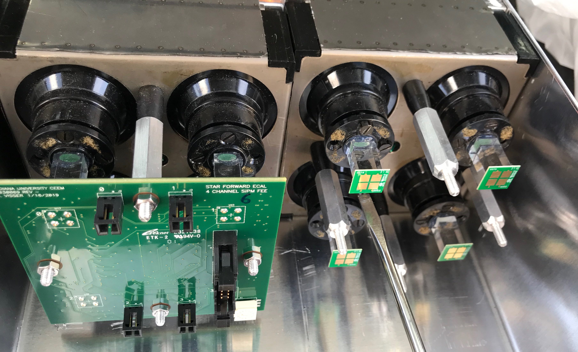
4 EMCal Modules at Fermilab: SiPM Readout
1 Module = 4 Towers
4-lightguides
Each lightguide:
2-SiPM readout
2 SiPMs
Per Tower
(Channel)
Custom light guides

Slide 11
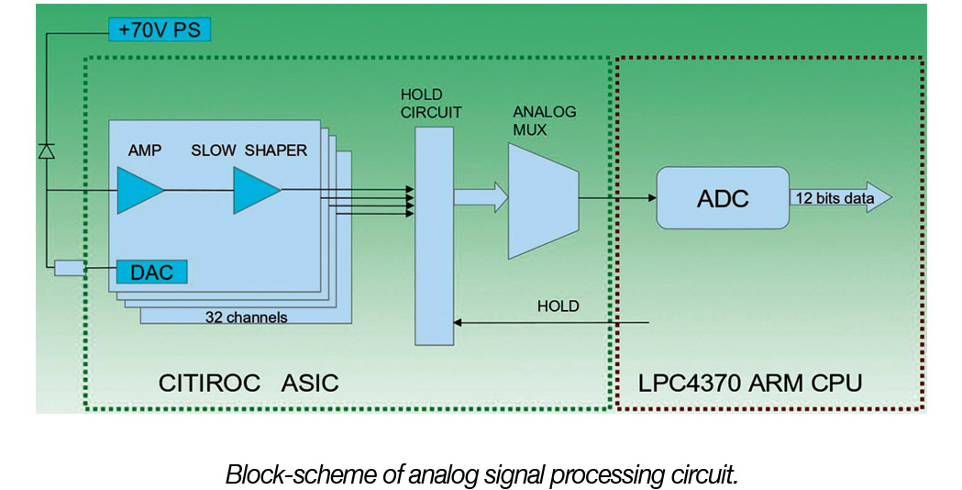
Test Readout with CAEN DT-5702
(32 channels, 12-bit ADC, TDC ~1ns resolution)
User controls:
SIPM bias HV (0-4.5V, DAC=0-255)
PreAmap Gain DAC: 0-60
Needs to use 2-chan for trigger, 30-chan available for readout
Unit cost: ~$3K
1296/30 x 3K = $130K
DT5202 (New) available, potential lower cost
- 64-channel CITIROC unit for FERS-5200
Cost: ~$5K (?)

Slide 13
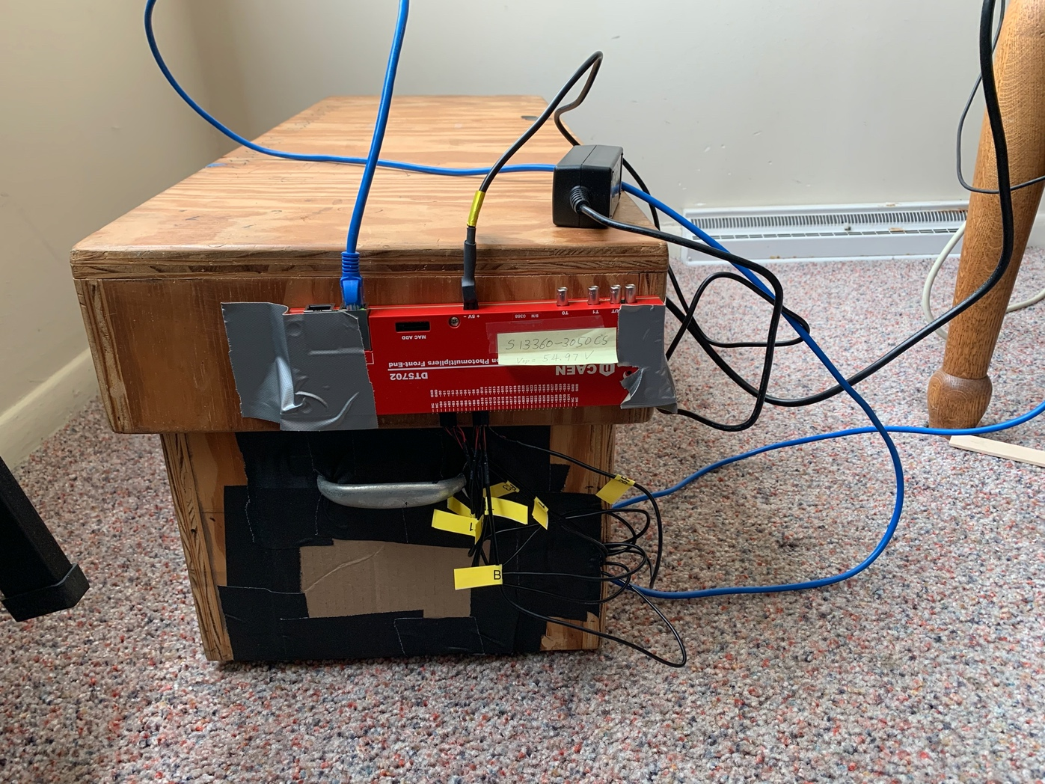
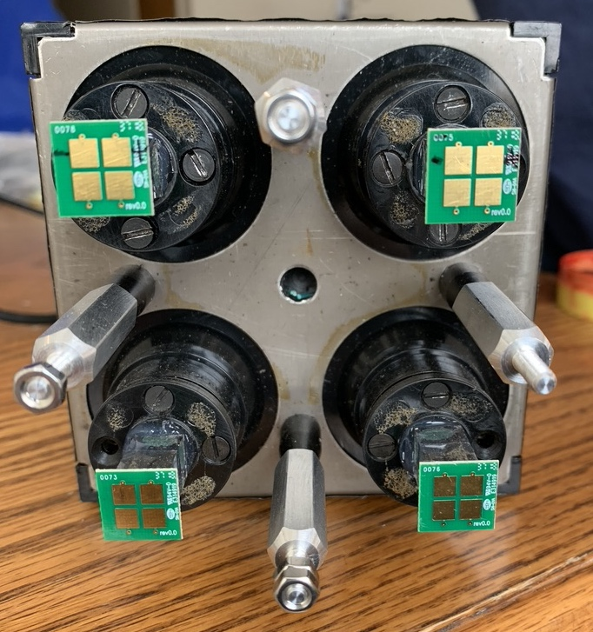
Two EMCal Modules Readout Setup @Fermilab
Kun & Ming
1x2 module setup
for cosmic ray
-8 readout channels
8 SiPMs + CAEN 7502 + Linux computer
11cm
11cm

Slide 14
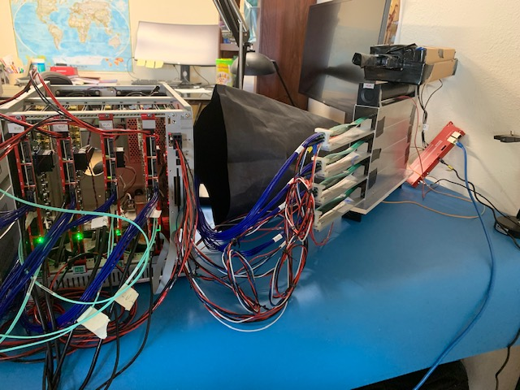
Cosmic Setup @Home
2 trigger bars: ch8, ch9
4 “shower” bars, ch0-ch5 used for SiPM readout gain tuning
ch8
Cosmic ray
ch5
ch4
ch9
ch0
ch1
ch8
ch9

Slide 15
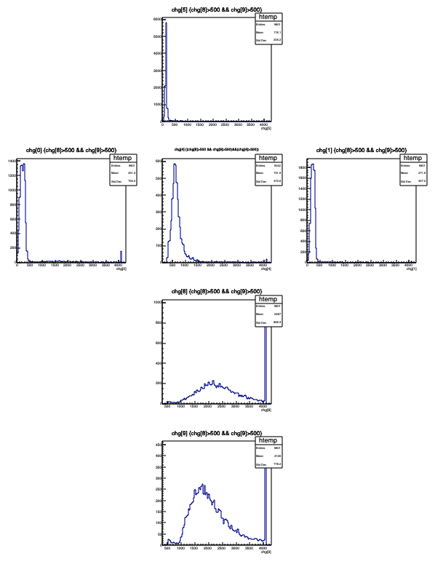
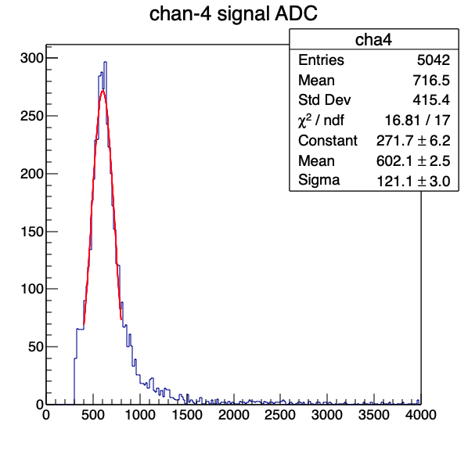
Scan preamp High Gain:
HG =1, LG = 20
mppc-cosmic-trigger-counters-Channel-4-5-HG1-LG20-8-9-HGLG-37-Thr350-run2.root
A= 602 +/-3
Sig = 121 +/-3

Slide 16
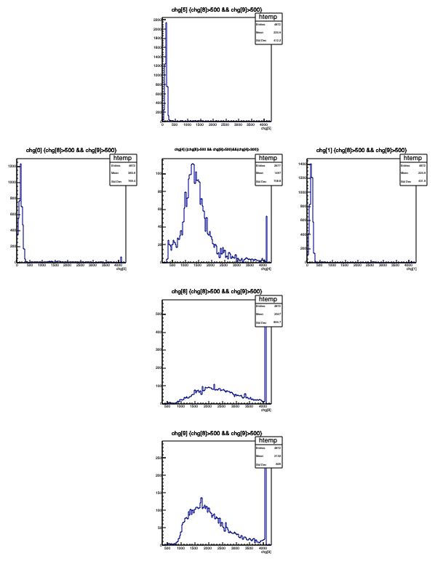
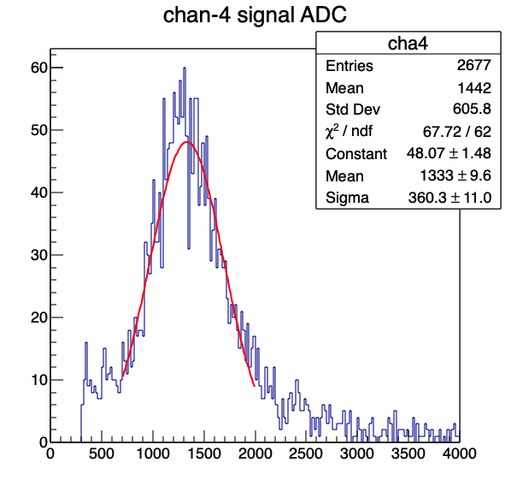
HG=40, LG = 40
mppc-cosmic-trigger-counters-Channel-4-5-HG40-LG40-8-9-HGLG-37-Thr350.root
A = 1333 +/- 10
Sig = 360 +/-11

Slide 17
Budget
Shipping from BNL to Fermilab: <20K
Additional mechanical support – floor stands
  Tech time @Fermilab, ~$10K ? (~2 wks)
  Material, $20K
Light guides & SiPMs
  2000 x $(10+20) = $60K
Trigger board development: ~$100K (?)
  Fast charge sum to provide EMCal trigger to DAQ
Readout hardware
  CAEN like: $130K
  sPHENIX (14-bit ADC for SiPM): $150 x 1296 = $195K
Trigger and backend readout integration into DAQ:
  3~6 months engineering work/postdoc, ~$100-200K
Safety reviews and documentation
  Mechanical and electrical systems, ~$20K

