Slide 1
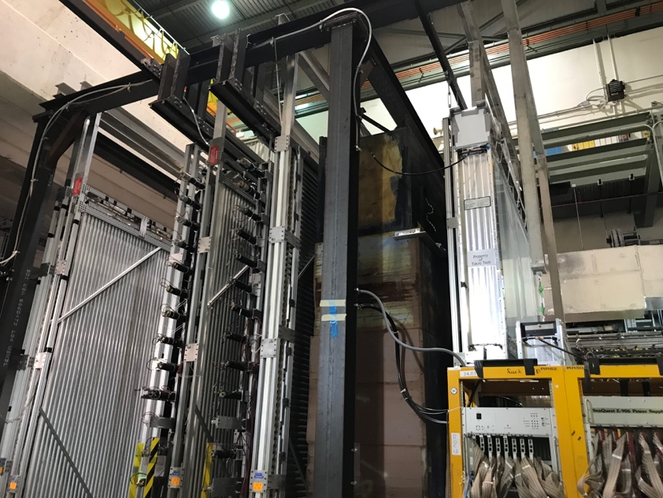
DarkQuest Layout, 02/18/2020
e^{+/-}, gamma
Iron absorber
~10m(?)
tracker
2nd EMCal
DarkQuest : FY23 – 25+, one EMCal behind ST-3 tracker
LongQuest: FY25+, add 2nd EMCal + one Tracker behind the St-4 Muon ID

Slide 2
Fermilab Beam Schedule Update: 2/18/2020
DarkQuest
LongQuest

