Slide 1
DP Detector Status & Plan need your help!
Ming Liu
Los Alamos
03/19/2020
Dark Photon Trigger Detector commissioning
EMCal Upgrade R&D

Slide 2
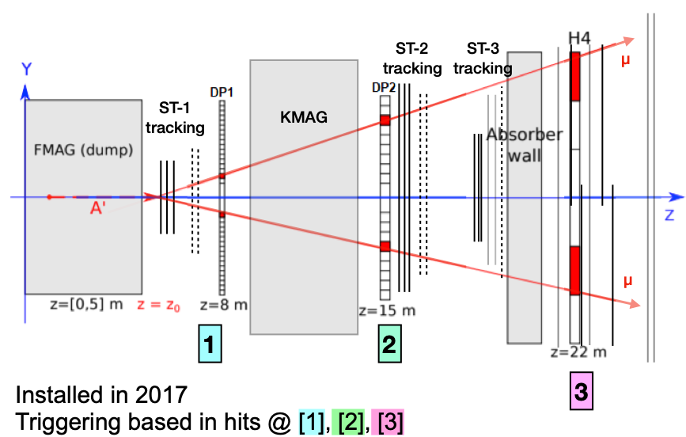
Dark Photon Detectors in E1039
EMCal
Prototype
EMCal
Prototype
Near detector for BG study
Far detector

Slide 3
Progress & Status
DP detectors integrated into the E1039 Main DAQ TDC readout
DP trigger inputs all cabled and timed-in → finished “recabeling”
  DP1 + DP2 + H4Y1
  Setup a new fast (H1+H2) trigger for DP V1495 trigger signal timing study
Ready to send 16-bit output to main FPGA trigger ->discussed with Trigger experts
  4x4 bits
Preparing trigger lookup table
  FPGA triggers
  DP based NIM triggers
Standalone DAQ for DP V1495 trigger system
  Remote access and operation
  Data analysis (root files)
An EMCal telescope with PHENIX EMCal modules
  Readout EMCal modules with SiPMs, cosmic rays
  Background study with a (2x2) EMcal modules with beam
  Electron, photon and hadron backgrounds

Slide 4
DP Trigger System
Production
Vertex
DP1
DP2
H4Y1
VTX Trigger
V1495
Main DAQ
TW TDC
TDC readout,
  Requires fast “Com. Stop”
Trigger roads
DP1+DP2+H4Y1
Com. Stop
4-bit vertex trigger
per quadrant:
Target
Dump
Displaced
Null
E1039
FPGA Trigger
Too slow for
DP V1495 TDC
Timing study

Slide 5
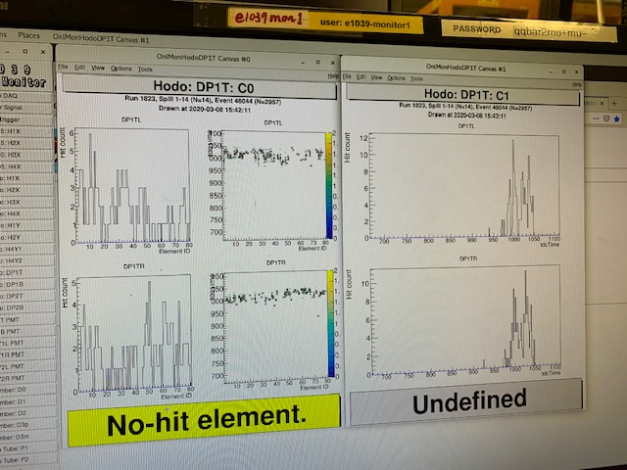
DP TDC Timing Already included in Main DAQ
- all channels timed-in for TDC Readout
Recent detector work: (see e-log)
Recovered one noisy channel by adjusting bias HV for SiPM;
The 2nd hot channel became normal after reconnecting cables;
Confirmed two dead channels (will fix later, requires opening the DP detector box)
Dead channel fraction: 2/520 = 0.4%
Ready for commissioning with beam!
Rough TDC timing with cosmic NIM trigger
Fine tuning with beam later

Slide 6
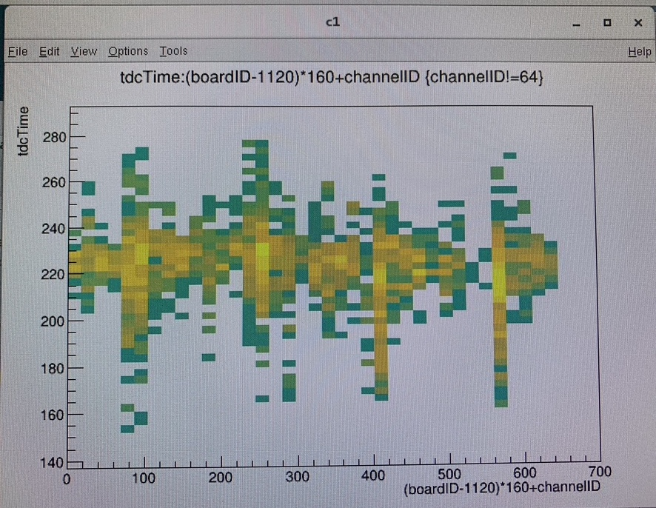
DP1+DP2 + H4Y1 Timed-In at V1495
Cosmic rays triggered by (H1+H2)
Internal delayed introduced
to align DP1, DP2 and H4Y1 signals
To make DP V1495 Trigger roads
Fine tuning later with beam
Q1
Q2
Q3
Q4

Slide 7
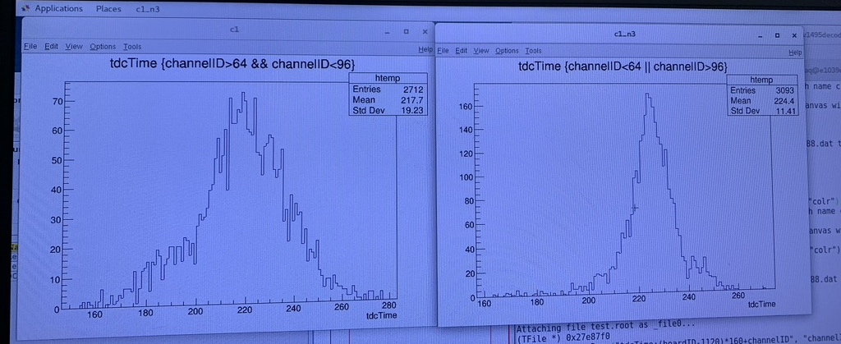
Timing Alignment: DP and H4Y1 signals in V1495
- able to achieve ~1nS precision with beams
H4Y1 Timing:
~19*19/16 = 23(nS)
DP1/2 Timing:
~11*19/16 = 13(nS)

Slide 8
DP - Next Step
Provide displaced trigger bits to the Main FPGA Trigger System
  One 16-chan ribbon cable
  4 x 4-bit
    Target
    Beam Dump
    Displaced
    Null
Optimize lookup table for performance
  DY & J/Psi simulation, target and dump seperation
  DP signal simulations
DP based NIM triggers?
  Min. Bias single muons from target?
  Target di-muons
  Other possibilities
Commissioning the trigger system with beam
It is unlikely we will have beam for E1039 in April-May this year;
What can we do/learn with cosmic data?

Slide 9
A Telescope with 2x2 EMCal Modules
Goals – to trigger and measure the energy of
High energy electrons:
  - (Trig-1 & large dE)
High energy photons:
-(NOT Trig-1) & Trig-2 & large dE
trigger/or hit rates
Energy spectra
4 x 4 = 16 SiPM readout channels
2 x 11 cm
2x2 SiPM
readout
2x2 SiPM
Trig-1
Trig-2
EMCal: dE
2x2 SiPM
2x2 SiPM
4 EMCal modules;
16 SiPM channels
beam
2 x 11 cm
~1cm Pb
(also a pre-shower detector)

Slide 10
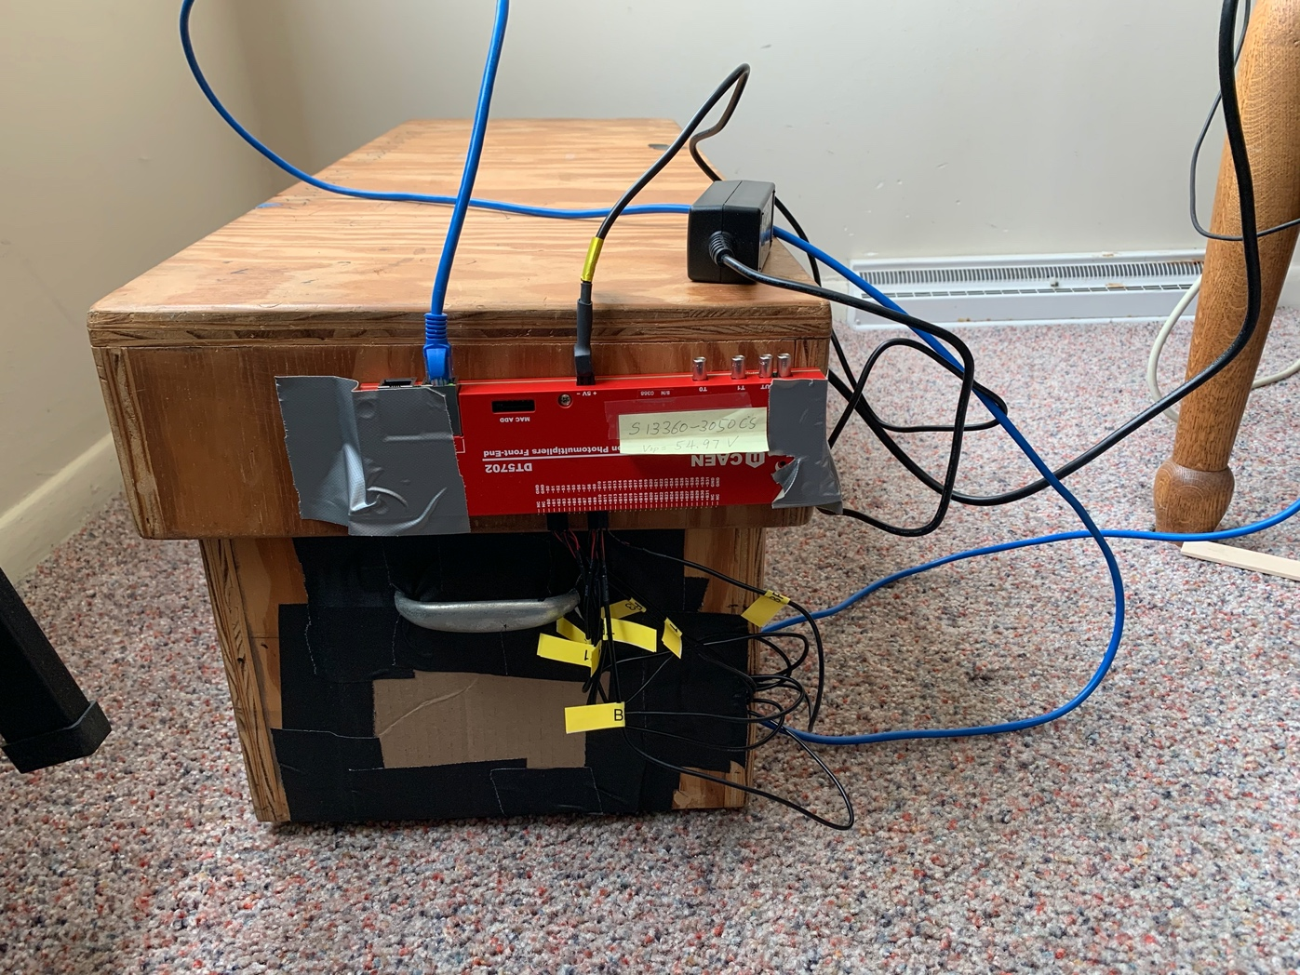
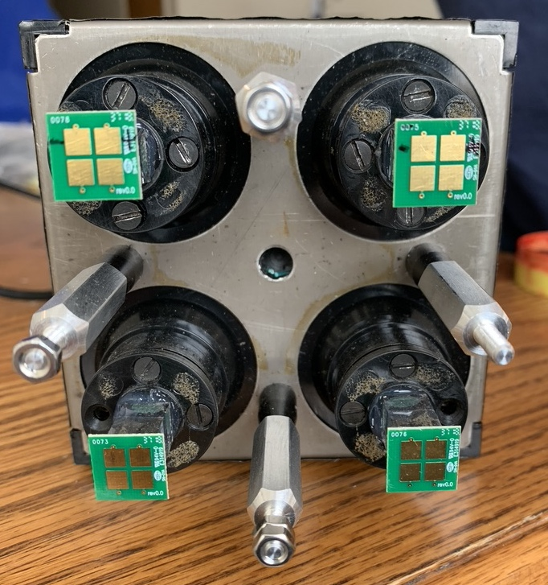
Two EMCal Modules Readout Setup
1x2 module setup
for cosmic ray
-8 readout channels
8 SiPMs + CAEN 7502 + Linux computer
11cm
11cm

Slide 11
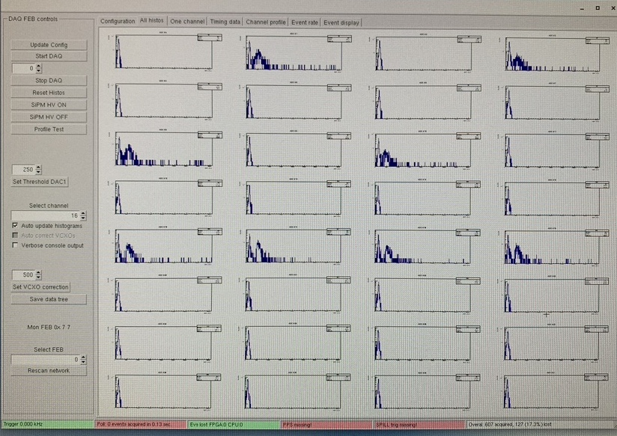
EMCal Readout R&D
Top-Down cosmic trigger = (T1 & B2 ) or (T3 & B4)
Cosmic ray
T1
T3
T2
T4
B1
B3
B2
B4

Slide 12
Plan – a telescope made of 2x2 EMCal modules to study the background
Make 2x2 EMCal telescope
Build a pre-shower detector / also a trigger detector
CAEN DT5720 readout for both
  Integrate CAEN DT7520 into SPinQuest DAQ
Detector and physics simulations
To do a test beam run later this year?
  Electron beam
  Proton beam
E1039 beam time THIS SPRING is very uncertain (April-May)
Any helpers on these tasks
are welcome!

Slide 13
Readout with CAEN DT5702
Could use helpers to make the pre-shower detectors – a good student project
Event Trigger for
High energy electrons
High energy photons
Trig-1 OR Trig-2
C0&C1
C2&C3
C4 … C19 [16]
Trig-1
Trig-2
EMCal: dE
EMCal Energy:
Sum of C4 + … C19
4 EMCal modules;
16 SiPM channels
beam
1cm Pb

Slide 14
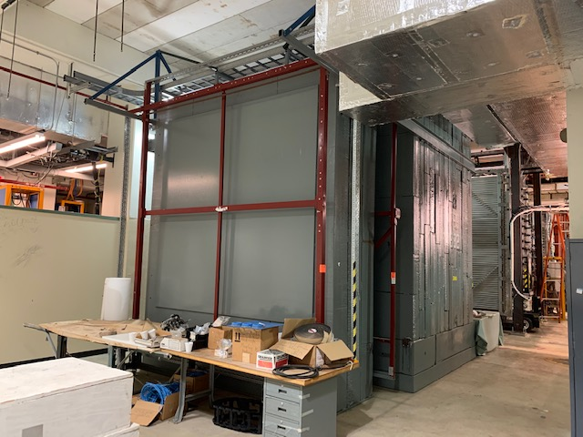
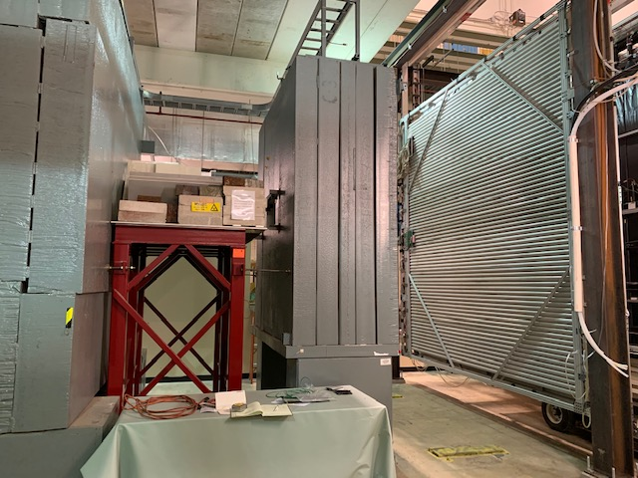
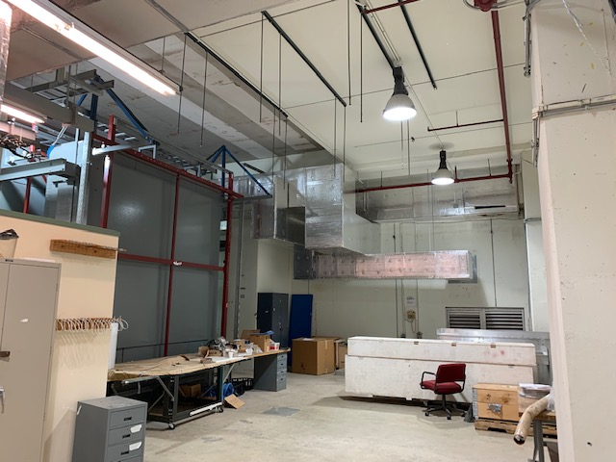
LongQuest
beam
ST4-MuID
Last detector
E1039
ST4-MuID
Last detector
E1039
Room for additional
detectors

Slide 15
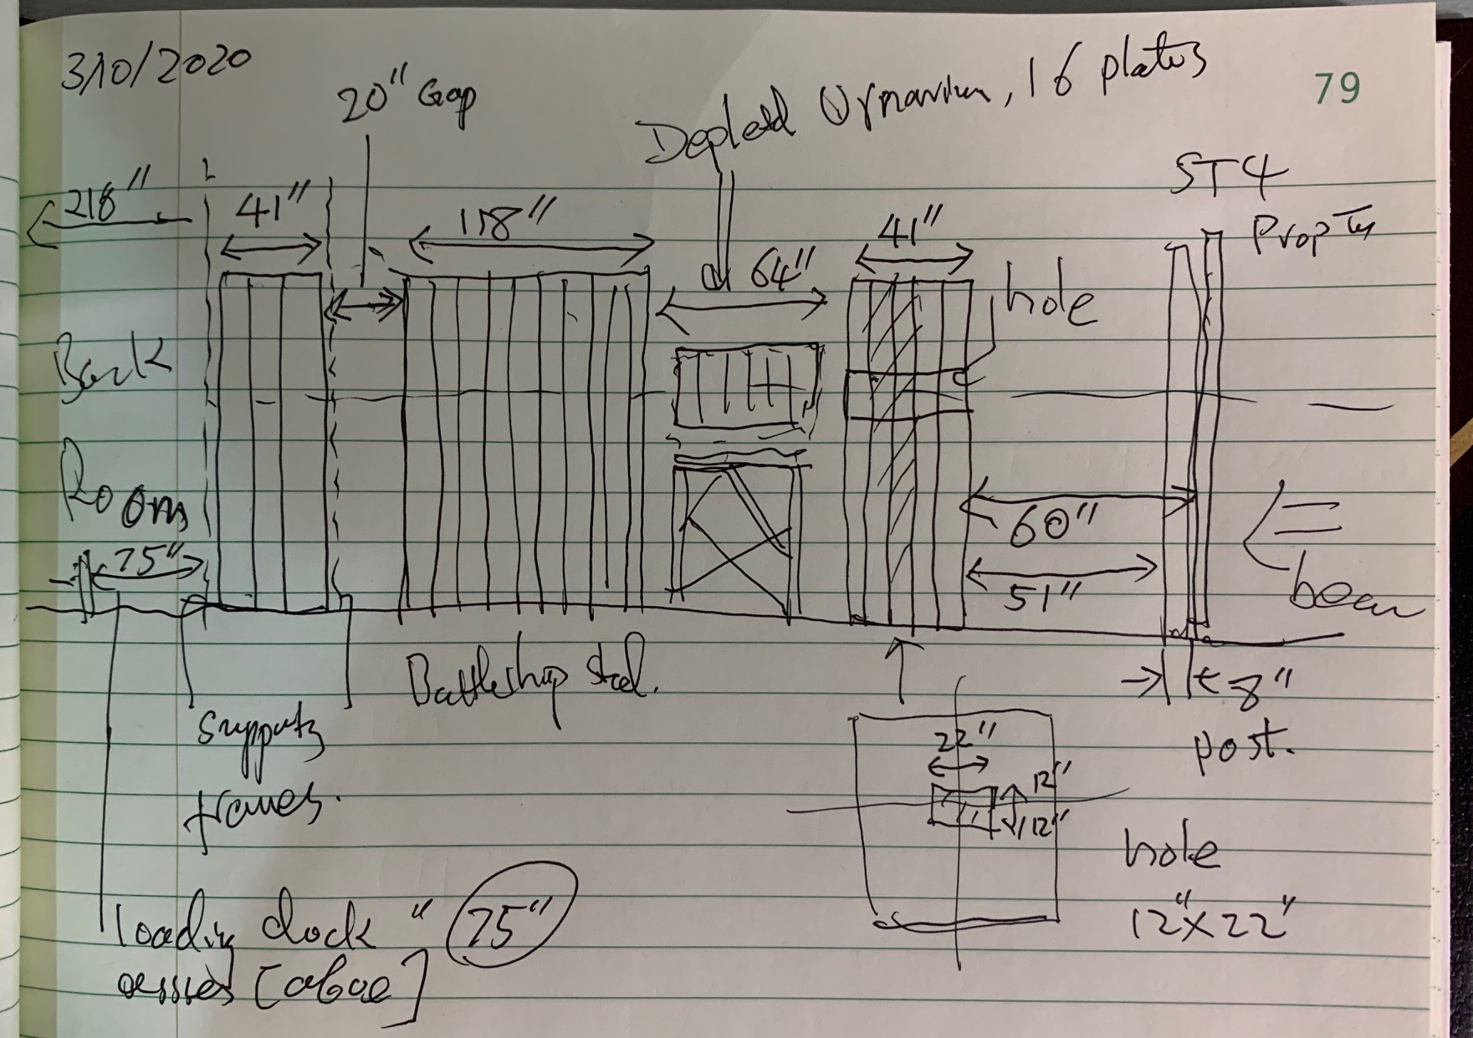
LongQuest Layout
- Floor Map of NM4 Behind SpinQuest
ST4-MuID
Last detector
E1039
beam

Slide 16
KTeV Layout
K-Mag
170
190

Slide 17
64”
Muon Filter 1;
41” thinck
Muon Filter 2;
118” thick
Muon Filter 3
41” thick

Slide 18
backup

Slide 19
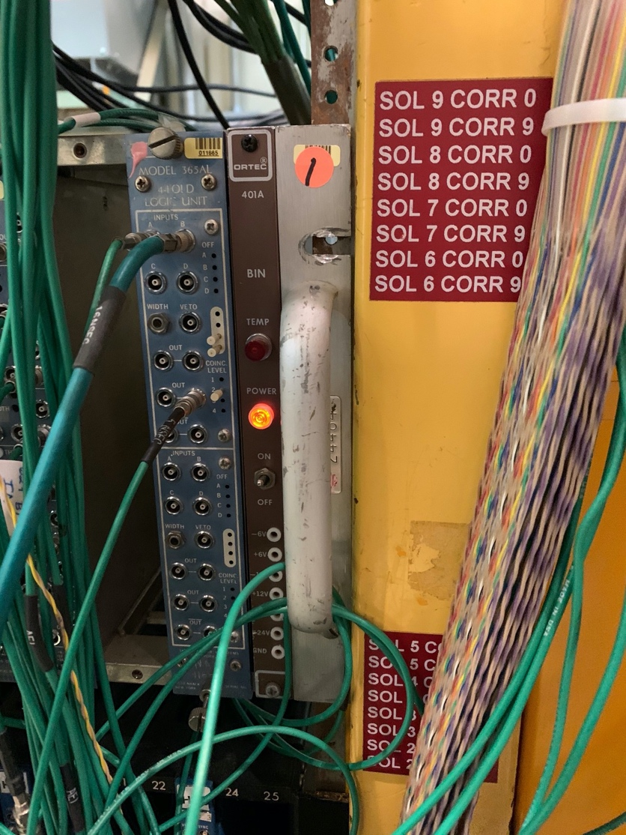
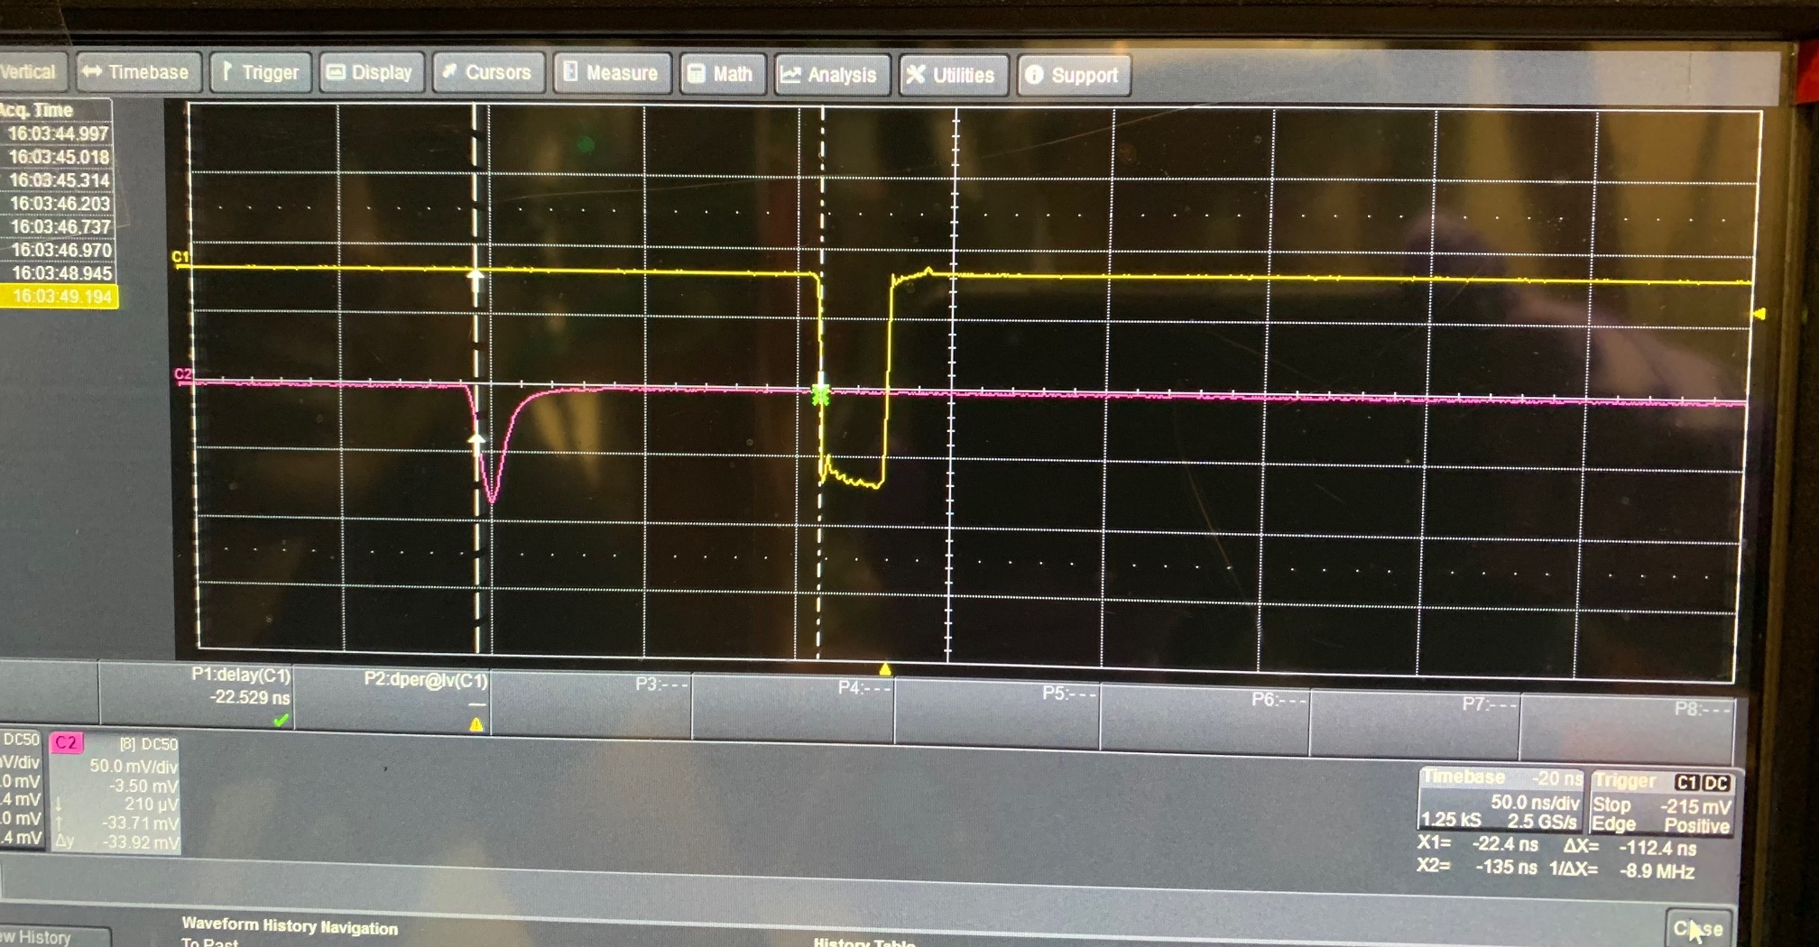
A New (H1+H2) Trigger in the Hall & DP Signals
Created a new fast (H1+H2) trigger for DP Trigger V149 Timing Study:
But H4Y1 comes late, very close to the new (H1+H2) Trigger:
- Additional 200nS delay applied to the
New (H1+H2) Trigger from the patch panel
New fast
H1+H2 Trigger
DP signal at V1495 Input
Comes ~ 120nS earlier

Slide 20
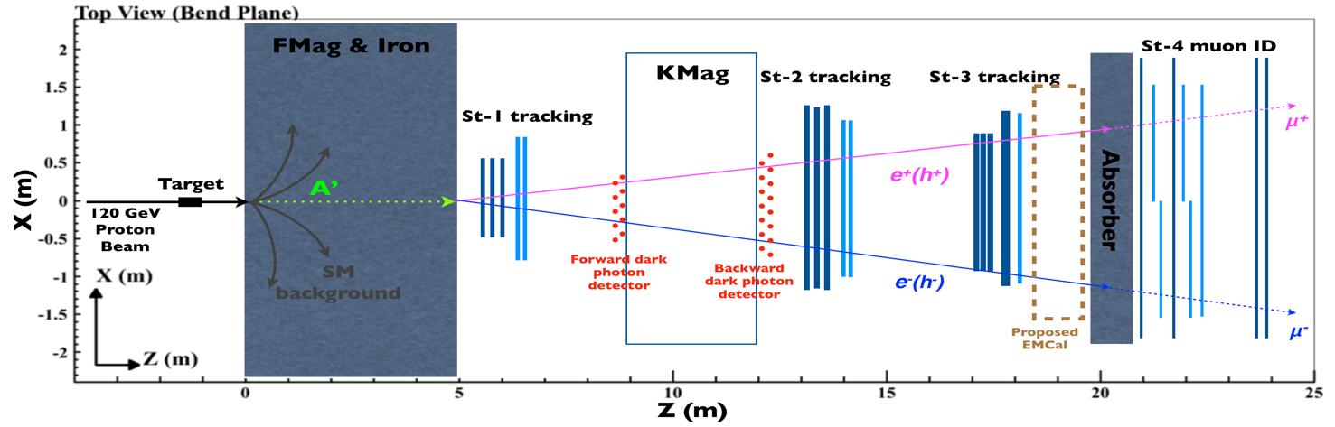
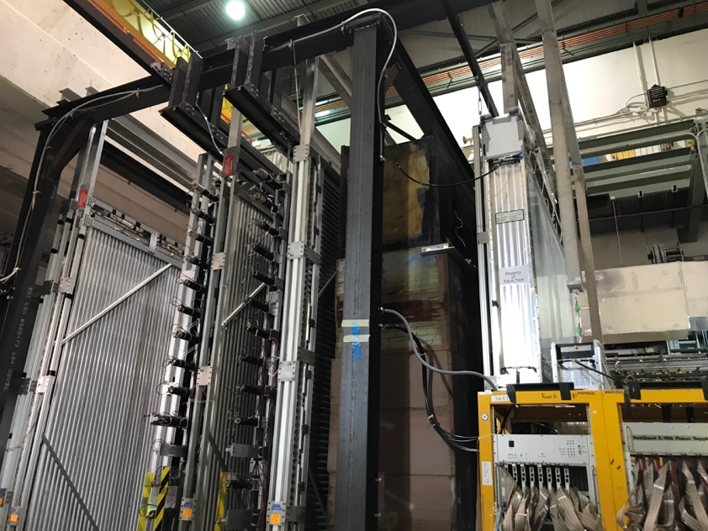
DarkQuest Layout, 02/18/2020
e^{+/-}, gamma
Iron absorber
~10m(?)
tracker
2nd EMCal
DarkQuest : FY23 – 25+, one EMCal behind ST-3 tracker
LongQuest: FY25+, add 2nd EMCal + one Tracker behind the St-4 Muon ID

