Slide 1
PHENIX EMCal Readout and CAEN SiPM Readout Module Performance Study
- Kun & Ming 05/28/2020 updated 06/23/2020, cosmic data analysis
Cosmic ray
@Bi-weekly DartQuest: https://indico.fnal.gov/event/43599/
SiPM Readout Module DT5702 Tuning with cosmic rays
  2cm x 2cm scintillator bars
  SiPM readout vis WLSF
HV Bias DAC
  HV ~ DAC value (0.5-4.5V/256 )
Trigger setup fixed
  Ch8 & ch9
Changed gain of HG and LG for chan 4 and 5.
  Study the central values of Ch4 vs HG=LG
  HG=LG = 63(max), 50, 40, 30, 20, 10, 5, 2, 1
ch4
ch8
ch9

Slide 2
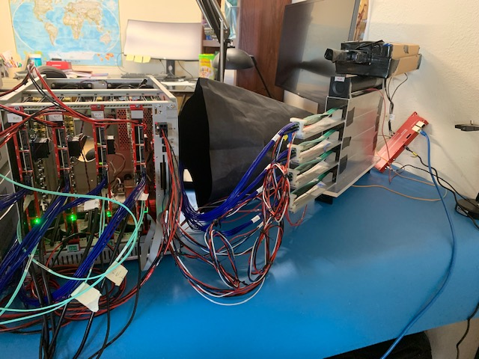
Cosmic Setup @Home
2 trigger bars: ch8, ch9
4 “shower” bars, ch0-ch5 used for SiPM readout gain tuning
ch8
Cosmic ray
ch5
ch4
ch9
ch0
ch1
ch8
ch9

Slide 3
Cosmic Trigger Tuning
Cosmic ray
CAEN 5702
Ch4 & Ch5:
HG= 51
LG= 51
Mean = 1967
Sigma = 527
Trigger paddles: Ch8 * 9
HG = 51
LG = 51
Thr = 350
ch4
ch8
ch9

Slide 4
PHENIX EMCal Module Study @Fermilab
STAR Test Beam Run in 2019
https://www.phenix.bnl.gov/WWW/publish/mxliu/SeaQuest/EMCal_Upgrade/STARNote-EMCal-TestBeam-2019.pdf

Slide 5
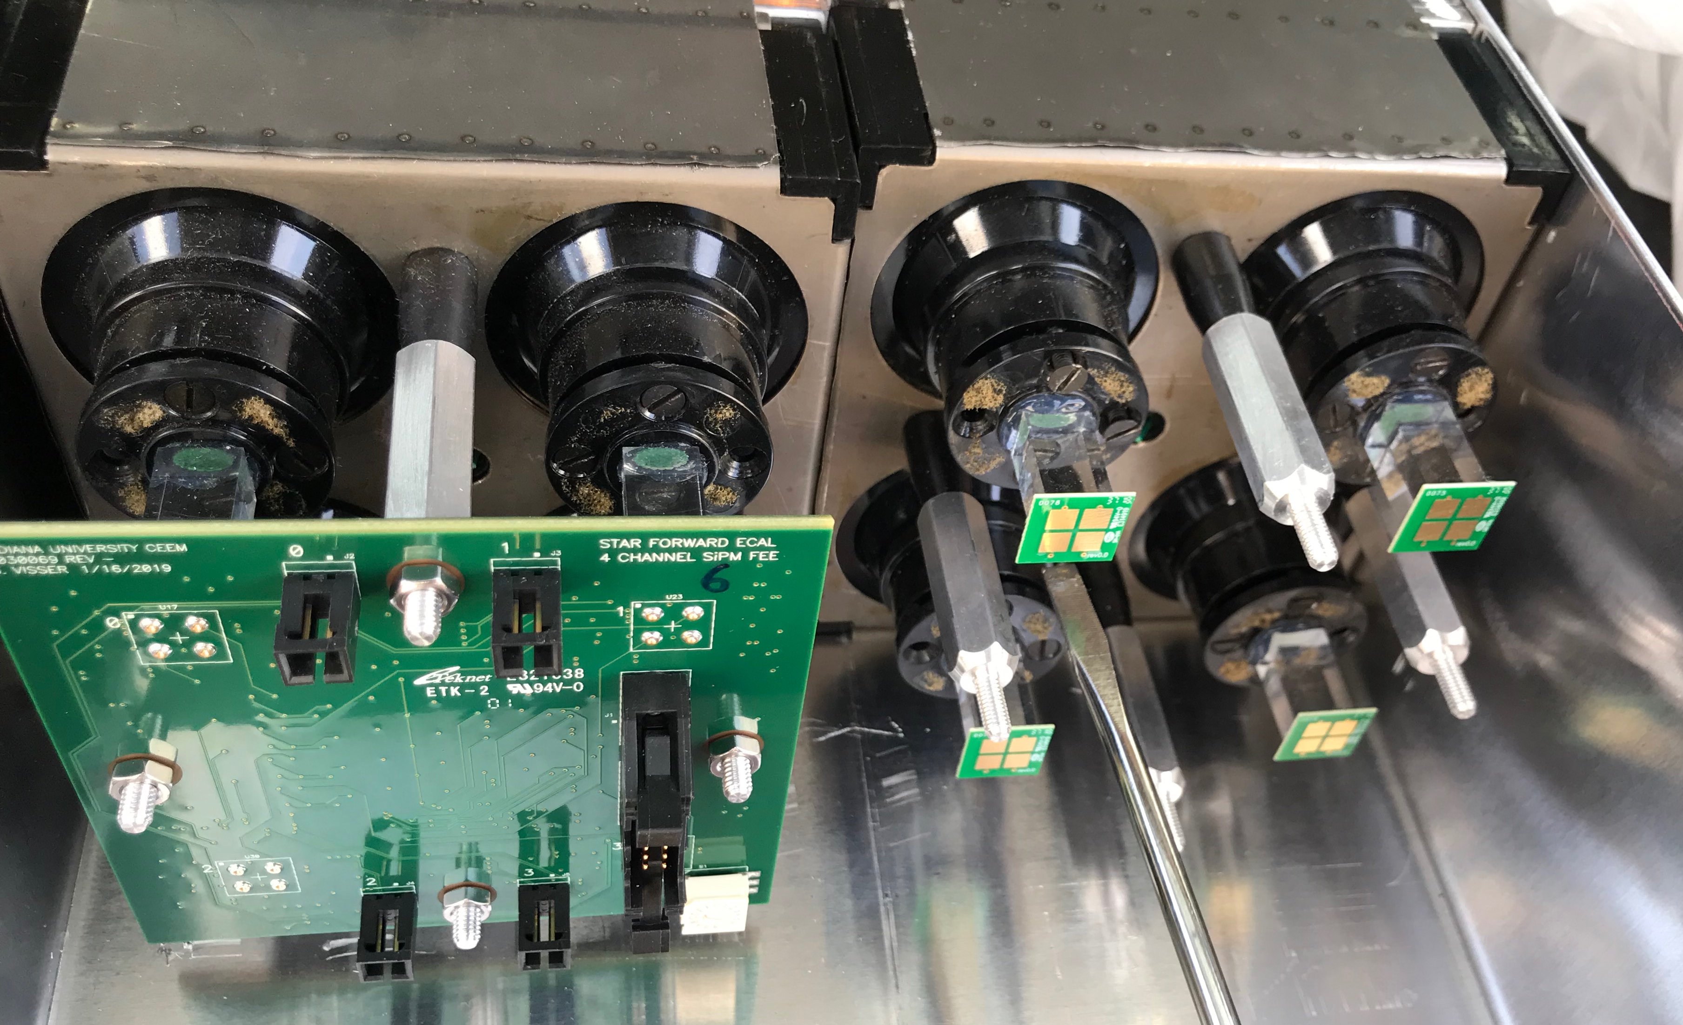
4 EMCal Modules at Fermilab: SiPM Readout
1 Module = 4 Towers
4-lightguides
Each lightguide:
2-SiPM readout
2 SiPM s
Per Tower
(Channel)

Slide 6
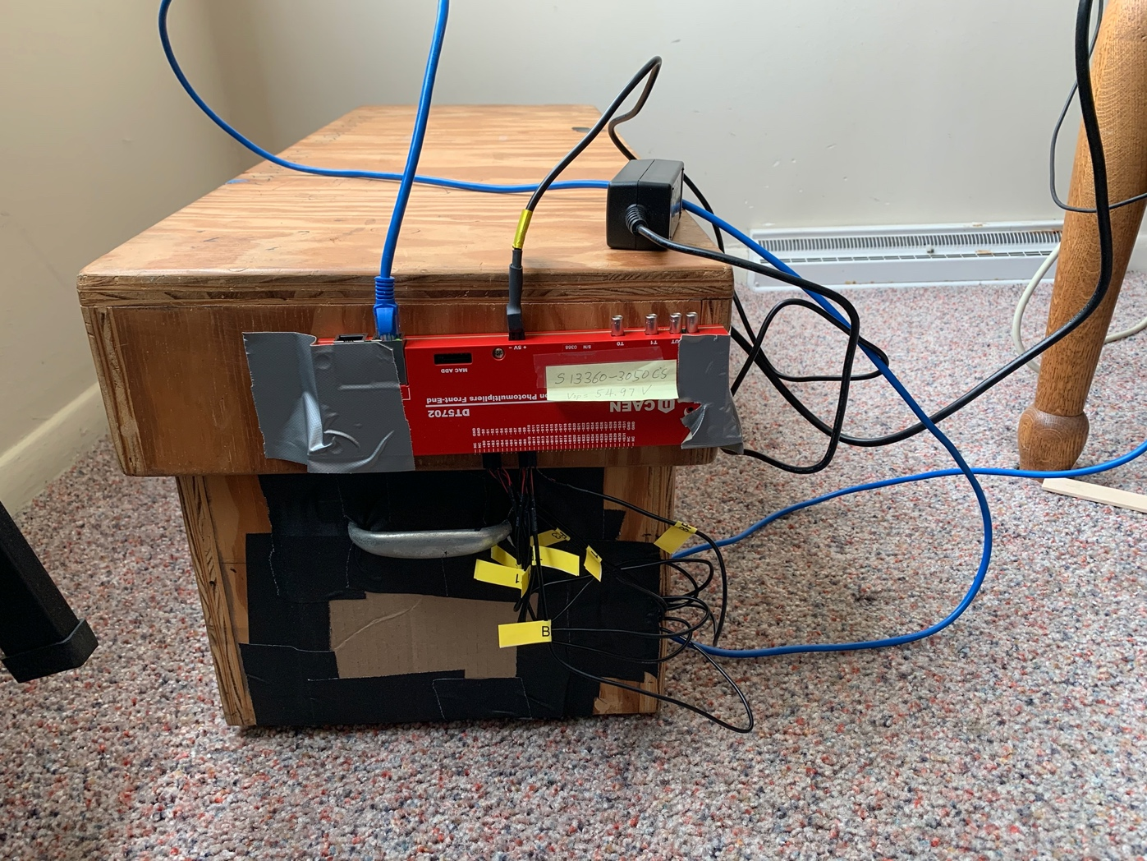
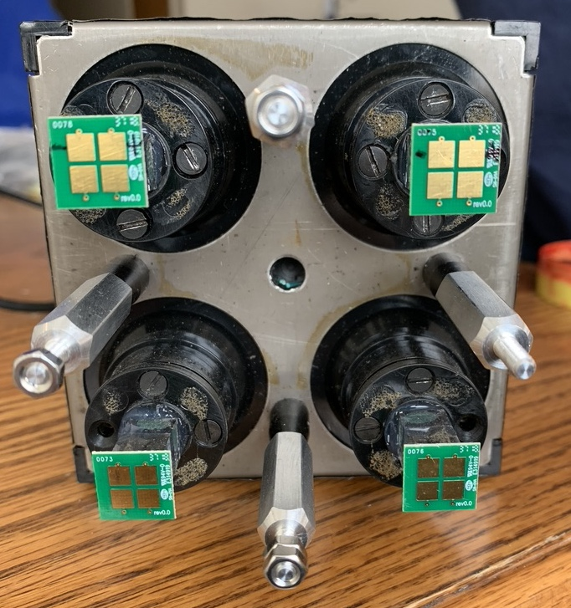
Two EMCal Modules Readout Setup @Fermilab
Kun & Ming
1x2 module setup
for cosmic ray
-8 readout channels
8 SiPMs + CAEN 7502 + Linux computer
11cm
11cm

Slide 7
FEE & SIPM Gain
STAR 2019 TB Note
Vertical vs horizontal muons:
~1/6 in signal (H)

Slide 8
Test Beam Data from 2019 Run
6GeV pi^{+/-} and e⁻
Light output: MIP vs E-shower
dE(e)/dE(MIP) = 785/33 = 24
MIP energy resolution:
- 5.08/32.8 = 15.5%
Energy resolution @6GeV, e-shower
- dE/E = 43.3/785 = 5.5%

Slide 9
MIP Signal in EMCal: independent of E, up to E~120GeV dE ~ 250MeV in EMCal
E-Shower/MIP = 4 x E (in GeV): ~20 for 5GeV e⁻
Uniform response to MIP
(GEANT Sim/STAR)

Slide 10
E-Shower Energy Resolution: Test Beam Data
- E1039: tracking dP/P ~1%, position resolution ~<1mm
EMCal dE/E = 11%/sqrt(E)
  used for pID
  background rejection

Slide 11
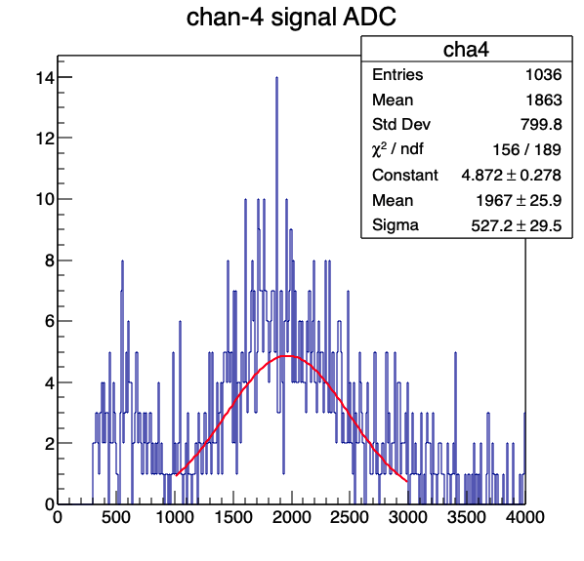
Signal <ADC> vs HG/LG, HV Bias Scan with Cosmic Rays
Data on FELIX-2 Server
  /home/maps/ming/trigger/FEBDAQMULT/DAQ
  Analysis macro : plot_6.C
With a single Gaussian Fit

Slide 12
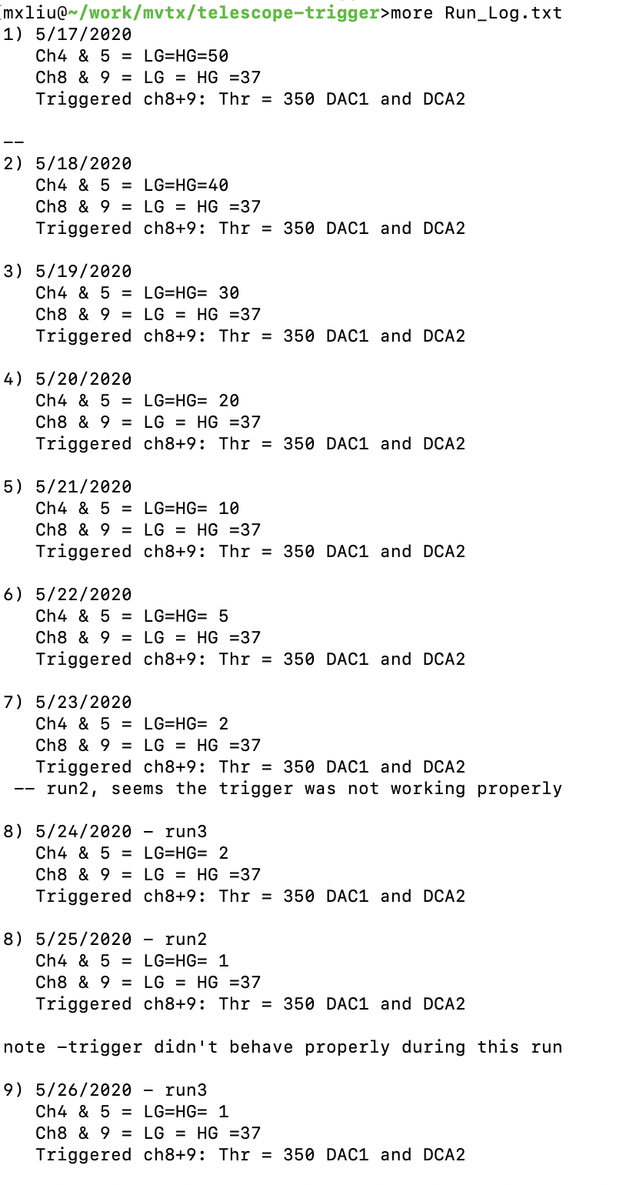
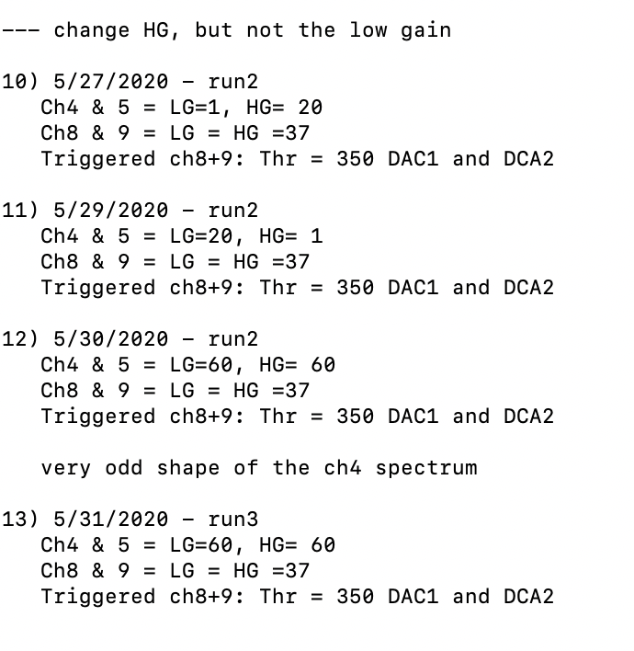
Scan Channel HG and LG for Chan-4/5
Trigger setting unchanged

Slide 13
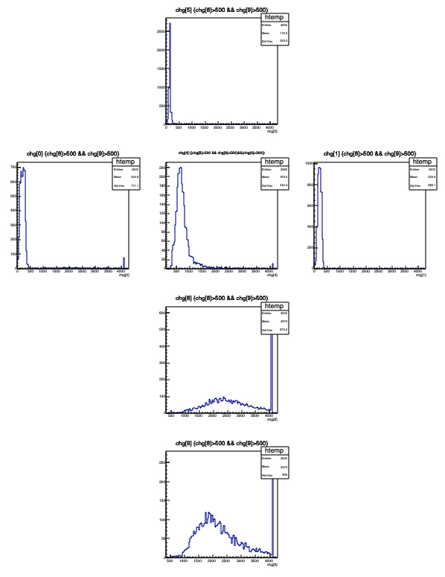
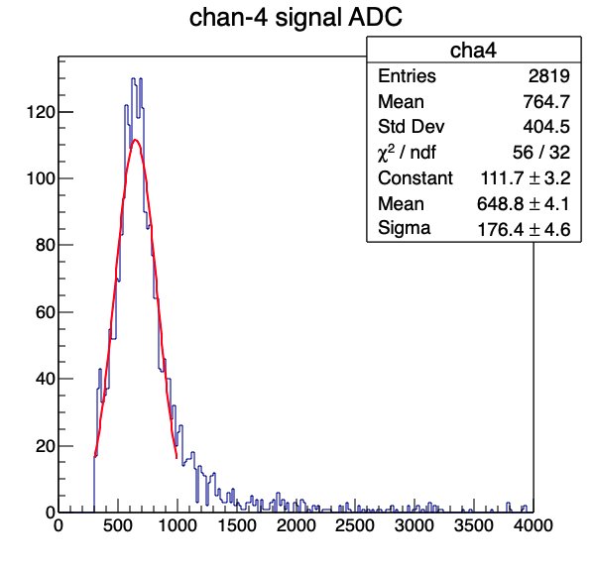
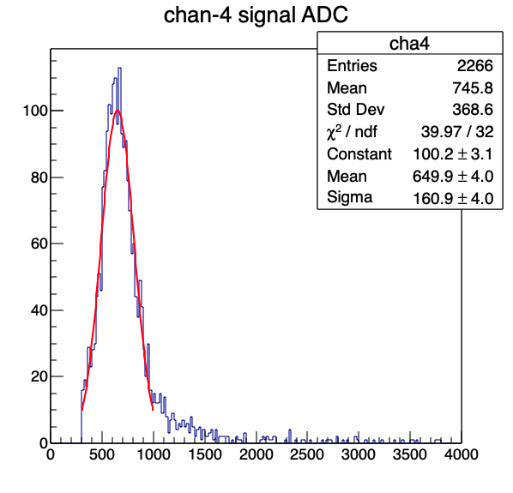
HG=1 and LG=1
mppc-cosmic-trigger-counters-Channel-4-5-HG1-LG1-8-9-HGLG-37-Thr350-run2.root
mppc-cosmic-trigger-counters-Channel-4-5-HG1-LG1-8-9-HGLG-37-Thr350-run3.root
A = 649 +/-4 (Run2); Sig= 176 +/-5
A = 650 +/- 4 (Run3); Sig = 161 +/-4
Run2
Run3

Slide 14
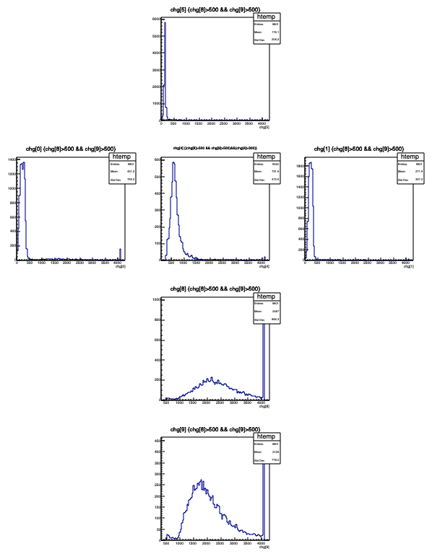
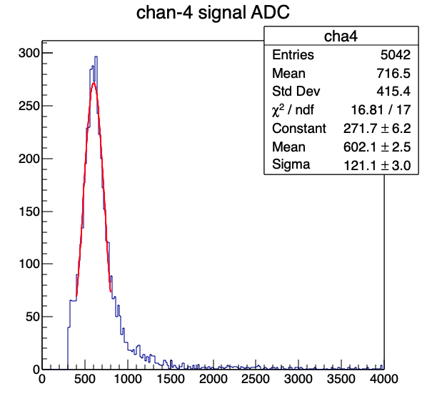
HG =1, LG = 20
mppc-cosmic-trigger-counters-Channel-4-5-HG1-LG20-8-9-HGLG-37-Thr350-run2.root
A= 602 +/-3
Sig = 121 +/-3

Slide 15
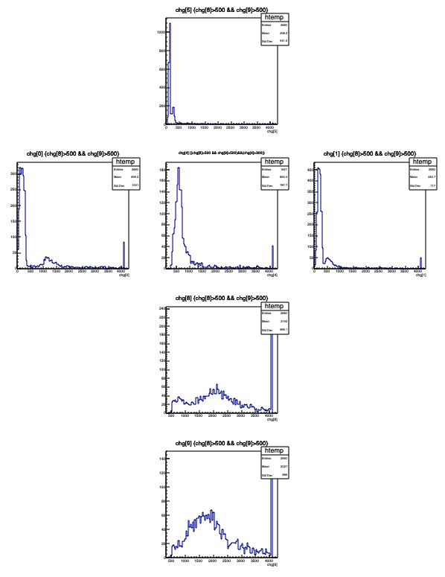
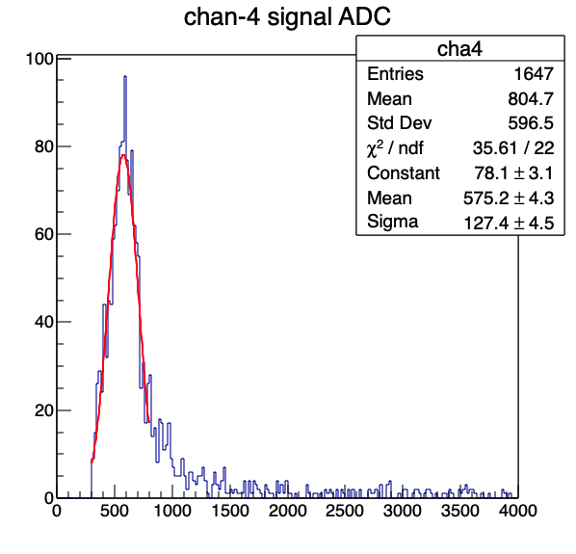
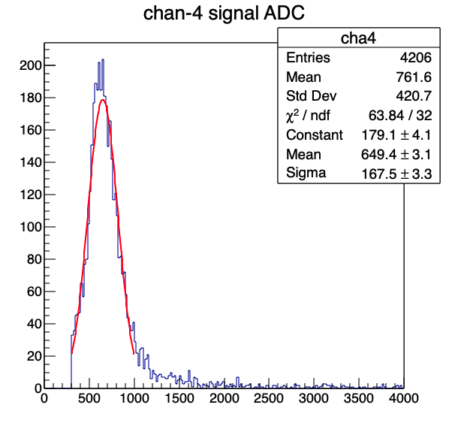
HG =2, LG =2
mppc-cosmic-trigger-counters-Channel-4-5-HG2-LG2-8-9-HGLG-37-Thr350-run2.root
mppc-cosmic-trigger-counters-Channel-4-5-HG2-LG2-8-9-HGLG-37-Thr350-run3.root
A = 575 +/- 4; Sig = 127 +/-5
A = 649 +/- 3; Sig = 167 +/- 3
Run3
Run2

Slide 16
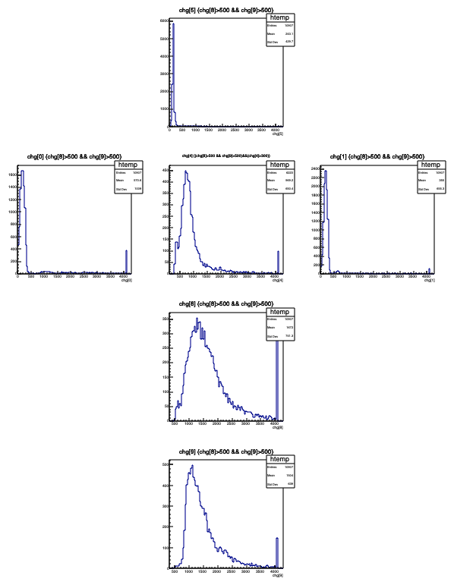
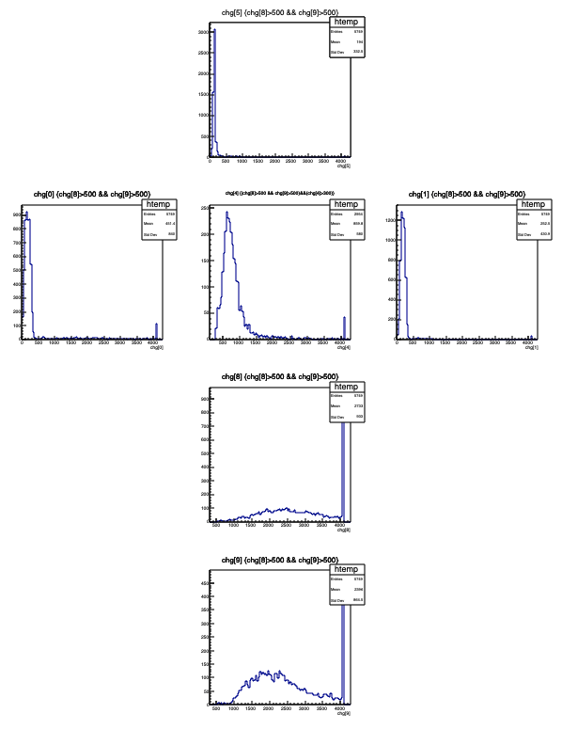
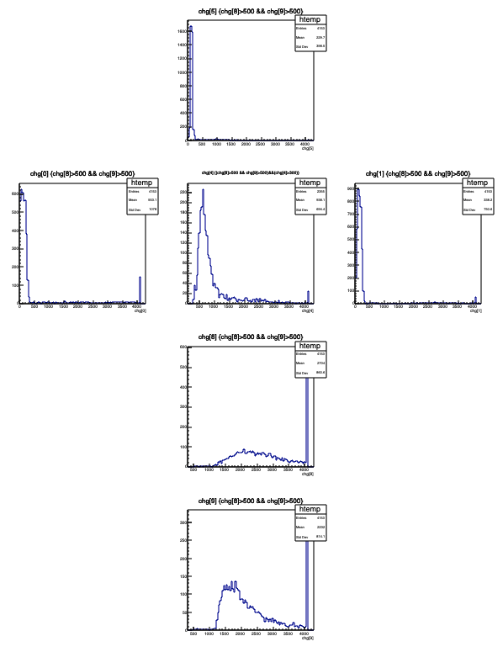
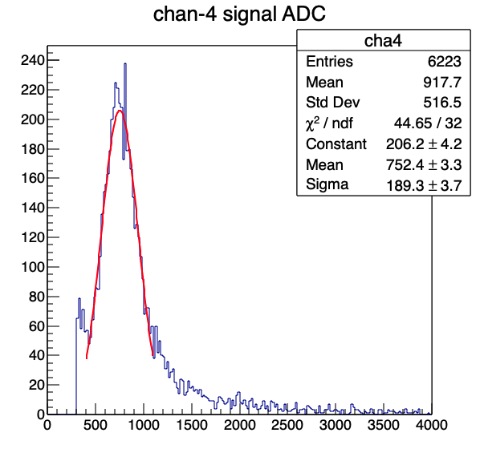
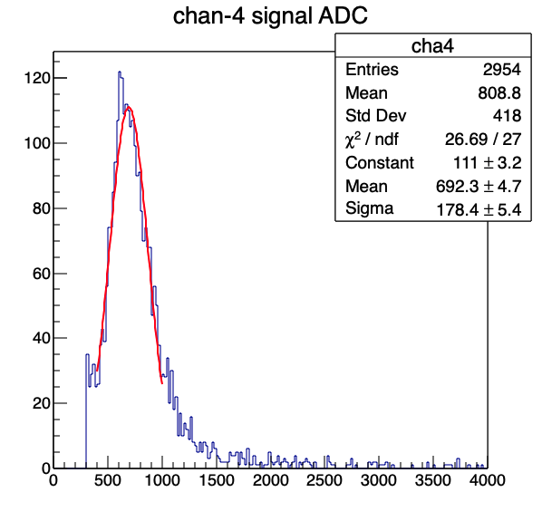
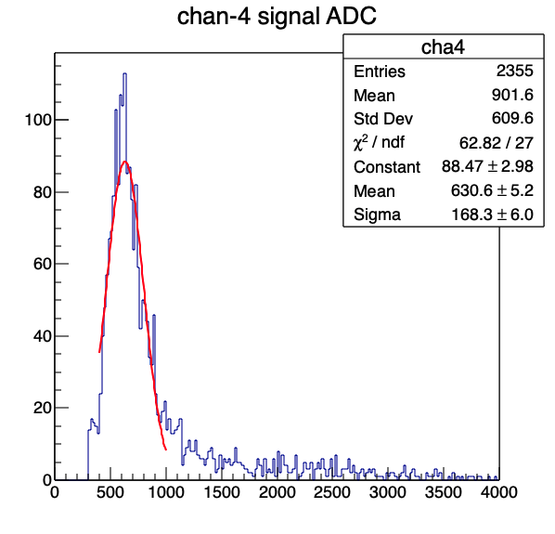
HG=5, LG =5
Run-1
Run-2
mppc-cosmic-trigger-counters-04082025-Channel-4-5-8-9-HG5-LG5.root
mppc-cosmic-trigger-counters-Channel-4-5-HG5-LG5-8-9-HGLG-37-Thr350-run2.root
mppc-cosmic-trigger-counters-Run1492-Channel-4-5-HG5-LG5-8-9-HGLG-37-Thr380.root
A= 752 +/- 3; Sig = 189 +/- 4
A = 692 +/- 5; Sig = 178 +/- 5
A = 630 +/- 5; Sig = 168 +/-6
Run-3
Run-1
Run-2
Run-3

Slide 17
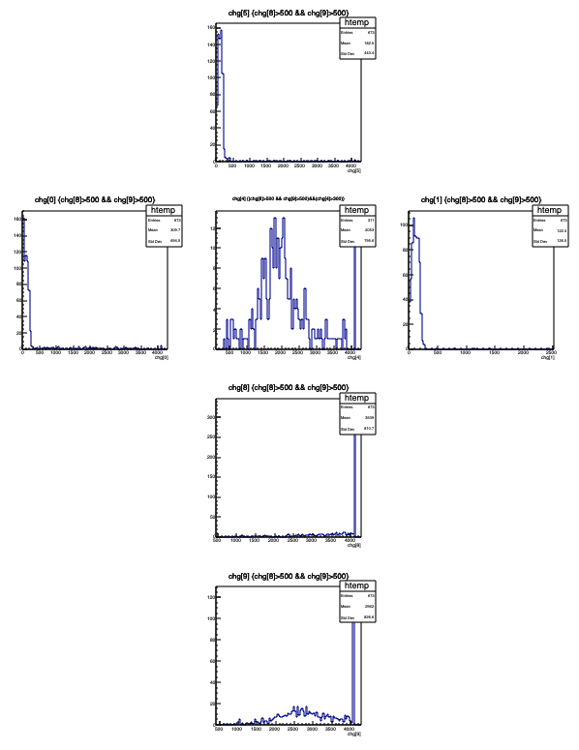
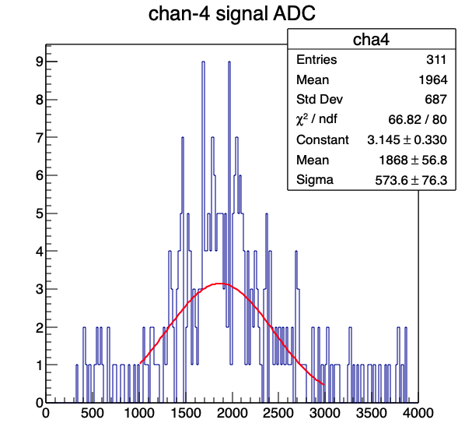
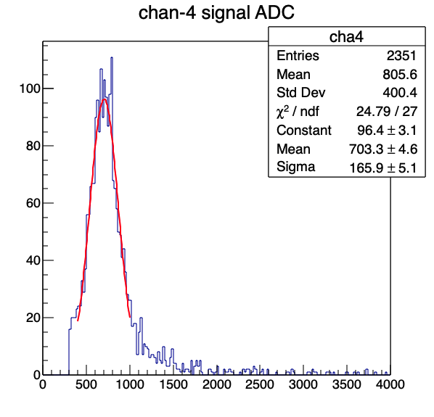
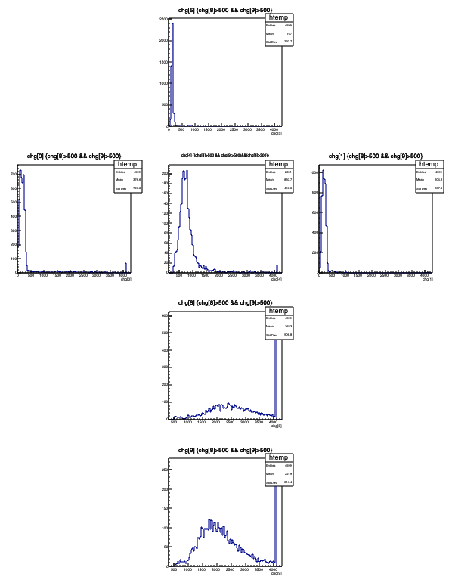
HGF =10, LG =10
Run 1
mppc_cosmic_trigger_C4_CH5_HG10_run1488.root
mppc-cosmic-trigger-counters-Channel-4-5-HG10-LG10-8-9-HGLG-37-Thr350-run2.root
A = 1868 +/- 57; Sig = 574 +/- 76
A = 703 +/- 5; Sig = 166 +/-5
Run 2

Slide 18
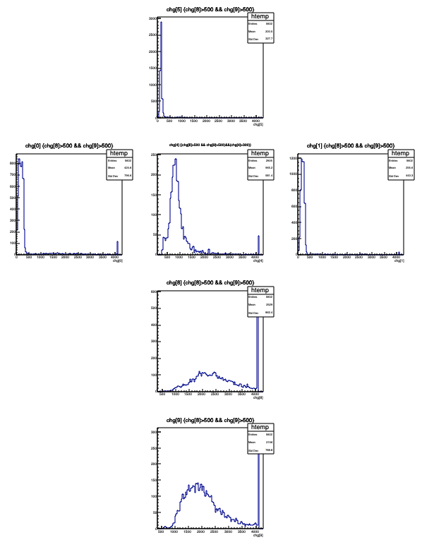
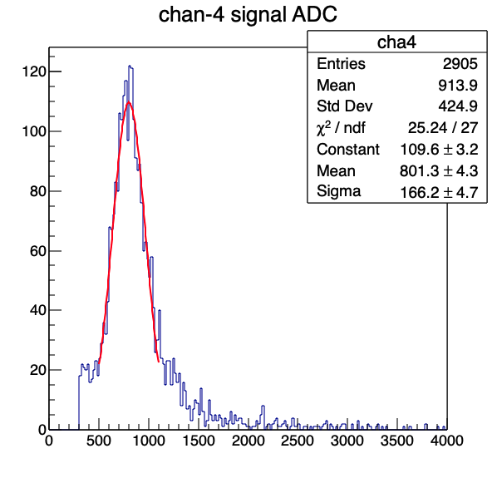
HG=20, LG=20
mppc-cosmic-trigger-counters-Channel-4-5-HG20-LG20-8-9-HGLG-37-Thr350-run2.root
A = 801 +/- 4
Sig = 166 +/-5

Slide 19
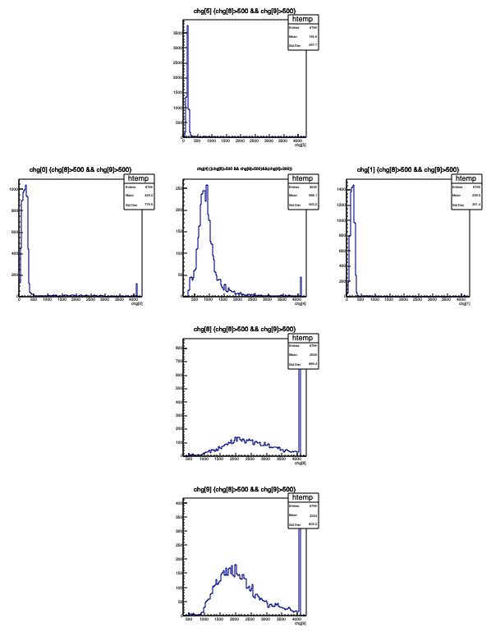
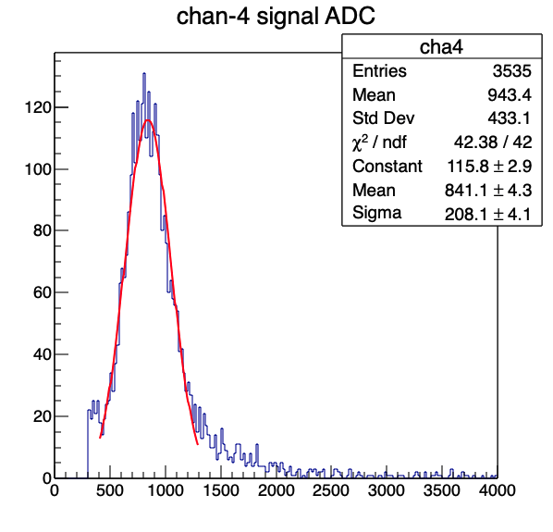
HG=20, LG=1
mppc-cosmic-trigger-counters-Channel-4-5-HG20-LG1-8-9-HGLG-37-Thr350-run2.root
A= 841 +/- 4;
Sig = 208 +/- 4

Slide 20
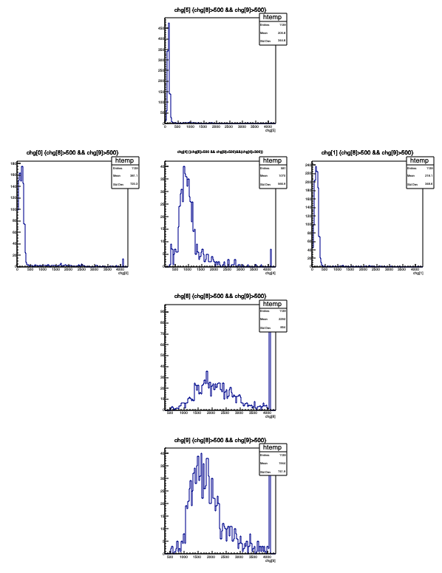

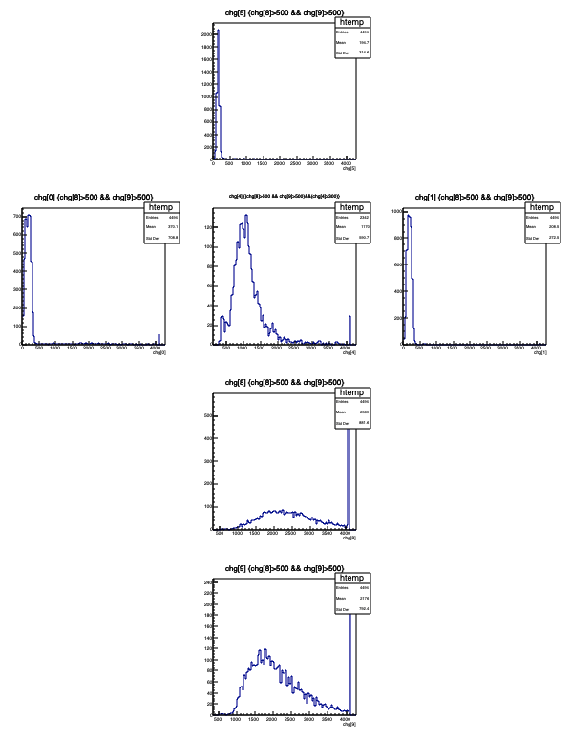
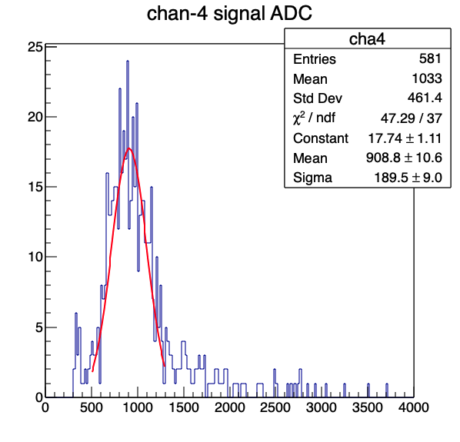
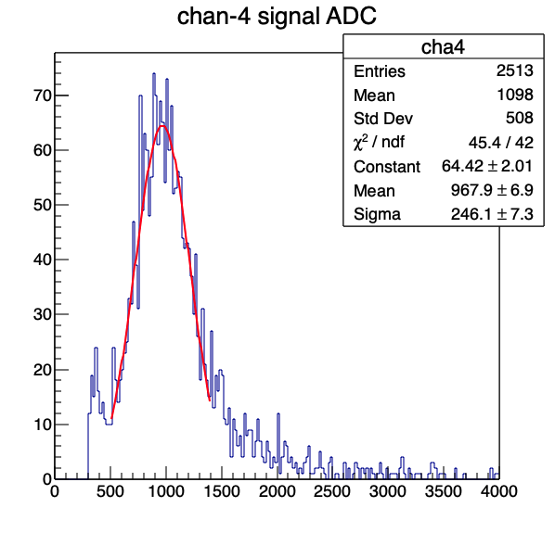
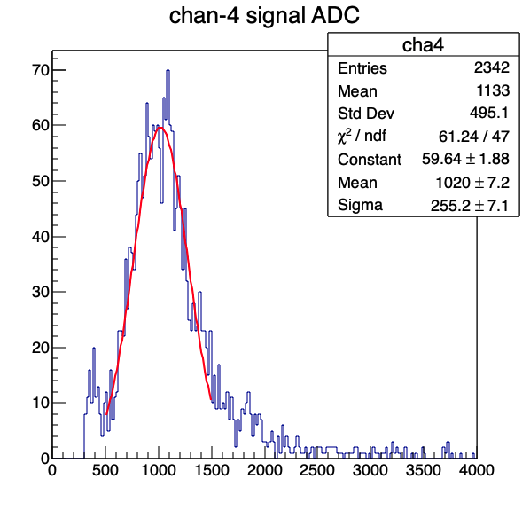
HG=30, LG = 30
1
2
mppc-cosmic-trigger-counters-Run1492-Channel-4-5-HG30-LG30-8-9-HGLG-37-Thr350.root
mppc-cosmic-trigger-counters-Channel-4-5-HG30-LG30-8-9-HGLG-37-Thr350.root
mppc-cosmic-trigger-counters-Channel-4-5-HG30-LG30-8-9-HGLG-37-Thr350-run2.root
A = 909 +/-11; Sig = 190 +/- 9
A = 968 +/- 7; Sig = 246 +/- 7
A = 1020 +/-7; Sig = 255 +/-7
Run2
Run2

Slide 21
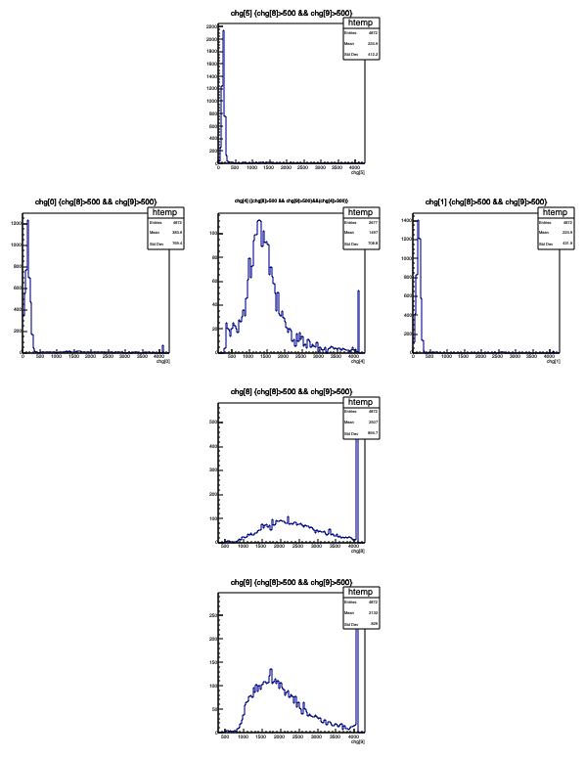
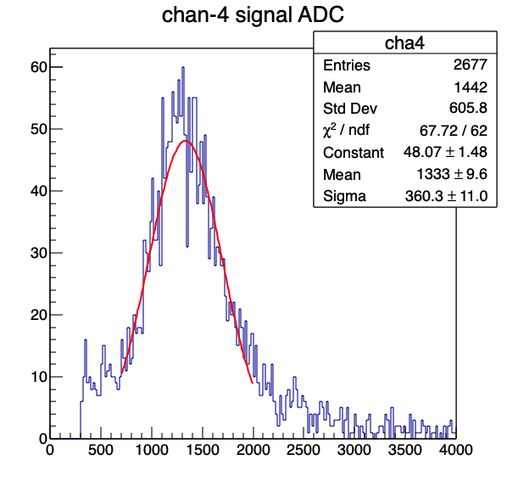
HG=40, LG = 40
mppc-cosmic-trigger-counters-Channel-4-5-HG40-LG40-8-9-HGLG-37-Thr350.root
A = 1333 +/- 10
Sig = 360 +/-11

Slide 22
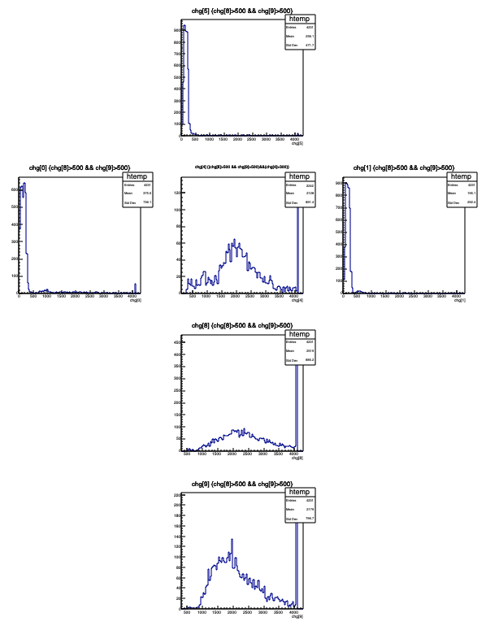
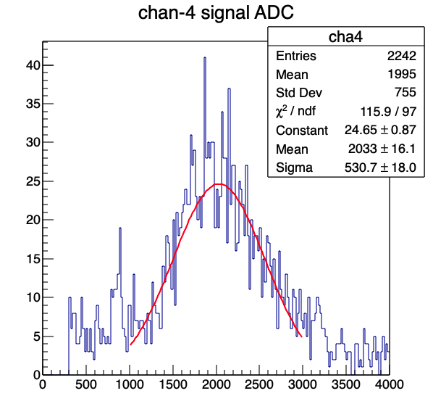
HG=50, LG=50
mppc-cosmic-trigger-counters-Channel-4-5-HG50-LG50-8-9-HGLG-37-Thr350.root
A = 2033 +/-16
Sig = 531 +/- 18

Slide 23
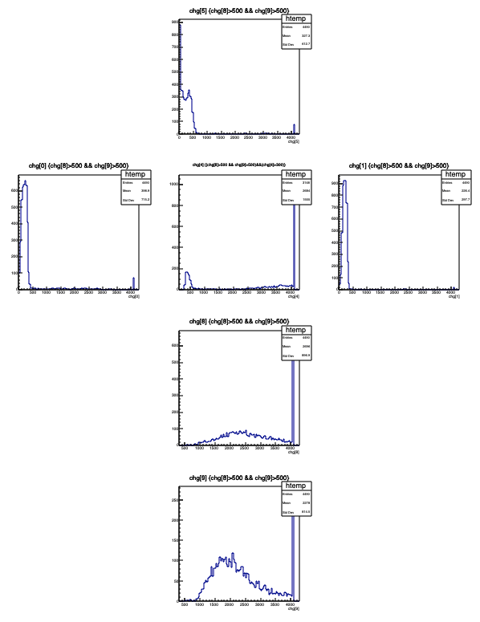
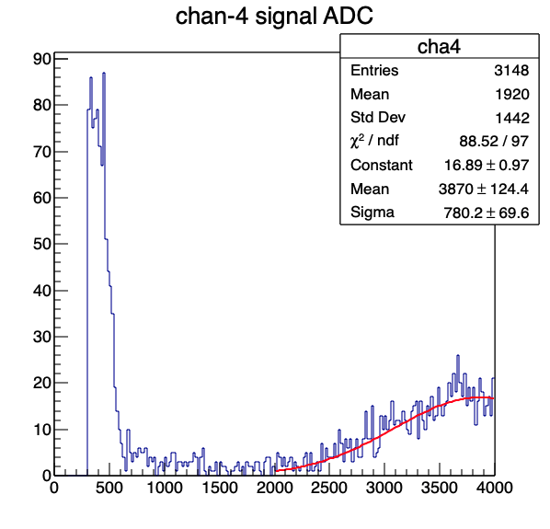
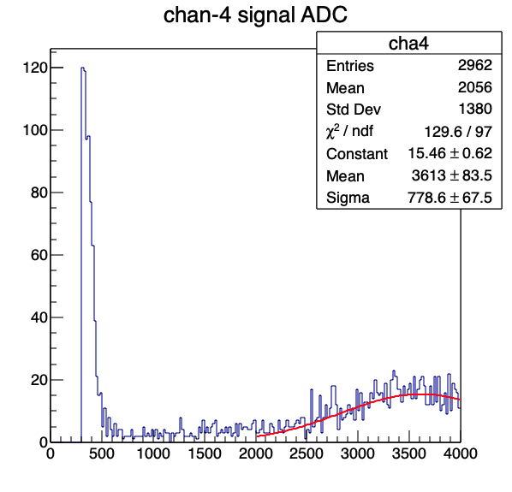
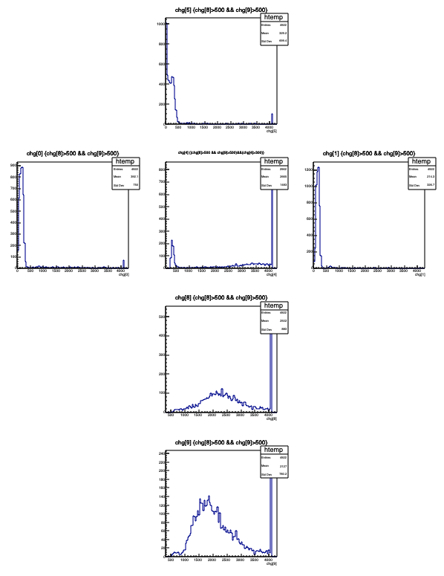
HG = 60, LG = 60
Run-2
mppc-cosmic-trigger-counters-Channel-4-5-HG60-LG60-8-9-HGLG-37-Thr350-run2.root
mppc-cosmic-trigger-counters-Channel-4-5-HG60-LG60-8-9-HGLG-37-Thr350-run3.root
A= 3870 +/- 124; Sig = 780 +/-70
A = 3613 +/- 84; Sig = 779 +/-68
Run-3
Run-3
Run-2

Slide 24
Summary: Mean vs High Gain
High Gain

Slide 25
HG Scan: Mean & Sig
Delta_V = 4 V over DCA = 256;
~ 1V / 64DAC
D_DAC = 20 -> dV = 0.31V

Slide 26
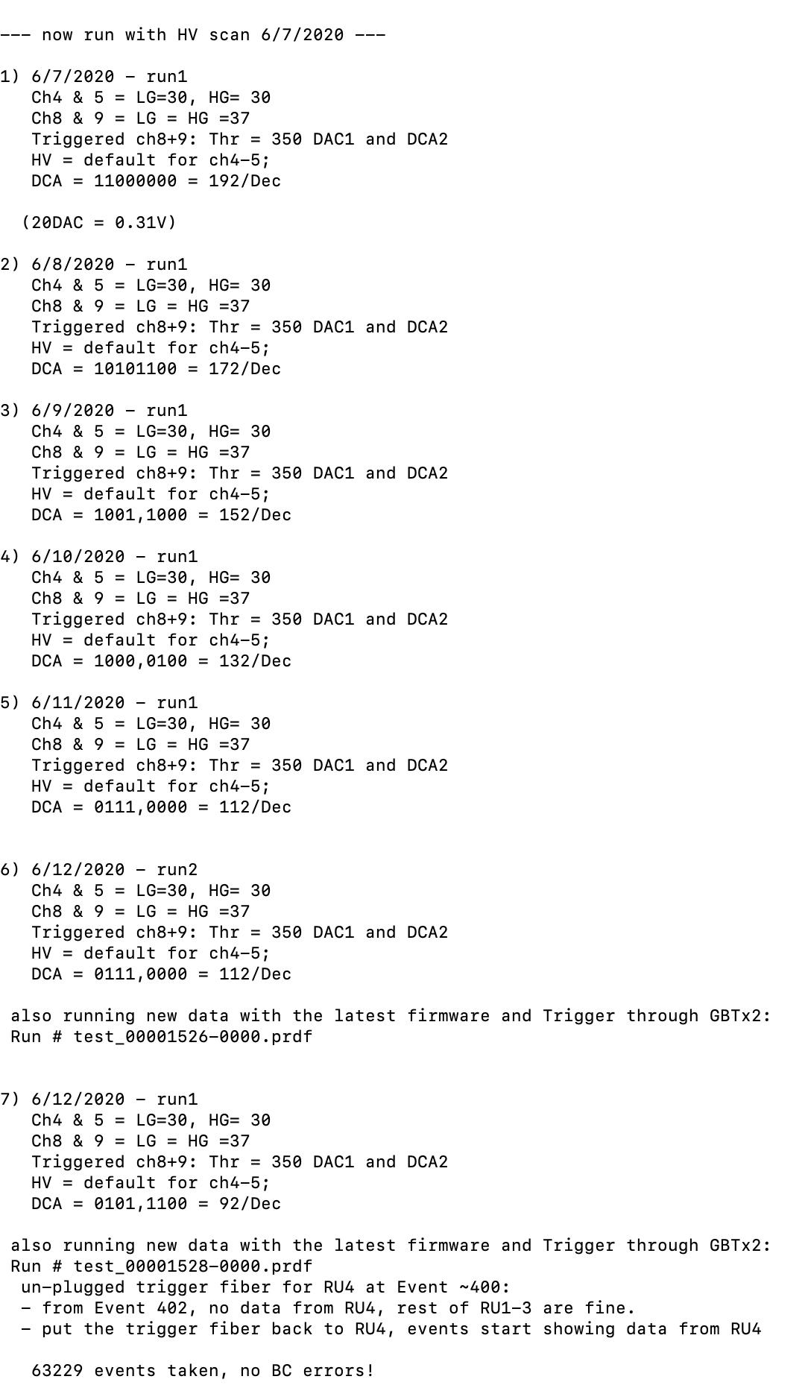
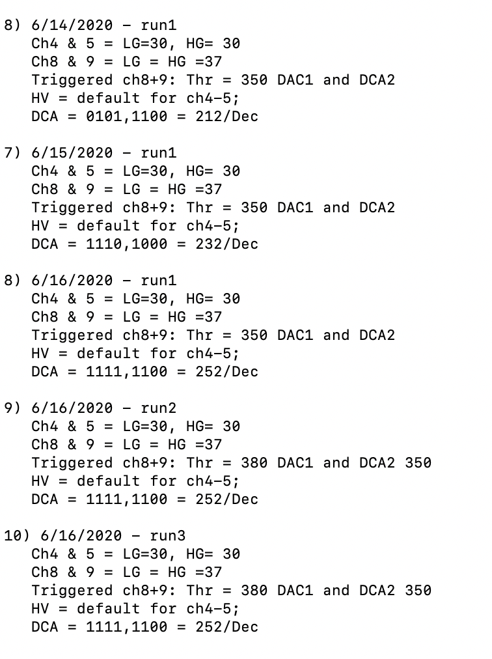
Scan SiPM HV Bias
Scan Chan-4/5
Trigger setting unchanged
HG=LG=30;
Scan HV bias DAC = 92 - 252

Slide 27
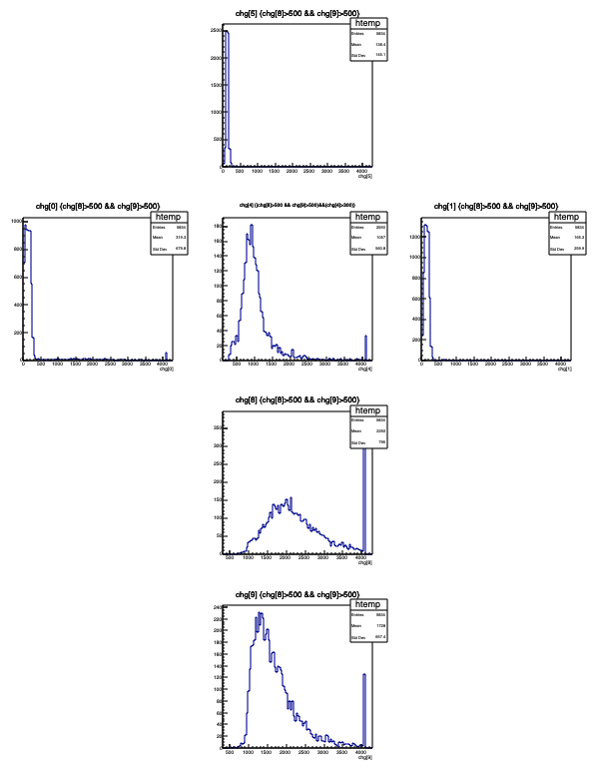
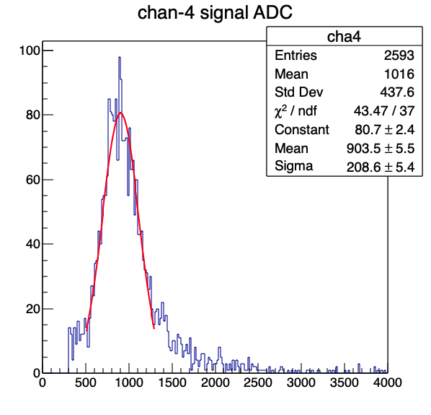
HV DAC = 92; LG ==LG == 30
mppc-cosmic-trigger-counters-Channel-4-5-HG30-LG30-HVBias-DAC-92-Ch8-9-HGLG-37-Thr350-run1.root
A = 904 +/- 6
Sig = 207 +/- 5

Slide 28
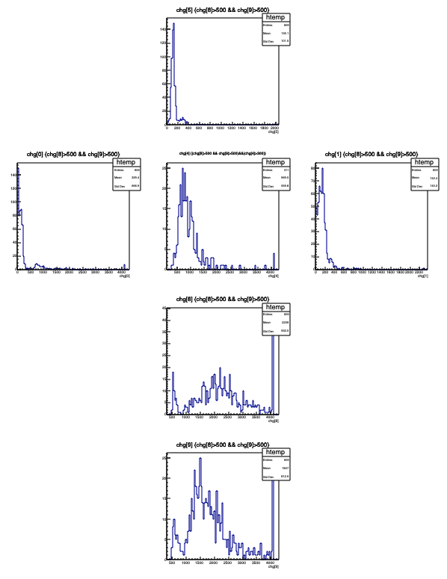
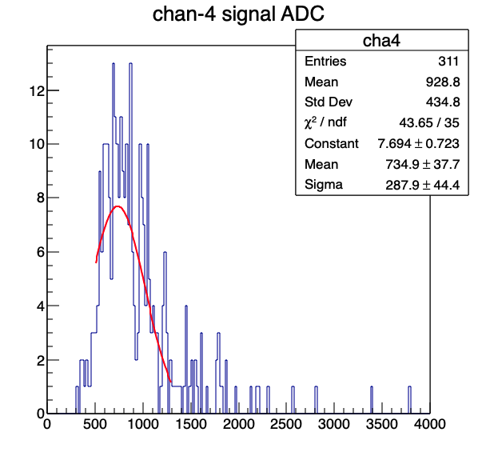
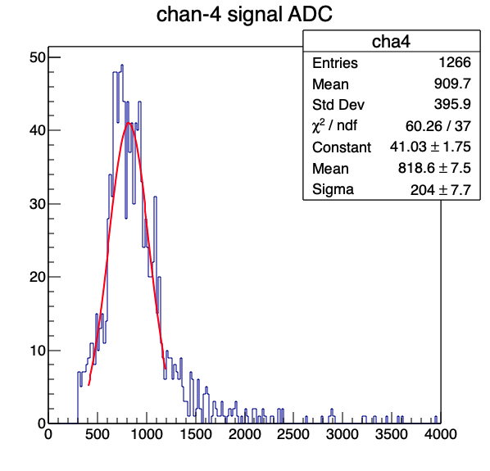
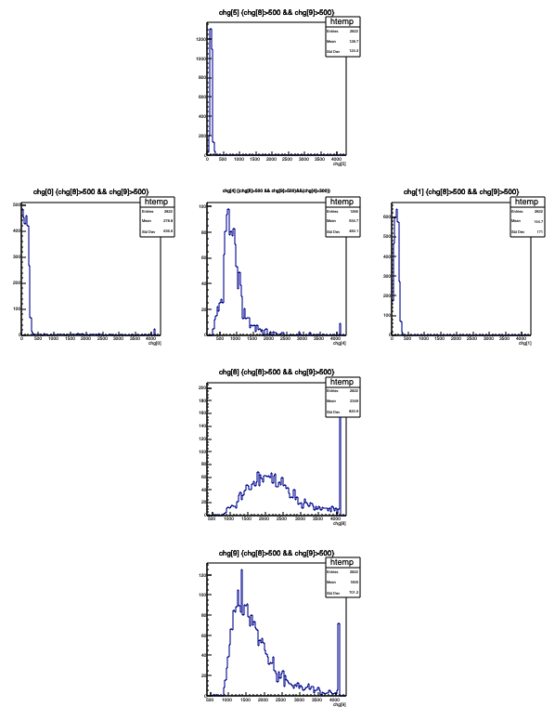
HV DAC = 112
mppc-cosmic-trigger-counters-Channel-4-5-HG30-LG30-HVBias-DAC-112-Ch8-9-HGLG-37-Thr350-run1.root
mppc-cosmic-trigger-counters-Channel-4-5-HG30-LG30-HVBias-DAC-112-Ch8-9-HGLG-37-Thr350-run2.root
A= 735 +/- 38; Sig = 288 +/- 44
A = 819 +/- 8; Sig = 204 +/-8

Slide 29


HV DAC = 132
mppc-cosmic-trigger-counters-Channel-4-5-HG30-LG30-HVBias-DAC-132-Ch8-9-HGLG-37-Thr350-run1.root
A = 889 +/- 9
Sig = 255 +/-10

Slide 30


HV DAC = 152
mppc-cosmic-trigger-counters-Channel-4-5-HG30-LG30-HVBias-DAC-152-Ch8-9-HGLG-37-Thr350-run1.root
A = 792 +/- 6; Sig = 227 +/- 6

Slide 31


HC DAC = 172
mppc-cosmic-trigger-counters-Channel-4-5-HG30-LG30-HVBias-DAC-172-Ch8-9-HGLG-37-Thr350-run1.root
A = 821 +/- 7
Sig = 199 +/- 7

Slide 32


HV DAC= 191
mppc-cosmic-trigger-counters-Channel-4-5-HG30-LG30-HVBias-DAC-191-Ch8-9-HGLG-37-Thr380-run1.root
A = 976 +/- 6
Sig = 210 +/- 7

Slide 33


HV DAC = 192 (Default)
mppc-cosmic-trigger-counters-Channel-4-5-HG30-LG30-HVBias-DAC-192-Ch8-9-HGLG-37-Thr350-run1.root
A = 996 +/- 6
Sig = 209 +/- 6

Slide 34


HV DAC = 212
mppc-cosmic-trigger-counters-Channel-4-5-HG30-LG30-HVBias-DAC-212-Ch8-9-HGLG-37-Thr350-run1.root
A = 1263 +/- 10
Sig = 325 +/- 10

Slide 35


HV DAC = 232
mppc-cosmic-trigger-counters-Channel-4-5-HG30-LG30-HVBias-DAC-232-Ch8-9-HGLG-37-Thr350-run1.root
A = 1642 +/- 17
Sig = 405 +/-17

Slide 36






HV DAC = 252
Run-1
Run-2
mppc-cosmic-trigger-counters-Channel-4-5-HG30-LG30-HVBias-DAC-252-Ch8-9-HGLG-37-Thr350-run1.root
mppc-cosmic-trigger-counters-Channel-4-5-HG30-LG30-HVBias-DAC-252-Ch8-9-HGLG-37-Thr380-350-run2.root
mppc-cosmic-trigger-counters-Channel-4-5-HG30-LG30-HVBias-DAC-252-Ch8-9-HGLG-37-Thr380-350-run3.root
A = 2028 +/- 41; Sig = 500 +/- 52
A = 2142 +/- 13; Sig = 409 +/- 12
A = 2133 +/- 11; Sig = 430 +/- 10
Run-3
Run-2
Run-3
Run-1

Slide 37
Summary: Mean vs HV DAC
HV DAC
Next to-do: set DAC = 232, and scan HG

Slide 38
Next to do:
Next to-do: set DAC = 232, and scan HG = 1 - 63
HV DAC
High Gain

