Slide 1
Run2-TDC Development and Test
Su-Yin Grass Wang, Jin-Yuan Wu, David Christian Da-Shung Su and Wen-Chen Chang

Slide 2
Outline
Improvements of Run2 TDC
Run2 TDC design
Deadtime estimation
Production test (with CODA)
Bin-Width Plot
Test # 1~5 (Cross-Talk, Resolution, Multi-Hits for Buffer 1~3, remove multiple hit function test)
Time line

Slide 3
Improvements of Run2-TDC
Zero suppression is naturally applied
Based on the multi-sampling principle, the TDC card records hits only. Zero suppression is intrinsic in the design.
Adjustable time window
The time window can be adjusted to fit all E906 detectors
Multiple events per interrupt (2 ~ 32, user defined)
Multiple hits elimination - keep only first hit in user select time region.
Scalar - keep counting the number of hits in each channel

Slide 4
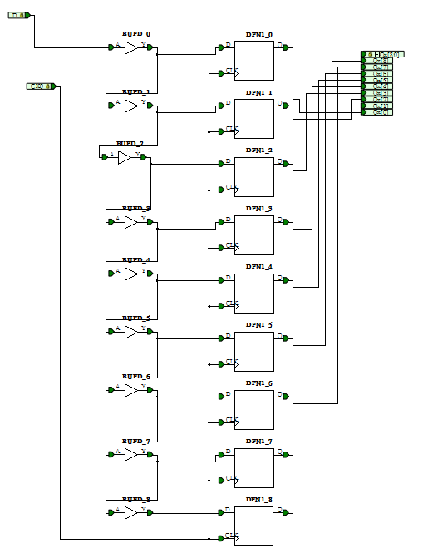
Run2 TDC Design
Input signals propagate in a 9-bin delay line.
There is a free running 250MHz clock inside the TDC.
Input transitions are recorded every 4 ns.
4ns / 9 bins~0.44ns/bin

Slide 5
Run2 TDC Design
Event buffer
First layer buffer
second layer buffer
The TDC records the time of every hit in each channel. A maximum of 4 hits per channel can be temporarily stored in the first layer buffer.
Every 4 clock cycles at 62.5 MHz, one hit in first layer buffer of each channel is transferred to the second layer and cleared. Data from a group of 4 channels are written into one of the 2 (or 4,8) circular buffers inside FPGA, in await for a trigger.
When a trigger arrives, the pointer of writing is shifted to the next circular buffer and the hits in the circular buffer are copied to the event buffer.

Slide 6
Multiple Hits Elimination
TFQ[0] (Data valid)
DD is the register controls multiple hits elimination.
DD[7]
=1: Eliminating Multiple Hits
DD[6]
=1: Updating Mode
=0: Non-updating Mode
DD[5:0]
0-63: Number of cycles of multiple hits elimination. 4ns*(4+DD[5:0])
(updating mode 0-31 only)
Reg1_0_Q[0]
DFN1_1_Q
(DFN1_2Off if DD[6]=1)
DFN1_0_Q
(DFN1_2On if DD[6]=1)
DFN1_2_Q
Q[5:0]
X
3
3
2
1
0
3F
3E
3D
3C
3
DFN1_3_Q
Hits from Reg1_0_Q[0] are blocked in this region.

Slide 7
Multiple Hits Elimination
In register map : 0x00c
BLKS(26-24) |DeMultiDD(23-16) |CR_Reset(15) | CR_Clear(0)
DeMultiDD (5-0) length of Inhibit : 0-63: Number of cycles of multiple hits elimination. 4ns*(4+DD[5:0]) (16 – 272 ns)
(updating mode 0-31 only)
DeMultiDD (6) update mode/NON –update mode
DeMultiDD (7) Elimination on/off
Raw data
Inhibit
TDC recorded

Slide 8
Scalar
TC[8..3]
62
63
0
1
2
3
4
5
TC[2]
TCQ[8..3]
62
63
0
1
2
3
4
5
TCQ[2]
SE[1]
SE[0]
QS[7..0]
CH0
1
2
3
4
5
SEL=TC[2]
ADDRA[5..0]
=TC[8..3]
(for read)
62
63
0
1
2
3
4
5
ADDRA[5..0]
(for write)
62
63
0
1
2
3
4
5
Write
(inv. RWA)
=TC[2]
DD is the register controls multiple hits elimination.
of multiple hits elimination. 4ns*(4+DD[5:0])

Slide 9
Run2 TDC Design
TDC bin width | ~0.44 ns
Minimum width of signal | 4 ns
Maximum number of hits in 64 ns | 4 hits
Width of accepted window | Adjustable: 4 – 2048 ns in a 4-ns step
Edge detection | Adjustable: leading edge only or both edges.
Maximum number of hits per trigger | Adjustable: 32-1024
Maximum numbers of events per IRQ | Adjustable: 2-32
Scalar buffer to record # of hits each channel | 8
Multiple Hits Elimination | Adjustable: Disable time window (16 -272)

Slide 10
Register Map
0x000 version number (e9061212)
0x004 CSR
0x008 test area =0xaaaaaaaa
0x00c
BLKS(26-24) |DeMultiDD(23-16) |CR_Reset(15) | CR_Clear(0)
0x010 0xe906e0## = # of events
0x014
Time Window On(31)
UP_LIMIT(25-16) | LOW_LIMIT(9-0)
0x030 –Time window Check
0x1000~0x1ffc = event buffer (1k internal)
0x2000~0x2ffc = test area
D31-D16 | D11 | D08 | D7-5 | D2-0
EN4X (CSR) | Trig Enable | BothEdge (Edge selection) | SEL(READ/WRITE addr) | M (buffer size)

Slide 11
Configuration
Event table
Adjustable
Time window width
CIP time
Event Buffer
Adjustable
buffer size
number of buffer
CSR [7:5] | Number of Circular Buffers | Circular Buffer Size (MB) | Buffer Timing Window | CIP Time
000 | 8 | 32 | 512 ns (-256 ns) | 32 x 16 x 16 ns = 8 us
001 | 4 | 64 | 1024 ns (-256 ns) | 64 x 16 x 16 ns = 16 us
011 | 2 | 128 | 2048 ns (-256 ns) | 128 x 16 x 16 ns = 32 us
CSR [2:0] | Number of events | Max. number of words/event
5 | 32 | 32
4 | 16 | 64
3 | 8 | 128
2 | 4 | 256
1 | 2 | 512
0 | 1 | 1024
Notes:
These buffer size corresponding to hit accepting window of 512, 1024 and 2048 ns. Due to effect of the RegPipe4a, the 100% hit accepting windows are 256 ns narrower.
The 256 ns here is the part close to the trigger of TDC. Since our trigger is delayed by 700us, we may not care.

Slide 12
DATA format
Header
D15 | D14 | D13 | D12 | D11 | D10 | D09 | D08 | D07 | D06 | D05 | D04 | D03 | D02 | D01 | D0
Trig [15:4] (trigger time) |  |  |  |  |  |  |  |  |  |  |  | Fine time
D31 | D30 | D29 | D28 | D27 | D26 | D25 | D24 | D23 | D22 | D21 | D20 | D19 | D18 | D17 | D16
1 | CNT[10:0] (number of hits) (could indicate truncated data readout ) |  |  |  |  |  |  |  |  |  |  | 0 | 0 | 0 | 1
Error check or checksum?
Data
D15 | D14 | D13 | D12 | D11 | D10 | D09 | D08 | D07 | D06 | D05 | D04 | D03 | D02 | D01 | D0
TDC [15:4] (data time) |  |  |  |  |  |  |  |  |  |  |  | Fine time
D31 | D30 | D29 | D28 | D27 | D26 | D25 | D24 | D23 | D22 | D21 | D20 | D19 | D18 | D17 | D16
Cable: 4,5,6,7 |  |  |  | Channel number: 0-15 |  |  |  | TriggerID (for multiTrigger setup) |  |  |  | 0 | 0 | 0 | positive or negative edge
Notes:
MSB = most significant bit

Slide 13
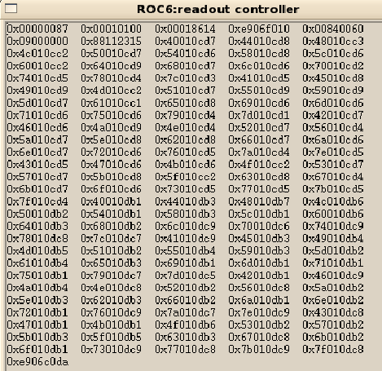
CODA raw data
Ignore every 0xe906e906 in DATA
FEE type
boardID
header
TDC setup= 0xffff0000&Reg(0x00c) +0x0000ffff&Reg(0x004)
Data
End of TDC data

Slide 14
Data transfer speed
A Gigabit Ethernet support at 1 Gbps (1000 Mbps =125 MBps)
VME backplane speed for BLT32 = 25 MB/s (25 B/us) = (10 us to readout each TDC)
In comparison with TDC readout speed, the internet speed won’t be the problem.

Slide 15
Minimum time to operate each TDC event
Initialize TDC Header
Trigger Enable
Trigger Disable
Check Tdc csr
Read Header File
10 us for each IRQ
1.950+ +1.230+1.920= 5.1 us
For each 32bit data point (each hit)= 234.17ns
(~17Byte/us) the TDC data transfer will be the main source of dead time
If there are data in buffer, read data

Slide 16
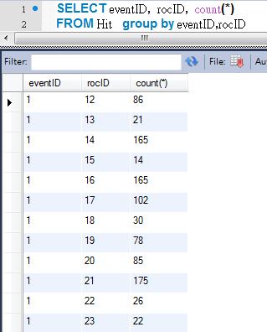
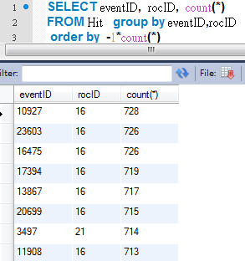
Real case: number of hits per ROC
In the final run (2173) of Run1
In the worst scenario, there are 750 hits per ROC per event .
To read all hits in the ROC, we need 750 *234.17ns =175.6 us
Suppose that there are 7 TDCs in that ROC, the dead time will be 175.6 (234ns *750 hits) + 7*5.1 (5.1us* 7 TDCs) +10 (IRQ)=221 us
That is much better than 680 us in the first run.

Slide 17
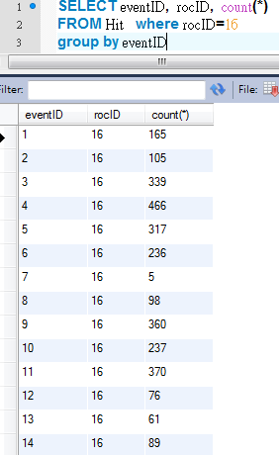
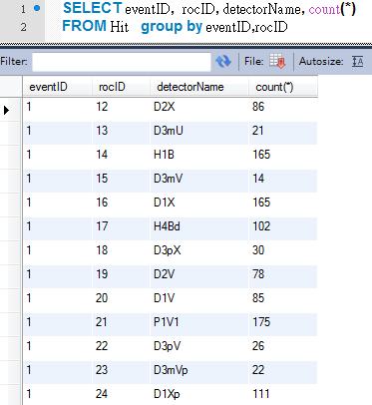
Roc 16 is usually the one with the largest num. of hits
In average, number of hits per ROC per event is less than 200.
46.9 (234ns *200 hits) +35.5 (5.1us* 7 TDCs) +10 (IRQ) = 92.4 us

Slide 18
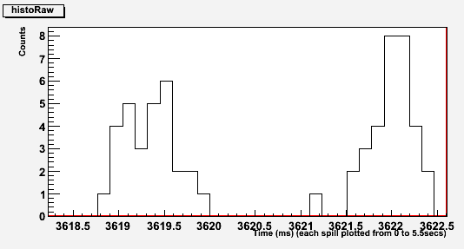
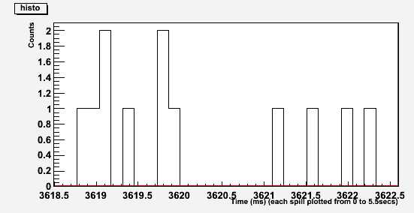
Deadtime estimation with Beam structure
137us bin size
Before Inhibit
Bin size =137 us
It looks that we won’t lose too much event when dead time is short than 137us.
Dead time was 680 us in Run1
If max hits per ROC is more than 391(=(137-35.5-10)/0.234), the dead time will be greater than 137us.
In Run 2173 there are 4852/26225 = 18.5% events with max hits more than 391 on ROC16.
After Inhibit

Slide 19
Production test with v1495 pulse generator
Jin-Yuan made a V1495 FPGA code which can drive V1495 as a pulse generator
The 40 MHz clock on the V1495 board is converted into 137 MHz (40*24/7) to drive all counters in the FPGA. (7.2917 ns)
The frequency does not match any frequency running on TDC card. So we can take it as random hit in some test.
We are using this pulse generator as a tool to perform the production test.
We prepared 4 kinds of test for Run2-TDC and two TDCs are tested.

Slide 20
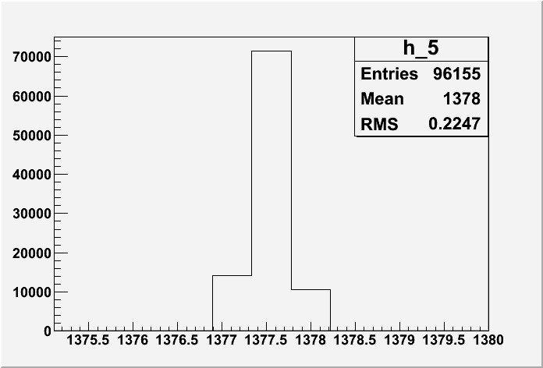
Test #1 Cross-Talk
Signal with time difference in the step of 7.2917 ns in each TDC channel.
TDC Channel (n) = TDC Channel (n+1) – 7.2917ns
TRIG

Slide 21
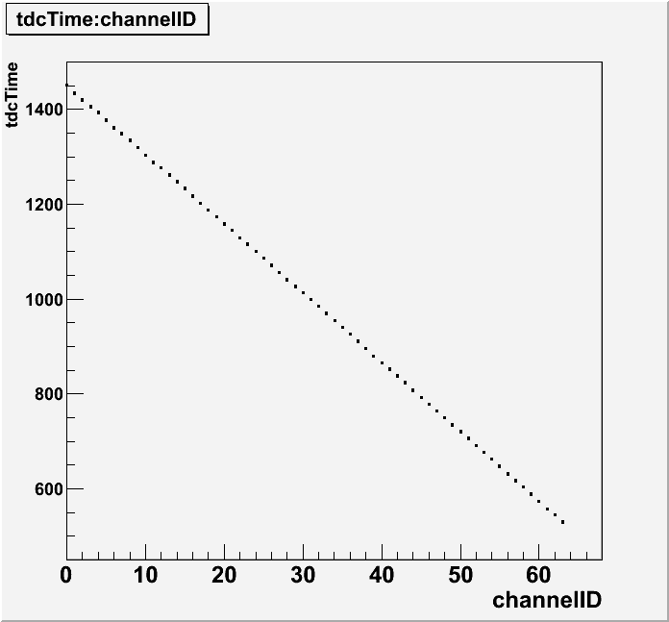
Test #1 Cross-Talk

Slide 22
Test#2 Resolution
If we fix the timing of the input signals and triggers, as we did in Test#1, all data are within 3 bins in the histogram. It is difficult to see how the calibration affects the TDC timing.
Example histogram from test#1

Slide 23
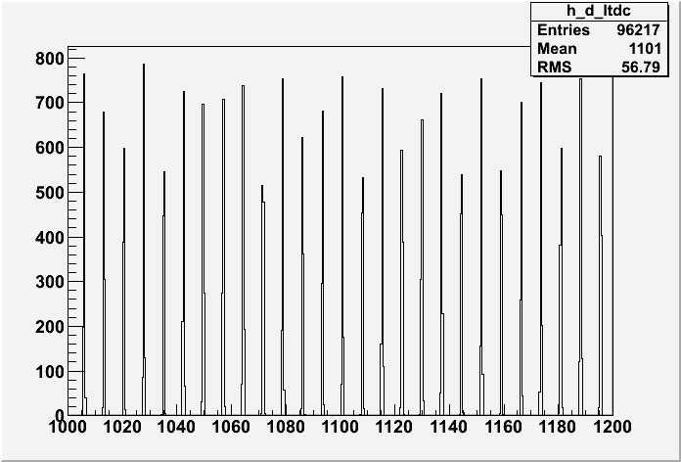
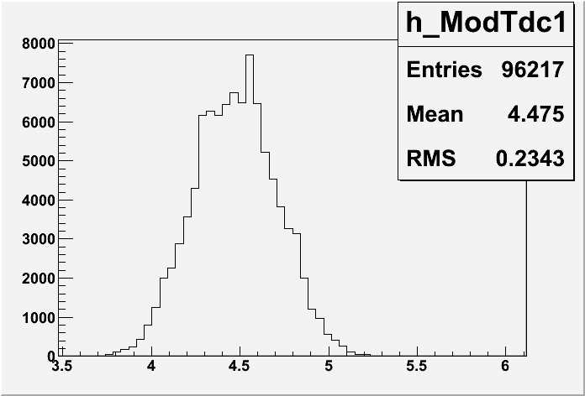
Test #2 Resolution
TRIG
A scan of hit timing in a step of 7.2917 ns.
For each event, trigger delay one clock cycle~ 7.2917 ns
Δt = t₀ + n*7.2917 Mod(Δt,7.2917) = Mod(t₀ + n*7.2917, 7.2917) = Mod(t₀, 7.2917) = t₀
Mod

Slide 24
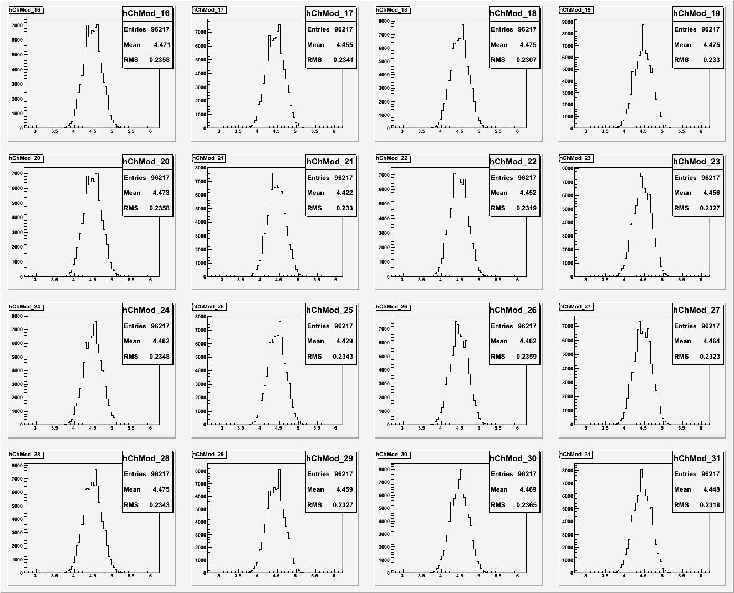
Test2 without Bin Width Calibration

Slide 25
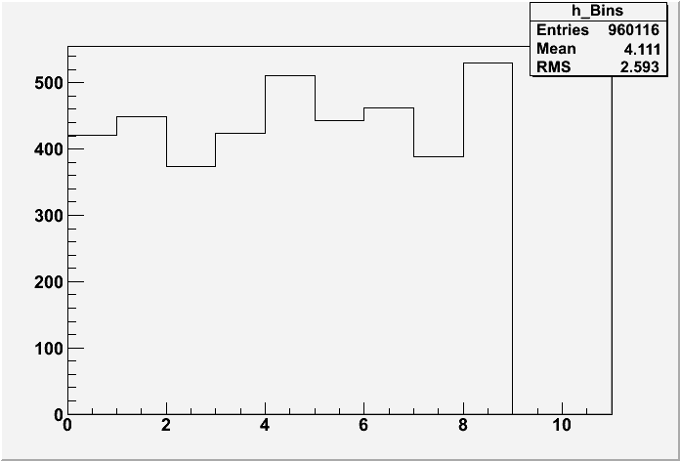
Bin-Width Plot
There are 9 bins in 4 ns.
Each bin should be around 444 ps at ideal conditions.
We made calibration tables for trigger and all 64 channels.
ps
bin

Slide 26
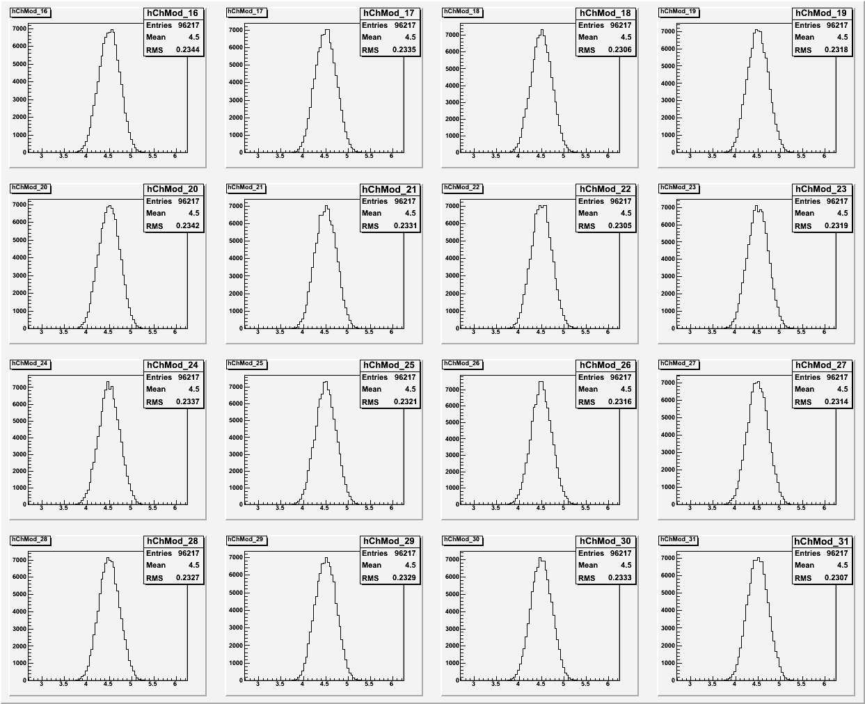
Test#2 with Bin-Width Calibration

Slide 27
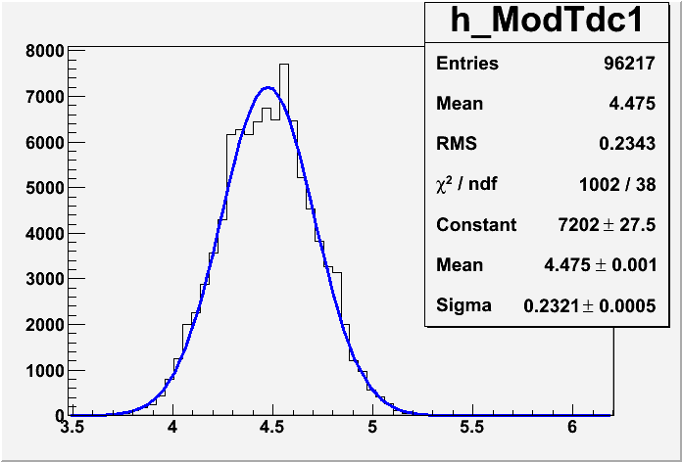
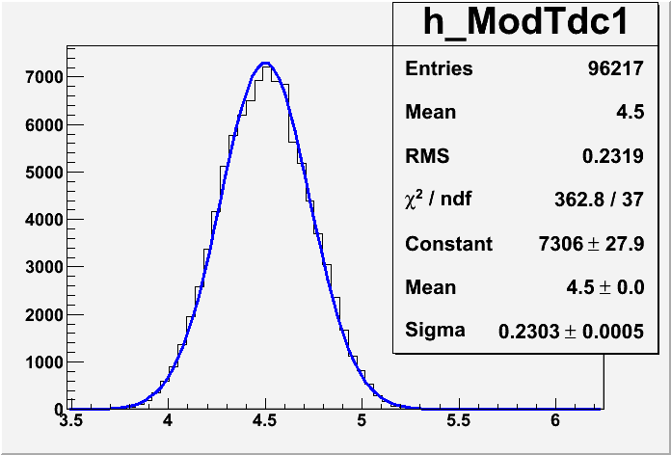
Test#2 Standard Deviation Study
Without Bin-Width Calibration, the σ is ~ 232.1ps
With Bin-Width Calibration, the σ is ~ 230.3 ps
Without Calibration
With Calibration
Using channel 28 as an example

Slide 28
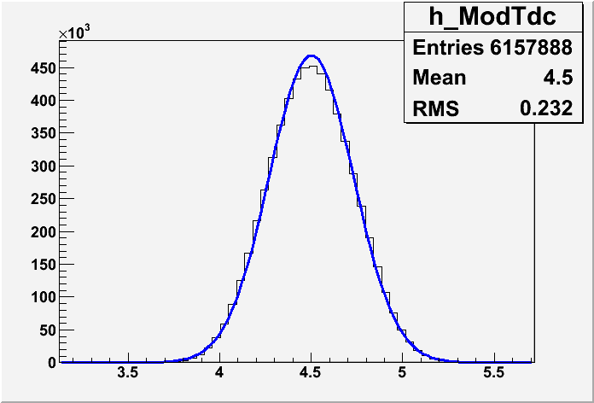
Test#2 with Bin-Width Calibration
Merging all the channels, the σ is 232 ps.
For the resolution that E906 needs, calibration won’t improve a lot. We may consider skipping the calibration.
Since we have the calibration table with both edge, we can always put calibration table into decoder if it’s required.

Slide 29
Test#3 Multi-Hit
One trigger with four hits.
Each hit is 4*7.2917 ns after the previous one.
The level one buffer can record up to five hits in 64 ns.
5 hits per channel,
Buffer pushing: clock cycle at 250 MHz.
Two Run2-TDCs passed this test
TRIG

Slide 30
Test#4 Multi-Hit
One trigger with more than 8 hits.
Each hit is delayed by 72.917ns
Test level 2 & 3 Buffers
Buffer popping: 1 hit/64 ns.
Two Run2-TDCs passed this test
TRIG

Slide 31
Test#5 Multiple Hits Elimination
One trigger with four hits.
Each hit is ~29 ns after the previous one.
Set the Multiple Hits Elimination for 32 ns
Should get 2 hits per channel per event.
Signal
Inhibit
TDC recorded
TRIG

Slide 32
Timeline
One TDC is implemented in E906DAQ system and tested (run 2379).
Feb 2013: new function development for multiple hits elimination and scalar
Feb- Mar 2013: Production Test
Test # 1~5 (Cross-Talk, Resolution, Multi-Hits for Buffer 1~3, multiple hits elimination)
Full system - test VME noise feedback with 12 TDCs in one VME crate
Mar 2013: full implement of TDCs with DAQ system and fine tune with E906 detectors/cosmic ray.

Slide 33
That’s it~ thank you~

Slide 35
Current Design
TDC internal clock
9 phase within 4ns
64 Channels Data
TRIG
There is a free running clock inside the TDC (250MHz with 9 phases)
The TDC records the internal time for every hit in each channel and trigger in the first layer buffer. Up to 4 hits per channel can be temporarily stored.
After every 4 clock cycles at 62.5 MHz, the hits being read out are cleared. Data from a group of 4 channels are written into one of the 2 (or 4,8) circular buffers in the SRAM256x16 block waiting for a trigger.
When a trigger arrives, the writing address is pointed to the next circular buffer and the current circular buffer is read out.

Slide 36
3 layers buffers
First layer buffer
second layer buffer
Third layer buffer

Slide 37
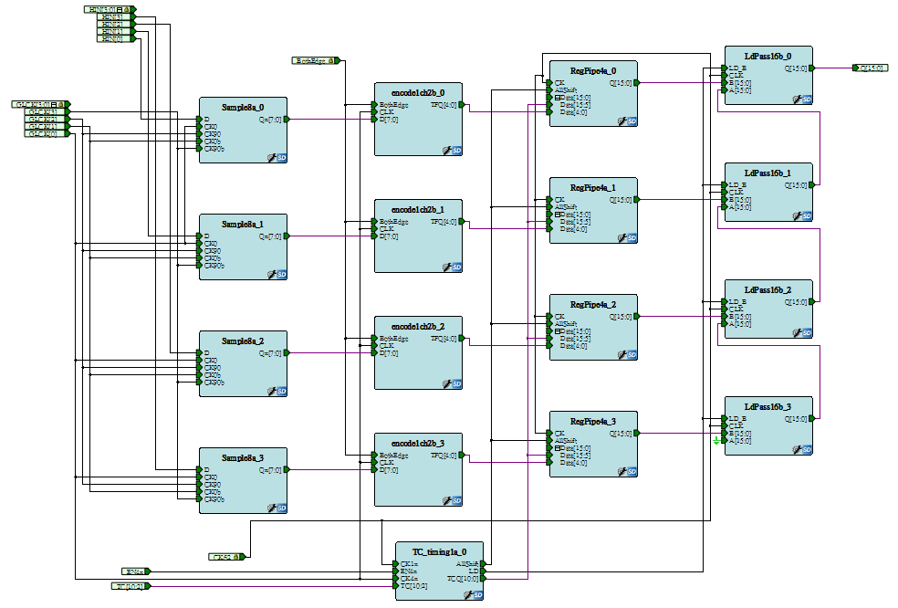
First layer buffer
4 hits per channel,
Buffer pushing: Any clock cycle at 250 MHz.
Buffer popping: 1 hit/64 ns.
RegPipe4a/ChGRP4a
Notes:
nothing to do with trigger

Slide 38
Second layer buffer
Second layer buffer, every 4 channels share a circular buffer
(Page size)*(Number of Pages) = 256, user defined.
Hits fill into a page continuously.
When a trigger is received, hits are filled to next page and the current page is copied to the third layer buffer. The sequence is called copy in progress (CIP).
(e.g. Page size=128 , CIP =128* 16 = 2048 clock cycle =2048 *16ns = 32us) (worth case scenario)
SRAM256x16/ ChGRP16a
Notes:
(CIP/ writing is trigger free/readout related to trigger)

Slide 39
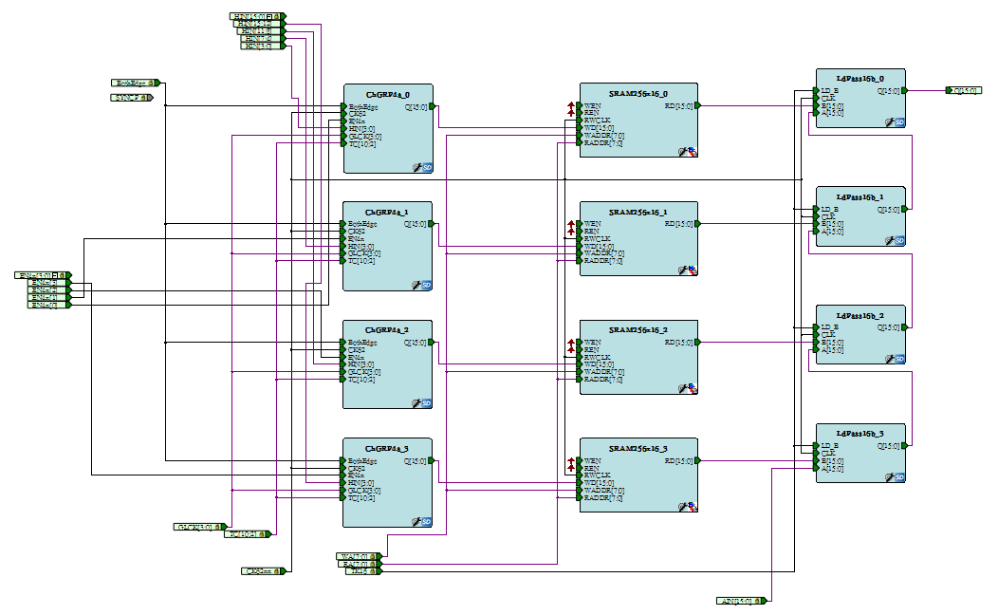
Second layer buffer
SRAM256x16/ ChGRP16a

Slide 40
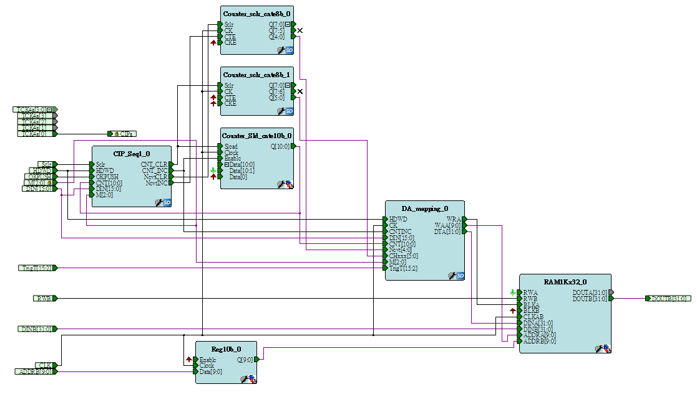
Third layer buffer
Buffer size =1 K
(Page size)*(Number of Pages) = 1024, user defined.
Hit filling during CIP
Readout from VME IRQ
Outbuffer1k

Slide 41
Test2 without Bin Width Calibration
Test2 with Bin Width Calibration

Slide 42
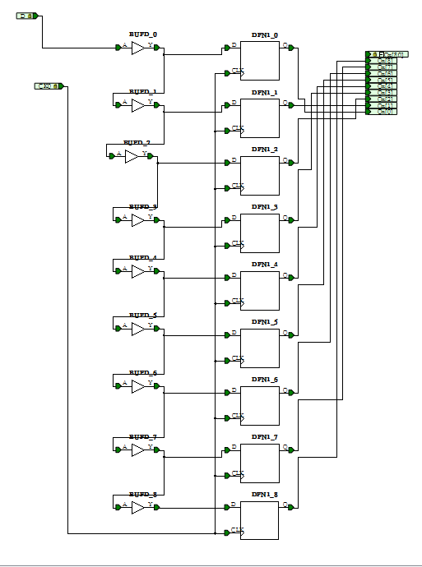

Slide 43
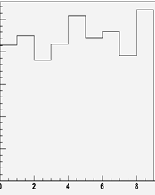
Bin-Width Plot
ps
ps
bin
bin

Slide 44
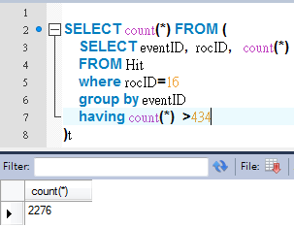
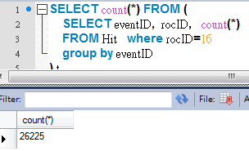
If Max hits per ROC is more than 434, the dead time will be large than 137us
In Run 2173 there are 2276/26225 = 8.7% events

Slide 45
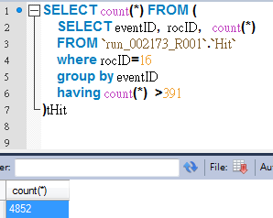
If Max hits per ROC is more than 391, the dead time will be large than 137us
In Run 2173 there are 4852/26225 = 18.5% events

Slide 46
Circular Buffer Timing Window
The hits in the PipeReg4a are written to the circular buffer every 64 ns per hit.
If the PipeReg4a is filled with 4 hits, it takes 256 ns to write them into circular buffer.

