Slide 1
TDC zero suppression
Jin-Yuan Wu, Grass Wang
Da-Shung Su, Wen-Cheng Chang
2012/Oct/02

Slide 2
New Design
We started it from scratch, only keep the FPGA input/output port.
The new TDC is based on multi-sampling principle. The TDC card records hits only, so that we don’t need zero suppression.

Slide 3
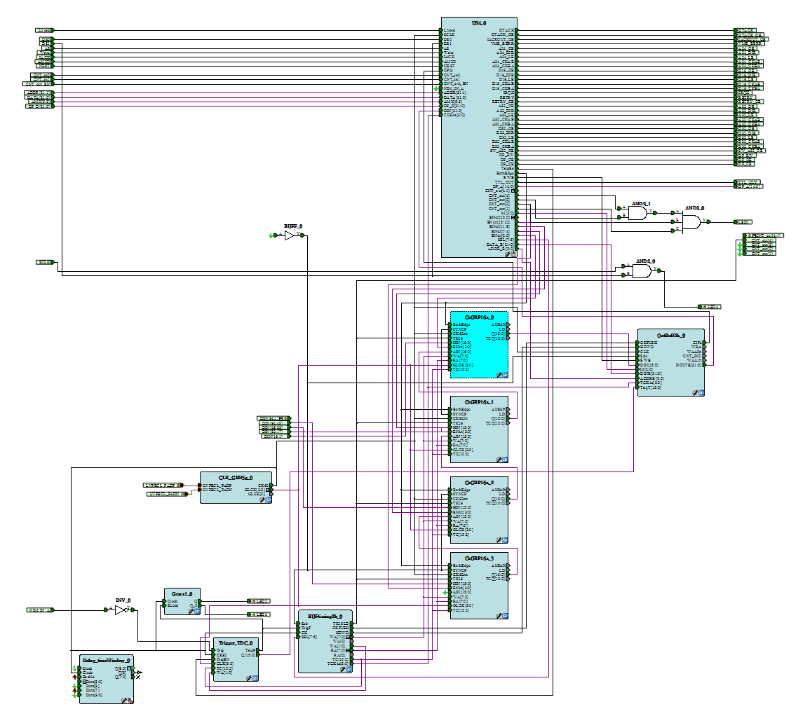
Third layer buffer
Second layer buffer
First layer buffer

Slide 4
3 layers buffers
First layer buffer
second layer buffer
Third layer buffer

Slide 5
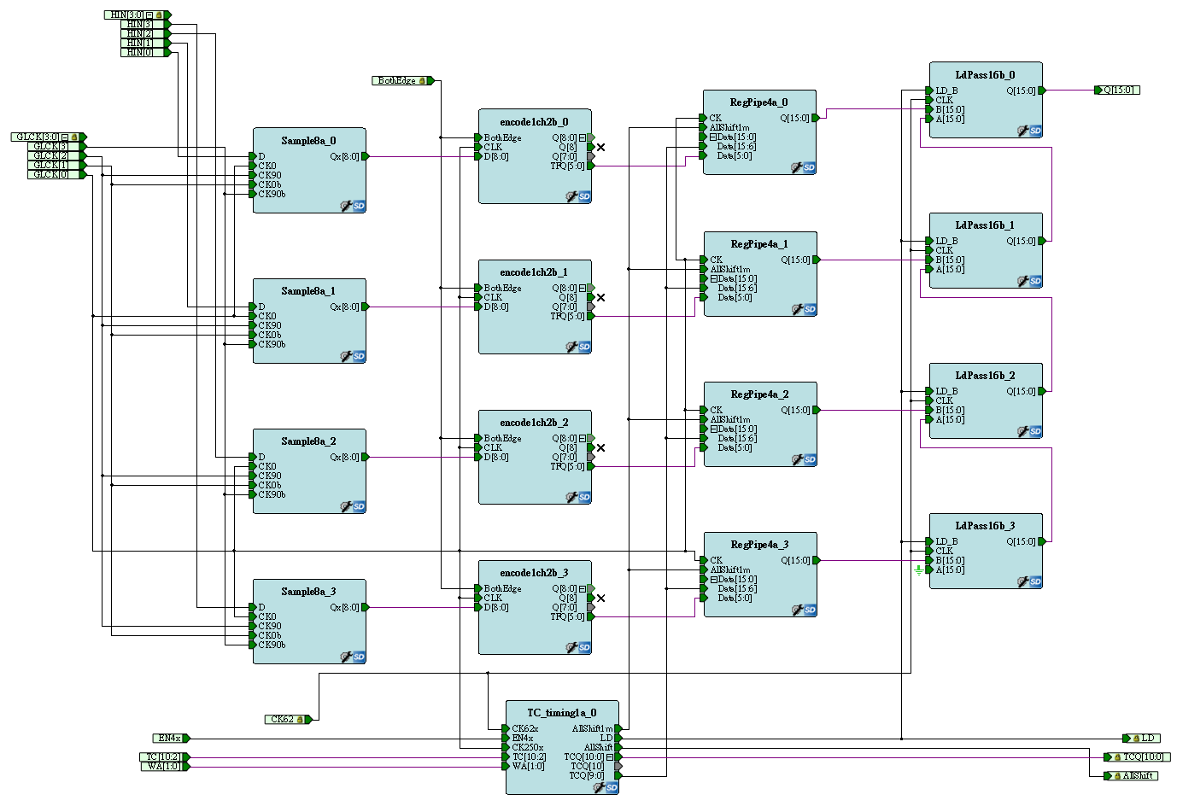
First layer buffer
4 hits per channel,
  Buffer pushing: Any clock cycle at 250 MHz.
  Buffer popping: 1 hit/64 ns.
  RegPipe4a/ChGRP4a
Notes:
nothing to do with trigger

Slide 6
Second layer buffer
Second layer buffer, every 4 channels share a circular buffer
  (Page size)*(Number of Pages) = 256, user defined.
  Hits fill into a page continuously.
  When a trigger is received, hits are filled to next page and the current page is copied to the third layer buffer. The sequence is called copy in progress (CIP).
  (e.g. Page size=128 , CIP =128* 16 = 2048 clock cycle =2048 *16ns = 32us) (worth case scenario)
  SRAM256x16/ ChGRP16a
Notes:
(CIP/ writing is trigger free/readout related to trigger)

Slide 7
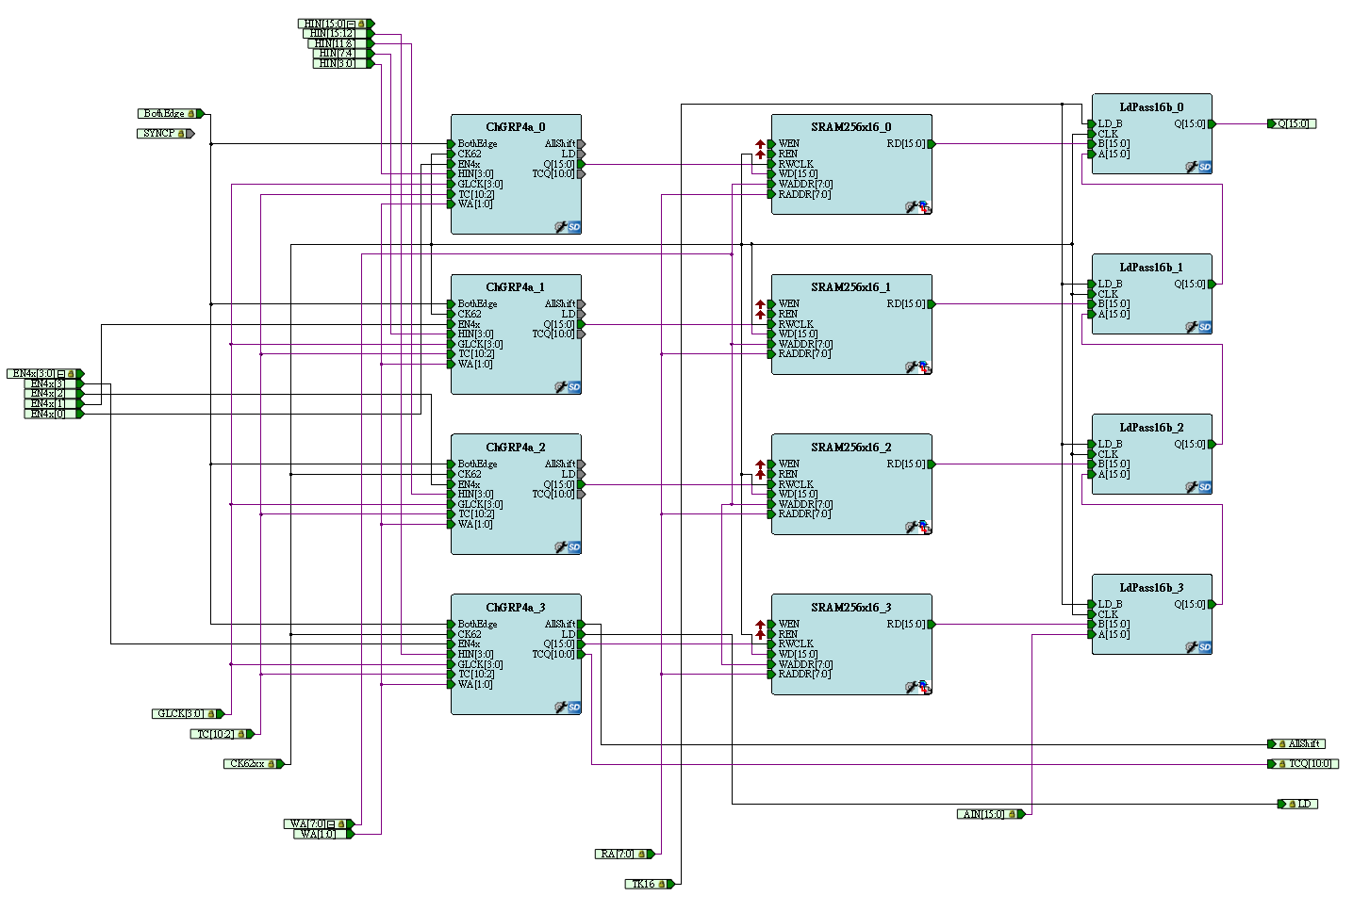
Second layer buffer
  SRAM256x16/ ChGRP16a

Slide 8
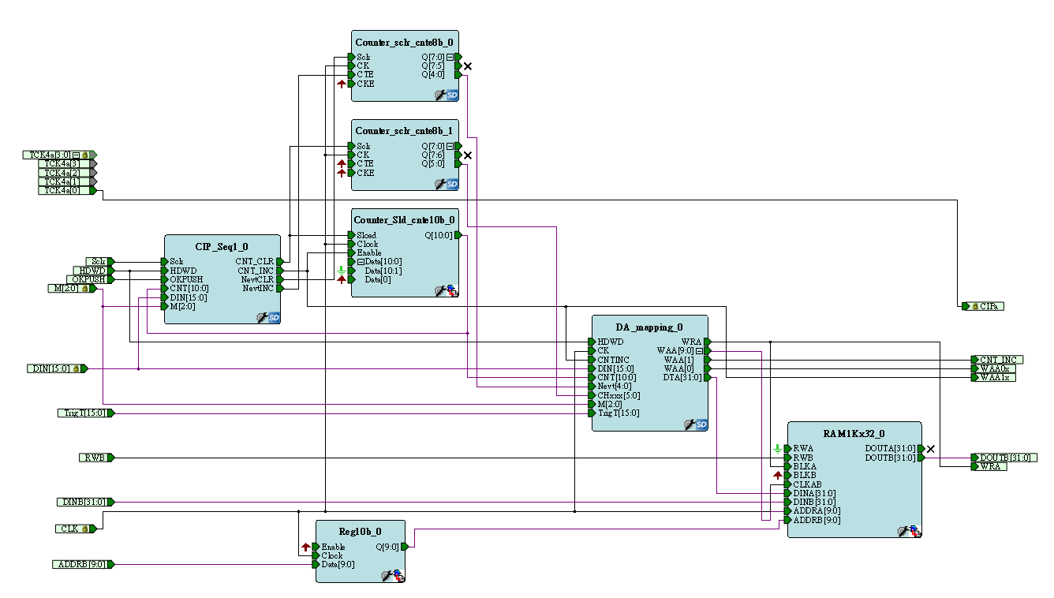
Third layer buffer
Buffer size =1 K
  (Page size)*(Number of Pages)
  = 1024, user defined.
  Hit filling during CIP
  Readout from VME IRQ
  Outbuffer1k

Slide 9
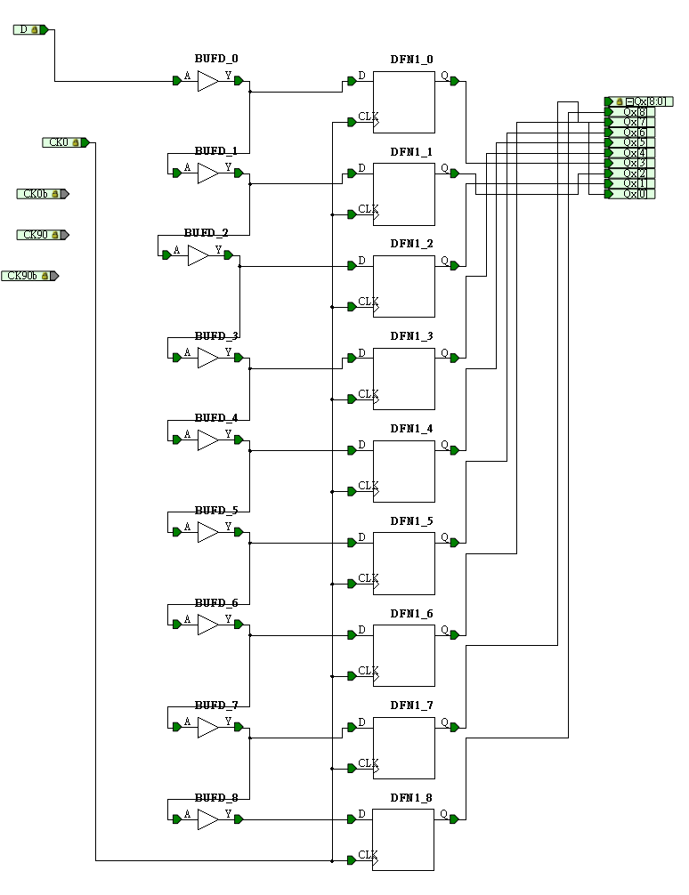
data resolution
250 MHz clock
9 phases
~0.444 ns resolution
1 | 10.26% | 410.32
2 | 11.89% | 475.47
3 | 10.22% | 408.74
4 | 12.30% | 491.83
5 | 10.41% | 416.55
6 | 11.16% | 446.48
7 | 9.55% | 382.18
8 | 10.42% | 416.88
9 | 13.79% | 551.53

Slide 10
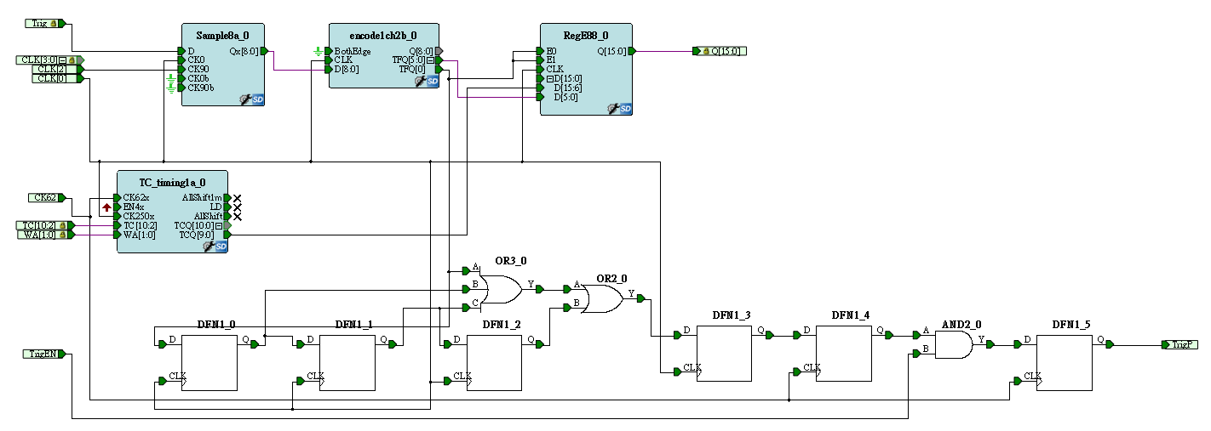
Trigger time resolution
The trigger time resolution is same with the data resolution.
Trigger time - Data time = TDC time

Slide 11
Current Design
Time resolution | ~0.44 ns
Two-hits resolution | 4 ns
Width of accepted window | 2us (user selected)
Edge detective | User selected leading edge only or both edges.
Maximum hits per trigger | User selected (32~1024)
Maximum events per IRQ | User selected (2~32)

Slide 12
Register Map
0x000 version (e9061206)
0x004 CSR
0x008 test area
0x1000~0x1ffc = event buffer (1k internal)
0x2000~0x2ffc = test area
?~? = dual port buffer (32 k)
D31-D16 | D08 | D7-5 | D2-0
EN4X (CSR) | BothEdge (Edge selection) | SEL(READ/WRITE addr) | M (buffer size)

Slide 13
DATA format
Header
D15 | D14 | D13 | D12 | D11 | D10 | D09 | D08 | D07 | D06 | D05 | D04 | D03 | D02 | D01 | D0
Trig [15:3] (trigger time) |  |  |  |  |  |  |  |  |  |  |  | Fine time
D31 | D30 | D29 | D28 | D27 | D26 | D25 | D24 | D23 | D22 | D21 | D20 | D19 | D18 | D17 | D16
1 | CNT[10:0] (number of hits) |  |  |  |  |  |  |  |  |  |  | 0 | 0 | 0 | positive or negative edge
Data
D15 | D14 | D13 | D12 | D11 | D10 | D09 | D08 | D07 | D06 | D05 | D04 | D03 | D02 | D01 | D0
TDC [15:4] (data time) |  |  |  |  |  |  |  |  |  |  |  | Fine time
D31 | D30 | D29 | D28 | D27 | D26 | D25 | D24 | D23 | D22 | D21 | D20 | D19 | D18 | D17 | D16
Cable: 4,5,6,7 |  |  |  | Channel number: 0-15 |  |  |  | Event number |  |  |  | 0 | 0 | 0 | positive or negative edge
Notes:
MSB = most significant bit

Slide 14
Data Throughput
(worst case scenario)
Assume 100% occupancy
each channel will output 4 Byte per event.
(32 bits for and channel information of one hit)
For each card: 4*64 = 256 byte per event
For a system with 100 cards: 25.6KB per event
Assume trigger rate 2KHz : 51.2 MB/s
(for only one card is 0.05 MB/s)
A Gigabit Ethernet support at 1 Gbps (1000 Mbps =125 MBps)
VME backplane speed for BLT32 =25MBytes/s (25Bytes/us) = (10 us to readout each TDC/event) (worst case scenario)
Notes:
The old TDC without zero suppression is ~ 1k bytes per event, which took ~90us to read out

Slide 15
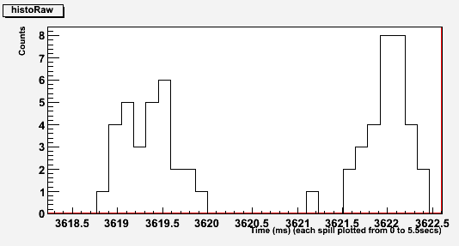
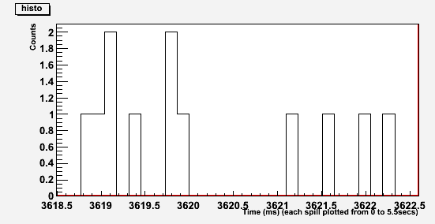
Beam structure
137us bin size
Before Inhibit
Bin size =137 us
Dead time was 680 us in the Run1
If the deadtime is 90us (70 us?), the dead part will decrease a lot …
After Inhibit

Slide 16
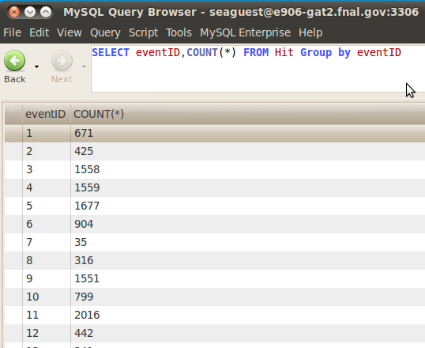
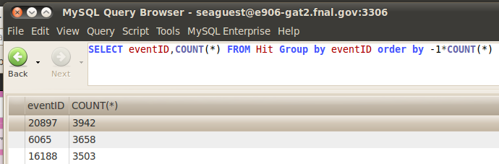
Real case
In the final run (2173) in Run1
The Max number of hit is less than 4000
In the worth case scenario, 4000 hits per events.
For one event we get 4* 4000 =16KB
we were assumeing 25.6KB on last page
so that, in the real run, the deadtime is much lower than what we estimated

Slide 17
Where are we …
The time information of data and trigger are tested
Time line
  Sep/Oct: main-function test, building the production test system
  Nov 2012: add future designs – time window cut and delay
  Dec 2012 :Production test
  Jan 2013 :Fine tune with E906 detectors/cosmic ray

Slide 18
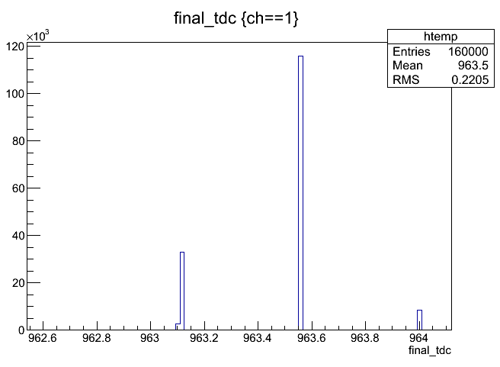
TDC main part test – Oct/2012

Slide 19
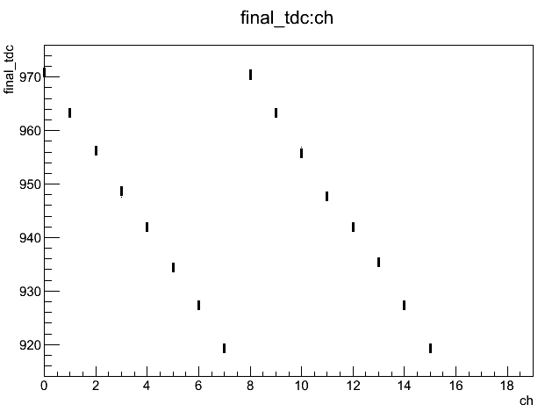
TDC main part test – Oct/2012

Slide 20
Thank you…

Slide 21
Backup

Slide 22
CIP (copy in progress) free:
2~32 buffer to store data during CIP. Data still can be record during CIP.

Slide 23
Transfer type | Speed
BLT32 | 25 MBytes/s
MBLT64 | 50 MBytes/s
2e VME | 88 MBytes/s

Slide 24
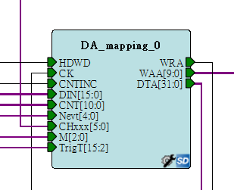
User selected buffer size
Maximum hits per trigger (32~1024)
Maximum events per IRQ (1~32)

