Slide 1
TDC zero suppression
Jin-Yuan Wu, Grass Wang
Da-Shung Su, Wen-Cheng Chang
2012/Jun/28

Slide 2
New Design
We started it from scratch, only keep the FPGA input/output port.
The new TDC is based on multi-sampling principle. The TDC card records hits only, so that we don’t need zero suppression.

Slide 3
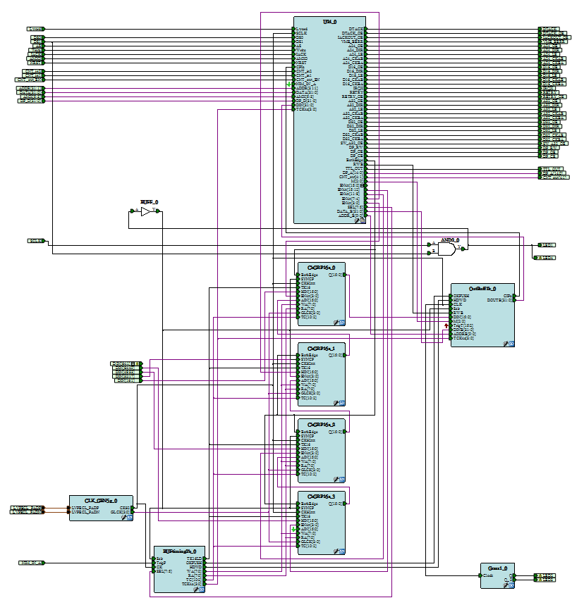
Third layer buffer
Second layer buffer
First layer buffer

Slide 4
3 layers buffers
First layer buffer
second layer buffer
Third layer buffer

Slide 5
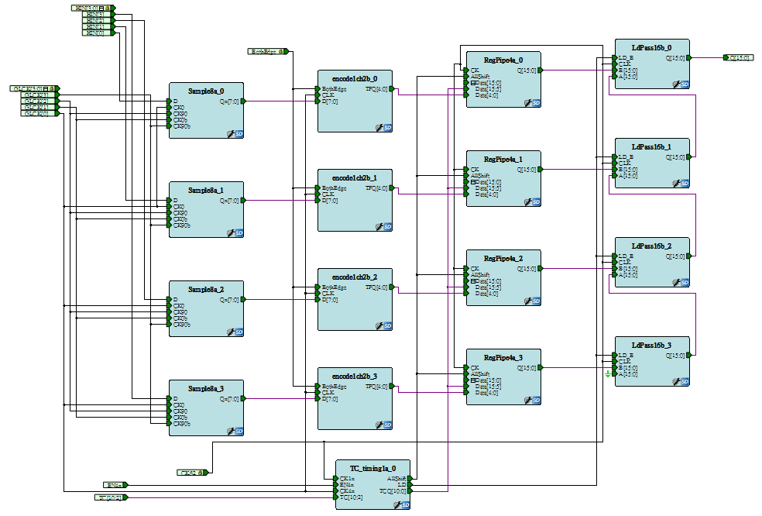
First layer buffer
4 hits per channel,
Buffer pushing: Any clock cycle at 250 MHz.
Buffer popping: 1 hit/64 ns.
RegPipe4a/ChGRP4a
Notes:
nothing to do with trigger

Slide 6
Second layer buffer
Second layer buffer, every 4 channels share a circular buffer
(Page size)*(Number of Pages) = 256, user defined.
Hits fill into a page continuously.
When a trigger is received, hits are filled to next page and the current page is copied to the third layer buffer. The sequence is called copy in progress (CIP).
(e.g. Page size=128 , CIP =128* 16 = 2048 clock cycle =2048 *16ns = 32us) (worth case scenario)
SRAM256x16/ ChGRP16a
Notes:
(CIP/ writing is trigger free/readout related to trigger)

Slide 7
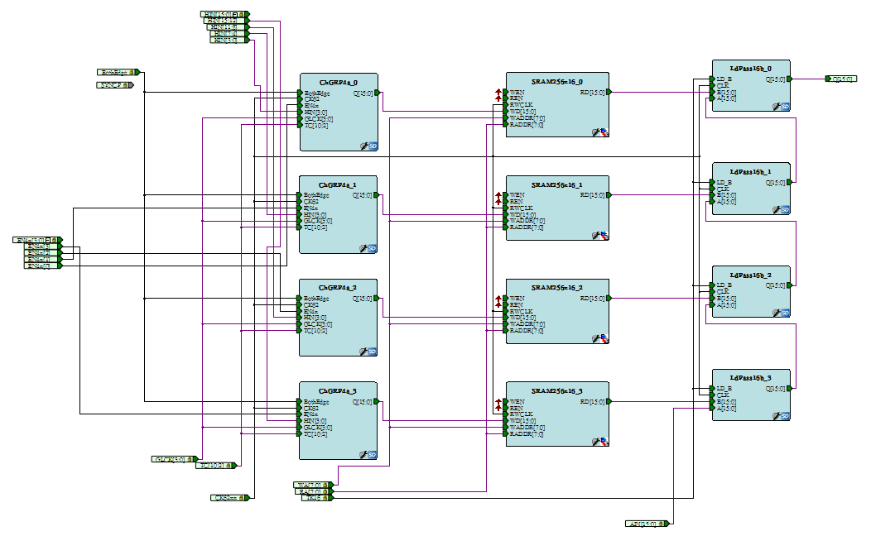
Second layer buffer
SRAM256x16/ ChGRP16a

Slide 8
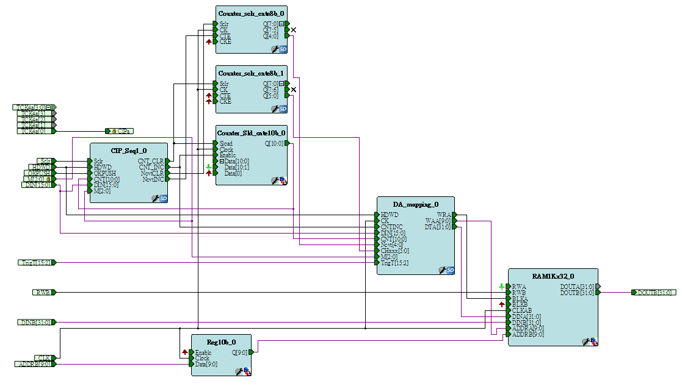
Third layer buffer
Buffer size =1 K
(Page size)*(Number of Pages) = 1024, user defined.
Hit filling during CIP
Readout from VME IRQ
Outbuffer1k

Slide 9
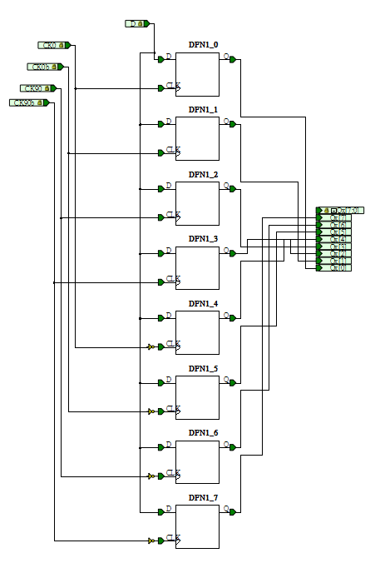
TDC resolution
250 MHz clock
8 phases
0.5 ns resolution

Slide 10
Current Design
Time resolution | 0.5 ns
Two-hits resolution | 4 ns
Width of accepted window | 8us (user selected)
Edge detective | User selected leading edge only or both edges.
Maximum hits per trigger | User selected (32~1024)
Maximum events per IRQ | User selected (2~32)

Slide 11
Register Map
0x000 version (e9061206)
0x004 CSR
0x008 test area
0x1000~0x1ffc = event buffer (1k internal)
0x2000~0x2ffc = test area
?~? = dual port buffer (32 k)
D31-D16 | D08 | D7-5 | D2-0
EN4X (CSR) | BothEdge (Edge selection) | SEL(READ/WRITE addr) | M (buffer size)

Slide 12
DATA format
Header
D15 | D14 | D13 | D12 | D11 | D10 | D09 | D08 | D07 | D06 | D05 | D04 | D03 | D02 | D01 | D0
Trig [15:3] (trigger time) |  |  |  |  |  |  |  |  |  |  |  |  | 0 | 0 | 0
D31 | D30 | D29 | D28 | D27 | D26 | D25 | D24 | D23 | D22 | D21 | D20 | D19 | D18 | D17 | D16
1 | CNT[10:0] (number of hits) |  |  |  |  |  |  |  |  |  |  | 0 | 0 | 0 | 0
Data
D15 | D14 | D13 | D12 | D11 | D10 | D09 | D08 | D07 | D06 | D05 | D04 | D03 | D02 | D01 | D0
TDC value |  |  |  |  |  |  |  |  |  |  |  |  | 0 | 0 | positive or negative edge
D31 | D30 | D29 | D28 | D27 | D26 | D25 | D24 | D23 | D22 | D21 | D20 | D19 | D18 | D17 | D16
0 | 0 | Channel number |  |  |  |  |  | Event number |  |  |  | 0 | 0 | 0 | TDC (MSB)
Notes:
MSB = most significant bit

Slide 13
Data Throughput (worst case scenario)
Assume 100% occupancy each channel will output 4 Byte per event. (32 bits for and channel information of one hit)
For each card: 4*64 = 256 byte per event
For a system with 100 cards: 25.6KB per event
Assume trigger rate 2KHz : 51.2 MB/s (for only one card is 0.05 MB/s)
A Gigabit Ethernet support at 1 Gbps (1000 Mbps =125 MBps)
VME backplane speed for BLT32 =25MBytes/s (25Bytes/us) = (10 us to readout each TDC/event) (worst case scenario)
If we need MBLT 64 (50 Mbytes/s), we need special design in buffer. They are not supported in the current version of FPGA code
Notes:
The old TDC without zero suppression is ~ 1k bytes per event, which took ~90us to read out

Slide 14
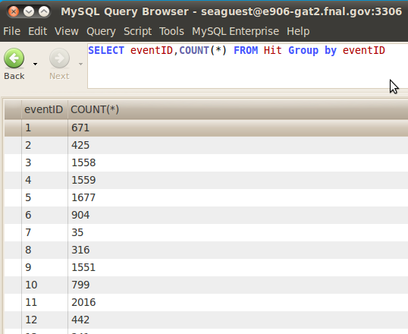
Real case
In the final run (2173) in Run1
The Max number of hit is less than 4000
In the worth case scenario, 4000 hits per events. For one event we get 4* 4000 =16KB
we were assumeing 25.6KB on last page
so that, in the real run, the deadtime is much lower than what we estimated

Slide 15
Where are we …
The final buffer can be readout now
The TDC logic before the final buffer need to be debug
Time line
Aug/Sep 2012: Debug
Oct/Nov 2012: Production test
Dec 2012 :Fine tune with E906 detectors/cosmic ray

Slide 16
Thank you…

Slide 17
Backup

Slide 18
CIP (copy in progress) free: 2~32 buffer to store data during CIP. Data still can be record during CIP.

Slide 19
Transfer type | Speed
BLT32 | 25 MBytes/s
MBLT64 | 50 MBytes/s
2e VME | 88 MBytes/s

Slide 20
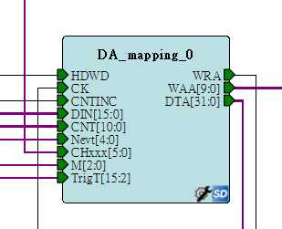
User selected buffer size
Maximum hits per trigger (32~1024)
Maximum events per IRQ (1~32)

