Slide 1
Some Thoughts about a New Dark Photon Trigger R&D for E906
Grass, Kun, Pat, Xinkun and Ming
Updated 06/18/2015 (v4)

Slide 2
E906 Trigger & DAQ System
(Pulse Gen.
V1495 @TB)
DAQ
VME/CPU
Ethernet
Hodos
Hits/
Start
TDC (xx)
Threshold Discriminator
……
L1-Trigger
V1495 (4)
(24x4)
L0 Trigger: not “actively” used
- 4 V1495 boards available
L1 Trigger: in operation
- 4 V1495 boards
(2) for Y-plane, not used
(2) for X-Plane, in use
- 700nS latency
L2 Trigger: pass through
1 V1495
Could do simple look-up
Trigger pattern
TS: Trigger Supervisor
L2-Trigger
V1495 (1)
L2: limited I/O
1(O), 5(I), 32x
only 2 (I) used
Trigger Supervisor
Comm.
Stop/Trigger

Slide 3
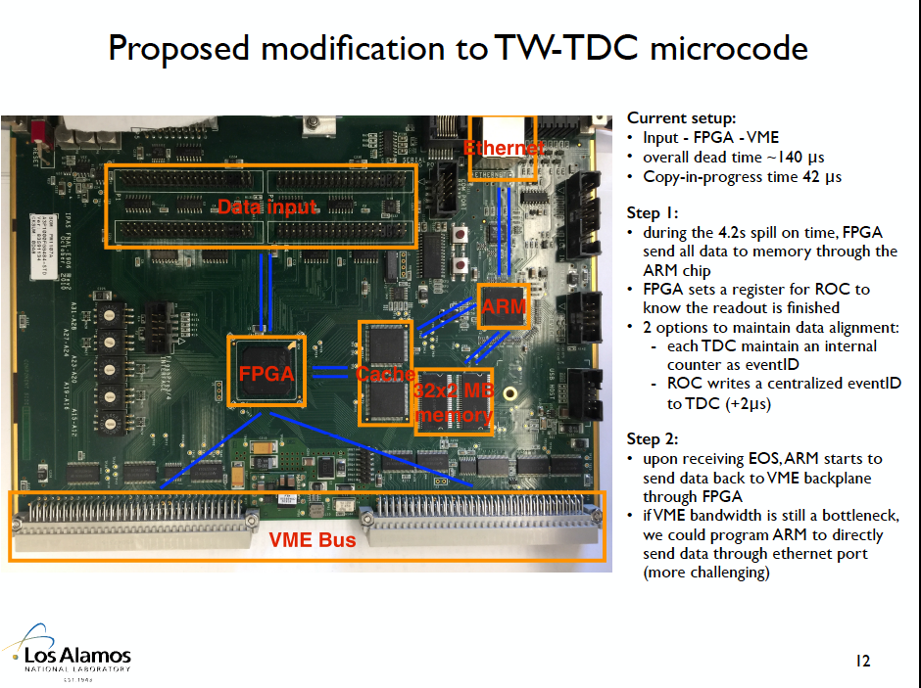

Slide 4
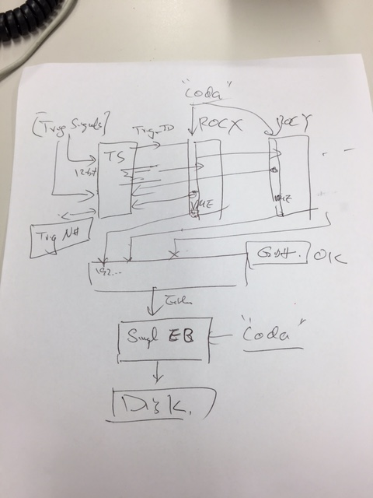
E906 DAQ for upgrade
TDC FPGA upgrade
  hold data within a spill, only send them out on EOS signal
  55 sec for readout TDC into disk
  New TDC data format with the global Trigger_ID information
  A global Trigger_ID generated by TS
  Using known pattern (from V1495 on the test bench) to validate the new TDC code on a standalone DAQ, as we did before @WH14, single ROC
DAQ integration
  Event assembly based on the global trigger_ID/Evt_ID in one spill
  TS accepts ROC responses
  Multi ROC readout

Slide 5
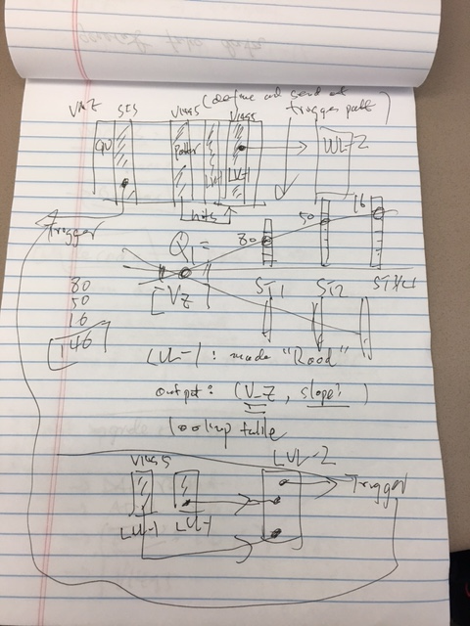
Standalone Trigger R&D
Road finder in each quadrant at LVL-1 V1495
  80+50+16
  Output VTX_Z and road information (N_ST1, N_ST2, N_ST3, Z_VTX) to LVL-2
AT LVL-2, make trigger decisions
  (Z_VTX, and roads information) via lookup table
  Send out trigger pattern to TS
A stand alone trigger DAQ
  Two (four) LVL-1 V1495
  One LVL-2 V1495
  One TS (SIS 3031)
  one V1495 to generate trigger hit pattern, and send them to LVL-1 to validate the performance
  (or a few TDCs for DAQ integration work)

Slide 6
Low Mass Dark Photon Displayed Vertex Trigger
Y-Plane Trigger:
- No mass cut
- Displaced z-vertex
Coincident with St-4 Hodos(?)
Quadrant triggers? 4 x V1495
Y-channels per quadrant:
1x V1495
80(St1) + 50(St2) + 8x2 (St4-Y1,2) = 146
96+64 = 160 inputs possible
  72+72+16 = 160 ( input possible)
  (2NIM=RFCLK+ComSTOP )
  32 outputs
Coincident Z-vtx
window matched@L2
St1
St2

Slide 7
Trigger Detector Layout Schematics beam view
http://kuraraypsf.jp/psf/ws.html
WLSF Y-11(200):
Att_L>3.5m
SiPMs (80/50)
Readout preAMs
cards
Y
80[ST01]
or 50 (ST2)
80[ST01]
or 50 (ST2)
Trigger LVL-1
& TDC
Fremilab extruded
scintillators
(8’ = 2.44m
above floor)
X
80[ST01]
or 50 (ST2)
80[ST01]
or 50 (ST2)
(X= -120cm)
Y = -50cm
Being tested for
SiPM Radhard

Slide 8
Dark Photon Q-Trigger
DAQ/Data stream
LVDS cable 2x16ch bundle available
Q1 (LVL1)
DAQ Trigger
LVL2
(vtxZ matching+road infor.)
Q2 (LVL1)
TS
(12 inputs total)
(1-free bit available)
Q3 (LVL1)
DP Trigger
1-bit
Q4 (LVL1)
MC simulation
Dummy pattern
A test stand needed!
To check FPGA
Logic
Timing
4 x 16-bit from 4 Q1-4/V1495
(2 x 32LVDS cables)
Q1: 80(ST1’) + 50 (ST2’) + 2x8(ST4-Y1/2) = 146, FANOUT ST4
Up to 72(ST1) + 72 (ST2) + 2x8(ST4Y1/2) = 160

Slide 9
Trigger Simulations
Gun MC to check the rates
  SM QCD processes
  Gun MC ~ real single rate (good to 50%)
  Separately generate some phi/eta/omega -> dimuon backgrounds?
    some long live-time and small nuclear cross section particles
J/Psi and DY signals to check the rates
  Contamination to low mass triggered events
Dark photon signals and trigger efficiencies
  Mass = 0.5, 1, 2.0, … 10GeV
  Various coupling constants
Rejection power
V1495 pulser
  can take MC input “road map” file to generate trigger pattern

Slide 10
Standalone Test Stand and Detectors
VME system + Linux
PC(Windows) FPGA programing
Total Cost w/ test stand: ~ $60K ($40K? detector only)
  VME crate: $5.5K
    Free one from LANL?
  VME controller: $4.0K
    can get an old one free from Fermilab
  V1495: $20K
    $3800 x 4 = $15K for 4
    4 available at E906,
    need a few (2?) at LANL test stand ($8K)
  SiPMTs: 35K
    130x4 = 520 channels
  Cables and connectors: $5K?
  Scintillating fibers/strips: $5K?
    Free LANL/Fermilab/BNL?
    ~$1/cc -> 100x1x1 x 160ch = 16K?
  New detector frame and support: $10K?
  NIM logic modules
Other test equipment: mostly available at Femrilab
  Pulse generator (V1495)
  Logic analyzer (TDC-II +PC/Linux DAQ)
  Trigger logic test stand (combination of above 2)
V1495 availability @E906
  4 x L0 not used in logic, passive pass-through
  2x Y-plane L1 not used
  2x spare boards
  Possibly up to 4+2+2=8 available in total
Programing V1495
  Altara compiler @TW PC
    Quarteus, free on Windows
Trigger Cost Estimate for Quadrant Scheme
SiPM: 350 x 4 x $30 ($36 for 20) = $42K (4 SiPM per strip)
V1495: 4x$3.8K = $15K
Scintillating strips 400 x $20(?)= 8K
preAmps: 400 x $20(?) = 8K
PS and controls: $10K (?)
Cables and LVDS cables: $10K(?)
Other M&S, frames, calibration system etc: $10K
Subtotal = $109K
VME Test Stand: subtotal = $9.5K
  VME crate: $3.5K
  VME Controlor: $4.0K
  Linux : $2K
Total = $115K

Slide 11
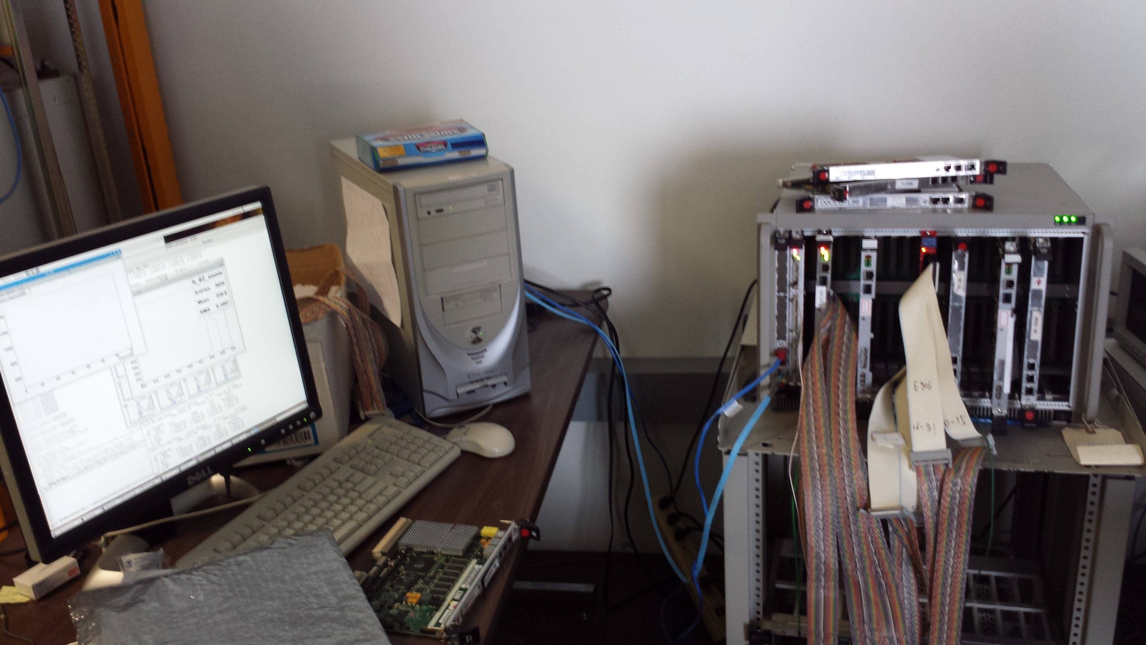
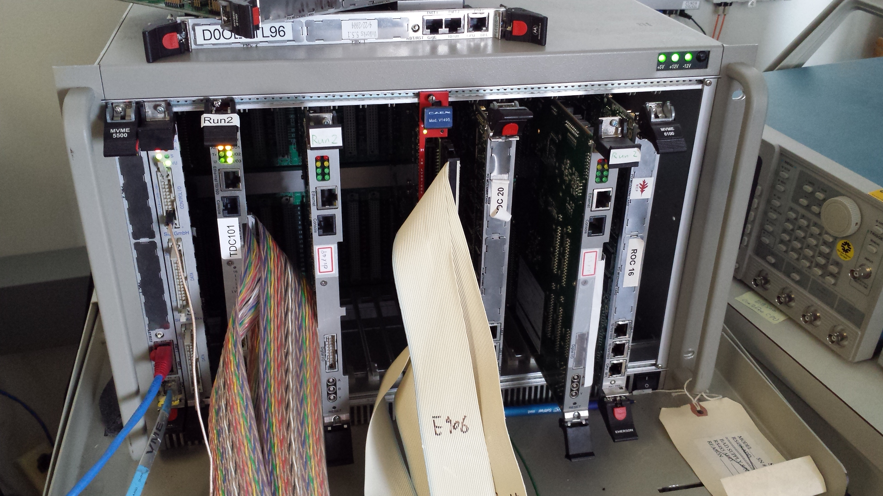
E906 DAQ (TDC)
Test Stand
PC/Linux: Jlab CODA, Ethernet Readout
CPU MVME5500: old VxWork (Jlab)
“TS” ?
TDC-II
V1495 pulse generator
V1495 L1 Trigger “development brd”
Windows PC: Altara FPGA programing
TDC Test Bench
-CNTRL
-SIS, as TS
-TDC-II (x)
-TDC-II (x)
-V1495, trigger inputs
at least 2, better 4
-V1495 as trigger
pattern emulator

Slide 12
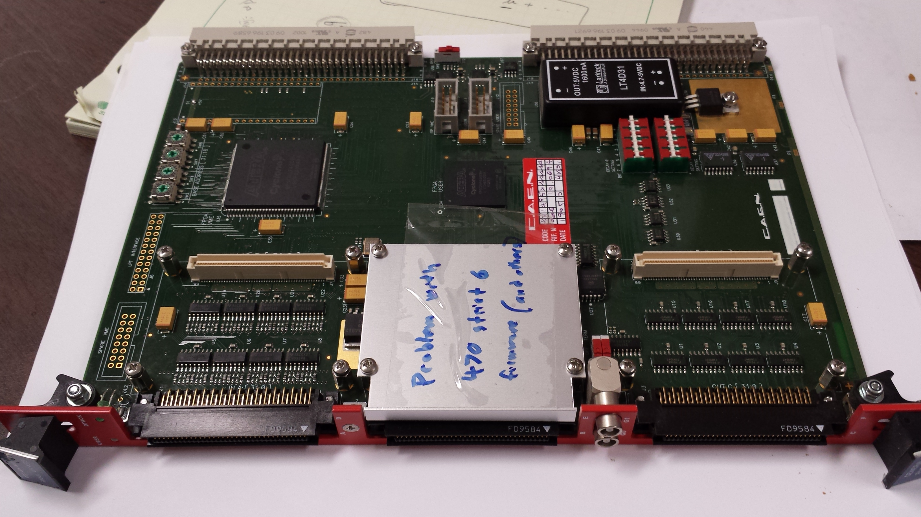
V1495 Board
2 Altara FPGA Chips: Cyclone-V

Slide 13
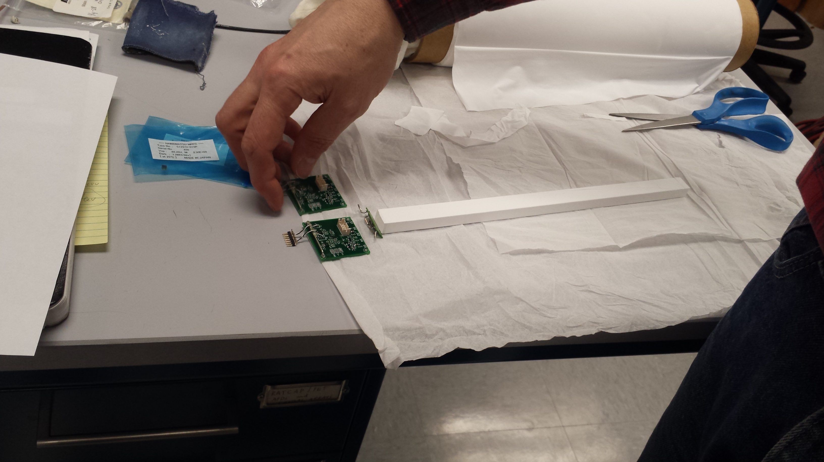
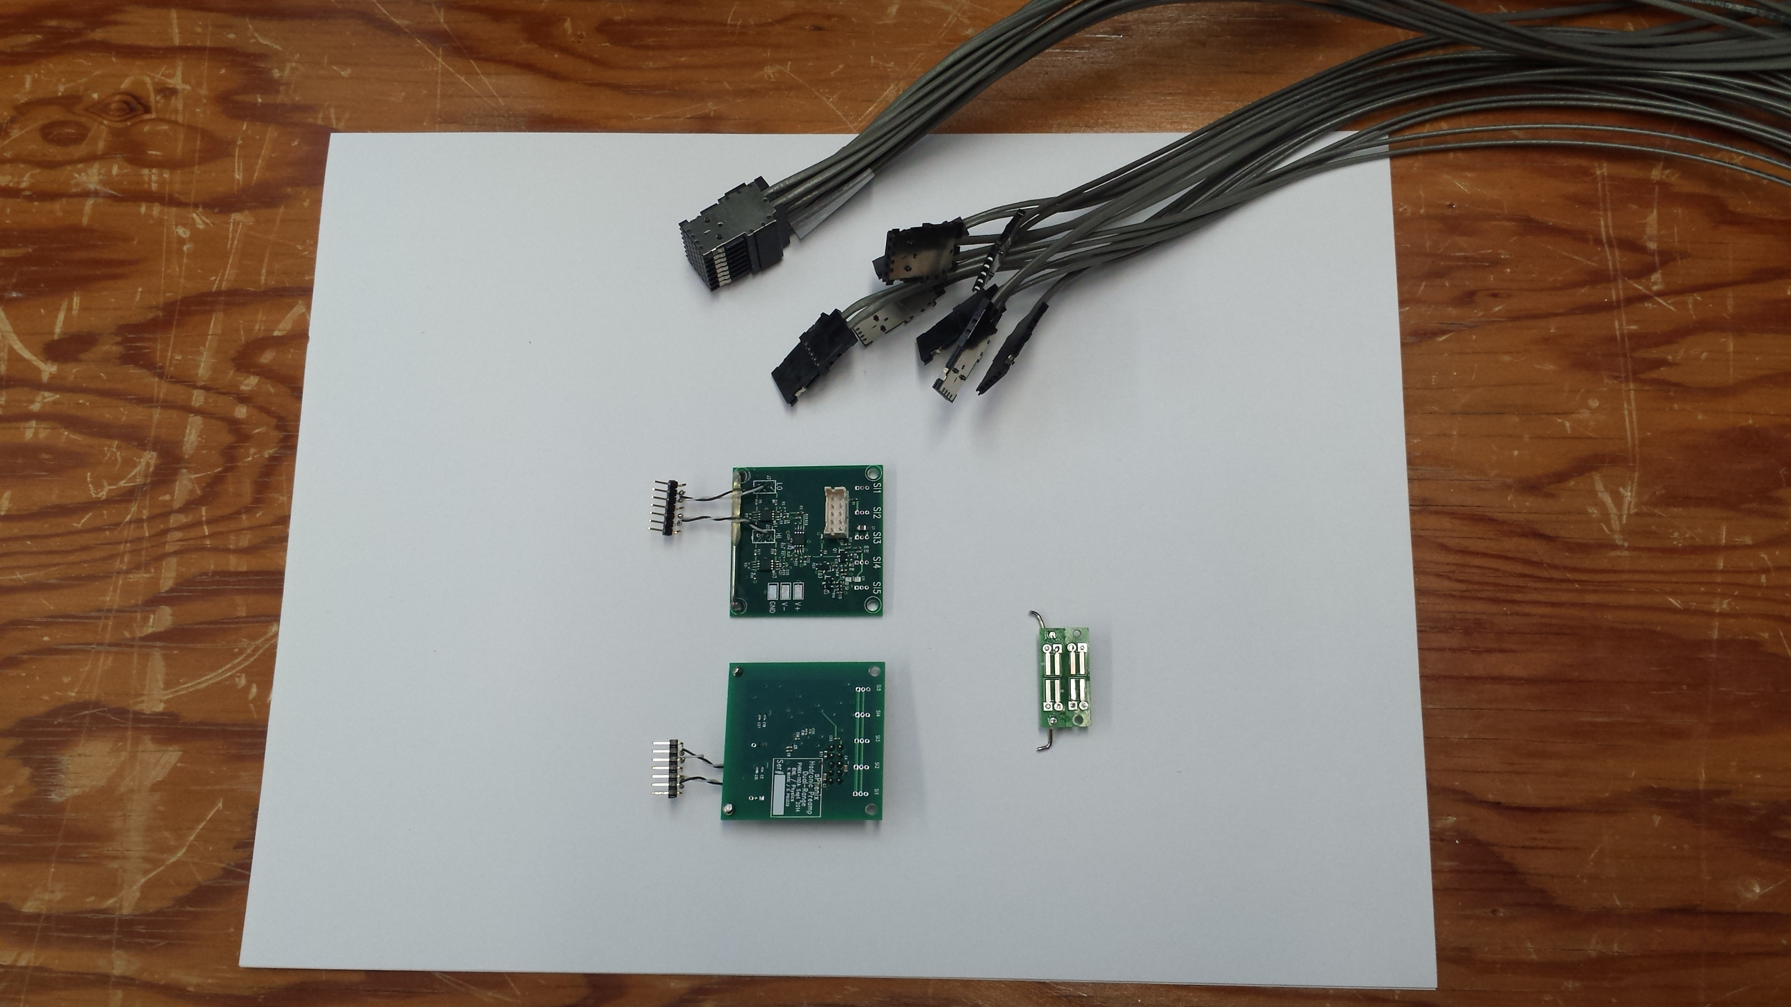
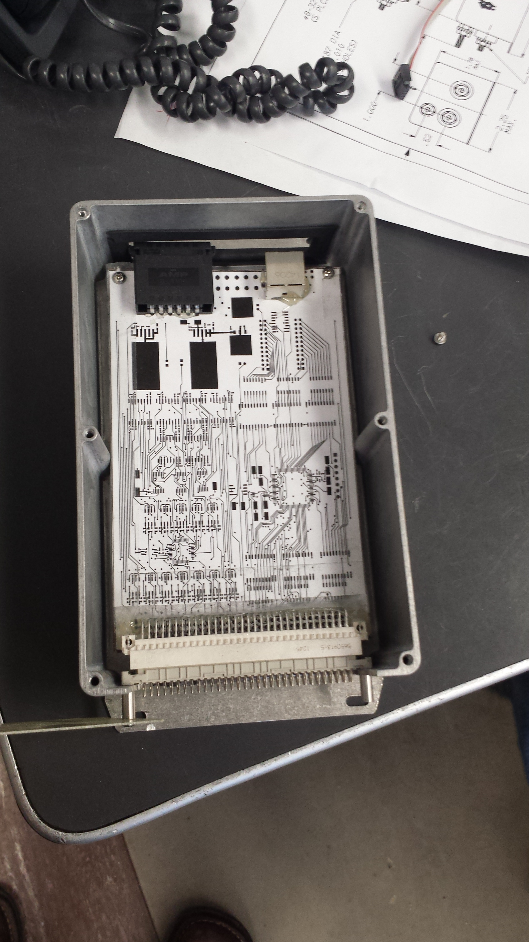
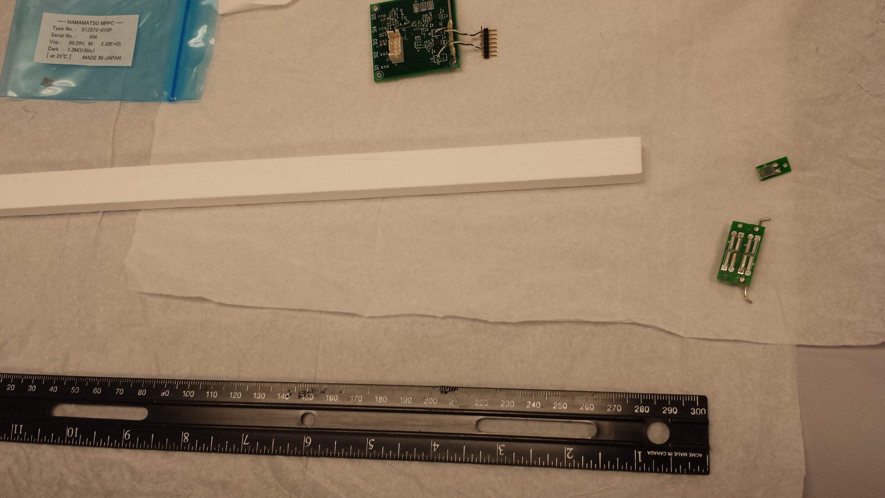
SiPM @BNL
sPHENIX EM/Hcal readout
  SiPM, Scintillating bar, LV/HV control box

Slide 14
Minimal Thickness for Light Yields
For thickness = 1.0cm, P > 5GeV
  dE/dx = 2.5MeV/cm
  Light yield = 2.5MeV / 100eV ~ 25K photons
  SiPM Eff = 20%
  Scintillating strip light collection Eff = 10% (?)
  Total “light yield” = 25K x 20% x 10% = 500 >>1
Required light output
  Photon detecting eff > 99%

Slide 15
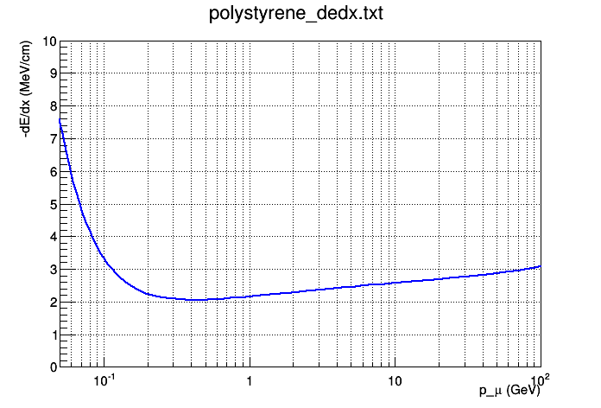
Plastic Scintillator dE/dx
Using polystyrene as example (same as FNAL scintillator factory)
Muon dE/dx = 2.41 MeV/cm @ 4 GeV, and 2.69 MeV/cm @ 20 GeV
  11.5% difference
For 4 GeV Kaon vs 20 GeV muon it’s an even bigger difference, 26.5%

Slide 16
Costing/Schedule (sPHENIX stuff)
Since this would need to be ready on a very short time-scale, and at low cost since there isn’t time to submit a true proposal to DOE. Not many solutions are feasible on such a short time scale and low budget
I suspect that the proposal here would fit under the cost/schedule constraints
  Uses SiPM + preamp.v0 + HBD ADC that has already been tested in beam at FNAL for sPHENIX
  Improved preamp.v1 exists now from Steve as well, can probably produce 1152 channels in a year ($10K?)
  Have enough HBD ADC boards (I think)
  Need ~ 1100 SiPMs. Might be ~$50K for the SiPMs? Shared with sPHENIX prototype, so possibly not an extra cost.
  Materials (Pb/W/Cu/SS + Sc) ~$50K?
Back of the envelope I guess this will reduce the backgrounds by a factor of 4 or more (depending on what the background actually is), while maintaining a W efficiency of ~80% (in region of overlap, where overlap is probably about 2/3).
  If background is from upstream kaons, the background reduction factor could be much larger than 4 from dE/dx cut.
  If background is from jets that shower in the absorber and then punch through, the rejection is perhaps 2 (Atsushi) or 4 (Mickey)

Slide 17
Trigger SiPM test @Summer
Borrow stuff from BNL/sPHENIX (Mickey)
  SiPM, BC408
  preAMP and IO board
  Cables
  Beam test at E906? In June?

Slide 18
Updated item list
VME crate+CNTRL, 1x
SIS, 1x (Taiwan), TS
V1495, 4x, with 3 daughter card for each V1495
  Also split cables, 24 total

Slide 19
Use 8-ch ASDQ from CDF?
LVL-1
V1498
LVL-2
ASDQ
10mm x 10mm extruded
Scintillators with
WLSF SiPM readout
8 SiPMs
Input:
DC coupled
Outputs:
LVDS
AQDQ: free from CDF
Or
sPHENIX Hcal preamps?

Slide 20
New Preamps from S. Boose/sPHENIX
10nS rising time

