Slide 1
Some Thoughts about a New Dark Photon Trigger R&D for E906
Grass, Kun, Pat and Ming

Slide 2
E906 Trigger & DAQ System
Pulse Gen.
V1495 @TB
DAQ
VME/CPU
Ethernet
Hodos
Hits/
Start
TDC (xx)
Threshold Discriminator
……
L1-Trigger
V1495 (4)
(96)
L0 Trigger: not “actively” used
- 4 V1495 boards available
L1 Trigger: in operation
- 4 V1495 boards
(2) for Y-plane, not used
(2) for X-Plane, in use
- 700nS latency
L2 Trigger: pass through
1 V1495
Could do simple look-up
TS: Trigger Supervisor
L2-Trigger
V1495 (1)
L2: limited I/O
1(O), 5(I), 32x
only 2 (I) used
Trigger Supervisor
Comm.
Stop/Trigger

Slide 3
Low Mass Dark Photon Displayed Vertex Trigger
Y-Plane Trigger:
- No mass cut
- Displaced z-vertex
Coincident with St-4 Hodos(?)
Quadrant triggers? 4 x V1495
Y-channels per quadrant:
- 1x V1495
40(St1) + 40(St2) + 8x2 (St4) = 96
96+64 = 160 possible
  72+72+16 = 160
  (2NIM=RFCLK+ComSTOP )
St1
St2
Coincident Z-vtx
window matched@L2

Slide 4
Trigger Simulations
Gun MC to check the rates
  SM QCD processes
  Gun MC ~ real single rate (good to 50%)
  Separately generate some phi/eta/omega -> dimuon backgrounds?
    some long live-time and small nuclear cross section particles
J/Psi and DY signals to check the rates
  Contamination to low mass triggered events
Dark photon signals and trigger efficiencies
  Mass = 0.5, 1, 2.0, … 10GeV
  Various coupling constants
Rejection power
V1495 pulser
  can take MC input “road map” file to generate trigger pattern

Slide 5
Standalone Test Stand and Detectors
VME system + Linux
PC(Windows) FPGA programing
Total Cost w/ test stand: ~ $60K ($40K? detector only)
  VME crate: $3.5K
    Free one from LANL?
  VME controller: $4.0K
    can get an old one free from Fermilab
  V1495: $15K
    $3800 x 4 = $15K for 4
    4 available at E906,
    need a few (2?) at LANL test stand ($8K)
  SiPMTs: 20K?
    40 x 4 = 160 channels
  Cables and connectors: $5K?
  Scintillating fibers/strips: $5K?
    Free LANL/Fermilab/BNL?
  New detector frame and support: $10K?
  NIM logic modules
Other test equipment: mostly available at Femrilab
  Pulse generator (V1495)
  Logic analyzer (TDC-II +PC/Linux DAQ)
  Trigger logic test stand (combination of above 2)
V1495 availability @E906
  4 x L0 not used in logic, passive pass-through
  2x Y-plane L1 not used
  2x spare boards
  Possibly up to 4+2+2=8 available in total
Programing V1495
  Altara compiler @TW PC
    Quarteus, free on Windows

Slide 6
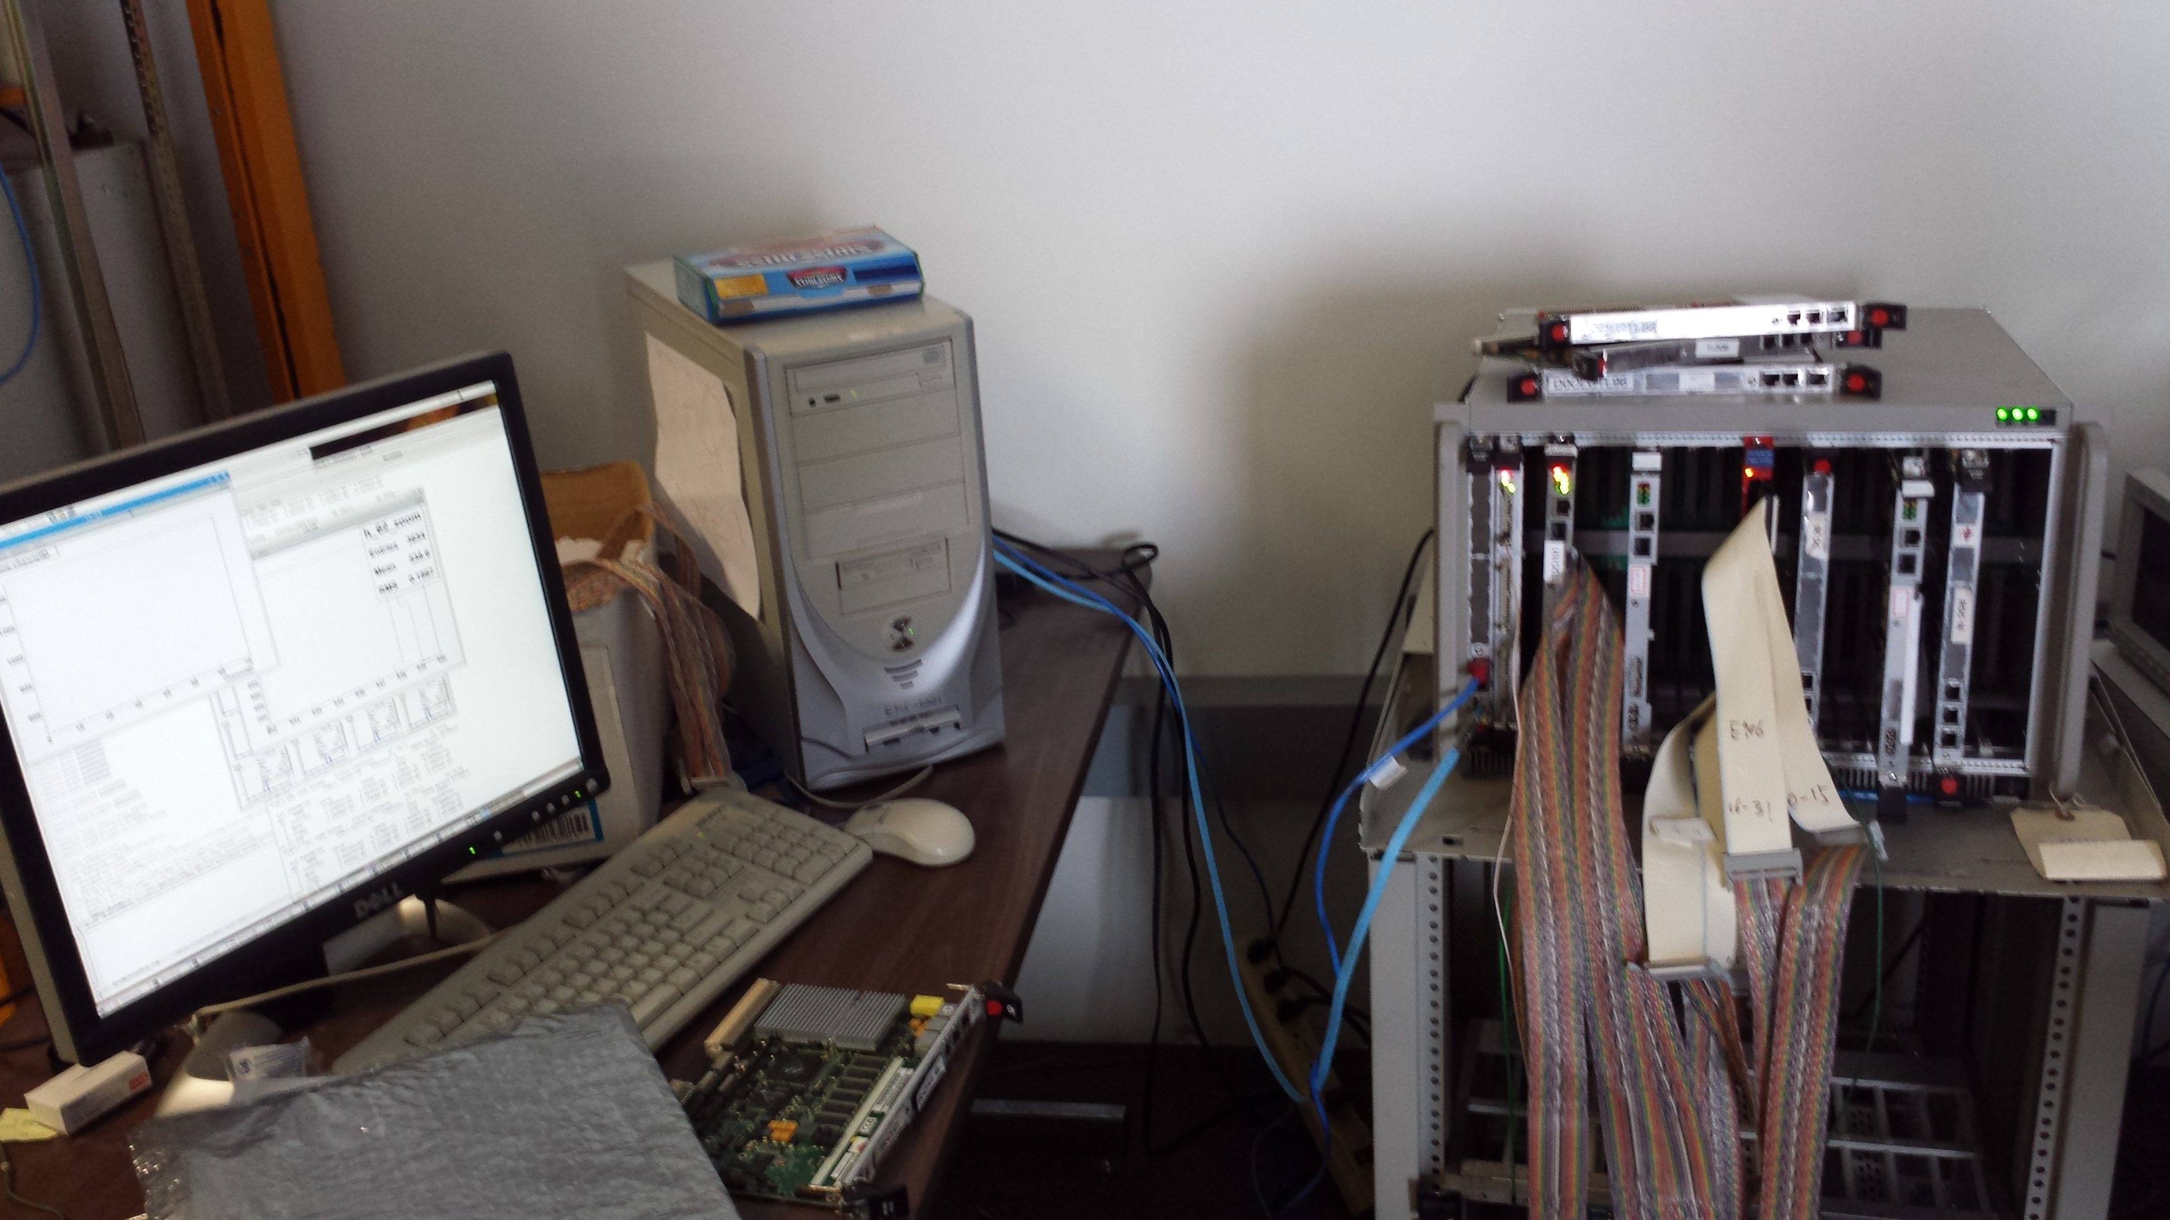
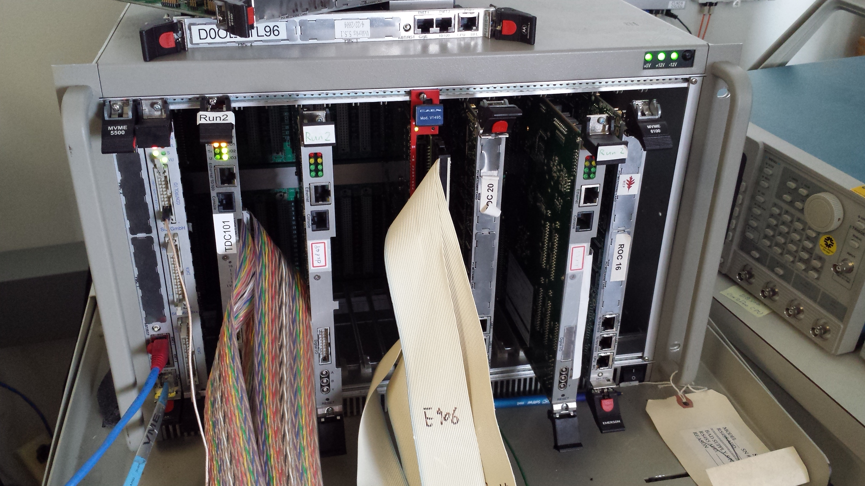
E906 DAQ Test Stand
PC/Linux: Jlab CODA, Ethernet Readout
CPU MVME5500: old VxWork (Jlab)
“TS” ?
TDC-II
V1495 pulse generator
V1495 L1 Trigger “development brd”
Windows PC: Altara FPGA programing

Slide 7
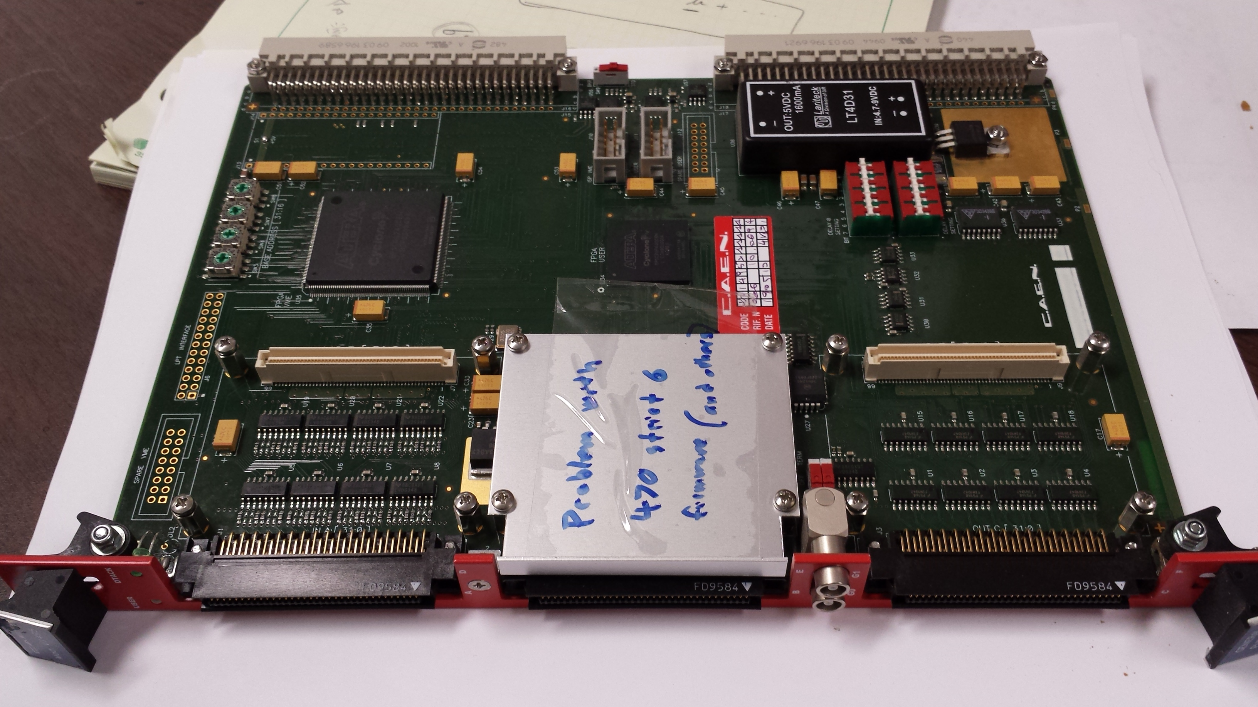
V1495 Board
2 Altara FPGA Chips: Cyclone-V

