Slide 1
Status 09/10/2011 Kun & Ming
http://www.phenix.bnl.gov/WWW/publish/mxliu/E906/09-10-2011/
External pulse calibrations: done
Timing relative to cosmic trigger
HV scan: done
HV plateau for the first hits, step=100V
# of after pulses per trigger for a given HV setting
TDC spectra for all channels: done
1st hits
Other hits (2nd, 3rd…)
Channel mapping and “tracklet” analysis – in progress
Online Monitoring – by UIUC
Offline analysis tool – by UIUC
Swap the Ha and Va planes at next opportunity: next week?
Investigate TWO “odd” channels
Vaxx…
Via TDC cards: always on…
Via NIM->TDC: low rates
Replace preAMP cards at next crane operation?
Conditioning prop tubes with “Negative” HV = ~2000V

Slide 2
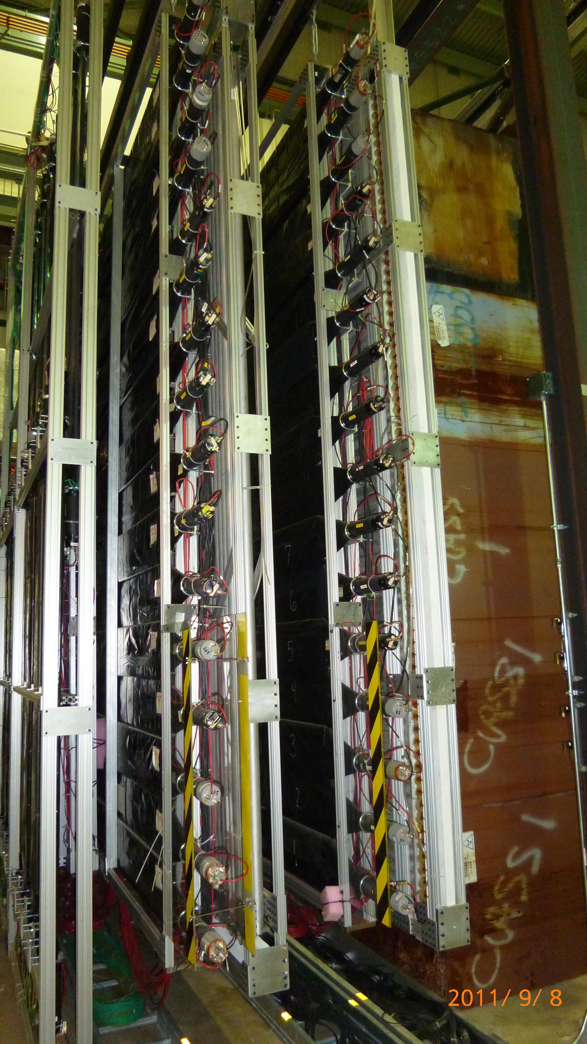
All 4 planes are (re)installed and read out via the new TDC cards
Cleaned and pained all detectors to the safety code
LV: from Exp hall
HV: from CR
Calibration w/ ext. pulser
TDC readout
All 4x9x16 channels
Gas:
Currently Ar/Co2
Will switch to new gas P10+CF4
Cosmic data triggered by ST3-4 hodoscopes through E906 DAQ
St4 is ready for beams!

Slide 3
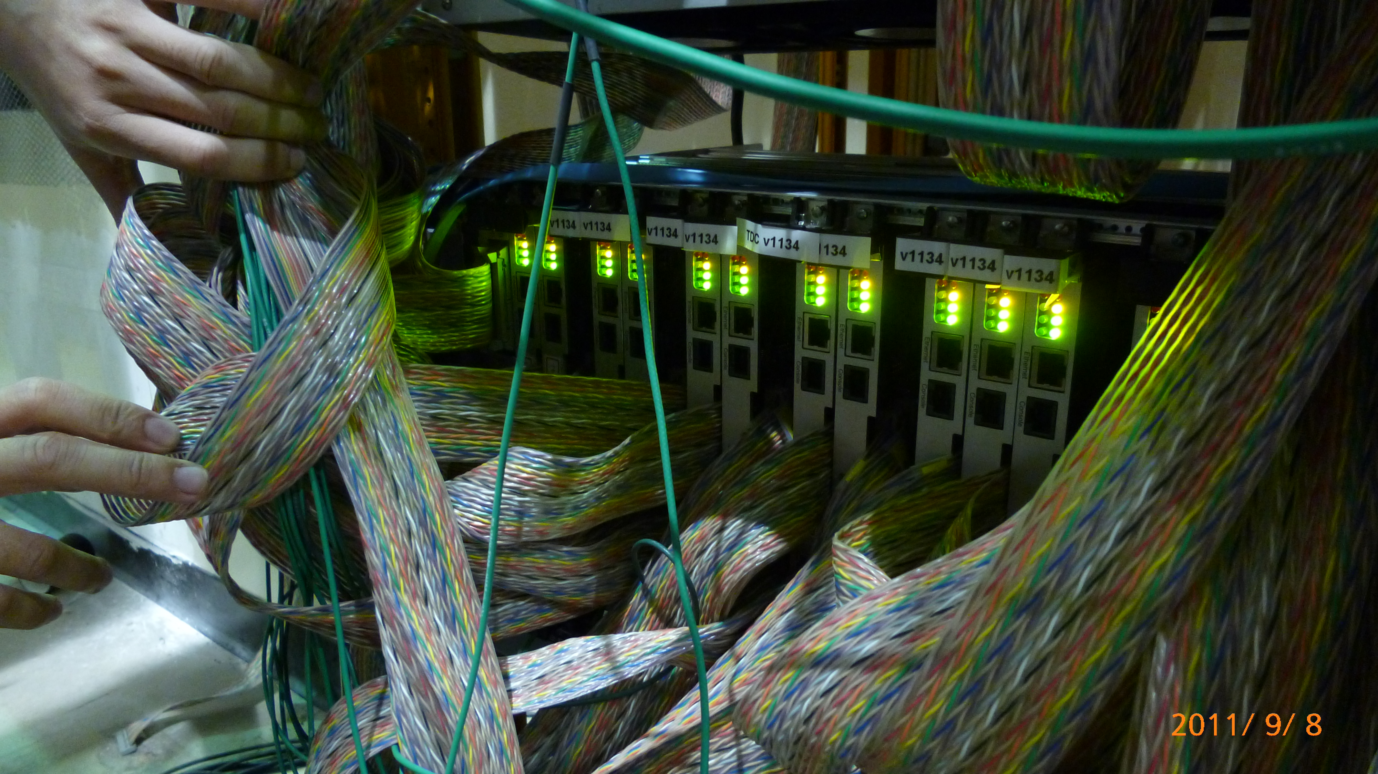
TDC readout all 36 modules

Slide 4
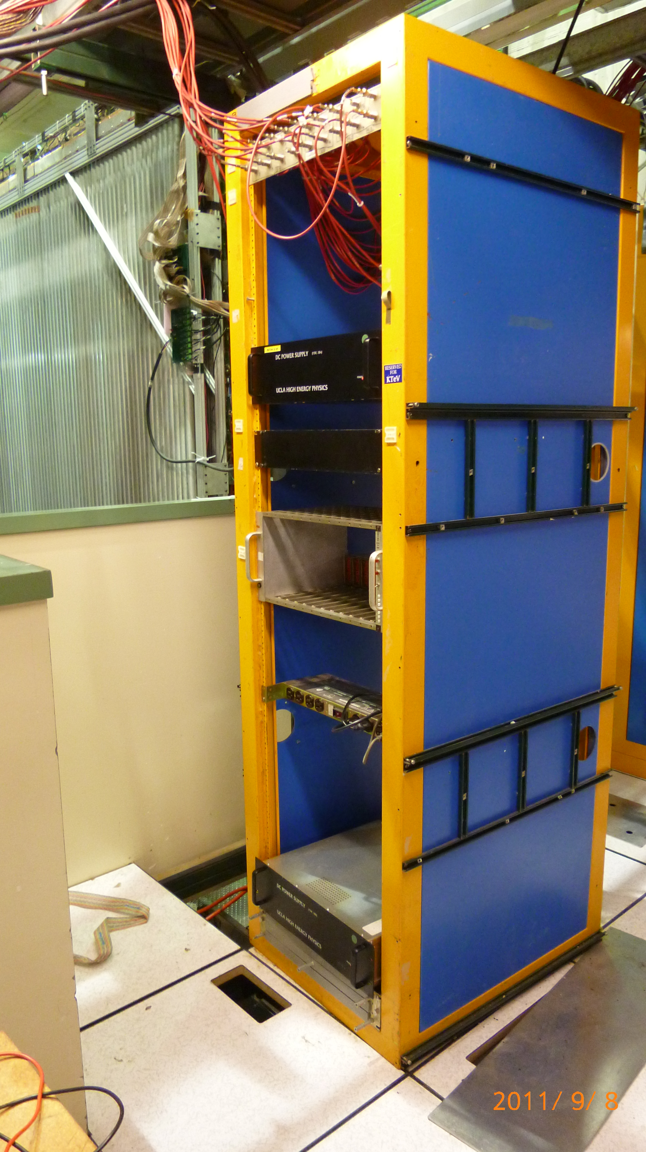
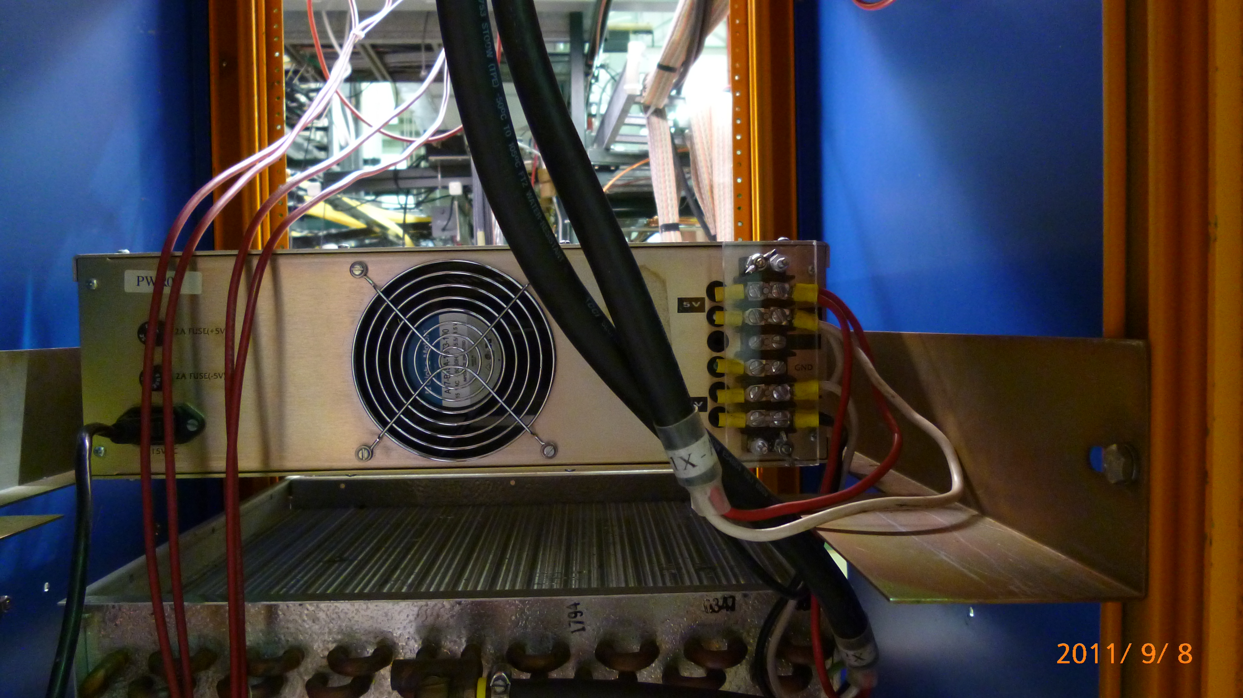
LV: 2 PS

Slide 5
Prop Tube TDC Timing Diagram
TDC Window
640 fixed
640
700
Ext. Pulser
ΔT=713
~200
Prop Tube
Cosmic Signal
Time
(nS)
0.0
1280 (fixed)
TDC
650
1100

Slide 6
Timing Test with External Pulser
Add additional delay 32nS and observed 34ns change:
ΔT=713
ΔT=679 (34)

Slide 7
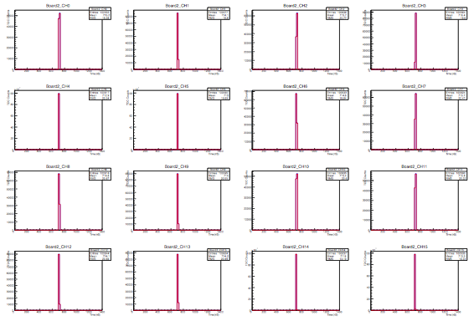
TDCs w/ External Pulser

Slide 8
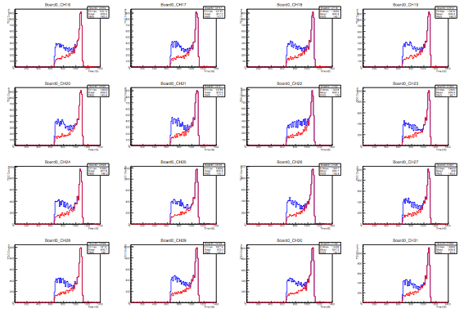
A typical module’s Cosmic TDC spectra (Ar/CO2: 80/20; HV = 2000V)
TDC

Slide 9
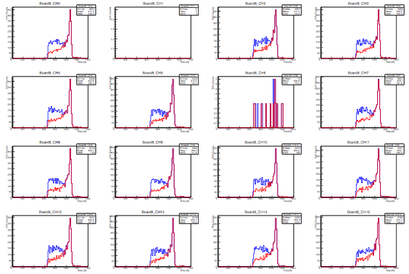
Bad Channels
Fraction of Bad Channels:
14/16*9*4= 2.43%

Slide 10
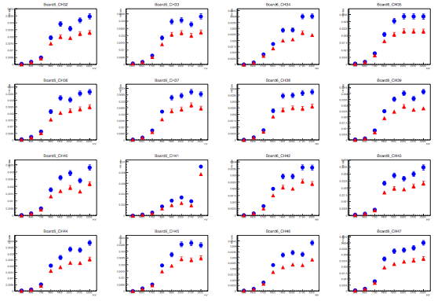
HV Scan

Slide 11
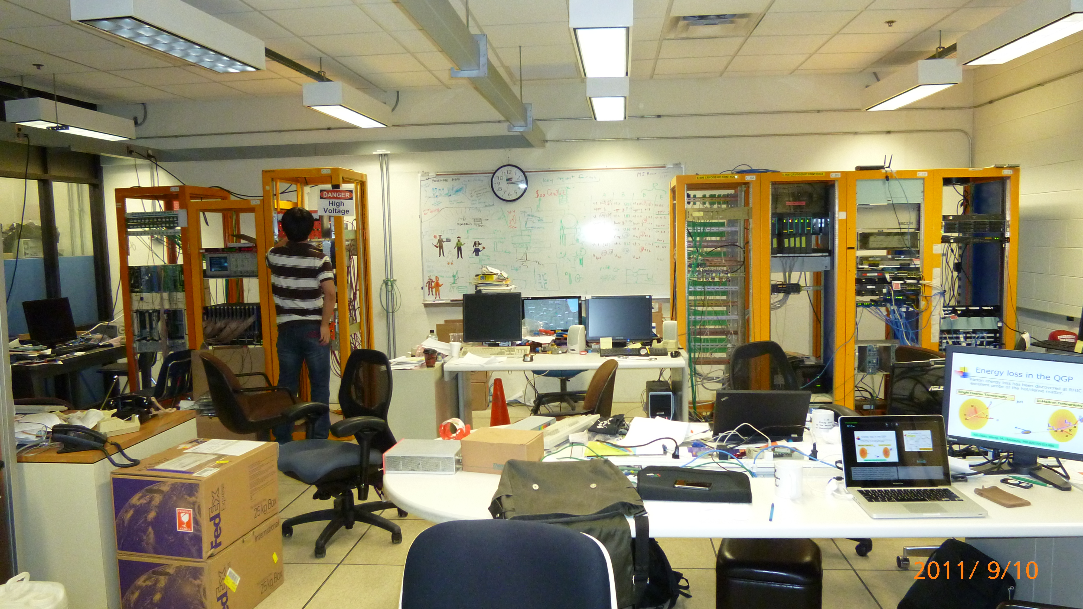
Counting House

Slide 12
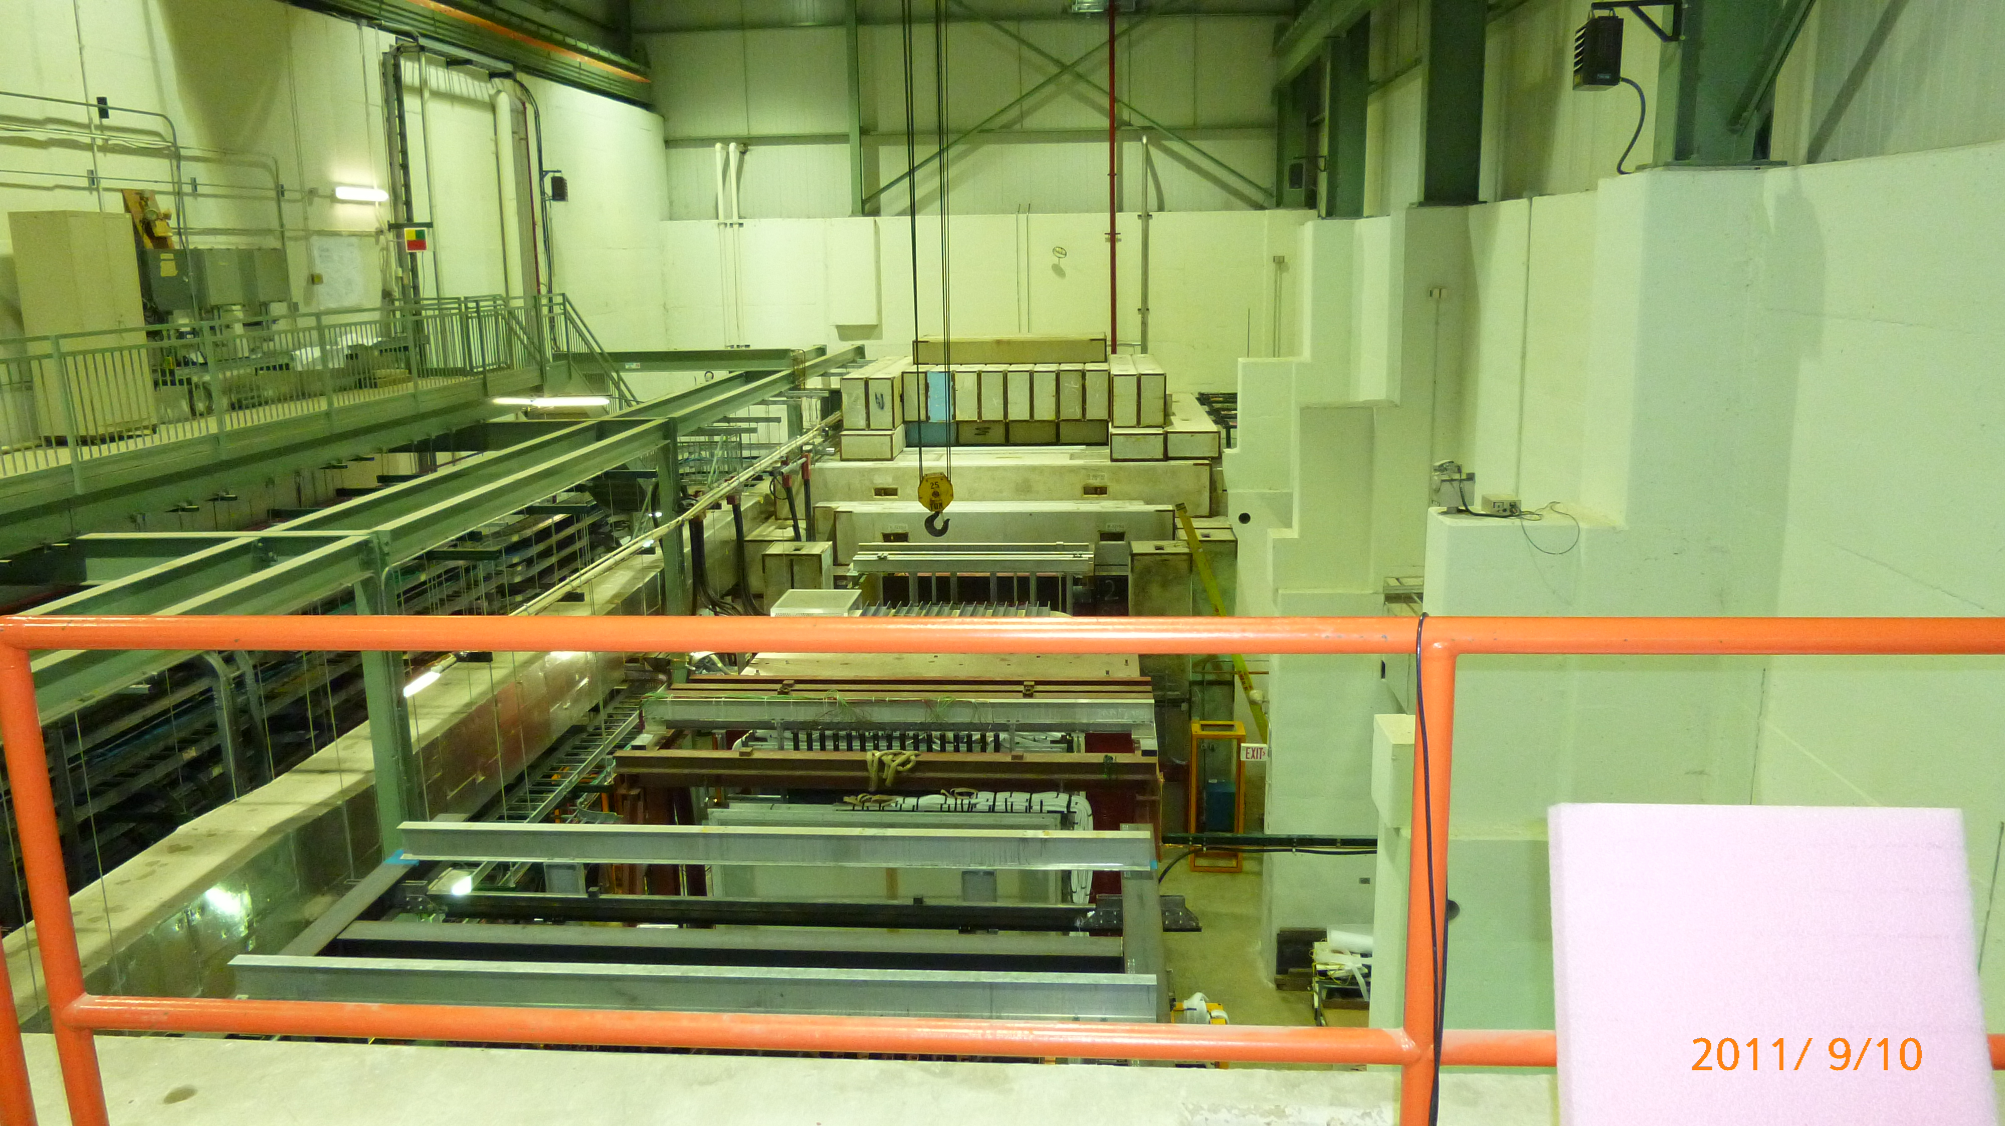
Exp. Hall

