Slide 1
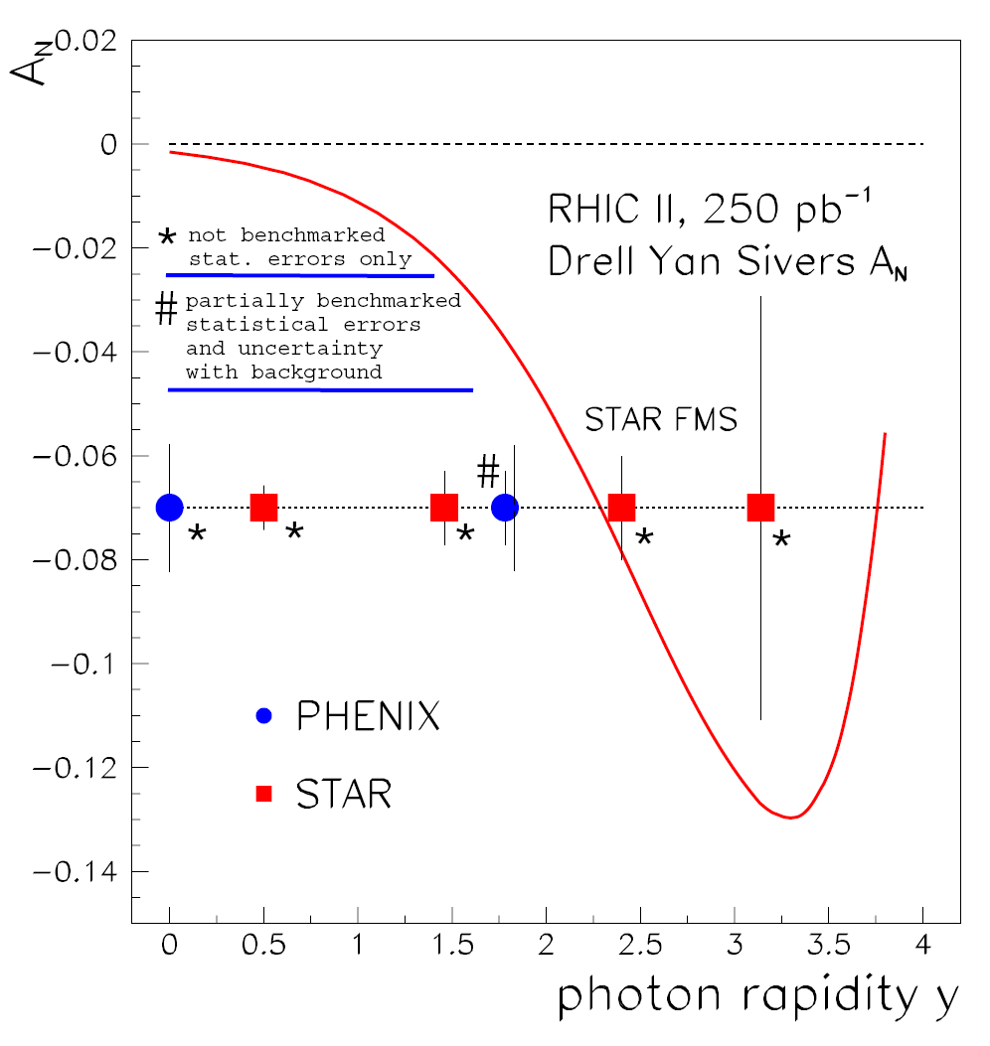
Drell-Yan A_{N}: the Old Plot
Luminosity Challenged pp@200GeV! http://www.phenix.bnl.gov/WWW/publish/mxliu/RHIC2-DY/pp200/
Expected Luminosity by 2015
  L ~50pb⁻¹
With upgrade (F)VTX detectors, it is feasible @PHENIX
  Drell-Yan X-section
  A_{N} and A_{LL}
Significant luminosity required to test the A_{N} sign change

Slide 2
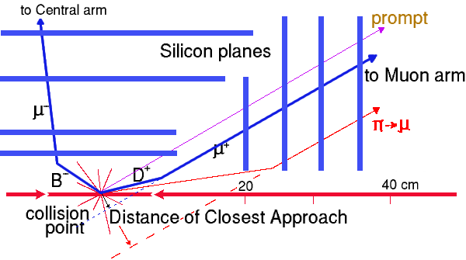
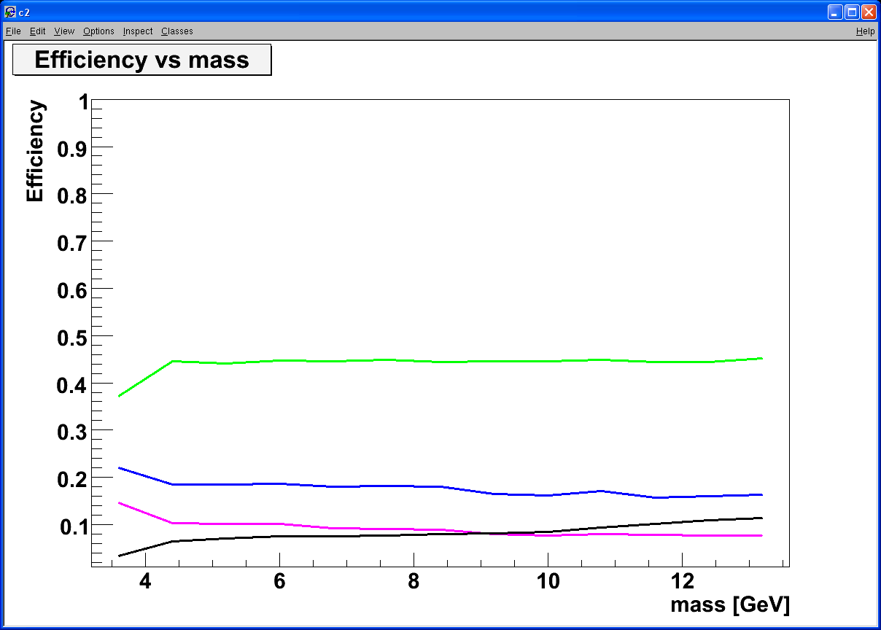
Silicon VTX, Heavy Quark and Drell-Yan
Tracking muons with MuTr+(F)VTX
  Prompt muons from DY
  Displaced tracks from π/K and heavy quark decays
p+p 200GeV
Drell Yan
DCA < 1 σ cut:
Increase DY/bb ~ 5
ϒ-states
Drell Yan
J/Ψ
charm
charm
beauty
beauty
combinatorial background

Slide 3
Expected Statistics: pp510
Luminosity = 300 pb⁻¹, Beam Polarization = 60% http://www.phenix.bnl.gov/WWW/publish/mxliu/RHIC2-DY/pp510/
PHENIX Muon Arms: 1.2 < |y| < 2.2(2.4)
For Drell-Yan, s^ > 2 GeV, full GEANT simulation:
Generated 100K pythia event for each file, 97 files, so a total of 100K x 97 = 9.7M
So the luminosity = 9.7M/sigma = 9.7x10^6 / (6.37x10^-5mb) = 970/6.37 pb^-1 = 152 pb^-1
For 300 pb^-1, we expect with K-factor = 1.4
South = 300/152 x 4602 x 1.4 = 12,716
North = 300/152 x 5077 x 1.4 = 14,028
Drell-Yan_N_total = 26,744
With beam pol = 0.6
delta_ALL = 1/Pol^2/sqrt(N) = 1.7%
delta_AN = 1/Pol / sqrt(N) = 1.0% * 1.4 (dilution factor)

Slide 4
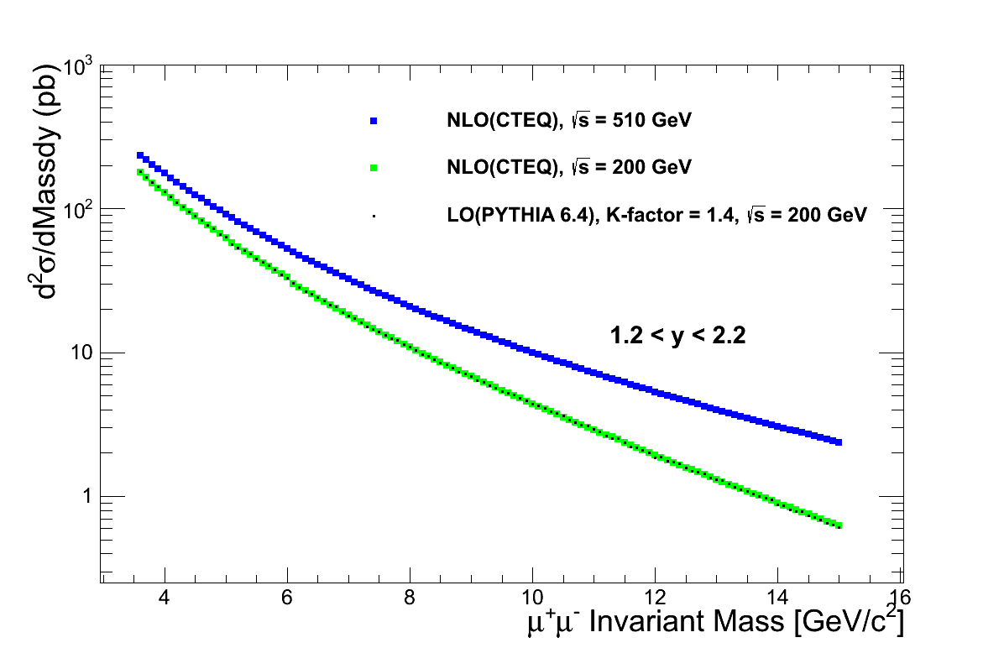
Drell-Yan Dimuon Cross Sections
PHENIX Muon Arm Acceptance

Slide 5
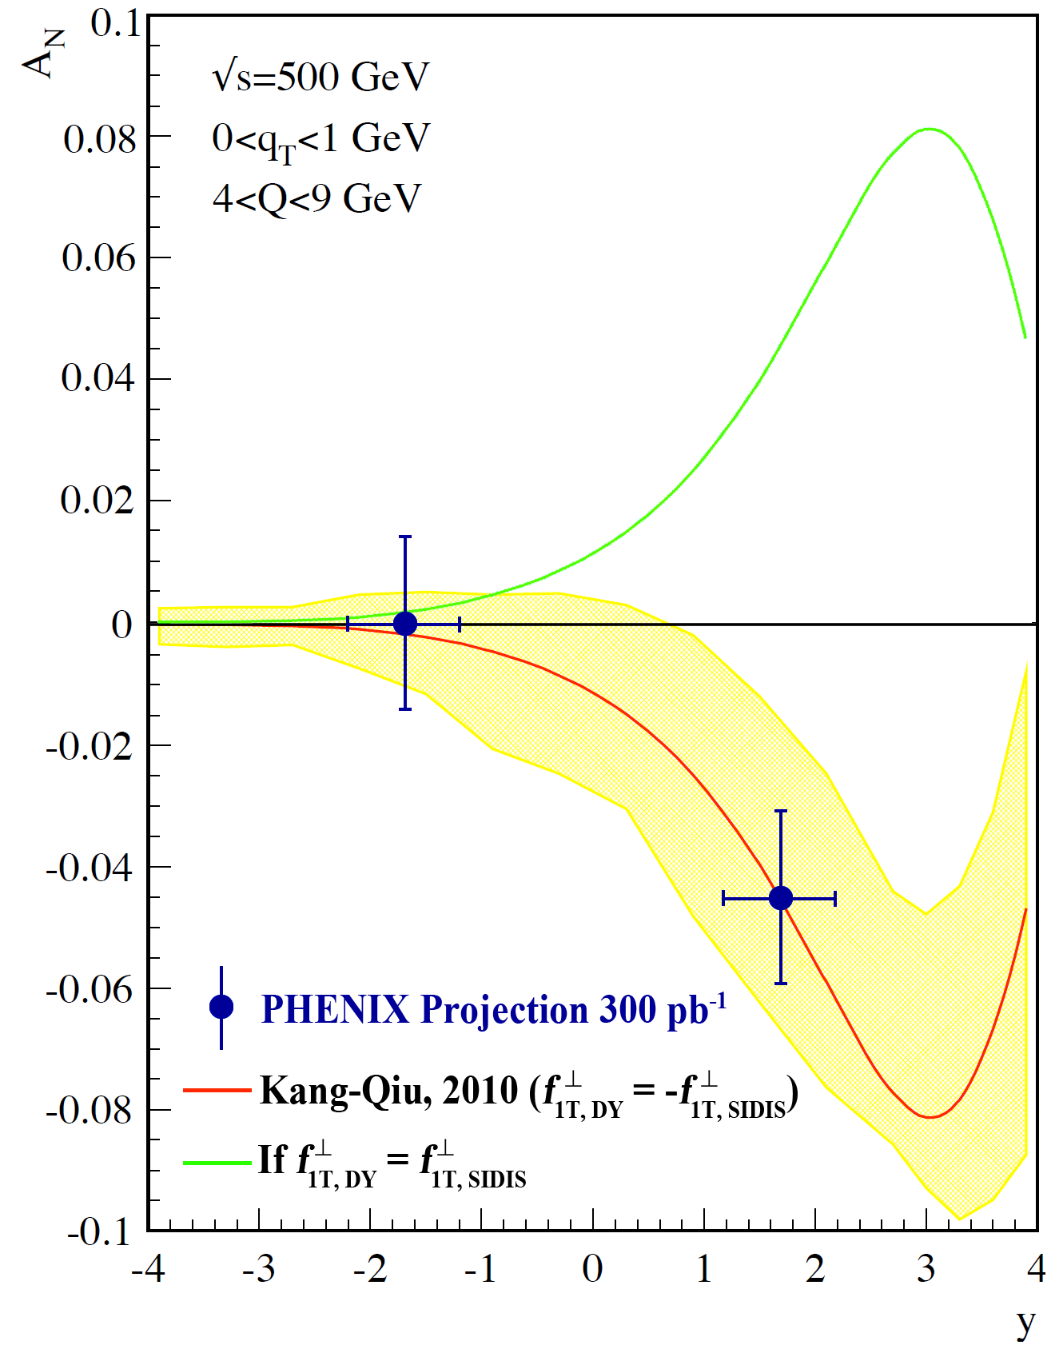
Drell-Yan Dimuon Transverse Single Spin Asymmetry A_{N} sensitivity projection:
PHENIX Muon Arms Acceptance
1.2 < |y| < 2.4
4.0 < Mass < 8.0 GeV
Integrated Luminosity = 300 pb⁻¹
Transverse Beam polarization = 60%
Red: expected A_{N} with sign change
Green: A_{N} without sign change

Slide 6
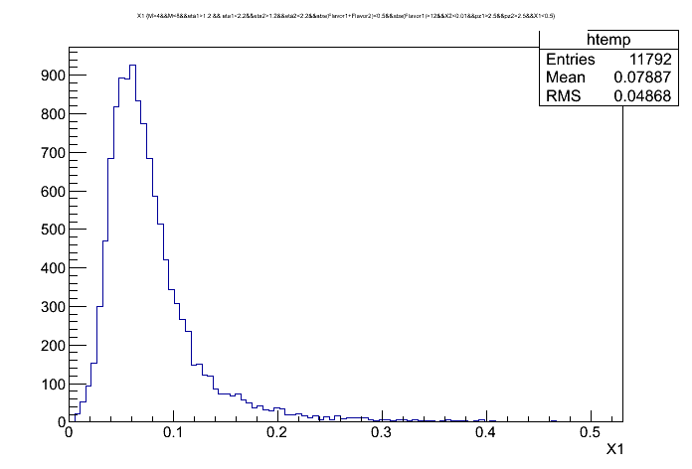
x1

Slide 7
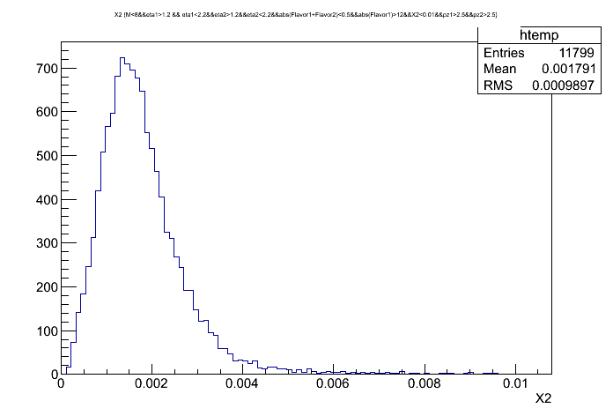
x2

Slide 8
Probing Sea Quark Polarization
1.2 < |y|<2.2(2.4)

Slide 9
Sea Quark ( ) Polarization Measurement Projection:
PHENIX fsPHENIX Acceptance
1.0 < y < 4.0
Integrated Luminosity = 300 pb⁻¹
Longitudinal Beam Polarization = 60%

