Slide 1
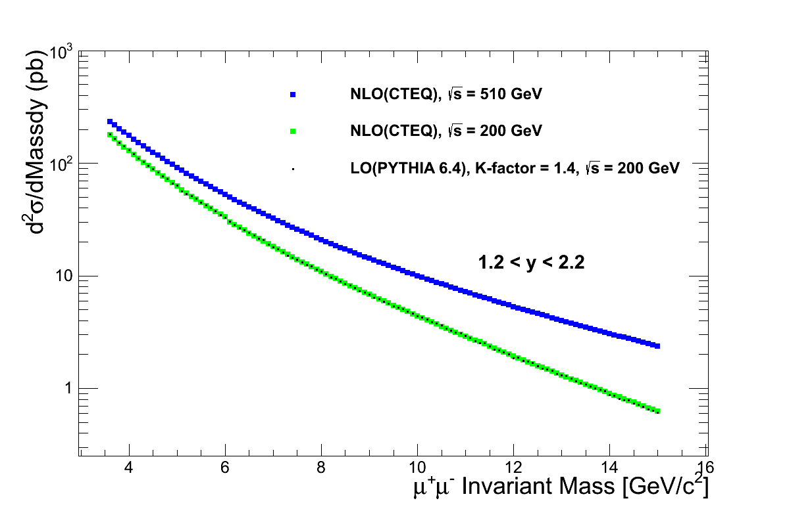
Drell-Yan Dimuon Cross Sections: p+p @RHIC
PHENIX Muon Arm Acceptance

Slide 2
Drell-Yan A_{N} p+p 510
Kang & Qiu 2010

Slide 3
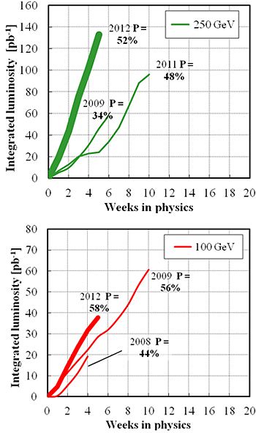
RHIC Projections
High Luminosity seems possible, Run12 pp 510GeV:
  130 pb⁻¹ / 5 weeks(CAD delivered)
  30pb⁻¹ / 5weeks(PHENIX accepted, |zvtx|<30cm)
PHENIX Run13+ expected performance
  Phenix_eff (vtx<30cm) = 40%
  Phenix_dimuon_trigger_eff = 80%
CAD projection: one year run
  L = 500pb⁻¹
  Beam Pol = 55%
  Phenx dimuon sampled luminosity |zvtx|<30cm
  L = 500 x 40% x 80% =160 pb⁻¹
Note:
It is possible to expand accepted z-vtx range far beyond the current +/-30cm limit for the dimuon events, and in such case, the sampled dimuon luminosity could be improved significantly, by a factor of ~1.7,
160pb⁻¹ → 270pb⁻¹
  In run12 pp510, the logged luminosities:
    30pb⁻¹ for |zvtx|<30cm
    50pb⁻¹ for no |zvtx| cut

Slide 4
Expected Statistics: p+p 510GeV
Luminosity = 500 pb⁻¹ delivered by CAD, Beam Polarization = 55%
PHENIX Muon Arms: 1.2 < |y| < 2.2(2.4)
For Drell-Yan, s^ > 2 GeV, full GEANT simulation:
Generated 100K pythia Drell-Yan events for each file, 97 files succeeded, a total of 100K x 97 = 9.7M events
Luminosity = 9.7M/sigma = 9.7x10^6 / (6.37x10^-5mb) = 970/6.37 pb^-1 = 152 pb^-1
For 160 pb^-1, with K-factor = 1.4
  Reconstructed DY dimuon events: N_{DY}= 14264
    South = 160/152 x 4602 x 1.4 = 6782
    North = 160/152 x 5077 x 1.4 = 7482

Slide 5
PHENIX Accepted Events
(F)VTX are used to reject backgrounds event-by-event within |Evt_zvtx|<15cm
  S/B >~ 5, N_{DY}(FVTX) ~ 50% x14262 = 7130
  r = B/(S+B)<~0.2
  A_{BG} =0

Slide 6
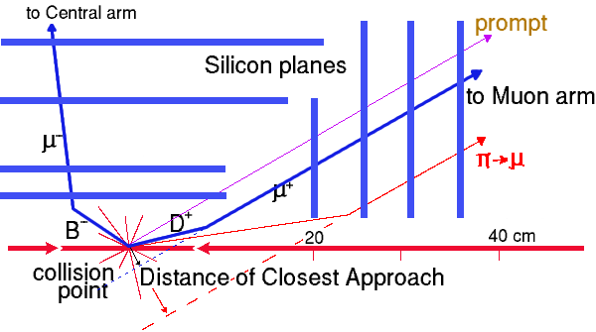
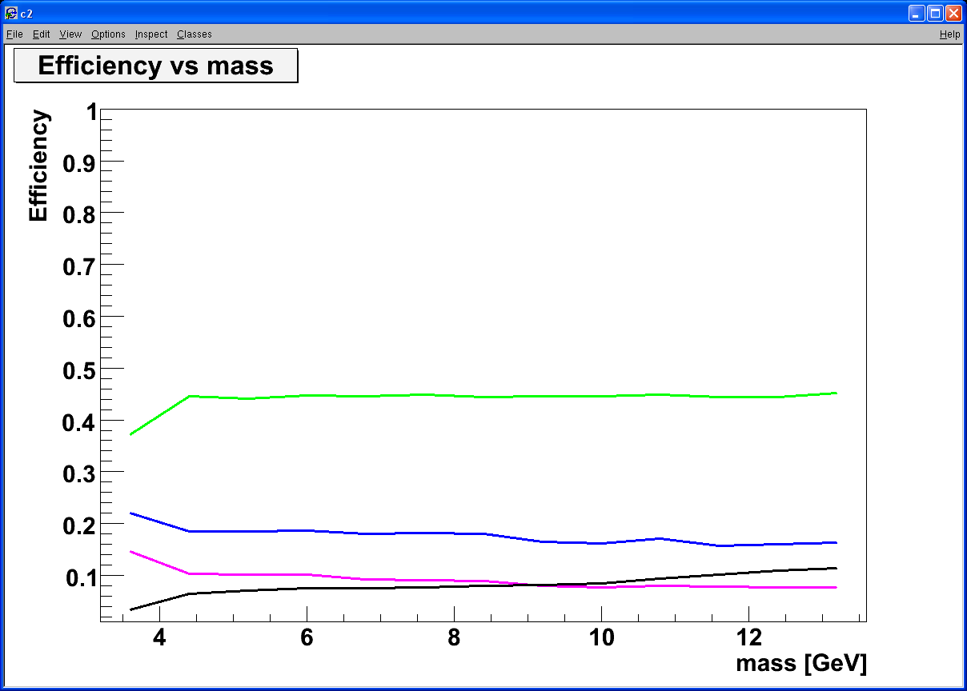
Drell-Yan Dimuon Measurements with (F)VTX in PHENIX
Tracking muons with MuTr+(F)VTX
  Prompt muons from DY, DCA <~ 100μm
  Displaced tracks from π/K and heavy quark decays, DCA >> 100μm
Simulation: p+p 200GeV
Drell Yan
DCA < 1 σ cut:
Increase DY/bb ~ 5
ϒ-states
Drell Yan
J/Ψ
charm
charm
beauty
beauty
combinatorial background

Slide 7
Background Fraction “r” Measurements
(F)VTX is used to measure background fraction “r=B/(B+S)” in the well accepted range |zvtx|<15cm
  |zvtx|<15cm, vtx acceptance
    50% of 160pb⁻¹ = 80pb⁻¹
    S/B ~1
  The error in “r” measurement is likely dominated by the systematic uncertainties, the statistical uncertainty is small < 2%.

Slide 8
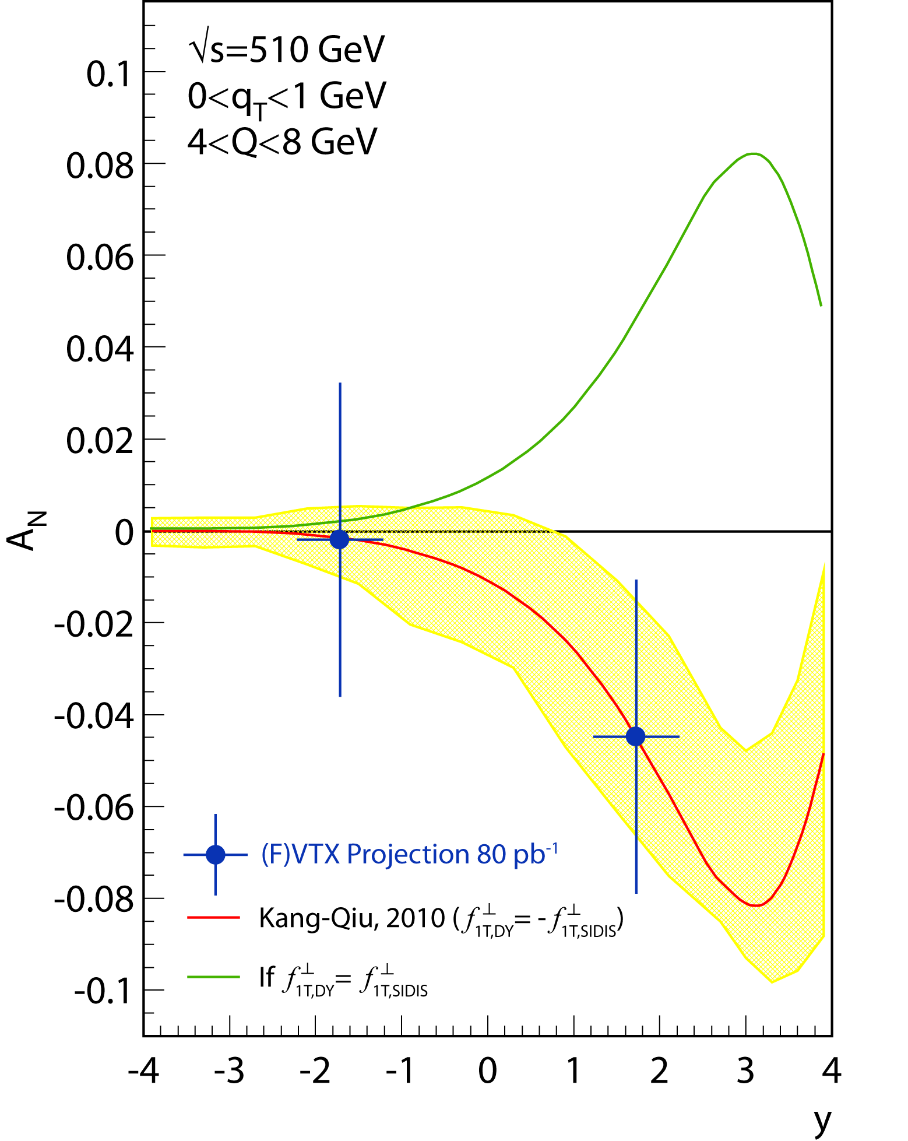
Drell-Yan Dimuon Transverse Single Spin Asymmetry A_{N} sensitivity projection:
CAD Integrated Luminosity = 500 pb⁻¹
Transverse Beam polarization = 55%
PHENIX Muon Arms Accepted 160pb⁻¹
PHENIX FVTX+Muon Accepted 80pb⁻¹
1.2 < |y| < 2.4
4.0 < Mass < 8.0 GeV
Red: expected A_{N} with sign change
Green: A_{N} without sign change

Slide 9
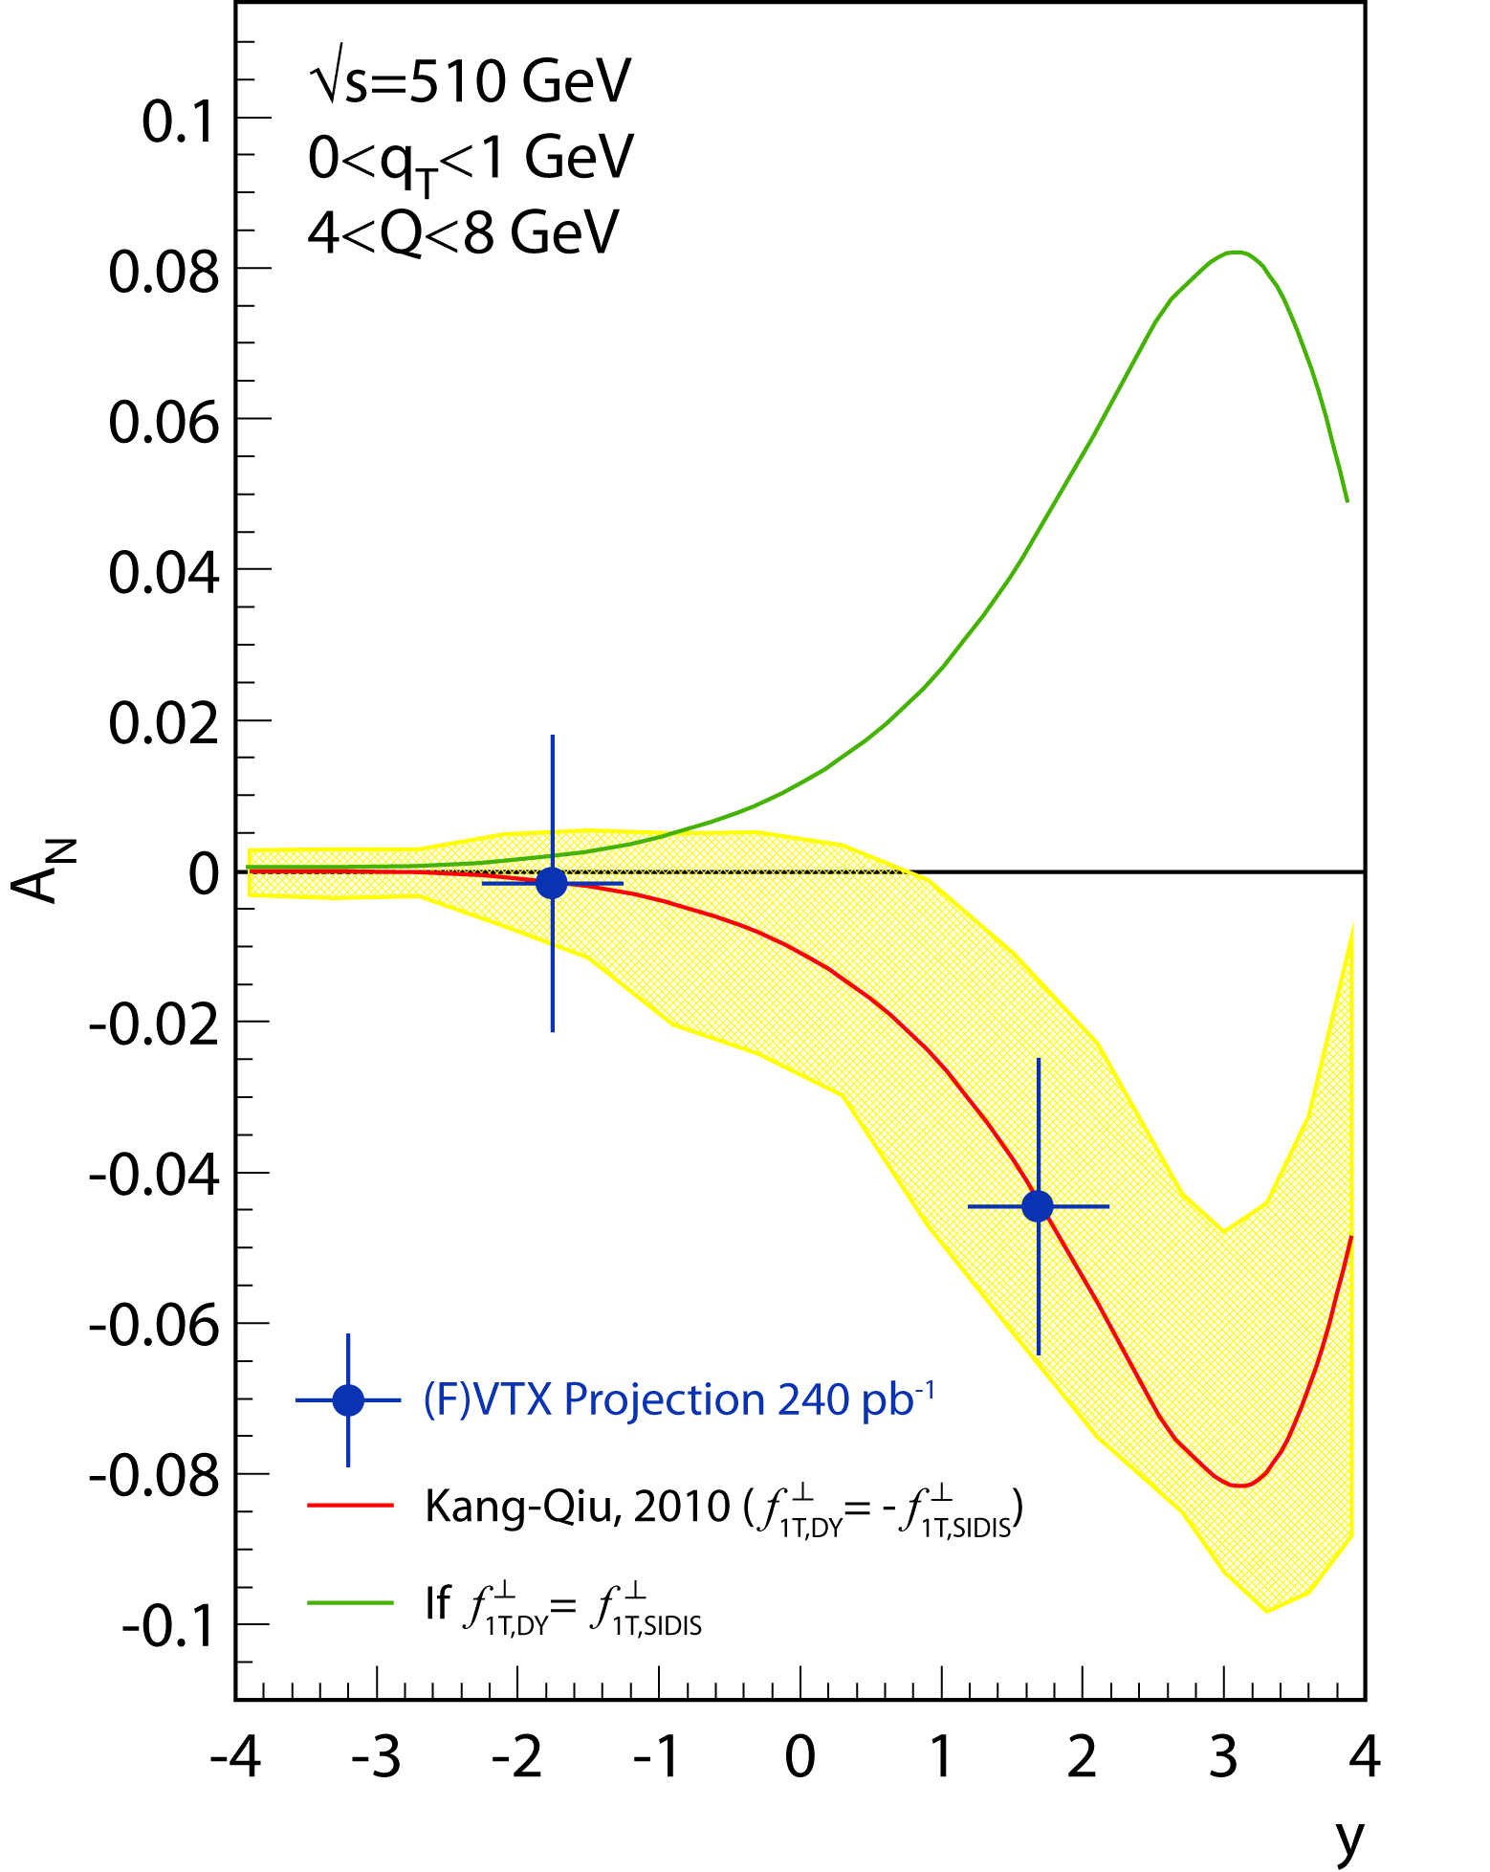
Drell-Yan Dimuon Transverse Single Spin Asymmetry A_{N} sensitivity projection:
CAD Integrated Luminosity = xxx pb⁻¹
Transverse Beam polarization = 55%
PHENIX FVTX/Muon Arms Accepted 240pb⁻¹ (3 years run)
1.2 < |y| < 2.4
4.0 < Mass < 8.0 GeV
Red: expected A_{N} with sign change
Green: A_{N} without sign change

Slide 10
Impact of the background fraction “r”
Measured asymmetry uncertainty vs “r’

Slide 11
PP510: Drell-Yan
N (1.5 < M < 2.5) = 8748; N’(4.0 < M < 8.0) = 5140
Dimuon Mass (GeV)
Dimuon Rapidity

Slide 12
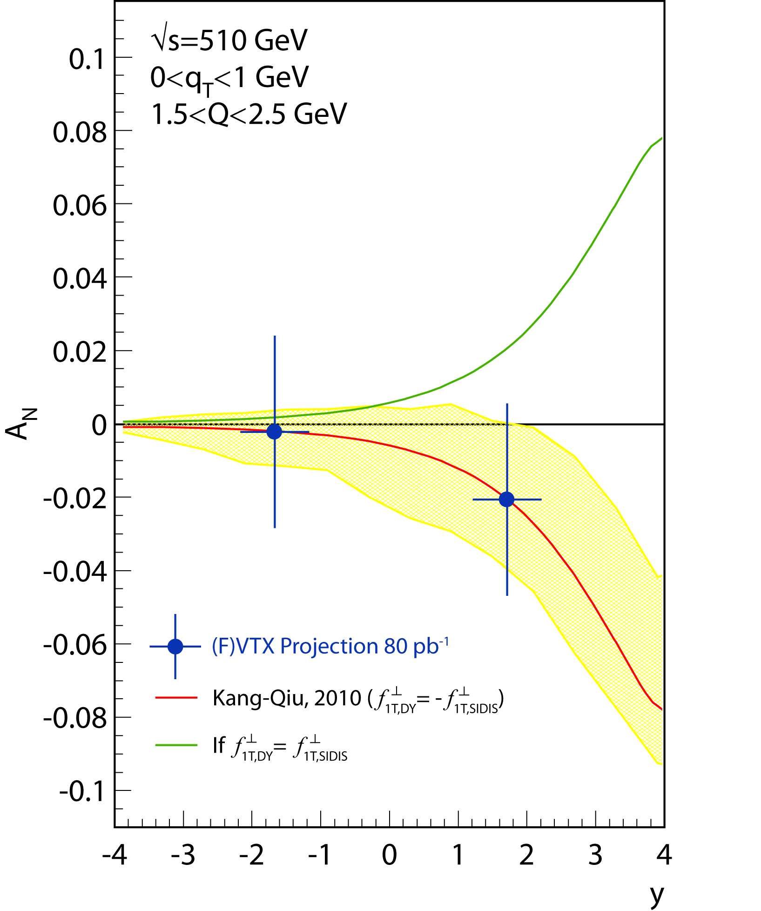

Low Mass Drell-Yan A_{N}
(assumed BG fraction r=0.2)

Slide 13
Probing Sea Quark Polarization
1.2 < |y|<2.2(2.4)
0.01
0.1
1.0

Slide 14
Sea Quark ( ) Polarization Measurement Projection:
PHENIX fsPHENIX Acceptance
1.0 < y < 4.0
Integrated Luminosity = 300 pb⁻¹
Longitudinal Beam Polarization = 60%

