Slide 1
PHENIX Spin Analysis with Muons
Ajeeta, Cesar, Ming et al
05/19/2021

Slide 2
Probe gluon polarization at small-x with “di-jet” analysis
Use forward muon/hadron to tag a “jet”
Use FVTX tracklets to measure azimuthal distribution
Identify “di-jet” events by measuring FVTX-tracklets in the opposite “phi”
To-do/work in progress:
1.taxi ride: run15pp 200GeV (transverse spin), run13pp 510GeV (longitudinal spin)
Output both singlemuon container (also dimuon ) and FVTX-tracklet container for correlation analysis
Run15pp taxi_output, w/o FVTX_tracklet container:
MB+Muon = 3.5TB; Muon Triggered 385GB
Run13pp ? similar
2. Spin analysis
Spin disk request for taxi output:
4~5TB for taxi output

Slide 3
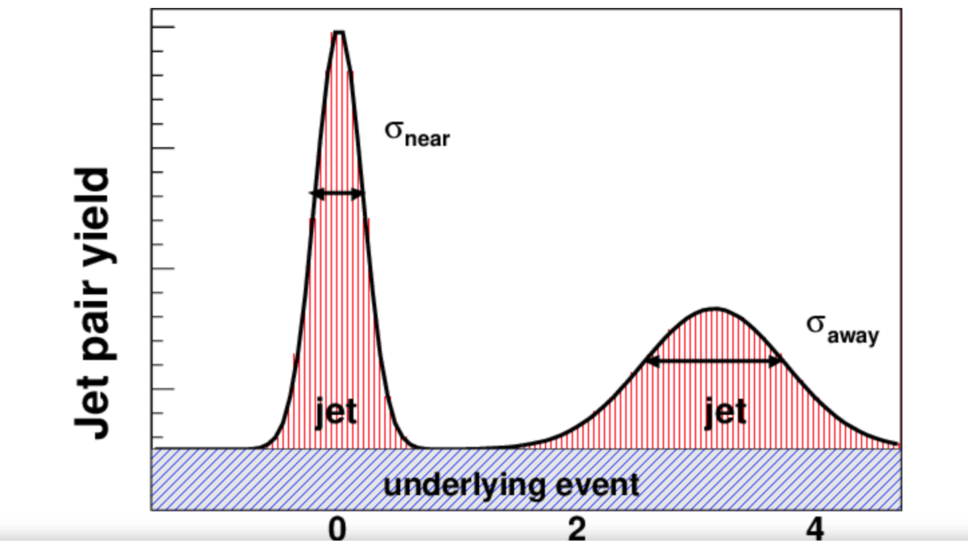
Muon/hadron
Di-jets
Forward c-cbar “jets” possible?
IP
FVTX tracklet
Forward di-jet events:
high pT muon + Opposite-side/phi (same arm) FVTX_tracklets event
for two spin combination (++) and (+-)
Spin Asymmetry A_LL ~ [(++) - (+-)]/[(++)+(+-)]/P^2
Gluon polarization at small -x

Slide 4
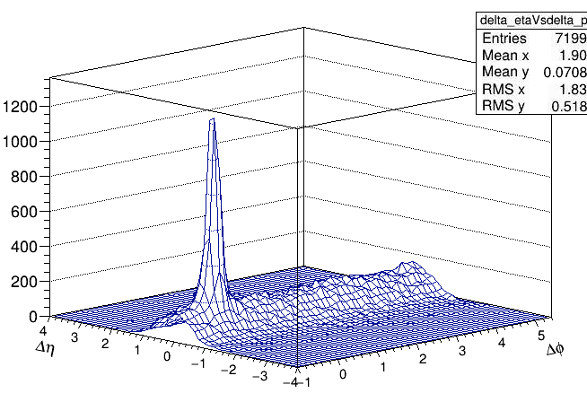
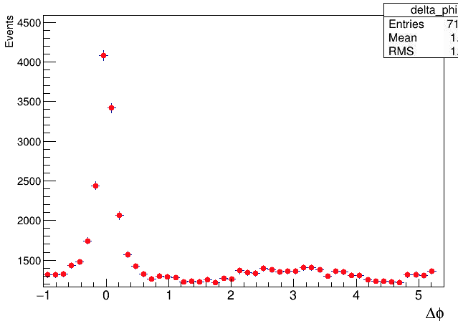
Local Taxi Analysis
Test run run15pp data and run13pp
Singlemuon container
Dimuon container
VTX tracklet container
PHENIX global variables
Triggers
Spin, beam-xing luminosity
Outputs:
Run15pp MB: 3.5TB
Run15pp MU: 385GB
Run13pp: ~5TB?

Slide 5
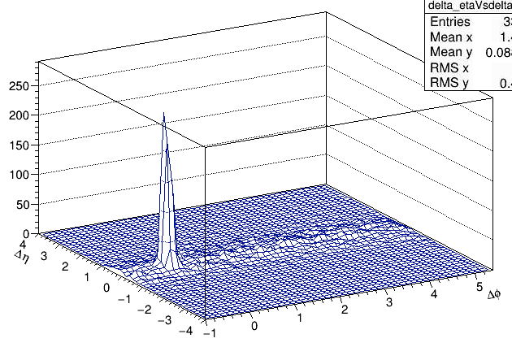
Local Taxi Analysis
Test run run15pp data and run13pp
Singlemuon container
Dimuon container
VTX tracklet container
PHENIX global variables
Triggers
Spin, beam-xing luminosity
Outputs:
Run15pp MB: 3.5TB
Run15pp MU: 385GB
Run13pp: ~5TB?

