Slide 1
Run15 J/Psi Multiplicity Dependence Analysis
Yasser, Cameron, Ming et al
08/12/2021
PHENIX HHJ Meeting
Data analysis daily technical note:
https://docs.google.com/document/d/1TmrvJvx_gYyC1yr2GJJNzFlUmRB5IERNnvV76_BURBo/edit
Analysis note (just started):
https://www.overleaf.com/project/610b64a9f2882779db01a804

Slide 2
Progress and Plan
Completed taxi runs
Run15pp, MB and MU
/gpfs/mnt/gpfs02/phenix/spin/spin1/phnxsp01/mxliu/taxi/Run15pp200CAMBP108/17544
/gpfs/mnt/gpfs02/phenix/spin/spin1/phnxsp01/mxliu/taxi/Run15pp200CAMUP108/17596
Run15pAu, MB and MU
/gpfs/mnt/gpfs02/phenix/fvtx/subsys/fvtx/mxliu/taxi/Run15pAu200CAMBPro108/17597
/gpfs/mnt/gpfs02/phenix/hhj/hhj1/mxliu/taxi/Run15pAu200CAMUPro108/17646/
Good run lists, Run15 pp and pAu
starting from Sanghoon’s good (muon + FVTX) lists
additional SVX multiplicity QA in progress, for pp
MC simulation to study effects on multiple-collisions in progress
MC signal: J/Psi in p+p -> J/Psi + X
Mixed events: Run15 pp MB + (pp->J/Psi MC)
Goal: finish systematic error estimations for DNP → preliminary physics results
BBC_rate dependent multi-collision effects
Cameron, Ajeeta et al

Slide 3
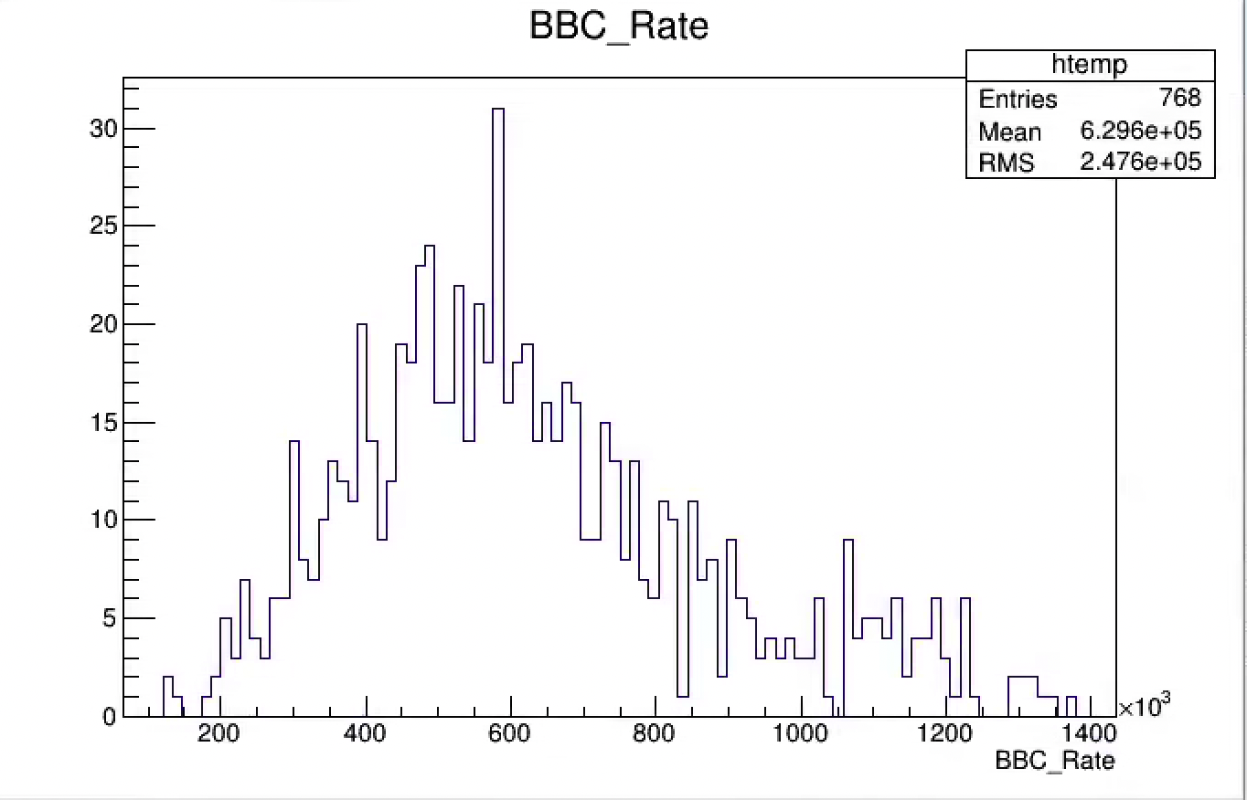
Run15 pp MB: BBC Rates
Study Evt_Mult_FVTX, SVX in 3 groups:
BBC < 400 kHZ
400< BBC < 800 kHz
BBC > 800kHz
Event selection:
|Evt_vtxZ| < 10 cm

Slide 4
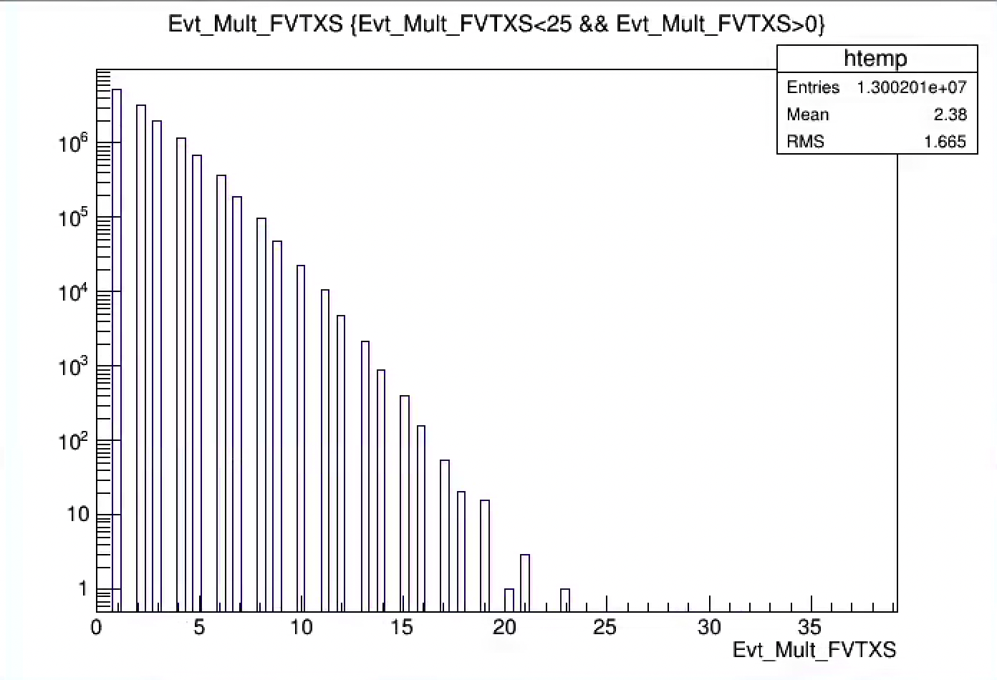
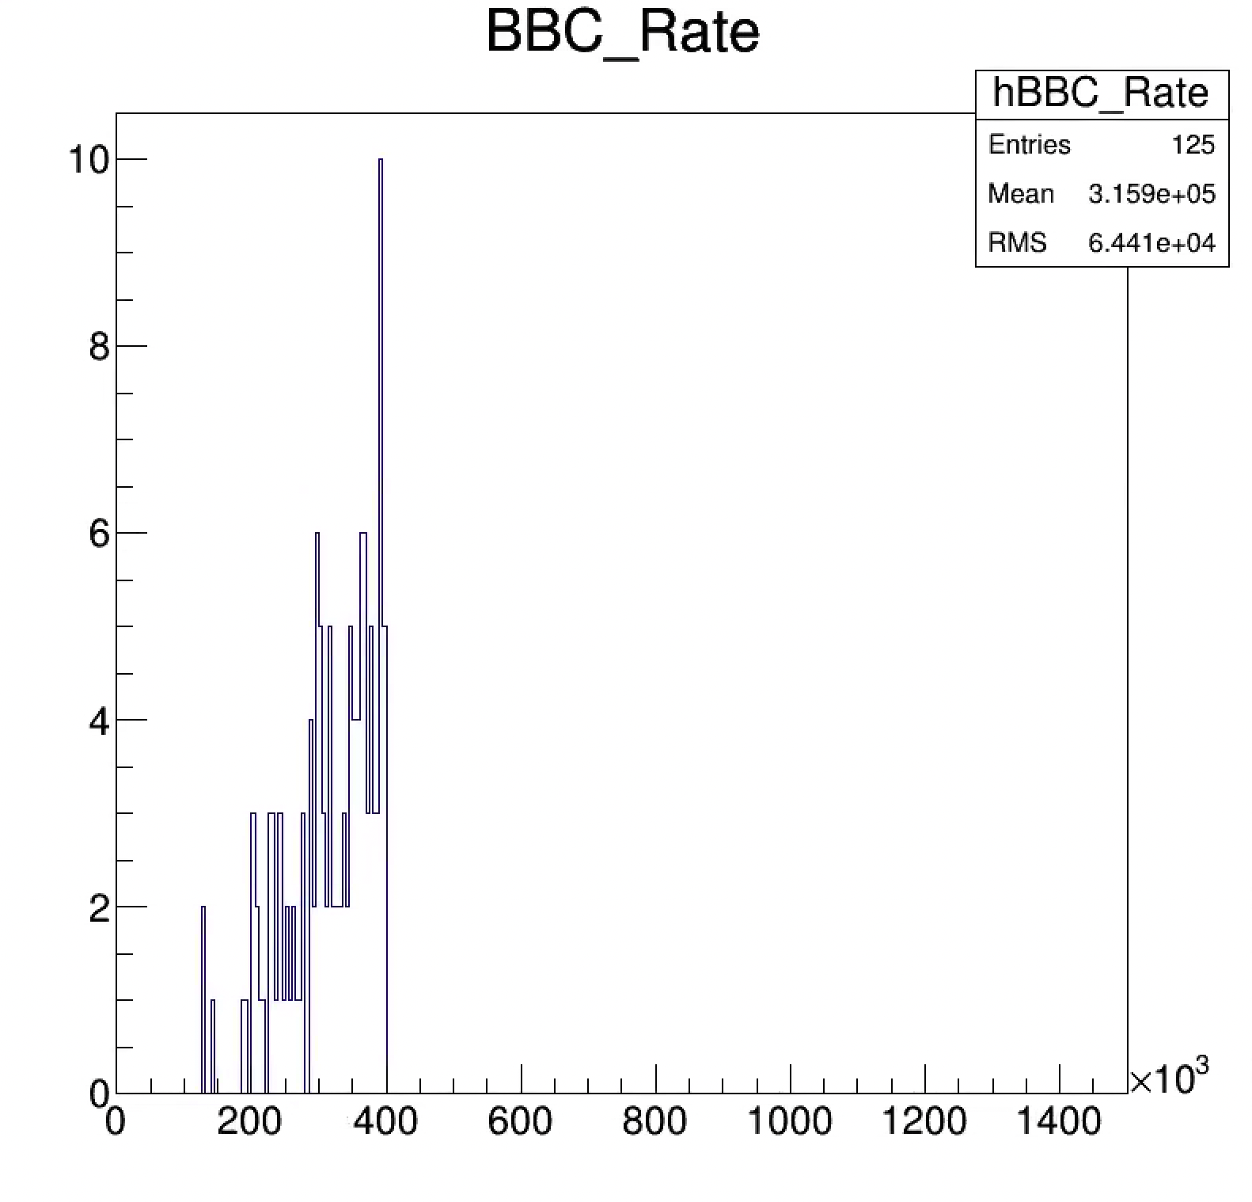
BBC < 400 kHz, Evt_Mult_FVTXS, from 10 good runs
Mean = 2.38
Sigma = 1.67

Slide 5
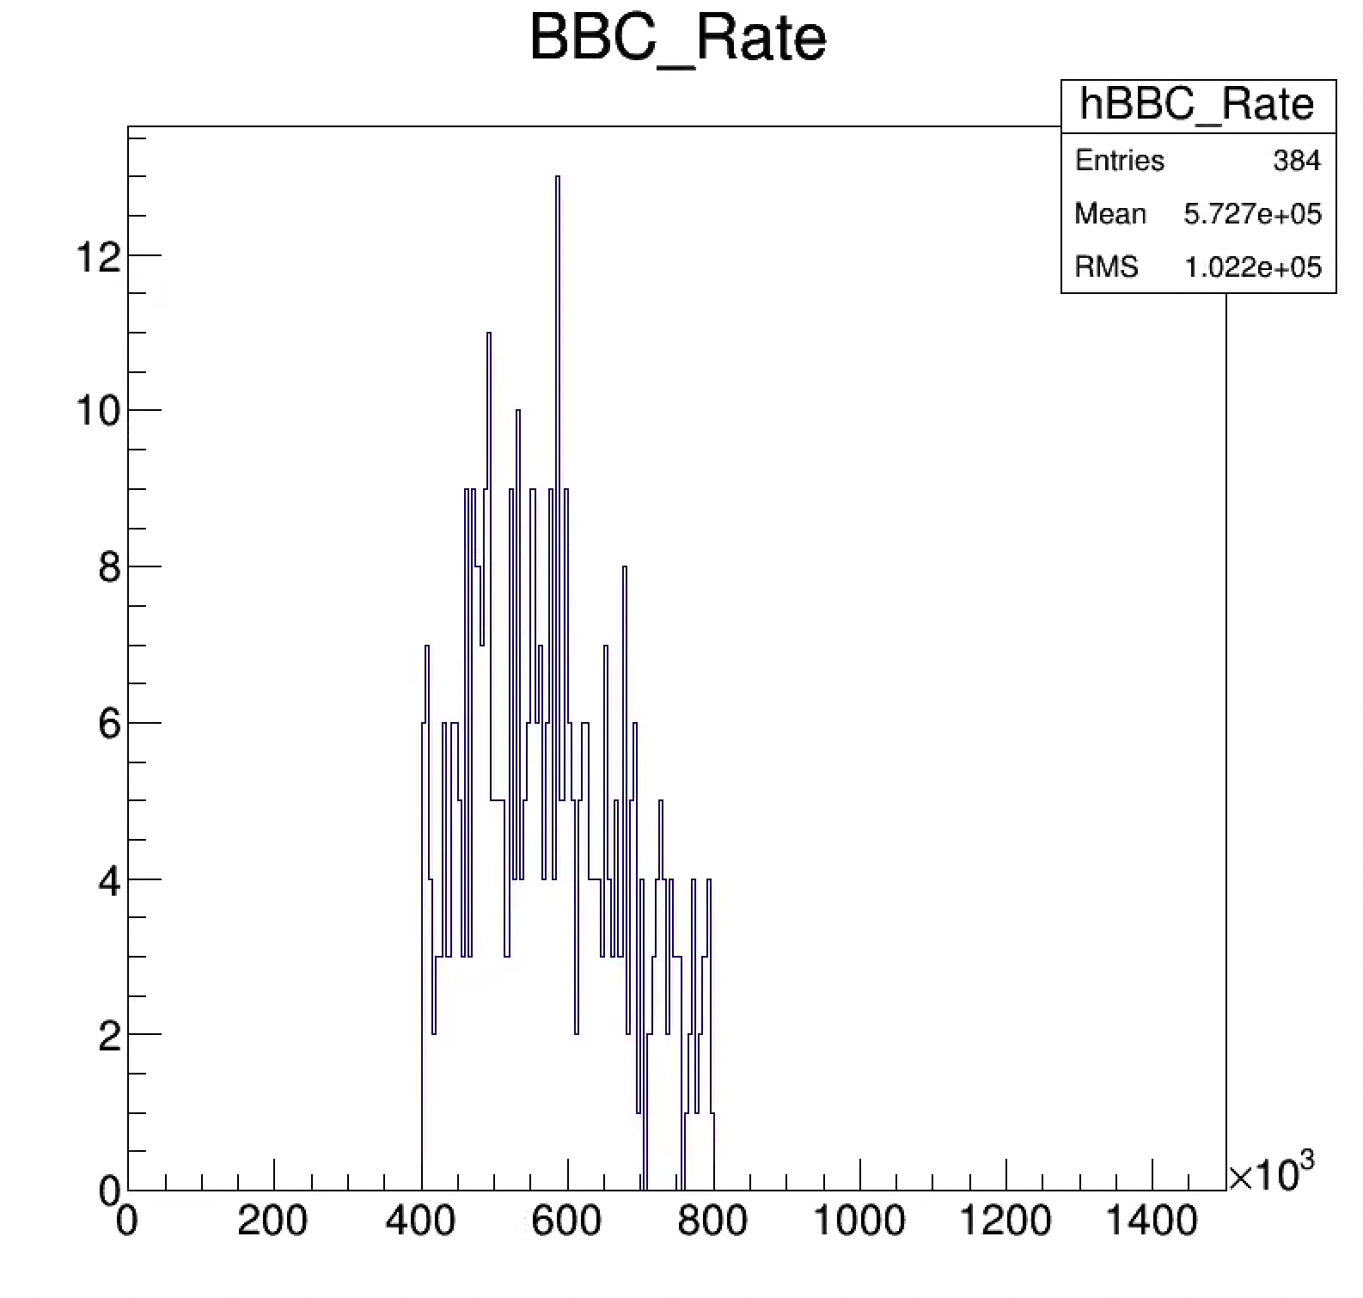
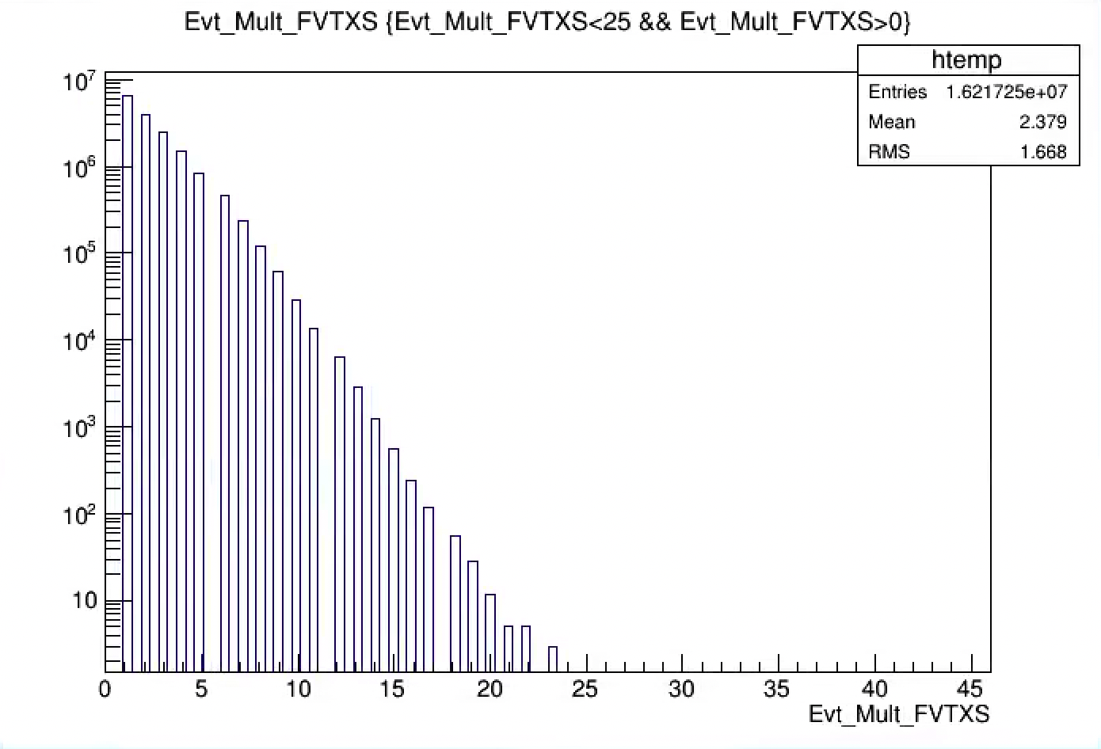
400 < BBC < 800 kHz, Evt_Mult_FVTXS, from 10 good runs
Mean = 2.38
Sigma = 1.67

Slide 6
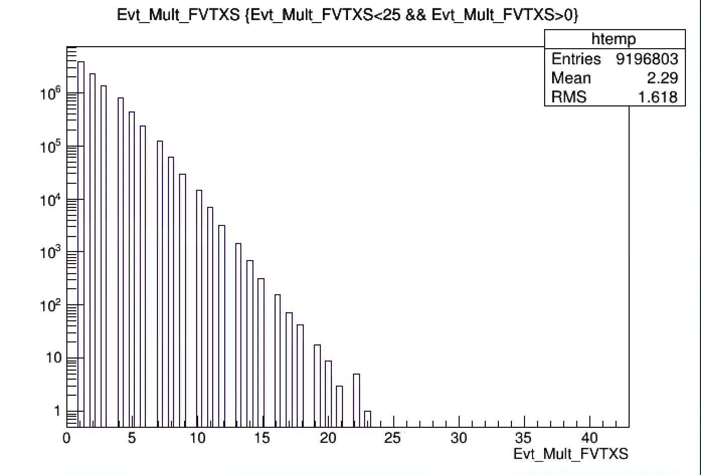
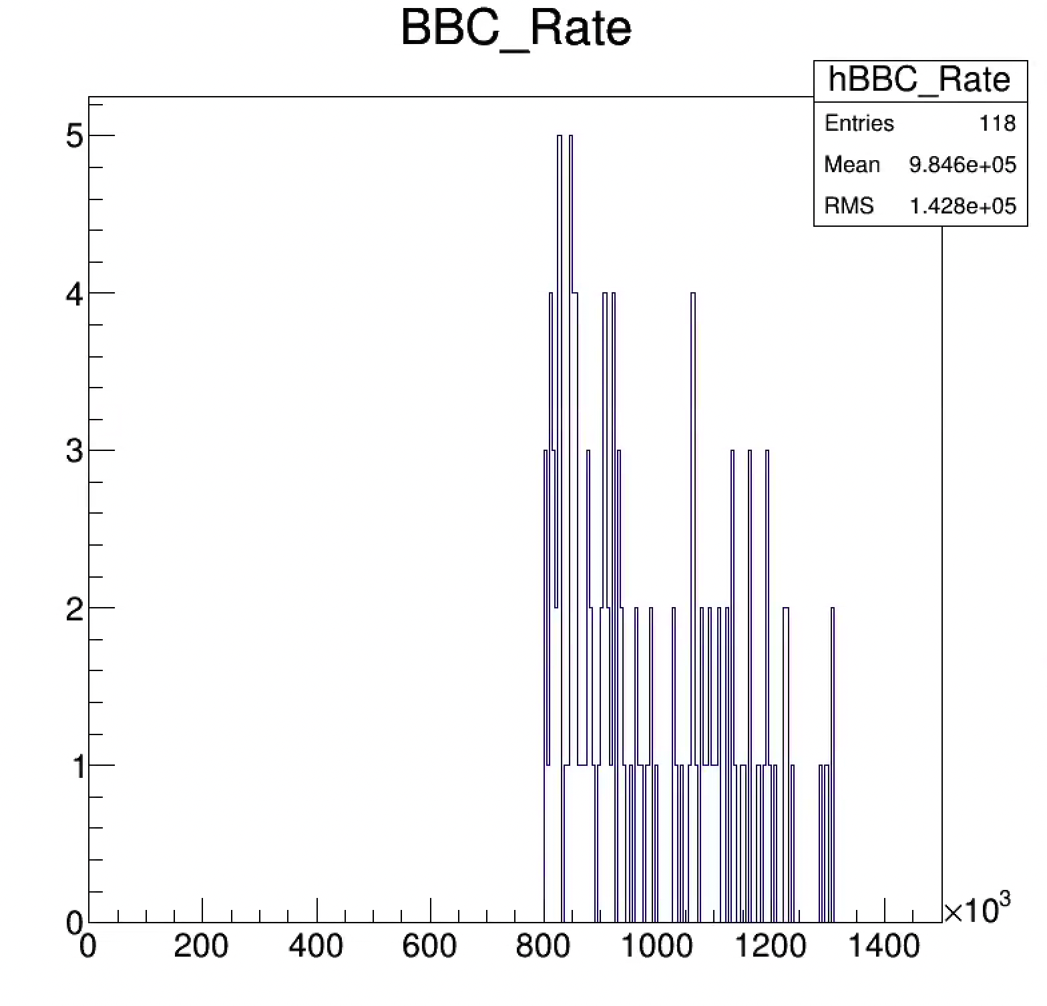
BBC > 800 kHz, Evt_Mult_FVTXS, from 10 good runs
Mean = 2.29
Sigma = 1.62

Slide 7
Close look at Evt_Mult_FVTX, SVX QA – in progress
Low BBC rate run: 421949 (good for both S and N arms)
BBC Rate – 320kHz
High BBC rate run: 426252 (Bad for north arm measurements)
BBC Rate – 850kHz

Slide 8
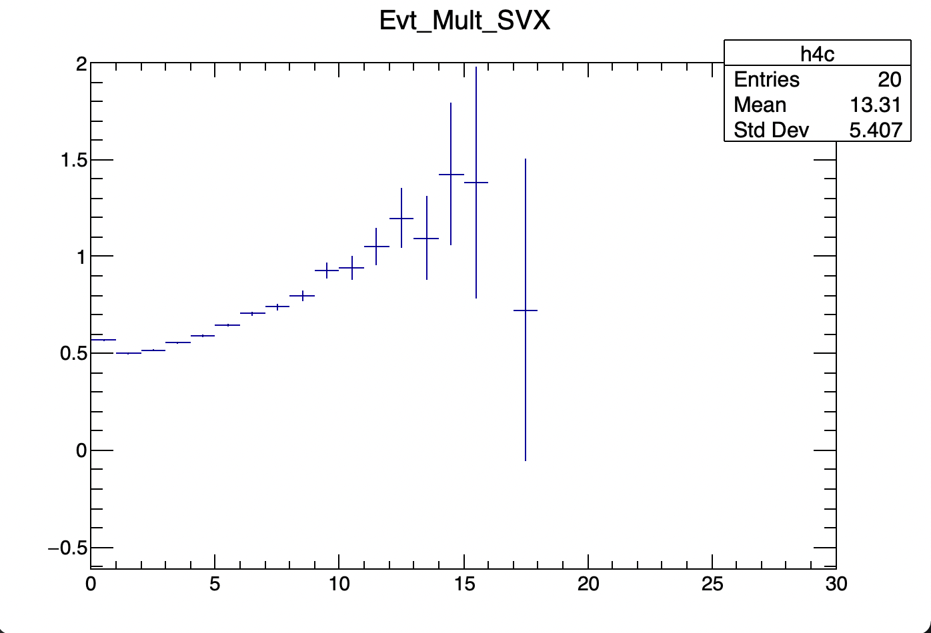
Ratios of Evt_Multi_SVX: (>800kHz)/(<400kHz)
From two MB runs:
>800kHz: (850)
Run 426252
<400kHz: (320)
Run 421949
More of pile up events?
Detector Acc/Eff change?

Slide 9
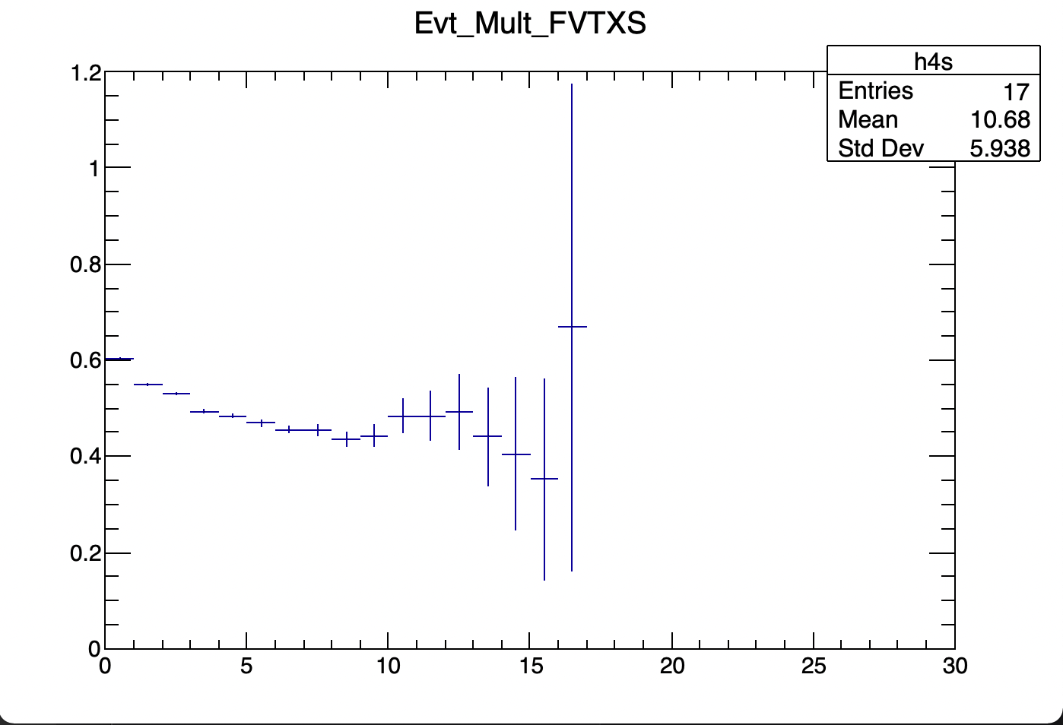
Ratios of Evt_Multi_FVTXS: (>800kHz)/(<400kHz)
From two MB runs:
>800kHz: (850kHz)
Run 426252
<400kHz: (322kHz)
Run 421949
Less of pile up events?
Detector Acc/Eff change?

Slide 10
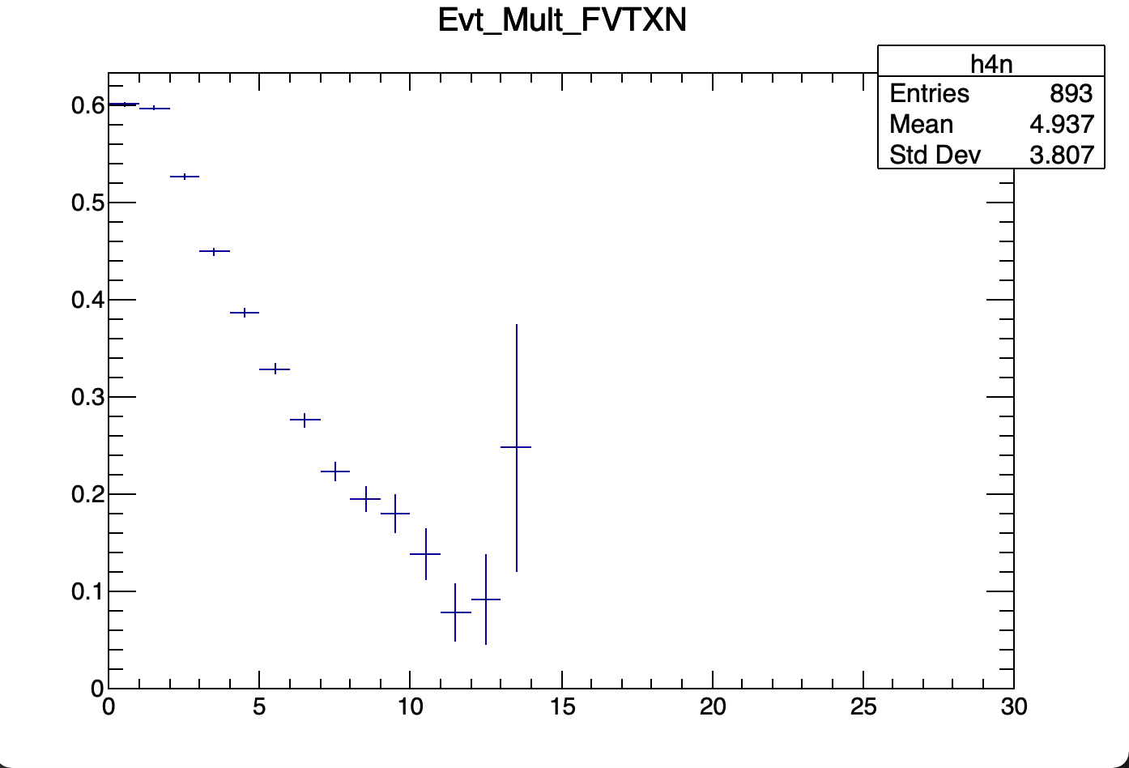
Ratios of Evt_Multi_FVTXN: (>800kHz)/(<400kHz)
From two MB runs:
>800kHz:
Run 426252
(bad for North arm)
<400kHz:
Run 421949

Slide 11
To-do’s:
More QA & Run selection on FVTX and SVX Multiplicity - in progress
Run15 pp MB events
FVTXN, FVTXS and SVX
PYTHIA pp simulations - in progress
Signal: p+p -> J/Psi + x
|Evt_vtxZ| < 10cm
Evt_Mutl_FVTX/SVX distributions
Event mixing with MB from run15pp
All MB collisions from wide vertex MB trigger
One MB + one J/Psi events (100% double collisions, J/Psi signal event)
Evt_Mutl_FVTX/SVX distributions -> check the distortion due to the 2nd MB collision
Estimate the contamination from 2nd MB collisions to the J/Psi signal events’ Evt_Mult_FVTX/SVX distributions
10% 2nd collisions
20%, 50% etc.

Slide 12
Backup slides

Slide 13
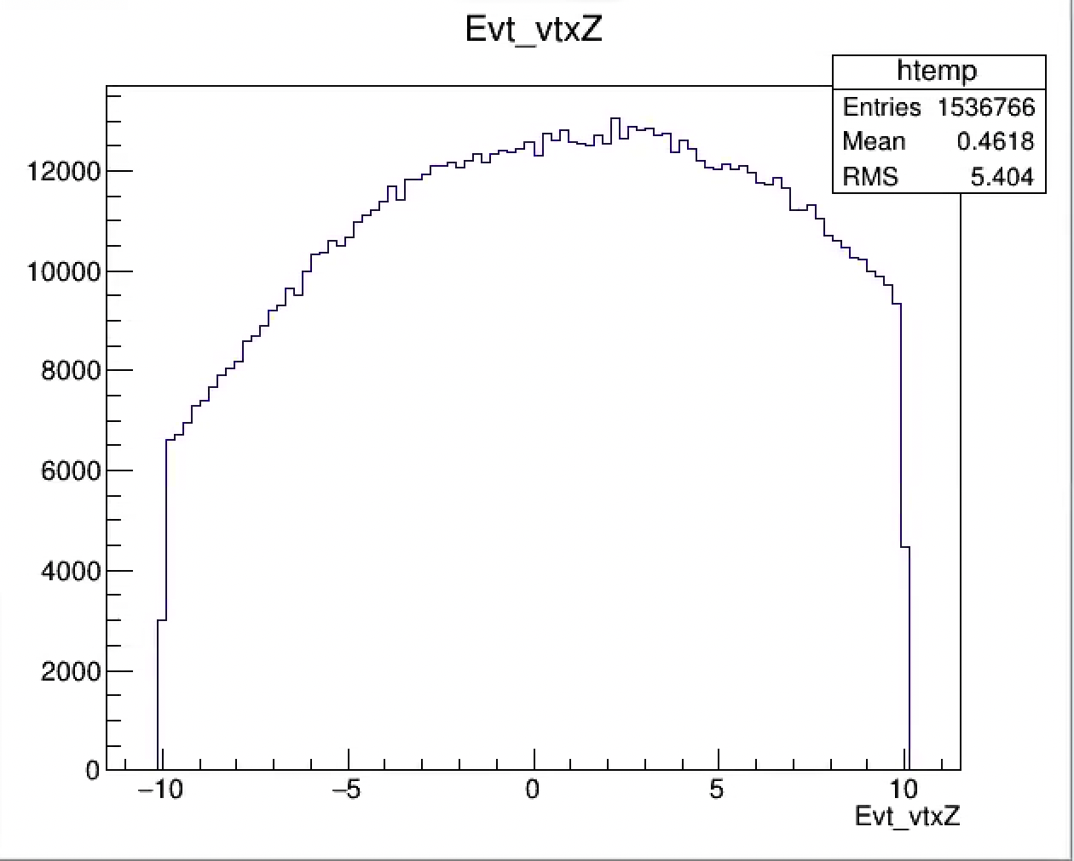
Run 421949: BBC_Rate = 320kHz

Slide 14
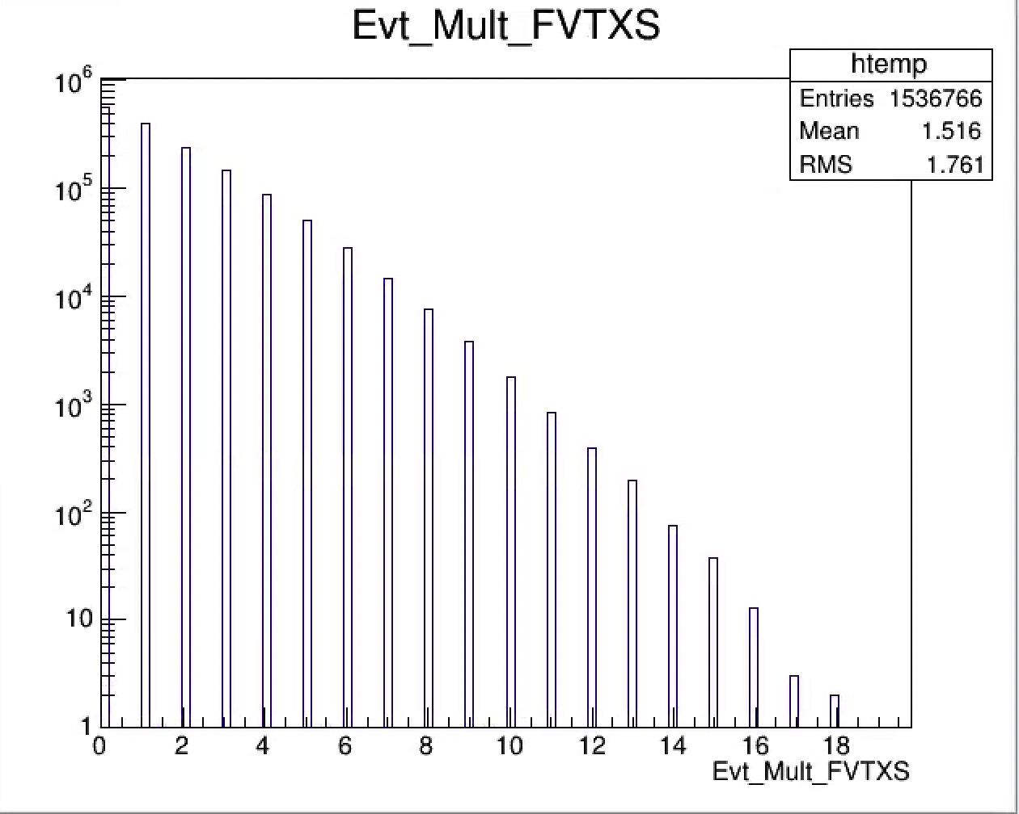
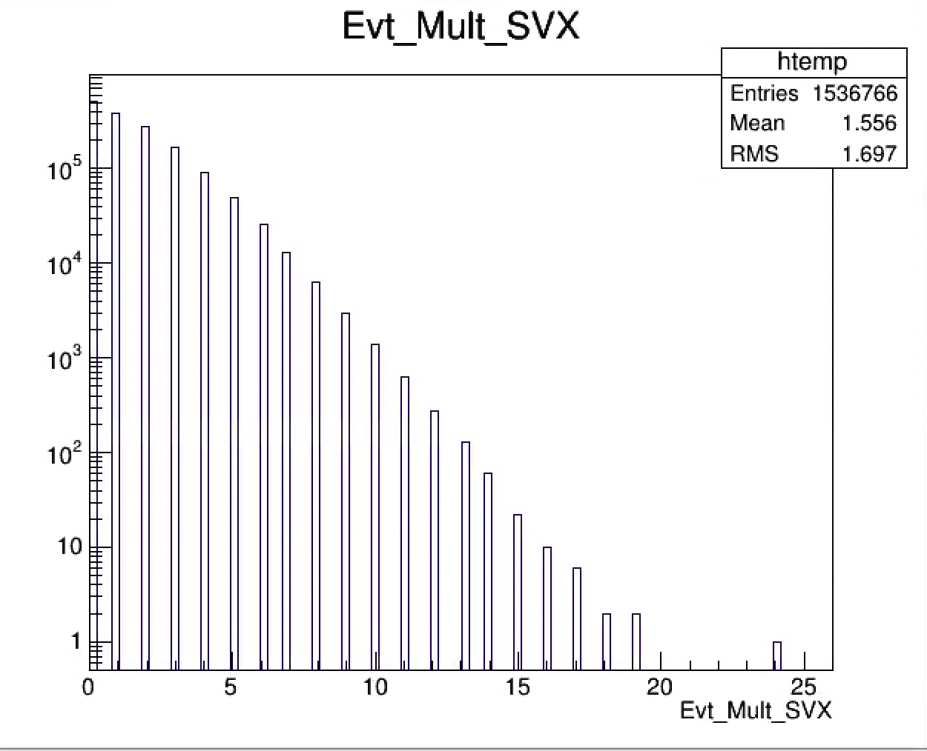
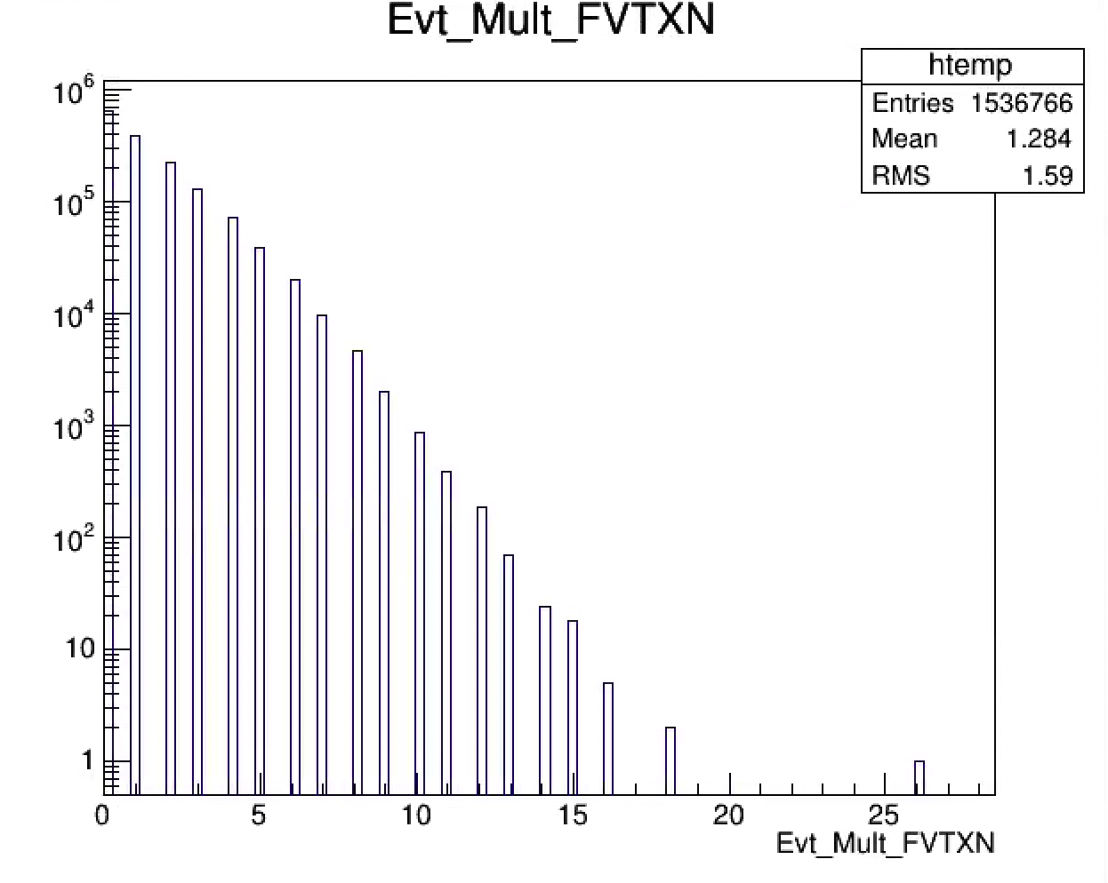
Run 421949: BBC_Rate = 320kHz
Tagged: good run

Slide 15
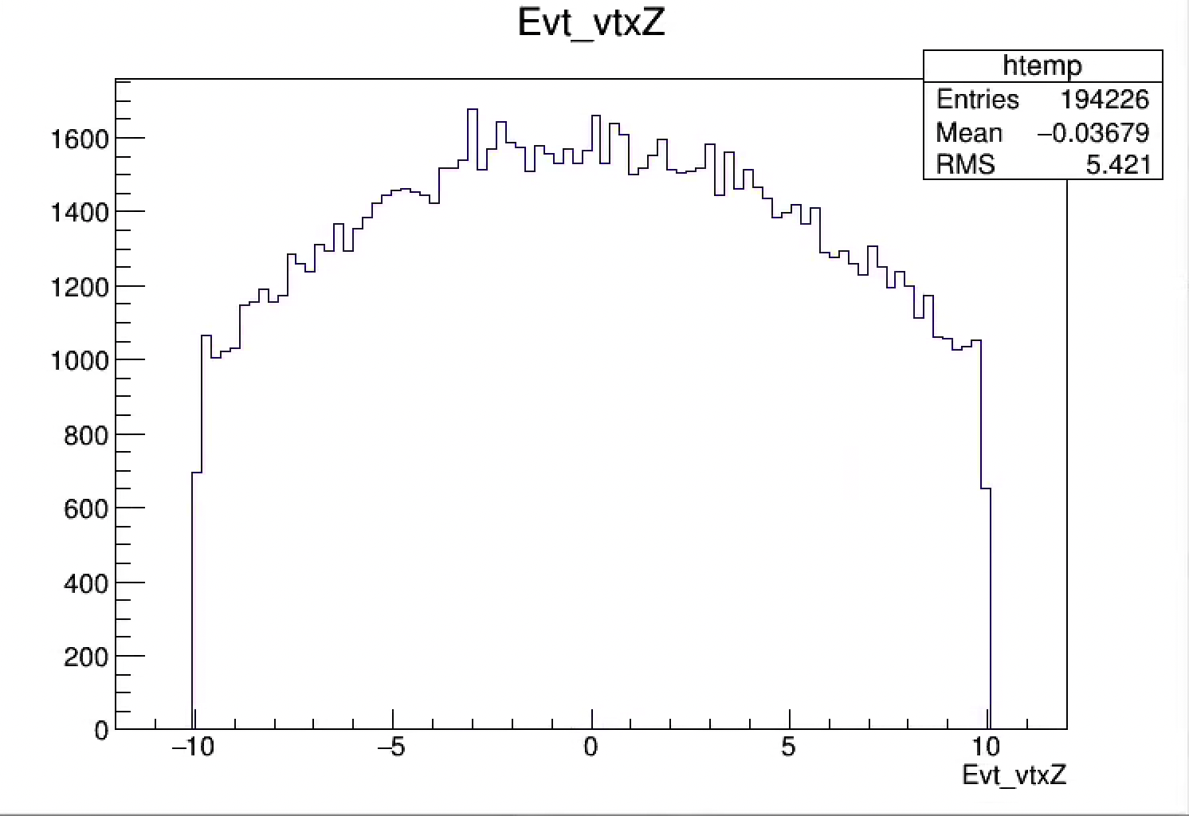
Run 426252: BBC_Rate = 850kHz

Slide 16
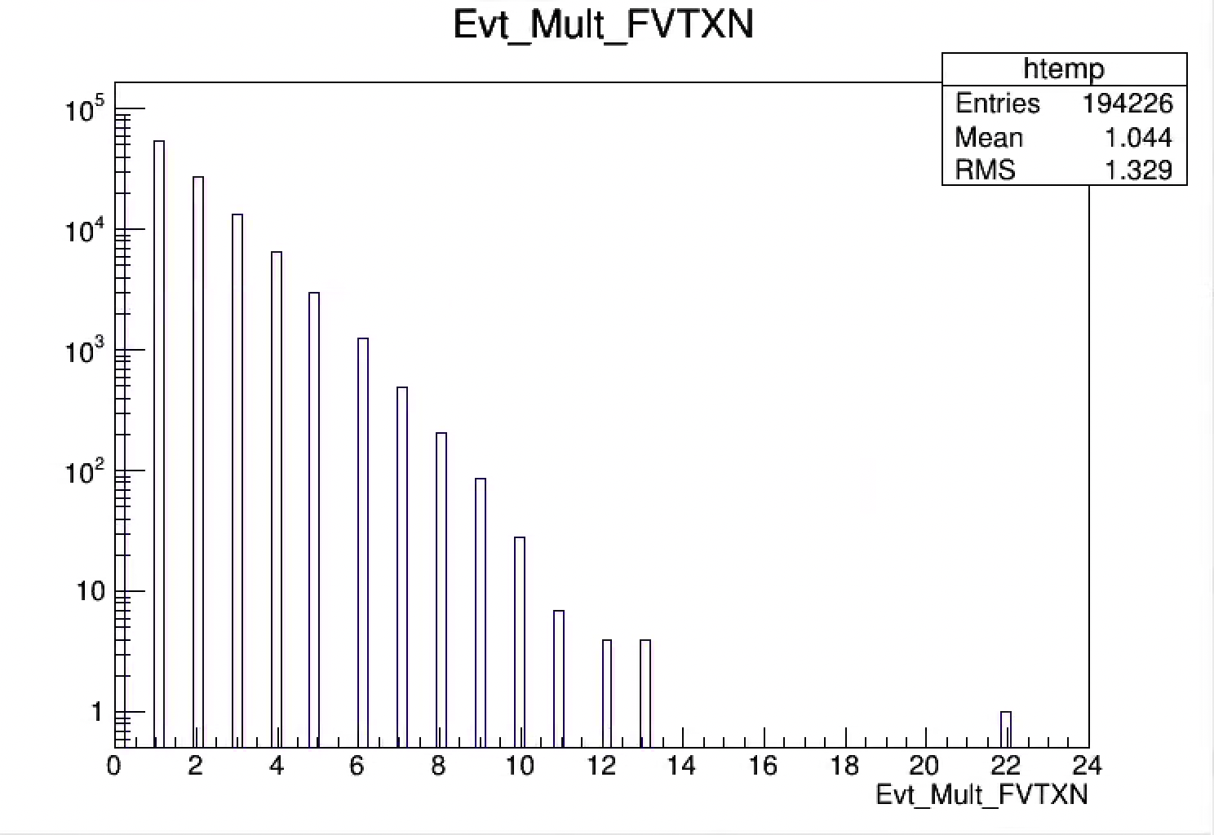
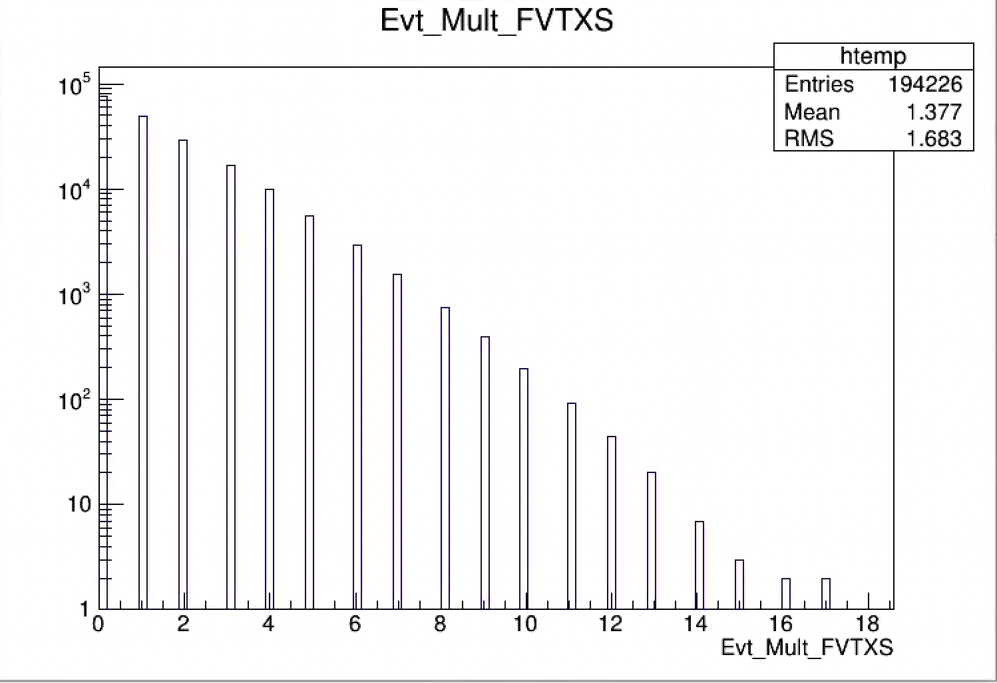
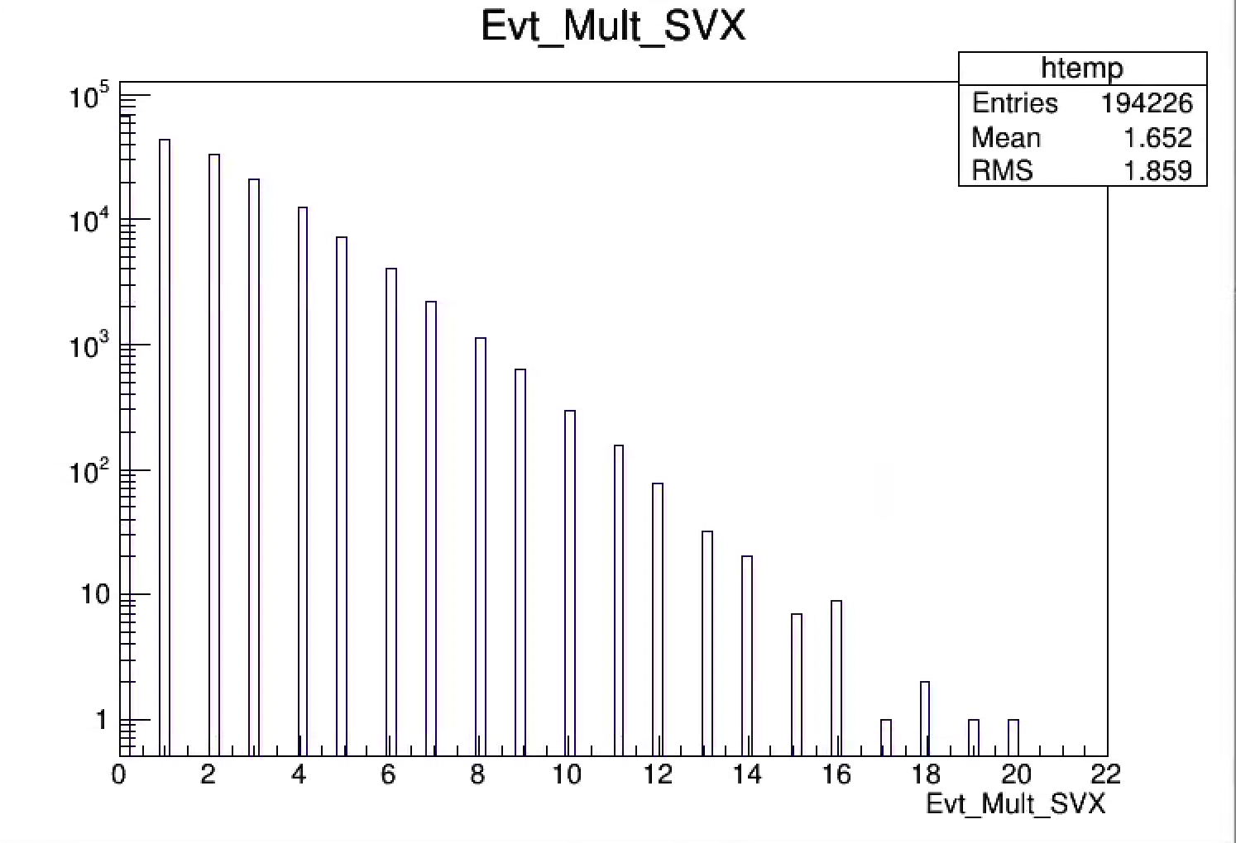
Run 426252: BBC_Rate = 850kHz
Tagged: Bad for North arm
bad

Slide 17
Run15 pp from the good runs: MU triggered events
MB FVTX and SVTX multiplicity distributions
MB FVTX and SVTX multiplicity distributions

Slide 18
Run15 pp BBC Rate Dependence Study
BBC Rate vs Run #:

Slide 19
Run15 pp MB: Evt_Mult_FVTXN(S), SVX
BBC Rates vs Run #
Evt_Multi_FVTXS:
High_BBC/Low_BBCratios
BBC_Rate < 200kHz
BBC_Rate > 400 kHz

Slide 20
J/Psi dimuon relative yield vs Evt_Mult_FVTX/SVX
Ratio of MU/MB Evt_Multi_FVTX/SVX

