Slide 1
Multiplicity Dependent HF Particle Productions in pp, pA and AA
FVTX Weekly Meeting
2/24/2021
Haiwang, Yasser, Cameron, Sanghoon (+ a student), Krista, Matt, Cesar, Ajeeta, Jin, Ming et al
A work in progress analysis google doc:
https://docs.google.com/document/d/1TmrvJvx_gYyC1yr2GJJNzFlUmRB5IERNnvV76_BURBo/edit?usp=sharing

Slide 2
What is the smallest QGP droplet? - from CNM to QGP formation in HI collisions
QGP created in AuAu and PbPb collisions
Jet quenching
Perfect Flow
QGP-like phenomena observed in high multiplicity pp and pA collisions
“Flow”
Correlations, “ridge”, but no “jet quenching” yet
Our goals:
To study quark hadronization in QGP -> Hadron gas -> free hadrons
Study the transition from CNM to QGP, from small to large collision systems
using pp, pA and AA data
Observables: multiplicity dependent production of
Dimuons: J/Psi, Psi’, Phi, and Omega etc.
Single muons: HF, D->mu; light hadrons, pi/K ->mu
Data sets:
Run15 pp510GeV
Run15 pp200, pAl and pAu
Initial state parton density
Final state re-scattering, re-generation
Interaction cross section

Slide 3
Many Multiplicity Dependent Observables – Showing Strong Effects from Initial and Final State Interactions
- e.g. Strangeness enhancement from ALICE
(1 s-quark)/pi
(2 s-quark)/pi
(3 s-quark)/pi
Initial state: # of s-quark density
Final state:
- re-scattering
- re-combination)

Slide 4
First Attempt: Run13 pp 510GeV - Haiwang Yu et al (2014)
Not PHENIX Preliminary

Slide 5
The Approach: FVTX Tracklet Multiplicity, Run13 pp510
FVTX_Multiplicity: N+S

Slide 6
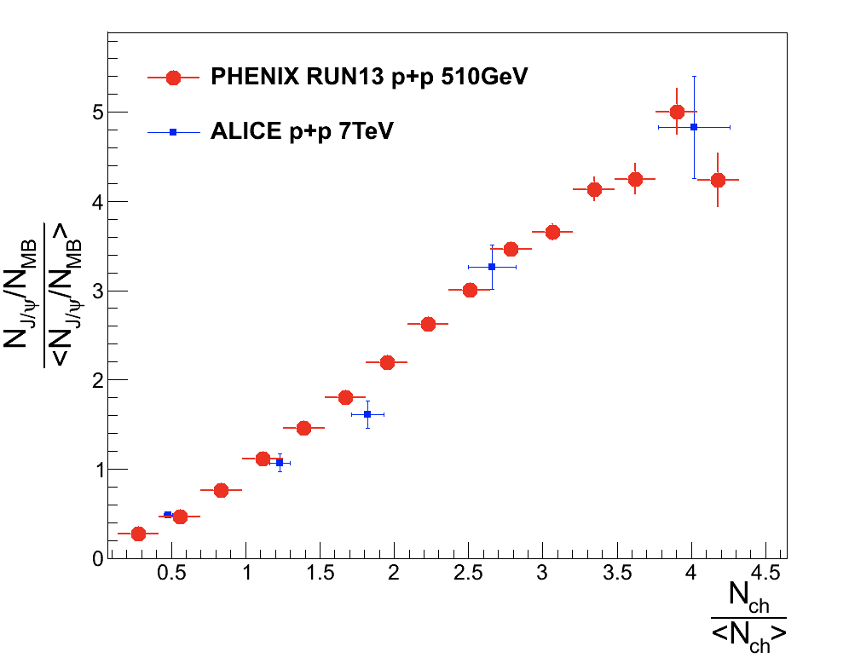
The Effects of Event Multiplicity Determination - Local vs Global correlations?
PHENIX plan:
- Use BBC_Hits (N, S), 3.1 < |eta| < 3.9
- also Opposite side FVTX_Multiplicity (N, S), 1.2 < |eta| < 2.2
Large rapidity gap:
- delta_eta (MuTr/FVTX – BBC ) >~ 1

Slide 7
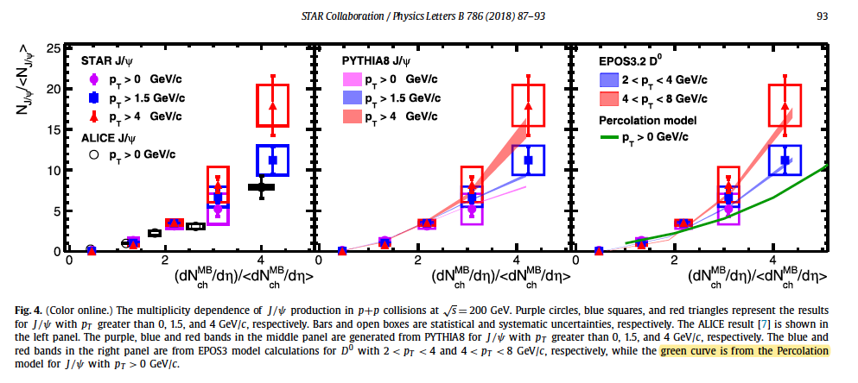
Recent STAR Results: pp200 (2018)
Track multiplicity: all tracks |eta| <1,

Slide 8
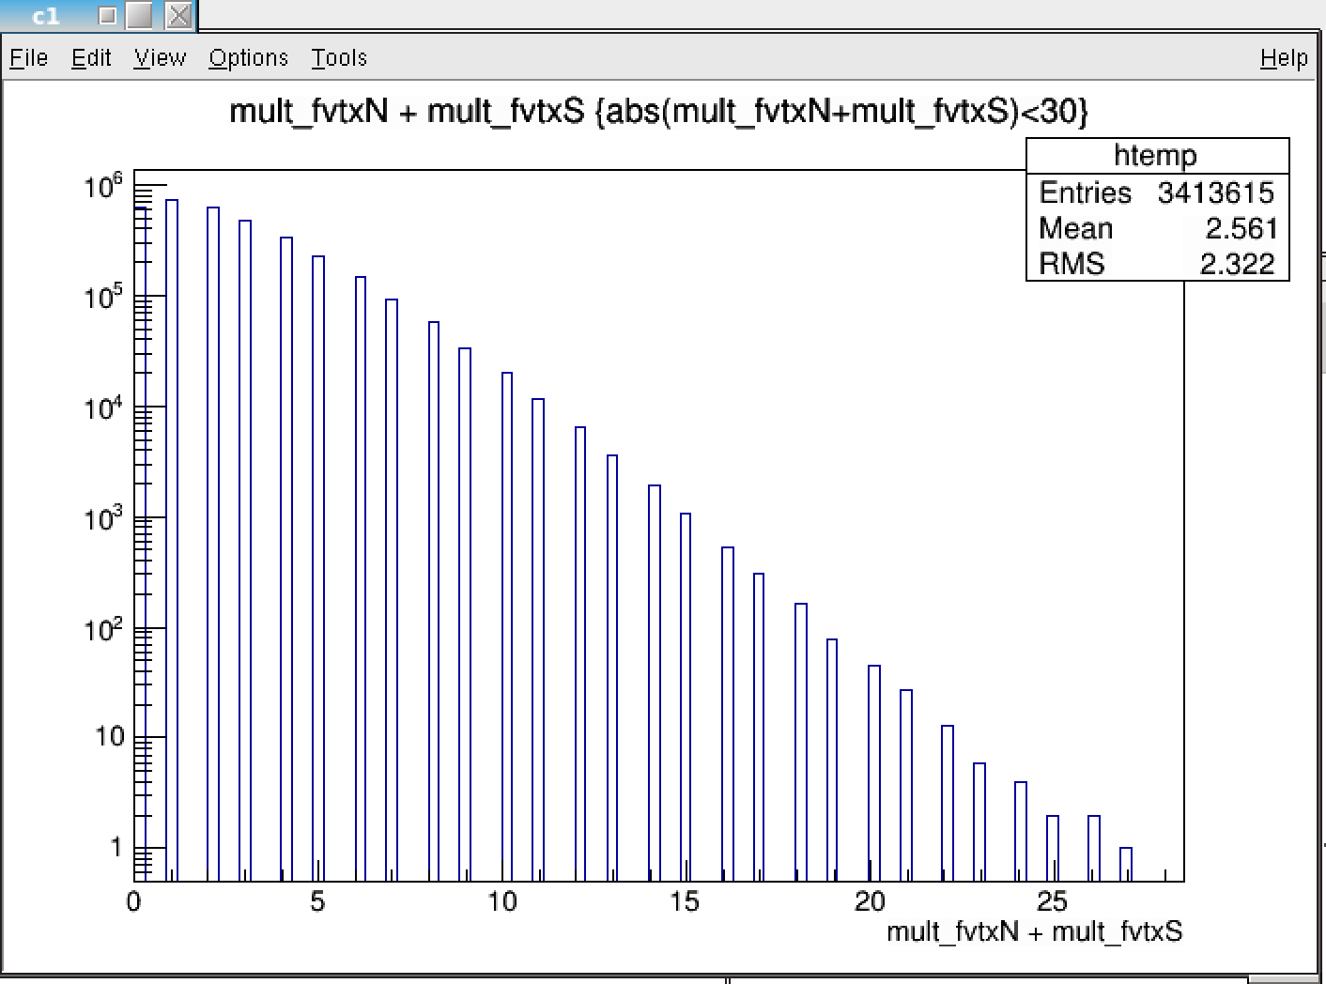
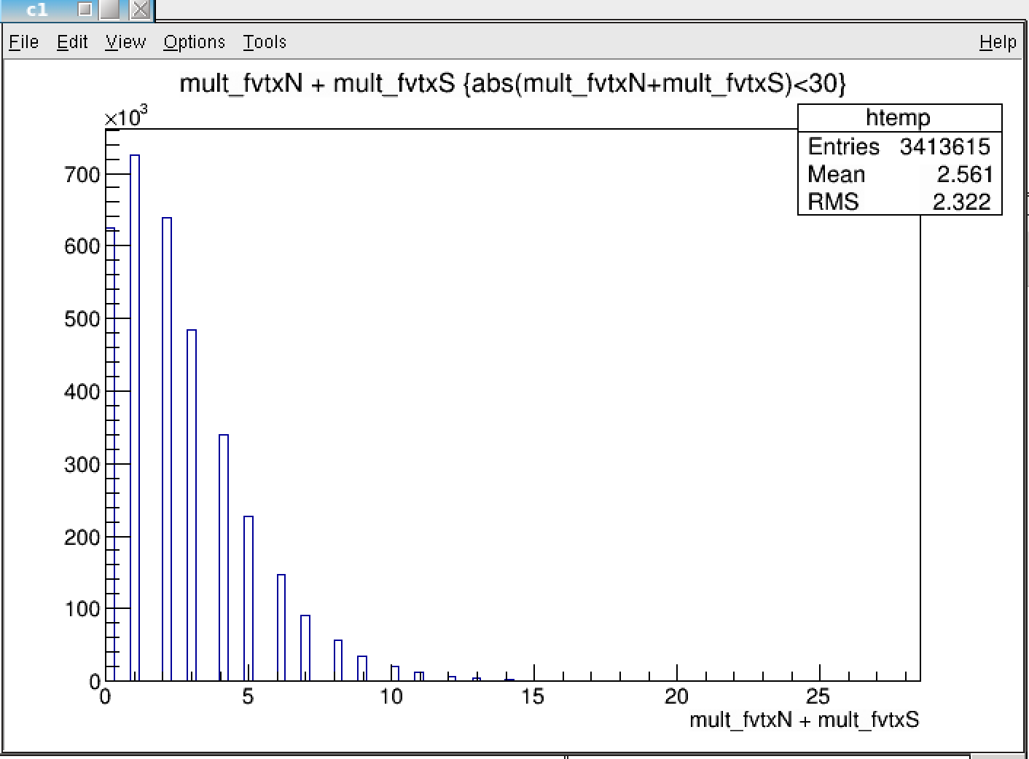
First Look of the Run15 pp200: Psi’/(J/Psi) - FVTX_Mutilicity and BBC_Multiplicity
Run15pp MB (Mult_FVTX, N+S), <avg> = 2.56
-> 10/<2.56> = 3.9
-> 7/<2.56> = 2.73

Slide 9
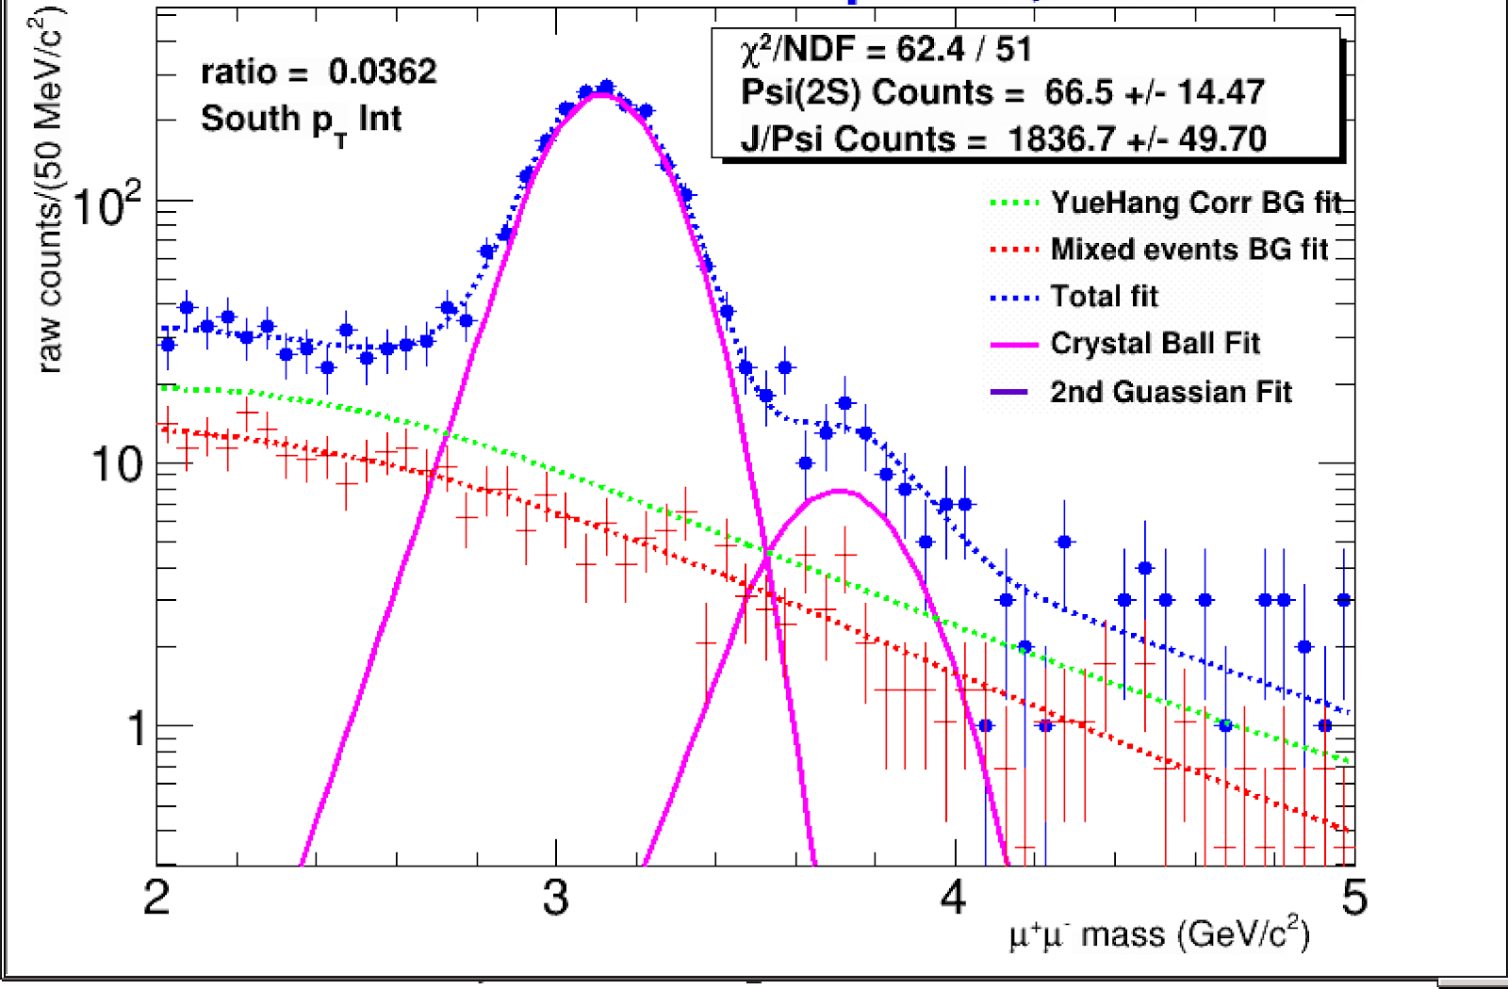
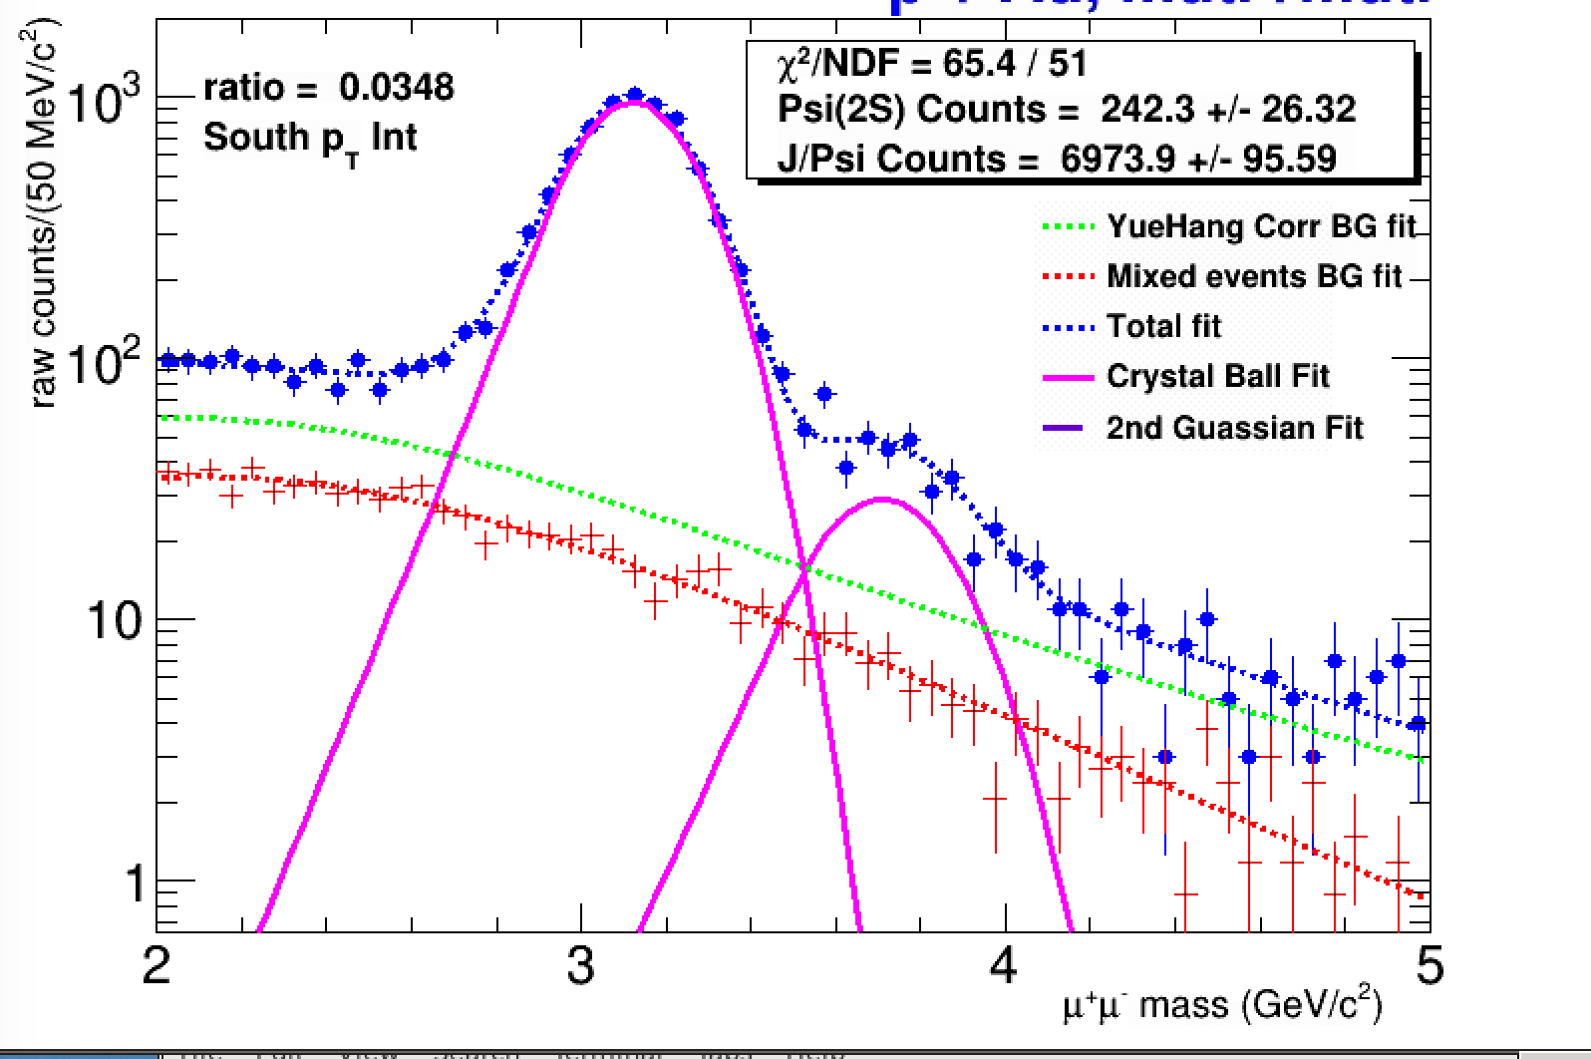
FVTX_Multiplicity Dependence: Psi’/(J/Psi)
(Evt_Mult_FVTXN + S ) > 10
-- “(Evt_Mult_FVTXN + S ) > 0
South: R_S = 66.5/1837 = 3.62 +/- 0.79%
South: R_S = 242.3/6974 = 3.47 +/- 0.38%

Slide 10
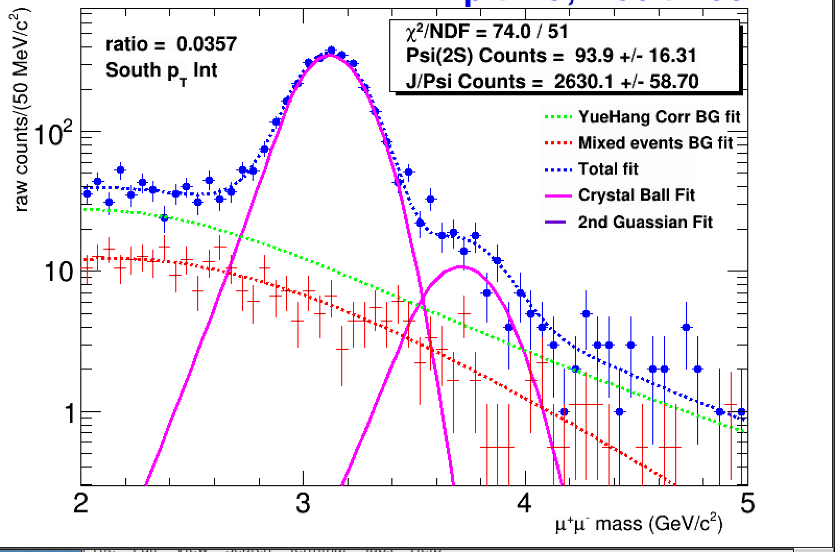
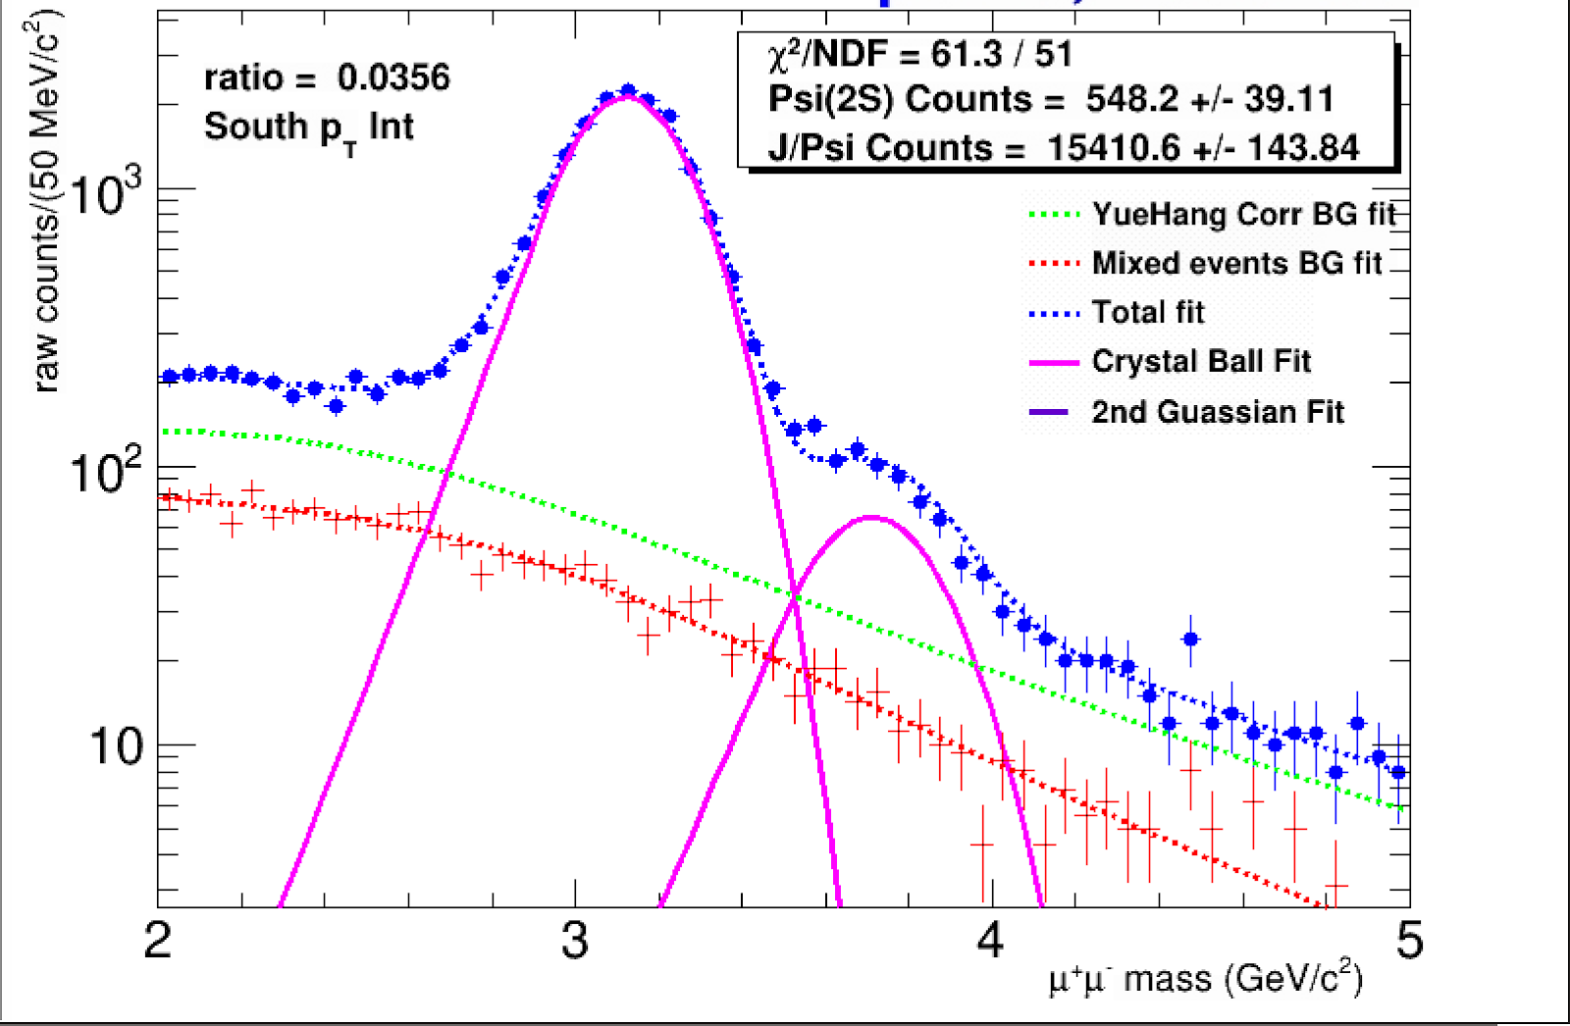
BBC_Multiplicity Dependence: Psi’/(J/Psi)
-- “(bbc, N + S ) > 15
-- “(bbc, N + S ) > 0
South: R_S = 93.9/2630 = 3.57 +/- 0.62%
South: R_S = 548.2/15411 = 3.56 +/- 0.25%

Slide 11
ALICE Latest Results – HP 2020 - Very flat Psi/(J/Psi) ratio, same for PHENIX
FVTX multiplicity dependence: Psi’/(J/Psi)
“(Evt_Mult_FVTXN + S ) > 10
R_N = 54.5/1387.9 = 3.92 +/- 1.2%
R_S = 66.5/1837 = 3.62 +/- 0.79%
“(Evt_Mult_FVTXN + S ) > 7
R_N = 92.3/2549 = 3.62 +/- 0.75%
R_S = 114.9/3475 = 3.31 +/- 0.55%
“(Evt_Mult_FVTXN + S ) > 0
R_N = 162.5/5013 = 3.24 +/- 0.44%
R_S = 242.3/6974 = 3.47 +/- 0.38%
BBC multiplicity:
“(bbcn + S ) > 15
R_N = 69.1/1912 = 3.61 +/- 0.74%
R_S = 93.9/2630 = 3.57 +/- 0.62%
“(bbcn + S ) > 10
R_N = 209.6/4828 = 4.34 +/- 0.47 %
R_S = 242/6894 = 3.51 +/- 0.37%
“(bbcn + S ) > 0
R_N = 401.8/10748 = 3.74 +/- 0.32%
R_S = 548.2/15411 = 3.56 +/- 0.25%

Slide 12
pA Collisions: Forward vs Backward Asymmetry - Need to check PHENIX Run15pAu data, also Run8 dAu data

Slide 13
Near Term Plan
Aim for PHENIX preliminary results for Run15 data
Relative yields: Psi’/(J/Psi) vs Evt_Multiplicity (FVTX, BBC)
Relative yields of J/Psi vs Evt_Multiplicity (FVTX, BBC)
data sets available: Run15pp, pAu data
Need to reprocess MB and MU data
Simulations, J/Psi, Psi’, Phi etc
Aim for PHENIX preliminary results for Run13 pp510 and later Run8 dAu (BBC only)
Relative yields: Psi’/(J/Psi) vs Evt_Multiplicity (FVTX, BBC)
Relative yields of J/Psi vs Evt_Multiplicity (FVTX, BBC)
data sets available: Run15pp, pAu data
Need to reprocess MB and MU data
Longer term Plan ~ later this year?
Study (J/Psi), Stopped-hadron and open charm (single muons) vs multiplicity
Ratio h+(largely K+)/h- (mix of pi- and K-) vs multiplicity
Ratios of Dimuons (J/Psi, Psi’, phi, Omega etc.)/single muons (h- or HF muon)

