Slide 1
Muon Multiplicity Analysis Update
Yasser, Cameron, Sanghoon, Ajeeta, Cesar, Xuan, Ming et al
03/10/2021
Work in progress google doc:
https://docs.google.com/document/d/1TmrvJvx_gYyC1yr2GJJNzFlUmRB5IERNnvV76_BURBo/edit?usp=sharing

Slide 2
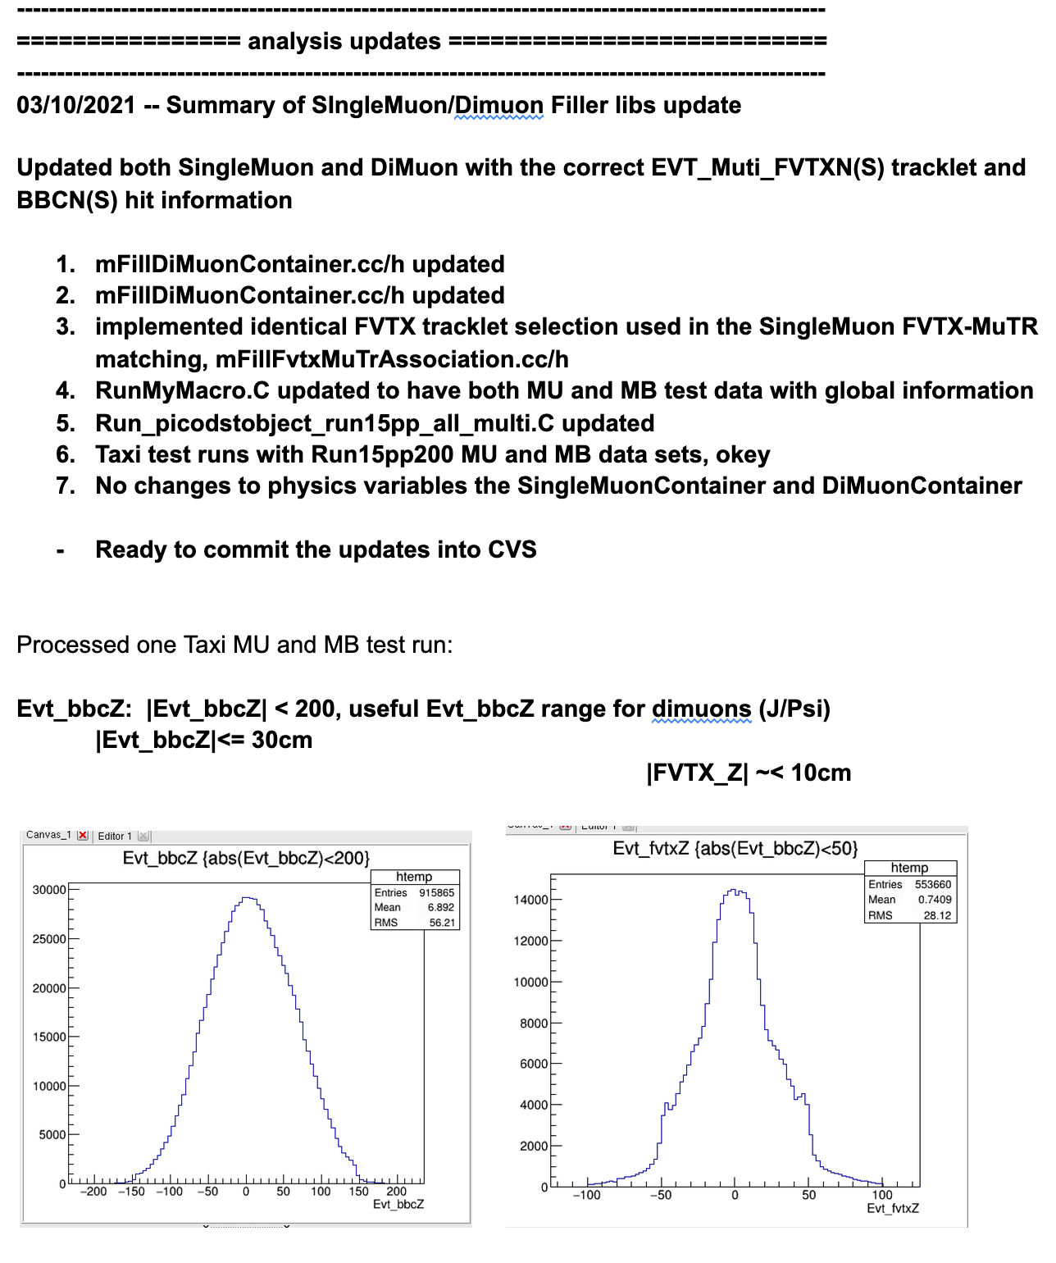
From the google doc analysis note:
Run15pp, pAu Taxi tested
Run13pp510 some issues

Slide 3
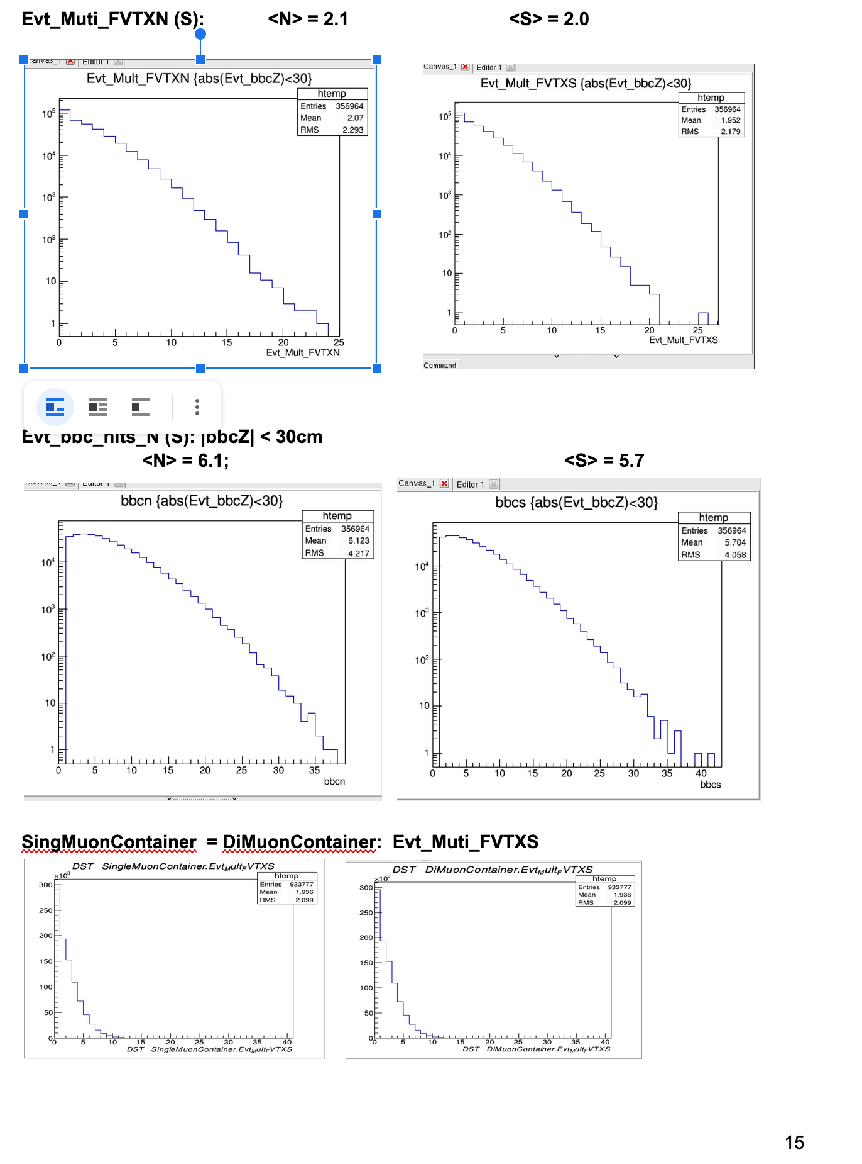
Reasonable FVTX and BBC hits distributions

Slide 4
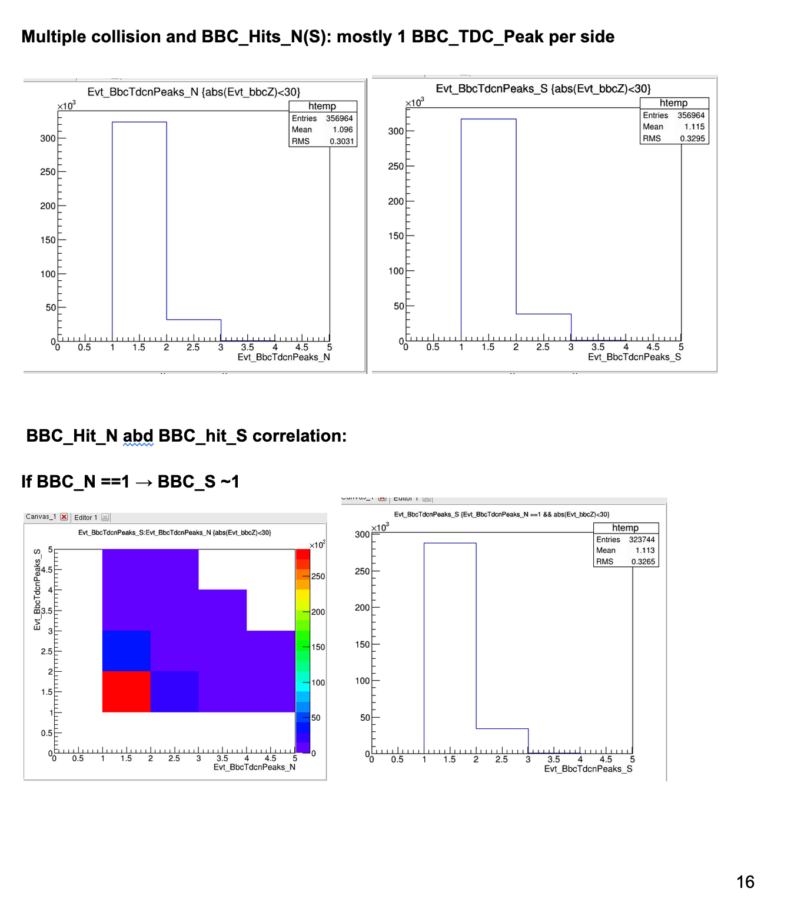
Multiple Collisions?
- BBC_Timing cluster, N, S

Slide 5
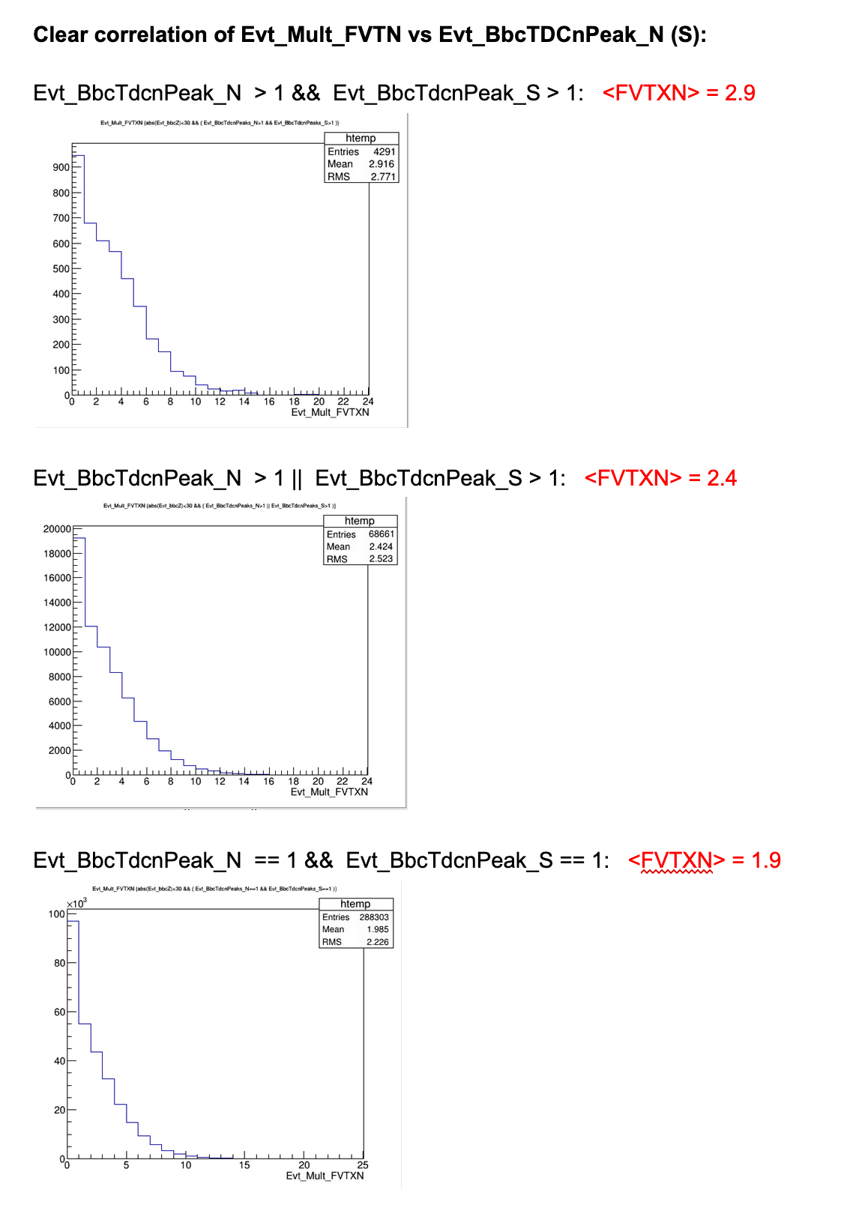
FVTX and BBC hits correlations:
Well separated in rapidity:
FVTX: 1.2 – 2.2
BBC: 3.1 – 3.9

Slide 6
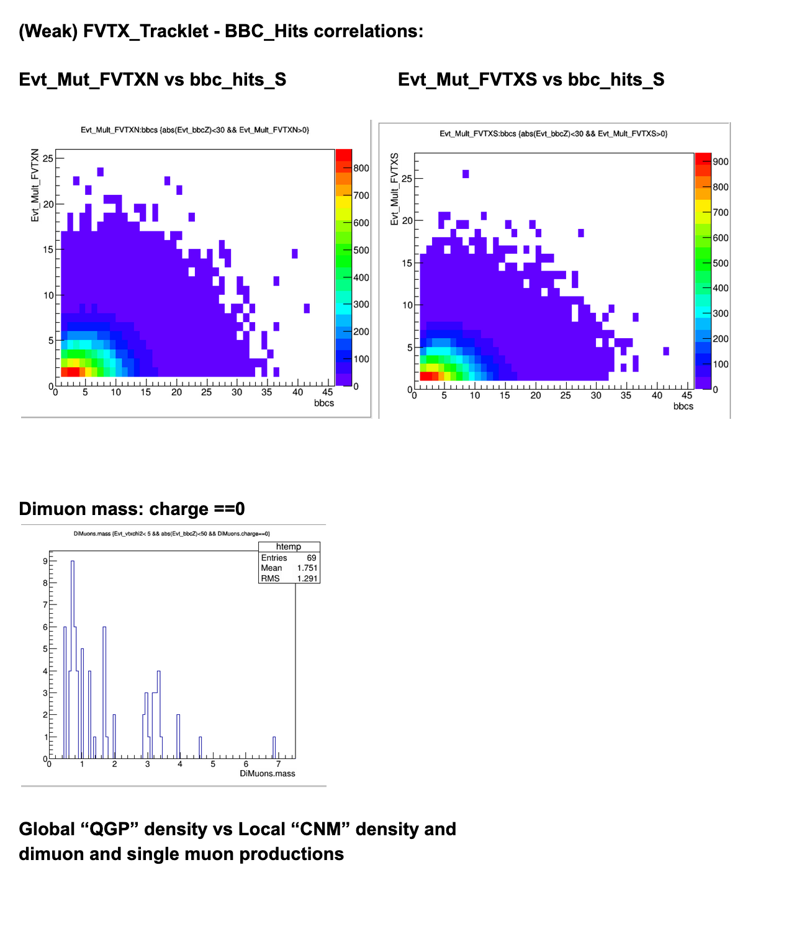

Slide 7
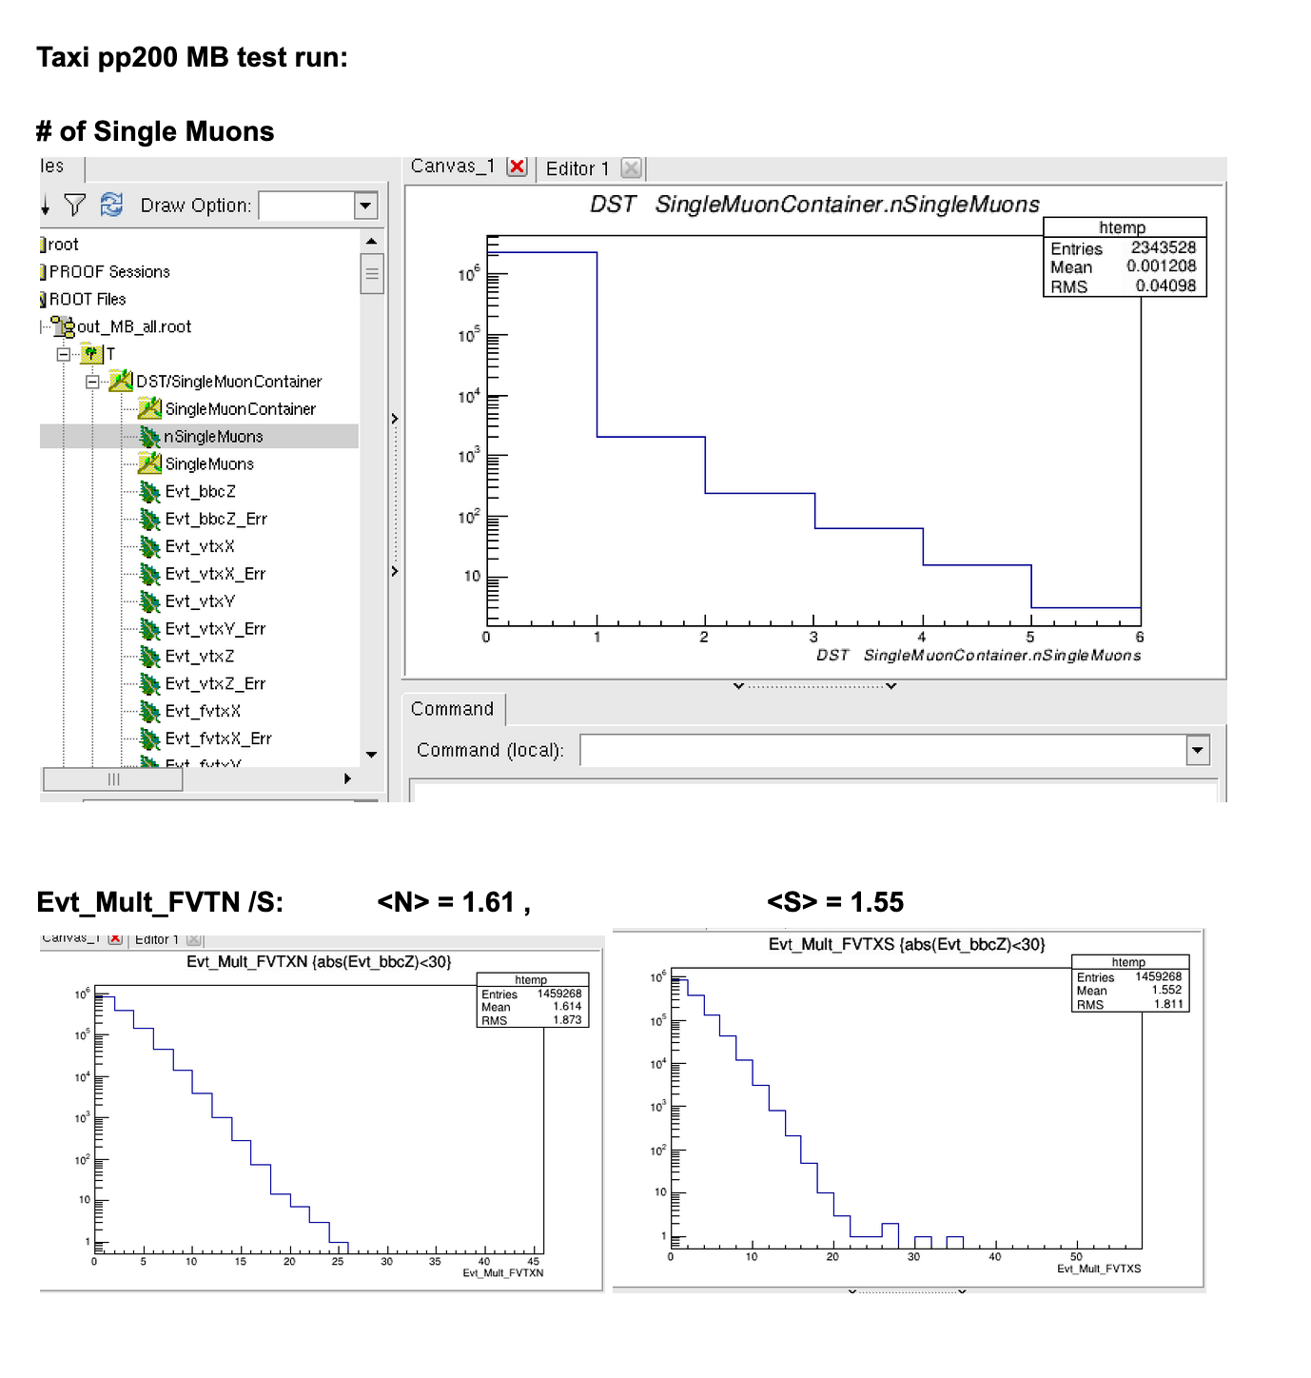
MB samples:
- Run15pp 200Gev

Slide 8
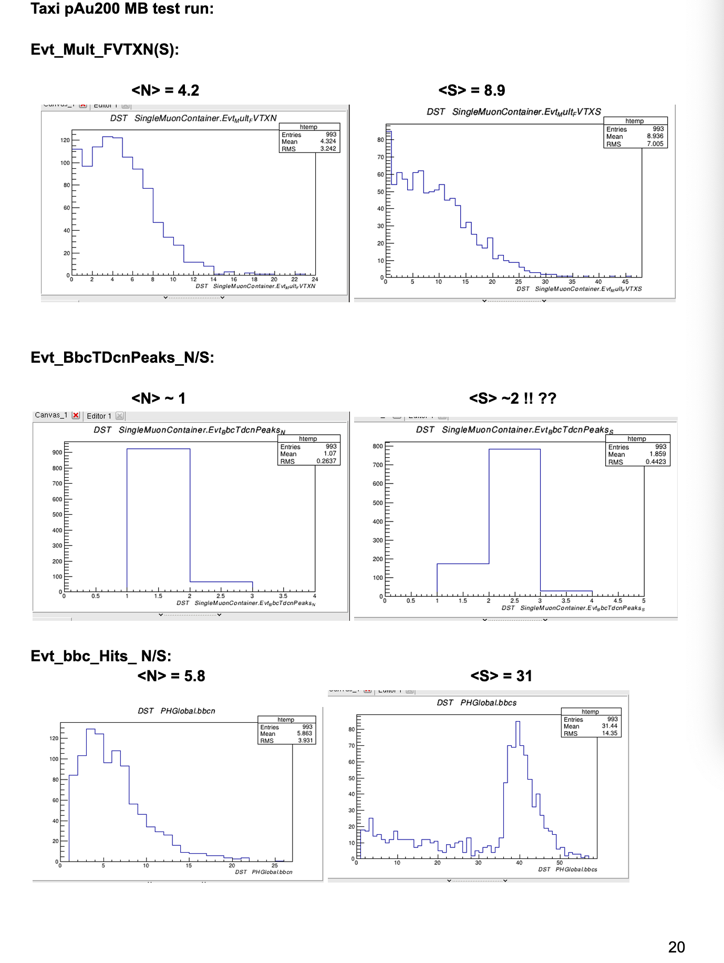
MB samples:
- Run15pAu 200Gev

Slide 9
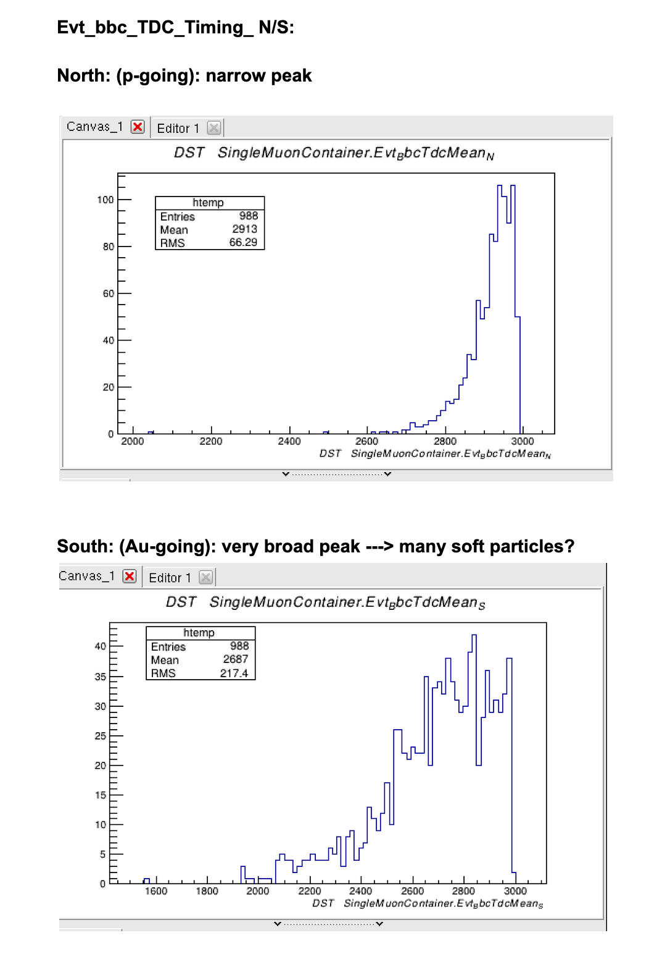
BBC Hit Timing

Slide 10
To Do List
Taxi rubs:
Taxi run15pp MU and MB
Taxi run15pAu MU and MB
Taxi run13pp510, MU and MB
Observables:
Check relative yields of (J/Psi, Psi’, Phi, and Gap-2 hadron and Gap-4 muons) vs event multiplicity: Evt_Mult_FVTXN(S) and Evt_bbcN(S)
Remove “multiple collision events”, with Evt_BbcTDCnPeak_N(S)
Qiao, done for Run15pAu, -→ analysis note, also Darren
D+Au scan
Simulations:
J/Psi, Psi’, phi acceptance corrections
vtxZ dependent Evt_Mult_FVTXN/S, and bbc_hits_N/S
Multiplicity-dependent reco-eff correction? should be very small
Goals:
Preliminary results by ~Summer
Later for sPHENIX

