Slide 1
Run15 pp/pAu J/Psi Multiplicty Analysis Update – Trigger Bias
Yasser, Cameron, Cesar and Ming et al
11/18/2021
HI PWG

Slide 2
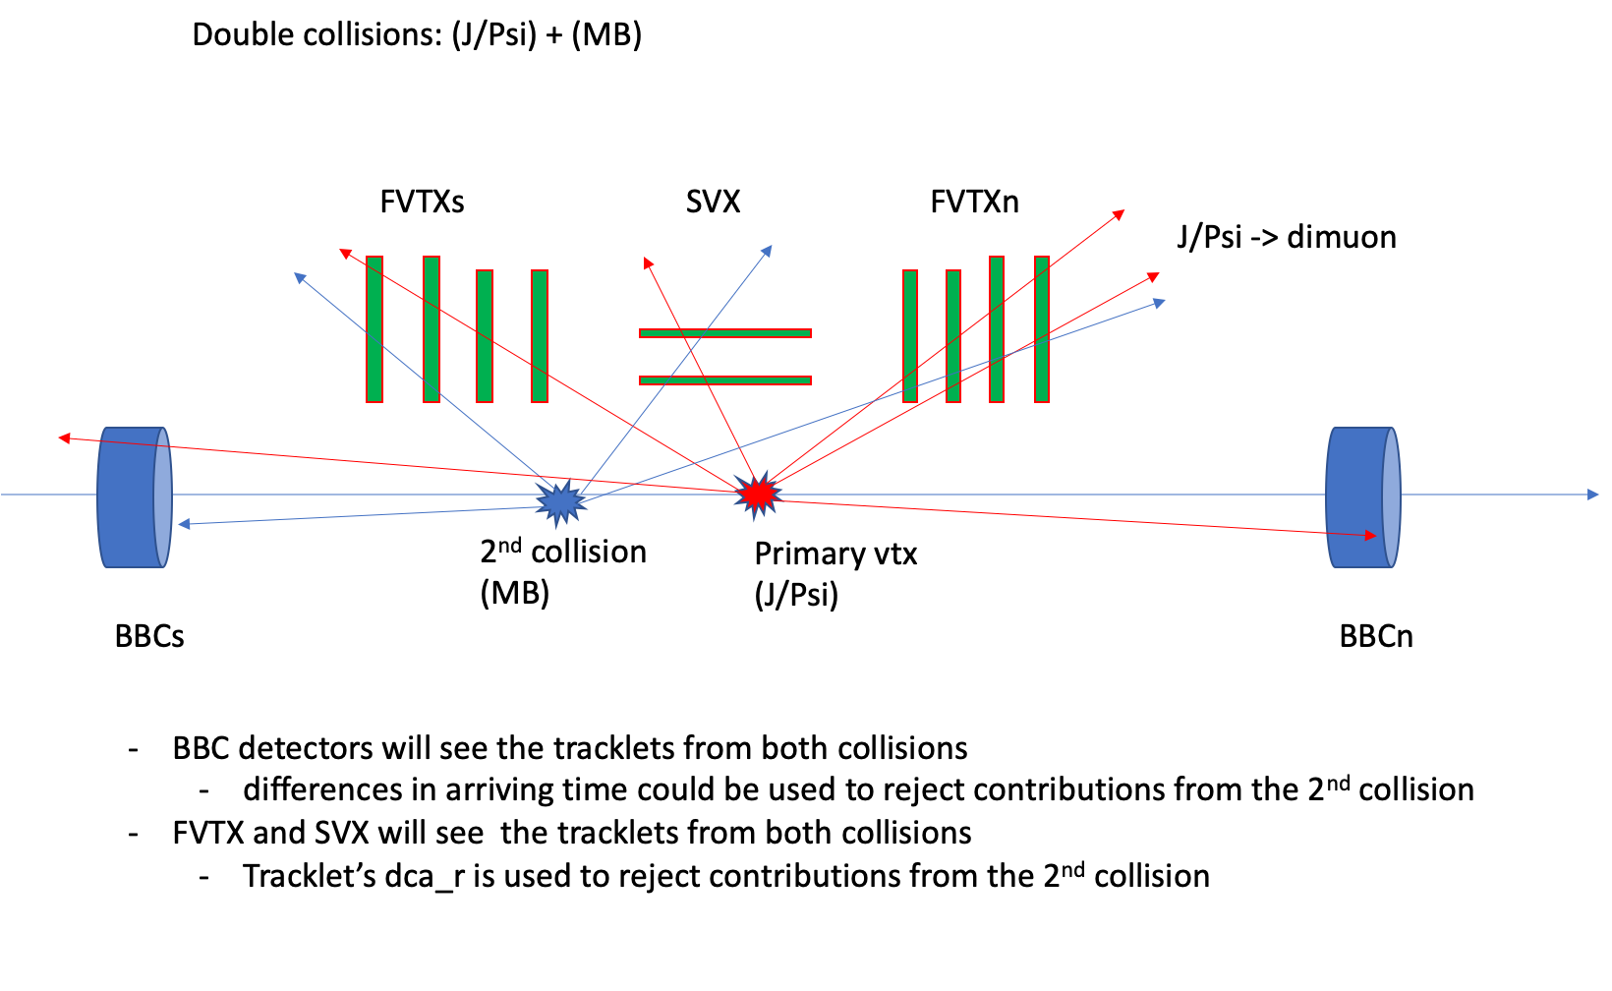
Event Multiplicity Determination in p+p/A collisions: FVTX/SVX/BBC
Potential BBCLL1 trigger bias due
to higher average BBC hits for
higher Evt_Mult_FVTX/SVX events
MB Trigger (BBCLL1) Efficiency:
<BBCLL1> = 0.55 +/-0.05
Hard scattering:
<high_pT Trigger> = 0.79 +/-0.02

Slide 3
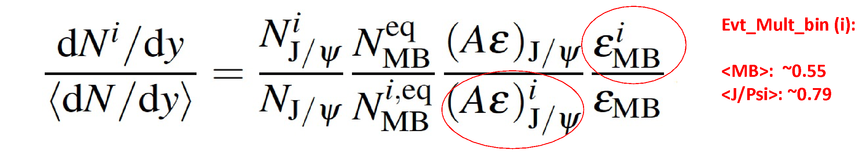

BBCLL1 Efficiency vs Evt_Mult_FVTX/SVX

Slide 4
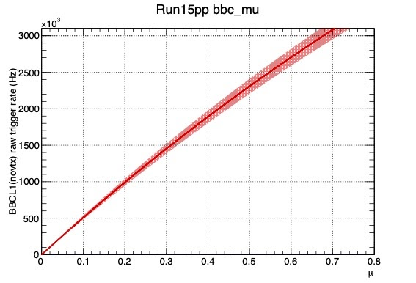
CLOCK Triggered data to Estimate the BBCLL1_Eff vs Event_Multiplicty in p+p and p+Au Collisions
Run15 p+p and p+A runs, we took significant amount of RHIC-Beam clock triggered data
Scaled trigger rate: ~50Hz
At a typical BBC rate ~ 500kHz,
# of collision per crossing ~ 0.1

Slide 5
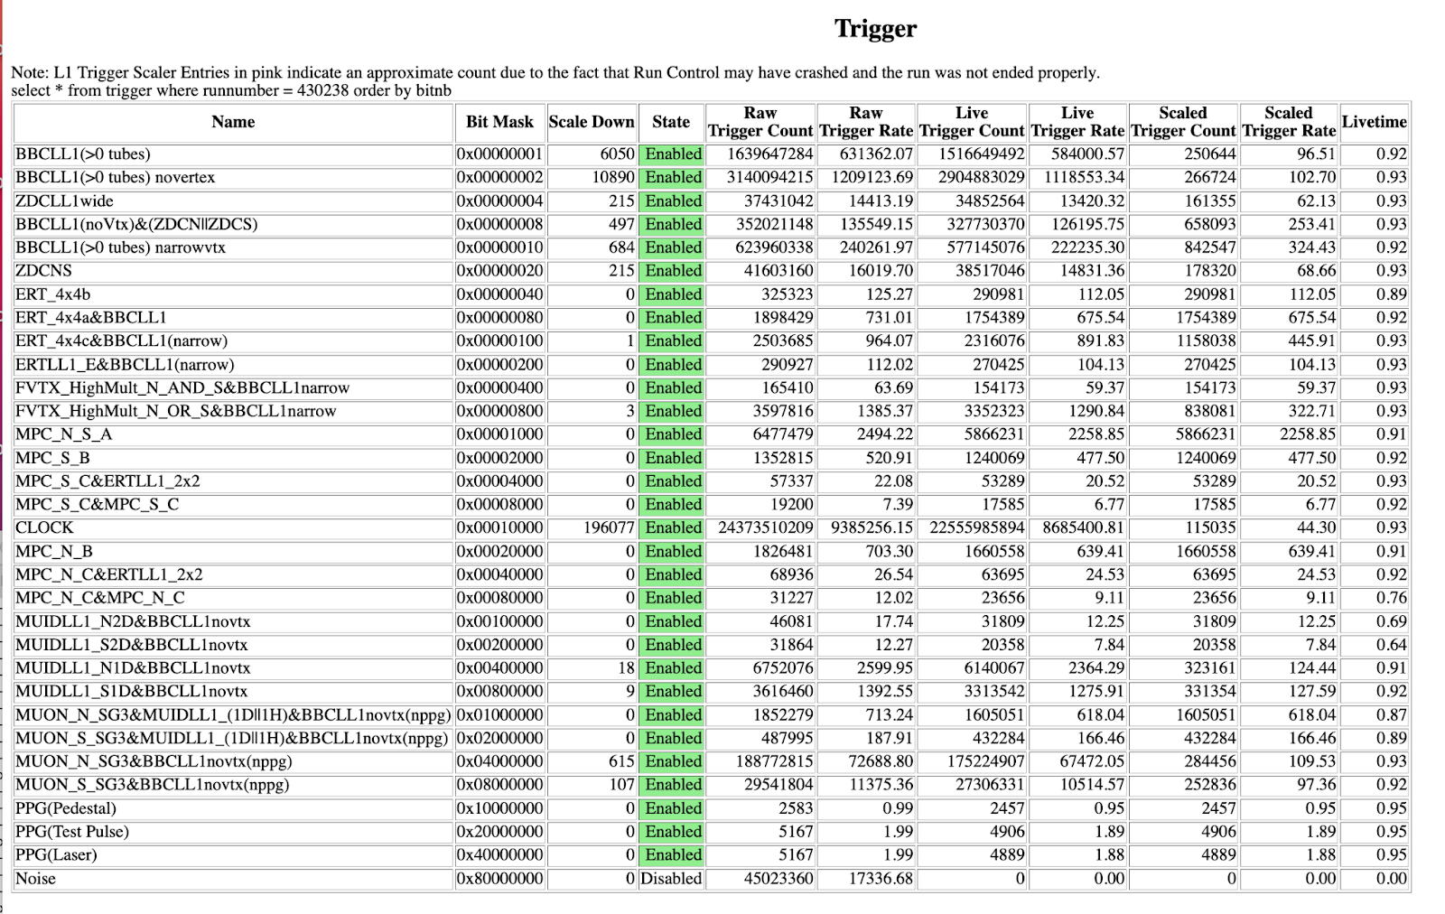
Run15 p+p Trigger Configuration: Run 430238

Slide 6
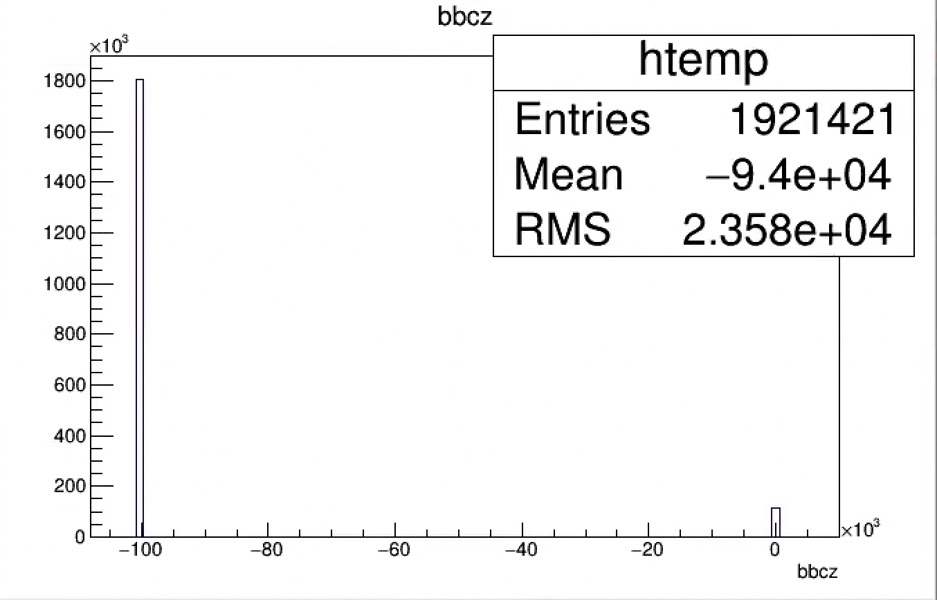
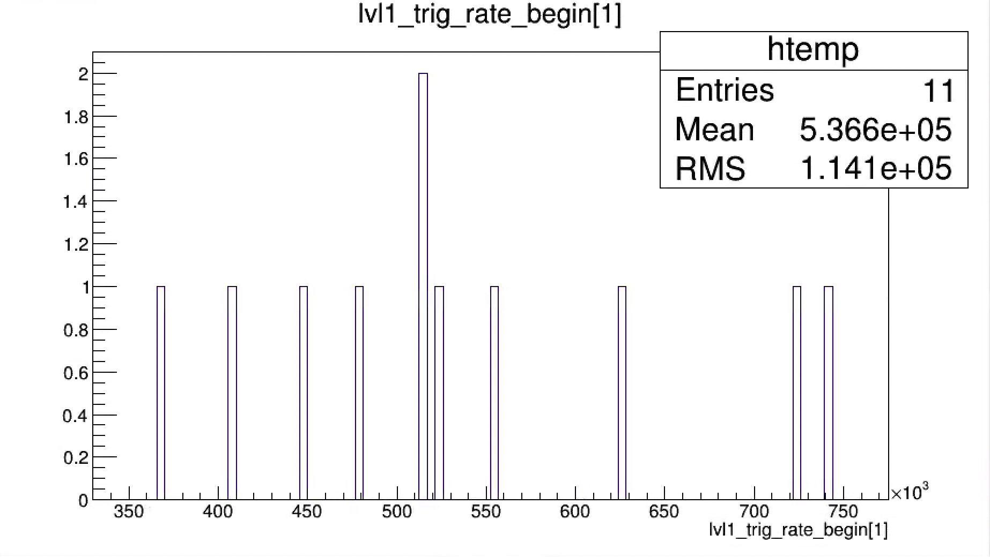
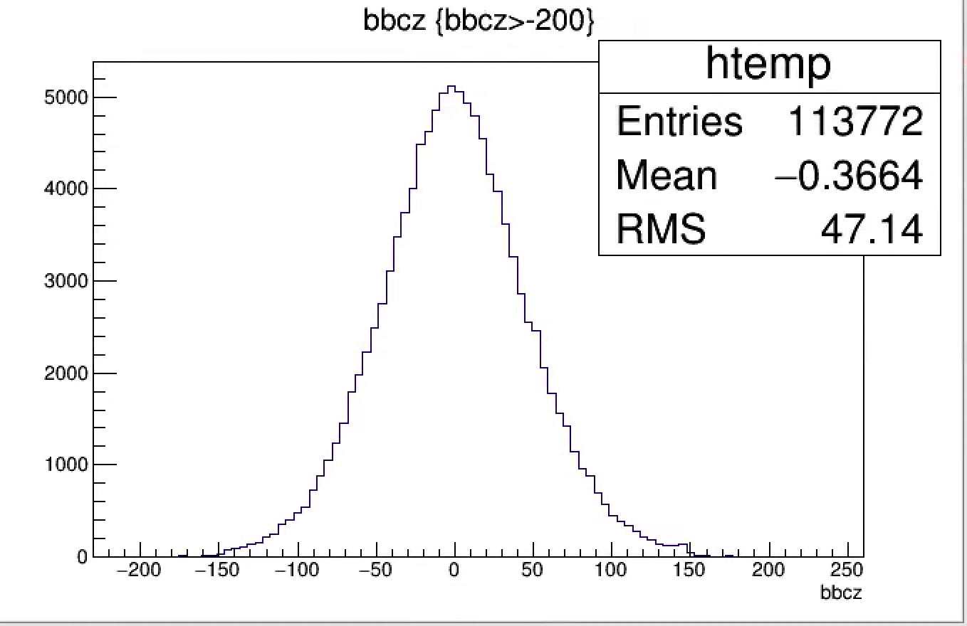
BBC_Z from Clock Triggered Data: Good
Expected:
- # of Collisions ~10% of crossings;
- <BBCLL1_Eff> = 0.55 +/- 0.05
➔ Fraction of collisions seen by BBC: (5.5 +/- 0.5)%
Observed fraction of valid collisions with |BBC_Z| < 200 cm
= 113772/1921421
= 5.9%
Valid bbcz
BBCLL1 Rate (novertex) ~ 500kHz

Slide 7

Estimate BBCLL1 Trigger Efficiency
(for activities within SVX/FVTX acceptance )
“BBCLL1 True” == ( BBCn > 0 && BBCs >0 ) or |BBC_Z| < 200cm
Some activities (tracklets) in SVX or FVTX

Slide 8
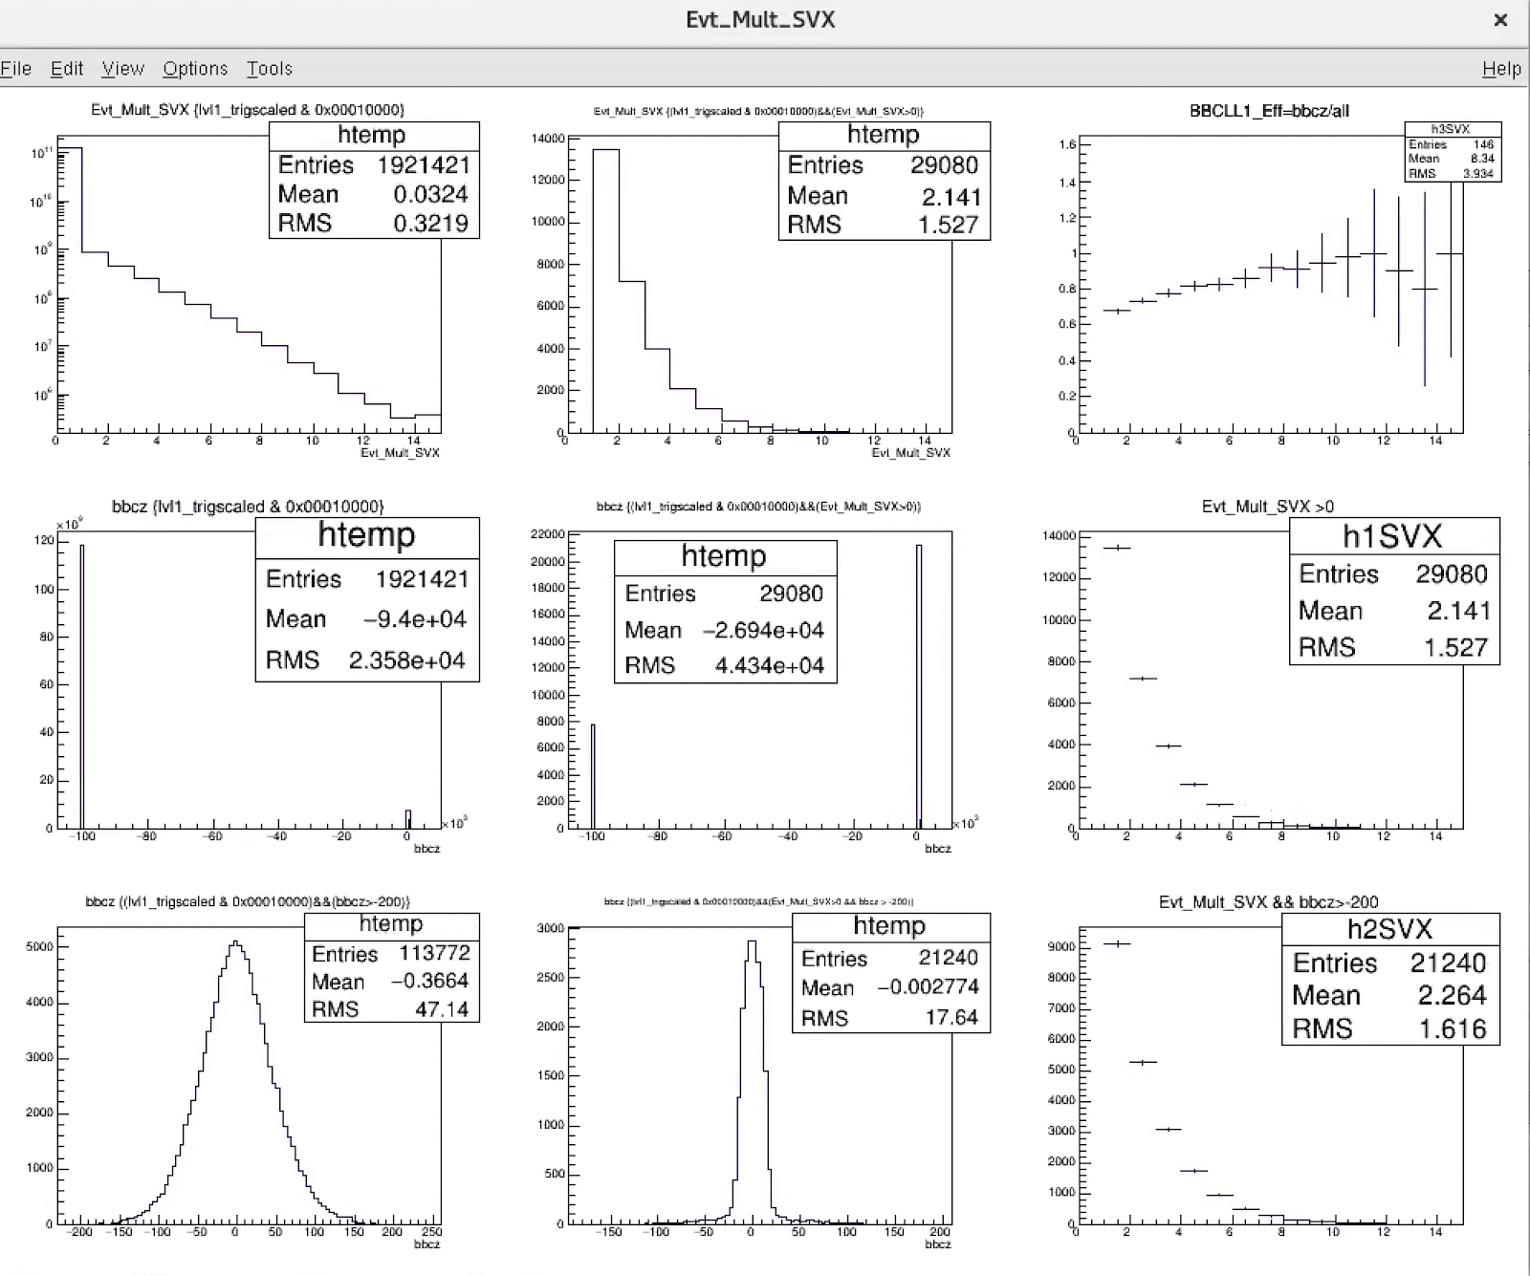
BBCLL1 vs Evt_Mult_SVX
BBCLL1_Eff
Evt_Mult_SVX
Evt_Mult_SVX >0
CLOCK triggered: Evt_Mult_SVX >0
<BBCLL1> = (bbcz>-200)/(all)
=21240/29080
= 73.0%
BBCLL1_Eff: 60 ~ 90%
Evt_Mult_SVX
Evt_Mult_SVX
CLK_Trig
Evt_Mult_SVX >0
& |bbz| < 200
bbcz
bbcz

Slide 9
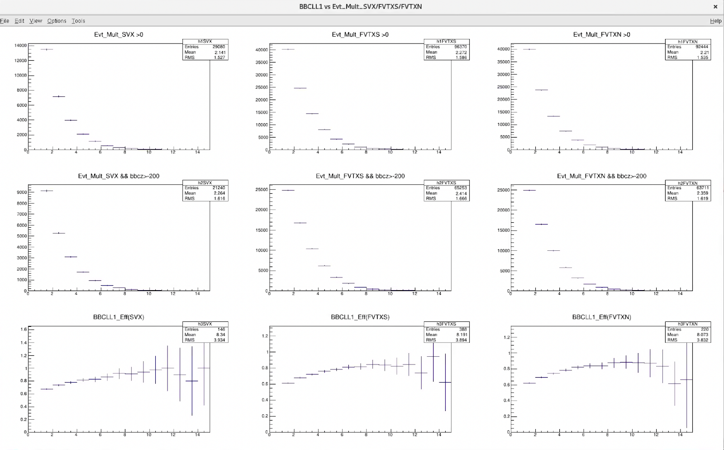
BBCLL1_Eff vs Evt_Mult_SVX/FVTX
Evt_Mult_SVX >0
Evt_Mult_FVTXS >0
Evt_Mult_FVTXN >0
Evt_Mult_SVX >0
& |bbz| < 200
BBCLL1_Eff
Evt_Mult_SVX
Evt_Mult_FVTXS
Evt_Mult_FVTXN

Slide 10
Run15 pp: from 11 runs
- will get better stats with more good runs (we have ~250 good runs)
SVX: 60 ~ 100%
FVTX: 60 ~ 85%

Slide 11
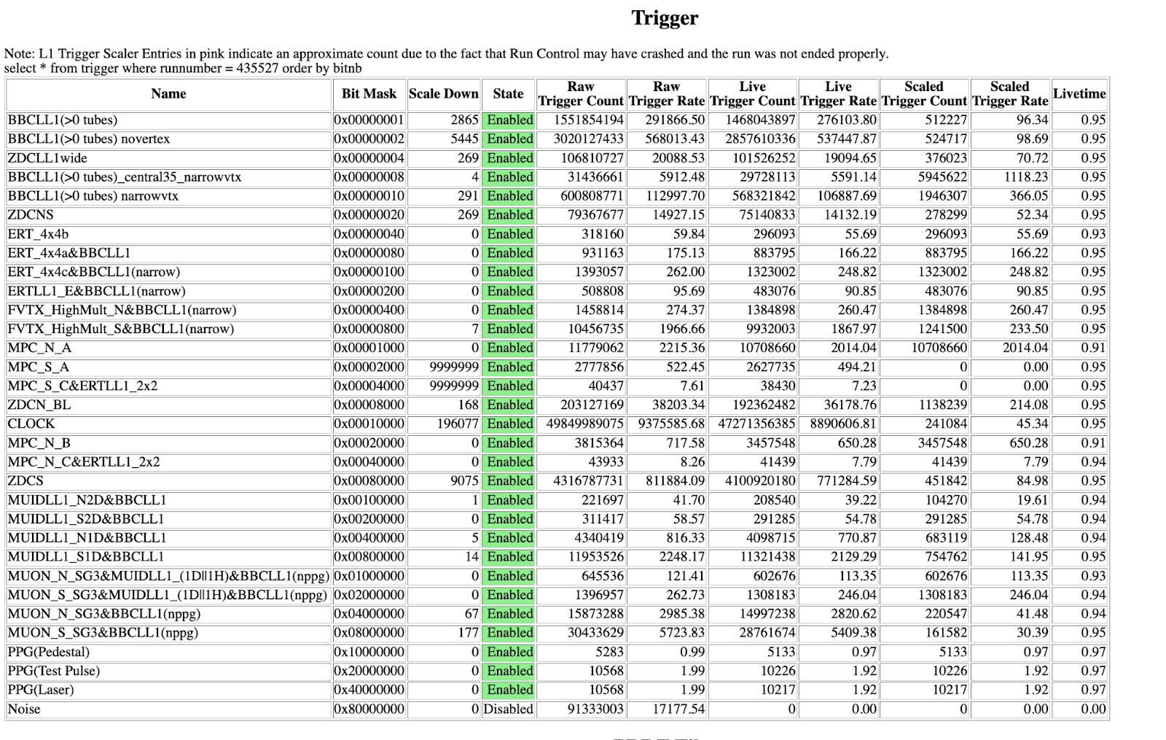
Run15 p+Au Trigger Configratoin: Run 435527

Slide 12
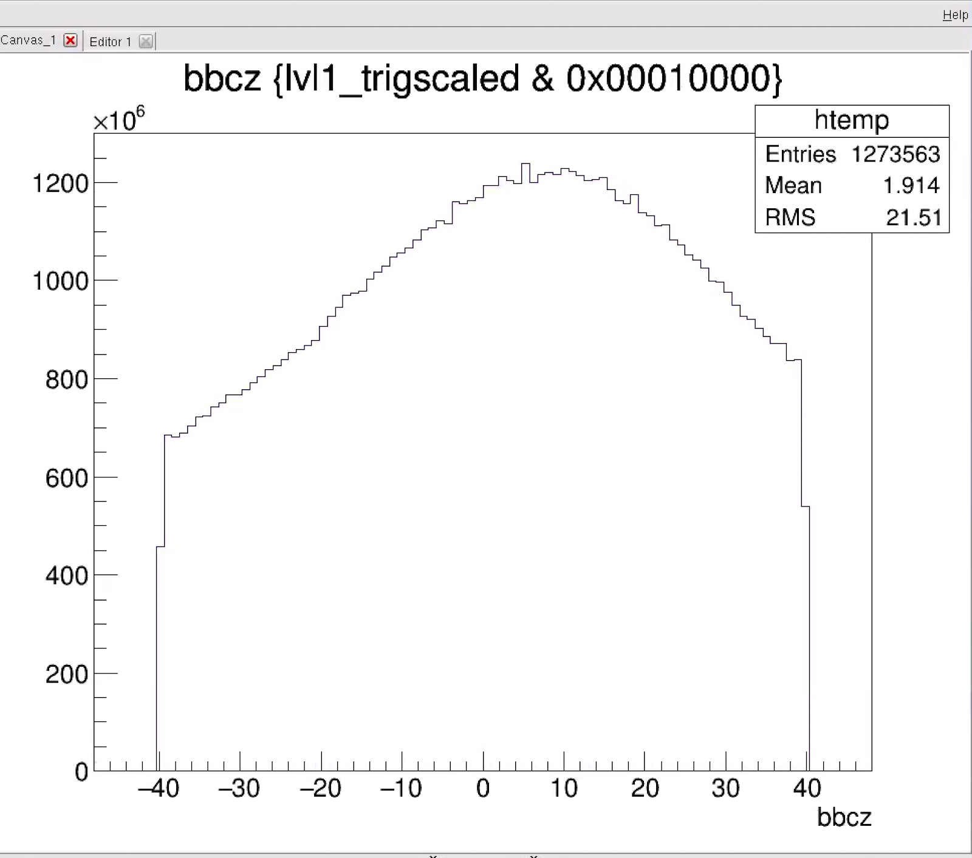
Run15pAu Muon Production: |bbcz| < 40cm
Applied |bbcz| < 40cm at DST production
…
FVTX information not available in other production
Need to reproduce the DST w/o bbcz cut
SVX available in CA production

Slide 13
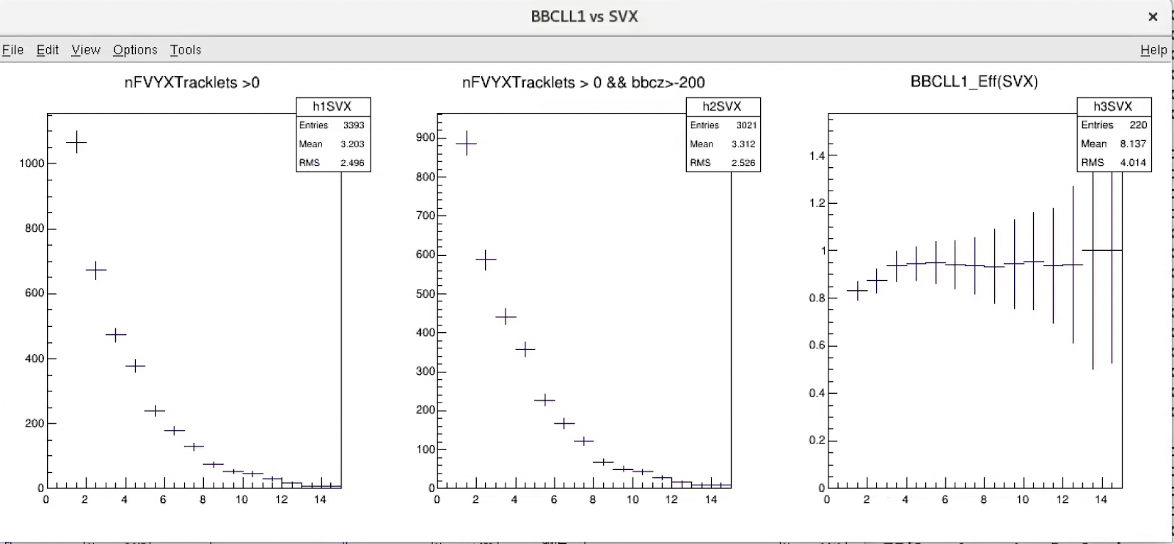
Run15pAu: CA production DST
- BBCLL1 vs Evt_Mult_SVX from one test run, need to run taxi (lack of disk space on HHJ now)
BBCLL1 trigger Efficiencies for MB:
(analysis notes: PPG224 and previous ones)
p+p: 55 +/-5 %
p+Au: 84 +/-3%
p+Al: 72 +/-4%
Hard p+p scatterings
(J/Psi, high pT pi0):
79 +/-2 %
BBCLL1_Eff
Evt_Mult_SVX

Slide 14
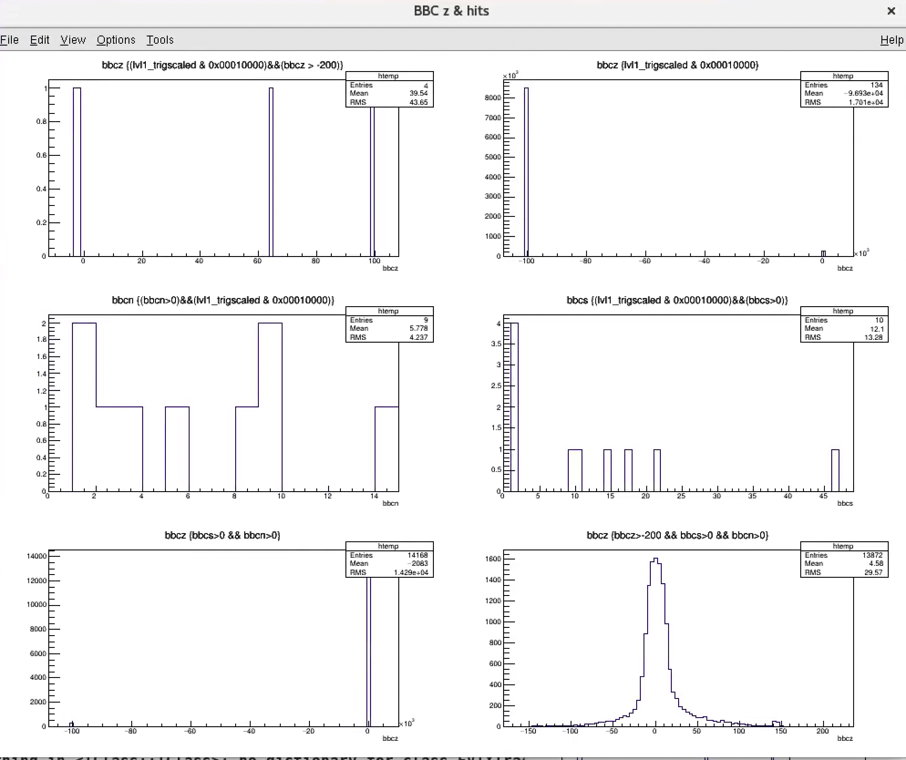
Reprocess run15pAu PRDF for Muon Data (FVTX)
Statistics:
- Just need to process 10~20 runs,
NOT the whole run16pAU
Setup for local production:
– many thanks to Chris and Sanghoon!
Test job seems good, 10k events
- BBC, SVX and FVTX
Need more disk space on HHJ: 2 TB
Local copy of one run of PRDF files (1~2TB)
Store output pDST (<100GB)
Taxi output of CA BBCLL1 analysis (< 50GB)
Clock data
Clock data
bbcz
bbcz
bbcn
bbcs
MB: bbcz
MB: bbcz

Slide 15
backup

Slide 16
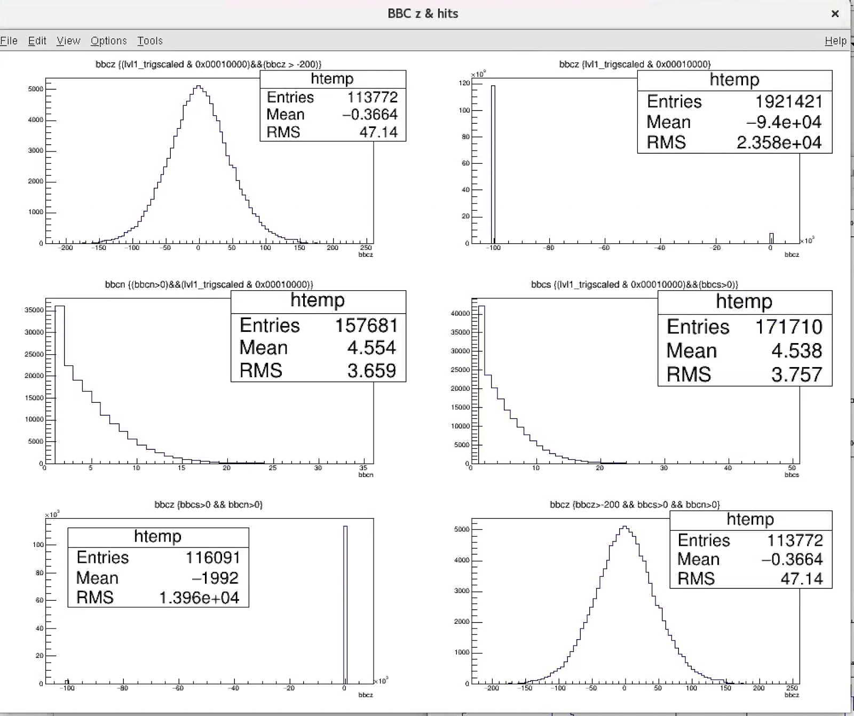
Run15pp: BBC Hits
“BBCLL1” Check:
(bbcz > -200)/(bbcs>0 && bbcn>0)
=113772/116091
=98.0%
bbcz/bbcn = 113772/157681
= 72.2%
bbcz/bbcs = 113772/171710
=66.3%
|bbcz| < 200
bbcz
bbcz
bbcn>0
bbcs>0
bbcn>0 && bbcs>0
bbcz
bbcz

Slide 17
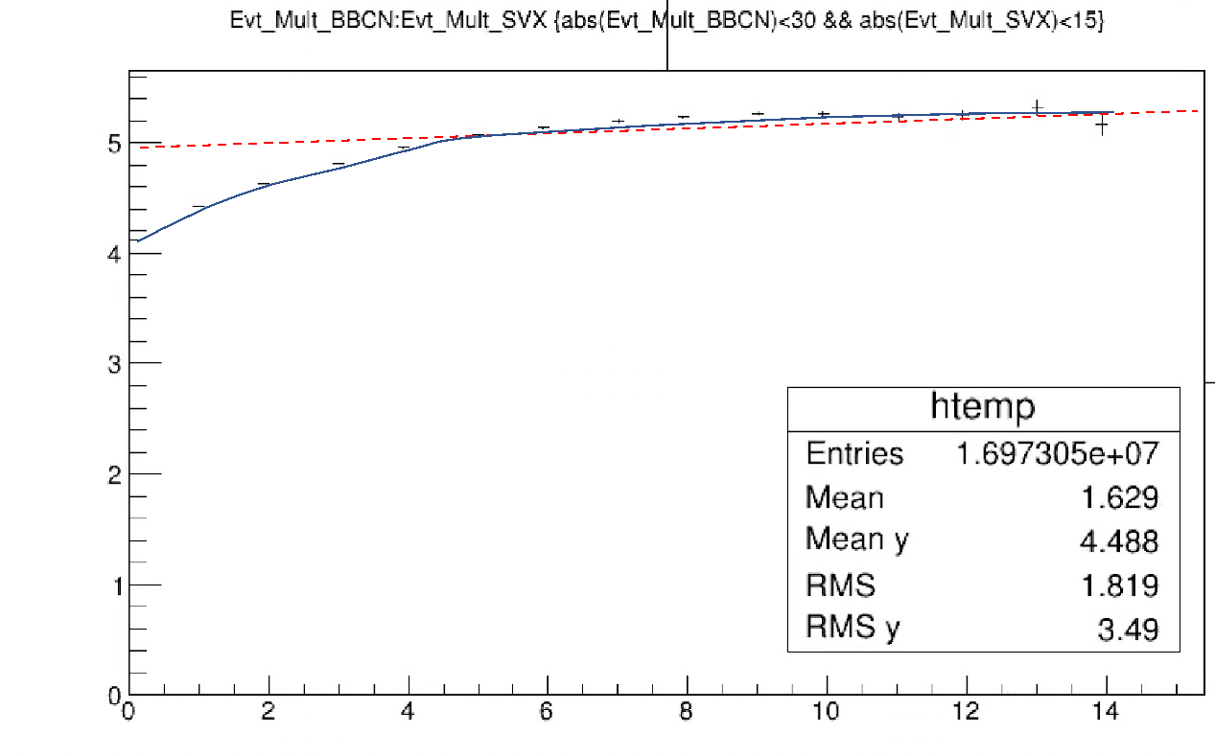
<Evt_Mult_BBCN> vs Evt_Mult_SVX in p+p Collisions
- weakly correlated at high Evt_Mult_BBC N/S
- good to use BBC_hits and SVX_hits as “independent” indicators of event activity
<Evt_Mult_BBCN>
BBCLL1 trigger Eff grows rapidly with Evt_Mult
at low Evt_Mult_SVX
Weak at high SVX_hit multiplicity
“saturate” at high multiplicity (pT)
BBCLL1_Eff:
0.55 +/- 0.05 (MB)
0.79 +/- 0.02 (high pT > 4GeV, p^0)
<Evt_Mult_SVX> ~1.5
Evt_Mult_SVX

Slide 18
Multiplicity Dependent BBCLL1 Trigger Bias
BBCLL1 trigger bias due to Event Multiplicity Change
  Higher Evt_Multi_FVTX/SVX -> higher BBC_Multiplicity -> higher BBCLL1 efficiency
Use simulations to estimate the bias
  Pythia p+p -> J/Psi -> mu+mu-; also next: p+p->MB
    But NOT requiring BBC hit information in the muon track reconstruction (z-vtx)
  PartonLevel:MPI = on
  Run15pp: run # 422070, MB events to get collision z-vertex
Macros: updated for BBCLL1 study special runs
  g3tog4_jpsi.C → pythia.root and PISAEvent.root
    removed the BbcRaw & BbcOut nodes from MB data
    Removed the BBC hit threshold setting (optimization follows)
    Allow all other particles in the HepMC output for BBC hit simulations
    Set bbcz <= vtxz (from the reference MB data) for muon track reco
  Fun4FVTX_Pisa.C -> DST.root and pDST.root
    |bbcz| < 100

