Slide 1
J/Psi Multiplicity Analysis Update
Yasser, Cameron, Cesar, Ming et al
10/28/2021
PHENIX HHJ Meeting

Slide 2
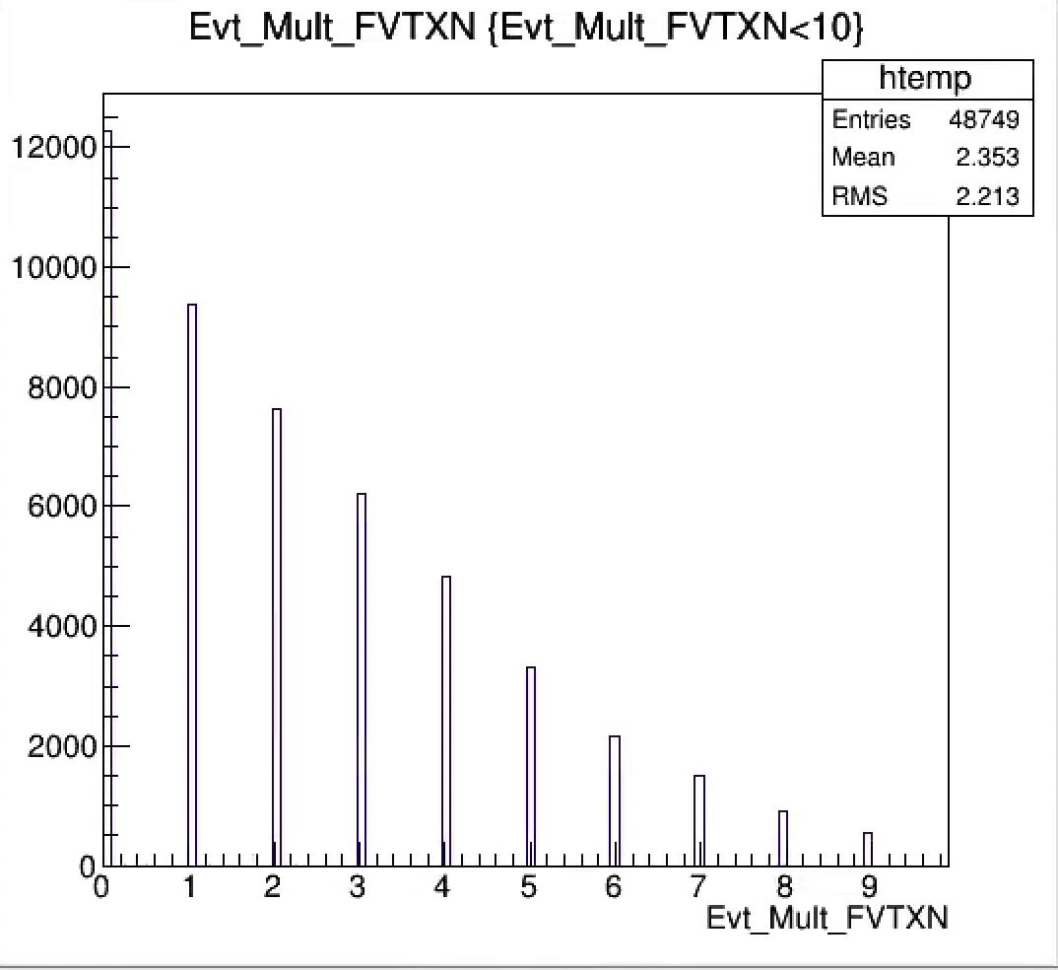
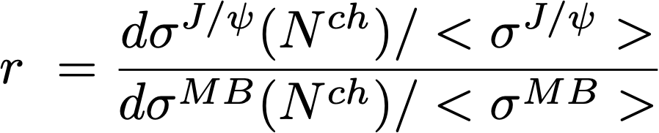
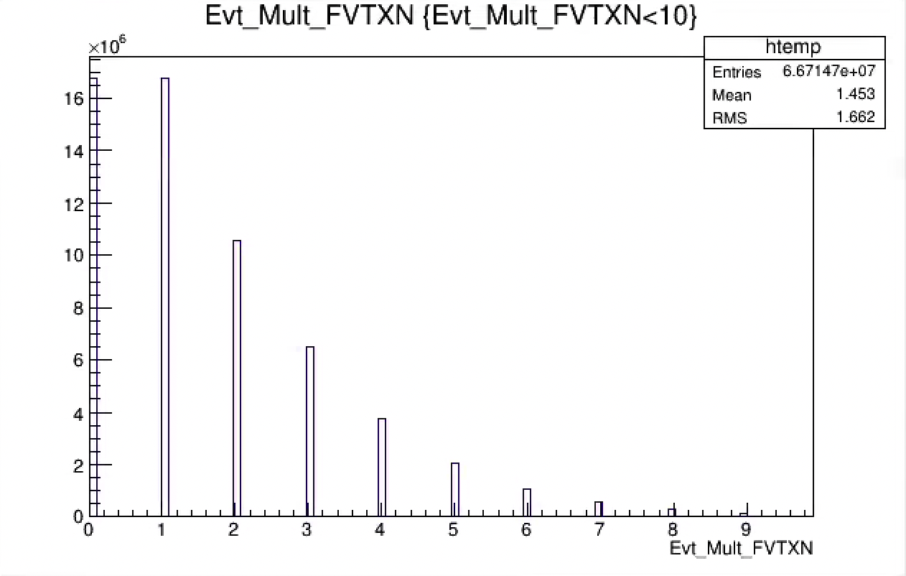
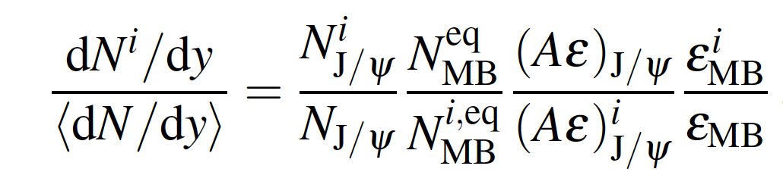
Differential J/Psi Yields vs Event Multiplicity N^{ch}
Normalized J/Psi event multiplicity differential ratio “r”:
J/Psi events
R =
Or relative yield for each multiplicity bin:
MB events
Evt_Mult (N^{ch})

Slide 3
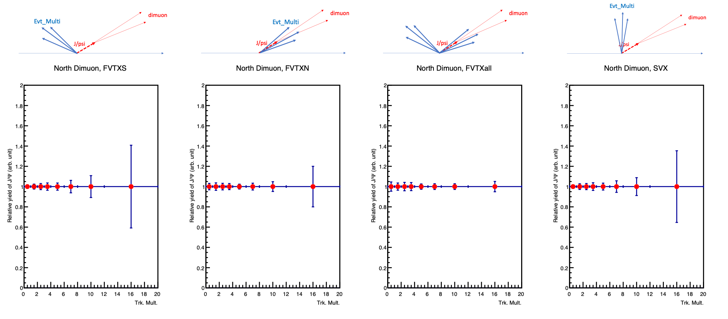
Relative J/Psi Yiels vs Event Multiplicity
- Run15 pp Projections
Evt_Mult_FVTX

Slide 4
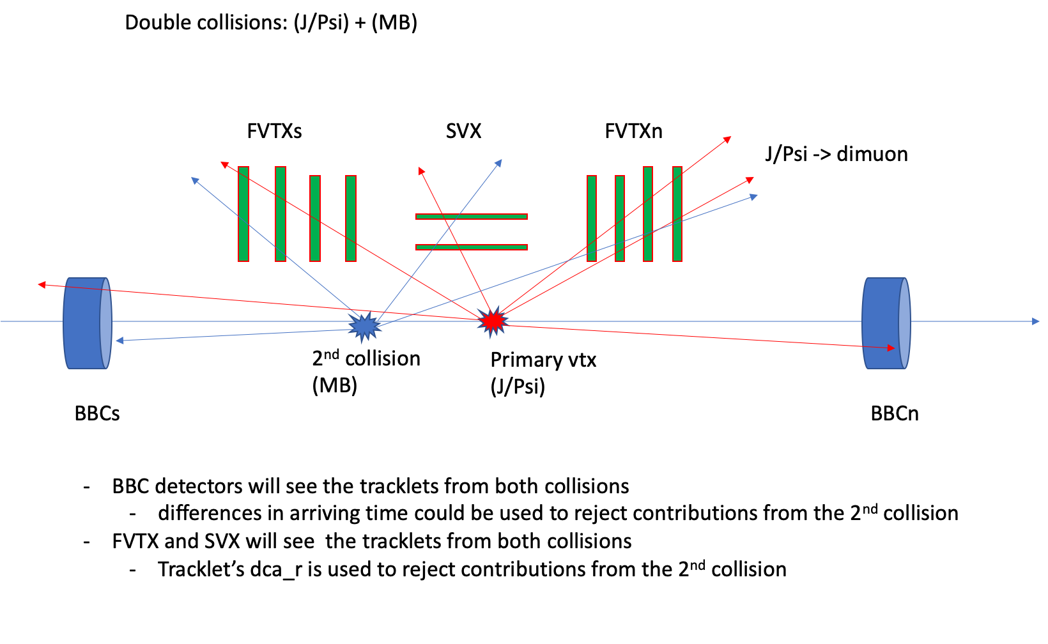
Event Multiplicity Determination in p+p collisions: FVTX/SVX/BBC

Slide 5
Recent Progress
Last time: how to deal with double collisions
  FVTX reconstructed 2nd z-vtx
  Confirmed with model calculation, ~10% correction
Event multiplicity correlations: FVTX, SVX and BBC
  How strongly/weakly are they correlated?
  Impacts on the physics interpretation: MPI, co-mover, hadronization …
Trigger bias: Event multiplicity dependence of BBCLL1 trigger efficiency
  J/Psi: MUID2D & BBCLL1 , eff ~ 79%
  MB: BBCLL1 (<15cm), eff ~ 55%

Slide 6
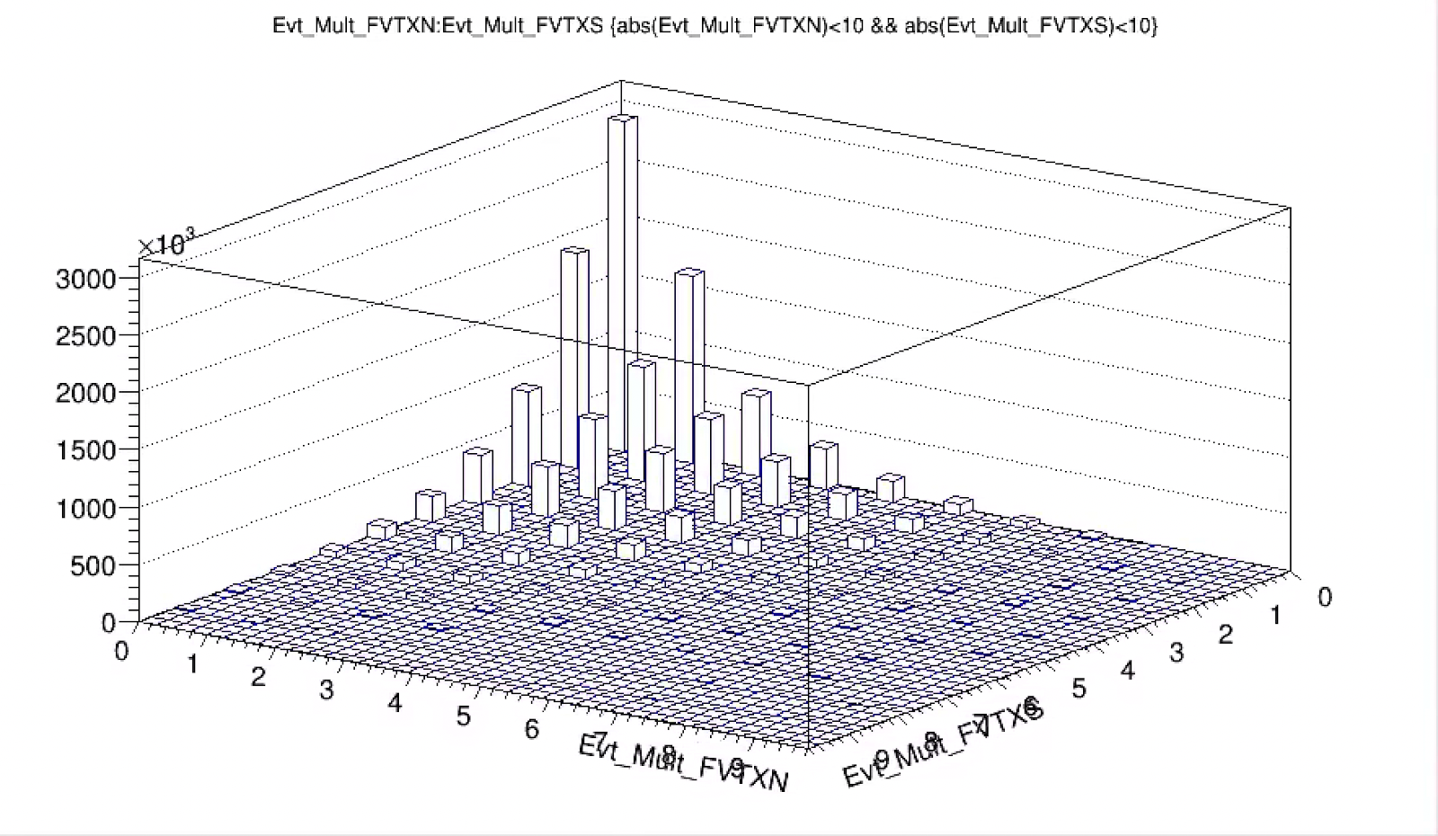
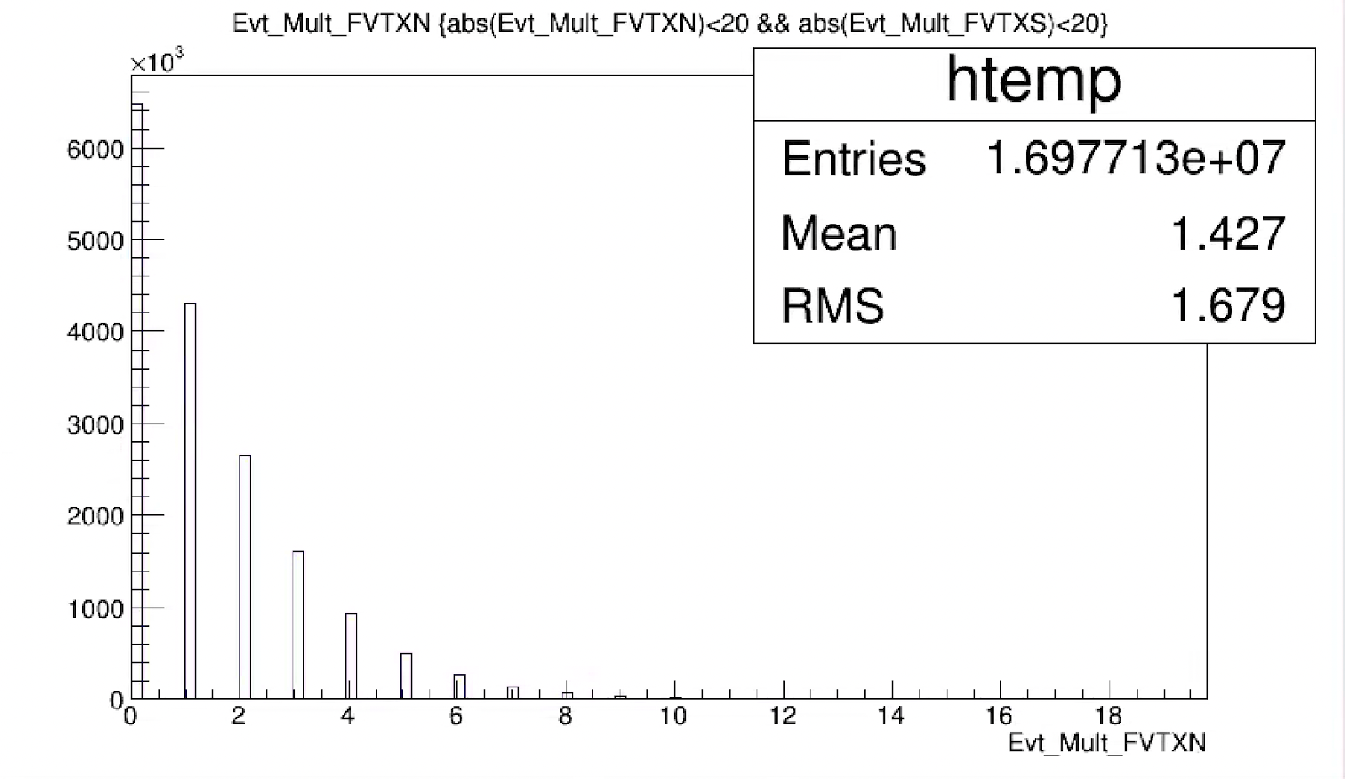
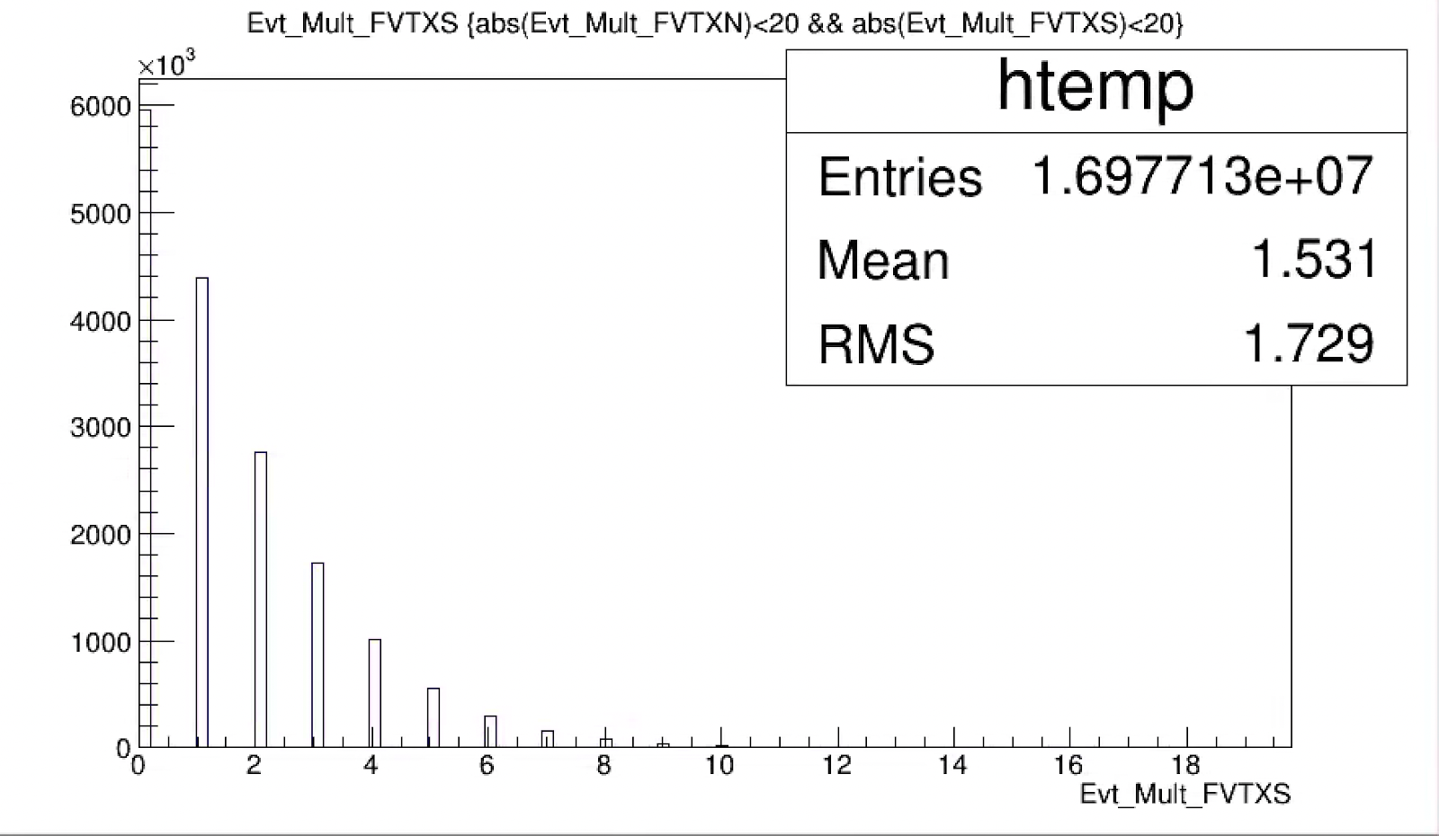
Event Multiplicity Correlation: FVTX_N vs FVTX_S
- only weakly correlated
Run15pp MB data sample:
  BBCLL1 (vtx<15cm)
  Offline event selection:
    |Evt_vtxZ|<10cm
    |Evt_bbcZ|<20cm
Evt_Mult_FVTXN
Evt_Mult_FVTXS
Evt_Mult_FVTXN
Evt_Mult_FVTXS

Slide 7
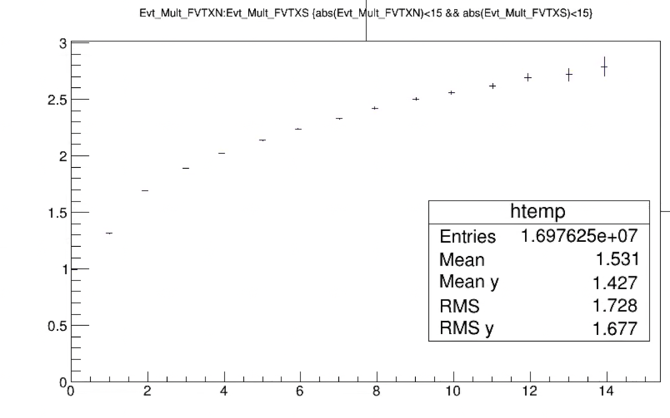
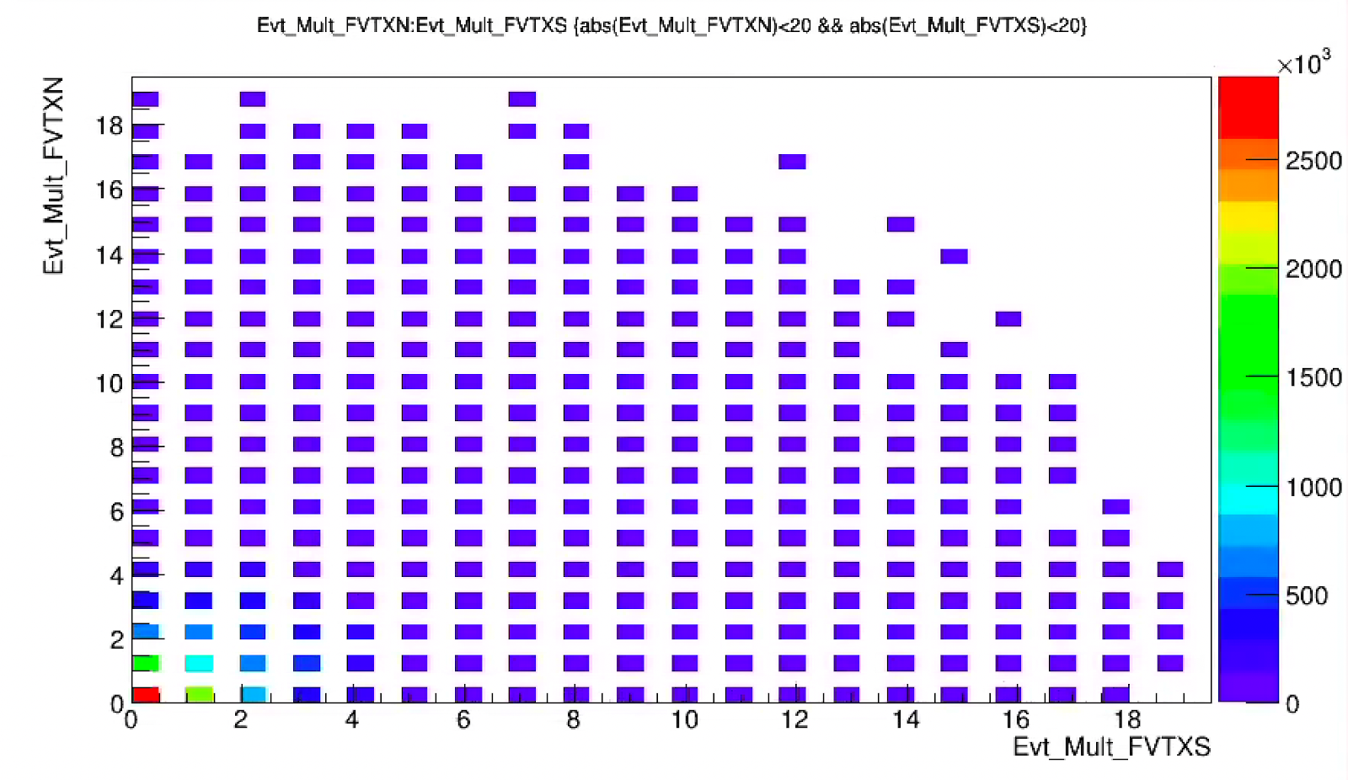
<Evt_Mult_FVTXN> vs Evt_Mult_FVTXS
- weakly correlated at high Evt_Mult_FVTXS
- good to use FVTX_N and FVTX_S as “independent” indicator of high event activity
<Evt_Mult_FVTXN>
Weak correlation at high multiplicity, “saturate”
Stronger correlation at low multiplicity, “rapid increase in activities”
Evt_Mult_FVTXS

Slide 8
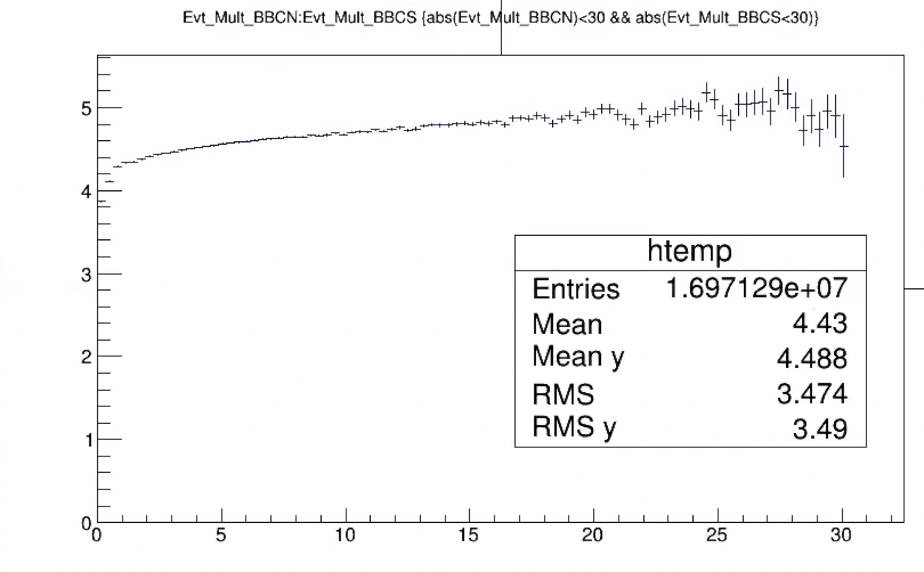
<Evt_Mult_BBCN(S)> vs Evt_Mult_BBCS
- weakly correlated at high Evt_Mult_BBC N/S
- expect rapid increase of BBCLL1_Eff at low multiplicity, then quikcy “saturate”
<Evt_Mult_BBCN>
BBCS
BBCN
common/global activity (“semi-hard scatterings”)
local activity, FSI, hadronization/fragmentation etc.
finite BBC acceptance etc.
-> almost “statistically independent”
Evt_Mult_BBCS

Slide 9
<Evt_Mult_BBCN(S)> vs Evt_Mult_SVX
- weakly correlated at high Evt_Mult_BBC N/S
- good to use BBC_hits and SVX_hits as “independent” indicators of event activity
<Evt_Mult_BBCN>
BBCLL1 trigger Eff grows rapidly with Evt_Mult
at low Evt_Mult_SVX
Weak at high SVX_hit multiplicity
“saturate” at high multiplicity (pT)
BBCLL1_Eff:
0.55 +/- 0.05 (MB)
0.79 +/- 0.02 (high pT > 4GeV, p^0)
Evt_Mult_SVX

Slide 10
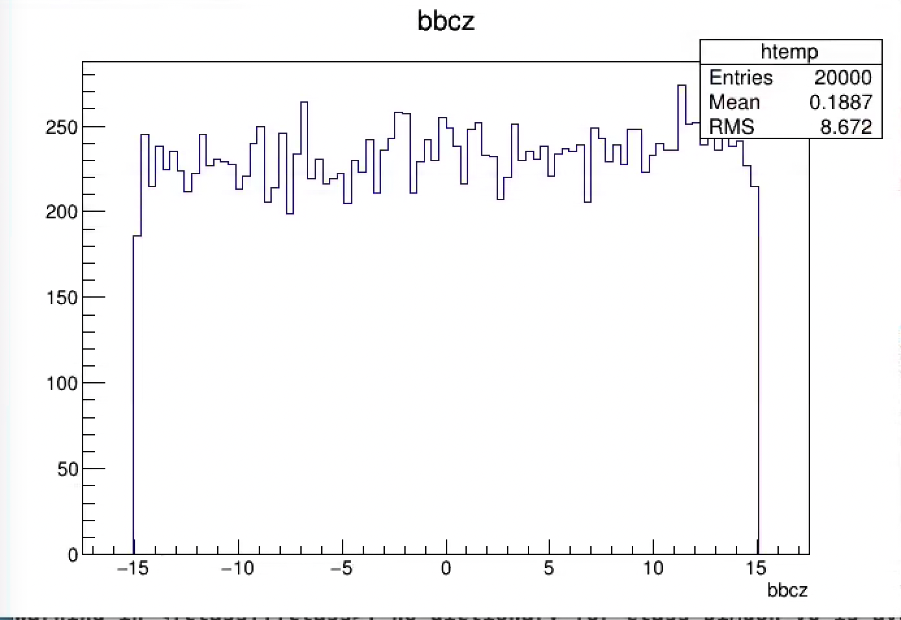
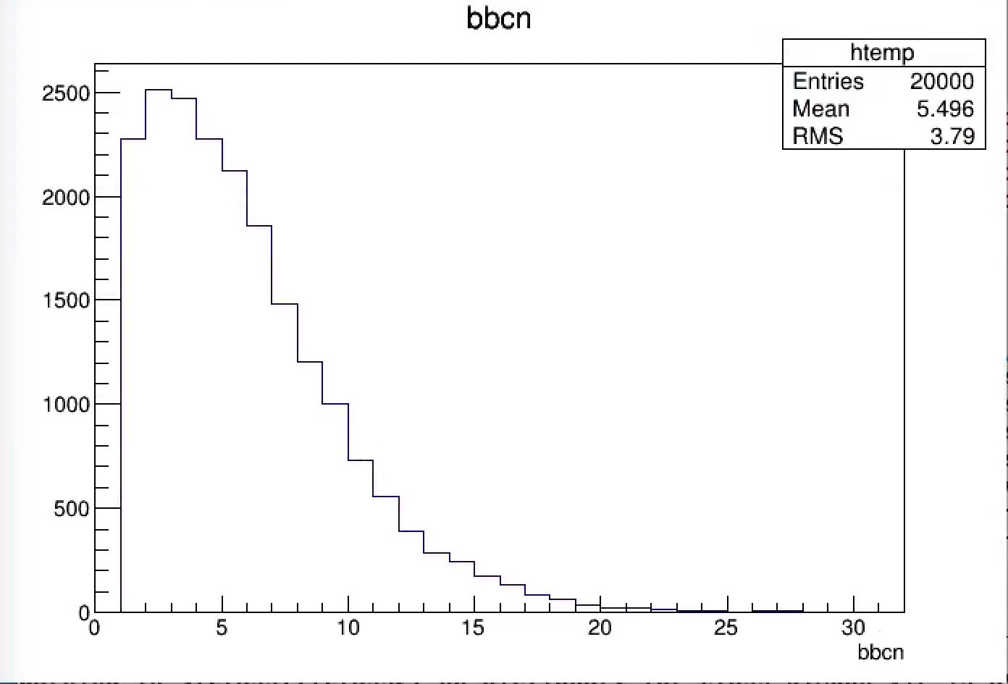
Use MC to Make the Evt_Mult Bias Corrections
- however, current PHENIX simulations all had BBC cuts at reconstruction …. Effectively already BBCLL1 selected
From recent PYTHIA pp->J/Psi simulations:
BBCn >=1 && BBCs >=1
Reco’ed bbcZ

Slide 11
New MC for Event Multiplicity Dependent Trigger Bias Study
- MB and J/Psi Events
Generate MB (or J/Psi) events with Pythia
  Reconstruct events w/o BBCLL1 requirements
→ use “true Pythia event vertex” for reconstruction;
Also evaluate with real data, beam-clk (and ZDC ?) triggered
Evt_Mult_bin (i):
<MB>: ~0.55
<J/Psi>: ~0.79

Slide 12
Summary and To-do’s
FVTX, SVX and BBC multiplicities are weakly correlated at high multiplicity region
  -> good “independent” indicators of local event activities in the high multiplicity region
New MC study for BBCLL1 trigger bias correction
  MB and J/Psi
  Important for the low Evt_Mult region (expect rapid increase of eff.)
Finalize results for preliminary
  Run15 pp, pAu

Slide 13
Backup slides

Slide 14
FVTX_N vs FVTX_S

Slide 15
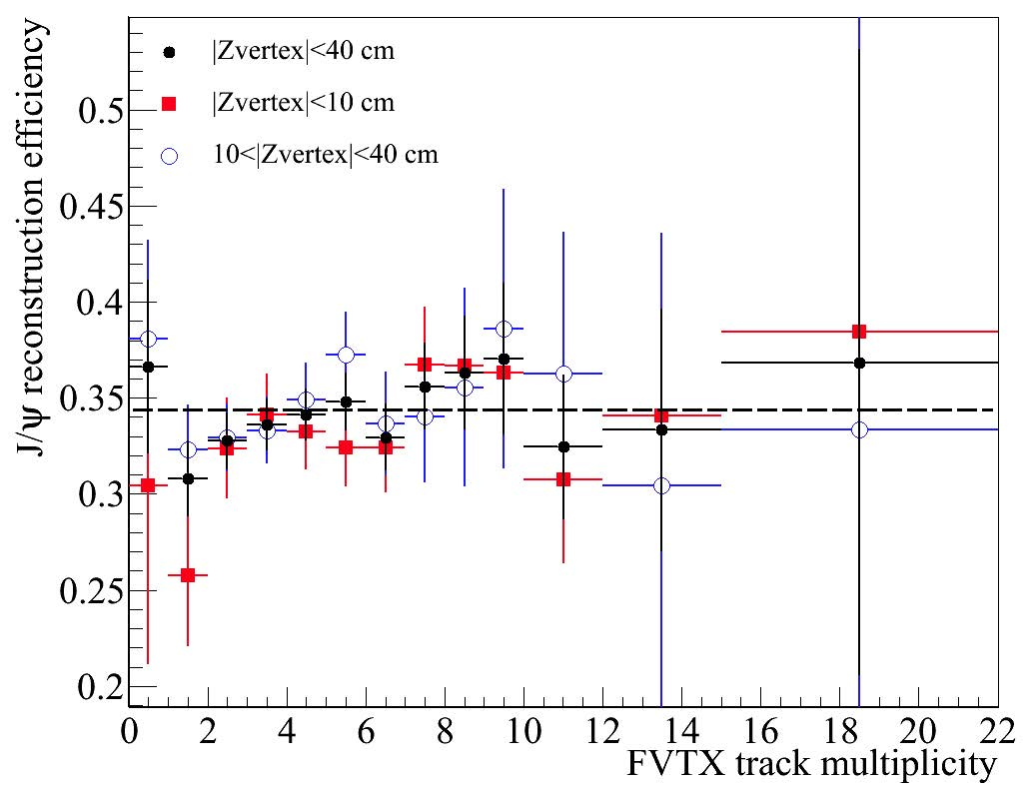
J/Psi Reconstruction Efficiency vs Multiplicity
FVTX multiplicity dependent
J/Psi reco efficiency:
<Eff> = 0.34 +/- 0.02

