Slide 1
Run15 J/Psi Multiplicity Analysis Update
Yasser, Cameron, Cesar and Ming
11/04/2021
HHJ Meeting

Slide 2
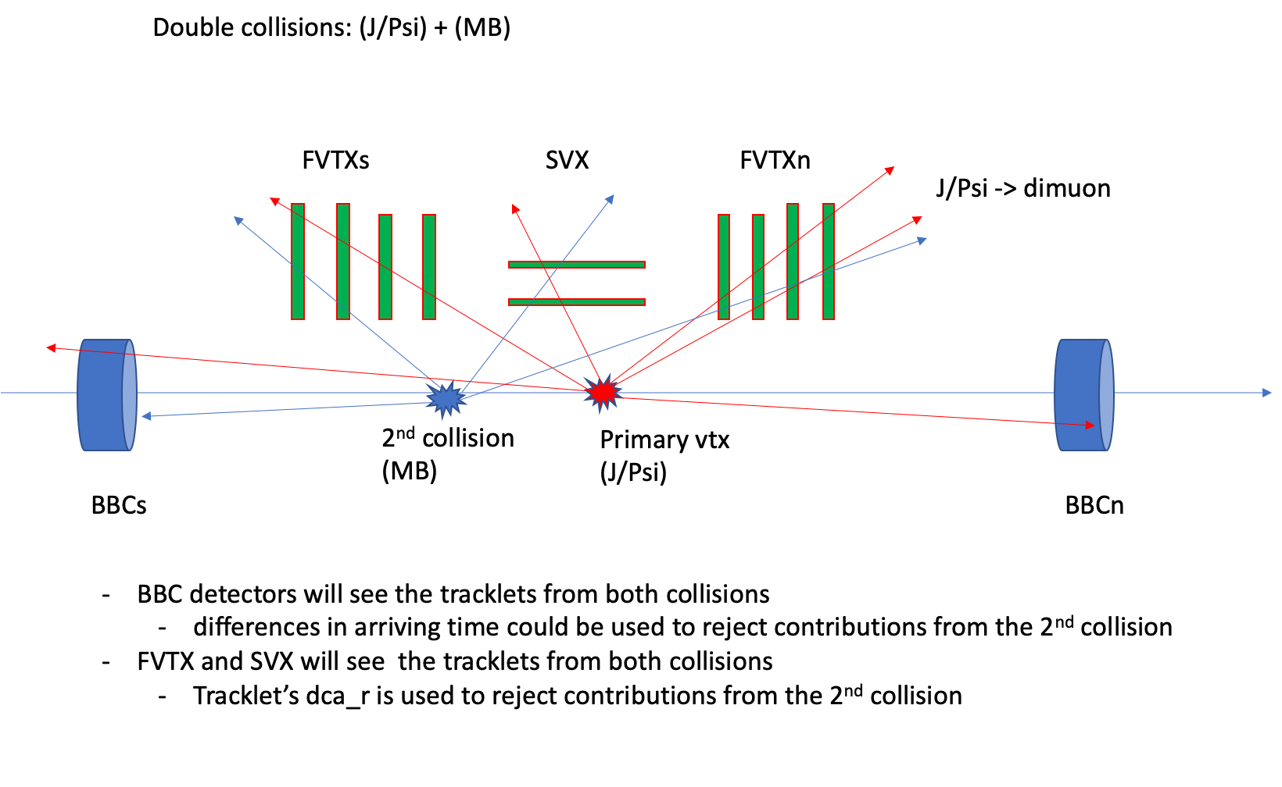
Event Multiplicity Determination in p+p collisions: FVTX/SVX/BBC
Potential BBCLL1 bias due
to higher average BBC hits for
higher Evt_Mult_FVTX/SVX

Slide 3
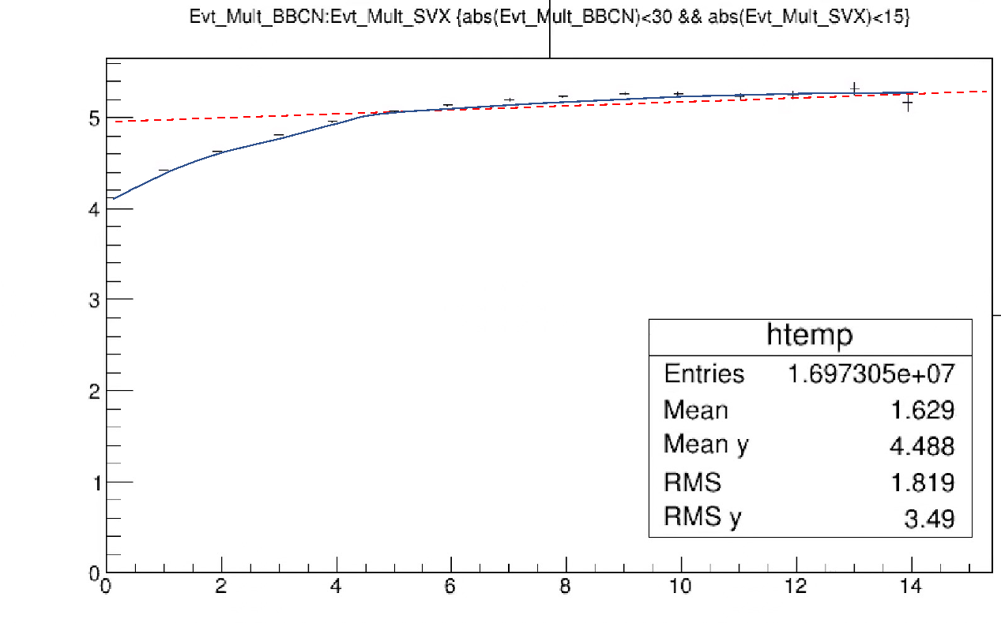
<Evt_Mult_BBCN> vs Evt_Mult_SVX - weakly correlated at high Evt_Mult_BBC N/S - good to use BBC_hits and SVX_hits as “independent” indicators of event activity
<Evt_Mult_BBCN>
BBCLL1 trigger Eff grows rapidly with Evt_Mult
at low Evt_Mult_SVX
Weak at high SVX_hit multiplicity
“saturate” at high multiplicity (pT)
BBCLL1_Eff:
0.55 +/- 0.05 (MB)
0.79 +/- 0.02 (high pT > 4GeV, p^0)
<Evt_Mult_SVX> ~1.5
Evt_Mult_SVX

Slide 4
BBCLL1 Efficiency vs Evt_Mult_FVTX/SVX

Slide 5
Multiplicity Dependent BBCLL1 Trigger Bias
BBCLL1 trigger bias due to Event Multiplicity Change
Higher Evt_Multi_FVTX/SVX -> higher BBC_Multiplicity
Use simulations to estimate the bias
Pythia p+p -> J/Psi -> mu+mu-; also next: p+p->MB
But NOT requiring BBC hit information in the muon track reconstruction (z-vtx)
PartonLevel:MPI = on
Run15pp: run # 422070, MB events to get collision z-vertex
Macros: updated for BBCLL1 study special runs
g3tog4_jpsi.C → pythia.root and PISAEvent.root
removed the BbcRaw & BbcOut nodes from MB data
Removed the BBC hit threshold setting (optimization follows)
Allow all other particles in the HepMC output for BBC hit simulations
Set bbcz <= vtxz (from the reference MB data) for muon track reco
Fun4FVTX_Pisa.C -> DST.root and pDST.root
|bbcz| < 100

Slide 6
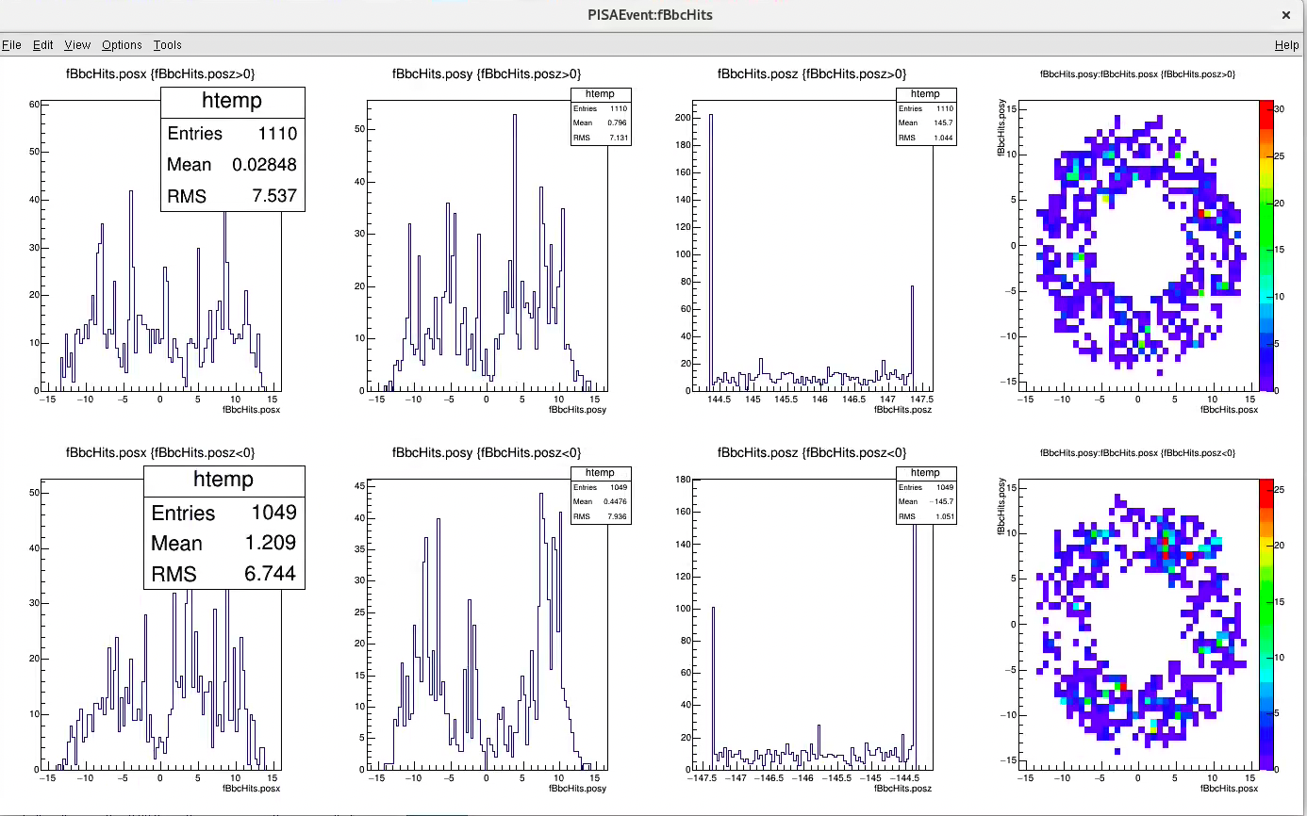
PISAEvent Outputs: p+p->J/Psi->mu+mu- X, “fBbcHits”
North BBC hits
Y
South BBC hits
X
Y
Z
X

Slide 7
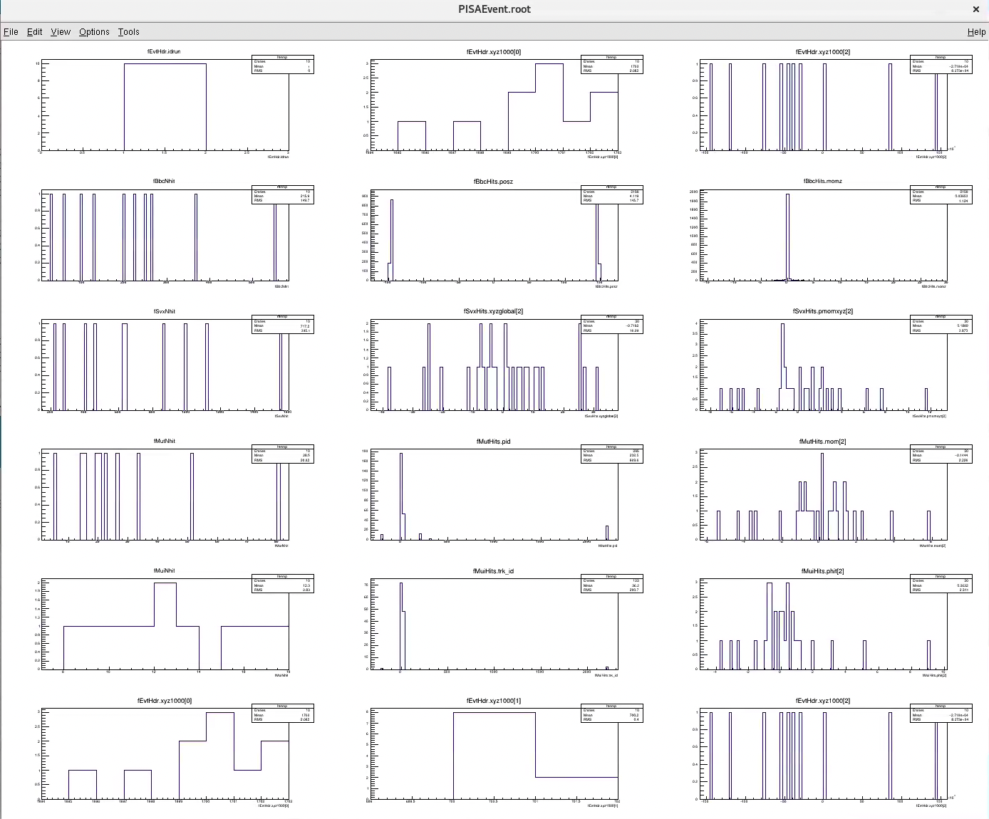
PISAEvent Outputs: BBC/SVX/MUT/MUI hits
BBC
SVX/FVTX
MUTR
MUID

Slide 8
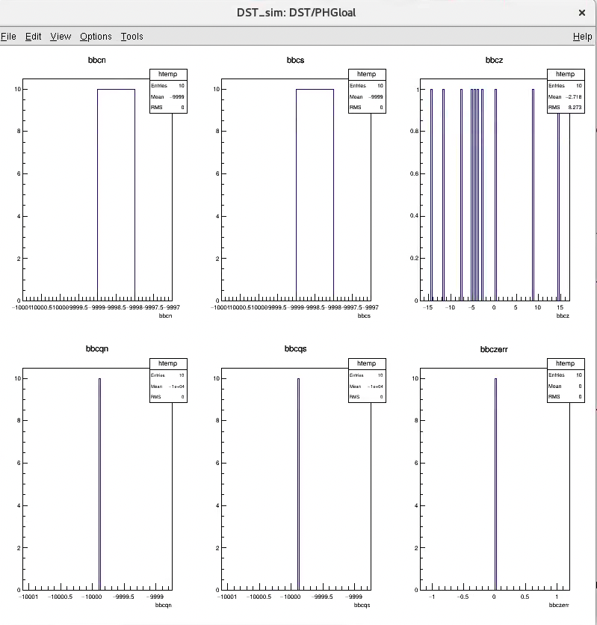
DST outputs: BbcOut?
BBC_Z <= evt_vtx_z (MB); okey
But no hit information in other variables needed for the BBCLL1 trigger decision
One-hit on each side
bbcn, bbcs
bbcqn, bbcqs
PHGlobal not filled properly?
Create BbcRaw node from PISA?
Missing BBC_Reco module in Fun4FVTX_Pisa.C?
bbcn
bbcs
bbcz
bbcns
bbcqs
Bbcz_err

Slide 9
Other Issues
Pythia simulation seems not stable
often crashes early at ~O(10) events
DST not complete ?
Missing some reco (BBC/ZDC like) modules?

Slide 10
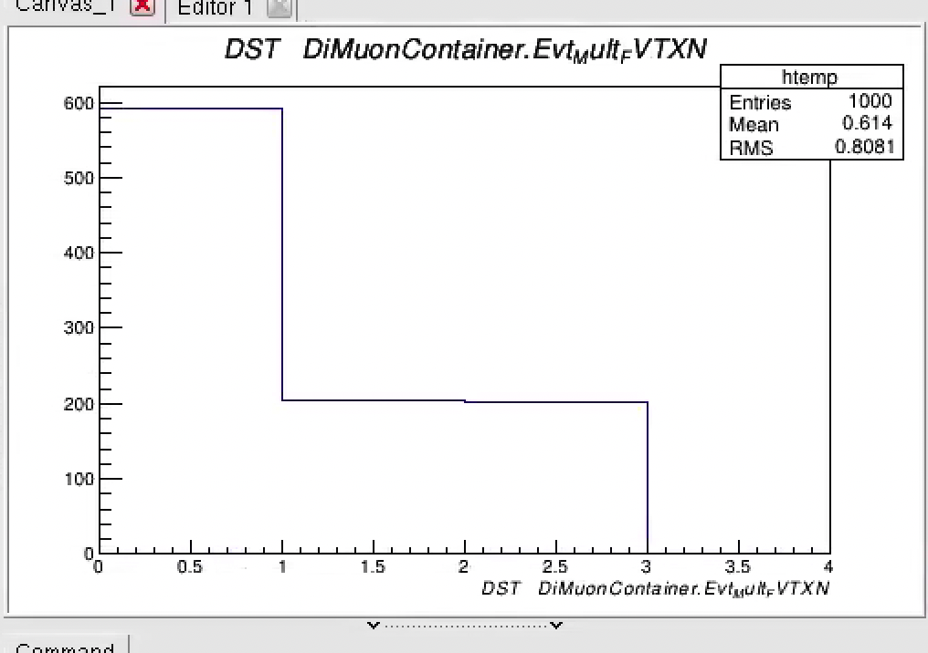
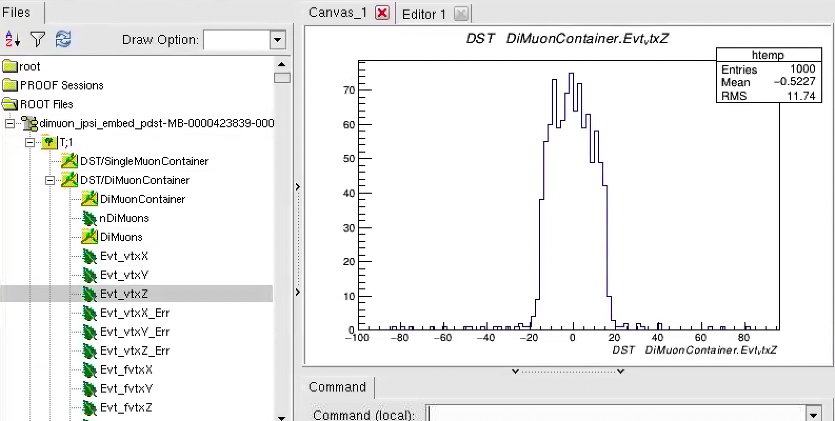
Large MC Samples Produced
used MB data “BbcRaw” and “BbcOut”
phpythia p+p -> J/Psi -> dimuons
Evt_Mult_FVTXN
Evt_bbcZ

Slide 11
Backup slides

