Slide 1
J/Psi Multiplicity Analysis Update
Yasser, Cameron, Sanghoon, Cesar, Ming et al
09/30/2021
HI PWG

Slide 2
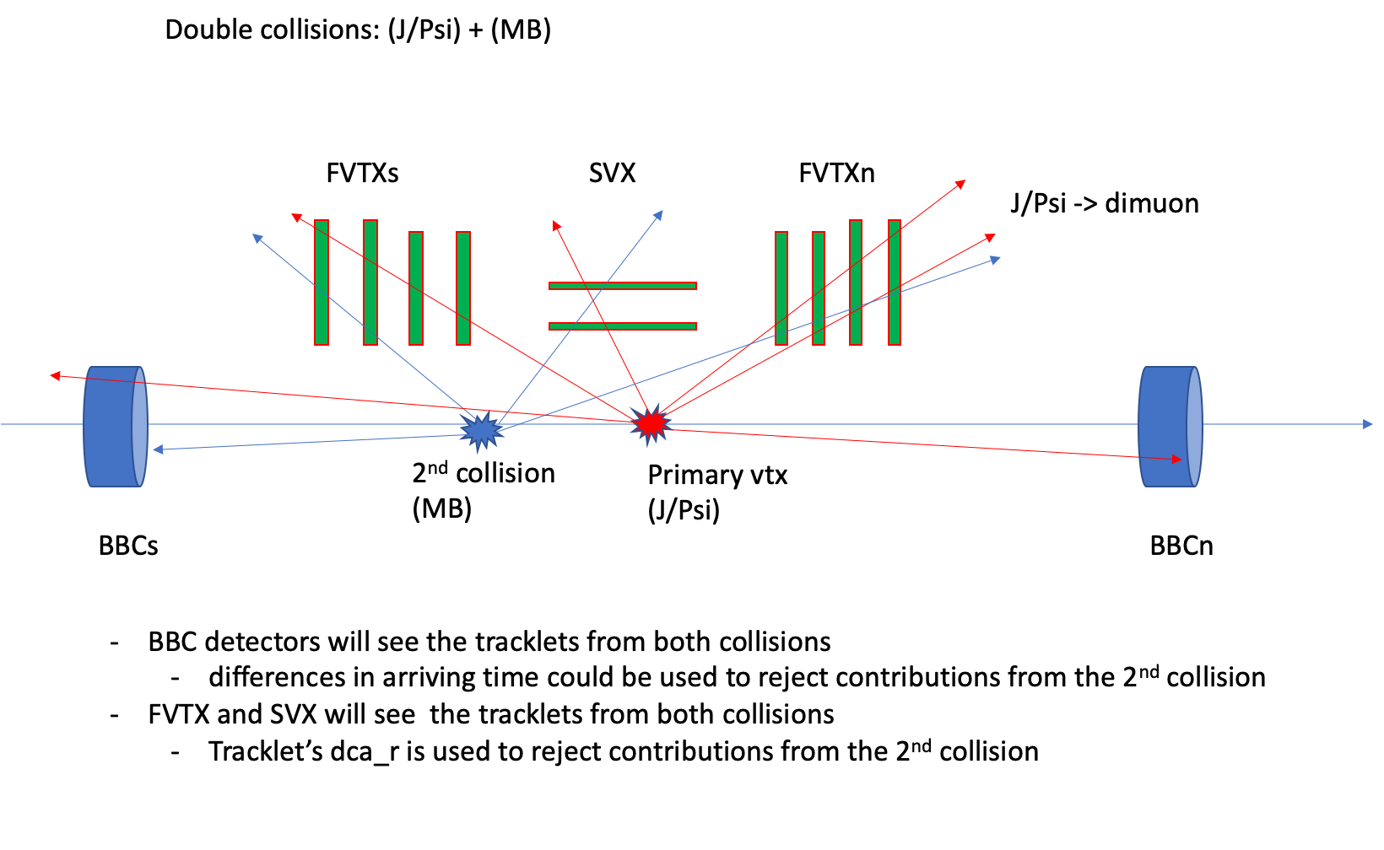
J/Psi and Event Multiplicity in Run15 p+p/pAu collisions: FVTX/SVX/BBC

Slide 3
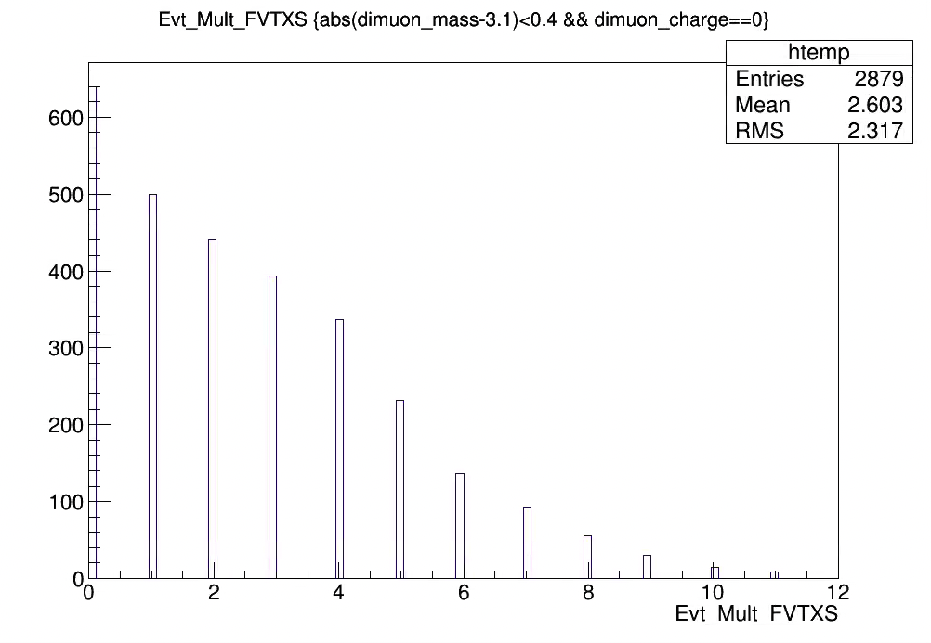
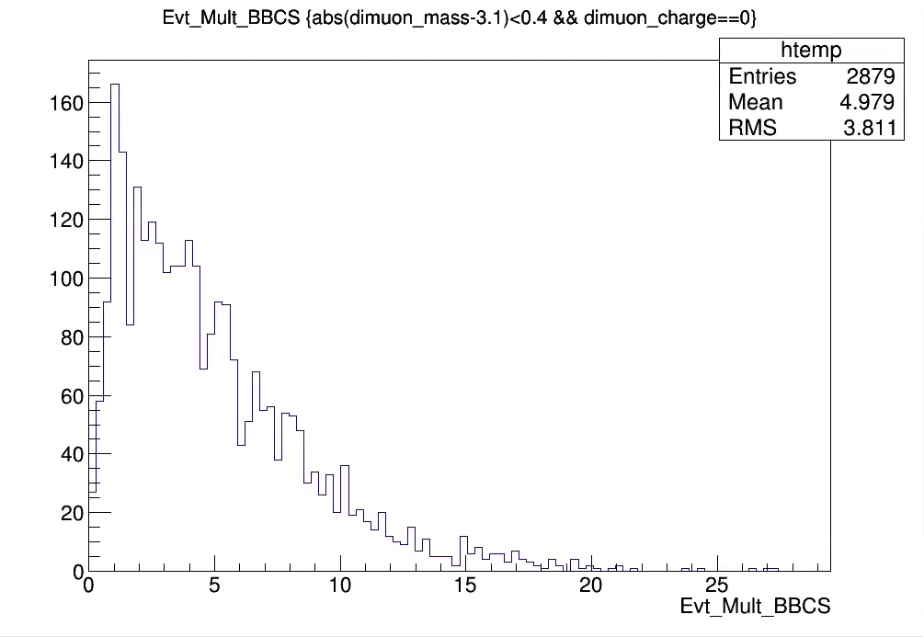
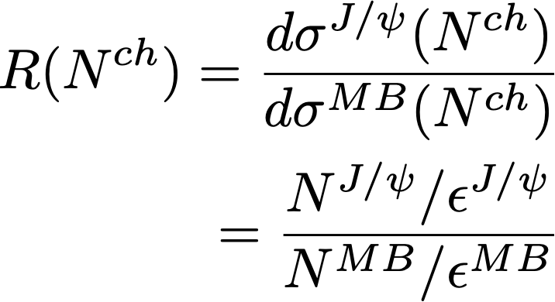
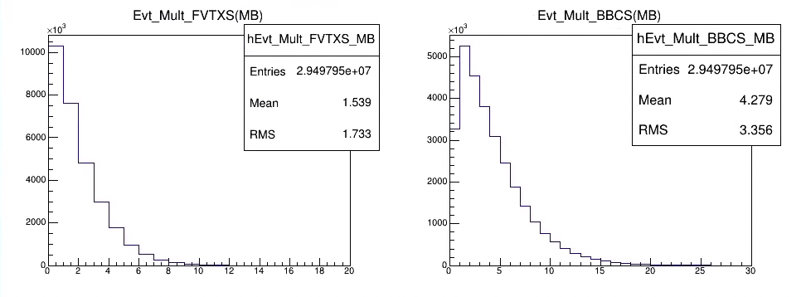
Physics Measurements
Event multiplicity distributions for J/Psi (Top) and MB (Bottom) events, run15pp
Relative differential J/Psi yield vs event charge track multiplicity N^{ch} determined by FVTX, SVX and BBC
Evt_Mult_FVTX(or SVX, BBC)
Normalized distributions,
J/Psi: FVTXS
J/Psi: BBCS
MB: FVTXS
MB: BBCS

Slide 4
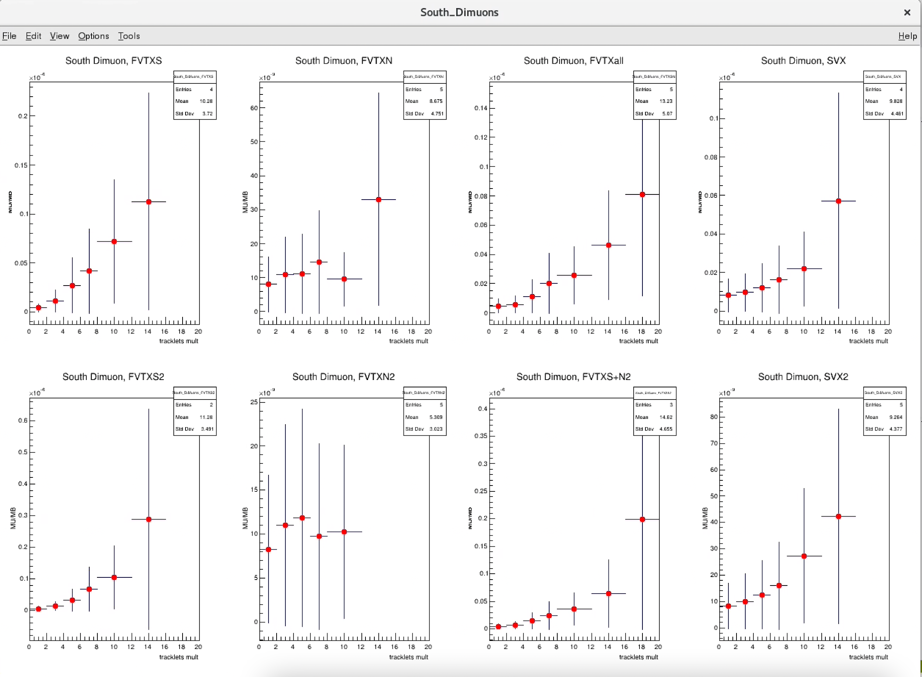
Raw Yield Ratios: Run15 pp North and South Dimuon J/Psi
North J/Psi
South J/Psi
Opposite arm
Same arm
Same arm
Opposite arm
FVTXS
FVTXN
FVTX(S+N)
SVX
FVTXS
FVTXN
FVTX(S+N)
SVX

Slide 5
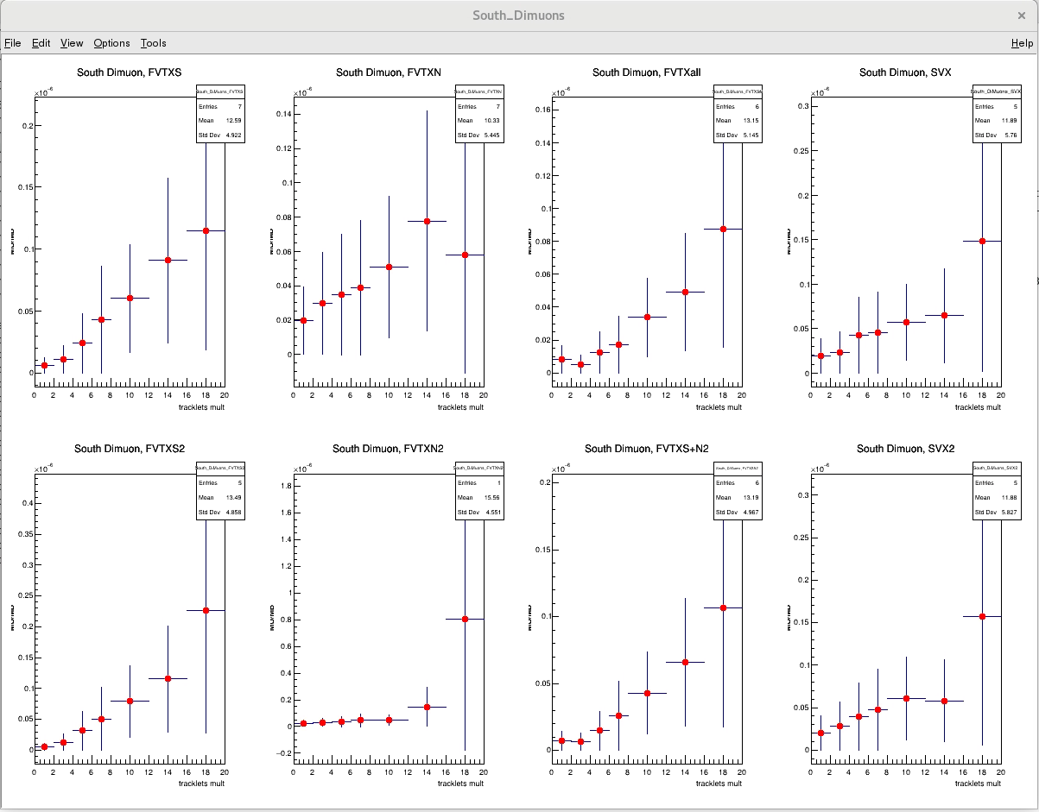
Raw Yield Ratios: Run15 p+Au North and South Dimuon J/Psi
North J/Psi
South J/Psi
Same arm
Same arm
FVTXS
FVTXN
FVTX(S+N)
SVX
FVTXS
FVTXN
FVTXS+N
SVX

Slide 6
Check the Correction Factors…

Slide 7
The “Efficiency” includes many factors
Detector acceptance
Independent of Evt_Mult
Detector & offline reconstruction efficiency
Weak dependance on Evt_Mult (and collision rate)
Trigger efficiency
Depending on physics process
Weakly depending on Evt_Mult_FVTX/SVX and collision rate (BBCLL1)
Trigger scaled down factor
Fixed value for a given run
The normalized relative yield “r”:
Most of the Acc*Eff canceled out, only leaving small corrections from multiplicity dependence, absorbed under “systematic”
+ double collision correction

Slide 8
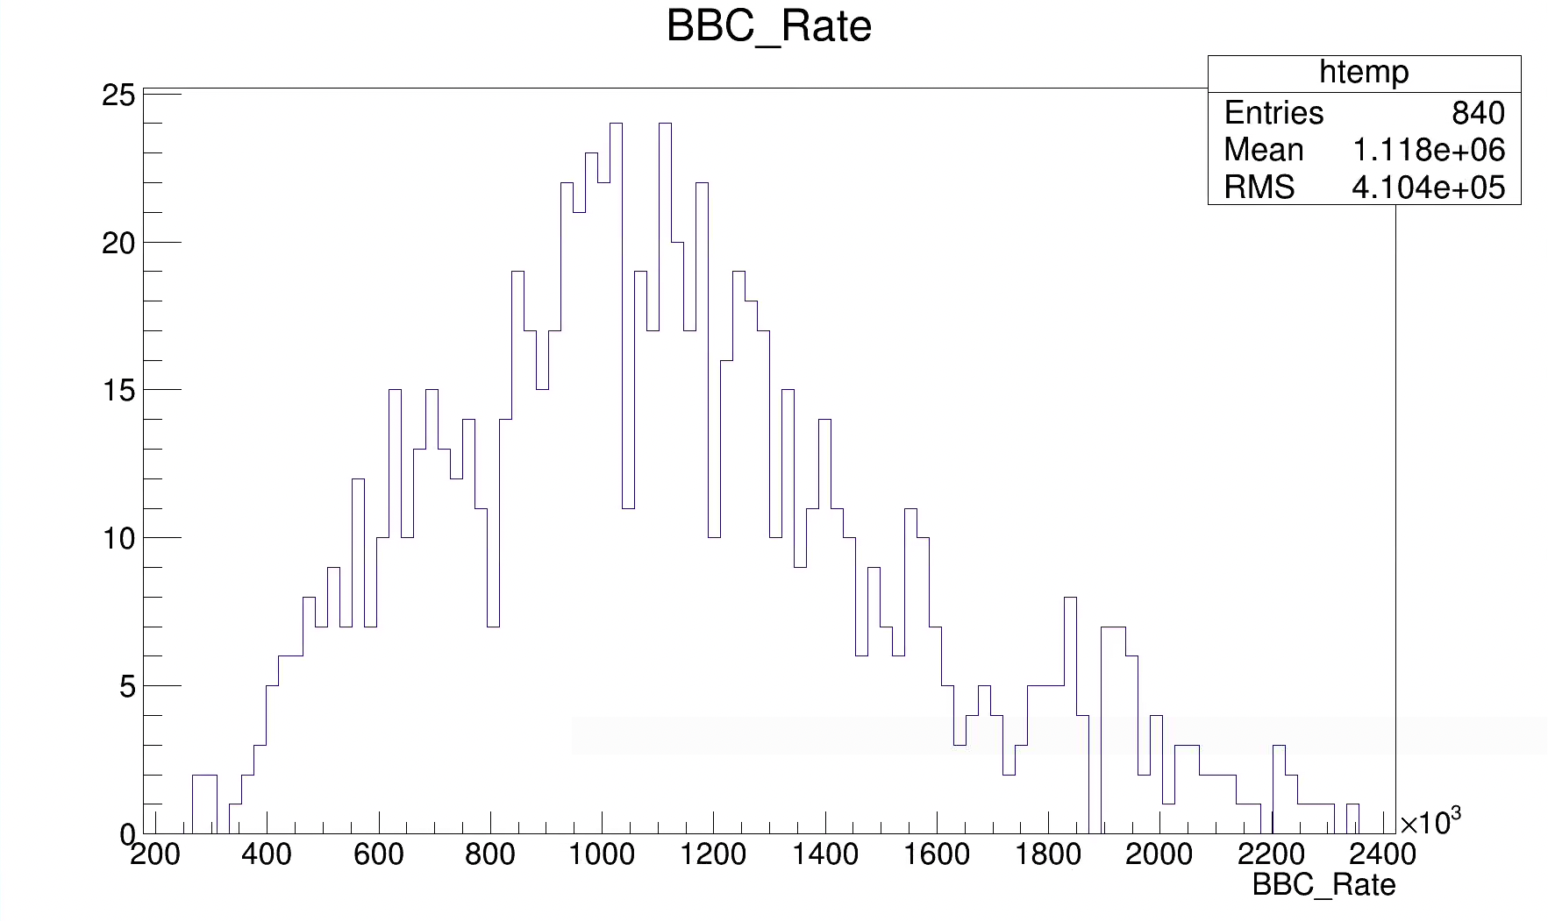
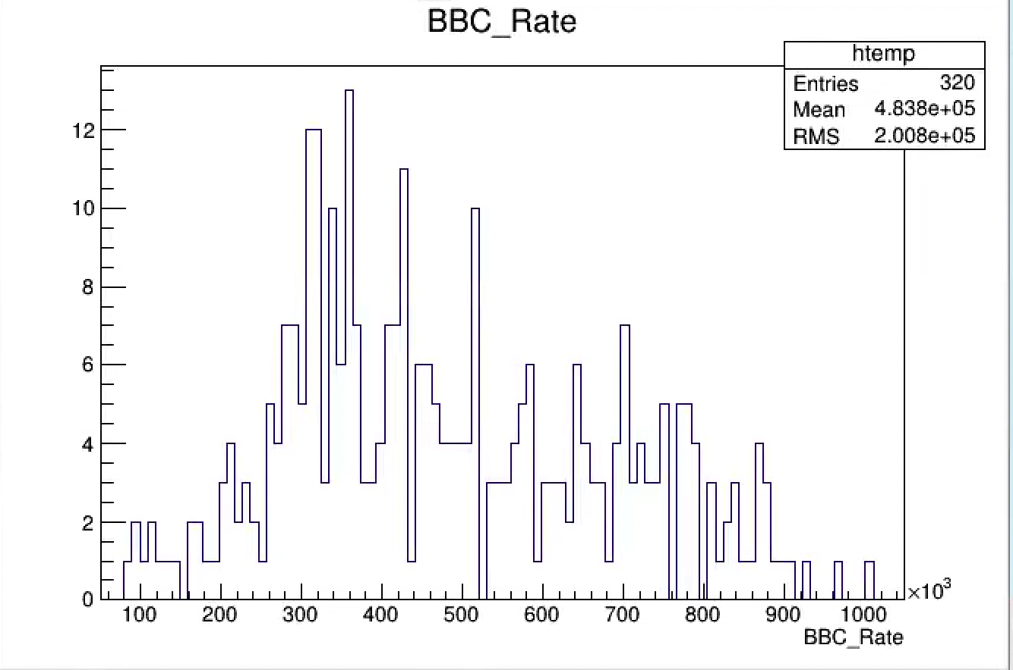
Impact of Double Collision on FVTX/SVX/BBC
Increase the Evt_Mult_FVTX/SVX/BBC, for both MB and J/Psi events
Run15 pp:
<BBC_Rate> = 1.1 MHz
Run15 pAu:
<BBC_Rate> = 0.48 MHz

Slide 9
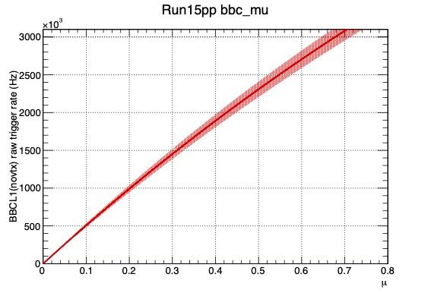
Multiple Collision Probability Table
BBCLL1_Eff = 55 +/ 5 % for run15 pp MB; 79 +/-2 % for hard scattering, PPG224 etc.
BBC Rate kHz | Mean_Mu | Prob. to have 2+ collisions
250 | 0.05 | 0.12%
500 | 0.1 | 0.47% <pAu>
1,000 | 0.2 | 1.8% <pp>
1,500 | 0.31 | 3.9%
2,000 | 0.43 | 6.9%
2,500 | 0.55 | 10%

Slide 10
Cross Check of Double Collision Fraction vs BBC_Rate
With a few selected runs in 3 BBC_Rate ranges … repeat with better stat

Slide 11
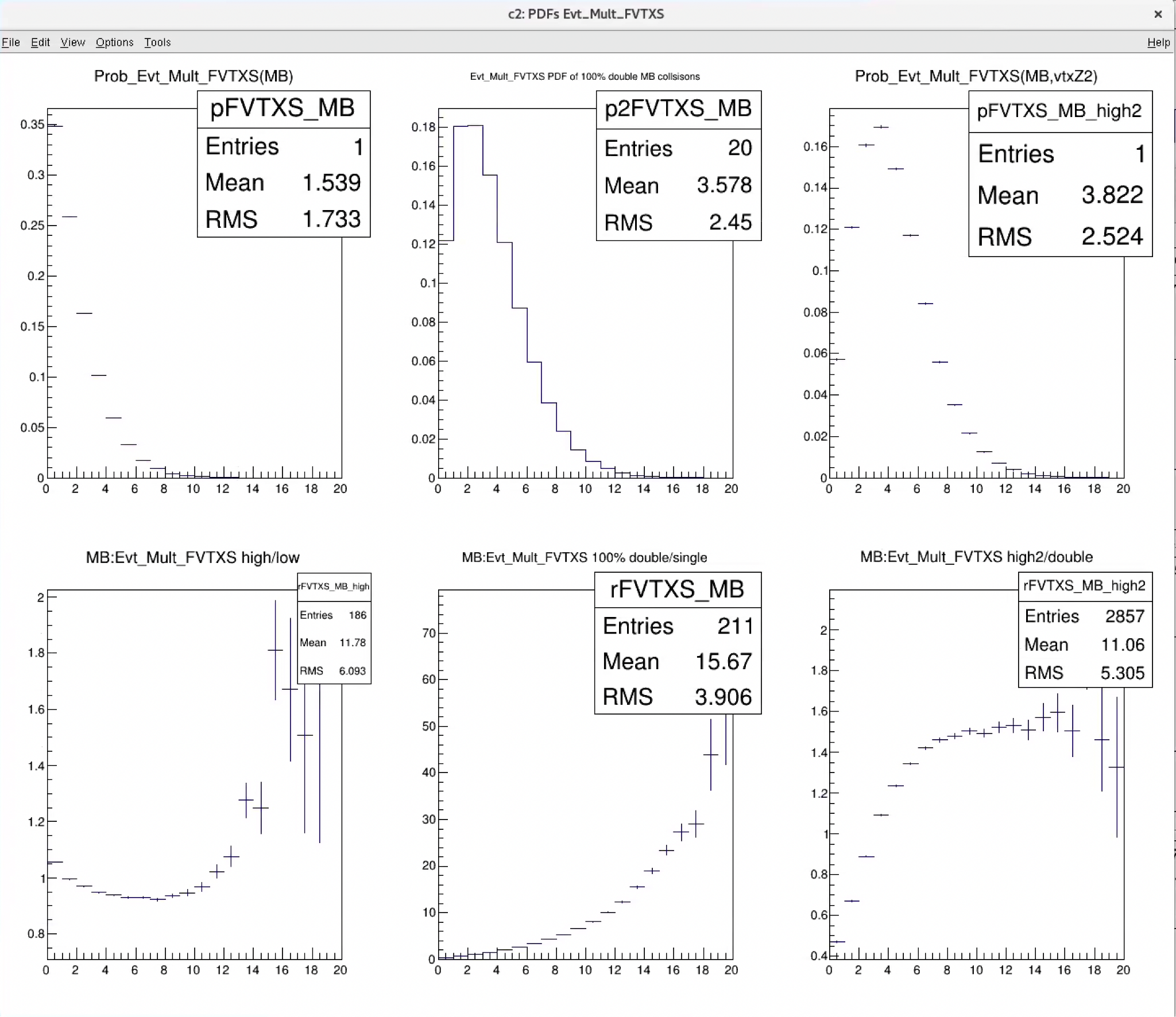
Evt_Mult_FVTXS: (MB,low), (Double_PDF),(Evt_vtxZ2)
1) Low BBC (<500kHz), mostly single collisions (>99.5%);
2) Estimate double collision PDF2x using “single collision” PDF from 1);
3) PDF2 from reconstructed/identified double collision events:
R1 = PDF(>1.5MHz)/PDF(<0.5MHz)
R2 =PDF2x/PDF
R3 =PDF2/PDF2x
- More double collisions reconstructed close to primary collision vtx (Z=+/-10cm)
- treat as systematic, +/-50%
PDF
PDF2x
PDF2, reco’d double
|Evt_vtxZ2|<100cm
R3:
PDF2/PDF2x
R1:
PDF(Hi)/PDF(Low)
R2: 100% double
PDF2x/PDF(Low)
Evt_Mult_FVTXS
Evt_Mult_FVTXS
Evt_Mult_FVTXS

Slide 12
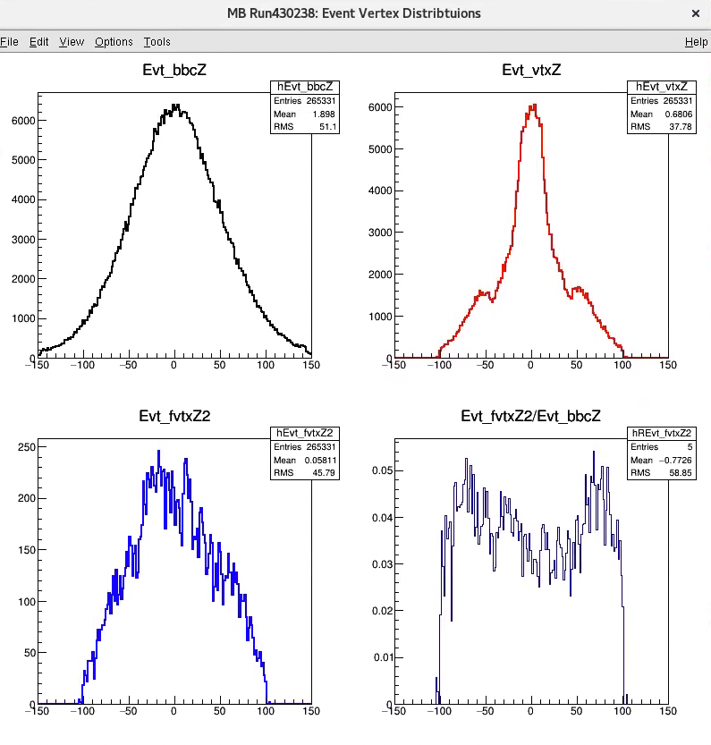
Cross Check Event Vertex Distributions:
MB1: BBCLL1(novtx)
Z_Sigma = 51cm
BBC_Rate = 1.24 MHz
@1.2 MHz, mu = 0.24,
prob 2.7 % having double collision
For |Evt_vtxZ| < 10cm events
Double collusion fraction ~3%, very close to the 2.7% estimated double collision fraction
2nd vtxZ distribution ~ BBC_Z
All BBC_Z
|Evt_vtxZ|<10 cm
2nd Evt_vtxZ2

Slide 13
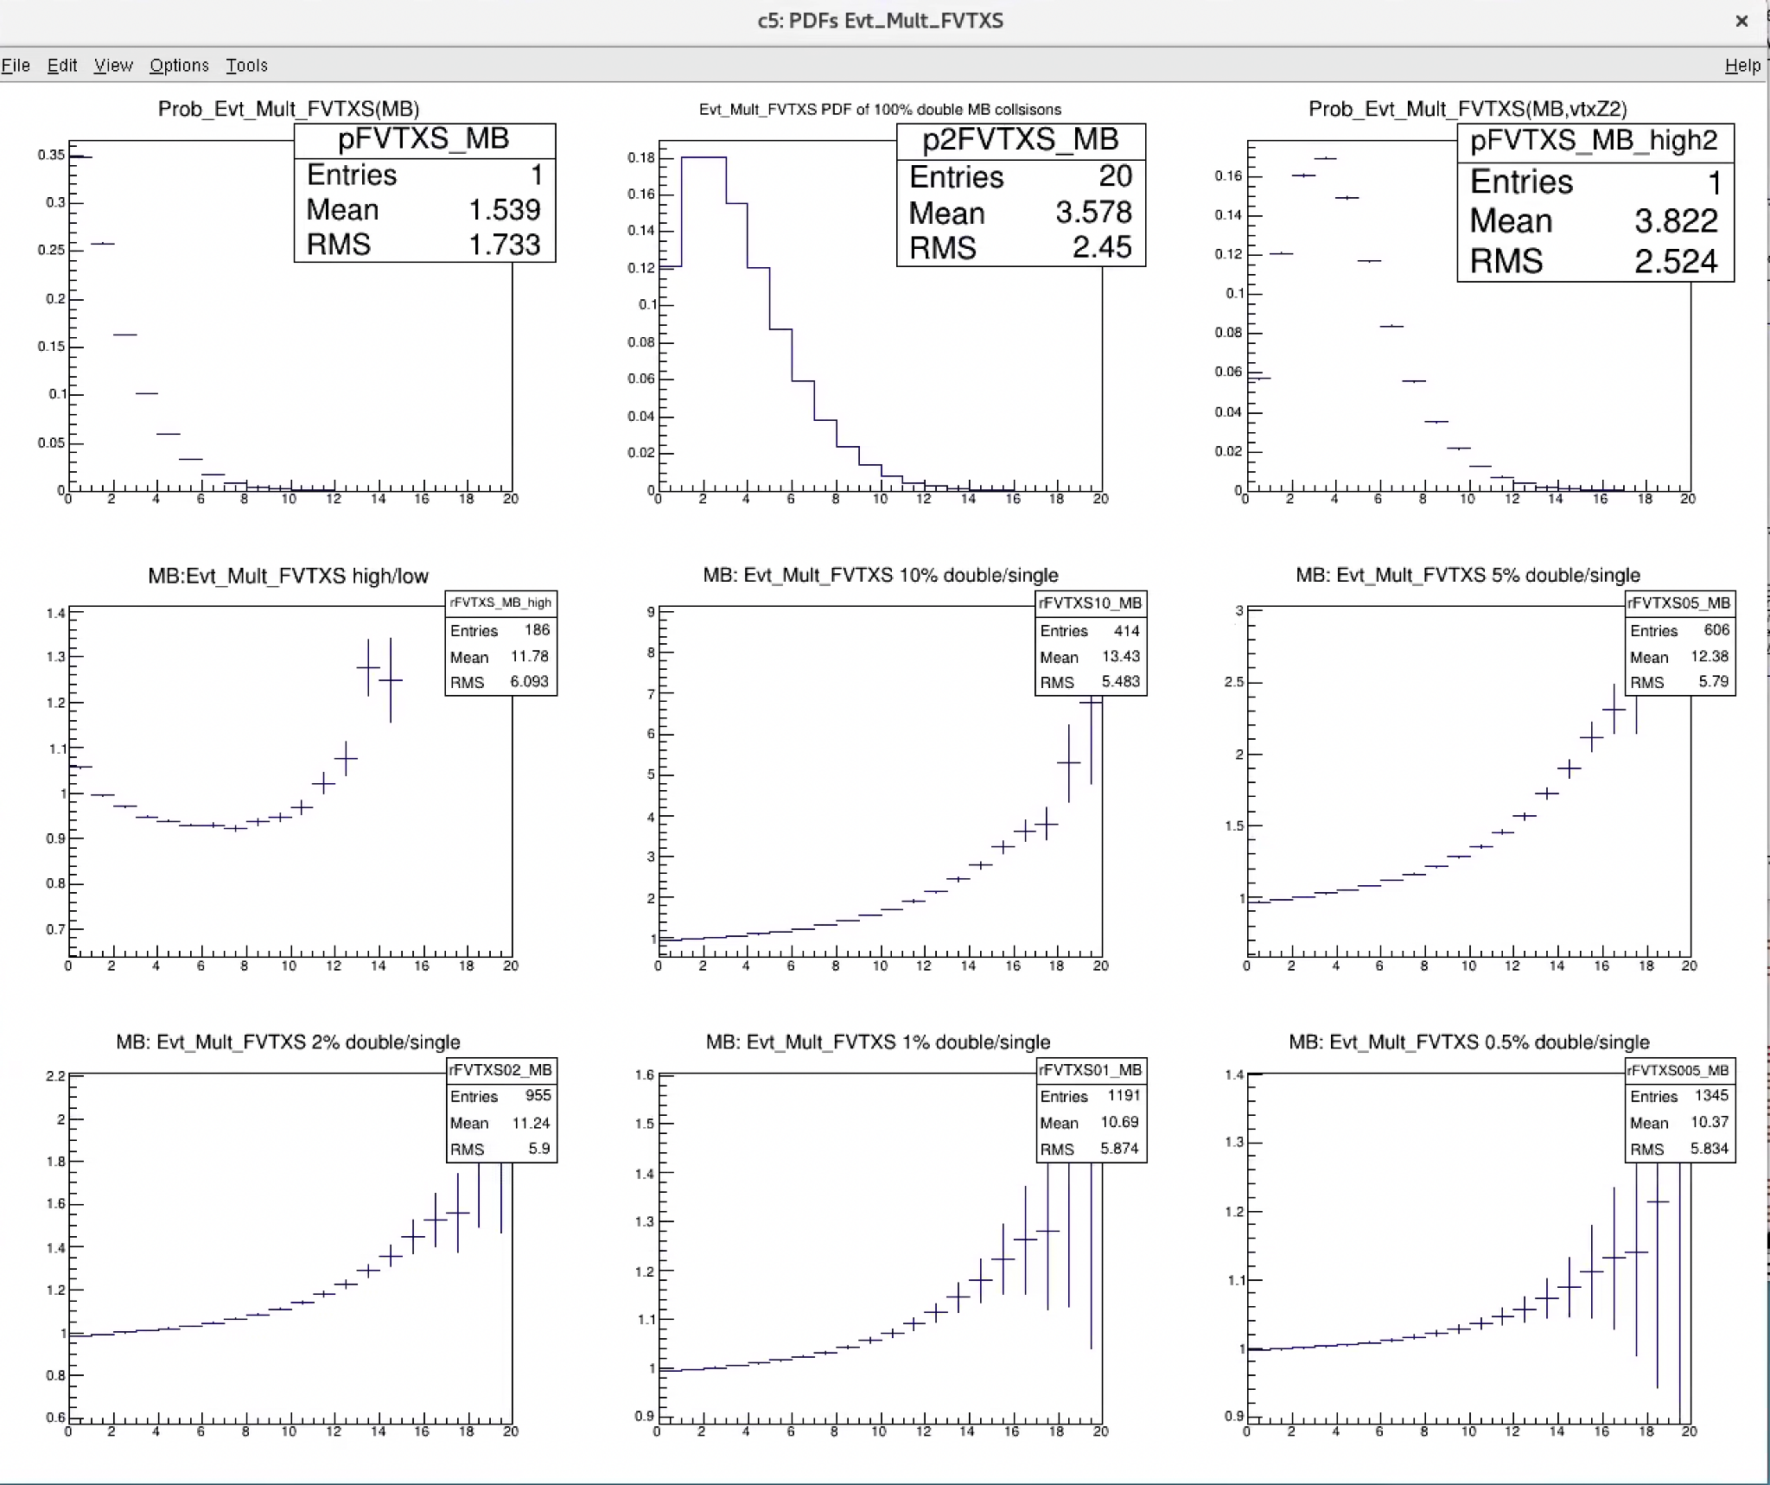
Evt_Mult_FVTXS
1. FVTXS PDF (BBC<0.6MHz)
2. Computed Double_PDF
3. PDF2: Double collision events with Evt_vtxZ2
4. PDF(high BBC)/PDF(low BBC)
5. PDF of Comp. 10% mix of double collisions
6. PDF of Comp. 5% mix of double collisions
7. PDF of Comp. 2% mix of double collisions
@~ 1.0MHz
8.PDF of Comp. 1% mix of double collisions
9.PDF of Comp. 0.5% mix of double collisions
The average FVTXS/N double collision correction factor < 5% at FVTX_S = 6;
normalized Evt_Mult_FVTXS
= 6/<1.5> = 4; ⇒ 4 times of mean
Make correction and assign systematic uncertainty, +/-50% of (5%)
2% doubles;
Corr. < 5%
1% doubles;
Corr. < 2%
0.5% doubles;
Corr. < 1%

Slide 14
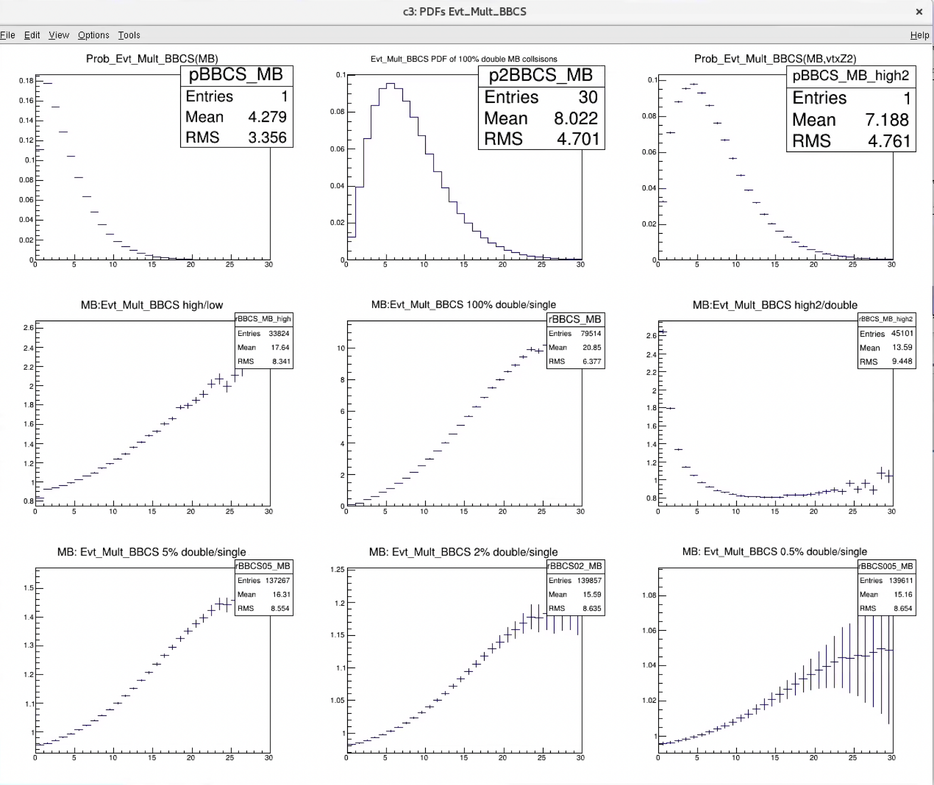
Evt_Mult_BBCS:(MB,low), (Double_PDF),(Evt_vtxZ2)
PDF, Low BBC_Rate, < 600kHz
Computed Double_PDF
PDF2, with |Evt_vtxZ2| < 100cm
R=PDF(BBC_high, 2MHz)/PDF(BBC_low)
R=Double_PDF/PDF
R=PDF2/Double_PDF
R = 5% double collisions
R = 2% double collisions (averaged rate of all runs)
R = 0.5% doubles
PDF
PDF2x
PDF2
~7% double collisions
The average BBCS/N double collision correction factor < 5% at BBCS = 10;
normalized Evt_Mult_BBCS
= 13/<4.2> = 3, 3 times of <mean>
~2% double collisions
Correction factor <5%

Slide 15
Other Run/Event Selection Optimization
FVTX/SVX acceptance vs Evt_vtxZ
Good run selection

Slide 16
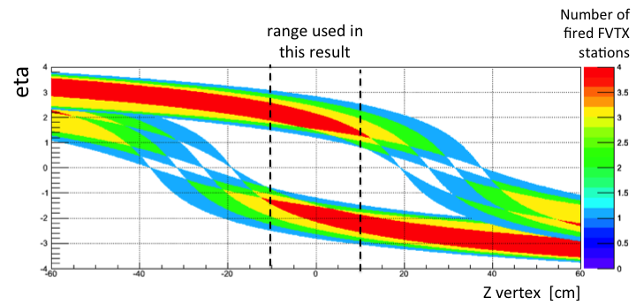
Collision vertex-Z dependent Acceptance: FVTX
|Evt_vtxZ|< 10cm
1 < |fvtx_eta| < 3
From analysis note: 1180

Slide 17
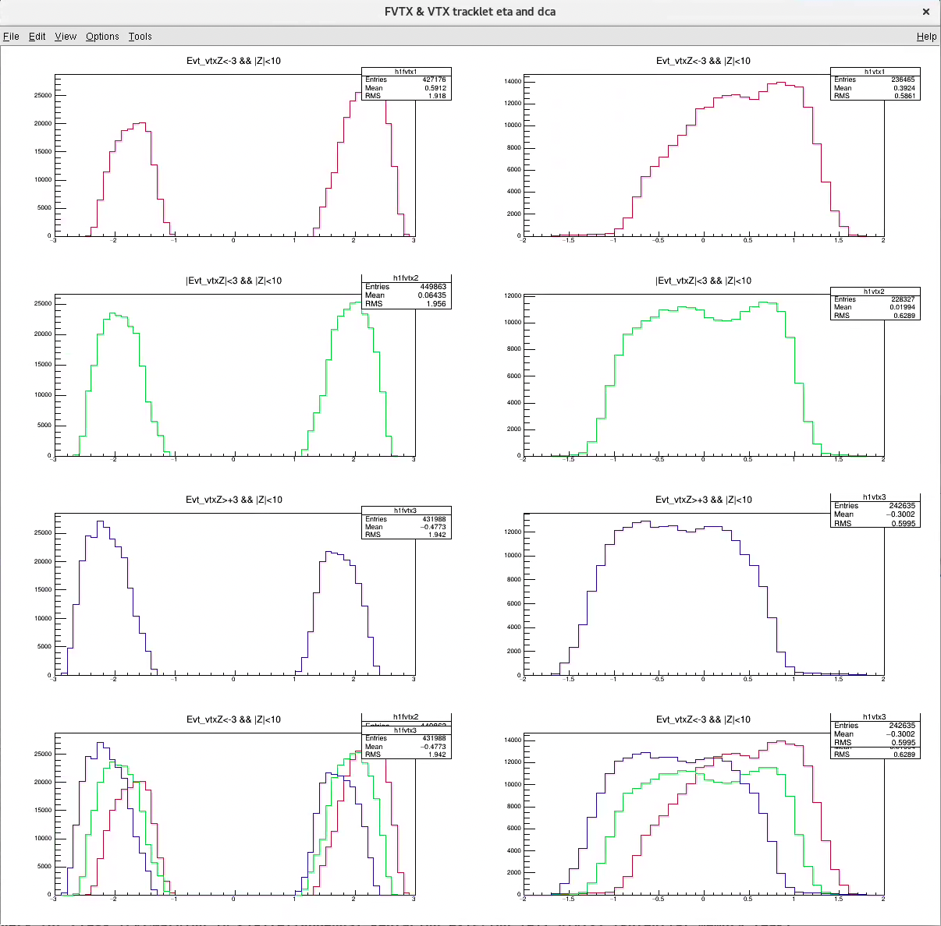
FVTX and SVTX Acceptance vs Evt_vtxZ
Z < -3cm
FVTX
SVX
For |Z| < 10 cm
FVTX: 1.4 < |eta| < 2.4
SVX: |eta| < 1.0
But one could use the fullo acceptance as long as we use the same runs for MB and MU events;
Don’t see much difference of two selections:
1.4 < |eta| < 2.4
1.0 < |eta| < 3.0 → prefered for statistics
-3< Z < +3cm
Z > +3cm

Slide 18
To Do’s – in next a few days
Update the plots, with final good run and event selection;
Already have the good run lists from Sanghoon’s run15 pp/pA analysis;
Consider to remove double collision events, ~85% efficient, to further reduced the bias from double collision;
No correction, just assign smaller systematic
Also the bias correction factor is similar for MB and J/Psi, thus most of them canceled out in the ratio
~2% double collision ===> < 0.3% negligible contribution
p+Au: double collision negligible, well within other uncertainties
Update the analysis note, prepare for preliminary:
Relative differential yield vs normalized event multiplicity

Slide 19
Backup slides

Slide 20
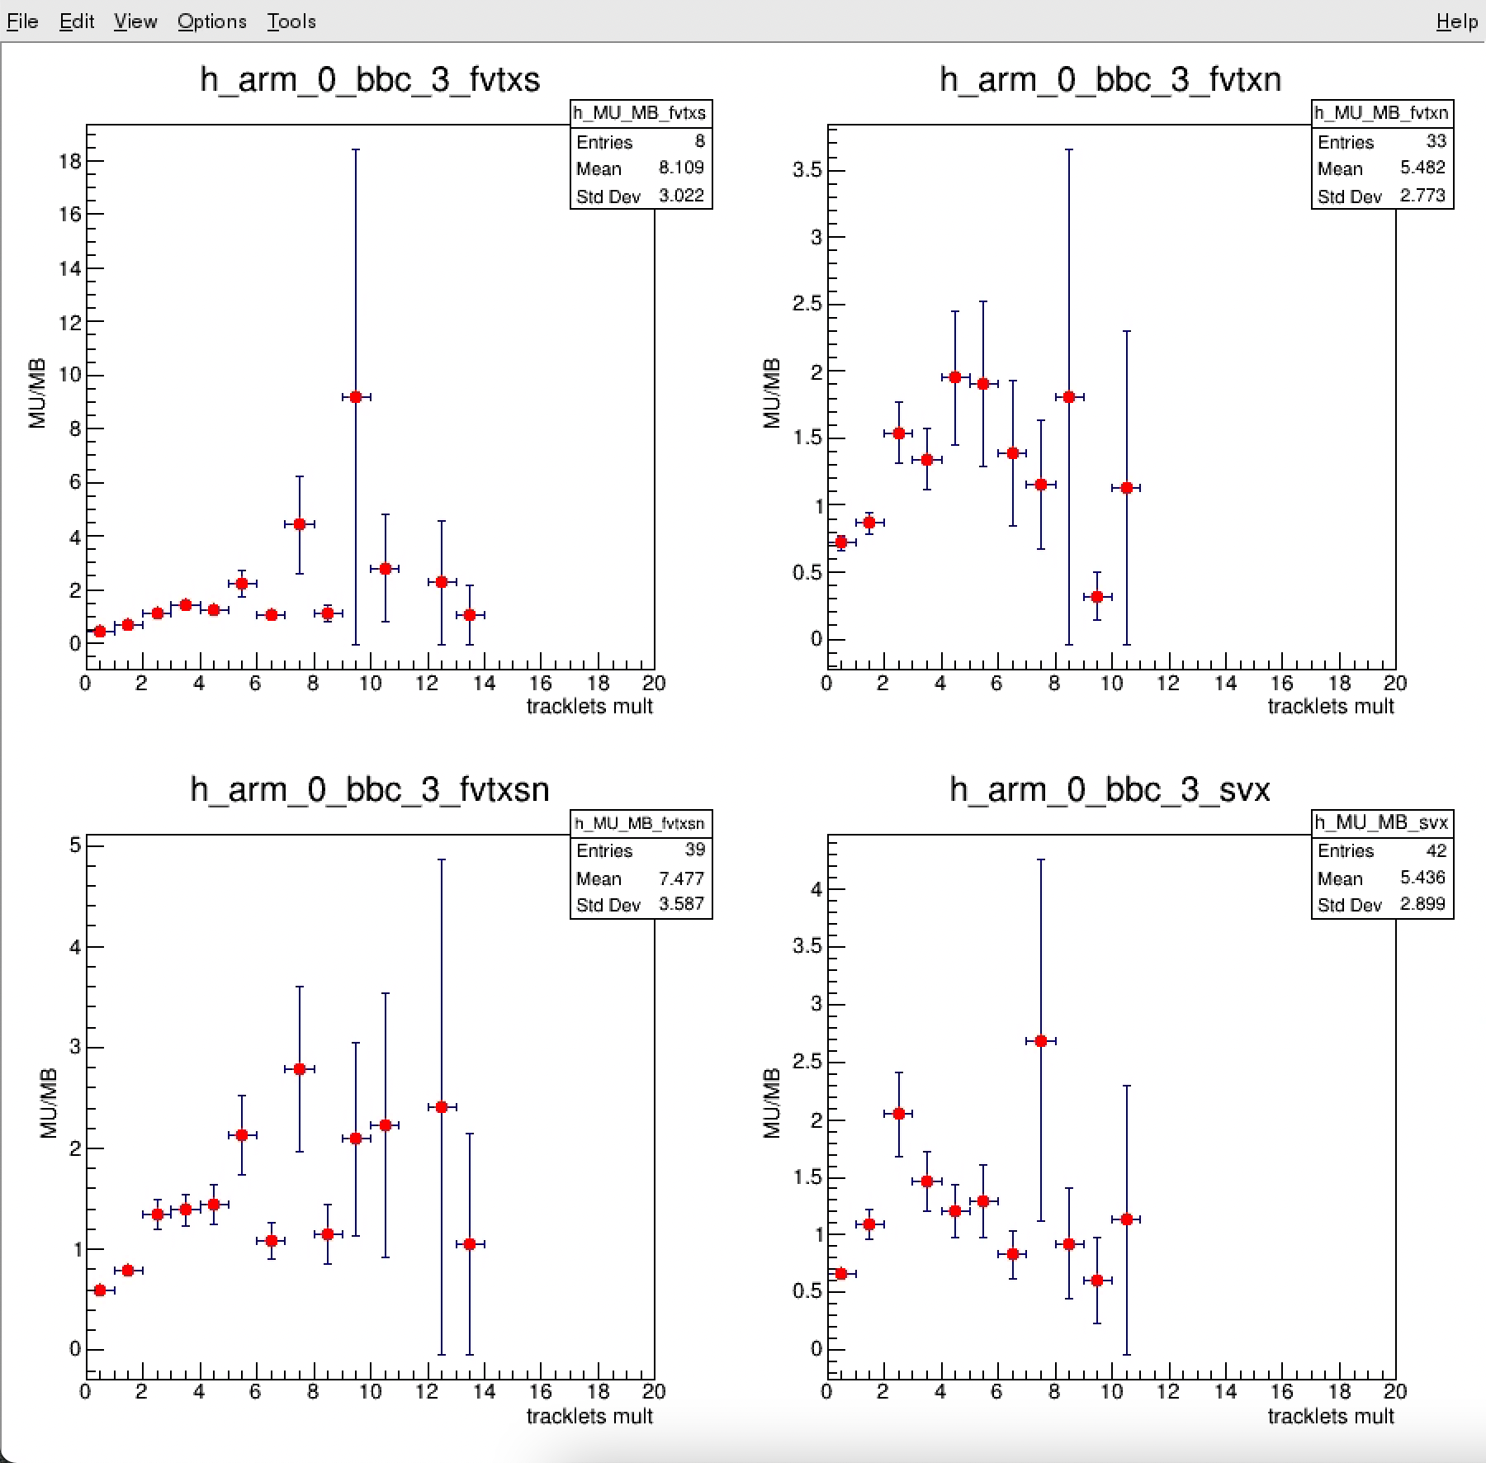
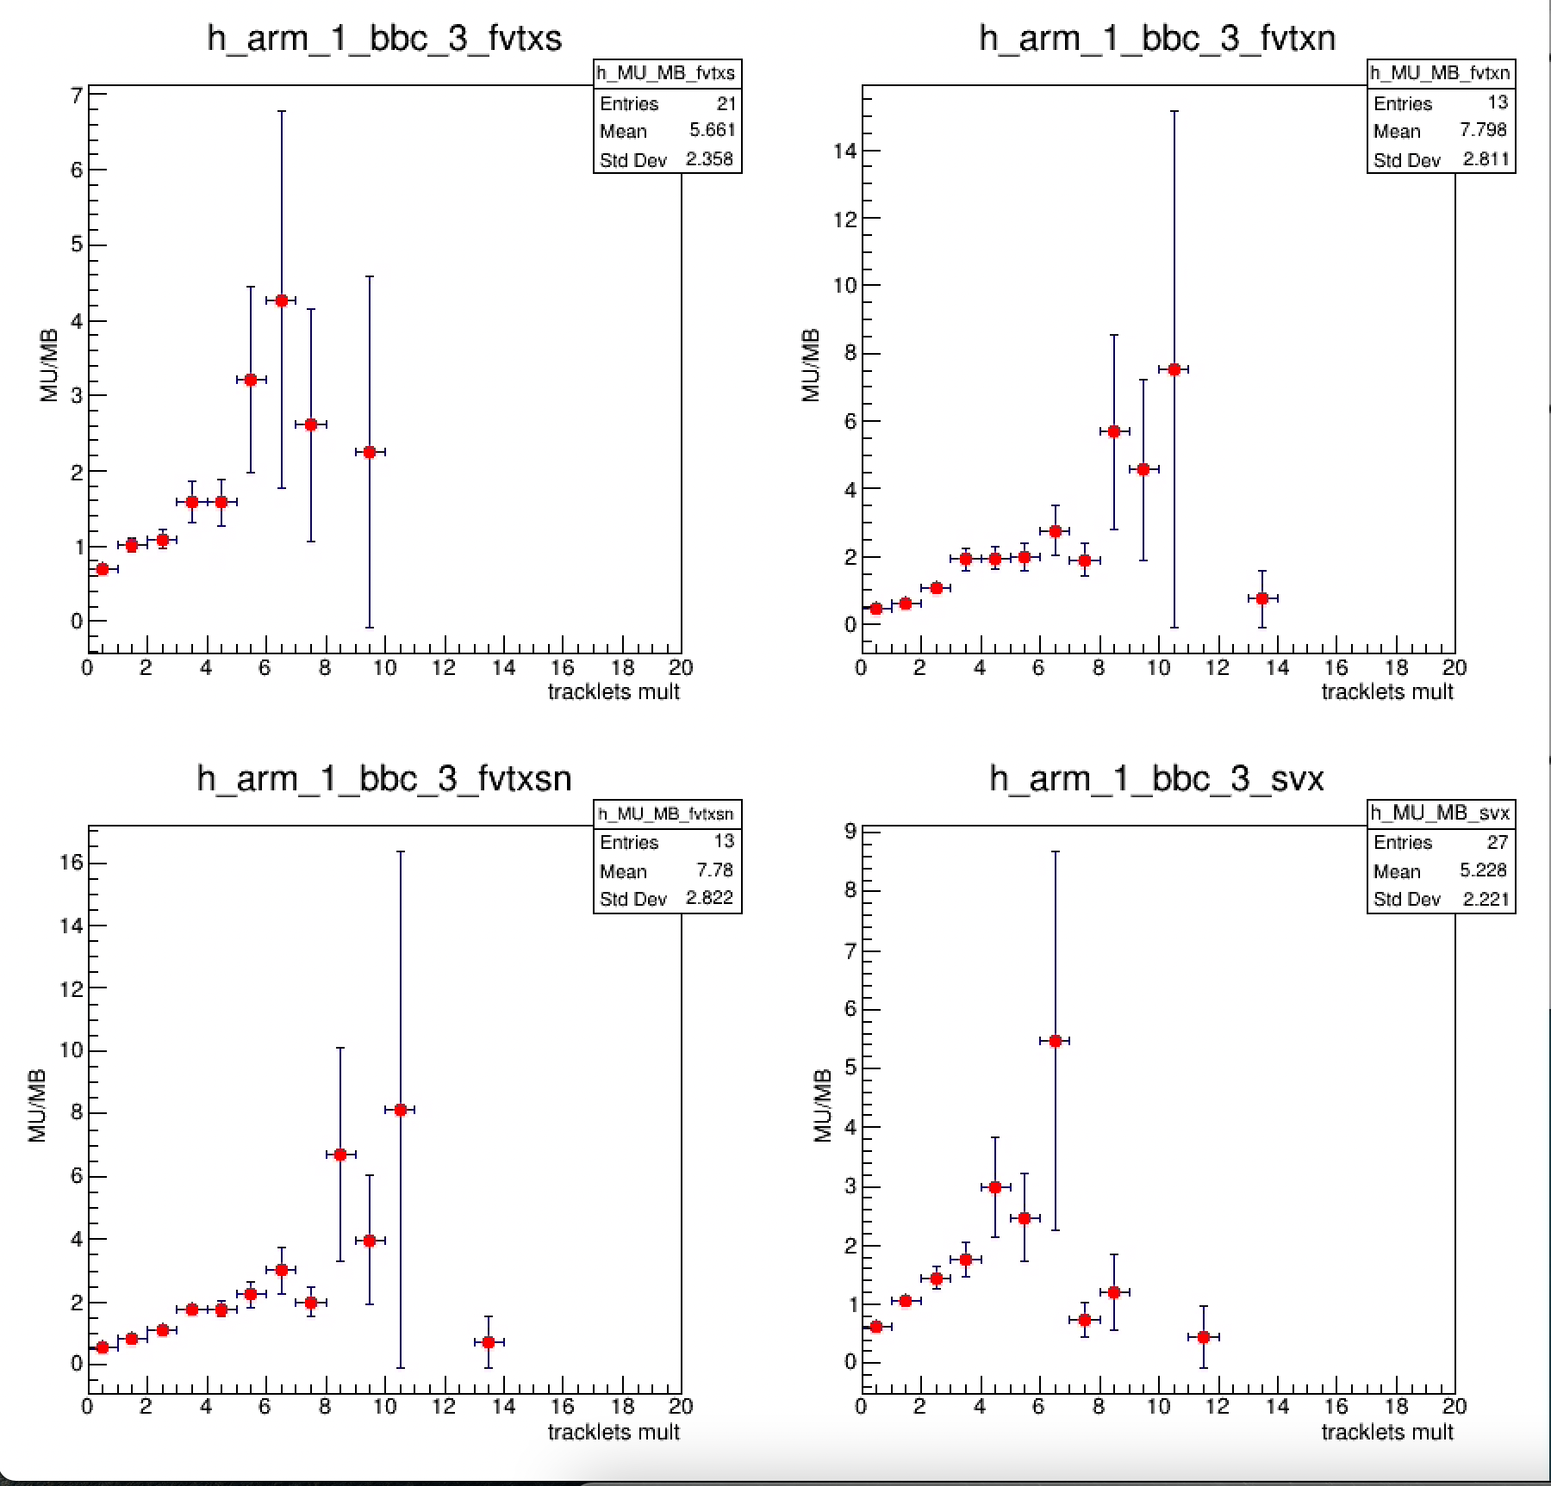
Normalized – work in progress

Slide 21
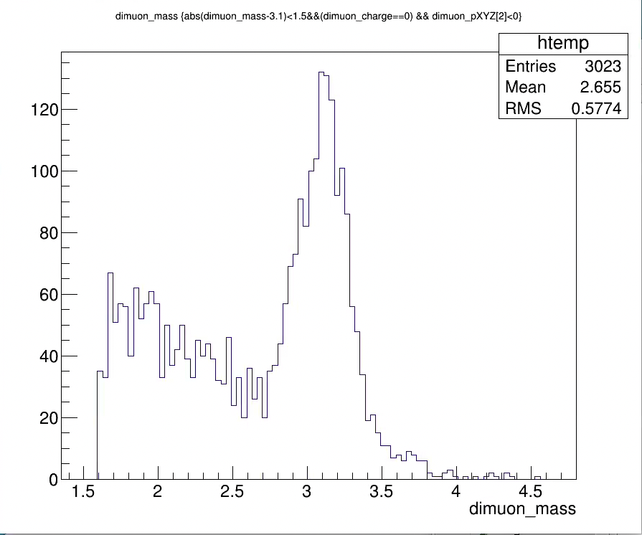
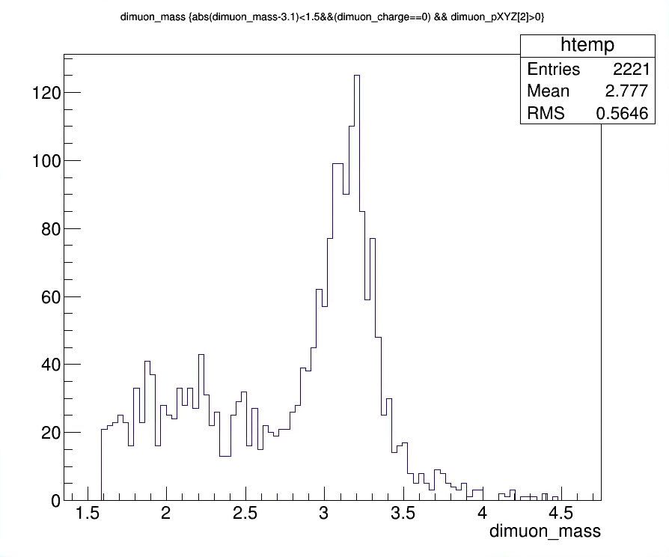
Run15pp: J/Psi Measured in South and North Arms

Slide 22
Run15pAu taxi outputs: 09/27/2021
MU data:
/gpfs/mnt/gpfs02/phenix/fvtx/subsys/fvtx/mxliu/taxi/Run15pAu200CAMUPro108/17768
MB data:
/gpfs/mnt/gpfs02/phenix/fvtx/subsys/fvtx/mxliu/taxi/Run15pAu200CAMBPro108/17755

Slide 23
Run15pp taxi outputs: 08/24/2021
MU data:
/gpfs/mnt/gpfs02/phenix/spin/spin1/phnxsp01/mxliu/taxi/Run15pp200CAMUP108/17697/data/
MB data:
/gpfs/mnt/gpfs02/phenix/spin/spin1/phnxsp01/mxliu/taxi/Run15pp200CAMBP108/17698/data

Slide 24
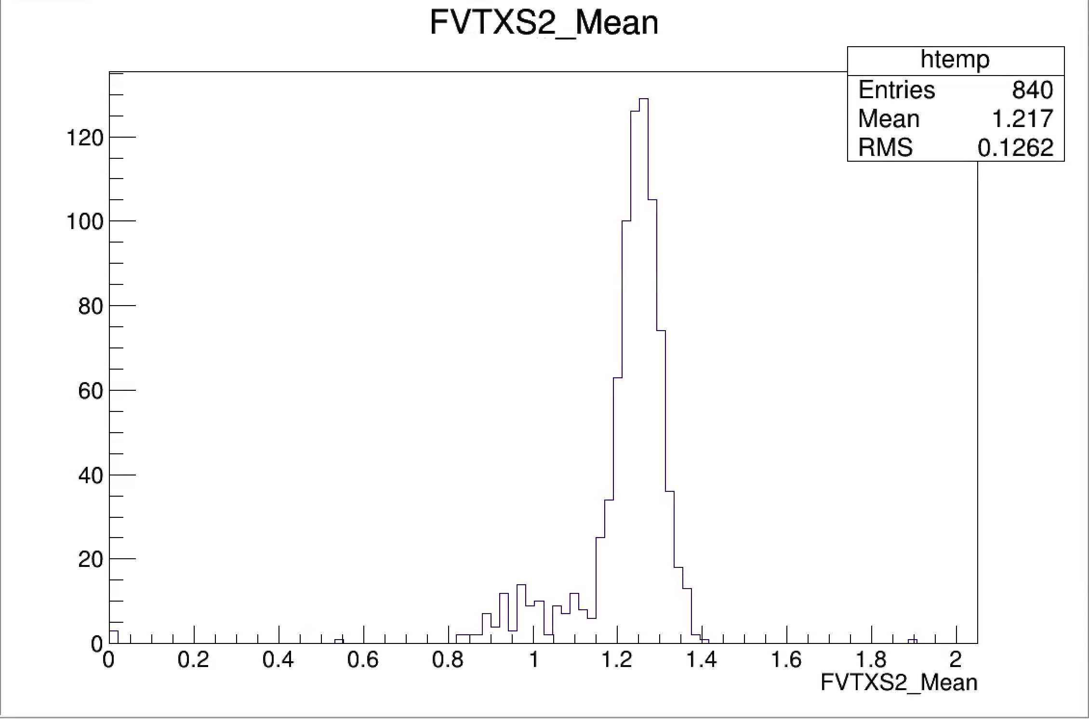
Run15 pp MB events
<FVTXS> = 1.5
<FVTXS2> = 1.3

Slide 25
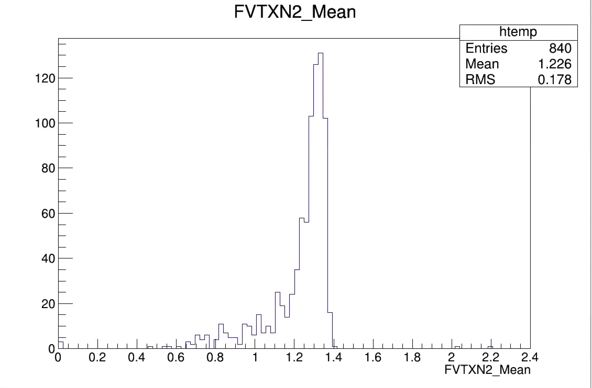
Run15 pp MB
<FVTXN> = 1.5
<FVTXN2> = 1.3

Slide 26
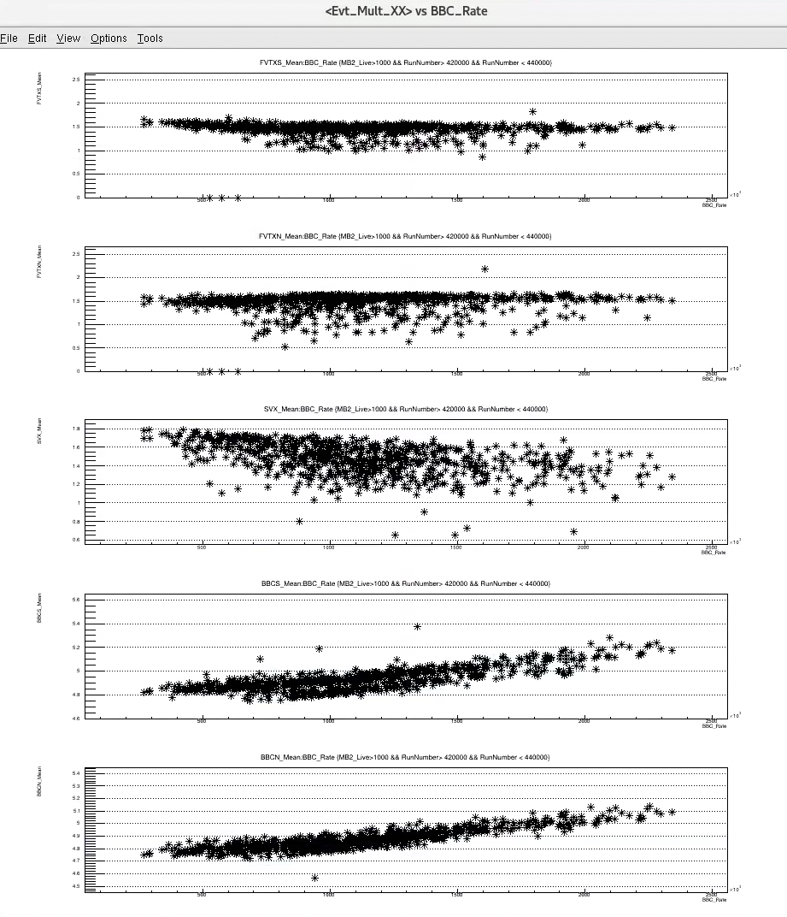
<Evt_Mult_FVTX/SVX/BBC> vs BBC_Rate:
- all 840 runs
Evt_Mult_FVTXS
<Evt_Mult_FVTX/SVX>:
flat vs BBC_Rate
Tracklets from double collision mostly rejected by dca_r cut (<0.2cm) and Evt_vtxZ2
Evt_BBC:
clear trend vs BBC_Rate
Contributions from double collisions
Evt_Mult_FVTXN
Evt_Mult_SVX
Evt_Mult_BBCS
(show Evt_Mult_BBC vs BBC_Rate, after Evt_vtxZ2 cut)
Evt_Mult_BBCNS

Slide 27
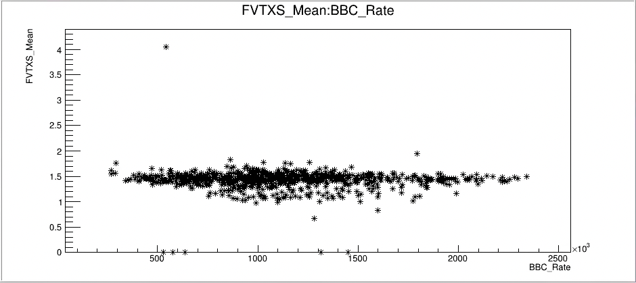
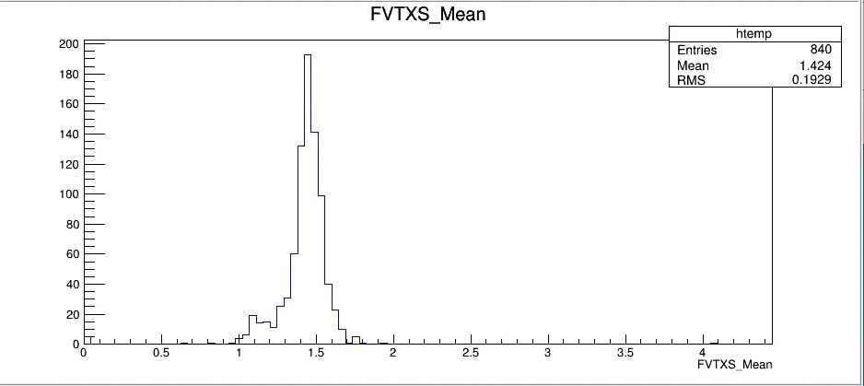
Evt_Mult_FVTXS: 1.3 < FVTXS < 1.7
Bad runs:

Slide 28
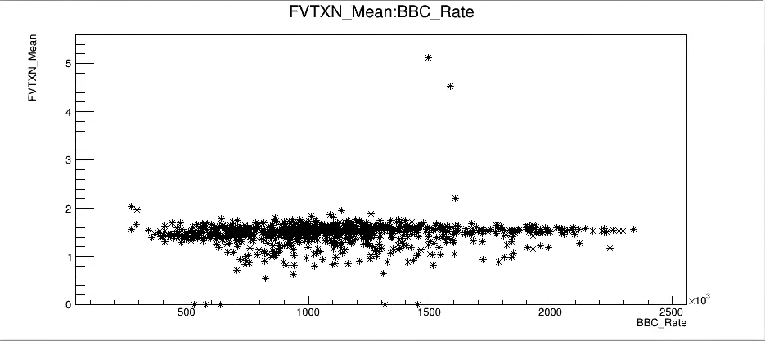
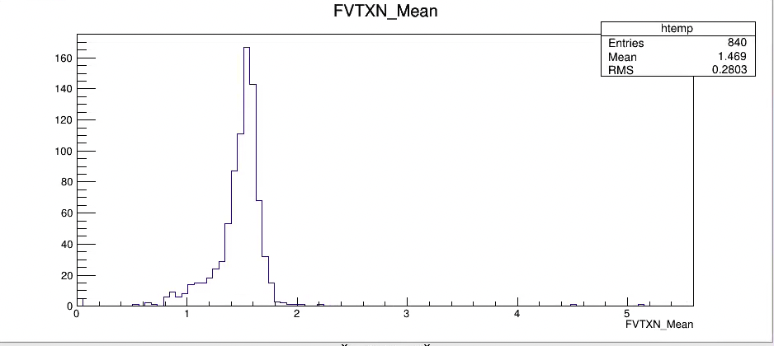
Evt_Mult_FVTXN: 1.3 < FVTXN < 1.7
Bad runs:

Slide 29
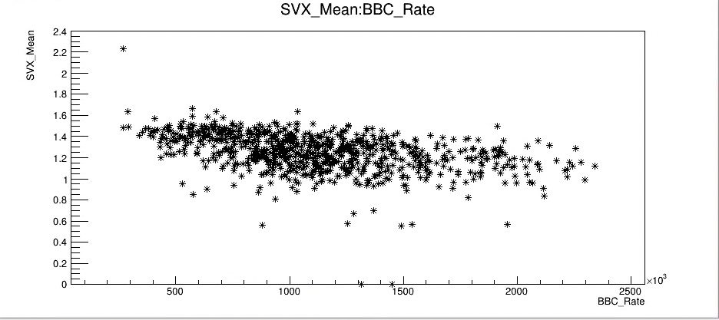
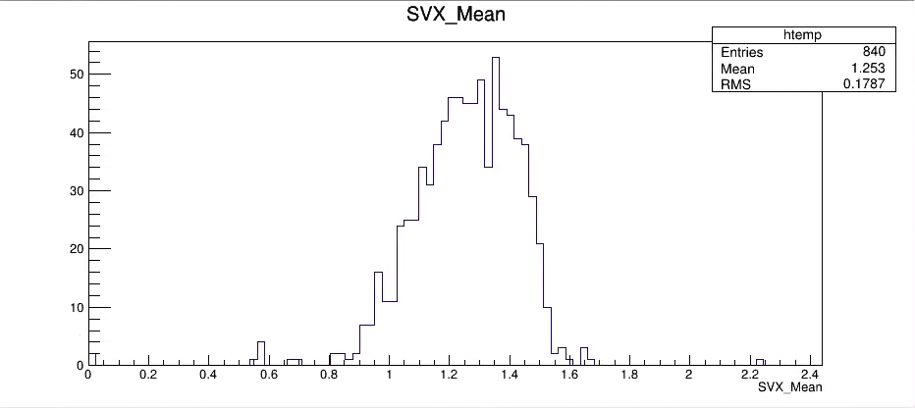
Evt_Mult_SVX: 0.8 < SVX < 1.6

Slide 30
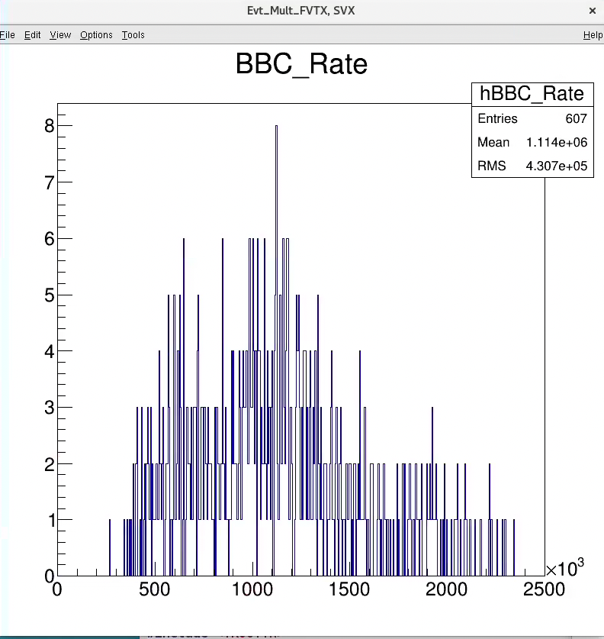
Run15pp MU good and bad run lists:naRun_SelectRun_v2.C
/fvtx/run15pp/run15pp_v10_MU_Evt_Mult_FVTXSVX_goodRun_list.txt
607 good runs
/fvtx/run15pp/run15pp_v10_MU_Evt_Mult_FVTXSVX_BadRun_list.txt

Slide 31
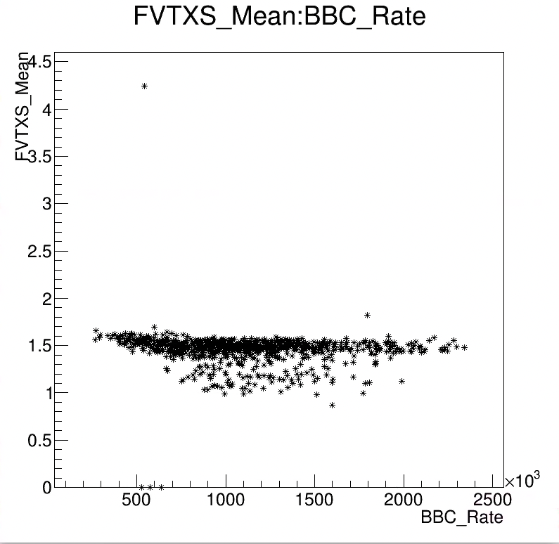
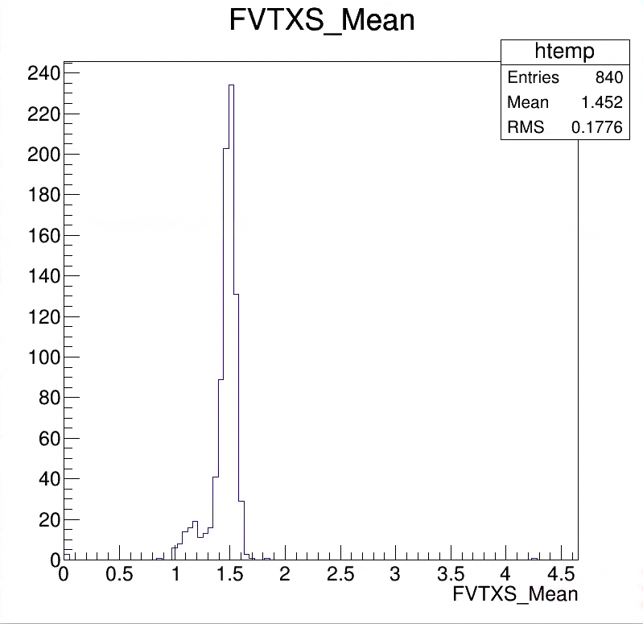
MB v10 events: anaRun: 1.3 < FVTXS < 1.7

Slide 32
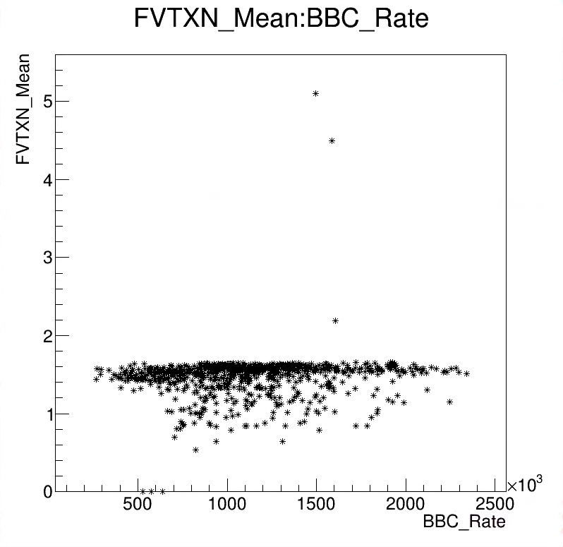
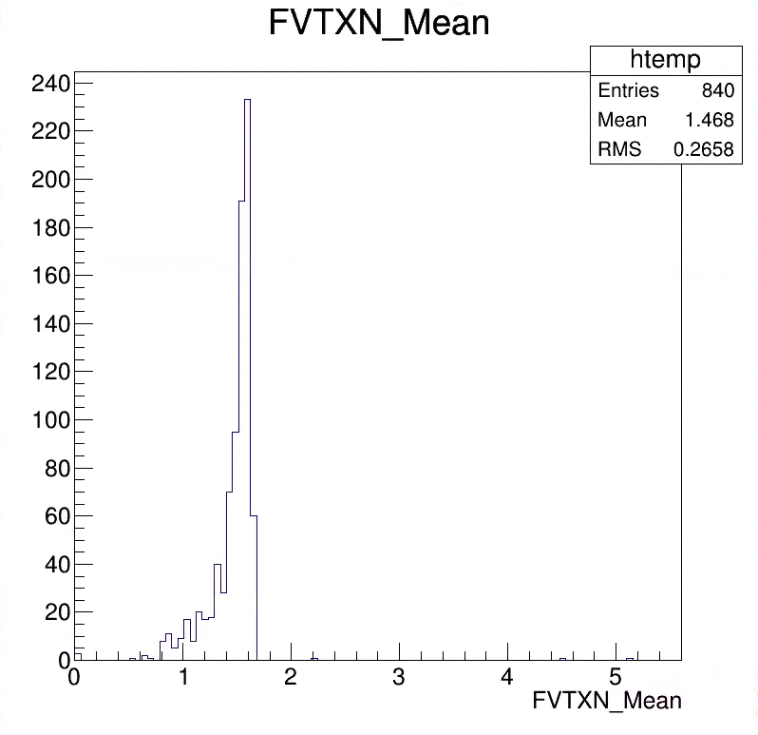
MB v10 events: anaRun: 1.3 < FVTXN < 1.7

Slide 33
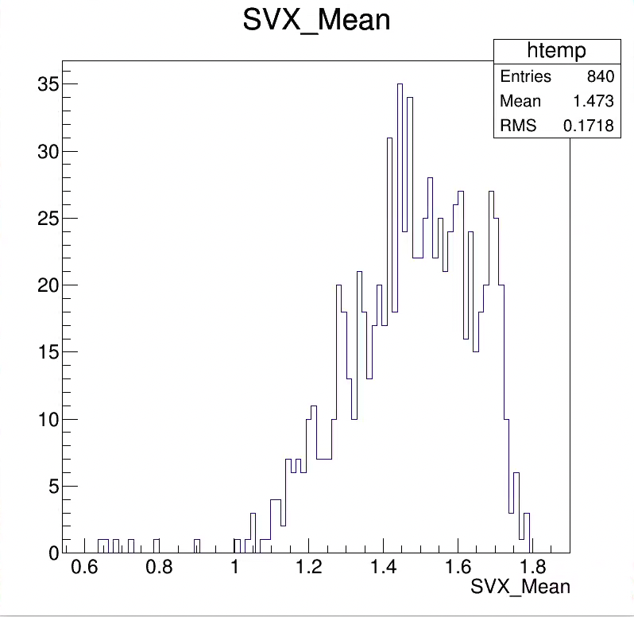
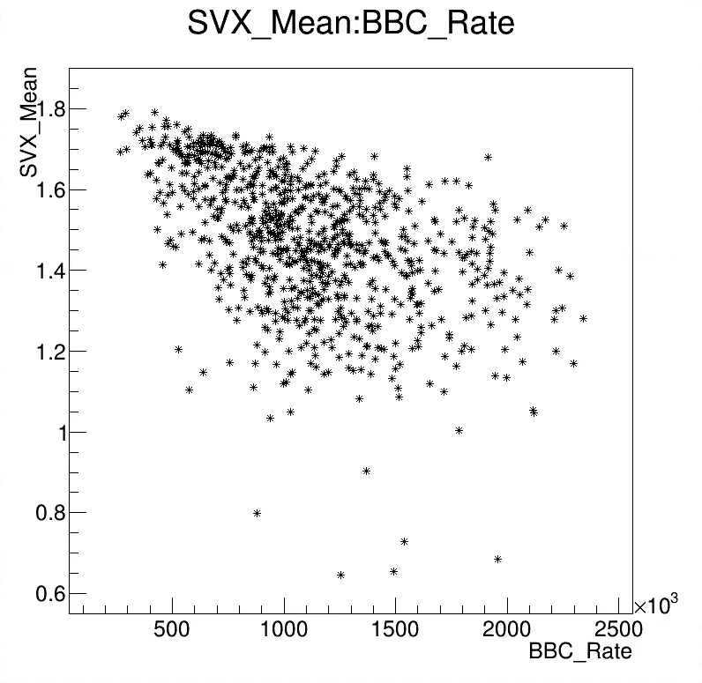
MB v10 events: anaRun: 1.0 < SVX < 1.8

Slide 34
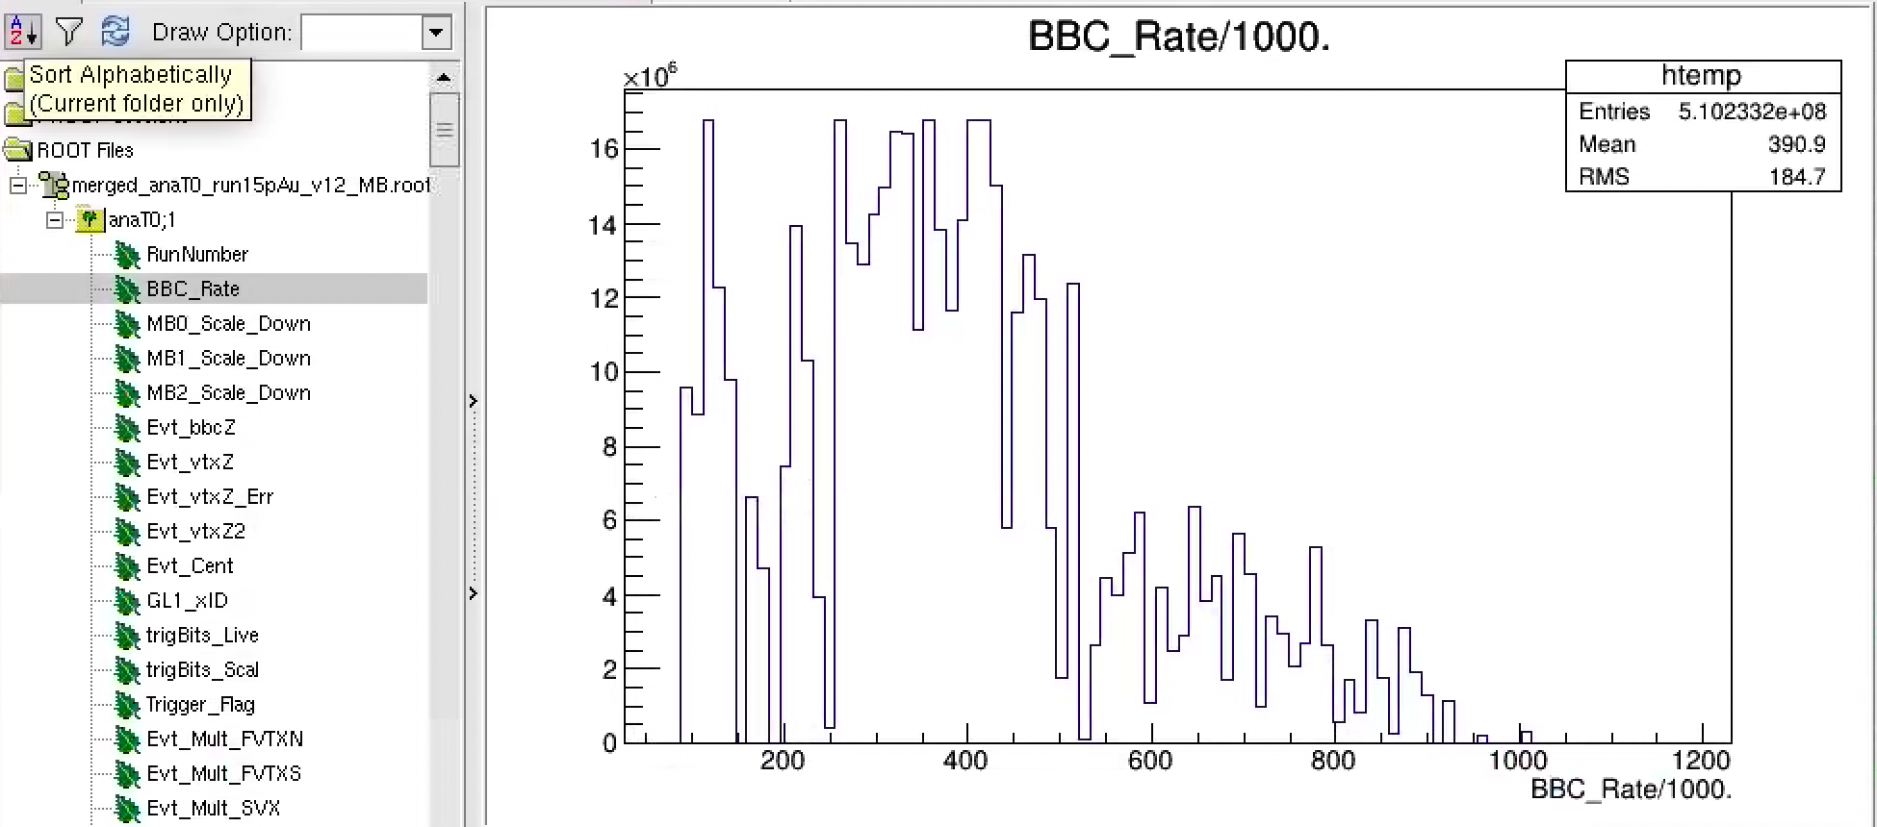
Run15 pAu:
MB BBC_rate: AVG = 390 kHz, ~0.2% of double collision
Evt averaged <BBC_Rate_Mean> = 390kHz
Run averaged <BBC_Rate_Mean> = 480kHz

Slide 35
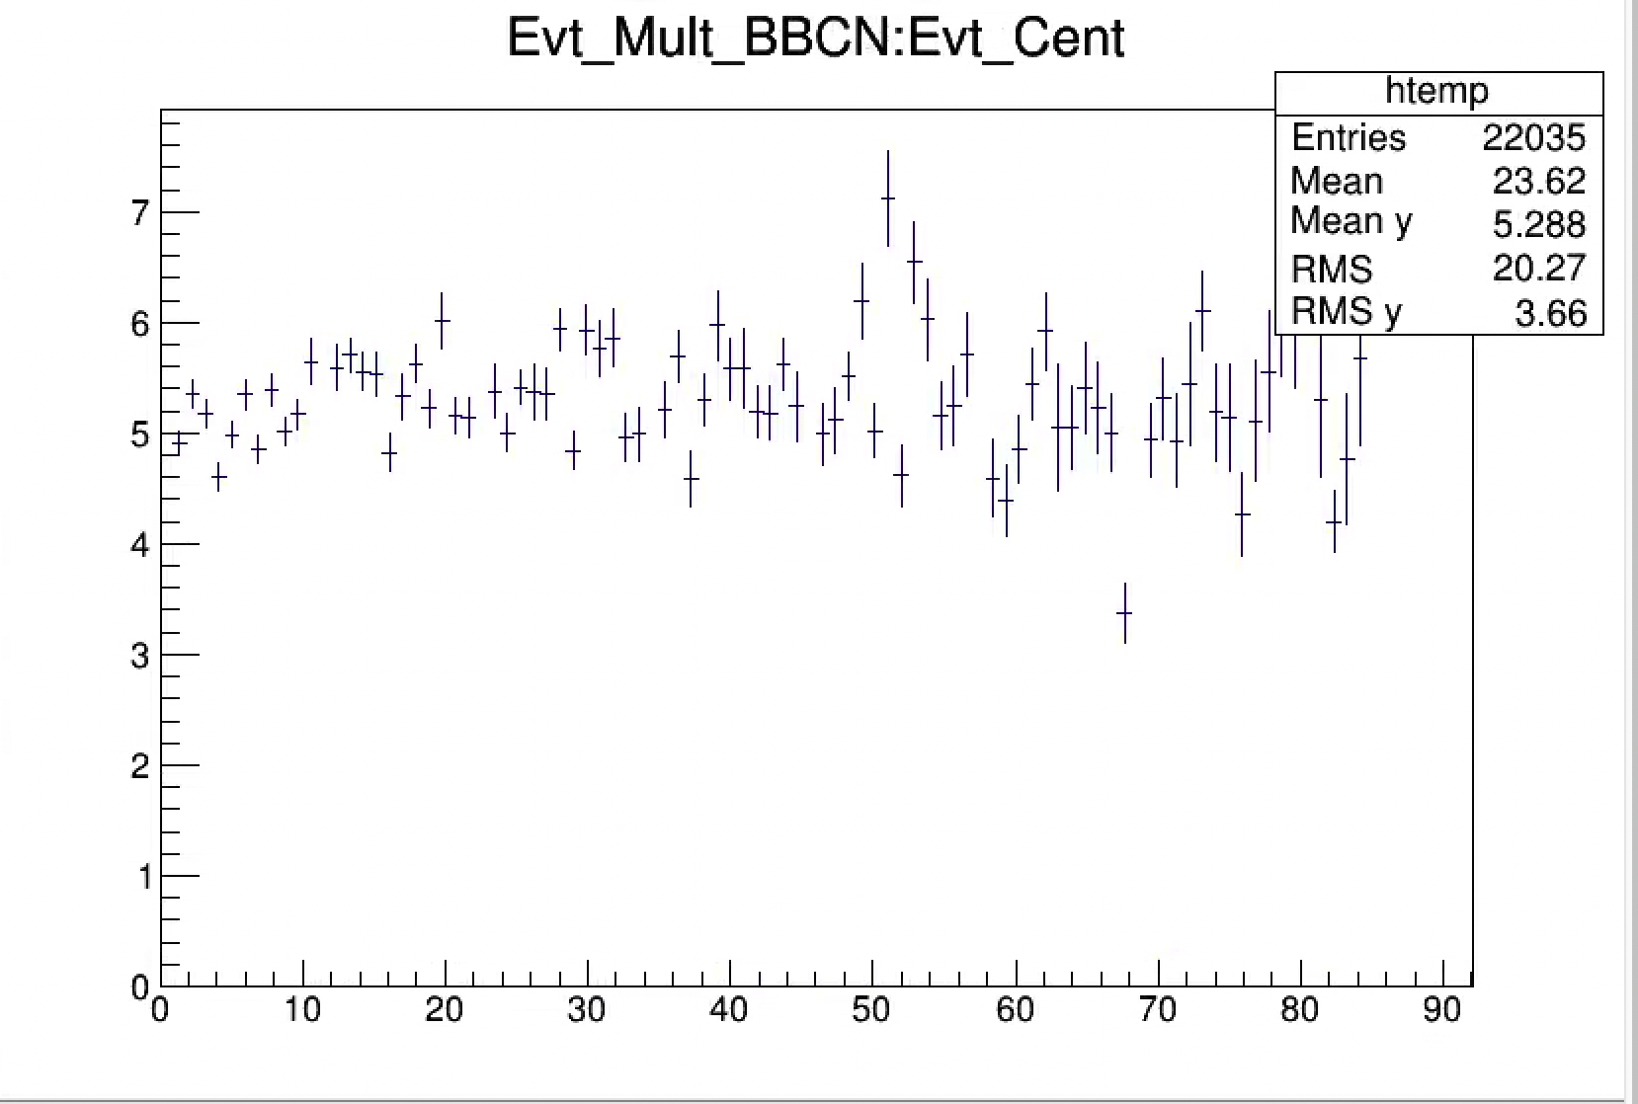
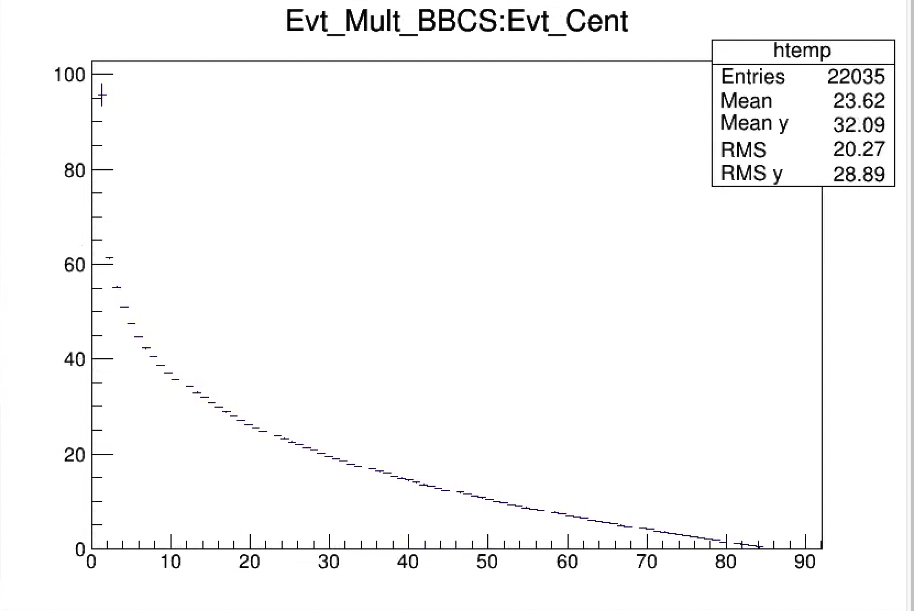
Trigger Bias and Event Multiplicity, run15 pAu, MB
BBCLL1 trigger

