Slide 1
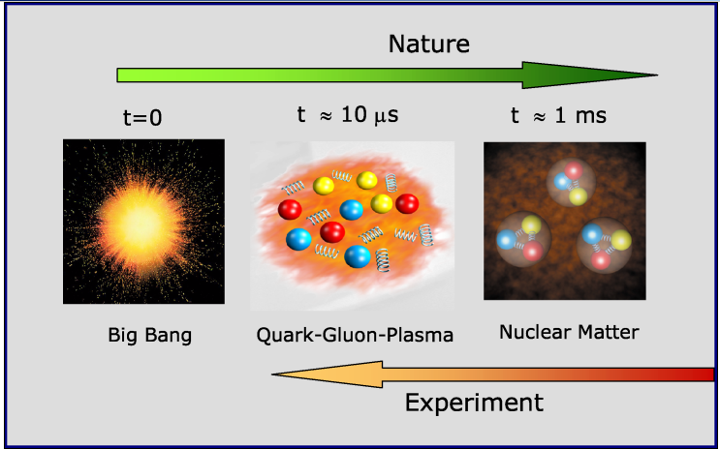
US Nuclear Physics Long Range Plan (2015)
- High energy nuclear physics, Ming X. Liu @P-25
Nuclear matter under extreme condition: Quark Gluon Plasmas (QGP) physics
Nucleon structure with quarks and gluons and QCD dynamics: novel phenomena in strong interaction
The origin of visible mass: >99% of the visible Universe
Hot QCD Matter – “recreate” the Big Bang in the Lab
Cold QCD Matter – structures & dynamics of QCD
High energy A+A collisions:

Slide 2
The sPHENIX Experiment at BNL
A new opportunity to study novel QCD matter and dynamics at the Relativistic Heavy Ion Collider at BNL
Relativistic Heavy Ion Collider at BNL
Hot QCD matter – QGP
The DOE NP flagship heavy ion physics program (LRP2015) “understanding the inner workings of QGP”
Under construction, day-1 physics 2023
Novel Cold QCD matter & dynamics
- Under active development, with detector upgrade
Nucleon/Nucleus structures & QCD dynamics
Why LANL?
A long history of leading major NP experiments,
including the sPHENIX heavy quark physics program,
“LANL flagship experimental capabilities”(LDRD’18)
Unique experimental and theoretical capabilities,
world-leading experts in physics
Bring in talents & new capabilities to LANL
July 2019

