Slide 1
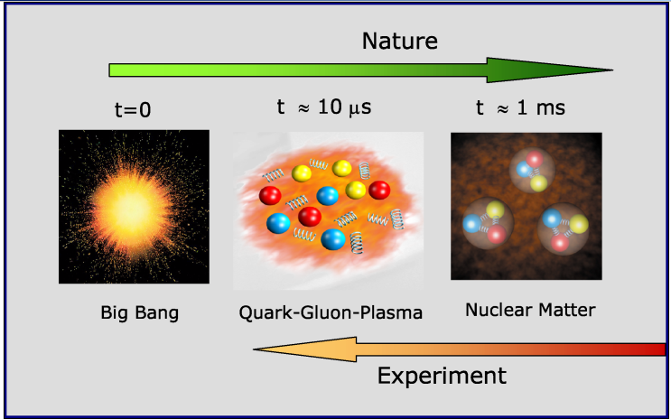
US Nuclear Physics Long Range Plan (2015)
- High energy nuclear physics, Ming X. Liu @P-25
Nuclear matter under extreme condition – quark gluon plasmas physics
Nucleon structure with quarks and gluons and QCD dynamics – novel phenomena in strong interaction
The origin of visible mass – 99% of the visible Universe

Slide 2
sPHENIX@RHIC: a new opportunity to study novel QCD matter and dynamics at the Relativistic Heavy Ion Collider at BNL
Hot QCD matter – QGP
- Well developed, DOE flagship heavy ion program (LRP2015) “understanding the inner workings of QGP”
Novel Cold QCD matter & dynamics
- Under active development, with detector upgrade
- Complementary to the EIC - the next US QCD facility
Relativistic Heavy Ion Collider at BNL
Fundamental QCD prediction:
“sign change” in jet production: p+p(sPHENIX) vs DIS(EIC)

