Slide 1
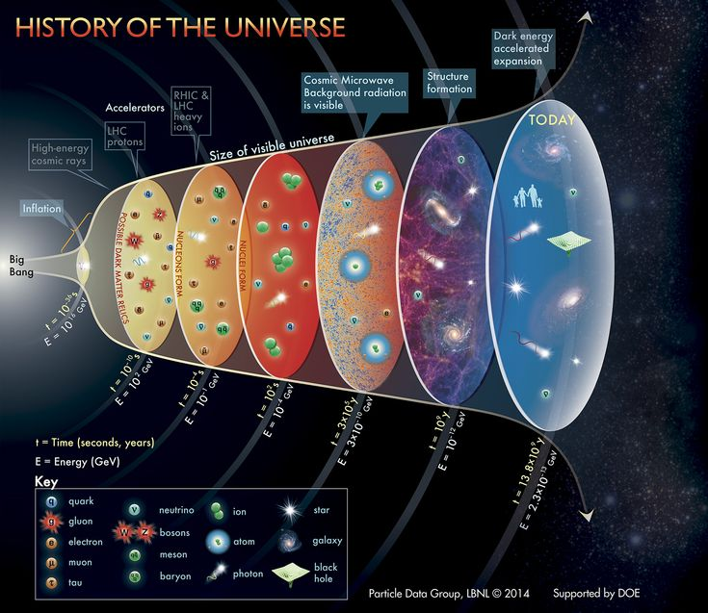
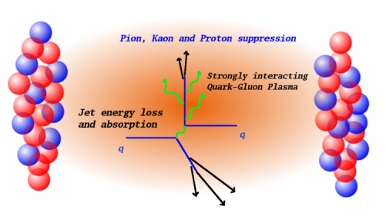
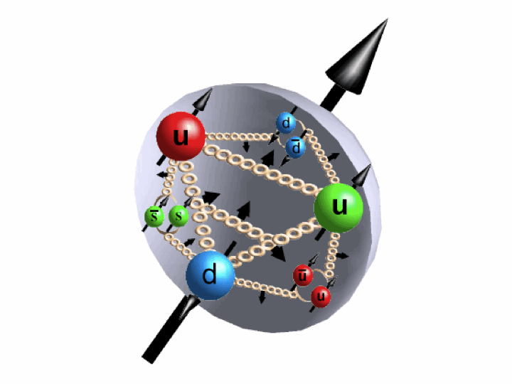
High Energy Nuclear & Particle Physics at LANL Align with National Road Map of Big Science
Most fundamental questions in physical science - from quarks to cosmos
- Develop & utilize (inter)national facilities w/ state of the art technology
NP NSAC Long Range Plan 2015
Near future: 2016-2027+, CD0/2016, ~CD1/2018
QGP physics with sPHENIX at RHIC/BNL
Future facility: 2027+, expected ~CD0/2019
QCD physics with Electron-Ion Collider in US
HEP P5 Report 2014
High intensity frontier @Fermilab
Dark matter
Neutrino probe
High energy frontier @LHC
LANL’s Leadership at key HENP National Programs next 5 ~ 10+ years
Many in the early stage of R&D, physics feasibility and project planning
QGP physics w/ sPHENIX at RHIC/BNL: Now – 2027+
Heavy quark probes with state of the art silicon pixel sensors (MAPS)
QCD physics w/ Electron-Ion Collider, eRHIC/BNL (or J-Lab) – 2025+
sPHENIX -> ePHENIX, R&D and physics feasibility
Novel nucleon structures, QCD and new physics at Fermilab: Now – 2020+
Sea-quarks inside nucleon; complementary to EIC
Dark photon/Dark Higgs search
LHC opportunity – Energy frontier
Fermilab opportunity - Intensity frontier
Critical to continue supporting the program and training the next generations
QGP
Proton
Branch out for LANL applied programs

